Slide 1


Multiple Myeloma Care
Translating Evolving Practices to
Oncology Nurses in Community Settings
Preassessment
(Please Complete)

Slide 2
Faculty
Patricia Mangan, MSN, CRNP
Nurse Practitioner, (Hematology/Oncology) Abramson Cancer Center
University of Pennsylvania
Philadelphia, PA

Slide 3
Faculty Chair Disclosure
Patricia Mangan, MSN, CRNP discloses the following relevant financial information
with ineligible companies:
Speaker's Bureau: BMS, Janssen, Karyopharm, Pfizer, Amgen, Takeda
Planner Disclosures
Academy Staff
John JD Juchniewicz, MCIS, CHCP, FACEHP, Wendy Gloffke, PhD, Natalie Kirkwood, RN, BSN, JD, and Paul Miniter, MS – No relevant financial relationships with any ineligible companies.
Clinical Reviewer
Oxana Megherea, PharmD, BCOP
– No relevant financial relationships with any ineligible companies.
All relevant financial relationships listed have been mitigated.

Slide 4
Commercial Support Disclosure
This activity is supported through an educational grant from Sanofi
Off-Label Usage
This presentation includes mention of medications that are not currently indicated in relapsed/refractory multiple myeloma (RRMM).

Slide 5


Accreditation
In support of improving patient care, American Academy of CME, Inc. is Jointly accredited by the Accreditation Council for Continuing Medical Education (ACCME), the Accreditation Council for Pharmacy Education (ACPE), and the American Nurses Credentialing Center (ANCC), to provide continuing education for the healthcare team.
American Academy of CME, Inc., designates this educational activity for 1.0 ANCC contact hours, including 0.9 pharmacology hours.
Provider approved by the California Board of Registered Nursing. California BRN Provider # CEP16993
For complete activity information

Slide 6
Objectives
Review evolving treatment options in RRMM and clinical implications
Examine how academic and tertiary care centers have integrated new treatments into practice in the setting of RRMM
Identify the most common and the unique chronic adverse events associated with long-term treatment of multiple myeloma
Describe the core principles surrounding mitigating and managing chronic adverse events in patients being treated in the RRMM setting
Outline the expanding roles of nurses, advanced practice providers (APPS), and
nurse navigators when patients are treated with newer options in the RRMM setting

Slide 7
Patients With Multiple Myeloma
Are Living Longer Than Ever
≈60%
90
80
70
60
50
40
30
20
10
0
LIVE MORE THAN
5 YEARS
after their diagnosis¹
As novel treatments are more broadly adopted into clinical practice, MM management is evolving to comprise long-term patient care and management, which, in turn, is expanding the roles of nurses, nurse navigators, and APPs in the RRMM setting.
5- year Survival Percentage
1975 2000 2014
Year
1. SEER Cancer Stat Facts: Myeloma. Accessed March 19, 2023. https://seer.cancer.gov/statfacts/html/mulmy.html.

Slide 8
FDA-Approved Therapy for Multiple Myeloma
Since 2000
Ixazomib
Daratumumab
Hyaluronidase
Daratumumab
Belantamab mafodotin
Elotuzumab
Talquetamab
Bortezomib
Thalidomide
Carfilzomib
Panobinostat
Isatuximab
Elranatamab
2005
2007
2013
2019
2021
2022
2024
2003
2006
2012
2015
2020
2023
Lenalidomide
Doxorubicin
Pomalidomide
Selinexor
ide-cel
Teclistamab
Expanded
Indications
cilta-cel
ide-cel > 1 prior lines
Antibody-drug conjugate
Immunomodulatory agent
Bispecifics
Monoclonal antibody
CAR T
Proteasome inhibitor
cilta-cel > 2 prior lines
Cytotoxic chemotherapy
SINE
Most common current MM treatment plan:
Combine 2-3 drug classes and add dexamethasone
HDAC inhibitor
CAR, chimeric antigen receptor; HDAC, histone deacetylase; MM, multiple myeloma; SINE, selective inhibitor of nuclear transport
Cancer.gov website. Drug therapy for multiple myeloma.

Slide 9
Common Treatments for Multiple Myeloma^{1,2}
Frontline (Induction)
Maintenance
Relapse
Rd: Lenalidomide/dex
Vd: Bortezomib/dex
RVd lite: Lenalidomide/bortezomib /dex lite
VRd: Bortezomib/lenalidomide/dex
KRd: Carfilzomib/lenalidomide/dex
Dara Rd: Daratumumab/lenalidomide/dex
Dara Cybord: Daratumumab/cyclophosphamide/
bortezomib/dex
DaraVRD: Daratumumab/bortezomib/lenalidomide/dex
Lenalidomide ±
Proteasome
Inhibitor
Bortezomib
Lenalidomide
Carfilzomib
Ixazomib
Pomalidomide
Daratumumab
Elotuzumab
Cyclophosphamide
Isatuximab
Selinexor
Teclistamab
Talquetamab
Elranatamab
Venetoclax t(11;14)
Plus new agents in
clinical trials:
Daratumumab ± Lenalidomide
Often in
Combination
Regimens
Supportive care is essential
  VTE prophylaxis
  Bone modifying agents
  Infection prevention
  Renal protection
  Health maintenance
dex, dexamethasone; VTE, venous thromboembolism
1. Faiman B, et al. J Adv Pract Oncol. 2016:7(suppl 1):17-29; 2. NCCN Clinical Practice Guidelines in Oncology: Multiple Myeloma—v.4.2024.

Slide 10
NCCN Recommendations for Adjunctive Treatment
Infection
  IVIG for recurrent infections
  Pneumococcal and influenza vaccine
  PJP, herpes and antifungal prophylaxis for high-dose or
  long-term steroids and teclistamab
  Herpes zoster prophylaxis with proteasome inhibitors, transplant, monoclonal antibodies, bispecific T-cell engagers
Bone disease
  Bisphosphonates, denosumab
  Radiation therapy
  Orthopedic consultation
  Vertebroplasty or kyphoplasty
  Calcium and Vitamin D supplementation
Renal dysfunction
  Avoid aggravating factors: contrast, NSAIDs, dehydration
  Not a contraindication to HCT
  Monitor bisphosphonates closely
Coagulation/thrombosis
  Prophylactic anticoagulation with IMiDs
Hypercalcemia
  Hydration, steroids, furosemide
  Zoledronic acid preferred
  Denosumab, calcitonin
Hyperviscosity
  Plasmapheresis
Anemia
  Consider erythropoietin
  Transfusion
  Type and screen patients prior to
  daratumumab administration
HCT, hematopoietic stem cell transplantation; ImiD, immunomodulatory drug; IVIG, intravenous immunoglobulin; NSAID, non-steroidal anti-inflammatory drug; PJP, pneumocystis jiroveci pneumonia
NCCN Clinical Practice Guidelines in Oncology: Multiple Myeloma—v.4.2024.

Slide 11
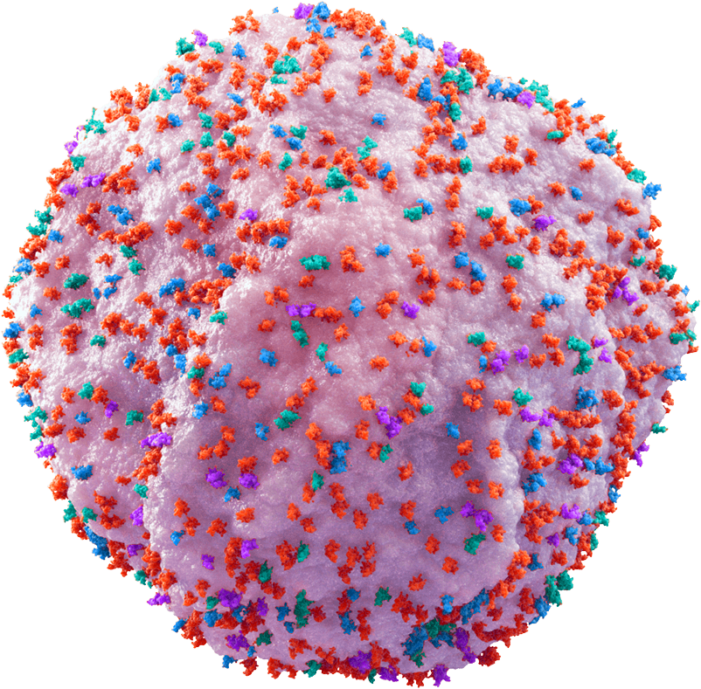
Antigen Targets in Multiple Myeloma (MM)
BCMA¹⁻³
Activates signal transduction pathways, upregulates anti-apoptotic proteins, and induces the expression of immunosuppressive molecules to drive MM cell proliferation and survival
SLAMF7⁶
Highly expressed on MM cells
Has a role in interactions between MM and stromal cells, as well as MM growth and survival and regulation of the immune response
GPRC5D^{4,5}
G protein-coupled receptor family C group 5 member D (GPRC5D) primarily expressed on myeloma cells, and limited to the hair follicle
of skin and hard keratinizing tissues
CD38^{7,8}
MM cells express high levels of CD38
Regulates migration and receptor-mediated adhesion and has ectoenzyme activity
SLAMF, signaling lymphocytic activation molecule family
1. D’Agostino M, et al. Curr Hematol Malig Rep. 2017;12(4):344-357; 2. Cho SF, et al. Front Immunol. 2018;9:1821; 3. Sanchez E, et al. Br J Haematol. 2012;158(6):727-738; 4. Mailankody S, et al. N Engl J Med. 2022;387:2296-1206; 5. Chari A, et al. N Engl J Med. 2022;387:2232-2244; 6. Tai YT, et al. Blood. 2008;112(4):1329-1337; 7. Malavasi F, et al. Physiol Rev. 2008;88:841-886; 8. Deaglio S, et al. J Immunol. 1998;160:395-402.

Slide 12
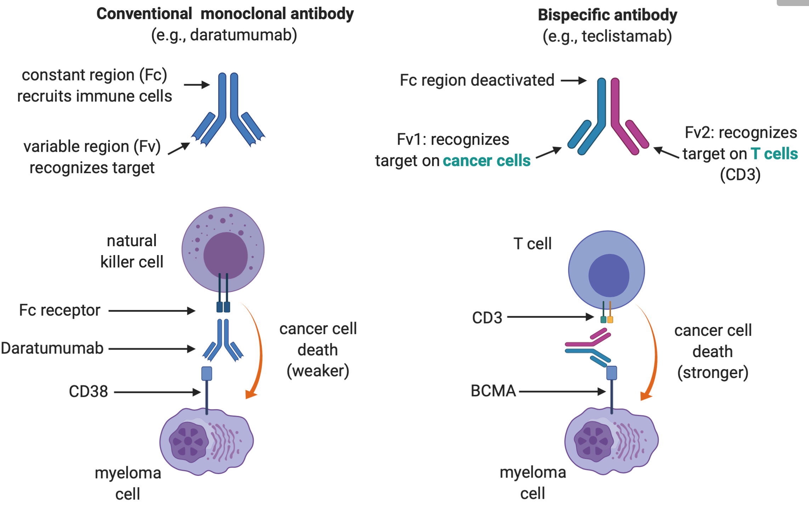
Bispecifics vs Conventional Monoclonal Antibodies
Created with BioRender.com

Slide 13
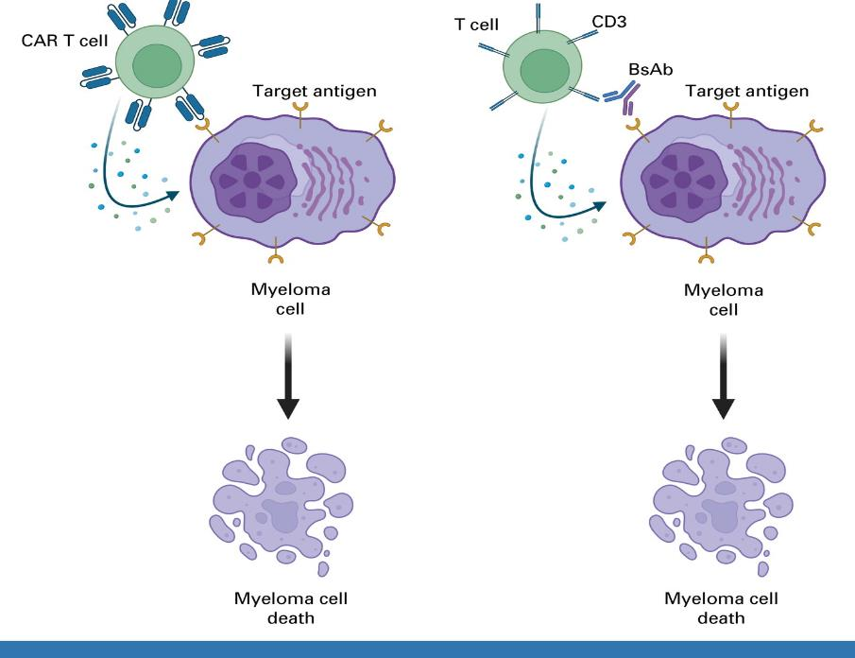
CAR T Cell and Bispecific Antibodies
Mechanism of Action¹
1. Holstein SA, et al. J Clin Oncol. 2023;41(27):4416-4429. Epub 2023 Jul 20.
Notes:
0:44:03-0:45:21

Slide 14
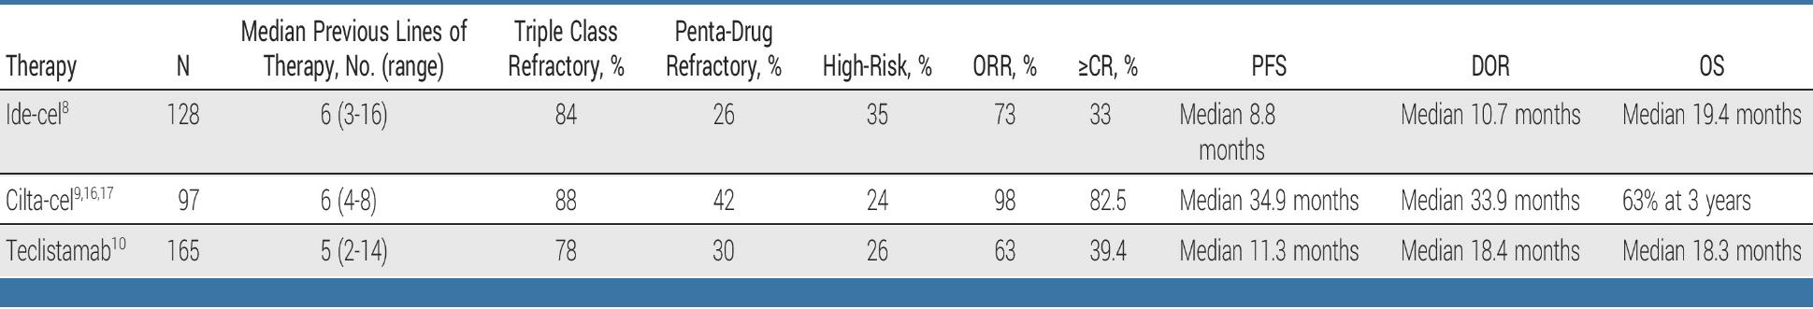
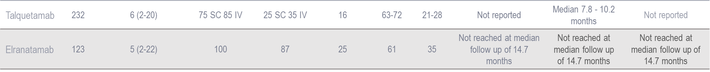
Efficacy Data – Registrational Trials¹⁻³
FDA-approved T Cell-directed Therapies
The FDA has mandated a black box warning for all marketed CAR-T therapies,
citing a potential risk of inducing malignant T-cell tumors.
CR, complete response; DOR, duration of response; ORR, overall response rate; OS, overall survival; PFS, progression-free survival
1. Holstein SA, et al. J Clin Oncol. 2023;41(27):4416-4429. Epub 2023 Jul 20; 2. Chari A, et al. N Engl J Med. 2022;387:2232-2244; 3. Lesokhin AM, et al. Nat Med. 2023;29(9):2259-2267.
Notes:
0:56:37-0:58:26

Slide 15
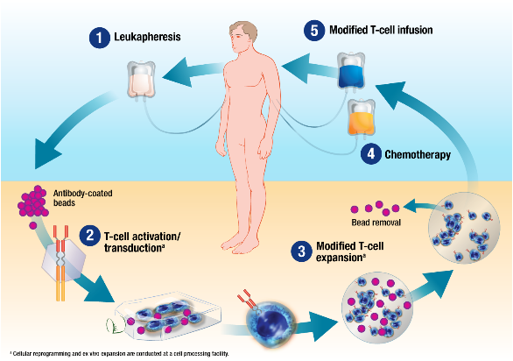
Overview of CAR T Cell Therapy
Manufacturing time can take up to 2-8 weeks
Courtesy of David Porter MD

Slide 16
Bridging Therapy Goals:
Disease Control and to Decrease Tumor Burden
Regimens
Steroids (eg, dexamethasone)
Previous treatment
Selinexor/pomalidomide/dexamethasone
D-PACE or D-ACE
Salvage auto transplant
Radiation
Indications
Control disease/rapidly growing disease
Bulky disease
Symptomatic patient (pain)
Major organ involvement or obstruction
Expected delay in CAR T cell production
Regimen selection
  Prior therapies
  Regimen-related AEs
  Site(s) of disease
  Comorbidities
  Blood counts
  Simplicity of administration
D-ACE, dexamethasone/doxorubicin/cyclophosphamide/etoposide; D-PACE, dexamethasone/cisplatin/doxorubicin/cyclophosphamide/etoposide

Slide 17
Lymphodepletion
  Lymphodepletion is necessary for expansion of CAR T cells:
    Lymphodepletion creates a “favorable” environment for CAR T cell expansion and survival in vivo
    Administered on D-5, D-4, D-3 before CAR T cells are infused on D + 0
      Fludarabine 30 mg/m² IV daily and cyclophosphamide 300-500 mg/m² IV x 3 days.¹⁻³
1. Locke FL, et al. Lancet Oncol. 2019;20:31-42; 2. Neelapu SS, et al. N Engl J Med. 2017;377:2531-2544; 3. Svaboda J, et al. Blood. 2019;134(supp1):1606.

Slide 18
Premedication and Prophylaxis Considerations¹
Cell infusion premedication:
  Acetaminophen and diphenhydramine (NO steroids)
Infection prophylaxis:
  Antiviral
  Antifungal and fluoroquinolone during neutropenic period
  PJP prophylaxis
Seizure prophylaxis may be considered
PJP, pneumocystis jiroveci pneumonia
1. Raje NS, et al. Lancet Haematol. 2022;9(2):e143-e161
Notes:
0:52:22-0:53:33

Slide 19
CAR T Adverse Events and Timelines^{1,2}
CAR T cell infusion
  Adverse Events >Day 30:
• Infection
• Cytopenias
• B cell aplasia
DAY
-5
0
7
14
21
28
30
Lymphodepletion
chemotherapy
CRS
Neurotoxicity
Delayed Onset
Neurotoxicity
Nausea/vomiting
1. Brudno JN, et al. Blood. 2016;127:3321-3330; 2. Neelapu SS, et al. Nat Rev Clin Oncol. 2018; 15:47-62.
Notes:
0:53:34-0:55:33

Slide 20
CAR T-Cell AEs Onset
Acute AEs¹
Delayed AEs^{2,3}
Cytokine-release syndrome
Immune effector cell–associated neurotoxicity syndrome
Cytopenias
Hemophagocytic lymphohistiocytosis/ macrophage activation syndrome
B-cell aplasia/hypogammaglobulinemia
Prolonged cytopenias
Late infections
Long-term neurologic events/
movement and neurocognitive treatment-emergent AEs
Transient cardiac AEs
Typically managed by
CAR T Cell Center
Typically managed by
primary oncology team
1. Maus MV, et al. J Immunother Cancer. 2020;8(2):e001511; 2. Cohen AD, et al. Blood Cancer J. 2022;12:32; 3. Chakraborty R, et al. Transplant Cell Ther. 2021;27:222-229.

Slide 21
CRS¹
Cause: Activation/expansion of CAR T cells
increases levels of cytokines
(IL-6, IL-15, INF-γ, GM-CSF, others)
Onset: variable; 1 to 5 days
Duration: 3 to 5 days
Risk: Variable up to 5% in >/= grade 3
Disease burden
Peak CAR T cell levels
Pre-treatment and peak cytokine levels
Biochemical Findings:
Organ-specific markers
  Creatinine, blood urea nitrogen
  Troponin
  Aminotransferases (AST/ALT), bilirubin
Cytokine panels not readily available for
“real-time” clinical use
Easy to measure surrogates: ferritin,
C-reactive protein
  Trend to monitor the tempo of CRS
In the end, CRS is a clinical, rather than laboratory diagnosis
Cytokine levels do not influence grading or treatment
Teachey DT, et al. Cancer Discov. 2016;6:664-679.

Slide 22
Treatment of CRS: Tocilizumab
Description | Humanized anti-IL-6 receptor IgG1_{K} monoclonal antibody
Mechanism of action | Inhibits IL-6 mediated signaling by binding to both soluble and membrane-bound human IL-6 receptors
FDA Expanded Approval 8/30/17 | For the treatment of CAR T cell-induced severe or life-threatening CRS in patients 2 years of age and older
Dose | Adults: 8 mg/kg once (max dose of 800 mg) As frequent as every 8 hours, max of 4 doses total
Administration | Intravenous over 1 hour
Required doses | Ensure that 2 doses of tocilizumab are available prior to infusion of CAR T cells
Monitor | For 7 days at the certified healthcare facility following infusion for signs and symptoms of CRS Monitor patients for signs or symptoms of CRS for 4 weeks after infusion and if present, seek immediate medicate attention
CAR, chimeric antigen receptor
Neelapu SS, et al. Nat Rev Clin Oncol. 2018;15:47-62. Neelapu SS, et al. Nat Rev Clin Oncol. 2018;15:218.

Slide 23
Neurotoxicity Associated with CAR T Therapy¹⁻⁴
Cause: Mechanism of toxicity is not clear
T cell vs cytokine mediated??
CAR T cells are seen in the CSF
Onset: 5-7 days after infusion; later than CRS
Duration: 5-10 days
Fully reversible except in cases of fatal
cerebral edema
Risk:
High disease burden
High IL-6 on Day 1
Pre-treatment and peak cytokine levels
Early or high-grade CRS
Peak CAR T-cell levels
Neuro assessments
Wide range of symptoms from headache to encephalopathy, seizures
Decreased attentiveness, anxiety, tremors, somnolence, disorientation, aphasia, nonsensical/tangential speech
Parkinson-like movement disorders
Treatment:
No clear response to anti-cytokine therapy
Use of steroids and anti-seizure medications
CAR, chimeric antigen receptor; CRS, cytokine release syndrome; CSF, cerebrospinal fluid; DIC, disseminated intravascular coagulation
1. Maude SL, et al. N Engl J Med. 2014;371(16):1507-1517; 2. Davila ML, et al. Sci Transl Med. 2014;6(224):224ra25; 3. Lee DW, et al. Lancet. 2015;385(9967):517-528;
4. Kochendorfer JN, et al. J Clin Oncol. 2015;33(6):540-549.

Slide 24
Medications Can Reduce Infection Risk
Type of Infection Risk | Medication Recommendation(s) for Healthcare Team Consideration¹
Viral: HSV/VZV | Acyclovir prophylaxis
Bacterial: blood, pneumonia, and urinary tract infection | Consider prophylaxis with levofloxacin
PJP (P. jirovecii pneumonia) | Consider prophylaxis with trimethoprim-sulfamethoxazole
Fungal infections | Consider prophylaxis with fluconazole
COVID-19 and Influenza | Antiviral therapy if exposed or positive for COVID per institution recommendations
IgG < 400 mg/dL (general infection risk) | Consider IVIg
ANC < 1000 cells/μL (general infection risk) | Consider GCSF 2 or 3 times/wk (or as frequently as needed) to maintain ANC > 1000 cells/μL and maintain treatment dose intensity
Some people receiving BCMA-targeting therapies have experienced infections
that are less common like CMV, PJP, EBV and fungal infections
ANC, absolute neutrophil count; CMV, cytomegalovirus; EBV, Epstein-Barr virus; GCSF, granulocyte colony-stimulating factor; HSV, herpes simplex virus; VZV, varicella zoster virus.
1. Raje NS, et al. Lancet Haematol.2022;9(2):143–161.

Slide 25
Screening/ Evaluation
Insurance clearance
Ramp-up doses
Inpatient
Acute AE period
Weekly/biweekly dosing and monitoring
Long-term monitoring
Bispecific Treatment Timeline
Week 1: Step-up dosing to mitigate incidence and severity of CRS and neurotoxicity Allow 48 hours between doses to assess for emerging CRS or ICANS Observation recommended as inpatient during step-up dosing at a REMS certified facility Hold dose for evidence of CRS or ICANS or active infection Premedicate 1-3 hours prior to all step-up doses and first full dose, or if prior dose was associated with CRS or ICANS Recommended pre-medications: glucocorticoid steroid, antihistamine, and antipyretic Week 2 and onward: requires coordination of care with the community team and facility

Slide 26
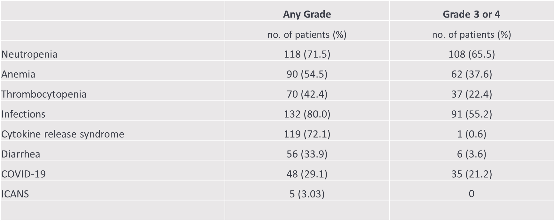
Teclistamab Safety
van de Donk N, et al. J Clin Oncol. 2023;41(November 16_suppl):8011.
Notes:
1:20:11-1:21:23

Slide 27
Teclistamab: CRS and ICANS
Prevention and Management
Step-up dosing: 0.06 mg/kg, 0.3 mg/kg, 1.5 mg/kg separated by at least 48 hours
Hospitalization recommended but may not be essential with robust outpatient monitoring
Dexamethasone (16 mg), acetaminophen, and diphenhydramine pre-medication before step-up and first full dose.
Tocilizumab is preferred for CRS management, although tocilizumab is not mentioned in teclistamab’s FDA prescribing information or REMS
Dexamethasone is preferred for ICANS management
Teclistamab PI. https://www.accessdata.fda.gov/drugsatfda_docs/label/2022/761291s000lbl.pdf. Accessed May 22, 2024.

Slide 28
Infections and Hypogammaglobulinemia
Teclistamab phase 2 (N = 165)^{1,2}
  80% developed infections, 55.2% grade 3-4
  74.5% developed hypogammaglobulinemia (IgG <500 mg/dL)
  12 deaths from COVID-19
  8 additional deaths from infections including one PML (JC virus)
  6 cases of pneumocystis pneumonia
Talquetamab phase 2 (N = 232)³
  ~40% developed infections, 7% grade 3-4
  ~80% developed hypogammaglobulinemia
  1 fatal infection, and no COVID-19 deaths
**Understanding of infection risk evolved during these studies, and many patients did not receive prophylaxis**
IgG, immunoglobulin G; JC, human polyomavirus 2; PML, progressive multifocal leukoencephalopathy.
1. Moreau P, et al. N Engl J Med. 2022;387:495-505; 2. van de Donk N, et al. J Clin Oncol. 2023;41(November 16_suppl):8011; 3. Chari A, et al. N Engl J Med. 2022;387:2232-2244.
Notes:
1:25:40-1:26:30
[Stopped and restarted between previous timestamp and this one]
TEC has higher risk inf vs Tal but have more risks
At 0.4 mg/kg QW and 0.8 mg/kg Q2W:
13 (9.1%) and 16 (11.0%) patients had COVID-19
Grade 3/4 in 0.7% and 2.1%
2 patients died from COVID-19
13.3% and 9.7% of patients received IVIG, respectivel

Slide 29
Infection Prophylaxis With Bispecifics *
Herpes zoster prophylaxis (FDA prescribing information)¹
Intravenous immune globulin
Pneumocystis prophylaxis for teclistamab
Evaluate for CMV reactivation with cytopenias or other suggestive clinical symptoms
Consider reduction in frequency to Q2W after stable response is achieved²
* Will probably be the same for all anti-BCMA bispecific agents
1. Teclistamab PI. https://www.accessdata.fda.gov/drugsatfda_docs/label/2022/761291s000lbl.pdf. Accessed May 22, 2024; 2. Usmani SZ, et al. J Clin Oncol.2023;41(suppl 16; abstr 8034).

Slide 30
Management of Oral AEs¹
Dexamethasone oral solutions “swish and spit” have been tried but with no proven benefit yet. Sour citrus or candies before meals are also recommended.
Glossitis
and Thrush
EARLY initiation of nystatin or mycelex is key to manage symptoms.
Taste Changes
OTC dry mouth rinse, gel, spray are recommended. Consider saliva substitute. Advise patients to avoid hot beverages.
Dry Mouth
Weight loss and anorexia are associated with taste changes. Nutritionist involvement and dietary modifications are recommended to support patients. An appetite stimulant with Marinol, if indicated, can also be utilized.
Education and emotional support are key strategies to manage oral toxicities.
Dietary modifications with small bites, eating upright, and sips with food can help manage symptoms.
Dysphagia
OTC, over-the-counter
1. Catamero D, Purcell K, Ray C, et al. Presented at the 20th International Myeloma Society (IMS) Annual Meeting Nurse Symposium; September 27–30, 2023; Athens, Greece.

Slide 31
Management of Dermatological AEs¹
Dry Skin
Heavy moisturizers
Pruritus
Loratadine 10 mg PO daily for
3–5 days post talquetamab dose and triamcinolone 0.1% cream BID
Hand and/or
foot peeling
Ammonium lactate 12% lotion to soles and palms BID
Injection site
reaction
Nail thinning and peeling
Body rash/ drug rash
Above plus consider methylprednisolone taper and betamethasone 0.05% cream BID
Nail hardeners, topical vitamin E oil, and triamcinolone 0.025% ointment
Consider dose HOLD for other grade 3 dermatologic AEs
Dermatology consults may be helpful as an early strategy
With experience, dermatologic AEs can be managed more easily vs oral AEs
These interventions were successful at reducing or resolving dermatologic AEs
1. Catamero D, Purcell K, Ray C, et al. Presented at the 20th International Myeloma Society (IMS) Annual Meeting Nurse Symposium; September 27–30, 2023; Athens, Greece.
Notes:
0:50:02-0:51:08

Slide 32
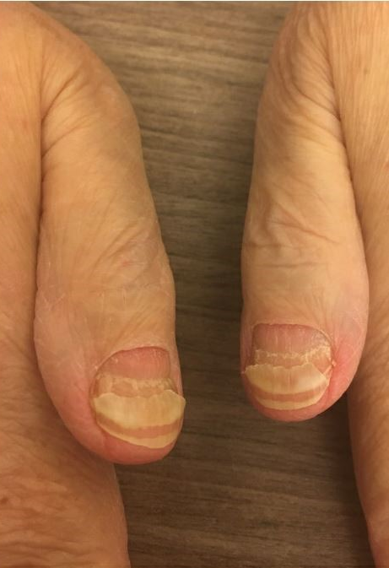
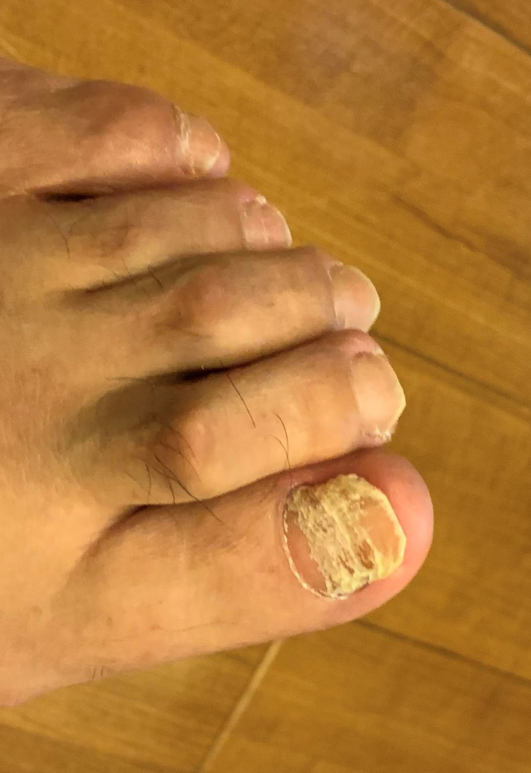
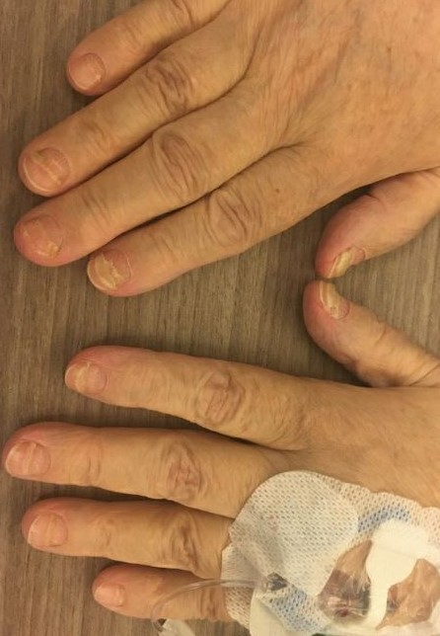
Nail Changes
(Associated with Talquetamab – GPRC5D)
Courtesy of Donna Catamaro, CRNP
Notes:
1:29:20-1:29:42

Slide 33
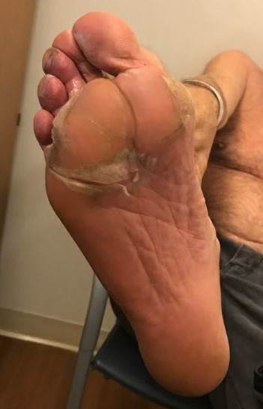
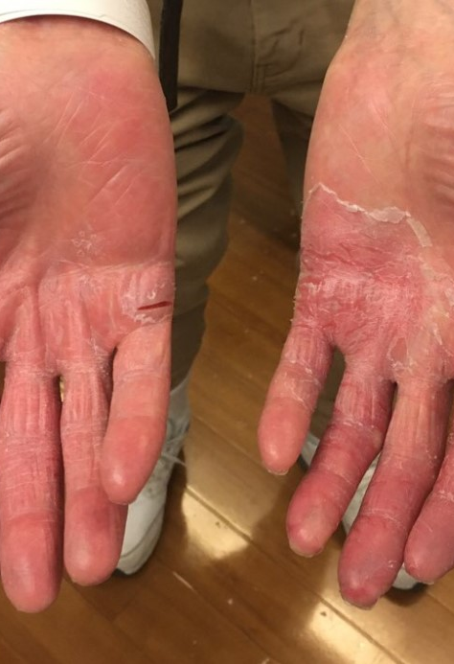
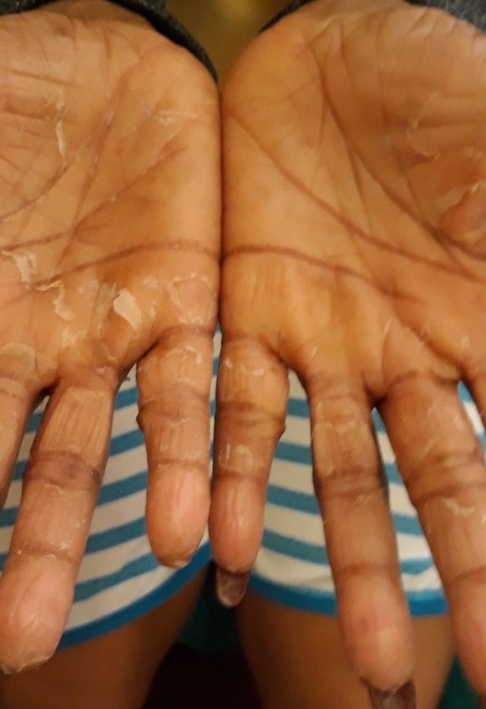
Palmar Plantar Desquamation
(Associated with Talquetamab – GPRC5D)
Courtesy of Donna Catamaro, CRNP

Slide 34
Comparison of Immunotherapy Approaches
 | MoABs | CARs | BiTEs
Off-the-shelf | YES | No | Yes
Ease of administration | +++ | + | + to ++
Repeated dosing required | Yes | No | Yes
Dependent on patient T cell “fitness” | No | Yes | Yes
Adverse events | IRR | CRS, neuro | CRS, neuro
Adverse event duration | NA | ~14-21 days | Ongoing
Durable clinical activity seen | Yes | Yes | Yes
Requires LD chemotherapy | No | Yes | No
LD, lymphodepleting; IRR, infusion-related reaction; MoAB, monoclonal antibody

Slide 35
Conclusion
Significant advances in the treatment of myeloma continue to improve survival
Highly effective immunotherapies, including CAR T and bispecifics, recently FDA approved for RRMM are showing great promise and are now moving earlier in lines
of therapy at relapse.
Close monitoring and aggressive management of the unique adverse events associated with these T cell-directed therapies is essential
Adaption of these agents in RR disease is successfully moving to the community setting. Nurses, in community and CAR T centers, are essential in the successful coordination, symptom management and patient/family education.
Myeloma patients are “Survivors”

Slide 36

Claim Credit

Slide 37
Resources

Slide 38
MM Treatment: Key AEs, Considerations
Drug Class | Name | Key Potential AEs | Nursing Considerations
Proteasome inhibitors | Bortezomib | PN, T, M, F | IV, SC; monitor platelets; safe in renal failure; reduce dose for hepatic disease
 | Carfilzomib | C, M, F, DVT, PN | Hydration, cardio/pulmonary; reduce dose for hepatic disease
 | Ixazomib | PN, T, GI, R | Reduce dose for hepatic/renal disease
Immunomodulatory agents | Lenalidomide | DVT, M, BD, R, D, rash | ASA if low risk and DOACs and warfarin if high risk for clots; weekly CBC x 8 wks
 | Thalidomide | DVT, M, BD, PN, drowsiness | As above
 | Pomalidomide | DVT, M, BD, F | As above
Monoclonal antibodies | Daratumumab | IR, M, RD | Infusion reaction risk; pre/post med as directed; interrupt infusion if reaction
 | Elotuzumab | IR, M, RD | As above
 | Isatuximab | IR, M, RD | As above
 | Daratumumab Hyaluronidase | ARR,M, RD | SQ administration over 5 minutes
AE, adverse event; ARR, administration related reaction ; ASA, acetylsalicylic acid; BD, birth defects; C, cardiac; D, diarrhea; DOAC, direct oral anticoagulant; DVT, deep vein thrombosis; F, fatigue; GI, gastrointestinal toxicities; IR, infusion reaction; IV, intravenous; LMWH, low molecular weight heparin; M, myelosuppression; MM, multiple myeloma; N, nausea; PN, peripheral neuropathy; R, renal dose adjustment necessary; RD, response disruption; SQ, subcutaneous; T, thrombocytopenia
US Food and Drug Administration. FDA approved drug products.
Notes:
-

Slide 39
MM Treatment: Key AEs, Considerations
Drug Class | Name | Key Potential AEs | Nursing Considerations
Alkylating agents | Melphalan | M, N, D | CBC diff monthly; renal dose adjustment
 | Cyclophosphamide | M, N, D | Monitor CBC platelets and differential, antiemetics
Corticosteroids | Prednisone | H, MS | Monitor blood sugar, insomnia, weight gain
 | Dexamethasone | H, MS | As above
Selective inhibitors of nuclear export (SINE) | Selinexor | D, N, T, F | Monitor Na+ and intake Prophylactic use of antiemetics
CBC, complete blood count; D, diarrhea; F, fatigue; H, hyperglycemia; M, myelosuppression; MM, multiple myeloma; MS, metabolic syndrome; N, nausea; T, thrombocytopenia
US Food and Drug Administration. FDA approved drug products.

Slide 40
Options to Consider Regarding 4+ Prior Lines*
 | Type of ​Immunotherapy​ | Availability/Logistics​ | Adverse Events
Ide-cel¹​ | ​CAR--T ​ (BCMA) | Cellular therapy center​ Manufacturing slot​ Manufacturing time​ One-time therapy​ REMS and CRS/ICANS management | CRS/NT (potentially severe)​ Infections​ Cytopenias (potentially severe)​
Cilta-cel^{2,3}​ | ​CAR-T​ (BCMA)
Teclistamab^{4,​5} | ​Bispecific​ (BCMA)​ | REMS and CRS/ICANS management Readily available​ Continuous therapy (SQ)​ | CRS/NT (unlikely severe)​ Infection risk (perhaps higher)​ Cytopenias (unlikely severe)​
Talquetamab​⁶ ⁻ | Bispecific​ (GPRC5D)​ |  | CRS/NT Skin-related events (rash)​ Nail-related events​ Dysgeusia​ Weight loss
Elranatamab​⁷ | ​Bispecific​ (BCMA)​ |  | CRS/NT Infection risk ​ Cytopenias ​
*Ide-cel was recently approved for patients after one or more lines of therapy and cilta-cel after 2 or more lines of therapy.
BCMA, B-cell maturation antigen; CAR, chimeric antigen receptor; CRS, cytokine release syndrome; GPRC5D, G protein–coupled receptor class C group 5 member D; ICANS, immune cell-associated neurotoxicity syndrome; NT, neurotoxicity; REMS, Risk Evaluation and Mitigation Strategy; SQ, subcutaneous
1. Munshi NC, et al. N Engl J Med. 2021;384:705-716; 2. Berdeja J, et al. Lancet. 2021;398:314-324; 3. Lin Y, et al. ASCO 2023, abstract 8009; 4. Moreau P, et al. N Engl J Med. 2022;387:495-505; 5. van de Donk N, et al. ASCO 2023, abstract 8011; 6. Chari A, et al. N Engl J Med. 2022;387(22):2232-2244; 7. Lesokhin AM, et al. Nat Med. 2023;29:2259–2267.

Slide 41
MM Treatment: Key AEs, Considerations
Drug Class | Name | Key Potential AEs | Nursing Considerations
CAR T | Ide Cel Cilta Cel | C, N, M, I | REMS CRS and neurotoxicity Hospitalize for close monitoring, near facility for one month Monitor for cytopenias and infections IVIG may be needed
Bispecifics | Teclistamab Talquetamab Elranatamab | C, N, I | REMS CRS and neurotoxicity Monitor in hospital recommended Monitor for cytopenias and infection on going IVIG may be needed Skin and nail and taste changes (talquetamab)
C, cytokine release syndrome; I, infection; M, myelosuppression; N, neurologic toxicities
C, cardiac; I, immune-related AEs; M, myelosuppression; N, neurotoxicity

Slide 42
CRS Grading: ASTCT Grading Scale¹
CRS parameter | Grade 1 | Grade 2 | Grade 3 | Grade 4
Fever | Temp ≥38°C | Temp ≥38°C | Temp ≥38°C | Temp ≥38°C
With
Hypotension | None | Not requiring vasopressors | Requiring vasopressor with or without vasopressin | Requiring multiple vasopressors
And/Or
Hypoxia | None | Requiring low-flow nasal cannula or blow-by | Requiring high-flow cannula, face mask, nonrebreather mask or Venturi mask | Requiring positive pressure (eg, CPAP, BiPAP, intubation, and mechanical ventilation)
ASTCT, American Society for Transplantation and Cellular Therapy; BiPAP, bilevel positive airway pressure; CPAP, continuous positive airway pressure
1. Lee DW, et al. Biol Blood Marrow Transplant. 2019;25:625-638.

Slide 43
Management of CRS^{1,2}
ASTCT CRS Grade | Management
Grade 1 | Antipyretics and IV hydration Diagnostic work-up to rule out infection Antibiotics if neutropenic
Grade 2 | Supportive care as in grade 1 IV fluid boluses and/or supplemental oxygen Tocilizumab +/- dexamethasone or its equivalent of methylprednisolone
Grade 3 | Supportive care as in grade 1 Consider monitoring in ICU Vasopressor support and/or supplemental oxygen Tocilizumab + dexamethasone 10 mg to 20 mg IV every 6 hours or its equivalent of methylprednisolone
Grade 4 | Supportive care as in grade 1 Monitoring in ICU Vasopressor support and/or supplemental oxygen via positive pressure ventilation Tocilizumab + methylprednisolone 1,000 mg/day Refractory CRS: anakinra, siltuximab, dasatinib, ruxolitinib, etanercept
ICU, intensive care unit; IV, intravenous
1. Neelapu SS, et al. Nat Rev Clin Oncol. 2018;15:47-62; 2. Neelapu SS. Hematol Oncol. 2019;37:48-52.

Slide 44
Treatment of CRS: Tocilizumab
Description | Humanized anti-IL-6 receptor IgG1_{K} monoclonal antibody
Mechanism of action | Inhibits IL-6 mediated signaling by binding to both soluble and membrane-bound human IL-6 receptors
FDA Expanded Approval 8/30/17 | For the treatment of CAR T cell-induced severe or life-threatening CRS in patients 2 years of age and older
Dose | Adults: 8 mg/kg once (max dose of 800 mg) As frequent as every 8 hours, max of 4 doses total
Administration | Intravenous over 1 hour
Required doses | Ensure that 2 doses of tocilizumab are available prior to infusion of CAR T cells
Monitor | For 7 days at the certified healthcare facility following infusion for signs and symptoms of CRS Monitor patients for signs or symptoms of CRS for 4 weeks after infusion and if present, seek immediate medicate attention
CAR, chimeric antigen receptor
Neelapu SS, et al. Nat Rev Clin Oncol. 2018;15:47-62. Neelapu SS, et al. Nat Rev Clin Oncol. 2018;15:218.

Slide 45
ICANS Assessment: What is Your ICE Score?
Orientation | Orientation to year, month, city, hospital: 4 points
Following commands | Ability to follow simple commands: 1 point
Naming | Ability to name 3 objects: 3 points
Writing | Ability to write a standard sentence: 1 point
Attention | Ability to count backwards from 100 by 10: 1 point
Grade 1: 7-9 points; Grade 2: 3-6; Grade 3: 0-2; Grade 4: unarousable, unable to complete assessment ¹
ICE, immune effector cell-associated encephalopathy
1. Lee DW, et al. Biol Blood Marrow Transplant. 2019;25:625-638.

Slide 46
ICANS Assessment¹
Neurotoxicity Domain | Grade 1 | Grade 2 | Grade 3 | Grade 4
ICE score | 7-9 | 3-6 | 0-2 | 0 (unable to perform)
Depressed level of consciousness | Awakens spontaneously | Awakens to voice | Awakens only to tactile stimulus | Unarousable, requires vigorous or repetitive stimuli to arouse. Stupor or coma.
Seizure | N/A | N/A | Any clinical seizure that resolves rapidly or nonconvulsive seizures on EEG that resolve without intervention | Life-threatening prolonged seizure; or repetitive clinical or electrical seizures without return to baseline in between
Motor findings | N/A | N/A | N/A | Deep focal motor weakness such as hemiparesis or paraparesis
Elevated intracranial pressure/cerebral edema | N/A | N/A | Focal/local edema on neuroimaging | Diffuse cerebral edema on neuroimaging, papilledema
EEG, electroencephalogram
1. Lee DW, et al. Biol Blood Marrow Transplant. 2019;25:625-38.

Slide 47
ICANS Management
ASTCT ICANS Grade | Management
Grade 1 | Aspiration precautions and IV hydration Seizure prophylaxis and levetiracetam EEG Image of brain Consider tocilizumab
Grade 2 | Supportive care as in grade 1 Consider dexamethasone or its equivalent of methylprednisolone
Grade 3 | Supportive care as in grade 1 Dexamethasone 10 mg to 20 mg IV every 6 h or its equivalent of methylprednisolone Control seizures with benzodiazepines (for short-term control) and levetiracetam +/- phenobarbital and/or lacosamide High-dose methylprednisolone 1000 mg/day for focal/local edema
Grade 4 | Supportive care as in grade 1 High-dose methylprednisolone 1000 mg/day Control seizures with benzodiazepines (for short-term control) and levetiracetam +/- phenobarbital and/or lacosamide Imaging of spine for focal motor weakness For diffuse cerebral edema, lower ICP by hyperventilation, hyperosmolar therapy with mannitol/hypertonic saline, and/or neurosurgery consultation for ventriculoperitoneal shunt
ICP, intracranial pressure
Neelapu SS, et al. Nat Rev Clin Oncol. 2018;15:47-62. Neelapu SS. Hematol Oncol. 2019;37:48-52.

Slide 48
Medications Can Reduce Infection Risk
Type of Infection Risk | Medication Recommendation(s) for Healthcare Team Consideration¹
Viral: HSV/VZV | Acyclovir prophylaxis
Bacterial: blood, pneumonia, and urinary tract infection | Consider prophylaxis with levofloxacin
PJP (P. jirovecii pneumonia) | Consider prophylaxis with trimethoprim-sulfamethoxazole
Fungal infections | Consider prophylaxis with fluconazole
COVID-19 and Influenza | Antiviral therapy if exposed or positive for covid per institution recommendations
IgG < 400 mg/dL (general infection risk) | Consider IVIg
ANC < 1000 cells/μL (general infection risk) | Consider GCSF 2 or 3 times/wk (or as frequently as needed) to maintain ANC > 1000 cells/μL and maintain treatment dose intensity
Some people receiving BCMA-targeting therapies have experienced infections
that are less common like CMV, PJP, EBV and fungal infections
ANC, absolute neutrophil count; CMV, cytomegalovirus; EBV, Epstein-Barr virus; GCSF, granulocyte colony-stimulating factor; HSV, herpes simplex virus; VZV, varicella zoster virus.
1. Raje NS, et al. Lancet Haematol.2022;9(2):143–161.

Slide 49
Comparison of Immunotherapy Approaches
 | MoABs | CARs | BiTEs
Off-the-shelf | YES | No | Yes
Ease of administration | +++ | + | + to ++
Repeated dosing required | Yes | No | Yes
Dependent on patient T cell “fitness” | No | Yes | Yes
Adverse events | IRR | CRS, neuro | CRS, neuro
Adverse event duration | NA | ~14-21 days | Ongoing
Durable clinical activity seen | Yes | Yes | Yes
Requires LD chemotherapy | N0 | Yes | No
LD, lymphodepleting; IRR, infusion-related reaction; MoAB, monoclonal antibody

Slide 50
MM Treatment: Key AEs, Considerations
Drug Class | Name | Key Potential AEs | Nursing Considerations
CAR T | Ide Cel Cilta Cel | C, N, M, I | REMS CRS and neurotoxicity Hospitalize for close monitoring, near facility for one month Monitor for cytopenias and infections IVIG may be needed
Bispecifics | Teclistamab Talquetamab Elranatamab | C, N, I | REMS CRS and neurotoxicity Monitor in hospital recommended Monitor for cytopenias and infection on going IVIG may be needed Skin and nail and taste changes (talquetamab)
C, cytokine release syndrome; I, infection; M, myelosuppression; N, neurologic toxicities
C, cardiac; I, immune-related AEs; M, myelosuppression; N, neurotoxicity

