Slide 1


Annual General Meeting 2019
September 26, 2019

Slide 2




Housekeeping
-Thank you for taking the time to support your community
-Thank ISNA Elementary for hosting
-Washroom facilities
-Water
-Golden Rule, Everyone will have an opportunity tonight.
-Thank SHORA advertisers
Confidential - Sherway Homeowner’s and Recreation Association
Notes:
2

Slide 3
Agenda
Nomination results / Elections
SHORA Financials
Year in review
Guest Speakers
- Ross Atikinson - Terrapure Environmental / Tonolli Canada
- Graham Sled, GHD - QEW Etobicoke Creek Construction
- Councillor Stephen Dasko, Ward 1 Updates / SHORA Updates
Quick Q + A, Adjournment & Social
Confidential - Sherway Homeowner’s and Recreation Association

Slide 4
SHORA Board Nominations / Election
2019 SHORA Executive Election run by SHORA Treasurer
SHORA Board of Director Positions:
  President
  Vice-President
  Secretary
  Treasurer
Next SHORA Meeting / SHORA Opportunities
Confidential - Sherway Homeowner’s and Recreation Association
Notes:
4

Slide 5
SHORA Financials 2018 - 2019
October 2018 Starting Balance = $4,800.77
Cash Flow In = $2,459.99
Cash Flow Out = $1,964.02
September 2019 Closing Balance = $5,296.74
Difference of $495.97
Events = 48%
Advertising = 50%
Miscellaneous = 2%
Events= 34%
Flyers Printing = 34%
D & O Insurance = 19%
Website = 13%
Confidential - Sherway Homeowner’s and Recreation Association
Notes:
5

Slide 6
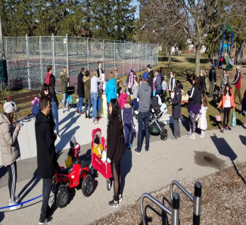

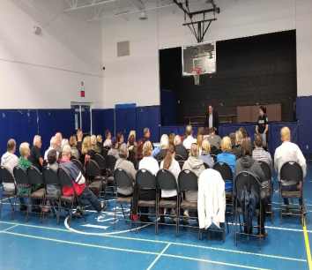
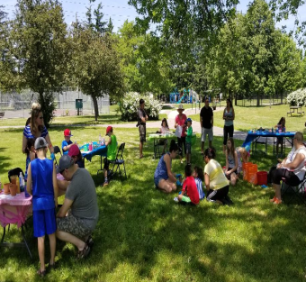
SHORA Year in Review
SHORA Events:
Deck the Streets Dec 22
Easter Egg Hunt April 13
Spring Clean May 4
Community Safety Meeting May 15
Community Garage Sale May 25
Art in the Park June 23
Wood Clean Up Sept 13
Looking Forward:
Pumpkin Walk Nov 1
Natural Ice Rink
MTO Construction Progress
Confidential - Sherway Homeowner’s and Recreation Association
Notes:
6

Slide 7
Guest Speaker – Ross Atikinson
Terrapure Environmental / Tonolli Canada
Confidential - Sherway Homeowner’s and Recreation Association
Notes:
7

Slide 8
Guest Speaker – Graham Sled
GHD Group
Confidential - Sherway Homeowner’s and Recreation Association
Notes:
8

Slide 9
MTO Contract 2
East of Cawthra to East of Dixie
Key Components:
- Replacement / reconfiguration of QEW/Dixie road underpass
Replacement of Ogden pedestrian bridge
Realignment of local service roads
Drainage improvements / storm water management ponds
Water main and sanitary sewer works
-Detail design is underway
-As early as Fall 2019 work may be done to relocate utilities
Contract 2 work expected to commence 2022 and last for 3-4 years.
Project timing is subject to funding, completion of detailed design, environmental permits and approvals.
Confidential - Sherway Homeowner’s and Recreation Association

Slide 10
Guest Speaker – Councilor Stephen Dasko
Mississauga Ward 1 City Councilor
Confidential - Sherway Homeowner’s and Recreation Association
Notes:
10

Slide 11
Q & A / Closing Comments
Quick Q + A, Adjournment & Social
Questions / Comments
Want to Volunteers
Contact Jamie
pugh@rogers.com
647-393-2199
Confidential - Sherway Homeowner’s and Recreation Association
Notes:
11

