Slide 1
Karl Marx
Value, Price and Profit (1865)
Economic and Philosophic Manuscripts of 1844

Slide 2
Karl Marx
Born: May 5, 1818 (Trier, Germany)
Died: March 17, 1883 (London, England)

Slide 3

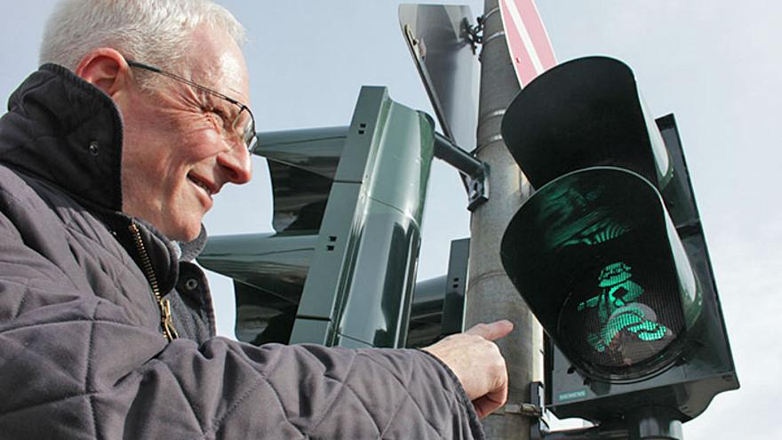
Karl Marx

Slide 4
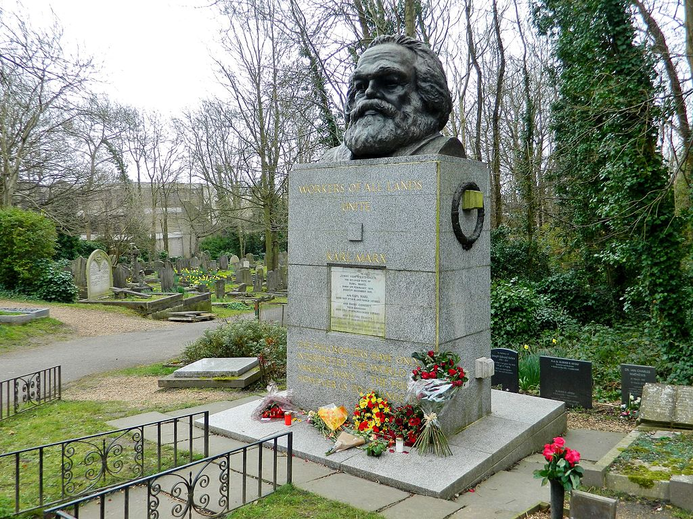
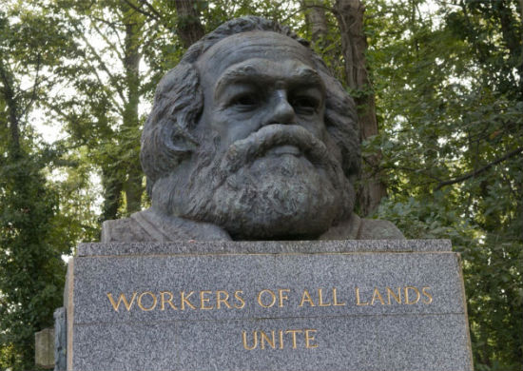
Karl Marx

Slide 5
Karl Marx
Labor theory of value
What is the basic unit of value?
“Commodity has a value because it is a crystallization of social labor.” (VPP 729) (This is loosely similar to Adam Smith.)
Labor is “the common social substance of all commodities.” (VPP 728)
Thus, the value is: the quantity of labor
  Note: this is not the same as the wages paid for that labor – the quantity of labor refers to the average time (not actual time) it generally takes across society to engage in that labor.

Slide 6
Karl Marx
Labor theory of value
Point: everything can ultimately be viewed as labor
Labor power – price that would be given for the use of a person’s power.
Capital (tools, factories, money) is just accumulated labor – it took labor to make it and/or to acquire it.
  All of this is the means of production.
Therefore, generally speaking there are two primary kinds of value (which are derived from labor):
  Labor power.
  Capital (accumulated labor).

Slide 7
Karl Marx
Surplus value
What is surplus value? How does it come about?
Example:
  You are a worker who earns wages of $30 per day, for 8 hours of work.
  That $30 is exactly the amount of money that is required to sustain you (i.e., to pay for that day’s equivalent of food, rent, etc.)
  It takes you 2 hours of labor to produce goods worth $30.
  The remaining 6 hours that you spend at work is labor (value) you give but are not compensated for.
    So where does that labor go?
      The labor produces goods sold at a profit.
      That profit is surplus value – for the capitalist employer.

Slide 8
Karl Marx
Surplus value
At the end of the day, what does each person have?
The worker
  You have given your labor in exchange for wages.
  These wages cover your sustenance; but there is nothing left over.
The capitalist employer
  She has given some of her capital in wages in exchange for your labor.
  Your labor is used to produce goods that are worth more than what she paid you for your labor; the capitalist employer retains this surplus value.
At the end of the day, you just stay afloat, while the capitalist employer amasses more and more capital from your labor.

Slide 9
Karl Marx
Exploitation
As society industrializes, what happens?
Each worker is able to produce more and more goods that are sold at a profit (resulting in greater surplus value to the capitalist employer).
While previously it took only 2 hours of labor to cover your needs, with division of labor and increased technology, it will take much less time.
This means that more and more of the worker’s time is spent without being compensated for their labor, and this goes to the capitalist employer.

Slide 10
Karl Marx
Exploitation
As society industrializes, what happens?
Over time, the capitalist employer’s capital continually increases, while the worker still only covers his needs and is unable to amass any capital.
Class conflict: This creates two distinct social (economic, political) classes:
  The bourgeoisie
    The few who possess the means of production.
  The proletariat
    The masses who possess only their labor power.

Slide 11
Karl Marx
Exploitation
As society industrializes, what happens?
  What happens to the capitalist employer?
  What happens to the worker?
  What happens to society?

Slide 12

Karl Marx
The Edukators (2004)
Characters:
Jan
Jule
Peter
Hardenberg
https://youtu.be/QXxiBAi_q54

Slide 13
Karl Marx
Marxism is not just a political and economic philosophy…
It is also a sociological theory – a “conflict theory”
Primarily about social class conflict – the conflict that arises from power and domination, from the bourgeoisie over the proletariat.
Social relations are forged out of class struggles – they reflect the different positions of power people hold in society. (You can look beyond an apparent social reality to find a deeper reality.)
This perspective can be applied to numerous fields: education, political science, anthropology, literary criticism, art, media studies, psychology, etc.
END

