Slide 1

OFFICE OF INDIAN EDUCATION
FORMULA PROGRAM
2021 NATIONAL JOHNSON O’MALLEY
ANNUAL CONFERENCE
ATLANTIC CITY, NJ
TUESDAY, SEPTEMBER 28, 2021
Notes:
Crystal:
Hello everyone, Thank you for joining the Office of Indian Education’s Formula Program’s 2021 NJOMA Annual Conference; we are going to go ahead and get started. My name is Dr. Crystal Moore and I am the Supervisory Group Leader of the Office of Indian Education Formula Team. I also have OIE Program Officers: Annabelle Toledo and Wanda Lee on the line, who will also be presenting and assisting in answering questions in the chat box. Please
The presentation that we will review today will be available on the EASIE Community website. You can also contact us or our OIE Partner Support Center to request a copy of these resources or guidance on how to access the Community site.

Slide 2
Presenters
Dr. Crystal Moore, Ed.D. (Choctaw)
Supervisory OIE Formula Group Leader
Annabelle Toledo (Jemez Pueblo)
Education Program Specialist
Wanda Lee, M.Ed. (Lumbee)
Education Program Specialist
Notes:
Crystal:
The presenters for today’s webinar are as follows:
Myself: Dr. Crystal Moore, Ed.D. (Choctaw)
Supervisory OIE Formula Group Leader
Annabelle Toledo (Jemez Pueblo)
Education Program Specialist
Wanda Lee, M.Ed. (Lumbee)
Education Program Specialist

Slide 3

Agenda
Welcome
Presenters/OIE Leadership Staff/Introduction
OIE Program Officers
OIE’s Programs
FY 2021 OIE Formula Awards Overview
Page 2: OIE Formula Awards Overview
Student Count Comparison
OIE Formula and JOM Comparison
New! Electronic Fillable ED 506 Form
Categories and Definitions for Formula Grants
Notes:
Crystal:
Next, I would like to review the agenda for today’s presentation.
Welcome
Presenters/OIE Leadership Staff/Introduction
OIE’s Programs
FY 2021 OIE Formula Awards Overview
Page 2: OIE Formula Awards Overview
Student Count Comparison
OIE Formula and JOM Comparison
New! Electronic Fillable ED 506 Form
Categories and Definitions for Formula Grants

Slide 4
Agenda Continued
IPC/LEA Relationship
IPC By-laws
Fiscal Management Overview
General Federal Cost Principles
What is the Grant Award Notice (GAN)
Recommended Resources
Contact US
Thank You for Participating
Questions and Answers
Notes:
Crystal:
IPC/LEA Relationship
IPC By-laws
Fiscal Management Overview
General Federal Cost Principles
What is the Grant Award Notice (GAN)
Recommended Resources
Contact US
Thank You for Participating
Questions and Answers

Slide 5
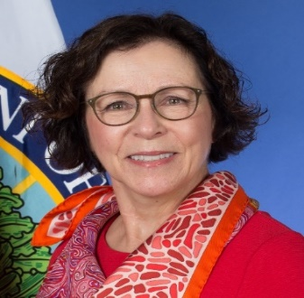
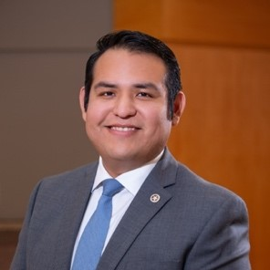
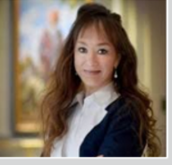

OIE Leadership Team
Ron Lessard (Mohawk)
Acting Executive Director for the White House Initiative on American Indian and Alaska Native
Ruth Ryder
Deputy Assistant Secretary for Formula Grants
Office of Elementary & Secondary Education
Julian Guerrero, Jr. (Comanche/
Kiowa)
Director,
Office of Indian Education, U.S. Department of Education
Dr. Crystal C. Moore (Choctaw)
Supervisory, Group Leader, Formula Team, Office of Indian Education, U.S. Department of Education
Notes:
Crystal:
I would first like to highlight the OIE Leadership Staff. We have:
Ron Lessard (Acting Executive Director for the White House Initiative on American Indian and Alaska Native Education),
Ruth Ryder (Deputy Assistant Secretary for Formula Grants Office of Elementary & Secondary Education)
Julian Guerrero, Jr. (Director, Office of Indian Education, U.S. Department of Education)
Dr. Crystal C. Moore (Supervisory, Group Leader, Formula Team, Office of Indian Education, U.S. Department of Education)

Slide 6
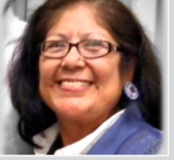
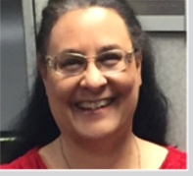
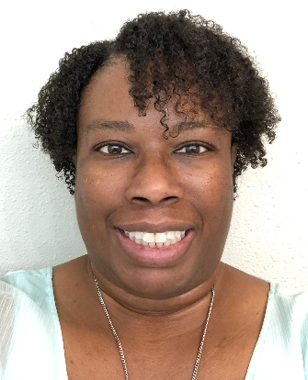

OIE Formula Program Officers
Annabelle Toledo
(Jemez Pueblo),
Education Program Specialist
Annabelle.Toledo@ed.gov
AL, AR, CT, FL, IA, IL, KS, LA, MA, MD, ME, MI, MN, MO, MS, NC, NE, NY, SC, VA, VT
Wanda Lee, M.Ed. (Lumbee),
Education Program Specialist
Wanda.Lee@ed.gov
OK
Dr. Marie Julienne, Ph.D.
Education Program Specialist
Marie.Julienne@ed.gov
AK, ID, MT, ND, OR, SD, WA
Tawanda Avery, M.Ed.-SPED, Education Program Specialist
Tawanda.Avery2@ed.gov
AZ, CA, CO, NM, NV, TX, UT, WY
Notes:
Crystal:
I would next like to highlight the OIE Formula Program Officers. We have:
Wanda Lee
Annabelle Toledo
Tawanda Avery
Dr. Marie Julienne

Slide 7
Office of Indian Education Programs
Formula Grants
National Activities
Discretionary Grants
Formula Grants
Grants to LEAs, BIE Schools, Tribes, Indian-Based Community Organizations (ICBO), and Indian Organizations (IO)
National Activities
1. National Advisory Council on Indian Education (NACIE)
2. National Indian Education Study (NIES)
3. Technical Assistant (TA) Contracts
a. Tribal Consultation
Discretionary Grants
1. Indian ED Professional Development (PD)
2. Native Youth Community Programs (NYCP) -Demonstration
3. State Tribal Ed Partnership (STEP) American
4. ARP-AIRE (Am Indian Resilience in Ed)
5. Native American Language (NAL)
Notes:
Crystal:
I would like to highlight the Office of Indian Education (OIE) Programs.
National Activities
1. National Advisory Council on Indian Education (NACIE)
2. National Indian Education Study (NIES)
3. Technical Assistant (TA) Contracts
a. Tribal Consultation
Discretionary Grants
1. Indian ED Professional Development (PD)
2. Native Youth Community Programs (NYCP) -Demonstration
3. State Tribal Ed Partnership (STEP) American
4. ARP-AIRE (Am Indian Resilience in Ed)
5. Native American Language (NAL)
Formula Grants
Grants to LEAs, BIE Schools, Tribes, Indian-Based Community Organizations (ICBO), and Indian Organizations (IO)

Slide 8
SY21 OIE Formula Awards Overview
48
39
24
81
Total Grantees:
1,302
Notes:
Crystal:
Next, I would like to review the SY2021-22 OIE Formula Awards Overview.
OIE had a total of 1302 grantees broken out into the follow applicant types.
LEA: 1102
Bureau Grant and Contract Schools: 91
Bureau Operated Schools: 50
LEA-Consortium: 29
Tribes Applying In Lieu of LEAs: 29
Indian Community Based Orgs.: 1
Total: 1302

Slide 9
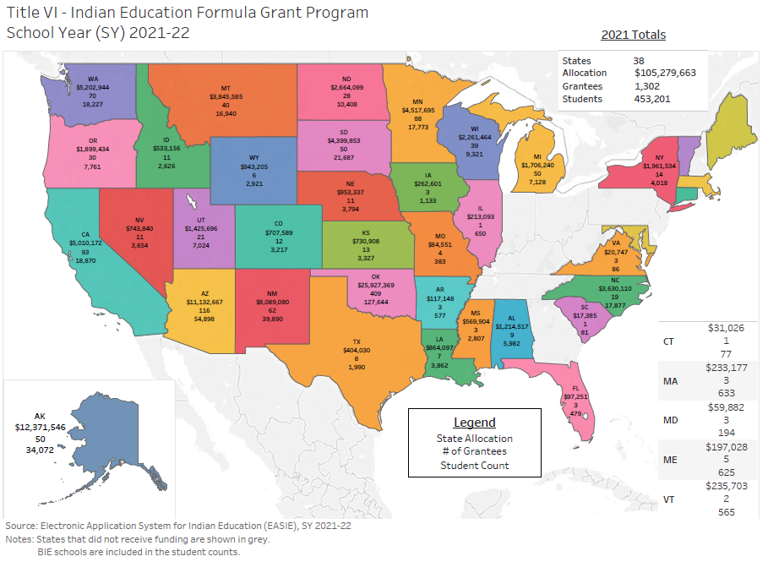

SY21 OIE Formula Award Overview
Notes:
Annabelle:
To continue with our SY2021-22 OIE Formula Award Overview, you can view a state map of the total state allocation, number of grantees, and Indian Student Count on this slide.

Slide 10
Student Count Comparison
All American Indian/Alaska Native students that are eligible for Johnson O’Malley are also eligible for Title VI Formula Grants to LEAs
Formula Grant (FY21)
453,201
JOM (FY15)
XXX
BIE-Funded
FY15
XXX
Notes:
Annabelle:
Next, I would like to review a Student Count Comparison between the EASIE Formula Grant, Johnson O’Malley, and BIE Funded students.
Number of Formula students:467,784 as of 2015
JOM: 321,250 as of 2014
BIE Funded: Approximately 42,000

Slide 11
OIE Formula & JOM Comparison
Formula Grants to LEAs
Johnson O’Malley Contracts
Funded by the U.S. Department of Education, Office of Elementary & Secondary Education, Office of Indian Education Title VI Formula Grants
Completion of a Title VI Student Eligibility Certification Form (ED 506)
Applicant Needs Assessment
(EASIE Part IFAQ 17.5-6)(6114)(c)(3)
Indian Parent Committee Approval (IPCA) Form with Application
Post Award LEA has authority over grant funds and personnel
Expenditures must be allowable, allocable, and reasonable based on Title VI statute and project, as well as Federal Cost Principles linked here: https://www.ecfr.gov/current/title-2/subtitle-A/chapter-II/part-200/subpart-E
Funded by the U.S. Department of the Interior, Bureau of Indian Education
Completion of JOM application with a copy of child's Certified Degree of Indian Blood (CDIB) Card or tribal membership card
Needs Assessment
Parent Committee Submits Application
Pre/Post JOM Parent Committee reviews and approves budget modifications
Notes:
Annabelle:
Next, I would like to compare the OIE EASIE Formula Grants to LEAs and Johnson O’Malley Contracts.
Formula Grants to LEAs
Funded by the U.S. Department of Education, Office of Elementary & Secondary Education, Office of Indian Education Title VI Formula Grants
Completion of a Title VI Student Eligibility Certification Form (ED 506)
Applicant Needs Assessment
(EASIE Part IFAQ 17.5-6)(6114)(c)(3)
Indian Parent Committee Approval (IPCA) Form with Application
Post Award LEA has authority over grant funds and personnel
Expenditures must be allowable, allocable, and reasonable based on Title VI statute and project, as well as Federal Cost Principles linked here: https://www.ecfr.gov/current/title-2/subtitle-A/chapter-II/part-200/subpart-E
Johnson O’Malley Contracts
Funded by the U.S. Department of the Interior, Bureau of Indian Education
Completion of JOM application with a copy of child's Certified Degree of Indian Blood (CDIB) Card or tribal membership card
Needs Assessment
Parent Committee Submits Application
Pre/Post JOM Parent Committee reviews and approves budget modifications

Slide 12

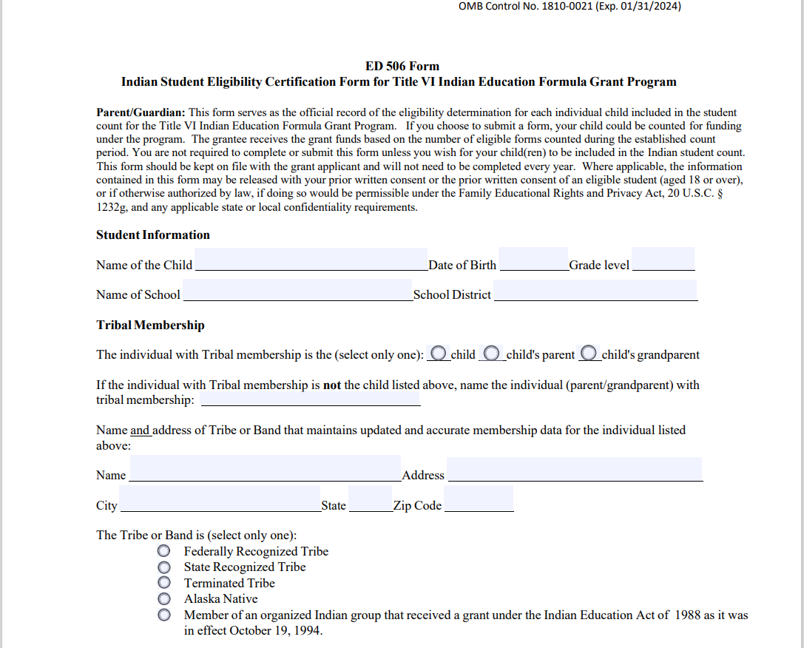
New! Electronic Fillable ED 506 Form
Link: https://easie.grads360.org/#communities/pdc/documents/9670
Notes:
Annabelle:
What Information is Required for the ED 506 Form?
For an ED 506 form to be completed in full, it must contain all the following information:
•Name of child and date of birth;
•School name and grade;
•Name of the Tribe, band, of Indians;
•Whether the Tribe listed is federally recognized; Alaska Native; state recognized; terminated; or an organized Indian group meeting;
•Name of the individual with tribal membership;
•Whether the individual named is the child, the child’s parent, or the child’s grandparent;
•Proof of membership, as defined by Tribe, which can be either: Membership or enrollment number (if readily available), OR other evidence establishing the membership;
•Name and address of the organization that maintains updated and accurate membership data for the Tribe, band, of Indians;
•The name and address of the parent or legal guardian of the child;
•Signature of the parent or the legal guardian of the child;
•Date the ED 506 Form was completed; and email address.

Slide 13

Categories and Definitions for Formula Grants
The categories are:
  Federally recognized (including Alaska Native)
  State-recognized
  Terminated
  Organized Indian group meeting the program’s definition.
These definitions for tribes appear on the ED 506 form.
  Federally recognized tribes are limited to those indigenous to the U.S.
  State-recognized tribes are tribes that have been recognized by a process established under state laws.
  Terminated tribes are those that once had a federally recognized status from the U.S. Department of the Interior and had that designation terminated.
  Other organized Indian group represents those that received a grant under the Indian Education Act of 1988 as it was in effect October 19, 1994.
  For more information: Link: Federal Register :: Office of Indian Education (OIE); Formula Grants to Local Educational Agencies
Notes:
Annabelle,
Next, I would like to review some Categories and Definitions for Formula Grants.
The categories are:
Federally recognized (including Alaska Native)
State-recognized
Terminated
Organized Indian group meeting the program’s definition.
These definitions for tribes appear on the ED 506 form.
Federally recognized tribes are limited to those indigenous to the U.S.
State-recognized tribes are tribes that have been recognized by a process established under state laws.
Terminated tribes are those that once had a federally recognized status from the U.S. Department of the Interior and had that designation terminated.
Other organized Indian group represents those that received a grant under the Indian Education Act of 1988 as it was in effect October 19, 1994.
For more information: Link: Federal Register :: Office of Indian Education (OIE); Formula Grants to Local Educational Agencies

Slide 14
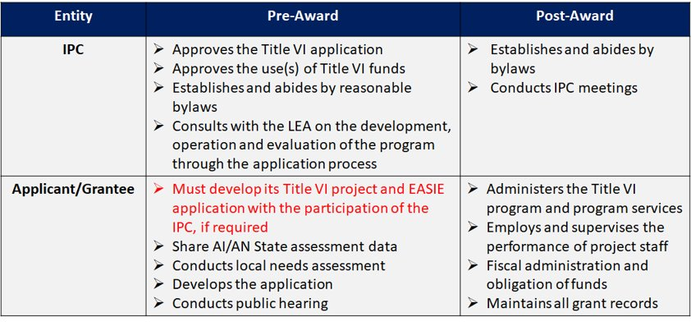
IPC/LEA Relationships
Link: https://easie.grads360.org/#communities/pdc/documents/20033
Notes:
Annabelle
Next, we will review the relationship between the IPC and Applicant/Grantee pre and post award.
Pre-Award the IPC…
Approves the Title VI application
Approves the use(s) of Title VI funds
Establishes and abides by reasonable bylaws
Consults with the LEA on the development, operation and evaluation of the program through the application process
Pre-Award the Applicant/Grantee…
Must develop its Title VI project and EASIE application with the participation of the IPC, if required
Share AI/AN State assessment data
Conducts local needs assessment
Develops the application
Conducts public hearing
Post Award the IPC…
Establishes and abides by bylaws
Conducts IPC meetings
Post Award the Applicant/Grantee...
Administers the Title VI program and program services
Employs and supervises the performance of project staff
Fiscal administration and obligation of funds
Maintains all grant records

Slide 15
Indian Parent Committee (IPC) By-Laws
In collaboration with LEA, the Indian Parent Committee establishes by-laws that define operations of the IPC.
By-laws should be updated regularly
By-laws should address all the technical details of a governing body
By-laws should address which members can sign and approve the Parent Committee Approval Form
New! Electronic fillable by-laws template in CoP website!
Communities360° - Home > Overview > EASIE Part II (grads360.org)
Notes:
Annabelle:
All Title VI LEA grantees are required to have Parent Committees and must establish bylaws. None of the other eligible entities are required to have an IPC and bylaws. The bylaws should define the leadership and membership composition, size of the board and how it will function. They should also identify the roles and duties of president and officers, rules and procedures for holding meetings, electing president, and/or appointing officers, conflict of interest policies and procedures, quorum/meeting/membership/voting, voting rights, and the many other regulations and procedures that govern their Indian Parent Committee. Link provided here:Communities360° - Home > Overview > EASIE Part II (grads360.org)
Directions: Within six months of receiving the award, the LEA assures the IPC will adopt and abide by reasonable bylaws for the conduct of the activities of the committee. (ESEA Section 6114(c)(4)(D)).

Slide 16
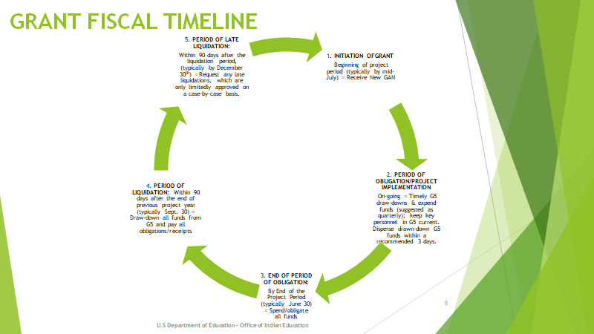
Fiscal Management Overview
https://easie.grads360.org/#communities/pdc/documents/19275
Notes:
Wanda:
GRANT FISCAL TIMELINE
1. INITIATION OF GRANT
Beginning of project period (typically by mid-July) = Receive New GAN
2. PERIOD OF OBLIGATION/PROJECT IMPLEMENTATION
On-going = Timely G5 draw-downs & expend funds (suggested as quarterly); keep key personnel in G5 current. Disperse drawn-down G5 funds within a recommended 3 days.
3. END OF PERIOD OF OBLIGATION:
By End of the Project Period (typically June 30) = Spend/obligate all funds
4. PERIOD OF LIQUIDATION: Within 120 days after the end of previous project year (typically Oct. 30) = Draw-down all funds from G5 and pay all obligations/receipts
5. PERIOD OF LATE LIQUIDATION:
Within 60 days after the liquidation period, (typically by December 30th) = Request any late liquidations, which are only limitedly approved on a case-by-case basis.

Slide 17
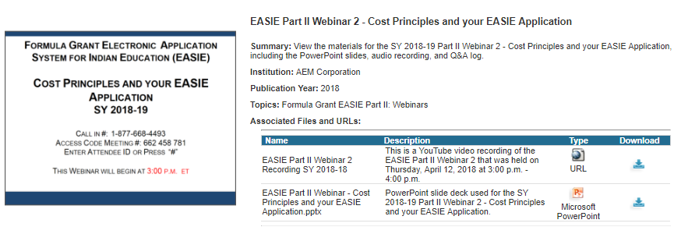
Budget – General Federal Cost Principles
    Users can find the Cost Principles and your EASIE Application Webinar Recording at the below link.
    Please note: This webinar was presented during the SY 2018-19 Part II grant process.
    Link: https://easie.communities.ed.gov/#communities/pdc/documents/16738
Notes:
Wanda:
Users can find the Cost Principles and your EASIE Application webinar recording at the below link.
Please note: This webinar was presented during the SY 2018-19 Part II grant process.
https://easie.communities.ed.gov/#communities/pdc/documents/16738

Slide 18
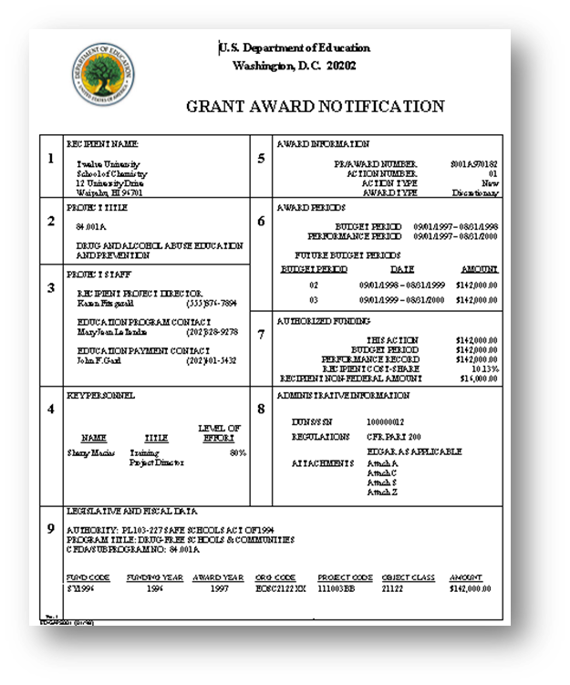
What Is The Grant Award Notice (GAN)?
The Grant Award Notification (GAN) is the official document that states the terms, conditions, and amount of an award and is signed by the official who is authorized to obligate funds on behalf of the Department of Education (i.e., Authorized Official Representative).
Notes:
Wanda:
WHAT IS THE GRANT AWARD NOTICE (GAN)?
The Grant Award Notification (GAN) is the official document that states the terms, conditions, and amount of an award and is signed by the official who is authorized to obligate funds on behalf of the Department of Education (i.e., Authorized Official Representative). This document can be found at G5.gov.

Slide 19

Recommended resources
EASIE Communities Website: https://easie.communities.ed.gov
EASIE Part I Communities Website Page:
https://easie.communities.ed.gov/#program/easie-part-i
EASIE Part I FAQ Document: https://easie.communities.ed.gov/#communities/pdc/documents/9682
EASIE Part II Communities Website Page:
https://easie.communities.ed.gov/#program/easie-part-ii
EASIE Part II FAQ Document: https://easie.communities.ed.gov/#communities/pdc/documents/9683
EASIE Annual Performance Report (APR) Communities Website Page: https://easie.communities.ed.gov/#program/easie-apr
EASIE Annual Performance Report (APR) FAQ Document: https://easie.communities.ed.gov/#communities/pdc/documents/9679
Notes:
Wanda:
Here are links to some very helpful resources that will assist you with the formula grant application process; pre and post submission, for each part.

Slide 20
Contact Us
If you have any questions about today’s presentation, please contact:
Office of Indian Education
400 Maryland Ave., SW
LBJ, Mail Stop 6335
Washington, DC 20202-6335
Telephone: 202-260-3774
Fax: 202-260-7779 or 202-205-0606
E-mail: indian.education@ed.gov
Notes:
Wanda:
If you have any questions about today’s presentation, please contact:
Office of Indian Education
400 Maryland Ave., SW
LBJ, Mail Stop 6335
Washington, DC 20202-6335
Telephone: 202-260-3774
Fax: 202-260-7779 or 202-205-0606
E-mail: indian.education@ed.gov

Slide 21

Questions
Notes:
Wanda:
So, this concludes our presentation for today.
We are going to take a few minutes to see if there are any questions that we can address in the time that remains.
*ONCE QUESTION/ANSWER PERIOD IS OVER*
It appears we have addressed as many of the questions as we could in the time remaining. If your question was not addressed, please contact OIE. That concludes today’s presentation! Thank you so much for your time and participation today and have a great day!

