Slide 1
Overcoming Nursing Management Challenges in Metastatic Castration-Resistant Prostate Cancer
Kathleen D. Burns, MSN, AGACNP-BC, OCN®
Nurse Practitioner
Division of Genitourinary Medical Oncology
City of Hope Comprehensive Cancer Center

Slide 2
Provided by i3 Health
ACCREDITATION
i3 Health is accredited with distinction as a provider of nursing continuing professional development by the American Nurses Credentialing Center’s Commission on Accreditation.
A maximum of 1.0 contact hour may be earned by learners who successfully complete this continuing nursing education activity.
INSTRUCTIONS TO RECEIVE CREDIT
An activity evaluation has been distributed. To claim credit, you must submit a completed and signed evaluation form at the conclusion of the program. Your certificate of attendance will be emailed to you in approximately 2 weeks.
UNAPPROVED USE DISCLOSURE
This educational activity may contain discussion of published and/or investigational uses of agents that are not indicated by the FDA. The planners of this activity do not recommend the use of any agent outside of the labeled indications.
The opinions expressed in the educational activity are those of the faculty and do not necessarily represent the views of the planners. Please refer to the official prescribing information for each product for discussion of approved indications, contraindications, and warnings.
DISCLAIMER
The information provided at this NCPD activity is for continuing education purposes only and is not meant to substitute for the independent medical/clinical judgment of a healthcare provider relative to diagnostic and treatment options of a specific patient’s medical condition.
COMMERCIAL SUPPORT
This educational activity is supported by independent educational grants from Sanofi Genzyme, Merck, and AstraZeneca.

Slide 3
Disclosures
Kathleen D. Burns, MSN, AGACNP-BC, OCN®
  Advisory board/panel: AVEO, Eisai, Exelixis
  Speaker’s bureau: Amgen, Astellas, AstraZeneca, AVEO, Exelixis, Pfizer, Sanofi Genzyme
i3 Health has mitigated all relevant financial relationships

Slide 4
Learning Objectives
Evaluate the diagnosis and staging of metastatic CRPC
Appraise the efficacy and safety profiles of novel therapies for metastatic CRPC as elucidated by recent clinical trials
Devise strategies to manage drug interactions and adverse events associated with novel therapies for metastatic CRPC
CRPC = castration-resistant prostate cancer.

Slide 5
Prostate Cancer (PC) in 2022
Prostate cancer accounts for 1 in 5 diagnoses of cancer in men. The ACS estimates that 268,490 new cases of prostate cancer will be diagnosed in the US in 2022
The median age at time of diagnosis is 66. Prostate cancer is rare before age 40
The incidence of prostate cancer is about 73% higher in Black men than in White men for reasons that remain unclear. Black men in the US and Caribbean have the highest documented prostate cancer incidence rates in the world
The ACS estimates that 34,500 men will die of prostate cancer in 2022
ACS = American Cancer Society.
ACS, 2022; Kensler et al, 2021.
Notes:
“One study found that after the 2012 US Preventive Service Task Force (USPSTF) guideline changes, there was a steeper drop in prostate specific antigen (PSA) testing in Black men than in White men,” says Siegel. “That’s concerning because early detection is especially important for Black men, who are twice as likely to die from prostate cancer as White men.”

Slide 6
PSA Screening
How Changes are Affecting Incidence and Risk of Death
Risk of dying from PC decreased by 50% from the mid-1990s to the mid-2010s due to improved treatment and earlier detection (PSA)
More recently, the risk of dying from PC is only decreasing by 0.6% per year
PSA = prostate-specific antigen.
ACS, 2022.
Notes:
How Changes in PSA Screening Are Affecting Incidence and Risk of Death
The risk of dying from prostate cancer decreased by about 50% from the mid-1990s to the mid-2010s due to improved treatment and earlier detection through screening with prostate specific antigen (PSA) testing, which helps find cancer when it is only in the prostate (localized). But in recent years, the risk of dying from prostate cancer is only decreasing by 0.6% a year. The cause for this slowing progress may be related to changes in screening guidelines
Despite the contribution of screening to a reduction in mortality, there was increasing evidence that PSA testing was causing undue harm through overdiagnosis and overtreatment of prostate cancer. As a result, the US Preventive Services Task Force (USPSTF) changed their screening guidelines
In 2008, the USPSTF recommended against routine screening with PSA testing for men age 75 and older and in 2012 for all men, which led to fewer men being screened
At first, reduced PSA testing was followed by rapid declines in the diagnosis of prostate cancer. But from 2014 to 2018, the incidence rate for local-stage disease stayed stable, whereas incidence rates for regional-stage disease rose each year by 4% and by 6% for distant-stage disease
As a result, the proportion of prostate cancers diagnosed at a distant stage has more than doubled over the past 10 years, from 3.9% to 8.2%
ACS researchers note that “controversy remains about the underutilized potential of the PSA test” to reduce deaths from prostate cancer by detecting potentially fatal disease

Slide 7
Metastatic CRPC
NCCN Guidelines for Prostate Cancer Diagnosis
Perform physical exam
Perform DRE to confirm clinical stage
Perform and/or collect PSA and calculate PSADT
Estimate life expectancy (see Principles of Life Expectancy-Estimation [PROS-A in NCCN])
Inquire about known high-risk germline mutations
Obtain family history
Regional prostate cancer
(Any T, N1, M0)
Metastatic prostate cancer
(Any T, any N, M1)
DRE = digital rectal exam; PSADT = PSA doubling time; NCCN = National Comprehensive Cancer Network; T = tumor; N = nodal; M = metastases.
NCCN, 2022.

Slide 8
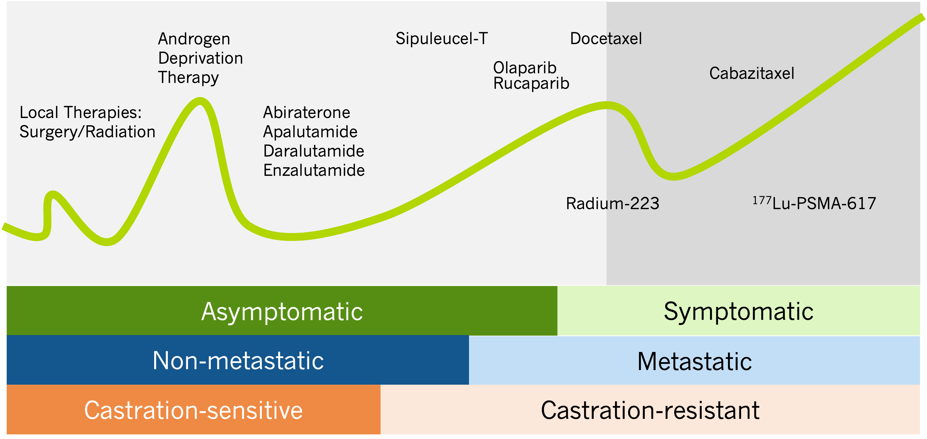
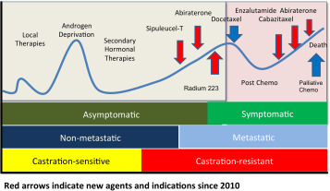
Metastatic CRPC: Diagnosis
Crawford et al, 2017.
Androgen
Deprivation
Therapy
Sipuleucel-T
Docetaxel
Olaparib
Cabazitaxel
Rucaparib
Local Therapies:
Surgery/Radiation
Abiraterone
Apalutamide
Daralutamide
Enzalutamide
Radium-223
¹⁷⁷Lu-PSMA-617
Asymptomatic
Symptomatic
Non-metastatic
Metastatic
Castration-sensitive
Castration-resistant

Slide 9
Alphabet Soup: Testing the Cancer for Mutations
Next-generation sequencing (NGS)
Comprehensive genomic profiling (CGP)
DNA sequencing
Primary tumor if not metastatic
Metastatic tissue, if possible; if not, then circulating DNA blood test
Patient education and managing expectations that these results may not be used right away
Ewalt et al, 2019.

Slide 10
PC: NCCN-Recommended Somatic Tumor Testing
Pretest Considerations
At present, tumor molecular and biomarker analysis may be used for treatment decision making, including understanding eligibility for biomarker-directed treatments, genetic counseling, early use of platinum chemotherapy, and eligibility for clinical trials. Clinical trials may include established and/or candidate molecular biomarkers for eligibility
Tumor molecular profiles may change with subsequent treatments. Re-evaluation may be considered at time of cancer progression for treatment decision making
Patients should be informed that tumor molecular analysis by DNA sequencing has the potential to uncover germline findings. Confirmatory germline testing may be recommended (see Posttest Considerations below, and see Tumor Testing in the Principles of Cancer Risk Assessment and Counseling (EVAL-A) in the NCCN Guidelines for Genetic/Familial High-Risk Assessment: Breast, Ovarian, and Pancreatic
Testing
Tumor testing for alterations in homologous recombination DNA repair genes, such as BRCA1, BRCA2, ATM, PALB2, FANCA, RAD51D, CHEK2, and CDK12 is recommended in patients with metastatic prostate cancer. This testing can be considered in patients with regional prostate cancer
Tumor testing for microsatellite instability-high (MSI-H) or deficient mismatch repair (dMMR) is recommended in patients with metastatic castration-resistant prostate cancer and may be considered in patients with regional or castration-naïve metastatic prostate cancer
TMB testing may be considered in patients with metastatic CRPC
Tumor Specimen and Assay Considerations
The panel strongly recommends a metastatic biopsy for histologic and molecular evaluation. When unsafe or unfeasibly, plasma ctDNA assay is an option, preferably collected during biochemical (PSA) and/or radiographic progression in order to maximize diagnostic yield
Caution is needed when interpreting ctDNA-only evaluation due to potential interference from clonal hematopoiesis of indeterminate potential (CHIP), which can result in a false-positive biomarker signal
DNA analysis for MSI and immunohistochemistry (IHC) for MMR are different assays measuring different biological effects caused by dMMR function. If MSI is used, testing using an NGS assay validated for prostate cancer is preferred
Posttest Consideration
Posttest genetic counseling is recommended if pathogenic/likely pathogenic variant (mutation) identified in any gene that has clinical implications if also identified in germline (eg, BRCA1, BRCA2, ATM, PALB2, CHEK2, MLH1, MSH2, MSH6, PMS2)
Posttest genetic counseling to assess for the possibility of Lynch syndrome is recommended if MSI-H or dMMR is found
NCCN, 2022.

Slide 11
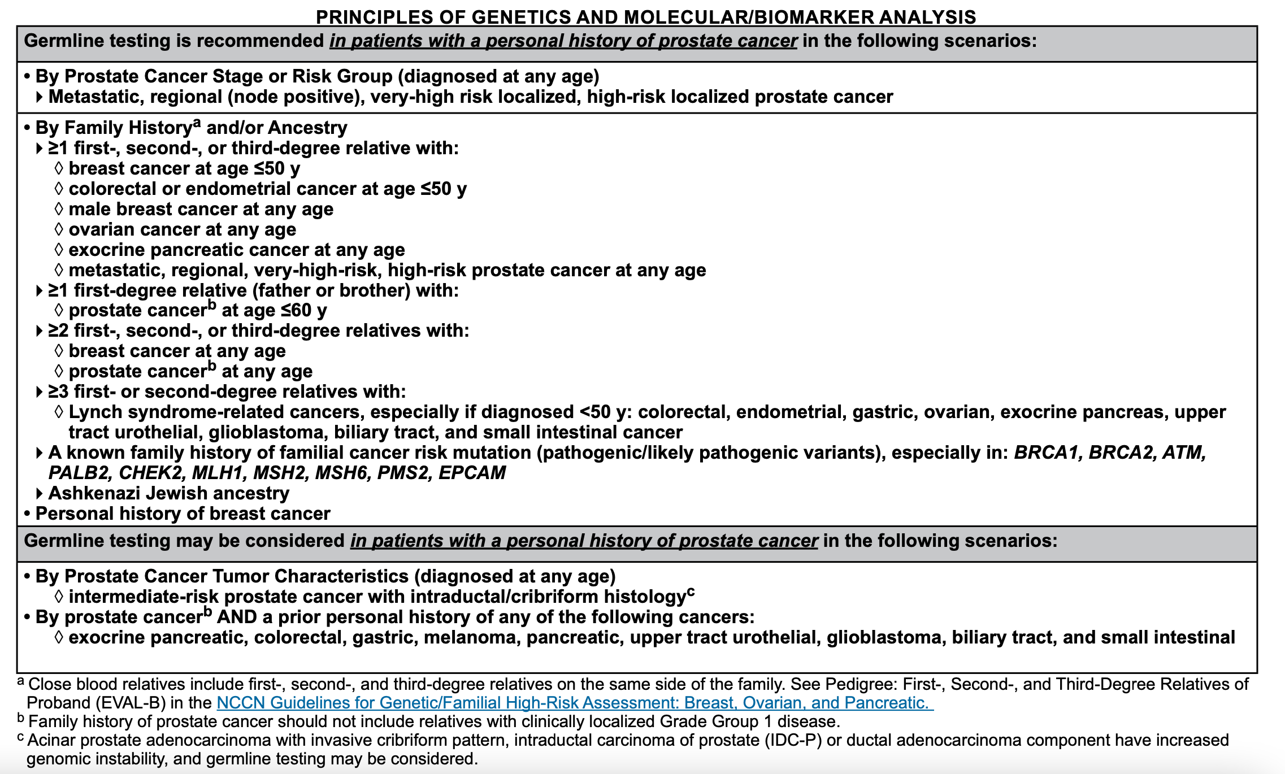
PC: NCCN-Recommended Germline Testing
Germline testing is recommended in patients with a personal history of prostate cancer in the following scenarios:
By Prostate Cancer Stage or Risk Group (diagnosed at any age)
Metastatic, regional (node positive), very-high-risk localized, high-risk localized prostate cancer
By Family Historyª or Ancestry
≥1 first-, second-, or third-degree relative with: Breast cancer at age ≤50 Colorectal or endometrial cancer at age ≤50 Male breast cancer at any age Ovarian cancer at any age Exocrine pancreatic cancer at any age Metastatic, regional, very-high-risk, high-risk prostate cancer at any age ≥1 first-degree relative (father or brother) with: Prostate cancer^{b} at age ≤60 ≥2 first-, second-, or third-degree relatives with: Breast cancer at any age Prostate cancer^{b} at any age ≥3 first- or second-degree relatives with Lynch syndrome-related cancers, especially if diagnosed <50: colorectal, endometrial, gastric, ovarian, exocrine pancreas, upper tract urothelial, glioblastoma, biliary tract, and small intestinal cancer A known family history of familial cancer risk mutation (pathogenic/likely pathogenic variants), especially in: BRCA1, BRCA2, ATM, PALB2, CHEK2, MLH1, MSH2, MSH6, PMS2, EPCAM Ashkenazi Jewish ancestry
Personal history of breast cancer
Germline testing may be considered in patients with a personal history of prostate cancer in the following scenarios:
By Prostate Cancer Characteristics (diagnosed at any age)
Intermediate-risk prostate cancer with intraductal/cribriform histology^{c}
By Prostate Cancer^{b} and a Prior Personal History of Any of the Following Cancers:
Exocrine pancreatic, colorectal, gastric, melanoma, pancreatic, upper tract urothelial, glioblastoma, biliary tract, and small intestinal
ªClose blood relatives include first-, second-, and third-degree relatives on the same side of the family. See Pedigree: First-, Second-, and Third-Degree Relatives of Proband (EVAL-B) in the NCCN Guidelines for Genetic/Familial High-Risk Assessment: Breast, Ovarian, and Pancreatic.
^{b}Family history of prostate cancer should not include relatives with clinically localized Grade Group 1 disease.
^{c}Acinar prostate adenocarcinoma with invasive cribriform pattern, intraductal carcinoma of prostate (IDC-P) or ductal adenocarcinoma component have increased genomic instability, and germline testing may be considered.
NCCN, 2022.

Slide 12
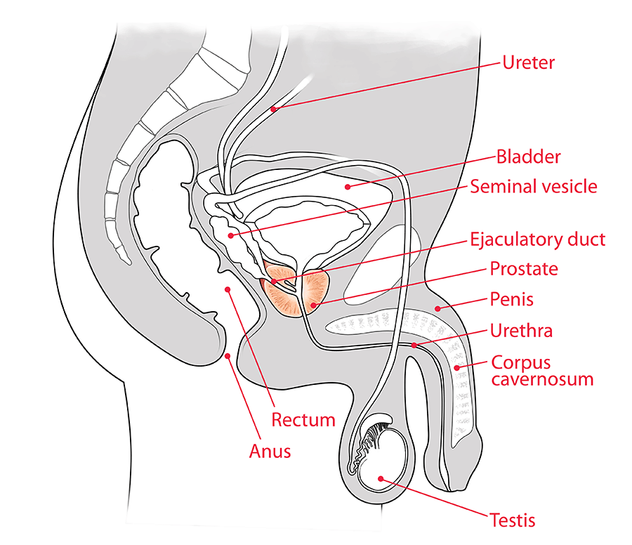
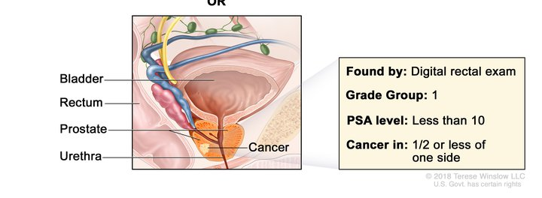
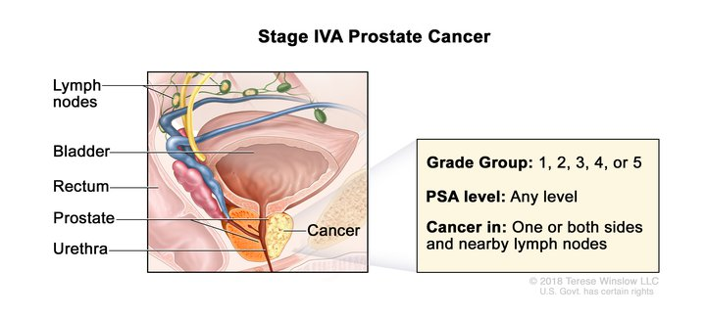
Prostate Cancer Staging
Stage I Prostate Cancer
Stage IVA Prostate Cancer
Hopkins Medicine, 2022; NCI, 2022a; NCI, 2022b.

Slide 13
mCRPC: Staging
TNM and Gleason
TNM staging: tumor, nodes, metastases
Gleason score
Risk Group | Grade Group | Gleason Score
Low/Very Low | Grade group 1 | Gleason score ≤6
Intermediate (Favorable/Unfavorable) | Grade group 2 | Gleason score 7 (3+4)
 | Grade group 3 | Gleason score 7 (4+3)
High/Very High | Grade group 4 | Gleason score 8
 | Grade group 5 | Gleason score 9-10
mCRPC = metastatic CRPC.
NCCN, 2022.
Notes:
Prostate Cancer: Stages and Grades
Approved by the Cancer.Net Editorial Board, 09/2021
Staging is a way of describing where the cancer is located, if or where it has spread, and whether it is affecting other parts of the body. Doctors use diagnostic tests to find out the cancer's stage, so staging may not be complete until all of the tests are finished. Staging for prostate cancer also involves looking at test results to find out if the cancer has spread from the prostate to other parts of the body. Knowing the stage helps the doctor recommend what kind of treatment is best and can help predict a patient's prognosis, which is the chance of recovery. There are different stage descriptions for different types of cancer.
There are 2 types of staging for prostate cancer:
Clinical staging. This is based on the results of DRE, PSA testing, and Gleason score (see “Gleason score for grading prostate cancer” below). These test results will help determine whether x-rays, bone scans, CT scans, or MRI are also needed. If scans are needed, they can add more information to help the doctor figure out the clinical stage
Pathologic staging. This is based on information found during surgery, plus the laboratory results of the prostate tissue removed during surgery, also called the pathology. The surgery often includes the removal of the entire prostate and some lymph nodes. Examination of the removed lymph nodes can provide more information for pathologic staging
TNM staging system
One tool that doctors use to describe the stage is the TNM system. This system is developed by the American Joint Committee on Cancer. Doctors use the results from diagnostic tests and scans to answer these questions:
Tumor (T): How large is the primary tumor? Where is it located?
Node (N): Has the tumor spread to the lymph nodes? If so, where and how many?
Metastasis (M): Has the cancer spread to other parts of the body? If so, where and how much?
The results are combined to determine the stage of cancer for each person. There are 5 stages: stage 0 (zero) and stages I through IV (1 through 4). The stage provides a common way of describing the cancer, so doctors can work together to plan the best treatments.
Gleason score for grading prostate cancer
Prostate cancer is also given a grade called a Gleason score. This score is based on how much the cancer looks like healthy tissue when viewed under a microscope. Less aggressive tumors generally look more like healthy tissue. Tumors that are more aggressive are likely to grow and spread to other parts of the body. They look less like healthy tissue. The Gleason scoring system is the most common prostate cancer grading system used. The pathologist looks at how the cancer cells are arranged in the prostate and assigns a score on a scale of 3 to 5 from 2 different locations. Cancer cells that look similar to healthy cells receive a low score. Cancer cells that look less like healthy cells or look more aggressive receive a higher score. To assign the numbers, the pathologist determines the main pattern of cell growth, which is the area where the cancer is most obvious, and then looks for another area of growth. The doctor then gives each area a score from 3 to 5. The scores are added together to come up with an overall score between 6 and 10.
Gleason scores of 5 or lower are not used. The lowest Gleason score is 6, which is a low-grade cancer. A Gleason score of 7 is a medium-grade cancer, and a score of 8, 9, or 10 is a high-grade cancer. A lower-grade cancer grows more slowly and is less likely to spread than a high-grade cancer.
Doctors look at the Gleason score in addition to stage to help plan treatment. For example, active surveillance (see Types of Treatment) may be an option for someone with a small tumor, low PSA level, and a Gleason score of 6. People with a higher Gleason score may need treatment that is more intensive, even if the cancer is not large or has not spread.
Gleason X: The Gleason score cannot be determined
Gleason 6 or lower: The cells look similar to healthy cells, which is called well differentiated
Gleason 7: The cells look somewhat similar to healthy cells, which is called moderately differentiated
Gleason 8, 9, or 10: The cells look very different from healthy cells, which is called poorly differentiated or undifferentiated
Cancer stage grouping
Doctors assign the stage of the cancer by combining the T, N, and M classifications. Staging also includes the PSA level (see Screening) and Gleason score.
Stage I: Cancer in this early stage is usually slow growing. The tumor cannot be felt and involves one-half of 1 side of the prostate or even less than that. PSA levels are low. The cancer cells look like healthy cells
Stage II: The tumor is found only in the prostate. PSA levels are medium or low. Stage II prostate cancer is small but may have an increasing risk of growing and spreading
Stage IIA: The tumor cannot be felt and involves half of 1 side of the prostate or even less than that. PSA levels are medium, and the cancer cells are well differentiated. This stage also includes larger tumors found only in the prostate, as long as the cancer cells are still well differentiated
Stage IIB: The tumor is found only inside the prostate, and it may be large enough to be felt during DRE. The PSA level is medium. The cancer cells are moderately differentiated
Stage IIC: The tumor is found only inside the prostate, and it may be large enough to be felt during DRE. The PSA level is medium. The cancer cells may be moderately or poorly differentiated
Stage III: PSA levels are high, the tumor is growing, or the cancer is high grade. These all indicate locally advanced cancer likely to grow and spread
Stage IIIA: The cancer has spread beyond the outer layer of the prostate into nearby tissues. It may also have spread to the seminal vesicles. The PSA level is high
Stage IIIB: The tumor has grown outside of the prostate gland and may have invaded nearby structures, such as the bladder or rectum
Stage IIIC: The cancer cells across the tumor are poorly differentiated, meaning they look very different from healthy cells
Stage IV: The cancer has spread beyond the prostate
Stage IVA: The cancer has spread to the regional lymph nodes
Stage IVB: The cancer has spread to distant lymph nodes, other parts of the body, or to the bones

Slide 14
mCRPC: Staging
Cancer Stage Grouping
Doctors assign the stage of the cancer by combining the T, N, and M classifications. Staging also includes the PSA level and Gleason score
Stage | Description
Stage I | Cancer in this early stage is usually slow growing. The tumor cannot be felt and involves half of 1 side of the prostate or even less than that. PSA levels are low. The cancer cells look like healthy cells
Stage II | The tumor is found only in the prostate. PSA levels are medium or low. Stage II disease is small but may have an increasing risk of growing and spreading
Stage IIA | The tumor cannot be felt and involves half of 1 side of the prostate or even less than that. PSA levels are medium, and the cancer cells are well differentiated. This stage also includes larger tumors found only in the prostate, as long as the cancer cells are still well differentiated
Stage IIB | The tumor is found only inside the prostate, and it may be large enough to be felt during DRE. The PSA level is medium. The cancer cells are moderately differentiated
Stage IIC | The tumor is found only inside the prostate, and it may be large enough to be felt during DRE. The PSA level is medium. The cancer cells may be moderately or poorly differentiated
Stage III | PSA levels are high, the tumor is growing, or the cancer is high grade. These all indicate a locally advanced cancer that is likely to grow and spread
Stage IIIA | The cancer has spread beyond the outer layer of the prostate into nearby tissues. It may also have spread to the seminal vesicles. The PSA level is high
Stage IIIB | The tumor has grown outside of the prostate gland and may have invaded nearby structures, such as the bladder or rectum
Stage IIIC | The cancer cells across the tumor are poorly differentiated, meaning they look very different from healthy cells
Stage IV | The cancer has spread beyond the prostate
Stage IVA | The cancer has spread to the regional lymph nodes
Stage IVB | The cancer has spread to distant lymph nodes, other parts of the body, or to the bones
Cancer.net, 2021.
Notes:
Prostate Cancer: Stages and Grades
Approved by the Cancer.Net Editorial Board, 09/2021
Staging is a way of describing where the cancer is located, if or where it has spread, and whether it is affecting other parts of the body. Doctors use diagnostic tests to find out the cancer's stage, so staging may not be complete until all of the tests are finished. Staging for prostate cancer also involves looking at test results to find out if the cancer has spread from the prostate to other parts of the body. Knowing the stage helps the doctor recommend what kind of treatment is best and can help predict a patient's prognosis, which is the chance of recovery. There are different stage descriptions for different types of cancer.
There are 2 types of staging for prostate cancer:
Clinical staging. This is based on the results of DRE, PSA testing, and Gleason score (see “Gleason score for grading prostate cancer” below). These test results will help determine whether x-rays, bone scans, CT scans, or MRI are also needed. If scans are needed, they can add more information to help the doctor figure out the clinical stage
Pathologic staging. This is based on information found during surgery, plus the laboratory results of the prostate tissue removed during surgery, also called the pathology. The surgery often includes the removal of the entire prostate and some lymph nodes. Examination of the removed lymph nodes can provide more information for pathologic staging
TNM staging system
One tool that doctors use to describe the stage is the TNM system. This system is developed by the American Joint Committee on Cancer. Doctors use the results from diagnostic tests and scans to answer these questions:
Tumor (T): How large is the primary tumor? Where is it located?
Node (N): Has the tumor spread to the lymph nodes? If so, where and how many?
Metastasis (M): Has the cancer spread to other parts of the body? If so, where and how much?
The results are combined to determine the stage of cancer for each person. There are 5 stages: stage 0 (zero) and stages I through IV (1 through 4). The stage provides a common way of describing the cancer, so doctors can work together to plan the best treatments.
Gleason score for grading prostate cancer
Prostate cancer is also given a grade called a Gleason score. This score is based on how much the cancer looks like healthy tissue when viewed under a microscope. Less aggressive tumors generally look more like healthy tissue. Tumors that are more aggressive are likely to grow and spread to other parts of the body. They look less like healthy tissue. The Gleason scoring system is the most common prostate cancer grading system used. The pathologist looks at how the cancer cells are arranged in the prostate and assigns a score on a scale of 3 to 5 from 2 different locations. Cancer cells that look similar to healthy cells receive a low score. Cancer cells that look less like healthy cells or look more aggressive receive a higher score. To assign the numbers, the pathologist determines the main pattern of cell growth, which is the area where the cancer is most obvious, and then looks for another area of growth. The doctor then gives each area a score from 3 to 5. The scores are added together to come up with an overall score between 6 and 10.
Gleason scores of 5 or lower are not used. The lowest Gleason score is 6, which is a low-grade cancer. A Gleason score of 7 is a medium-grade cancer, and a score of 8, 9, or 10 is a high-grade cancer. A lower-grade cancer grows more slowly and is less likely to spread than a high-grade cancer.
Doctors look at the Gleason score in addition to stage to help plan treatment. For example, active surveillance (see Types of Treatment) may be an option for someone with a small tumor, low PSA level, and a Gleason score of 6. People with a higher Gleason score may need treatment that is more intensive, even if the cancer is not large or has not spread.
Gleason X: The Gleason score cannot be determined
Gleason 6 or lower: The cells look similar to healthy cells, which is called well differentiated
Gleason 7: The cells look somewhat similar to healthy cells, which is called moderately differentiated
Gleason 8, 9, or 10: The cells look very different from healthy cells, which is called poorly differentiated or undifferentiated
Cancer stage grouping
Doctors assign the stage of the cancer by combining the T, N, and M classifications. Staging also includes the PSA level (see Screening) and Gleason score.
Stage I: Cancer in this early stage is usually slow growing. The tumor cannot be felt and involves one-half of 1 side of the prostate or even less than that. PSA levels are low. The cancer cells look like healthy cells
Stage II: The tumor is found only in the prostate. PSA levels are medium or low. Stage II prostate cancer is small but may have an increasing risk of growing and spreading
Stage IIA: The tumor cannot be felt and involves half of 1 side of the prostate or even less than that. PSA levels are medium, and the cancer cells are well differentiated. This stage also includes larger tumors found only in the prostate, as long as the cancer cells are still well differentiated
Stage IIB: The tumor is found only inside the prostate, and it may be large enough to be felt during DRE. The PSA level is medium. The cancer cells are moderately differentiated
Stage IIC: The tumor is found only inside the prostate, and it may be large enough to be felt during DRE. The PSA level is medium. The cancer cells may be moderately or poorly differentiated
Stage III: PSA levels are high, the tumor is growing, or the cancer is high grade. These all indicate locally advanced cancer likely to grow and spread
Stage IIIA: The cancer has spread beyond the outer layer of the prostate into nearby tissues. It may also have spread to the seminal vesicles. The PSA level is high
Stage IIIB: The tumor has grown outside of the prostate gland and may have invaded nearby structures, such as the bladder or rectum
Stage IIIC: The cancer cells across the tumor are poorly differentiated, meaning they look very different from healthy cells
Stage IV: The cancer has spread beyond the prostate
Stage IVA: The cancer has spread to the regional lymph nodes
Stage IVB: The cancer has spread to distant lymph nodes, other parts of the body, or to the bones

Slide 15
Case Study 1: Mr. DB
Mr. DB is a 65-year-old male with prostate cancer. He was previously treated surgically with radical prostatectomy and with radiation/ADT. Recently, his PSA has risen from 1.2 to 9 in 3 months, and testosterone is <7. The cancer has metastasized to 2 bony sites in his pelvis and 1 painful site in his lumbar spine
What might you expect him to have as part of his treatment?
  Denosumab
  ADT
  Radiation to the spine
  Chemotherapy
  All of the above
ADT = androgen deprivation therapy.
Notes:
No genomics done
Financial toxicity
Caregiver support

Slide 16
Case Study 1: Mr. DB (cont.)
Mr. DB is a 65-year-old male with prostate cancer. He was previously treated surgically with radical prostatectomy and with radiation/ADT. Recently, his PSA has risen from 1.2 to 9 in 3 months, and testosterone is <7. The cancer has metastasized to 2 bony sites in his pelvis and 1 painful site in his lumbar spine
What might you expect him to have as part of his treatment?
  Denosumab
  ADT
  Radiation to the spine
  Chemotherapy
  All of the above
Notes:
No genomics done
Financial toxicity
Caregiver support

Slide 17
NCCN Guidelines: Systemic Therapy mCRPC
CRPC, Imaging Studies Positive for Metastases | Metastatic lesion biopsy Tumor testing for MSI-H or dMMR and for homologous recombination gene mutations (HRRm) if not previously performed Consider tumor mutational burden (TMB) testing | Continue ADT to maintain castrate levels of serum testosterone (<50 ng/dL) Additional treatment options: Bone antiresorptive therapy with denosumab (category 1, preferred) or zoledronic acid if bone metastases present Palliative RT for painful bone metastases Best supportive care | Small Cell/ Neuroendocrine Prostate Cancer (NEPC) | First-line and subsequent treatment options Chemotherapy Cisplatin/etoposide Carboplatin/etoposide Docetaxel/etoposide Cabazitaxel/carboplatin Best supportive care
 |  |  | Adenocarcinoma | No prior docetaxel/no prior novel hormone therapy Preferred regimens Abiraterone Docetaxel Enzalutamide Useful in certain circumstances Radium-223 for symptomatic bone metastases (category 1) Sipuleucel-T Other recommended regimens Other secondary hormone therapy
NCCN, 2022.

Slide 18
Types of Systemic Treatments for PC
Hormonal therapy: orchiectomy/LHRH agonists/antagonists
Targeted therapy: PARP inhibitors
Chemotherapy: docetaxel/cabazitaxel
Immunotherapy: sipuleucel-T/pembrolizumab
Radiopharmaceuticals: radium-223/Lutetium-177
Bone-modifying drugs: denosumab/zoledronic acid
LHRH = luteinizing hormone-releasing hormone; PARP = poly–adenosine diphosphate ribose polymerase.
NCCN, 2022; Cancer.net, 2021.
Notes:
Side effects of hormonal therapy
These treatments will cause side effects that generally go away after treatment has finished, except in those who have had an orchiectomy. General side effects include the following:
Erectile dysfunction
Loss of sexual desire
Hot flashes with sweating
Gynecomastia, which is growth of breast tissue that sometimes can lead to discomfort
Depression
Cognitive dysfunction and memory loss
Heart problems and heart disease
Weight gain
Loss of muscle mass
Osteopenia or osteoporosis, which is thinning of bones
Learn more about coping with the sexual side effects of prostate cancer treatment in the Coping With Treatment section.
Although testosterone levels may recover after stopping treatment, some who have received LHRH agonists for many years may continue to have hormonal effects, even if they are no longer taking these drugs.
Another serious side effect of these treatments is the risk of developing metabolic syndrome. Metabolic syndrome is a set of conditions, such as obesity, high levels of blood cholesterol, and high blood pressure, that increases a person’s risk of heart disease, stroke, and diabetes. Currently, it is not certain how often this happens or exactly why it happens, but it is quite clear that patients who receive hormonal therapy have an increased risk of developing metabolic syndrome. The risk is increased even if temporary medical castration is used. Find out more about the symptoms of hormone deprivation and how to manage them (www.cancer.net/cancer-types/prostate-cancer-treatment)

Slide 19
Metastatic CRPC
AR inhibitors, such as abiraterone or enzalutamide
Targeted therapy with olaparib or rucaparib
Chemotherapy with docetaxel, especially if there is bone pain or other cancer-related symptoms
Chemotherapy with cabazitaxel if docetaxel stops working
Immunotherapy with sipuleucel-T/pembrolizumab
Radium-223 or a bone-modifying drug to treat cancer that has spread to the bone
Lutetium: ¹⁷⁷Lu-PSMA-617
AR = androgen receptor.
NCCN, 2022; Cancer.net, 2021.
Notes:
Metastatic castration-resistant prostate cancer can be difficult to treat. ASCO recommends continuing treatment that lowers hormone levels for metastatic castration-resistant prostate cancer. ASCO has treatment recommendations for hormone therapy for advanced cancer and for systemic treatment of metastatic castration-resistant prostate cancer.
Treatment options for metastatic castration-resistant prostate cancer are listed below. Treatment in a clinical trial may also be an option.
AR inhibitors, such as abiraterone or enzalutamide
Targeted therapy with olaparib or rucaparib
Chemotherapy with docetaxel, especially if there is bone pain or other cancer-related symptoms
Chemotherapy with cabazitaxel if docetaxel stops working
Immunotherapy with sipuleucel-T
Radium-223 or a bone-modifying drug to treat cancer that has spread to the bone
Remission and the chance of recurrence
https://www.cancer.net/cancer-types/prostate-cancer/types-treatment

Slide 20
Manopause
Chemical castration or orchiectomy from surgery
Sexual dysfunction
Vasomotor symptoms
Body composition and metabolism changes
Potential cardiovascular harm
Thromboembolic events
Fatigue/anemia
Neurocognitive dysfunction
Depression/emotional lability
Body image: gynecomastia/penile shrinking
ADT
Nguyen et al, 2015; Patil & Bernard, 2018.
Notes:
Since androgen deprivation is the main stay of prostate cancer treatment, let's talk about the side effects.

Slide 21
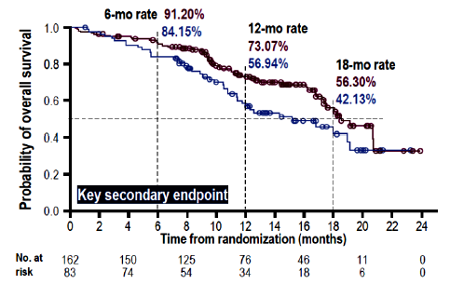
PROfound: Olaparib for Patients With HRR Mutation
PARP Inhibitors Better Than Abi/Enza Switch
Olaparib 300 mg BID
n=162
Cohort A | Olaparib (n=162) | Physician’s choice (n=83)
Median OS (months) | 18.50 | 15.11
Hazard ratio (95% CI) | 0.64 (0.43-0.97) P=0.0173
Key eligibility criteria
mCRPC with disease progression on prior NHA, eg abiraterone or enzalutamide
Alterations in ≥1 of any qualifying gene with a direct or indirect role in HRR
Cohort A:
BRCA1, BRCA2, or ATM
N=245
Physician’s choice
n=83
2:1 randomization
Cohort B:
Other alterations
N=142
Olaparib 300 mg BID
n=94
Physician’s choice
n=48
Stratification factors:
Previous taxane
Measurable disease
Primary end point:
Radiographic progression-free survival (rPFS) in Cohort A (RECIST 1.1 and PCWG3 by BICR)
Key secondary end points:
rPFS in Cohorts A + B
Confirmed radiographic objective response rate (ORR) in Cohort A
Time to pain progression (TTPP) in Cohort A
Overall survival (OS) in Cohort A
rPFS: 7.39 months vs 3.55 months in Cohort A
NHA = next-generation hormonal agent; BID = twice a day; BICR = blind independent central review; HRR = homologous recombination repair.
Hussain et al, 2019; de Bono et al, 2020.
Notes:
Notably, there was >80% crossover and overall survival (OS) benefit was seen nonetheless!

Slide 22
Can PARP Inhibitors Help More Men With Prostate Cancer?
Notes:
Prostate Cancer
Daniel P. Petrylak, MD:
Saad and colleagues will present much-anticipated results of the phase III PROpel trial comparing the addition of olaparib vs placebo to abiraterone as first-line treatment of metastatic castration-resistant prostate cancer (CRPC). The abstract reports positive results in patients with or without homologous recombination repair gene mutations—potentially eliminating the need for genetic testing before initiating a PARP inhibitor in patients with CRPC.
Only about 15 % of men have the specific mutations. We also know that PARPis have other functions in addition to DNA repair: particularly control of genes who’s expression is driven by AR (cross-talk)

Slide 23
PROpel: Olaparib + Abiraterone vs Placebo + Abiraterone
First-Line mCRPC
Interim analysis of international, randomized, double-blind phase 3 trial (data cutoff: July 30, 2021)
Key eligibility criteria:
Patients with mCRPC
No prior tx for mCRPC
Ongoing ADT
Docetaxel for mHSPC allowed
No prior abiraterone
No screening for HRR mutations required, but optional biopsies and blood collected for NGS testing
ECOG PS 0/1
(N=796)
Olaparib 300 mg BID +
Abiraterone 1,000 mg QD
(n=399)
Stratified by metastatic disease sites (bone only vs visceral vs other), taxane for mHSPC (yes vs no)
Until radiographic progression or unacceptable toxicity
Crossover from placebo to
olaparib not permitted
Placebo + Abiraterone
1,000 mg QD
(n=397)
Primary end point:
rPFS by investigator
Secondary end points:
OS, time to subsequent therapy or death, PFS2, ORR, HRRm prevalence (retrospectively assessed), HRQOL, safety
QD = every day; HRRm = homologous recombination repair mutated; HRQOL = health-related quality of life.
Saad, Armstrong et al, 2022; Clarke et al, 2022.

Slide 24
PROpel: Olaparib + Abiraterone (cont.)
rPFS (Primary End Point)
Olaparib + abiraterone significantly reduced risk of progression or death by 34% per investigator assessment (P<0.0001), consistent with 39% risk reduction per BICR (nominal P<0.0001)
rPFS benefit with olaparib was seen across all prespecified subgroups, including HRRm and non-HRRm
Outcome | Olaparib + abiraterone (n=399) | Placebo + abiraterone (n=397) | HR (95% CI)
rPFS by investigator assessment (primary end point)
Median, months | 24.8 | 16.6 | 0.66 (0.54-0.81; P<0.0001)
12-month | 71.8% | 63.4%
24-month | 51.4% | 33.6%
rPFS by BICR
Median, mo | 27.6 | 16.4 | 0.61 (0.49-0.74; nominal P<0.0001)
12-month | 73.8% | 60.6%
24-month | 53.7% | 34.1%
Saad, Armstrong, et al, 2022; Clarke, 2022.

Slide 25
PROpel: Safety Summary
Cardiac and Thromboembolic AEs, HRQoL
Incidence of new primary malignancies and pneumonitis balanced between arms
No cases reported of MDS/AML
HRQoL per FACT-P was comparable between arms over time
Safety Outcome, n (%) | Olaparib + Abiraterone (n=399) | Placebo + Abiraterone (n=397)
Any AE | 387 (97.2) | 376 (94.9)
Any grade ≥3 AE | 188 (47.2) | 152 (38.4)
Death due to an AE | 16 (4.0) | 17 (4.3)
Any AE leading to: Dose interruption of olaparib/placebo Dose reduction of olaparib/placebo D/c of olaparib/placebo D/c of abiraterone | 178 (44.7) 80 (20.1) 55 (13.8) 34 (8.5) | 100 (25.3) 22 (5.6) 31 (7.8) 35 (8.8)
Cardiac and Thromboembolic AE, n(%) | Olaparib + Abiraterone (n=399) | Placebo + Abiraterone (n=397)
Cardiac failureª | 6 (1.5) | 5 (1.3)
Embolic and thromboembolic events, arterialª | 8 (2.0) | 10 (2.5)
Embolic and thromboembolic events, venousª Pulmonary embolism | 29 (7.3) 26 (6.5) | 13 (3.3) 7 (1.8)
ªStandardized MedDRA query (SMQ).
MDS = myelodysplastic syndrome; AE = adverse event; AML = acute myeloid leukemia; FACT-P = Functional Assessment of Cancer Therapy-Prostate.
Notes:
AE, adverse event; AML, acute myeloid leukemia; d/c, discontinuation; FACT-P, Functional Assessment of Cancer Therapy—Prostate; HRQoL, health-related quality of life; MDS, myelodysplastic syndromes.

Slide 26
PROpel: Olaparib + Abiraterone (cont.)
Investigator Conclusions
Addition of olaparib to first-line abiraterone significantly prolonged rPFS vs placebo + abiraterone in patients with mCRPC
Safety profile consistent with established profiles for each drug
  Most common adverse events in abiraterone + olaparib arm: anemia, fatigue/asthenia, and nausea
  Incidence of new primary malignancies and pneumonitis balanced between arms
  No cases of MDS/AML reported
Investigators concluded that olaparib + abiraterone is first combination regimen to demonstrate clinical benefit in first-line mCRPC regardless of HRRm status
Saad, Armstrong et al, 2022; Clarke et al, 2022.

Slide 27
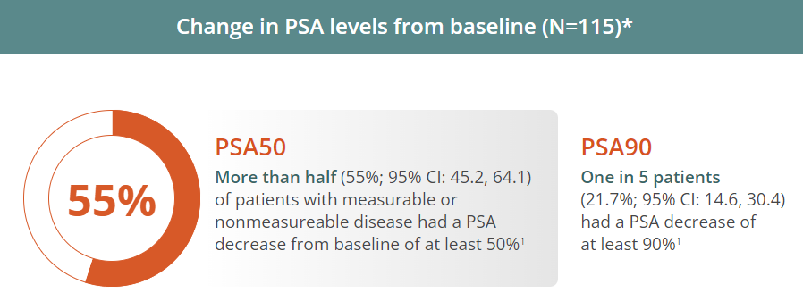
Rucaparib for Patients With BRCA-Mutated mCRPC
Most common adverse reactions in TRITON2:
  ≥20%; grade 1-4
  Fatigue/asthenia (62%)
  Nausea (52%)
  Anemia (43%)
  AST/ALT elevation (33%)
  Decreased appetite (28%)
  Rash (27%)
  Constipation (27%)
  Thrombocytopenia (25%)
  Vomiting (22%)
  Diarrhea (20%)
AST = aspartate aminotransferase; ALT = alanine aminotransferase.
Abida et al, 2020; Rubraca® prescribing information, 2022.
Notes:
Rucaparib is indicated for the treatment of adult patients with a deleterious BRCA mutation (germline and/or somatic)-associated metastatic castration-resistant prostate cancer (mCRPC) who have been treated with androgen receptor-directed therapy and a taxane-based chemotherapy. Select patients for therapy based on an FDA-approved companion diagnostic for Rubraca. This indication is approved under accelerated approval based on objective response rate and duration of response. Continued approval for this indication may be contingent upon verification and description of clinical benefit in confirmatory trials.

Slide 28
Managing Expectations With PARP Inhibitors
Counsel patients prior to treatment specifically on risk of hematologic and GI AEs, as well as fatigue
Prepare for regular blood tests for AE monitoring for cytopenias and liver function tests
Prepare for the possibility of blood transfusions
Ensure recovery from heme toxicity from prior anticancer therapies before starting PARPi
Focus on anemia/fatigue
  Multiple etiologies
    Nutrition
    Anxiety, depression
    Sleep
    Anemia: r/o bleeding, iron deficiency, B12, folic acid
    Low testosterone
    Lack of activity
    Pain
  Consider referrals: nutrition, psych, heme, PT/OT
GI = gastrointestinal; AE = adverse event; r/o = risk of; PT = physical therapy; OT = occupational therapy.
Tookman et al, 2020; Cleveland Clinic, 2021; Patil & Bernard, 2018.

Slide 29
Chemotherapies for mCRPC: Docetaxel
Docetaxel: a taxane with many indications
  Patient preparation
  Premeds
  Family caregiver
  Body image changes
  Side effects:
    Hair loss
    Peripheral neuropathy
    Mouth sores
    Infection
    Fluid retention
    Fatigue
    Skin/nail changes
Ho & Mackey, 2014; Chemocare.com, 2022b.
Notes:
Fluid retention with weight gain, swelling of the ankles or abdominal area.
Peripheral neuropathy (numbness in your fingers and toes) may occur with repeated doses. This should be reported to your health care provider
Nausea
Diarrhea
Mouth sores
Hair loss
Fatigue and weakness
Infection
Nail changes (color changes to your fingernails or toenails may occur while taking docetaxel. In extreme, but rare, cases nails may fall off. After you have finished docetaxel treatments, your nails will generally grow back) (see skin problems)

Slide 30
Chemotherapies for mCRPC: Cabazitaxel
Second-line chemotherapy
  Taxane derivative/microtubule inhibitor
    Patient preparation
    Premeds
    Family caregiver
    Body image changes
    Risk of febrile neutropenia, expect growth factor use
Specific considerations
  IV access
Side effects (in comparison to docetaxel)
  More febrile neutropenia, neutropenic infection, diarrhea, hematuria
  Less peripheral neuropathy, stomatitis, peripheral edema, alopecia, nail disorders
IV = intravenous.
Kreis et al, 2022; Chemocare.com, 2022a; Oudard et al, 2017; Sperlich & Saad, 2013.
Notes:
Low blood counts. Your white and red blood cells and platelets may temporarily decrease. This can put you at increased risk for infection, anemia and/or bleeding
Nadir: this is the 'low point'. It is the point at which your blood counts are the lowest they will be during this treatment
Nadir: 8-12 day
Diarrhea
Fatigue
Nausea

Slide 31
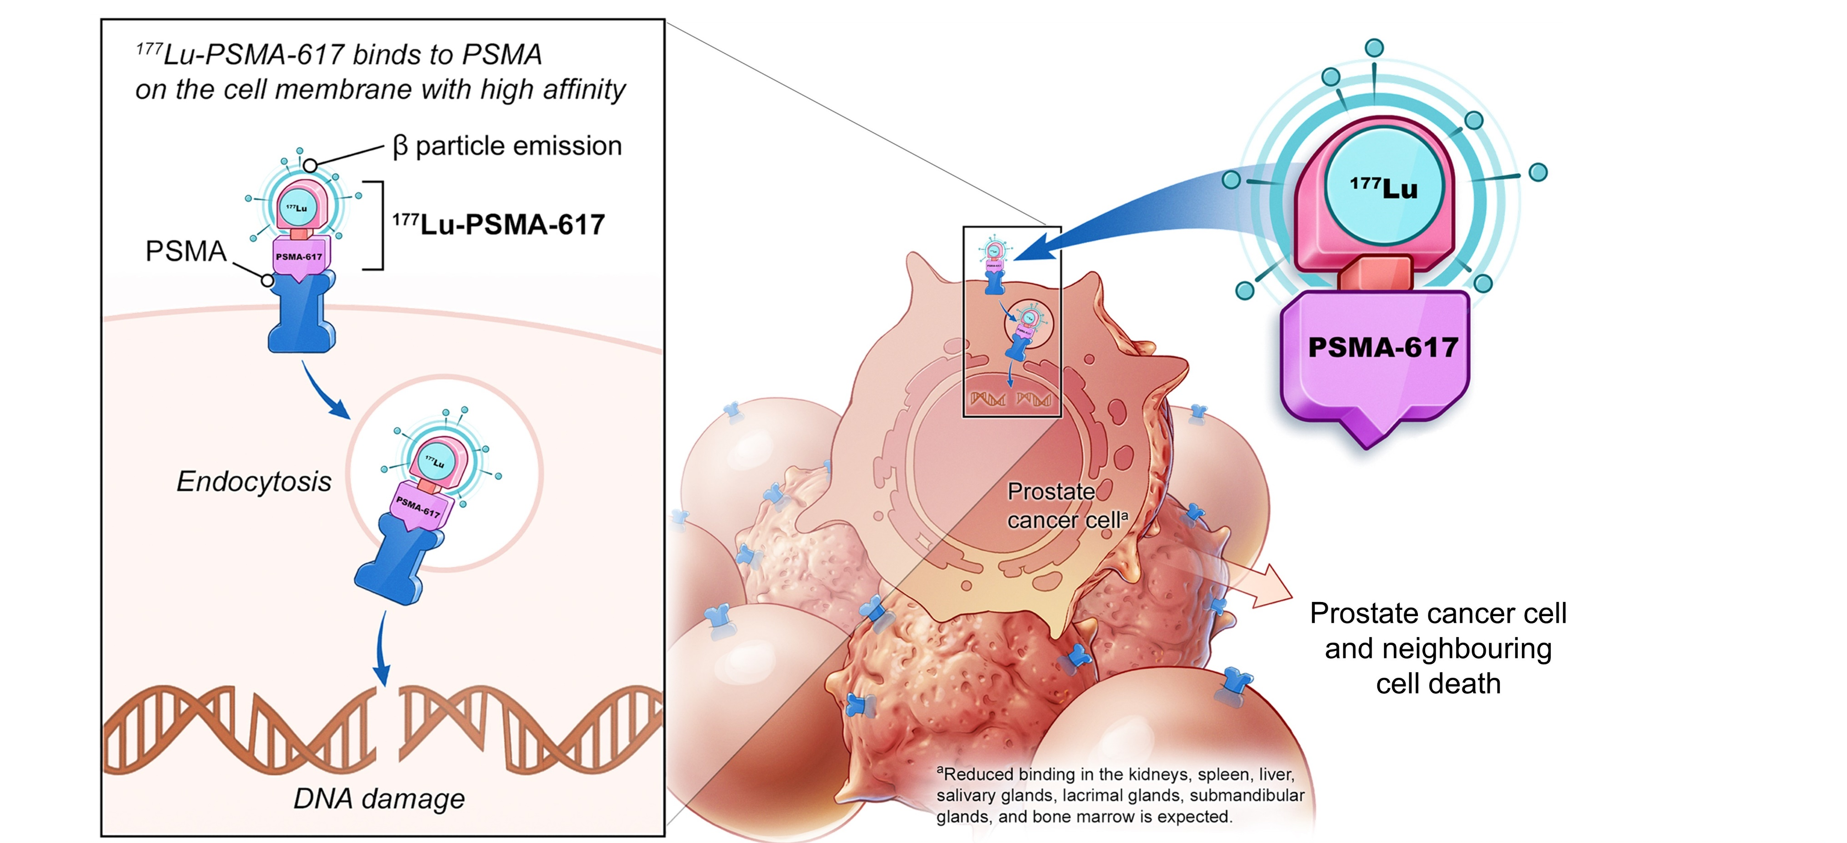
¹⁷⁷Lu-PSMA-517: Mechanism of Action
Morris et al, 2021; FDA, 2022.
Notes:
On March 23, 2022, the Food and Drug Administration approved the radioligand therapy ¹⁷⁷Lu-PSMA-617 for the treatment of prostate-specific membrane antigen (PSMA)-positive metastatic castration-resistant prostate cancer (mCRPC) in adult patients who have received treatment with androgen receptor pathway inhibition and taxane-based chemotherapy.
On the same day, the FDA approved gallium Ga 68 gozetotide, a radioactive diagnostic agent for positron emission tomography (PET) of PSMA-positive lesions, including selection of patients with metastatic prostate cancer for whom ¹⁷⁷Lu-PSMA-617 PSMA-directed therapy is indicated. Gallium Ga 68 gozetotide is the first radioactive diagnostic agent approved for patient selection for a radioligand therapeutic agent.
Efficacy was evaluated in the Phase III VISION trial, which demonstrated a statistically significant improvement in the primary endpoints OS and radiographic progression-free survival. Hazard ratio (HR) for OS was 0.62 (95% CI: 0.52-0.74; p < 0.001) for the comparison of ¹⁷⁷Lu-PSMA-617 with best standard care (BSoC) to BSoC. Median OS was 15.3 months (95% CI: 14.2-16.9) on the ¹⁷⁷Lu-PSMA-617 with BSoC arm and 11.3 months (95% CI: 9.8, 13.5) on the BSoC arm.

Slide 32
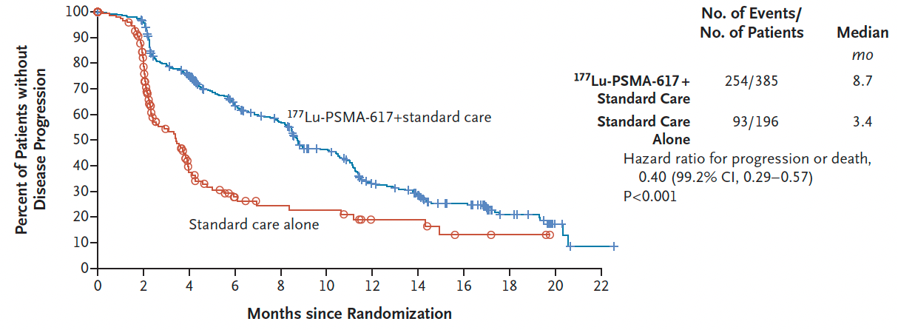
VISION: ¹⁷⁷Lu-PSMA-617 for mCRPC
Efficacy Summary
Imaging-Based Progression-Free Survival
Median OS (¹⁷⁷Lu-PSMA-617 vs standard therapy): 15.3 mo vs 11.3 mo (HR 0.62, P<0.001)
Time to first symptomatic skeletal event (¹⁷⁷Lu-PSMA-617 vs standard therapy): 11.5 mo vs 6.8 mo (HR 0.50, P<0.001)
Sartor et al, 2021.

Slide 33
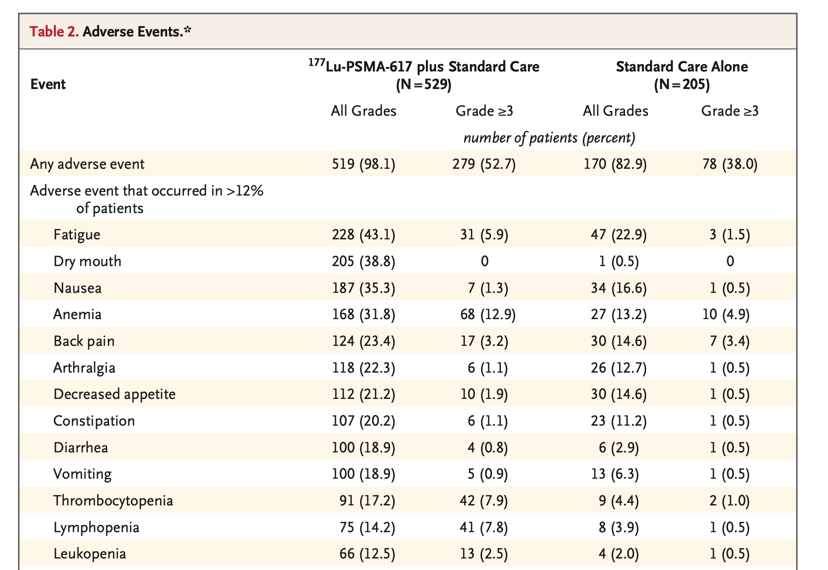
VISION: ¹⁷⁷Lu-PSMA-617 for mCRPC (cont.)
Adverse Events
Event | ¹⁷⁷Lu-PSMA-617 + standard care (N=529) |  | Standard care alone (N=205)
 | All grades | Grade ≥3 | All grades | Grade ≥3
Any AE | 519 (98.1%) | 279 (52.7%) | 170 (82.9%) | 78 (38.0%)
AE that occurred in >12% of patients
Fatigue | 228 (43.1%) | 31 (5.9%) | 47 (22.9%) | 3 (1.5%)
Dry mouth | 205 (38.8%) | 0 | 1 (0.5%) | 0
Nausea | 187 (35.3%) | 7 (1.3%) | 34 (16.6%) | 1 (0.5%)
Anemia | 168 (31.8%) | 68 (12.9%) | 27 (13.2%) | 10 (4.9%)
Back pain | 124 (23.4%) | 17 (3.2%) | 30 (14.6%) | 7 (3.4%)
Arthralgia | 118 (22.3%) | 6 (1.1%) | 26 (12.7%) | 1 (0.5%)
Decreased appetite | 112 (21.2%) | 10 (1.9%) | 30 (14.6%) | 1 (0.5%)
Constipation | 107 (20.2%) | 6 (1.1%) | 23 (11.2%) | 1 (0.5%)
Diarrhea | 100 (18.9%) | 4 (0.8%) | 6 (2.9%) | 1 (0.5%)
Vomiting | 100 (18.9%) | 5 (0.9%) | 13 (6.3%) | 1 (0.5%)
Thrombocytopenia | 91 (17.2%) | 42 (7.9%) | 9 (4.4%) | 2 (1.0%)
Lymphopenia | 75 (14.2%) | 41 (7.8%) | 8 (3.9%) | 1 (0.5%)
Leukopenia | 66 (12.5%) | 13 (2.5%) | 4 (2.0%) | 1 (0.5%)
Sartor et al, 2021.

Slide 34
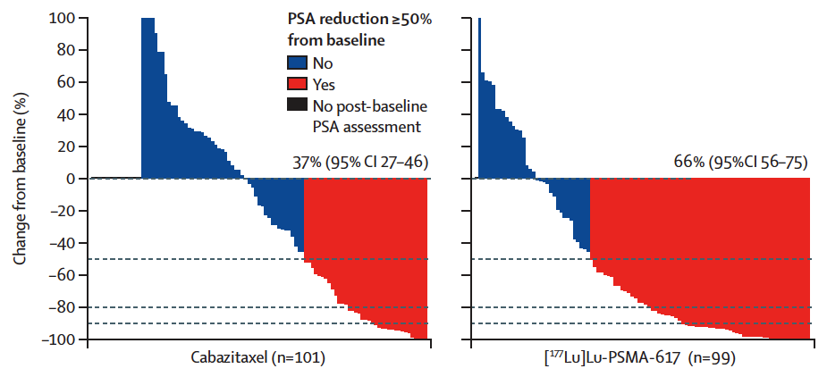
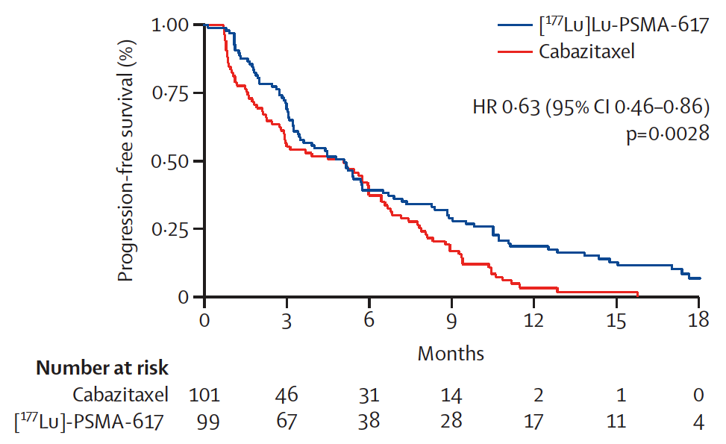
TheraP ANZUP 1603: ¹⁷⁷Lu-PSMA-617 vs Cabazitaxel for mCRPC
PSA Response and Progression-Free Survival
Hofman et al, 2021a; Hofman et al, 2021b.

Slide 35
¹⁷⁷Lu-PSMA-617: Access
Some Patients and Cancer Centers Have Experienced Delays
Trials have selected patients based on PSMA PET
  Still a struggle to get the gallium-68-PSMA PET scans
IV once every 6 weeks for 4-6 doses
  Median time to progression: 4-6 months
  20% without cancer growth at 1 year
A major side effect is dry mouth
  Saliva-producing glands have PSMA expression
PET = positron emission tomography.
Novartis, 2022; PluvitcoTM prescribing information, 2022; Hofman et al, 2021b.
Notes:
Decreased saliva is reversible
Benefit of Lutetium:
It is not a CURE. On average, 20% at a year have controlled prostate cancer. Average response is 6 months.

Slide 36
Differences Between TheraP and VISION
 | VISION | TheraP
Number of patients randomized | 831 | 200
Control arm | ARTA (abi, enza) | Cabazitaxel
Progression to enter |  | Rising PSA and PSA >20 ng/mL
PSMA PET characteristics for inclusion | ≥1 positive lesion (>liver SUV) and no major negative sites (12.6% excluded) | PSMA SUVmax >20 at any site and no FDG-positive/PSMA-negative sites (28% excluded)
Visceral disease | 12% | 7% ¹⁷⁷Lu / 13% cabazi
Top toxicities | Fatigue 43% Dry mouth 38.8% | Fatigue 70% Dry mouth 60%
Dose reductions | 5.7% | 12%
Discontinuation due to toxicity | 11.9% | 1%
SUV = standard uptake value.
Sartor et al, 2021; Hofman et al, 2021b.
Notes:
More patients have PSA drops, which is not the gold standard of outcome.
Patients who didn’t have PSMA expression did much worse. They don’t benefit. Perhaps they have more dedifferentiated or more neuroendocrine expression.
TheraP trial was smaller and their criteria was much stricter than VISON.

Slide 37
Immunotherapy: Pembrolizumab
Metastatic MSI-high or dMMR prostate cancer
After failure with docetaxel, a novel hormonal agent, or both
Safety
  60% experienced any adverse event; 15% grade ≥3
  Fatigue, diarrhea, decreased appetite, nausea, pruritus, asthenia
  15% experienced any immune-mediated AE; 6% grade ≥3
NCCN, 2022; Antonarakis et al, 2020.

Slide 38
Future Directions

Slide 39
New Imaging Techniques for Prostate Cancer
Tracer | Excretion | Detection Rates | Panel Recommendation
Ga-68 PSMA-11 (PSMA- HBED-CC) | Renal | 40% sensitivity and 95% specificity to detect nodal involvement in primary staging of intermediate-, high-, and very–high-risk patients; 92% patient-level PPV in BCR | May be used for detection of disease at initial staging, biochemical recurrence, and progression of disease in bone and soft tissues (see NCCN Guidelines algorithm for more details)
F-18 piflufolastat (DCFPyL) | Renal | 31%-42% sensitivity and 96%-99% specificity to detect nodal involvement in primary staging of unfavorable intermediate-risk, high-risk, and very–high-risk patients 85%-87% patient-level CLR in BCR | May be used for detection of disease at initial staging, biochemical recurrence, and progression of disease in bone and soft tissues (see NCCN Guidelines for more details)
C-11 choline | Hepatic and renal | 53%-96% PPV in BCR | May be used for detection of disease at biochemical recurrence and progression of disease in bone and soft tissues (see NCCN Guidelines algorithm for more details)
F-18 fluciclovine (FACBC) | Renal | 87%-91% CLR in BCR | May be used for detection of disease at biochemical recurrence and progression of disease in bone and soft tissues (see NCCN Guidelines algorithm for more details)
PPV = positive predictive value; BCR = biochemical recurrence; CLR = correct localization rate.
NCCN, 2022.
Notes:
https://www.cancer.gov/news-events/cancer-currents-blog/2020/prostate-cancer-psma-pet-ct-metastasis
https://www.cancer.gov/news-events/cancer-currents-blog/2020/prostate-cancer-psma-pet-ct-metastasis
Fluciclovine F18:
Is a synthetic amino acid PET imaging agent labeled with F18 (molecular weight 132)
Is recognized and taken up by amino acid transporters that are upregulated in many cancer cells, including prostate cancer
Is taken up preferentially by prostate cancer cells, compared with surrounding normal tissues
Is not metabolized or incorporated into newly synthesized proteins
Limited urinary activity may facilitate delineation of lesions directly adjacent to the urinary bladder

Slide 40
Novel Combinations and Agents
AR-targeted therapy
  Abiraterone ± apalutamide: phase 3 (NCT02257736)
AR-targeted therapy + PARPi
  Olaparib + abiraterone: phase 3 PROpel (NCT03732820), interim results presented at ASCO GU 2022
  Niraparib + abiraterone: phase 3 MAGNITUDE (NCT03748641), interim results presented at ASCO GU 2022
AR-targeted therapy with serine/threonine kinase inhibitor
  Abiraterone + ipatasertib (AKT inhibitor) + prednisone/prednisolone: phase 3 IPATential150 (NCT03072238)
Immune checkpoint inhibitors and immune checkpoint inhibitor combinations
  Pembrolizumab: phase 2 KEYNOTE-199 (NCT02787005), completed February 2022
  Pembrolizumab + docetaxel: phase 3 KEYNOTE-921 (NCT03834506)
  Nivolumab + docetaxel: phase 3 CheckMate 7DX (NCT04100018), recruiting
  Atezolizumab + cabozantinib (multityrosine kinase inhibitor): phase 3 CONTACT-2 (NCT04446117), recruiting
  Atezolizumab + enzalutamide: phase 3 IMbassador250 (NCT03016312)
ASCO = American Society of Clinical Oncology; AKT = protein kinase B.
Clinicaltrials.gov, 2022; Saad, Efstathiou, et al, 2022; Clinicaltrials.gov, 2022; Saad, Armstrong et al, 2022; Clinicaltrials.gov, 2022; Chi et al, 2022; Sweeney et al, 2021;
Clinicaltrials.gov, 2022; Antonarakis et al, 2022; Clinicaltrials.gov, 2022; Clinicaltrials.gov, 2022; Clinicaltrials.gov, 2022; Clinicaltrials.gov, 2022; Powles et al, 2022.

Slide 41
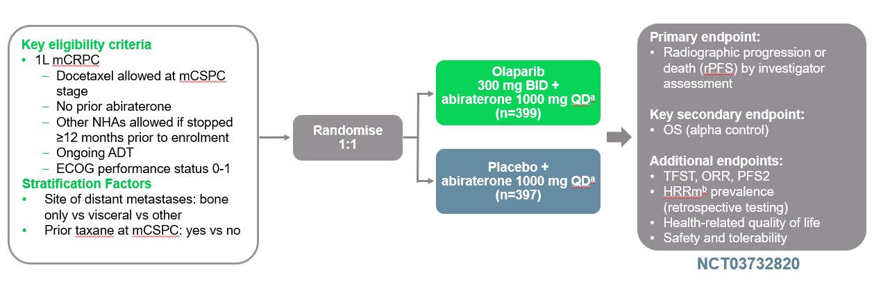
PROpel: Abiraterone ± Olaparib
Combination of AR Targeted Agents With PARPi: an Example
Key eligibility criteria:
  1L mCRPC
  Docetaxel allowed at mHSPC stage
  No prior abiraterone
  Other NHAs allowed if stopped
  ≥12 months prior to enrollment
  Ongoing ADT
  ECOG performance status 0-1
Stratification factors:
Site of distant metastases: bone only vs visceral versus other
Prior taxane at mHSPC: yes vs no
Olaparib 300 mg BID +
abiraterone 1,000 mg QD
(n=399)
1:1 randomization
Placebo + abiraterone 1,000 mg QD
(n=397)
 | Olaparib + abiraterone (n=399) | Placebo + abiraterone (n=397)
HRRm | 111 (27.8%) | 115 (29.0%)
HRR non-mut | 279 (69.9%) | 273 (68.8%)
Primary end point:
rPFS by investigator assessment
Key secondary end point:
OS (alpha control)
Additional end points:
TFST, ORR, PFS2
HRRm prevalence (retrospective testing)
Health-related quality of life
Safety and tolerability
1L = first line; TFST = time to first subsequent therapy.
Saad, Armstrong, et al, 2022.

Slide 42
MAGNITUDE: Niraparib + Abiraterone Acetate and Prednisone
First-Line mCRPC
International, randomized, double-blind phase 3 trial
(cutoff for final rPFS analysis: October 8, 2021)
Key eligibility criteria:
Patients with mCRPC
No prior systemic tx for mCRPC
No prior PARPi
Prior AAP permitted for mCRPC if ≤4 mo
BPI-SF worst pain score ≤3
No uncontrolled HTN, severe/unstable angina, MI, or ischemia
ECOG PS 0/1
(N=670)
Prescreened for HRR biomarker (BM) statusª
Primary end point:
Radiographic PFS by central review
Secondary end points:
OS
Time to symptomatic progression
Time to cytotoxic chemotherapy
Niraparib 200 mg PO QD + AAP^{b}
HRR BM-positive
(n=423)
1:1
Placebo PO QD + AAP^{b}
Niraparib 200 mg PO QD + AAP^{b}
HRR BM-negative
(n=247)
1:1
Placebo PO QD + AAP^{b}
Until PD, unacceptable toxicity, death,
or end of study (total study duration ~66 mo)
ªHRR BM-positive per tissue and/or plasma assays for ATM, BRCA1, BRCA2, BRIP1, CDK12, CHEK2, FANCA, HDAC2, PALB2.
^{b}AAP: abiraterone acetate 1,000 mg PO QD + prednisone 10 mg PO QD.
AAP = abiraterone acetate + prednisone; HTN = hypertension; MI = myocardial infarction; ECOG = Eastern Cooperative Oncology Group.
Chi et al, 2022.

Slide 43
MAGNITUDE: Investigator Conclusions
In this multicohort phase 3 trial, addition of niraparib to first-line AAP significantly prolonged rPFS vs placebo + AAP in patients with mCRPC and HRR gene alterations
  Risk of progression or death significantly reduced by 47% in BRCA1/2-mutated subgroup and by 27% in all HRR BM-positive patients
Prespecified futility analysis found no benefit with addition of niraparib to AAP in patients who were HRR BM-negative, and IDMC stopped enrollment of this cohort
Niraparib + AAP improved other clinical outcomes vs placebo + AAP in HRR BM-positive cohort
  Time to cytotoxic CT, time to symptomatic progression, time to PSA progression, and ORR improved
HRQOL maintained with niraparib + AAP in HRR BM-positive cohort
No new safety signals identified
Investigators concluded that findings support use of niraparib + AAP as first-line treatment option for patients with mCRPC and HRR gene alterations, underscoring need to test for HRR gene alterations in this patient population
IDMC = independent data monitoring committee.
Chi et al, 2022.

Slide 44
Conclusions for mCRPC
Once castration resistance develops, sequencing is dictated by the following:
  Pace of disease
  Bone only vs soft tissue (radium-223)
  DNA sequencing results
  PSMA PET scan results (¹⁷⁷Lu-PSMA-617)
CLINICAL TRIALS are almost ALWAYS a good option!
  CAR T, BiTE antibody therapy, engineering the immune system towards a target
CAR = chimeric antigen receptor.
NCCN, 2022,

Slide 45


Drug-to-Drug Interactions and the Role of Multidisciplinary Care
Images courtesy of Microsoft PowerPoint.
Spratt et al, 2021.
Notes:
Potential for DDIs with second-generation ARIs
As many patients with PC are older and may have comorbidities that require long-term, concomitant medication, it is important to consider the potential for DDIs between second-generation ARIs and comedications used in this population. Common comorbidities in patients with PC include hypercholesterolemia, hypertension, diabetes mellitus, asthma, urologic complications, depression, and neurologic disorders, with frequently reported comedications including antihypertensives and agents for other cardiovascular disorders, analgesics, treatments for urological and gastrointestinal disorders, antidepressants, anxiolytics, and anti-dementia drugs.
Both apalutamide and enzalutamide exhibit the potential for DDIs when co-administered with medications that are substrates for several metabolizing enzymes and drug transporters. Apalutamide and enzalutamide have been linked to the induction of cytochrome P450 (CYP) 3A4, 2C9, and 2C19. These enzymes metabolize up to 50% of medications. In a post hoc analysis of the SPARTAN trial, the risk of falls was increased in patients receiving apalutamide and concomitant alpha-blockers or antidepressants. Apalutamide also has the potential to interact with uridine-diphosphate glucuronosyltransferase, P-glycoprotein (P-gp), breast cancer resistance protein (BCRP), and organic anion-transporting polypeptide (OATP) 1B1, whereas enzalutamide might also interact with CYP2C8 inhibitors or inducers. Consequently, in order to reduce the risk of DDIs, the respective prescribing information recommends that practitioners avoid simultaneous use of apalutamide or enzalutamide with these medications. Medicinal products that should be used with caution include antithrombotics, such as dabigatran; antihypertensives, such as amlodipine, statins such as rosuvastatin, and cardiac glycosides, such as digoxin.

Slide 46

Strategies to Manage Drug-to-Drug Interactions
Empowering patients to know their med list and keep it updated
Food and herbal supplements
www.allaboutherbs.com
MSKCC, 2022.

Slide 47


Food-to-Drug Interactions
Most common are grapefruit and Seville oranges, which block furanocoumarins (cytochrome P450 3A4-CYP3A4)
Docetaxel/abiraterone interactions
Image credit: Canva. Licensed under Free Media License.
Bailey et al, 2013.
Notes:
How does grapefruit juice affect medication?
Drugs are broken down, or metabolized, in the body by a variety of enzymes, which are substances that help produce a biochemical reaction. Grapefruit, a hybrid citrus fruit of the sweet orange and pomelo varieties, contains furanocoumarins, chemical compounds that can interfere with those enzymes. Specifically, furanocoumarins may block an enzyme called cytochrome P450 3A4 (CYP3A4), a critical component that helps the body break down drugs.
If CYP3A4 is blocked, drugs that are not metabolized may not work as designed. Or they may stay in the bloodstream longer, build up in the blood and become toxic. “This can lead to a greater concentration of drugs in the body,” Dr. Perre says. “Patients may be at risk for muscle damage, heart arrhythmia or other conditions.” How grapefruit juice and medications interact depends on a variety of factors, especially the amount of CYP3A4 in the body. That’s why the impact and side effects of this interaction vary from patient to patient.
Canadian researchers have identified at least 85 drugs that may interact with grapefruit juice. For patients with cancer, the juice is believed to block the metabolization of some chemotherapy drugs, such as vincristine, used to treat small cell lung cancer, head and neck cancers and breast cancer, and docetaxel, used to treat prostate and breast cancers. Grapefruit juice also should be avoided when taking:
Statins prescribed to lower cholesterol
Calcium channel blockers, drugs intended to treat high blood pressure
Some anti-anxiety drugs
Corticosteroids intended to treat ulcerative colitis or Chron’s disease
Some drugs that treat abnormal heart rhythms
Some antihistamines
“Grapefruit is the most well-known example of a food-drug interaction,” Dr. Perre says. Some less popular citrus fruits, such as Sevillian orange, pomelo and star fruit, have similar properties to grapefruit and should be avoided, as well. Dr. Perre suggests patients ask their doctors about potential side effects of their prescription drugs and how they may interact with certain foods or other drugs.

Slide 48

Grading/Assessment of Adverse Events
CTCAE v4.02 for Fatigue
Grade 1 | Grade 2 | Grade 3 | Grade 4 | Grade 5
Fatigue relieved by rest | Fatigue not relieved by rest; limiting instrumental ADLs | Fatigue not relieved by rest; limiting self-care ADL | - | -
CTCAE = Common Terminology Criteria for Adverse Events. ADL = activity of daily living.
Image credit: João Pedro Brigatti.
CTCAE, 2017.

Slide 49
Management of Adverse Events
Assess
Grade toxicity
Impact on quality of life
Nursing interventions to minimize side effects
Dose reduce and monitor
The goal is to continue treatments as long as they are effective
Bennet et al, 2020.

Slide 50
Nursing Interventions/Patient Counseling
ONS PEP cards
Team-based care
Social work, dietitian, PT or OT
Pharmacist
Translator
Mental health professionals
Genetic counselor
Surgeon
Geriatrician
Integrative medicine providers
Support groups/caregivers
ONS = Oncology Nursing Society; PEP = putting evidence into practice.
Oncology Nursing Society, 2022; Madsen et al, 2009; Woodson, 2019; Droz et al, 2017; Prostate Cancer Research Institute, 2022.

Slide 51
Case Study 2
Which of the following statements should NOT require any action by the nurse?
  “The copay for these new pills is $2,500 per month. I'm not sure I can afford that?”
  “I don't know what meds I'm on. My pregnant daughter is so great and pours all the meds for me”
  “I feel my best when I do the same exercises that I did before my diagnosis”
  “I read that I should be increasing protein and meat with a diagnosis of prostate cancer to maintain more muscle mass"

Slide 52
Case Study 2
Which of the following statements should NOT require any action by the nurse?
  “The copay for these new pills is $2,500 per month. I'm not sure I can afford that?”
  “I don't know what meds I'm on. My pregnant daughter is so great and pours all the meds for me”
  “I feel my best when I do the same exercises that I did before my diagnosis”
  “I read that I should be increasing protein and meat with a diagnosis of prostate cancer to maintain more muscle mass"

Slide 53
Key Takeaways for Metastatic CRPC
Much progress has been made in the treatment of mCRPC
mCRPC has become much more complicated to manage with novel drugs and new combinations
DDIs and patient education are more critical than ever
Multidisciplinary teams and shared decision making are steps to success
DDI = drug-drug interaction.

Slide 54
References
Abida W, Patnaik A, Campbell D, et al (2020). Rucaparib in men with metastatic castration-resistant prostate cancer harboring a BRCA1 or BRCA2 gene alteration. J Clin Oncol, 38(32):3763-3772. DOI:10.1200/JCO.20.01035
American Cancer Society (2022). Prostate cancer research highlights. Available at: https://www.cancer.org/research/acs-research-highlights/prostate-cancer-research-highlights.html
Antonarakis E, Piulats JM, Gross-Goupil M, et al (2020). Pembrolizumab for treatment-refractory metastatic castration-resistant prostate cancer: multicohort open-label phase II KEYNOTE-199 study. J Clin Oncol, 38(5):395-405. DOI:10.1200/JCO.19.01638
Bailey DG, Dresser G & Arnold JMO (2013). Grapefruit-medication interactions: forbidden fruit or avoidable consequences? CMAJ, 185(4):309-316. DOI:10.1503/cmaj.120951
Bennet C, Davis ID & Hamid AA (2020). Nursing implications of recent changes in management practices for metastatic prostate cancer. Semin Oncol Nurs, 36(4):151047. DOI:10.1016/j.soncn.2020.151047
Cancer.net (2021). Prostate cancer: stages and grades. Available at:https://www.cancer.net/cancer-types/prostate-cancer/stages-and-grades
Chemocare.com (2022). Docetaxel. Available at: https://chemocare.com/chemotherapy/drug-info/docetaxel.aspx
Chi K, Rathkopf D, Smith M, et al (2022). Phase 3 MAGNITUDE study: First results of niraparib (NIRA) with abiraterone acetate and prednisone (AAP) as first-line therapy in patients (pts) with metastatic castration-resistant prostate cancer (mCRPC) with and without homologous recombination repair (HRR) gene alterations [oral presentation]. J Clin Oncol, 40(6_suppl) 12-12. DOI:10.1200/JCO.2022.40.6_suppl.012
Clarke N, Wiechno P, Alekseev B, et al (2018). Olaparib compared with abiraterone in patients with metastatic castration-resistant prostate cancer: a randomized, double-blind, placebo-controlled, phase 2 trial. Lancet Oncol, 19(7):975-986. DOI:10.1016/S1470-2045(18)30365-6
Clarke NW, Armstrong AJ, Tiery-Vuillemin A, et al (2022). Abiraterone and olaparib for metastatic castration-resistant prostate cancer. NEJM Evidence. DOI:10.1056/EVIDoa2200043
Cleveland Clinic (2021). Cancer fatigue. Available at: https://my.clevelandclinic.org/health/diseases/5230-cancer-fatigue
Clinicaltrials.gov (2022a). An efficacy and safety study of apalutamide (JNJ-56021927) in combination with abiraterone acetate and prednisone versus abiraterone acetate and prednisone in participants with chemotherapy-naïve metastatic castration-resistant prostate cancer (mCRPC). NLM identifier: NCT02257736.
Clinicaltrials.gov (2022b). A study of atezolizumab (anti-PD-L1 antibody) in combination with enzalutamide in participants with metastatic castration-resistant prostate cancer (mCRPC) after failure of an androgen synthesis inhibitor and failure of, ineligibility for, or refusal of a taxane regimen (IMbassador250). NLM identifier: NCT03016312.
Clinicaltrials.gov (2022c). A study of niraparib in combination with abiraterone acetate and prednisone versus abiraterone acetate and prednisone for treatment of participants with metastatic prostate cancer (MAGNITUDE). NLM identifier: NCT03748641.
Clinicaltrials.gov (2022d). A study of nivolumab or placebo in combination with docetaxel in men with advanced castration-resistant prostate cancer (CheckMate 7DX). NLM identifier: NCT04100018.

Slide 55
References (cont.)
Clinicaltrials.gov (2022e). Ipatasertib plus abiraterone plus prednisone/prednisolone, relative to placebo plus abiraterone plus prednisone/prednisolone in adult male patients with metastatic castrate-resistant prostate cancer (IPATential150). NLM identifier: NCT03072238.
Clinicaltrials.gov (2022f). Study of cabozantinib in combination with atezolizumab versus second NHT in subjects with mCRPC (CONTACT-02). NLM identifier: NCT04446117.
Clinicaltrials.gov (2022g). Study of pembrolizumab (MK-3475) in participants with metastatic castration-resistant prostate cancer (mCRPC)(MK-3475-199/KEYNOTE-199). NLM identifier: NCT02787005.
Clinicaltrials.gov (2022h). Study of pembrolizumab (MK-3475) plus docetaxel versus placebo plus docetaxel in chemotherapy-naïve metastatic castration-resistant prostate cancer (mCRPC) (MK-3475-921/KEYNOTE-921). NLM identifier: NCT03834506.
Clinicaltrials.gov (2022i). Study on olaparib plus abiraterone as first-line therapy in men with metastatic castration-resistant prostate cancer. NLM identifier: NCT03732820.
Common Terminology Criteria for Adverse Events v5.0 (2017). Available at: https://ctep.cancer.gov/protocoldevelopment/electronic_applications/docs/ctcae_v5_quick_reference_8.5x11.pdf
Crawford ED, Petrylak D & Sartor O (2017). Navigating the evolving therapeutic landscape in advanced prostate cancer. Urol Oncol, 35S:S1-S13. DOI:10.1016/j.urolonc.2017.01.020
de Bono J, Mateo J, Fizazi K, et al (2020). Olaparib for metastatic castration-resistant prostate cancer. N Engl J Med, 382(22):2091-2102. DOI:10.1056/NEJMoa1911440
Droz JP, Albrand G, Gillessen S, et al (2017). Management of prostate cancer in elderly patients: recommendations of a task force of the International Society of Geriatric Oncology. Eur Urol, 72(4):521-531. DOI:10.1016/j.eururo.2016.12.025
Ewalt MD, West H & Aisner DL (2019). Next generation sequencing—testing multiple genetic markers at once. JAMA Oncol, 5(7):1076. DOI:10.1001/jamaoncol.2019.0453
Ho MY & Mackey JR (2014). Presentation and management of docetaxel-related adverse effects in patients with breast cancer. Cancer Manag Res, 6:253-259. DOI:10.2147/CMAR.S40601
Hofman M, Emmett L, Sandhu S, et al (2021a). 117Lu-PSMA0617 (LuPSMA) versus cabazitaxel in metastatic castration-resistant prostate cancer mCRPC) progressing after docetaxel: updated results including progression-free survival (PFS) and patient-reported outcomes (PROs) (TheraP ANZUP 1603). J Clin Oncol, 39(suppl_6):6-6. DOI:10.1200/JCO.2021.39.6_suppl.6
Hofman M, Emmett L, Sandhu S, et al (2021b). (177Lu) Lu-PSMA-617 versus cabazitaxel in patients with metastatic castration-resistant prostate cancer (TheraP): a randomised, open-label, phase 2 trial. Lancet, 397(10276) 797-804. DOI:10.1016/S0140-6736(21)00237-3
Hussain M, Mateo J, Fizazi K, et al (2019). PROfound: Phase 3 study of olaparib versus enzalutamide or abiraterone for metastatic castration-resistant prostate cancer (mCRPC) with homologous recombination repair (HRR) gene alterations. Ann Oncol, 30(suppl_5): 851-934. DOI:10.1093/annonc/mdz394
Johns Hopkins Medicine (2022). Prostate cancer stages. Available at: https://www.hopkinsmedicine.org/health/conditions-and-diseases/prostate-cancer/prostate-cancer-stages

Slide 56
References (cont.)
Kensler KH, Pernar CH, Mahal BA, et al (2021). Racial and ethnic variation in PSA testing and prostate cancer incidence following the 2012 USPSTF recommendation. J Natl Cancer Inst, 113(6):719-726. DOI:10.1093/jnci/djaa171
Kreis K, Horenkamp-Sonntag D, Scheider U, et al (2022). Safety and survival of docetaxel and cabazitaxel in metastatic castration-resistant prostate cancer. BJU Int, 129(4):470-479. DOI:10.1111/bju.15542
Madsen LT, Craig C, Kuban DA, et al (2009). A multidisciplinary prostate cancer clinic for newly diagnosed patients. CJON, 13(3):305-309. DOI:10.1188/09.CJON.305-309
Memorial Sloan Kettering Cancer Center (2022). About herbs, botanicals & other products. Available at: https://www.mskcc.org/cancer-care/diagnosis-treatment/symptom-management/integrative-medicine/herbs
Morris M, de Bono J, Chi K, et al (2021). Phase III study of lutetium-177-PSMA-617 in patients with metastatic castration-resistant prostate cancer (VISION). Jour of Clin Oncol, 39(18_suppl). DOI:10.1200/JCO.2021.39.15_suppl.LBA4
National Cancer Institute (2022). Prostate Cancer Treatment (PDQ®)—patient version. Available at: https://www.cancer.gov/types/prostate/patient/prostate-treatment-pdq#:~:text=Stage%20I,-Enlarge&text=Stage%20I%20prostate%20cancer.,during%20surgery%20for%20other%20reasons.
National Comprehensive Cancer Network (2022). Clinical Practice Guidelines in Oncology: prostate cancer. Version 4.2022. Available at: https://www.nccn.org/professionals/physician_gls/pdf/prostate.pdf
Nguyen PL, Alibhai SMH, D’Amico AV, et al (2015). Adverse effects of androgen deprivation therapy and strategies to mitigate them. European Urology, 67(5):825-836. DOI:10.1016/j.eururo.2014.07.010
Novartis (2022). Novartis provides update on production of radioligand therapy medicines. Available at: https://www.novartis.com/news/media-releases/novartis-provides-update-production-radioligand-therapy-medicines
Oncology Nursing Society (2022). Symptom interventions overview. Available at: https://www.ons.org/the-pep-topics
Oudard S, Fizazi K, Sengeløv L, et al (2017). Cabazitaxel versus docetaxel as first-line therapy for patients with metastatic castration-resistant prostate cancer: a randomized phase III trial—FIRSTANA. J Clin Oncol, 35(28):3189-3197. DOI:10.1200/JCO.2016.72.1068
Patil T & Bernard B (2018). Complications of androgen deprivation therapy in men with prostate cancer. Oncology (Williston Park), 32(9):470-474.
Powles T, Yuen KC, Gillessen S, et al (2022). Atezolizumab with enzalutamide versus enzalutamide alone in metastatic catration-resistant prostate cancer: a randomized phase 3 trial. Nature Medicine, 28(1):144-153. DOI:10.1038/s41591-021-01600-6
Prostate Cancer Research Institute (2022). Support groups. Available at: https://pcri.org/supportgroups
Rubraca® (rucaparib) prescribing information (2022). Clovis Oncology. Available at: https://clovisoncology.com/pdfs/RubracaUSPI.pdf

Slide 57
References (cont.)
Saad F, Armstrong A, Thiery-Vuillemin A, et al (2022). PROpel: Phase III trial of olaparib (ola) and abiraterone (abi) versus placebo (pbo) and abi as first-line (1L) therapy for patients (pts) with metastatic castration-resistant prostate cancer (mCRPC) [oral presentation]. Jour of Clin Oncol, 40(6_suppl) 11-11. DOI:10.1200/JCO.2022.40.6_suppl.011
Saad F, Efstathiou E, Attard G, et al (2022). Apaluamide plus abiraterone acetate and prednisone in metastatic, castration-resistant prostate cancer (ACIS): a randomised, placebo-controlled, double-blindk, multinationl, phase 3 study. Lancet Oncol, 22(11):1541-1559. DOI:10.1016/S1470-2045(21)00402-2
Sartor O, de Bono J, Chi KN, et al (2021). Lutetium-177-PSMA-617 for metastatic castration-resistant prostate cancer. N Engl J Med, 385(12):1091-1103. DOI:10.1056/NEJMoa2107322
Sperlich C & Saad F (2013). Optimal management of patients receiving cabazitaxel-based chemotherapy. Can Urol Assoc J, 7(2suppl_1):s18-s24. DOI:10.5489/cuaj.275
Spratt DE, Shore N, Sartor O, et al (2021). Treating the patient and not just the cancer: therapeutic burden in prostate cancer. Prostate Cancer Prostatic Dis, 24:647–661. DOI:10.1038/s41391-021-00328-1
Sweeney C, Bracarda S, Sternberg CN, et al (2021). Ipatasertib plus abiraterone and prednisolone in metastatic castration-resistant prostate cancer (IPATential150): a multicentre, randomized, double-blind, phase 3 trial. Lancet, 398(10295):131-142. DOI:10.1016/S0140-6736(21)00580-8
Tookman L, Krell J, Nkolobe B, et al (2020). Practical guidance for the management of side effects during rucaparib therapy in a multidisciplinary UK setting. Ther Adv Med Oncol, 12:1758835921980. DOI:10.1177/1758835920921980
US Food and Drug Administration (2022). FDA approves Pluvicto for metastatic castration-resistant prostate cancer. Available at: https://www.fda.gov/drugs/resources-information-approved-drugs/fda-approves-pluvicto-metastatic-castration-resistant-prostate-cancer
Woodson AH (2019). Genetic counseling considerations for men with prostate cancer. Can J Urol, 26(52):40-41. PMID:31629428

