Slide 1
Emerging Literature in the Management of Antiplatelet Therapy
Lia Argevani, PharmD
PGY-1 Pharmacy Resident
Ascension St. Vincent’s Healthcare
March 15, 2021

Slide 2
Disclosure Information for Powerpoint Presentation Lia Argevani, PGY1 Pharmacy Resident
I have no relevant financial relationships with any ACCME-defined commercial interest* to disclose.
AND
I will not discuss off label use and/or investigational use in my presentation
*A commercial interest is any entity producing, marketing, re-selling, or distributed health care goods or services consumed by, or used on, patients.
Notes:
Examples of relevant relationships to be reported include: Salary/Employee, royalty, patent holder, consulting fees, Non-CE Services received directly from the Commercial Interests, ownership Interest (stock, stock options), other
‹#›

Slide 3
01
Compare current guidelines for antiplatelet therapy following acute coronary syndrome with recommendations from recent literature
02
03
Objectives
Describe the use of antiplatelet therapy following TAVR and the role of cardiac comorbidities in selecting an antiplatelet regimen
Discuss updates in literature regarding management of antiplatelet therapy post ischemic stroke
TAVR: Transaortic valve replacement

Slide 4
A Brief History of Aspirin
Willow used as medicine in ancient civilizations since 1300 BC
Connelly D. J Pharm Pharmacol. Sep 2014.

Slide 5
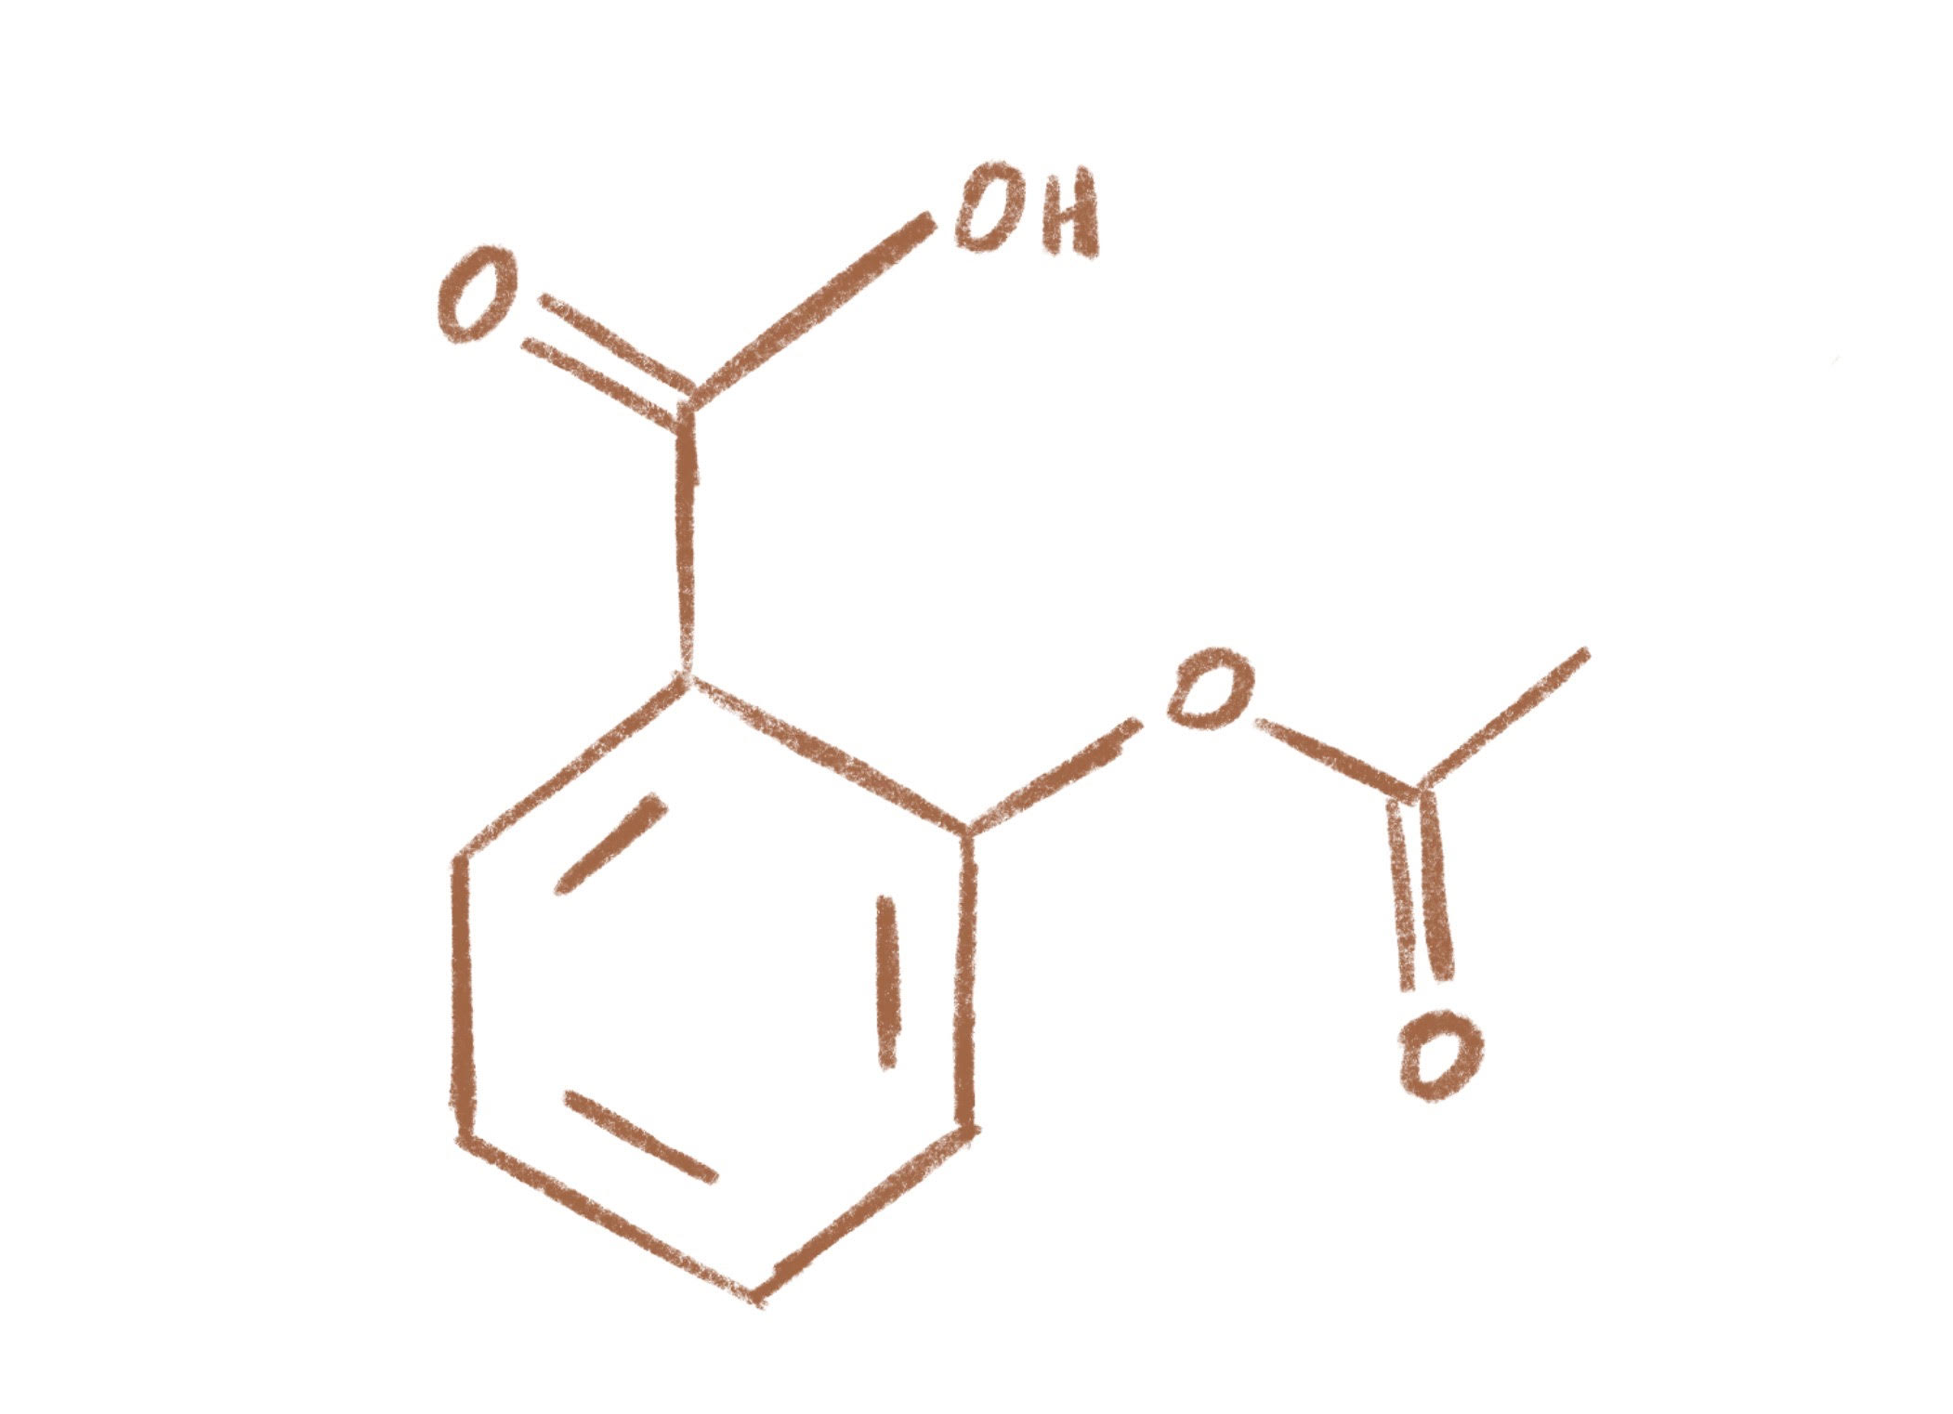
A Brief History of Aspirin
Willow used as medicine in ancient civilizations since 1300 BC
1897 - German chemist Felix Hoffman finds that adding acetyl group reduces irritant properties
Connelly D. J Pharm Pharmacol. Sep 2014.

Slide 6
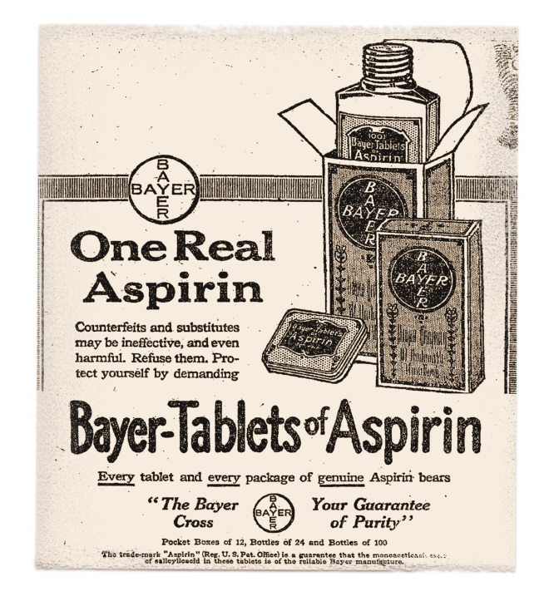
A Brief History of Aspirin
Willow used as medicine in ancient civilizations since 1300 BC
1897 - German chemist Felix Hoffman finds that adding acetyl group reduces irritant properties
1899 - Bayer patents process of adding acetyl group and names acetylsalicylic acid
A SPIR IN
Connelly D. J Pharm Pharmacol. Sep 2014.

Slide 7
A Brief History of Aspirin
Willow used as medicine in ancient civilizations since 1300 BC
1897 - German chemist Felix Hoffman finds that adding acetyl group reduces irritant properties
1899 - Bayer patents process of adding acetyl group and names acetylsalicylic acid
A SPIR IN
1974 – First randomized controlled trial of aspirin studied secondary prevention of heart attack
Connelly D. J Pharm Pharmacol. Sep 2014.

Slide 8
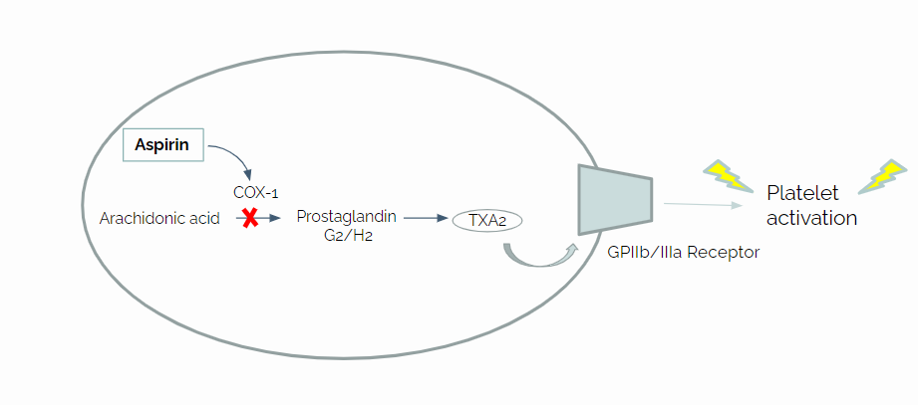
Mechanism of Action
Aspirin
COX-1
Platelet activation
Arachidonic acid
Prostaglandin
G2/H2
TXA2
GPIIb/IIIa Receptor

Slide 9
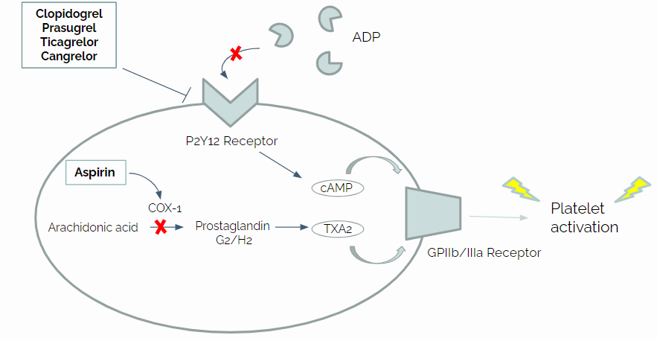
Mechanism of Action
Clopidogrel
Prasugrel
Ticagrelor
Cangrelor
ADP
P2Y12 Receptor
Aspirin
cAMP
COX-1
Platelet activation
Arachidonic acid
Prostaglandin
G2/H2
TXA2
GPIIb/IIIa Receptor

Slide 10
P2Y12 Inhibitors
1997
Clopidogrel
2011
Ticagrelor
Irreversible
Prodrug
Longest onset
Reversible
Active drug
Most potent
2009
Prasugrel
2015
Cangrelor
Irreversible
Prodrug
Longest duration
First IV P2Y12
Shortest duration
Expensive

Slide 11
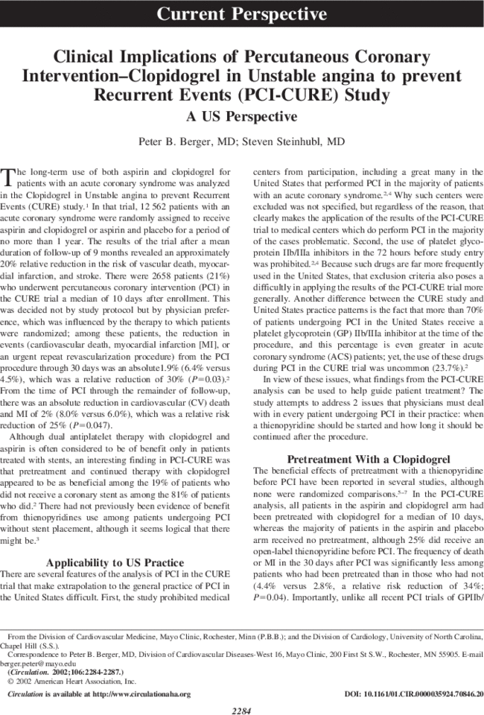
Dual Antiplatelet Therapy (DAPT)
Defined as the use of aspirin concomitantly with a P2Y12 inhibitor for maximal antiplatelet effect
First studied in the CURE trial of 2001
Demonstrated significant benefit on ischemic events in patients undergoing percutaneous coronary intervention without ST segment elevations
Yusuf S et al. N Engl J Med. 2001.
Notes:
https://www.ncbi.nlm.nih.gov/pmc/articles/PMC5920448/ - history of antiplatelet therapy

Slide 12
Acute Coronary Syndrome

Slide 13
Acute Coronary Syndrome (ACS)
Sudden, reduced blood flow to the heart resulting in myocardial ischemia
Often results from disruption of atherosclerotic plaque in coronary vessels
Estimated to occur every 40 seconds in the United States
Heart Disease Facts. Cdc.gov. Updated Sept 2020.
Notes:
https://www.cdc.gov/heartdisease/facts.htm

Slide 14
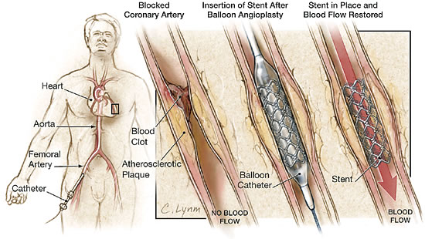
Percutaneous Coronary Intervention (PCI)
600,000 to 1 million procedures annually in US
30 day mortality ~1.5%
Medgadget.com
Bricker et al. Circulation, May 2019; 12(5).
Notes:
- Increasing prevalence of PCI, typically not for multivessel disease or complex lesions.. 600,000-1 million procedures annually., In-hospital Mortality only around 1.3% but can range from 0.65% (elective) to ~5% for STEMI

Slide 15
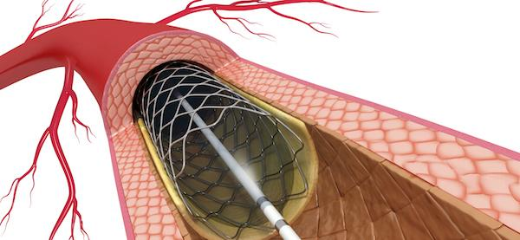
Stent Thrombosis
May occur at various time frames
Acute (< 24 hours)
Subacute (< 30 days)
Late (> 30 days)
Very late (> 12 months)
Stent thrombosis mortality rates range from 20-45%
Risk factors
Patient-related (low ejection fraction, diabetes, age)
Type of ACS
Lesion characteristics
Stent thrombogenicity
Reejhsinghani R et al. Vasc Health Risk Manag. 2015.
Luscher et al. Circulation. Feb 2007.
Notes:
Mech – stents are foreign bodies inducing platelet adhesion, may also have high pressure implantation inducing vascular injury
Early thrombosis = 1%, beyond 30 days 0.2-0.6% annually - fairly infrequent but high rates of mortality w/ 20% expected to have recurrent thrombosis . 10% of all cardiac deaths associated with stent thrombosis.
Reported rates tend to be lower in clinical trials (or meta-analyses of clinical trials) than in registries, as trials often enroll lower risk patients.
Silent – only seen on angiography w/o symptoms, possible – unexplained death 30 days or later, probably – unexplained death within 30 days or abnormal EKG w/ recent stent, definite – thrombosis on angiograph + ischemic signs/sx in 48 hrs
Risk factors – type of ACS, higher risk with STEMI possibly due to increased inflammation from necrotic tissue upon re-exposure to blood flow; stent thrombogenicity – strut thickness, polymer type

Slide 16
Evolution of PCI
1987
2002
2008
2015
1st generation bare metal stent
1st generation drug eluting stent
2nd generation drug eluting stent
3rd generation drug eluting stent
Increased risk stent restenosis from inflammation
Impaired
reendothilialization with higher late thrombosis
Lower rates of thrombosis but caused polymer hypersensitivity
Decreased hypersensitivity but diminished late vessel healing
4th generation?
Canfield et al. J Pers Med. Dec 2018;
Notes:
https://www.ncbi.nlm.nih.gov/pmc/articles/PMC6313463/
Since the introduction of drug-eluting stents (DES), most interventional centers have noted stent thrombosis up to 3 years after implantation, a complication rarely seen with bare-metal stents.
As a result, although primarily aimed at preventing vascular smooth muscle cell proliferation and migration (ie, key factors in the development of restenosis), DES also impair reendothelialization, which leads to delayed arterial healing, and induce tissue factor expression, which results in a prothrombogenic environment.
Very late stent thrombosis is distinctly associated solely with DES – likely due to hypersensitivity reactions, excessive fibrin deposits or neoatherosclerosis
No overall significant difference between rates of stent thrombosis between BMS and DES, just the timing differs (for BMS really rare past the first month)
The point behind DES was to inhibit the response to injury responsible for restenosis after BMS
Novel approach stents coated with substances that facilitate reendothelialization such as CD34 antibodies

Slide 17
2016 ACC/AHA Update
How long should DAPT be continued for?
P2Y12 inhibitor therapy should be given for at least 12 months after BMS or DES implantation
When should we do longer DAPT?
In patients without a high bleeding risk who have tolerated DAPT, continuation > 12 months may be reasonable
When should we do shorter DAPT?
In patients with high bleeding risk after DES implantation, discontinuation of P2Y12 inhibitor after 6 months may be reasonable
BMS: bare metal stent
DES: drug eluting stent
Levine et al. J Am Coll Cardiol. Sep 2016.
Notes:
Considering all of these factors, selection of an antiplatelet regimen is paramount to ensuring success of the stent. DAPT is standard of care after PCI, has been essential in reducing stent thrombosis but for how long? Even CURE trial has shown increased bleeding risk.
https://www.ahajournals.org/doi/epub/10.1161/STR.0000000000000211 - guidelines

Slide 18
Bleeding Definitions
GUSTO
Moderate or severe depending on whether hemodynamic compromise present.
03
BARC
Classified as Types 1-5
in increasing severity where Type 5 is fatal bleeding.
01
02
TIMI
Minor or major depending on if hemoglobin drops >5 mg/dL, and presence of intracranial or fatal bleeding
BARC: Bleeding Academic Research Consortium
GUSTO: Global Use of Streptokinase and tPA for Occluded Coronary Arteries
TIMI: Thrombolysis in Myocardial Infarction
Wells et al. CADTH Optimal Use Report. Mar 2019.

Slide 19
Shorter DAPT Trials
Study | Intervention | P2Y12 Inhibitor | Primary Endpoint | Result
SMART-DATE (2018) | 6 vs. 12 months | Primarily clopidogrel | All cause death, MI, or stroke | 4.7% vs. 4.2% (p=0.03)
DAPT-STEMI (2018) | 6 vs. 12 months | Any | All cause mortality, MI, revascularization, major bleeding | No difference
REDUCE (2019) | 3 vs. 12 months | Any | All cause mortality, MI, stent thrombosis, stroke, bleeding, target vessel revascularization | No difference
Hahn et al. Lancet. Mar 2018.
Kedhi et al. Br Med J. 2018.
DeLuca et al. EuroIntervention. 2019.
Notes:
DAPT-STEMI (STEMI only, randomized after 6 months if event free) - https://www.ncbi.nlm.nih.gov/pmc/articles/PMC6167608/
SMART-DATE https://pubmed.ncbi.nlm.nih.gov/29544699/
REDUCE - https://eurointervention.pcronline.com/article/final-results-of-the-randomised-evaluation-of-short-term-dual-antiplatelet-therapy-in-patients-with-acute-coronary-syndrome-treated-with-anew-generation-stent-reduce-trial (pcrusername, pcrpassword)
-> these are using a mix of p2y12s

Slide 20
TICO (2020)
Study Design
Randomized, unblinded, controlled trial
Population
2978 patients who underwent PCI at 38 centers in South Korea
Intervention
3 months DAPT → ticagrelor monotherapy
12 months DAPT
Kim et al. JAMA. 2020.
Notes:
Bioresorbable polymer sirolimus eluting stents; loading doses of asa 300mg and ticagrelor 180 mg if not already taking. Asa dose = 100 mg. use of other antiplatelets or anticoagulants not allowed

Slide 21
Study Population
Characteristic | 3 months DAPT (n = 1527) | 12 months DAPT (n = 1529)
Mean age, years | 61 | 61
Female | 79% | 80%
Prior Event Prior PCI Prior Stroke Prior MI Prior CABG | 9% 4% 4% 1% | 8% 4% 3% 1%
Presentation Unstable angina NSTEMI STEMI | 29% 35% 36% | 32% 32% 36%
Patients with increased risk of bleeding were excluded
Prior hemorrhagic stroke
Traumatic brain injury in last 6 months
Need for oral anticoagulation
Hemoglobin ≤ 8 mg/dL
Kim et al. JAMA. 2020.
Notes:
randomization stratified according to presence of diabetes and STEMI, randomized 1 day after PCI. Primary PCI in 34% of patients – only included patients presenting w/ ACS (excluded elective PCI) which are more likely to clot and bleed

Slide 22
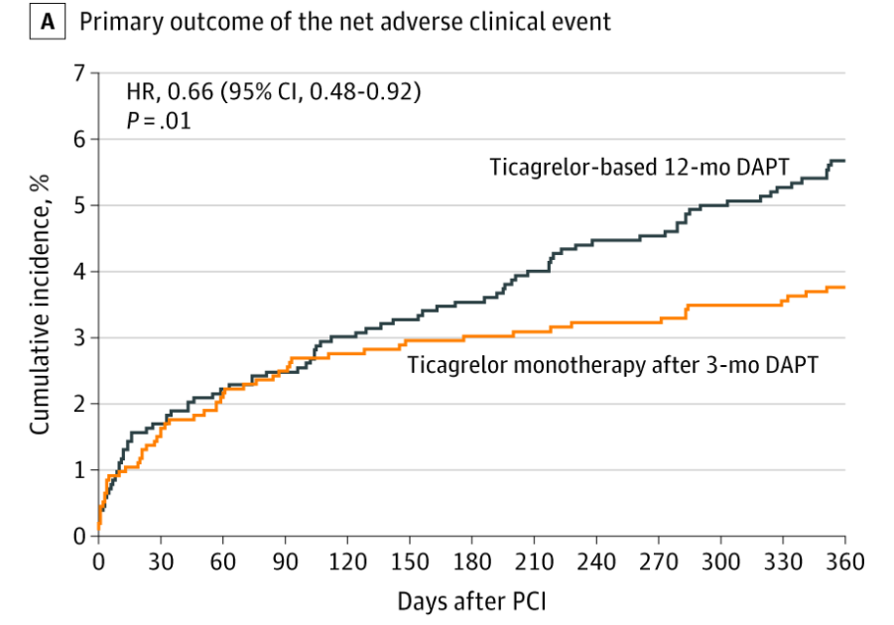
Results
Primary outcome: composite of major bleeding and adverse cardiac/cerebrovascular events (death, MI, stent thrombosis, stroke, target vessel revascularization)
5.9%
Endpoint | Absolute difference, %
Primary outcome | -1.98 (-3.5 to -0.45)
TIMI Bleeding Major Major or minor | -1.33 (-2.4 to -0.27) -2.06 (-3.52 to -0.6)
Major cardiac or cerebrovascular event | -1.05 (-2.23 to 0.13)
TIMI: Thrombolysis in Myocardial Infarction Bleeding Criteria
3.9%
Kim et al. JAMA. 2020.
Notes:
Primary outcome: 3.9% vs. 5.9%. Lower than expected event rates. Discussion about composite outcome
TIMI major: intracranial, hemorrhage w/ hgb decrease of 5, fatal bleeding causing death w/in 7 days; study was actually underpowered so definitely underpowered for these secondary outcomes. No differences in stent thrombosis

Slide 23
TICO Critique
Strengths
Large sample size
Only patients with ACS included
Clinical outcomes assessed by members of independent committee
Limitations
Composite outcome used
Excluded patients with high bleeding risk
Randomization occurred after PCI vs. at 3 months
Only included patients from South Korea
Kim et al. JAMA. 2020.
Notes:
Patients w/ high bleeding risk = 40% of those undergoing PCI
Randomization after 3 months but landmark results showed consistency w/ main results
South Korea but not using clopidogrel

Slide 24
TICO Takeaways
3 months of DAPT with ticagrelor reduced the risk of a composite of major bleeding and adverse ischemic events
The effect of shorter DAPT on ischemic events is still unclear due to the use of a composite outcome
Results cannot be generalized to patients with a high baseline risk of bleeding

Slide 25
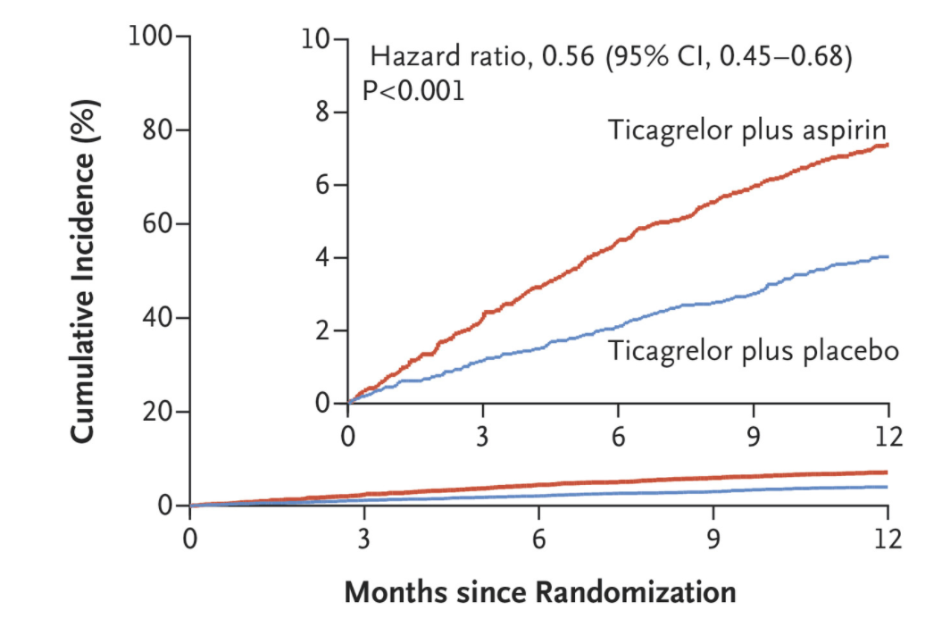
TWILIGHT (2019)
3 vs. 12 months of ticagrelor DAPT after PCI
Only included patients at high risk of bleeding or ischemic events
Primary outcome: Incidence of BARC type 2, 3 or 5 bleeding
Mehran et al. N Engl J Med. Nov 2019.
Notes:
vs TICO excluded patients w/ high bleed risk

Slide 26
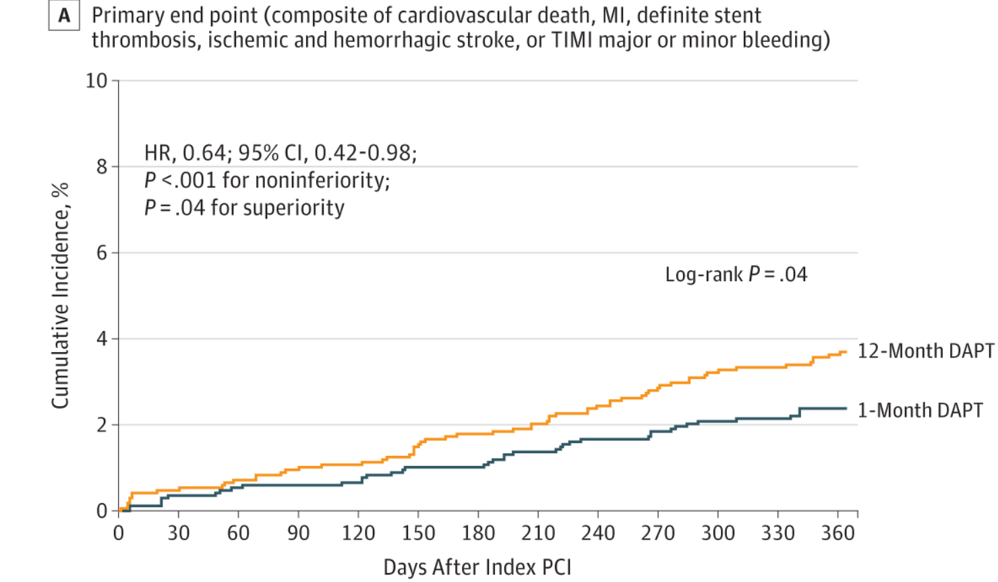
STOP-DAPT 2 Overview (2019)
Randomized, multicenter open label trial in Japan
1 month of DAPT followed by clopidogrel monotherapy vs. 12 months of DAPT
No difference in secondary outcome evaluating ischemic events, but less bleeding in experimental group
Limitation: > 60% with stable coronary artery disease in both groups
Watanabe et al. JAMA. Jun 2019.
Notes:
The shortest duration of DAPT…

Slide 27
Extended DAPT Trials
Study | Intervention | P2Y12 Inhibitor | Primary Endpoint | Result
DES-LATE (2014) | 12 vs. 36 months | Clopidogrel | CV related death, MI, or stroke | No difference
DAPT (2014) | 12 vs. 30 months | Clopidogrel/ prasugrel | Death, MI, or stroke 2. Stent thrombosis | Decreased with extended DAPT 4.3% vs. 5.9% 0.4% vs. 1.4%
PEGASUS (2015) | 12 vs. 33 months | Ticagrelor | CV related death, MI, or stroke | Decreased with extended DAPT (7.85% vs. 9.04%)
OPTIDUAL (2015) | 12 vs. 33 months | Clopidogrel | Death, MI stroke, or major bleeding | No difference
Notes:
Moving away with longer durations due to improvements in stent technology but this is what happened before.
https://www.ahajournals.org/doi/10.1161/JAHA.119.012639#:~:text=The%20most%20recent%20American%20College,an%20acute%20coronary%20syndrome%20(ACS)
DAPT - The current study detected an increased risk of myocardial infarction (both stent-related and non–stent-related) in both study groups during the first 3 months after discontinuation.

Slide 28
Extended DAPT Safety
Study | Intervention | P2Y12 Inhibitor | Bleeding Endpoint | Result
DES-LATE (2014) | 12 vs. 36 months | Clopidogrel | TIMI Major | No difference, but trend towards increase
DAPT (2014) | 12 vs. 30 months | Clopidogrel/ prasugrel | GUSTO severe or moderate bleeding | Increased in extended DAPT (2.5% vs. 1.6%)
PEGASUS (2015) | 12 vs. 33 months | Ticagrelor | TIMI Major | Increased in extended DAPT (2.6% vs. 1.1%)
OPTIDUAL (2015) | 12 vs. 33 months | Clopidogrel | International Society on Thrombosis and Hemostasis | No difference

Slide 29
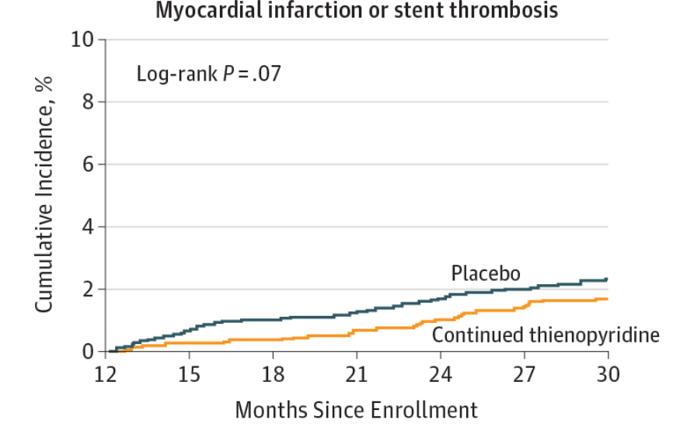
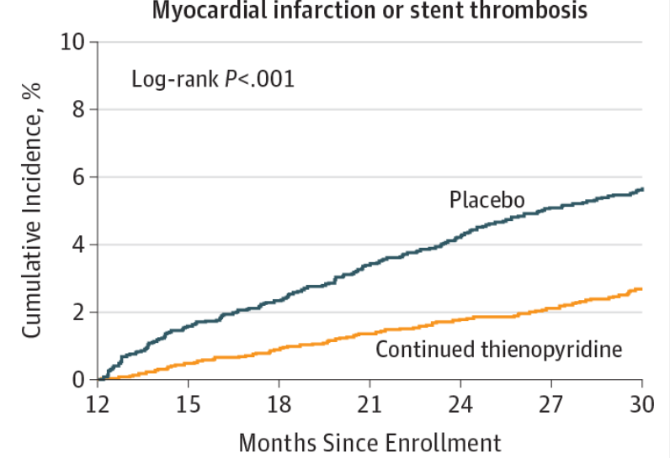
The DAPT Score
Criteria | Points
Age ≥ 75 65 – 74 < 65 | -2 -1 0
Smoker | 1
Diabetes | 1
MI at presentation | 1
Prior PCI or prior MI | 1
Stent diameter < 3 mm | 1
Paclitaxel – eluting stent | 1
CHF or LVEF < 30% | 2
Saphenous vein graft PCI | 2
MI: myocardial infarction; PCI: percutaneous coronary intervention; CHF: congestive heart failure; LVEF: left ventricular ejection fraction
Score < 2
Score ≥ 2
Yeh et al. JAMA. Apr 2016.
Notes:
So who benefits? Can be hard to balance in clinical practice. Yeh et al. conducted study that developed and validated a tool to help assess risk vs. benefit of DAPT past 12 months (@30 months)
Continued thienopyridine was associated with smaller increases in bleeding among the high score group.
https://jamanetwork.com/journals/jama/fullarticle/2508253

Slide 30
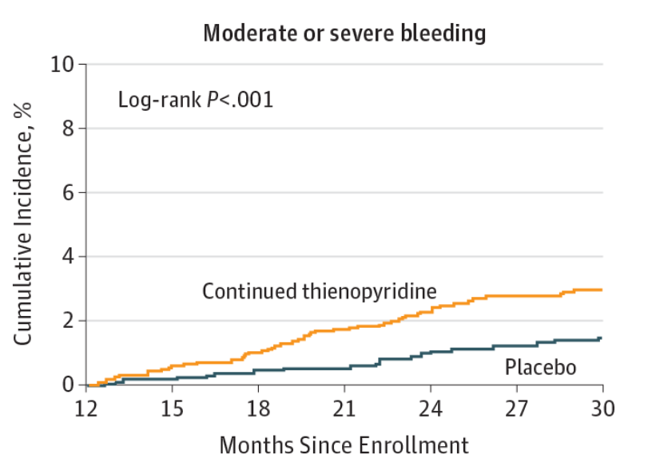
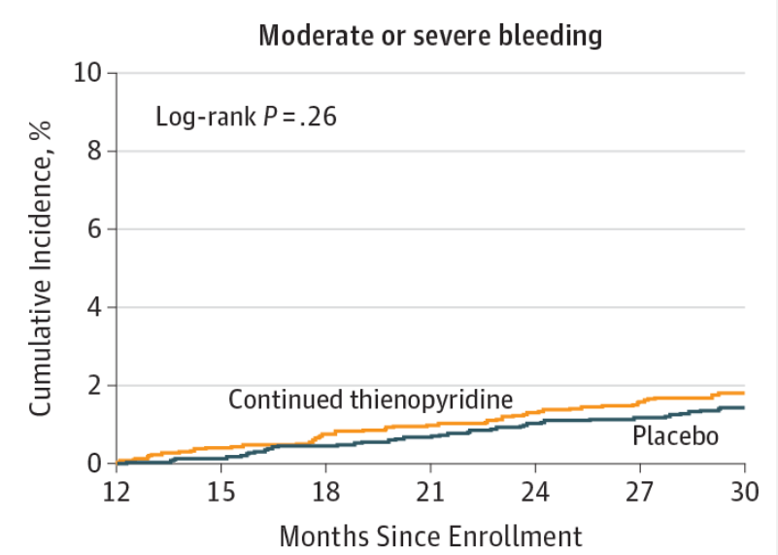
The DAPT Score
Criteria | Points
Age ≥ 75 65 – 74 < 65 | -2 -1 0
Smoker | 1
Diabetes | 1
MI at presentation | 1
Prior PCI or prior MI | 1
Stent diameter < 3 mm | 1
Paclitaxel – eluting stent | 1
CHF or LVEF < 30% | 2
Saphenous vein graft PCI | 2
MI: myocardial infarction; PCI: percutaneous coronary intervention; CHF: congestive heart failure; LVEF: left ventricular ejection fraction
Score < 2
Score ≥ 2
Yeh et al. JAMA. Apr 2016.
Notes:
Continued thienopyridine was associated with smaller increases in bleeding among the high score group.
https://jamanetwork.com/journals/jama/fullarticle/2508253

Slide 31
Summary
Shorter durations of DAPT after ACS may decrease incidence of bleeding
Longer DAPT may lower incidence of ischemic events but at increased risk of bleeds
More literature is needed to explore different regimen options
Populations that may benefit from various durations are still not well identified
Notes:
Continuing aspirin vs. P2Y12? What happens after 12 months?

Slide 32
Assessment Question #1
RH is a 87 year old male who presents with STEMI and undergoes PCI with a drug-eluting stent. He reports a history of anemia and liver cirrhosis.
DAPT Score= -1
Which of the following is the most appropriate regimen for RH?
DAPT for 3 months, then aspirin alone
DAPT for 12 months, then aspirin alone
DAPT for 36 months, then aspirin alone
Aspirin only
STEMI: ST Elevation Myocardial Infarction

Slide 33
Assessment Question #1
RH is a 87 year old male who presents with STEMI and undergoes PCI with a drug-eluting stent. He reports a history of anemia and liver cirrhosis.
DAPT Score= -1
Which of the following is the most appropriate regimen for RH?
DAPT for 3 months, then aspirin alone
DAPT for 12 months, then aspirin alone
DAPT for 36 months, then aspirin alone
Aspirin only
STEMI: ST Elevation Myocardial Infarction

Slide 34
Transcatheter Aortic Valve Replacement (TAVR)

Slide 35
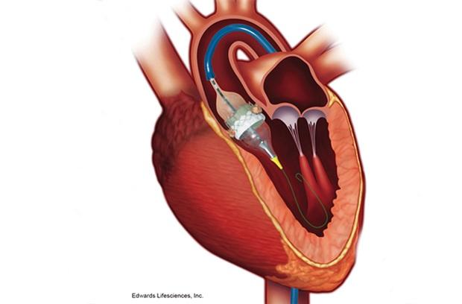
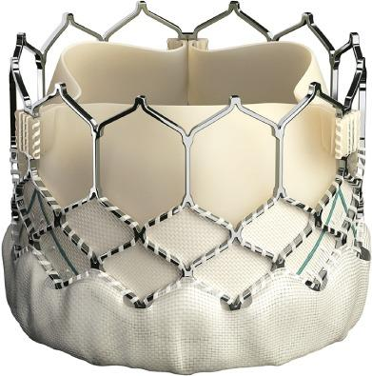
TAVR
A catheter based procedure to replace a stenotic aortic valve
Historically used for patients that were not candidates for open heart surgery
Recently expanded indication to include patients at low surgical risk
FDA Expands TAVR Indication to Low-Risk Patients. ACC.org. Aug 19,2019.

Slide 36
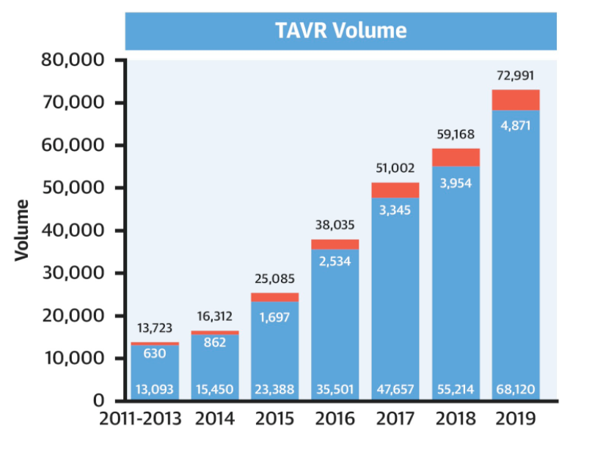
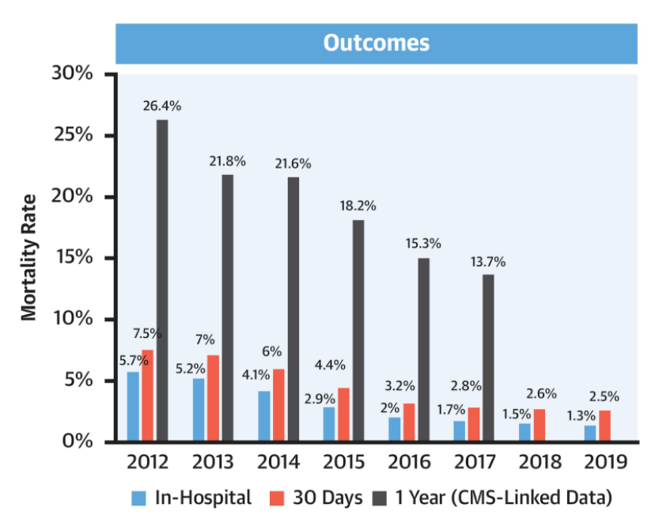
Increasing Use of TAVR
Carroll J et al. J Am Coll Cardiol. 2020 Nov.
Notes:
https://www.dicardiology.com/article/tavr-now-dominant-form-aortic-valve-replacement-united-states#:~:text=TAVR%20Procedure%20Volumes%20In%20the,TAVR%20for%20low%2Drisk%20patients.
72,000 procedures performed in 2019, exceeding all surgical aortic replacement ~55,000
Decreased in-hospital /30-day mortality and stroke rates compared to TAVRs performed in 2011-2013
Early TAVR = 2011-2013

Slide 37
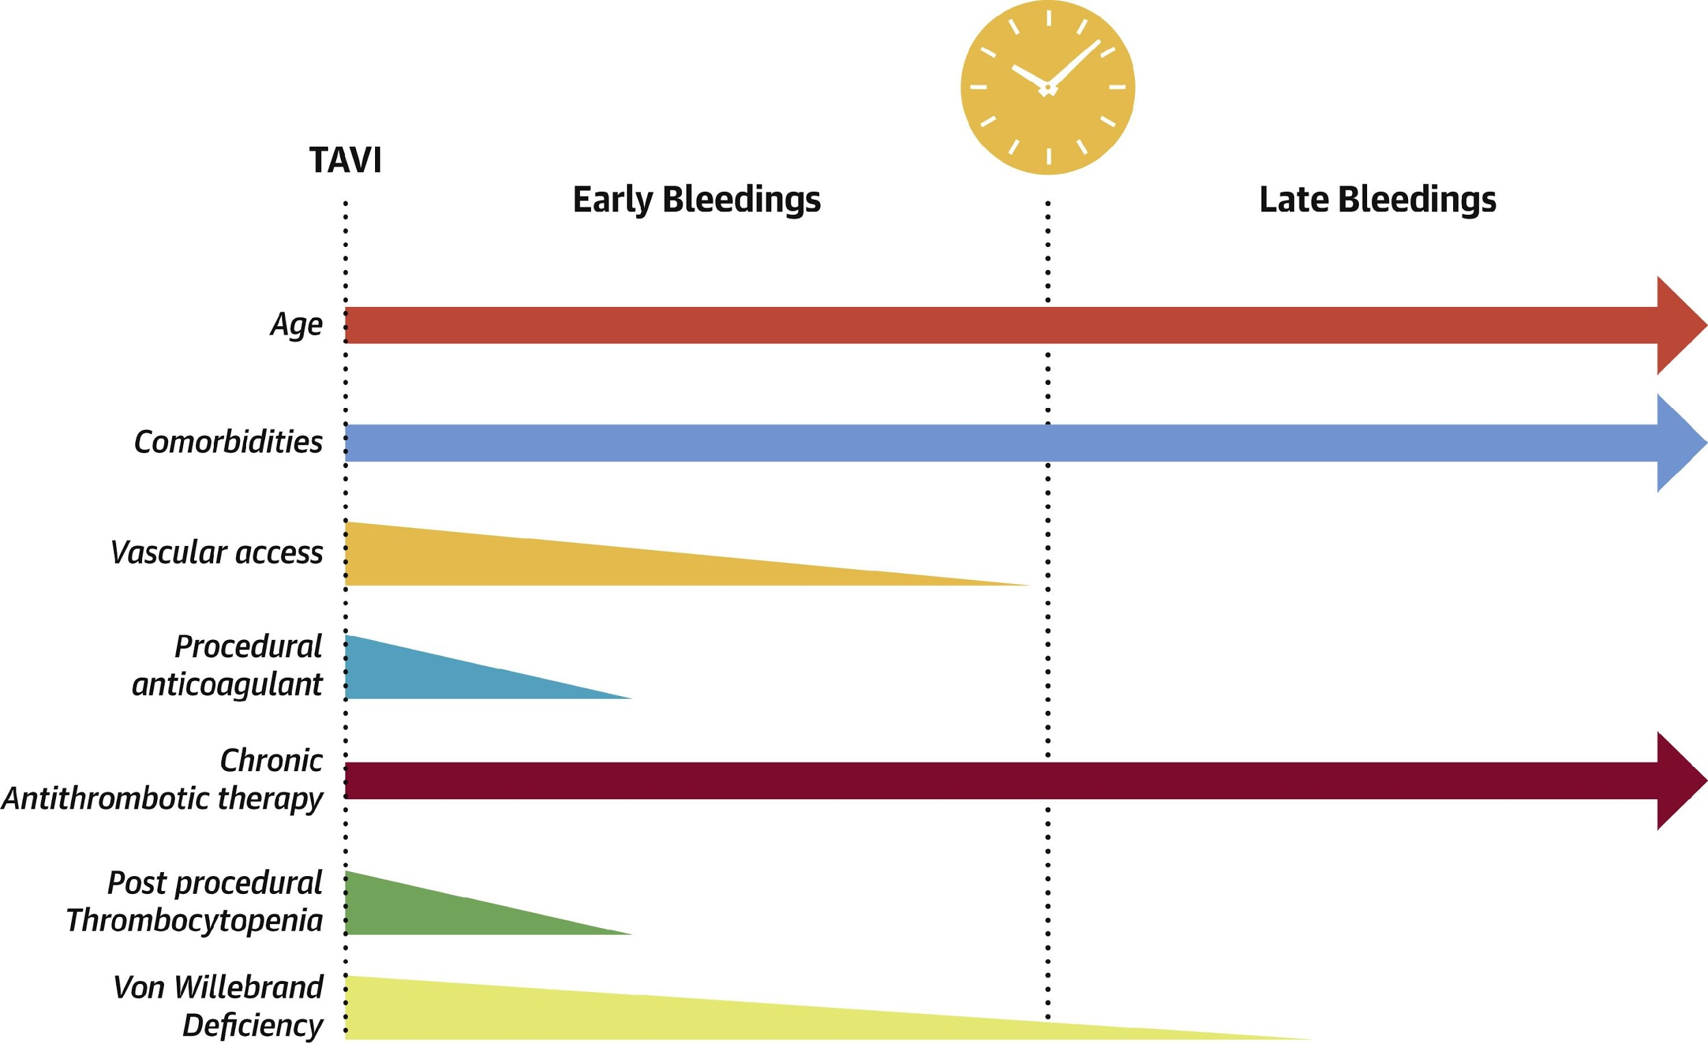
TAVR Risks
Bleeding
High prevalence of comorbidities
Acquired vWF deficiency and thrombocytopenia
High mortality associated with late onset bleeding (>30 days after TAVR)
Thrombosis
High prevalence of patients with increased thromboembolic burden
Risk of stroke peaks within 48 hours, but remains elevated for 3 months
vWF: von Willebrand Factor
Mangieri et al. J Am Coll Cardiol. Oct 2019.
Notes:
Bleeding – Combordities = peripheral vasculopathy, chronic kidney disease; acquired – 67% vWF and 45% thrombocytopenia. unfolding of vWF multimers impairs their pivotal role in primary hemostasis and platelet activation due to turbulent flow through the stenotic valve. Can persist due to shear stress across regurgitant prosthesis. Acquired thrombocytopenia secondary to increased platelet consumption secondary to an immune response (to the bioprosthesis material or to the fixation medium) or to an inflammatory reaction. Reduction in procedural bleeding with better techniques from 24% to 10 to 3%, but high mortality persists with late onset bleeding, represented mostly by GI, and neurological bleeidng
Thrombosis – little is known about TAVR endothelialization, post mortem findings, endo possibly as early as 28 days, likely complete by 3 months; decreased turbulence, flow velocity, shear rate through TAVR vs native valve (may contribute to thrombosis)
Increased thromboembolic burden – severe atherosclerosis/atrial fibrillation
Peaks within 48 hrs because can have ischemic stroke from dislodegement of debris during deployment

Slide 38
2020 ACC/AHA Update
What antithrombotic therapy should be used after TAVR?
Aspirin 75-100 mg daily is reasonable in the absence of other indications for oral anticoagulants
Should DAPT be used?
Clopidogrel with aspirin for 3-6 months may be reasonable in patients at low risk of bleeding
What is the role for anticoagulation?
Use of a VKA to achieve an INR of 2.5 for at least 3 months may be reasonable in patients at low risk of bleeding
VKA: vitamin K antagonist
Otto et al. Circulation. 2020.
Notes:
https://www.ahajournals.org/doi/pdf/10.1161/CIR.0000000000000923 – pg. e142
Warfarin - PARTNER 2 investigators reported that the use of an anticoagulant (95% warfarin) after TAVI in intermediate– or higher–surgical risk patients was associated with a lower incidence of an increase in mean gradient >10 mm Hg over the first year after implantation.²³ This Doppler finding may reflect the development of leaflet thrombosis,
- Abdul et al. Combining warfarin with either SAPT or DAPT in patients w/ afib found no benefits with stroke, or adverse CV events but increased risk of major bleeding.

Slide 39
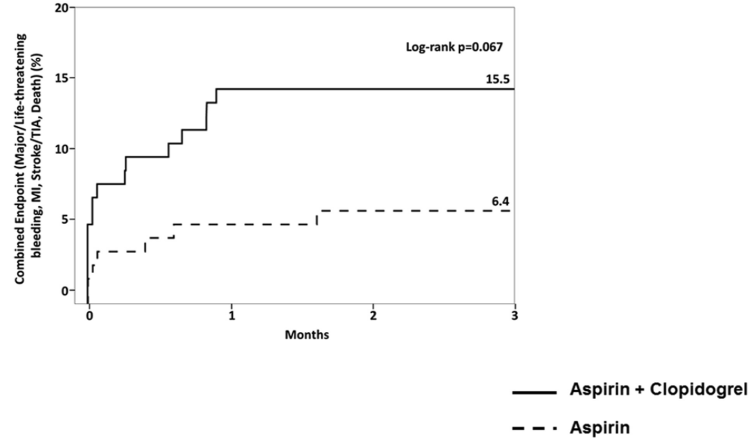
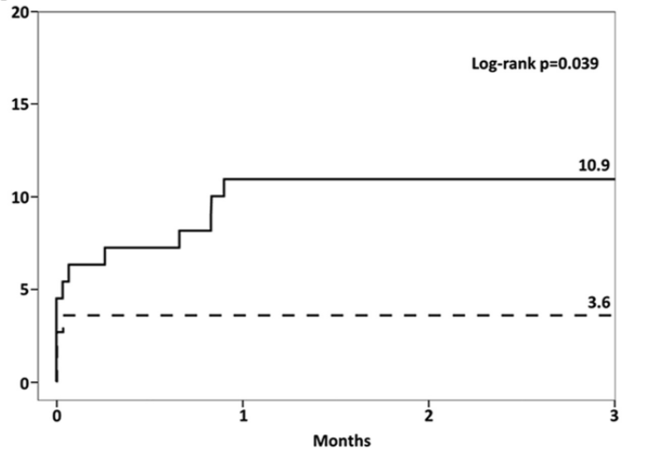
ARTE (2017)
Randomized, controlled, open label trial
222 patients undergoing TAVR with no indication for anticoagulation
Primary outcome: incidence of death, MI, stroke or major bleeding within 3 months
Composite
Bleeding
Rodes-Cabau et al. JACC Cardiovasc Interv. Jul 2017.
Notes:
Where the first recommendation came from, small underpowered, composite outcome not significant
Stopped prematurely @ 74% enrollment; hypothesis generating – more bleeding p = 0.03; also for balloon expandable Edwards valves.
No robust evidence about the recommendation of DAPT at the time of the guidelines
Zuo et al. meta analysis?

Slide 40
POPular TAVI A (2020)
Study Design
Randomized, open label, controlled trial
Population
665 patients who underwent TAVR with no indication for anticoagulation
Intervention
Aspirin monotherapy
Aspirin + clopidogrel x 3 months
Brouwer et al. New Engl J Med. Oct 2020.

Slide 41
Baseline Characteristics
Characteristic | Aspirin monotherapy (n = 331) | Aspirin + clopidogrel (n = 334)
Age, years | 80.4 | 79.5
NYHA Class III or IV | 64.0% | 65.9%
LVEF > 50% 31-50% ≤ 30% | 73.7% 22.4% 3.9% | 73.4% 19.5% 7.2%
Coronary Artery Disease | 40.5% | 41.3%
Previous MI | 8.5% | 9.3%
Previous Stroke | 5.4% | 3.6%
NYHA: New York Heart Association; LVEF: left ventricular ejection fraction
Brouwer et al. New Engl J Med. Oct 2020.
Notes:
excluded those with DES in past 3 months or BMS in past month.

Slide 42
Results
Endpoint | Aspirin monotherapy | Aspirin + Clopidogrel | Risk Ratio | p Value
Primary Outcome (12 months) All bleeding (VARC/BARC) Non-procedure related bleeding | 15.1% 15.1% | 26.6% 24.9% | 0.57 (0.42 to 0.77) 0.61 (0.44 to 0.83) | 0.001 0.005
Secondary Outcomes First Composite* Second Composite** | 23.0% 9.7% | 31.1% 9.9% | 0.74 (0.57 to 0.95) 0.98 (0.62 to 1.55) | 0.04 0.93
*Death from cardiovascular causes, non-procedure related bleeding, stroke, myocardial infarction **Death from cardiovascular causes, ischemic stroke, myocardial infarction
VARC: Valve Academic Research Consortium; BARC: Bleeding Academic Research Consortium
Brouwer et al. New Engl J Med. Oct 2020.
Notes:
VARC does not differentiate between procedure and non-procedural bleeding, so procedural bleeding defined by BARC type 4 (intracranial bleeding within 48 hrs surg operation, reoperation after closure of sternotomy to controll bleeding, transfusion of at least 5 PRBC units within 48 hrs or chest tube output 2L within 24 hrs) + also bleeding at puncture site. - so nonprocedure related bleeding excluded this BARC 4 def
Powered for first composite (which includes bleeding) but not second composite, which isolates ischemic events
Going for superiority for primary and noninferiority for secondary outcomes, but if met went for superiority (first composite met)
Driven by differences in major bleeding; not able to detect thromboembolic events but individual death, stroke, MI had no difference
4.8% in asa alone group received clopidogrel alone
oral anticoag initiated in 13.3% of ASA alone and 9.6% in DAPT early on in 90 days (usually for new onset afib)
The incidence of severe procedure-related bleeding, defined as BARC type 4, was low (1.8%), but it was observed only in patients receiving aspirin plus clopidogrel.
TAVI access site accounted for 29 of 50 patients (58.0%) receiving aspirin alone and in 48 of 89 patients (53.9%) receiving aspirin plus clopidogrel Although most bleeding was related to the TAVI access site, these events did not qualify as procedure-related BARC type 4 bleeding and were classified as non–procedure-related. but there was stat sig difference between groups for major, life threatening or disabling bleeding (RR 0.48, stat sig) 10% vs 5% rate and driven by major bleeding events
Most bleeding occurred by 30 days

Slide 43
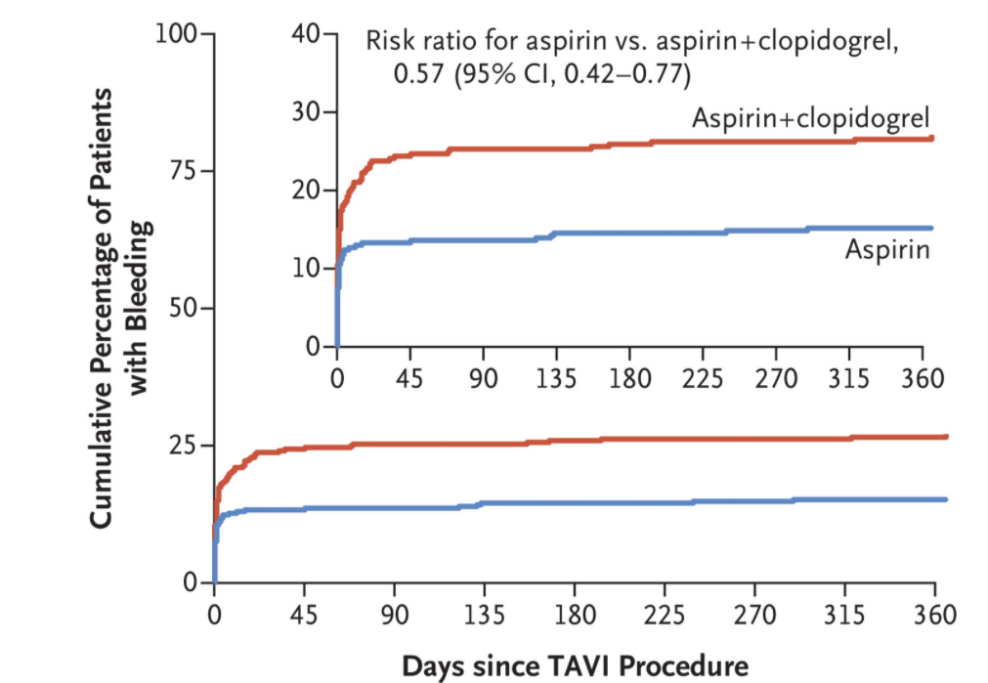
Results
Brouwer et al. New Engl J Med. Oct 2020.
Notes:
Most bleeding occurred by 30 days, not the kind associated with high mortality

Slide 44
POPular TAVI A Critique
Strengths
Trial outcomes were adjudicated by committee
No patients were lost to follow up at 12 months
Results robust against sensitivity analysis of per-protocol group
Limitations
Not powered to detect thromboembolic events
Complex bleeding definition
Included some patients on anticoagulation although group was small
May not be generalizable to Asian populations

Slide 45
Valve Thrombosis
Overall incidence of clinical valve thrombosis ~ 2.8%
Rates of subclinical thrombosis may be higher
Characteristic | Odds Ratio (95% CI) | p Value
Age > 80 years | 0.8 (0.3 – 2.2) | 0.65
Atrial fibrillation | 1.8 (0.4-7.1) | 0.43
Obesity | 4.6 (1.6 – 13.1) | 0.005
Antiplatelet therapy alone | 79.1 (3.1 – 1994.5) | 0.008
What about anticoagulation therapy alone?
Jose et al. JACC Cardiovasc Interv. Apr 2017.
Notes:
Retrospective analysis of 649 TAVR procedures; mean time to thrombosis 181 days; clinical = symptoms or increased transvalvular aortic gradients
https://www.jacc.org/doi/full/10.1016/j.jcin.2017.01.045#fig5

Slide 46
GALILEO (2020)
Study Design
Randomized, open label, controlled trial
Population
1664 TAVR patients with no indication for anticoagulation
Intervention
Rivaroxaban 10 mg + aspirin x 3 months → rivaroxaban monotherapy
DAPT x 3 months → aspirin
Dangas et al. N Engl J Med. Jan 2020.

Slide 47
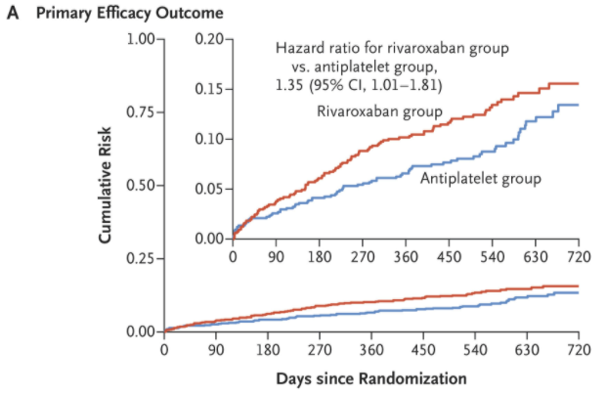
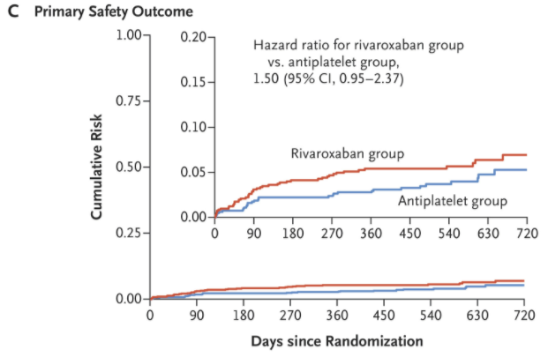
Results
Death from any cause or thromboembolic events
Life-threatening, disabling or major bleeding
Terminated early due to safety concerns
Dangas et al. N Engl J Med. Jan 2020.
Notes:
Driven by noncardiovascular deaths
Led to recommendation in the guidelines that the use of low dose Xarelto plus aspirin was contraindicated in the absence of anticoag indication

Slide 48
Attrition Bias
Premature Discontinuation
Rivaroxaban Arm 37.1%
Antiplatelet Arm 23.6%
On-treatment analysis
Primary efficacy outcome | HR 1.21 (0.86 to 1.70)
Primary safety outcome | HR 1.53 (0.94 to 2.49)
Dangas et al. N Engl J Med. Jan 2020.

Slide 49
GALILEO Takeaways
Use of rivaroxaban post TAVR increased risk of death from any cause or thromboembolic events
Unbalanced drug discontinuation rates may make interpretation of the results uncertain
Due to results of GALILEO, guidelines recommend against use of rivaroxaban monotherapy after TAVR

Slide 50
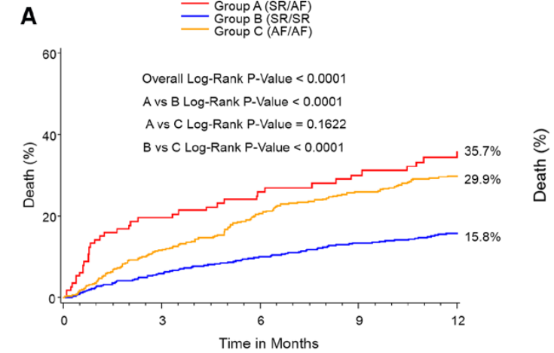
TAVR and Atrial Fibrillation
Due to similar risk factors, atrial fibrillation and aortic stenosis may coexist in up to 50% of patients
Mortality is significantly increased in TAVR patients with atrial fibrillation, especially if new-onset
Development of atrial fibrillation after TAVR ranges from 6-53%
Biviano et al. Circ Cardiovasc Interv. 2016.
Stortecky et al. Circ Cardiovasc Interv. 2013.
Notes:
Up to this point, all studies have excluded patients with atrial fibrillation requiring anticoagulation, but this is a large population
Management of these patients not well addressed in the ACC guidelines but ESC guidelines suggest use of VKA alone or in combination with asa or clopidogrel but risk of bleeding not well studied
New onset vs. pre-existing?
https://www.ahajournals.org/doi/pdf/10.1161/CIRCINTERVENTIONS.115.002766
https://www.ahajournals.org/doi/10.1161/circinterventions.112.000124

Slide 51
POPular TAVI B (2020)
Study Design
Randomized, open label, controlled trial
Population
313 patients who underwent TAVR with an indication for anticoagulation
Intervention
OAC monotherapy
Clopidogrel + OAC x 3 months
OAC: oral anticoagulant (warfarin or direct oral anticoagulant)
Nijenhuis et al. New Engl J Med. Apr 2020.

Slide 52
Baseline Characteristics
Characteristic | OAC monotherapy (n = 157) | Clopidogrel + OAC (n = 156)
Age, years | 80.9 | 81.0
NYHA Class III or IV | 75.8% | 70.5%
LVEF > 50% 31-50% ≤ 30% | 58.0% 34.4% 7.6% | 62.2% 29.5% 8.3%
Atrial fibrillation | 95.5% | 94.2%
Previous MI | 8.9% | 12.8%
Previous Stroke | 9.6% | 9.6%
Nijenhuis et al. New Engl J Med. Apr 2020.

Slide 53
Baseline Characteristics
Characteristic | OAC monotherapy (n = 157) | Clopidogrel + OAC (n = 156)
Age, years | 80.9 | 81.0
NYHA Class III or IV | 75.8% | 70.5%
LVEF > 50% 31-50% ≤ 30% | 58.0% 34.4% 7.6% | 62.2% 29.5% 8.3%
Atrial fibrillation | 95.5% | 94.2%
Previous MI | 8.9% | 12.8%
Previous Stroke | 9.6% | 9.6%
Nijenhuis et al. New Engl J Med. Apr 2020.

Slide 54
Results
Endpoint | OAC monotherapy | Clopidogrel + OAC | Risk Ratio | p Value
Primary Outcome (12 months) All bleeding (VARC/BARC) Non-procedure related bleeding | 21.7% 21.7% | 34.6% 34.0% | 0.63 (0.43 to 0.9) 0.64 (0.44 to 0.92) | 0.01 0.02
Secondary Outcomes First Composite* Second Composite** | 31.2% 13.4% | 45.5% 17.3% | 0.69 (0.51 to 0.92) 0.77 (0.46 to 1.31)
*Death from cardiovascular causes, non-procedure related bleeding, stroke, myocardial infarction **Death from cardiovascular causes, ischemic stroke, myocardial infarction
Nijenhuis et al. New Engl J Med. Apr 2020.
Notes:
same thing where puncture site bleeding and minor procedure related bleeding classified as non-procedure related bleeding
TAVI access site was the most common location of bleeding in both groups (about half in both groups) - significant? no stat sig difference for major or life threatening but may not be powered to detect.
both secondary outcomes met noninferiority, but first met superiority
most bleeding occurred

Slide 55
POPular TAVI B Limitations
Strengths
Multicenter trial spanning 17 sites across Europe
Broad inclusion criteria
3 month adherence to clopidogrel was 95%
Limitations
Details on specific anticoagulant and dosing not provided
Aspirin use not tracked
Timing for initiation after procedure is unclear
Small sample size
Notes:
discretionary allowance of cessation of clopidogrel 1 month earlier or later than 3 months, but 3 month adherence still 95%

Slide 56
Future Directions
Trial | Est. completion | Clinicaltrials.gov identifier
AVATAR Anticoagulation Alone Versus Anticoagulation and Aspirin Following Transcatheter Aortic Valve Interventions | April 2021 | NCT02735902
ENVISAGE TAVI AF Edoxaban Compared to Standard Care After Heart Valve Replacement Using a Catheter in Patients With Atrial Fibrillation | June 2021 | NCT02943785
ADAPT-TAVR Anticoagulant Versus Dual Antiplatelet Therapy for Preventing Leaflet Thrombosis and Cerebral Embolization After Transcatheter Aortic Valve Replacement | September 2021 | NCT03284827
Notes:
Trends?

Slide 57
Summary
There is a significant risk of bleeding and thrombosis associated with TAVR
Whether the patient has an indication for oral anticoagulation influences selection of therapy
Dual antiplatelet therapy and combination with anticoagulation increases risk of bleeding after TAVR
Additional literature is underway to further explore optimal regimens
Notes:
Continuing aspirin vs. P2Y12? What happens after 12 months?

Slide 58
Assessment Question #2
Patient JT is scheduled to undergo TAVR for severe aortic stenosis. Past medical history includes coronary artery disease and congestive heart failure. Which of the following is true?
JT should receive rivaroxaban following TAVR to prevent against subclinical leaflet thrombosis
Dual antiplatelet therapy should be started for 3-6 months followed by lifelong aspirin
Dual antiplatelet therapy would have a negligible risk of bleeding compared to aspirin alone
No antithrombotic therapy should be started since JT is not at high risk for thrombosis

Slide 59
Assessment Question #2
Patient JT is scheduled to undergo TAVR for severe aortic stenosis. Past medical history includes coronary artery disease and congestive heart failure. Which of the following is true?
JT should receive rivaroxaban following TAVR to prevent against subclinical leaflet thrombosis
Dual antiplatelet therapy should be started for 3-6 months followed by lifelong aspirin
Dual antiplatelet therapy would have a negligible risk of bleeding compared to aspirin alone
No antithrombotic therapy should be started since JT is not at high risk for thrombosis

Slide 60
Ischemic Stroke

Slide 61
What is Ischemic Stroke?
Blockage of blood flow to the brain leading to tissue ischemia and infarct
Cardioembolic
Non-cardioembolic
Transient Ischemic Attack
Blockage from thrombus originating in the heart
Blockage due to atherosclerosis in cerebral vessels
Temporary blockage without acute infarction
Transient Ischemic Attack. StatPearls. Nov 2020.
Notes:
https://www.ncbi.nlm.nih.gov/books/NBK459143/ - statpearls

Slide 62
795,000
Annual cases of stroke in the United States
1 in every 6
$46 billion
185,000
Cardiovascular deaths due to stroke
Stroke related costs in the United States
Recurrent Strokes
Stroke by the Numbers
Stroke Facts. CDC.gov.
Notes:
https://www.cdc.gov/stroke/facts.htm#:~:text=Stroke%20Statistics&text=Every%20year%2C%20more%20than%20795%2C000,are%20first%20or%20new%20strokes.&text=About%20185%2C000%20strokes%E2%80%94nearly%201,have%20had%20a%20previous%20stroke.&text=About%2087%25%20of%20all%20strokes,to%20the%20brain%20is%20blocked.

Slide 63
NIH Stroke Scale
Evaluates stroke severity
11 elements
Level of consciousness
Visual/motor acuity
Speech
21-42 = Severe stroke
16-20 = Moderate-severe stroke
Total score 0-42
5-15 = Moderate stroke
1-4 = Minor stroke
0 = No stroke symptoms
NIH Stroke Scale. Stroke.nih.gov.
Notes:
https://www.stroke.nih.gov/resources/scale.htm

Slide 64
2019 AHA Guidelines
Which agents should we use to prevent recurrent stroke?
Antiplatelet agents are recommended over anticoagulation for non-cardioembolic stroke
Which antiplatelet should we use for secondary prevention?
Choice should be individualized to patient specific factors
What if recurrent stroke occurs while on aspirin?
The benefit of increasing the dose of aspirin or switching to alternative antiplatelet agent is unclear
Powers et al. Stroke. Dec 2019.
Notes:
https://www.ahajournals.org/doi/epub/10.1161/STR.0000000000000211 - guidelines

Slide 65
New Recommendations
Should we switch to warfarin for secondary stroke prevention?
Switching to warfarin is not indicated after a non-cardioembolic stroke
Should we use triple antiplatelet therapy for secondary stroke prevention?
Triple therapy (aspirin + clopidogrel + dipyridamole) is harmful and should not be administered
What about dual antiplatelet therapy (DAPT)?
Powers et al. Stroke. Dec 2019.
Notes:
TARDIS trial for triple therapy
https://www.ahajournals.org/doi/epub/10.1161/STR.0000000000000211 - guidelines

Slide 66
Stroke DAPT Literature
CHANCE (2013)
THALES (2020)
POINT (2018)

Slide 67
CHANCE (2013)
Study Design
Randomized, double-blind, placebo-controlled trial
Population
5170 patients with minor ischemic stroke or high risk* TIA at 114 centers in China
Intervention
Clopidogrel 75 mg x 90 days + aspirin 75 mg x 21 days
Aspirin 75 mg x 90 days + placebo
Within 24 hrs
TIA: transient ischemic attack
*ABCD score ≥4
Wang et al. N Engl J Med. 2013.
Notes:
Clopidogrel loaded with 300 mg
Primary outcome: ischemic stroke at 90 days

Slide 68
CHANCE (2013)
Endpoint | Clopidogrel + aspirin (n = 2584) | Aspirin (n = 2586) | Hazard ratio | p value
Incidence of Stroke at 90 days | 212 (8.2%) | 303 (11.7%) | 0.68 (0.57-0.81) | <0.001
Stroke, MI or death from CV causes | 216 (8.4%) | 307 (11.9%) | 0.69 (0.58-0.82) | <0.001
Ischemic Stroke | 204 (7.9%) | 295 (11.4%) | 0.67 (0.56-0.81) | <0.001
No difference in hemorrhagic stroke, MI, death from CV causes, death from any cause
No difference in incidence of mild, moderate or severe bleeding (0.2-1.2% in both groups)
MI: myocardial infarction
CV: cardiovascular
Wang et al. N Engl J Med. 2013.

Slide 69
CHANCE Critique
Strengths
Strong study design with large sample size
Defined regimen with timing criteria provided
Results were consistent across all major subgroups
Limitations
Limited generalizability with only Chinese patients included
CYP2C19 polymorphisms
Higher death rate for stroke
Long term outcomes unknown
Unclear benefit for severe strokes

Slide 70
CHANCE Takeaways
Clopidogrel + aspirin x 21 days reduced incidence of stroke with no significant increase in bleeding in those with minor stroke/TIA
DAPT initiated within 24 hours of symptom onset for maximal benefit against recurrent ischemic stroke
Limited generalizability and long term outcomes unknown

Slide 71
POINT (2018)
Study Design
Randomized, double-blind, placebo-controlled trial
Population
4881 patients with minor stroke or high risk* TIA at 269 sites in 10 countries
Intervention
Clopidogrel 75 mg + aspirin 50-325 mg x 90 days
Aspirin 50-325 mg + placebo x 90 days
Within 12 hrs
*ABCD² score ≥4
Johnston et al. N Engl J Med. 2018.
Notes:
Clopidogrel loaded with 600 mg

Slide 72
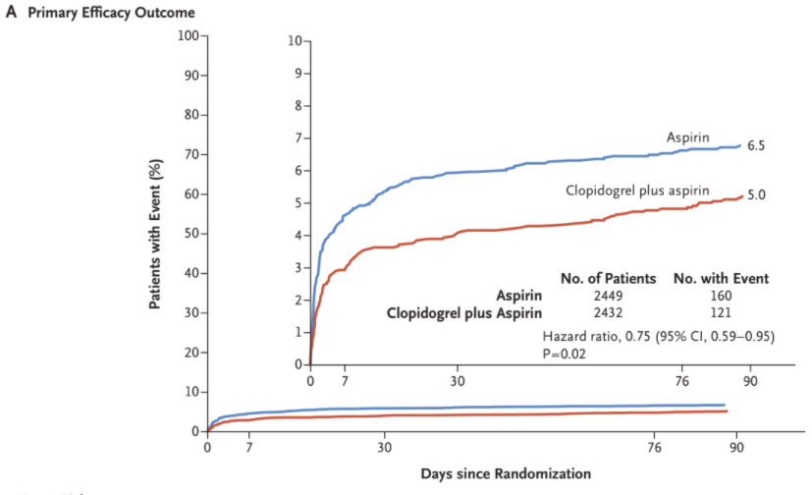
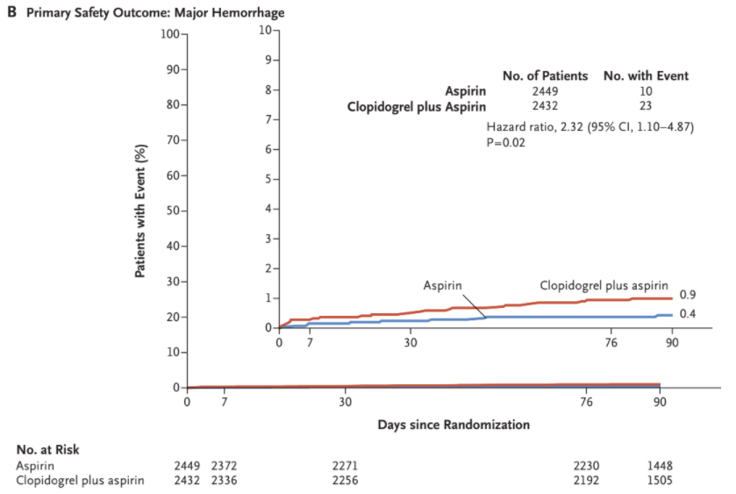
Results
Primary outcome: Incidence of stroke, MI or death from major ischemic events at 90 days
Major hemorrhage: intracranial, intraocular with vision loss, transfusion ≥ 2 units PRBC, death from hemorrhage
Trial halted after 84% enrollment due to unequivocal benefit for ischemic events
and higher risk of major hemorrhage
PRBC: packed red blood cells
Johnston et al. N Engl J Med. 2018.

Slide 73
POINT Takeaways
Clopidogrel + aspirin x 90 days reduced incidence of stroke with a significant increase in major bleeding in those with minor stroke/TIA
DAPT was started within 12 hours of index event
Broadens the results of the CHANCE trial with improved generalizability but still excludes moderate and severe stroke populations

Slide 74
THALES (2020)
Study Design
Randomized, double-blind, placebo-controlled trial
Population
11016 patients with mild-moderate ischemic stroke or high risk* TIA at 414 centers in 28 countries
Intervention
Ticagrelor + aspirin x 30 days
Aspirin + placebo x 30 days
Within 24 hrs
*ABCD² score ≥6
Johnston et al. N Engl J Med. 2020.
Notes:
Aspirin 300-325 mg then 75-100 mg daily
NIHSS 5 or less.
After 30 days, just standard of care according

Slide 75
Baseline Characteristics
Characteristic | Ticagrelor-aspirin (n = 5523) | Aspirin (n = 5493)
Age, years | 65.2 | 65.1
Race White Black Asian | 53.8% 0.4% 42.6% | 53.7% 0.6% 42.6%
Time from symptom onset to randomization < 12 hours | 32.8% | 32.3%
Event Stroke TIA | 91.1% 8.9% | 90.2% 9.8%
NIHSS score ≤ 3 > 3 | 60.8% 30.3% | 60.3% 29.9%
Notes:
African Americans underrepresented, although included NIH up to 5, most still 3 or less. mostly stroke, less so for TIA

Slide 76
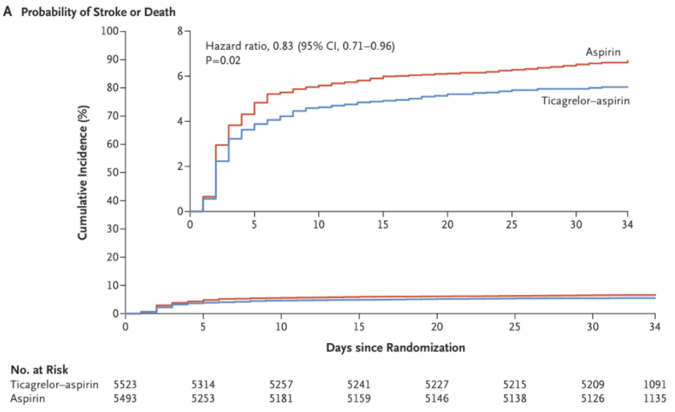
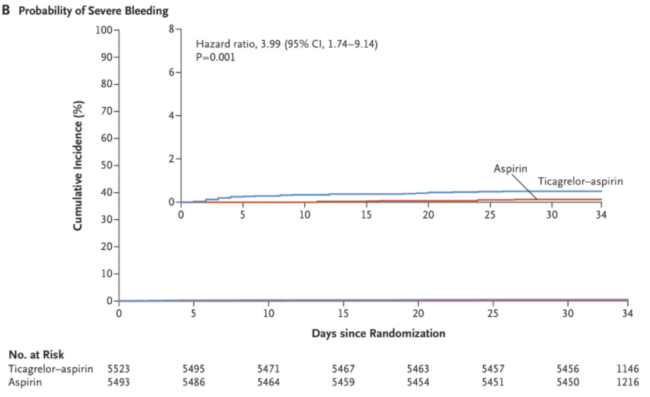
Results
Primary outcome: Stroke or death within 30 days
Time to first severe bleeding event
Conclusion: Decreased incidence of composite of stroke or death within 30 days, but increased risk of severe bleeding
Johnston et al. N Engl J Med. 2020.

Slide 77
THALES Critique
Strengths
Large sample size with over 10,000 patients
Multicenter trial covering diverse geographical area
Included some patients with moderate stroke
Follow up occurred in all but 15 patients
Limitations
Long term outcomes past 60 days unknown
Extensive exclusion criteria including patients requiring anticoagulation or those with cardioembolic strokes
14.3% in DAPT group discontinued treatment prematurely
Notes:
Followed for an additional 30 days after 30 day trial treatment

Slide 78
CHANCE
POINT
THALES
Comparison
Clopidogrel 300 mg load
ASA 75 mg
DAPT for 21 days
NIHSS ≤ 3 or TIA
Decreased stroke at 90 days
No difference in bleeding
Clopidogrel 600 mg load
ASA 50-325 mg
DAPT for 90 days
NIHSS ≤ 3 or TIA
Decreased stroke, MI, death at 90 days
Increased major bleeding
Ticagrelor 180 mg, then 90 mg daily
ASA 75-100 mg
DAPT for 30 days
NIHSS ≤ 5 or TIA
Decreased stroke or death at 30 days
Increased major bleeding
Notes:
Loaded asa for thales.., after fibrinolysis, need concomitant anticoag,

Slide 79
Summary
DAPT may decrease incidence of ischemic events with increased risk of bleeding
Therapy must be started within 12-24 hours after symptom onset
Results may not be generalizable to severe strokes or those who underwent fibrinolysis
More literature is needed to clarify the role of DAPT with concomitant anticoagulation
Notes:
What about triple therapy? If need anticoag

Slide 80
Assessment Question #3
Which of the following patients would be a candidate for receiving dual antiplatelet therapy following ischemic stroke?
65 year old female with NIHSS of 8
42 year old male presenting 36 hours after symptom onset
89 year old male with history of hemorrhagic stroke and recurrent GI bleeds
51 year old female presenting with high risk TIA within 10 hours after onset

Slide 81
Assessment Question #3
Which of the following patients would be a candidate for receiving dual antiplatelet therapy following ischemic stroke?
65 year old female with NIHSS of 8
42 year old male presenting 36 hours after symptom onset
89 year old male with history of hemorrhagic stroke and recurrent GI bleeds
51 year old female presenting with high risk TIA within 10 hours after onset

Slide 82
Presentation Takeaways
New literature evaluating optimal antiplatelet regimens following ACS, TAVR and ischemic stroke continues to challenge current guidelines
More studies are needed to define populations that would benefit from various durations of dual antiplatelet therapy
Antiplatelet therapy for all indications should be tailored based on patient specific factors for optimal outcomes

Slide 83
Emerging Literature in the Management of Antiplatelet Therapy
Lia Argevani, PharmD
PGY-1 Pharmacy Resident
Ascension St. Vincent’s Healthcare
March 15, 2021

