Slide 1
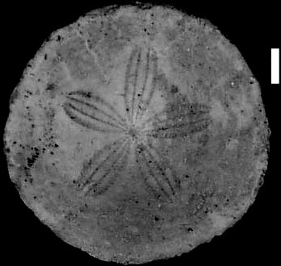
Echinoids and Paleoecology
The southeast during the late Eocene

Slide 2
Paleoautecology is the study of how fossil species interacted with their environments
Echinoids (sea urchins, sand dollars, etc.) live only in marine water. They have no mechanism for salt balance in their bodies, so have to be in normally saline seawater.
Sea urchins (strict sense) live on the bottom, but most sand dollars, sea biscuits, heart urchins, etc. live buried in the bottom.
They require particular modifications of the shell (or “test”) to make their burrows, to live in them, to move through the sediment, and to gather food and rid themselves of their waste.
Different types of sediment require different test shapes, so we can infer from the test what kind of sediment a fossil species burrowed into.

Slide 3
Approximate distribution of limestone in the upper Eocene
Suwannee Strait
Limestone generally requires shallow, tropical, clear marine water to form because that is where the constituent mineral (calcite) most easily forms.

Slide 4
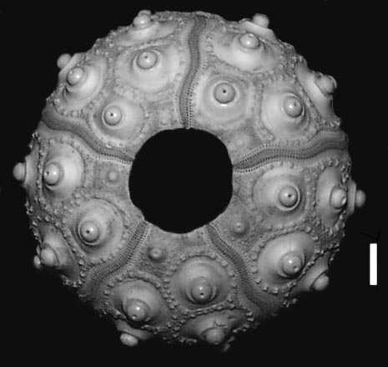
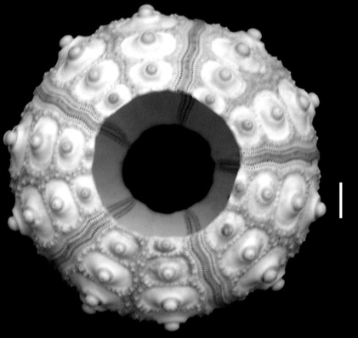
Regular Echinoids
(Phyllacanthus imperialis)
Are radially/pentamerally symmetrical.
Can move in any direction they choose.
Usually have either stout spines or very long slender ones.
Have no mechanism for burrowing into the substrate, though some lift objects onto their dorsal surfaces, either for shade or camouflage.

Slide 5
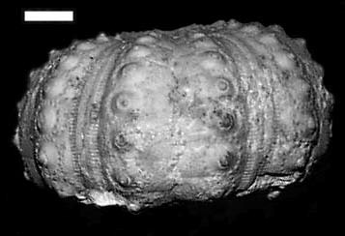
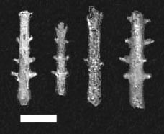
Regular Echinoids
(Prionocidaris mortoni)

Slide 6
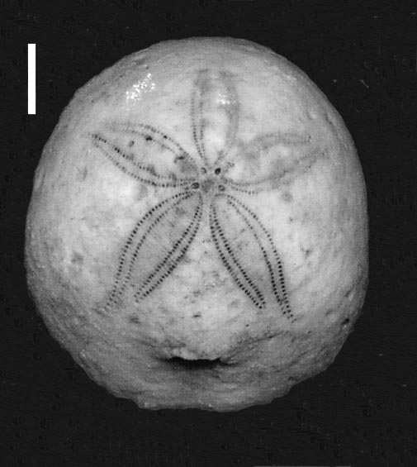
Irregular Echinoids
(Rhyncholampas gouldii)
Are bilaterally symmetrical.
Can move easily in only one direction – with the mouth in front of the periproct.
Usually have tiny spines, rarely also long slender ones.
Have complex sets of mechanisms for burrowing into the substrate. These mechanisms are often reflected in the test (shell) features, and we can infer the kind of sediment they inhabited from these features.

Slide 7
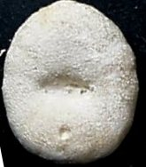
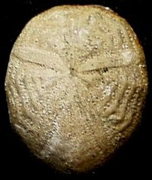
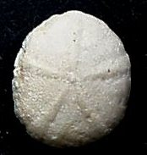
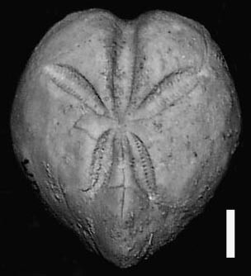
Irregular Echinoids
(Eupatagus
antillarum)
(Periarchus pileussinensis)
(Oligopygus wetherbyi)
(Schizaster
armiger)

Slide 8
Heart Urchins
(spatangoid echinoids)
Compare the density of tubercles
and the petal morphology of these
two species. Also notice the pores in the ambulacra and the fasciole.
(Eupatagus antillarum)
(Schizaster armiger)

Slide 9
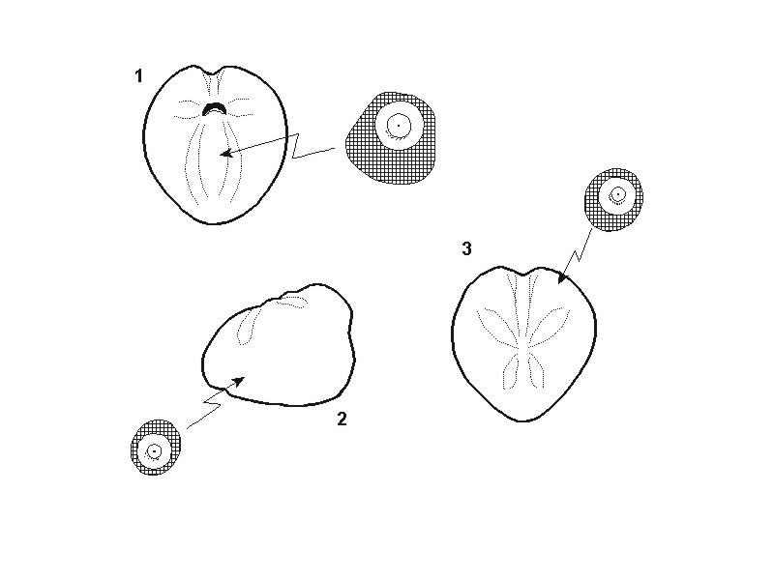
Lateral and Anterior Tubercles
Spines on the underside pull backward and are used like galley oars to propel the animal forward.
These indicate burrowing, but don’t give any clue about what sort of sediment is burrowed.
Spines on the front and sides that pull upward and backward are used to excavate material from the burrow walls.
The asymmetry of the muscle scars around the tubercles indicates the direction of the power stroke of the spine.

Slide 10
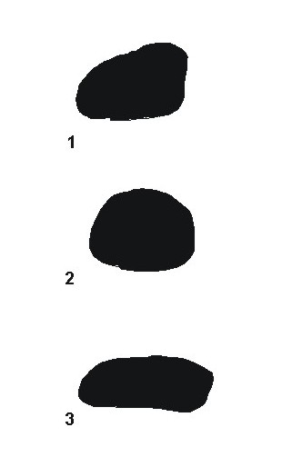
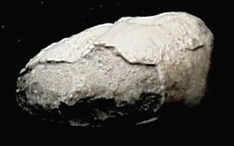
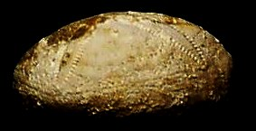
Longitudinal Profile
The more wedge-shaped the echinoid in cross-section, the greater the number of spines that can be brought to bear on excavating the front of the burrow.
MUD
SAND
SAND
(Schizaster armiger)
(Eupatagus antillarum)

Slide 11
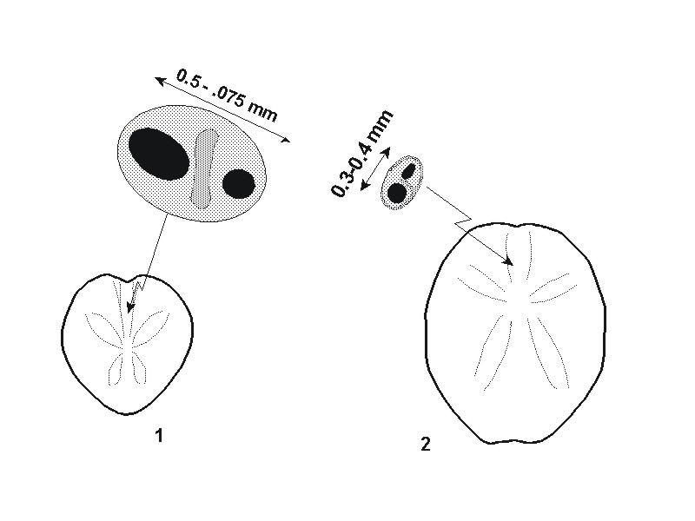
Pores of Anterior Ambulacrum
For excavating a long tunnel to the surface. (MUD)
Cannot excavate a long tunnel to the surface. (SAND)
.
Schizaster armiger Eupatagus antillarum

Slide 12
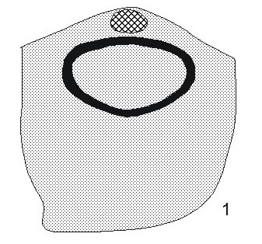
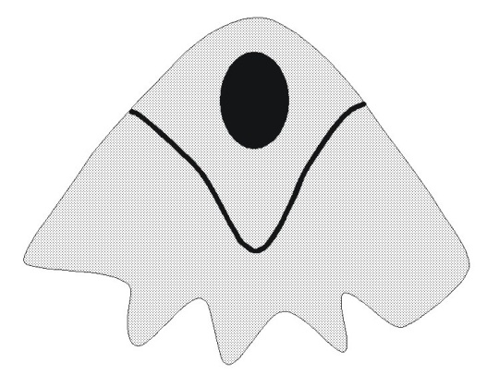
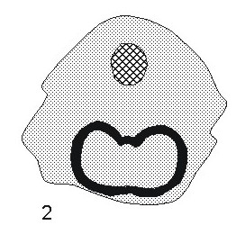
The Anal or Subanal Fasciole
A bilobed or open-topped fasciole, as opposed to an ovate one, allows excavation of a more extensive waste tube at the back of the burrow. This is useful in fine, relatively impermeable sediments.
Ovate subanal fasciole
SAND
Bilobed subanal fasciole
MUD
Anal fasciole
MUD or SAND

Slide 13
Summary of Features and Their Interpretation
SAND-BURROWING ECHINOIDS:
Up/back spine power stroke.
Sparse dorsal tubercles
Flush petals
Flattened or domed profile
Small pores in anterior amb
Ovate subanal fasciole (or none)
MUD-BURROWING ECHINOIDS:
Up/back spine power stroke.
Dense dorsal tubercles
Depressed petals
Wedge-shaped profile
Large pores in anterior amb
Anal or bilobed subanal fasciole

Slide 14
Turning Autecological Interpretation into Paleoenvironmental Data
Determine which localities have sufficient diversity of irregular burrowing echinoids for the analysis.
For each locality, determine the proportion of sand-dwelling and mud-tolerant species.
Identify regions with localities dominated by one or the other sediment type, if possible.

Slide 15
Earliest Late Eocene
N
All localities are dominated
By sand-dwelling echinoids
GEORGIA
75 km
Coarse Bottom
Suwannee
Strait

Slide 16
Middle Late Eocene
A region dominated
by mud-dwelling echinoids lies between coarser, sandy bottoms
N
GEORGIA
75 km
Muddy Bottom
Coarse Bottom
Coarse Bottom
Suwannee
Strait

Slide 17
Latest Late Eocene
A region dominated
by mud-dwelling echinoids lies landward of coarser bottoms
N
GEORGIA
75 km
Muddy Bottom
??
Coarse Bottom
Suwannee
Strait

Slide 18
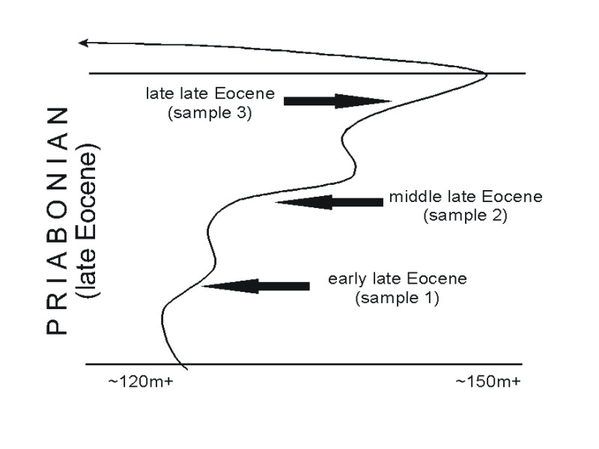
Eocene Sea Level Curve

Slide 19
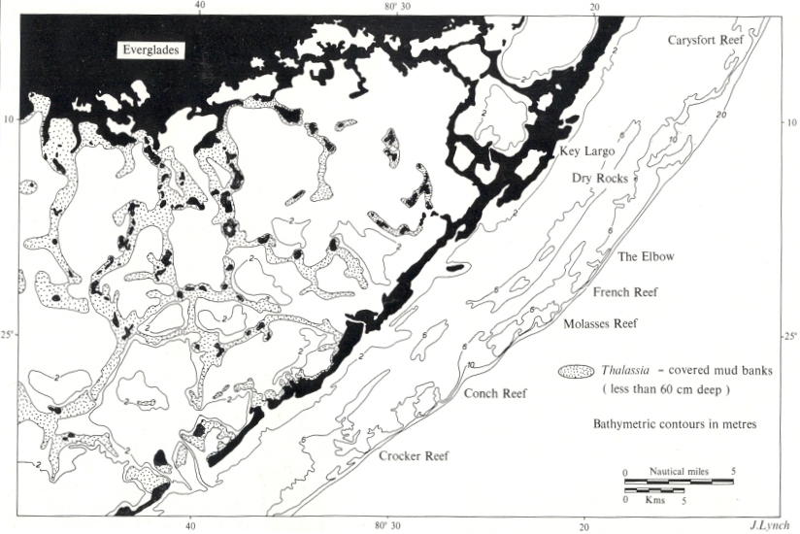
Modern Lime Sediments of South Florida
Fort Valley
FLORIDA STRAIT
(deep water)
Valdosta
Carbonate mud
Skeletal sand
Reefs and associated coarse sediment

Slide 20
? SAND
?? COVERED
Mostly Mud
In Florida, the southernmost echinoid localities are dominated by sand-dwellers and the proportion of mud-tolerant species increases northward. We cannot find echinoids near the Strait, but other fossils found in drill cores indicate sandy sediments there.
Half and Half
All
Sand
LAND?

Slide 21
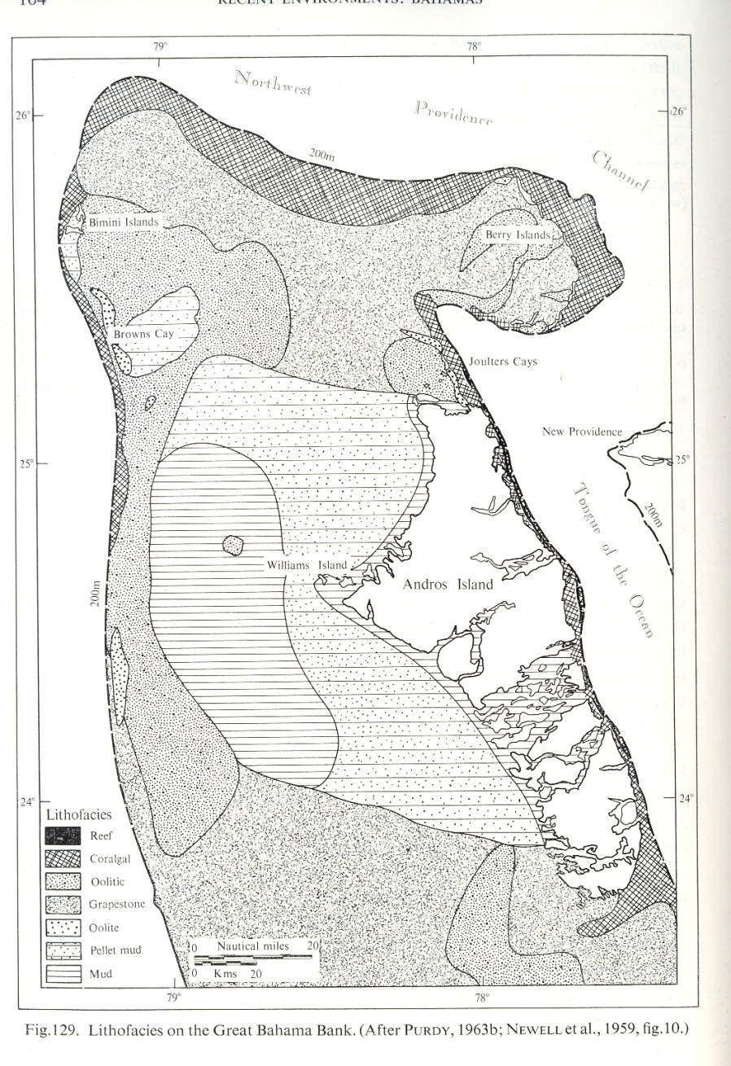
Modern Lime Sediments of the Bahamas
Valdosta
The Great Bahama Bank seems to be a good analogue for Florida during the Eocene.
Florida was southeast of the Suwannee Strait from the Georgia shelf, just as the Bahamas are now southwest of the Florida Strait from the Florida shelf.
What is now Orlando was probably on or near an island like Andros Island.
The water deepened and the bottom became muddy toward the north. This is well reflected in the proportion of Eocene mud-tolerant echinoid species.
Unfortunately, the northern edge of the Florida bank is now deeply buried and no echinoids are known there. Other, small fossils from cores suggest carbonate sands at the edge.
Geophysical work suggests reefs on both flanks of the Strait.
(deep water)
Orlando
FLORIDA STRAIT
(deep water)

Slide 22
Florida
MODERN ANALOGUES
OF EOCENE DEPOSITS
Florida Straits
Great Bahama Bank
South Georgia Shelf
Suwannee Strait
North Florida Bank

Slide 23
CONCLUSIONS
Characteristics of the tests of echinoids can be used to infer the sediment types in ancient deposits of a region.
By determining the proportions of species preferring different sediment types at various localities, a map of the distribution of sediments during a time interval can be prepared.
Such maps prepared for Georgia (and Florida) for three time slices in the Late Eocene record the initial rising of sea-level as marine conditions spread across the region.
South Georgia during this time was analogous to the present Florida Keys – a carbonate shelf, rimmed by coarse sediments and with an inner muddy lagoon.
Florida at the same time was analogous to the present Great Bahama Bank – an isolated bank rimmed with coarse sediments and with a muddy central lagoon.

