Slide 1
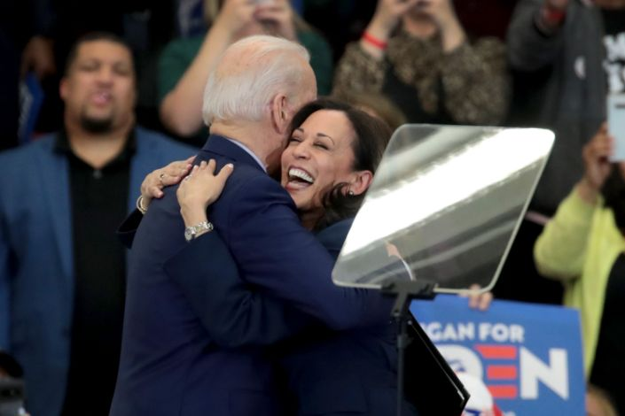
Florida 2020 Elections

Slide 2
welcome

Slide 3
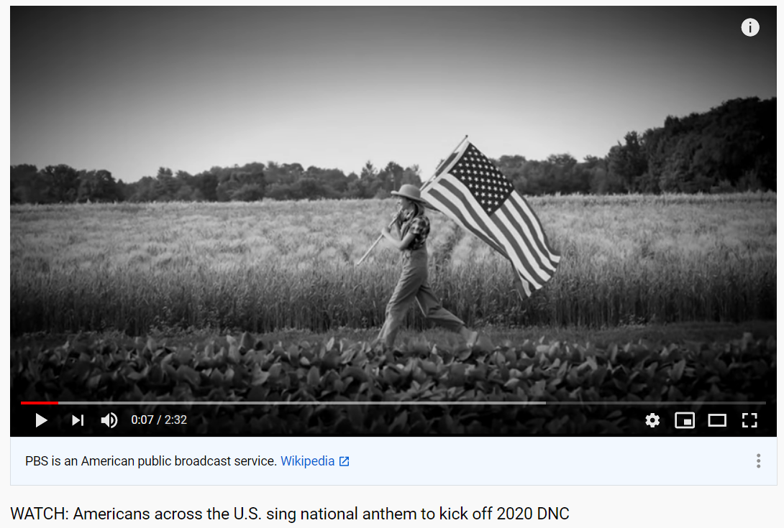
National Anthem
https://www.youtube.com/watch?v=B9oijBHCBv0

Slide 4
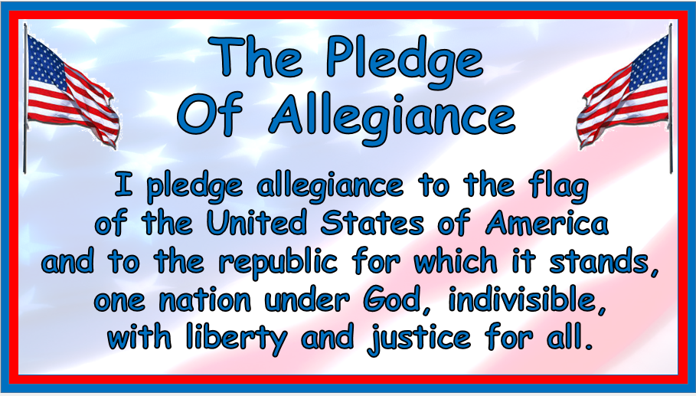
Pledge of Allegiance

Slide 5
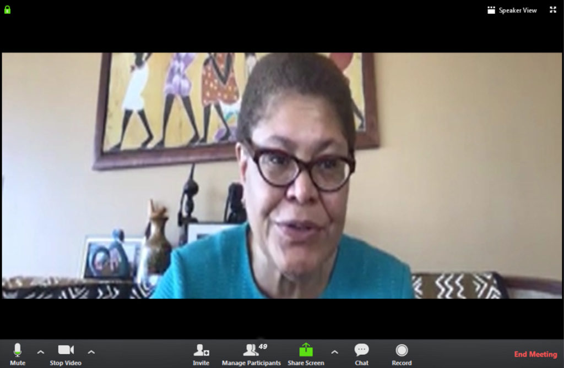
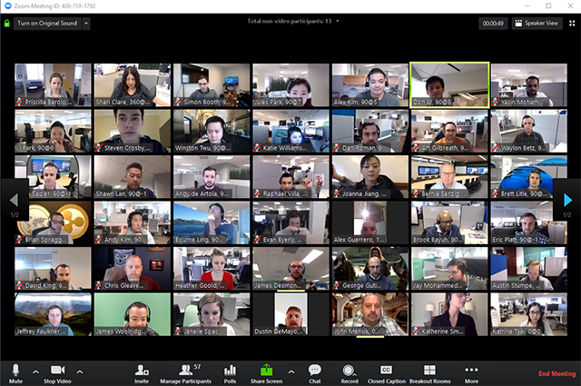
Speaker View

Slide 6
Side By Side Mode

Slide 7
Club Business

Slide 8
Treasurer’s Report

Slide 9
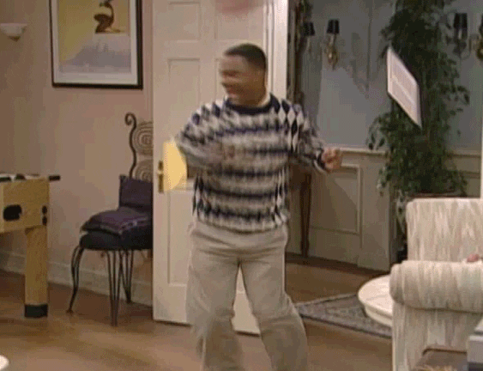
Thank You

Slide 10
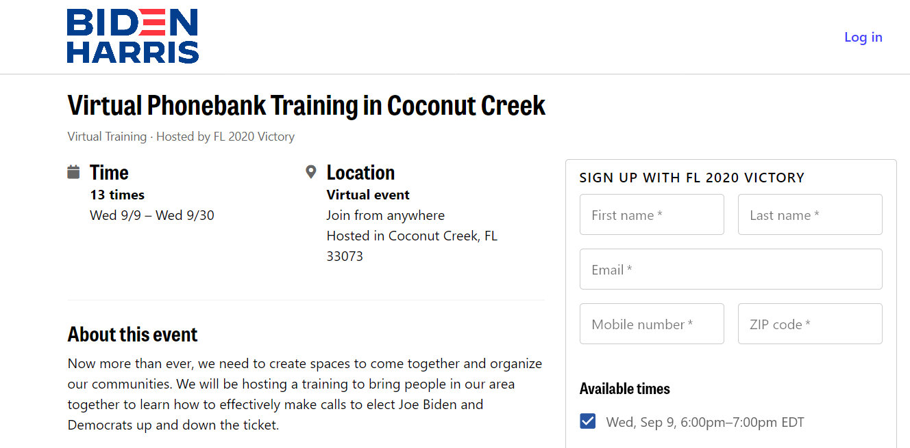
Biden Harris Campaign
Paulina Litter | paula.litter@2020victory.com
https://www.mobilize.us/joebiden/event/309924/

Slide 11
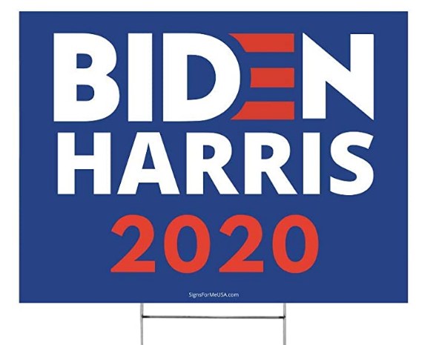
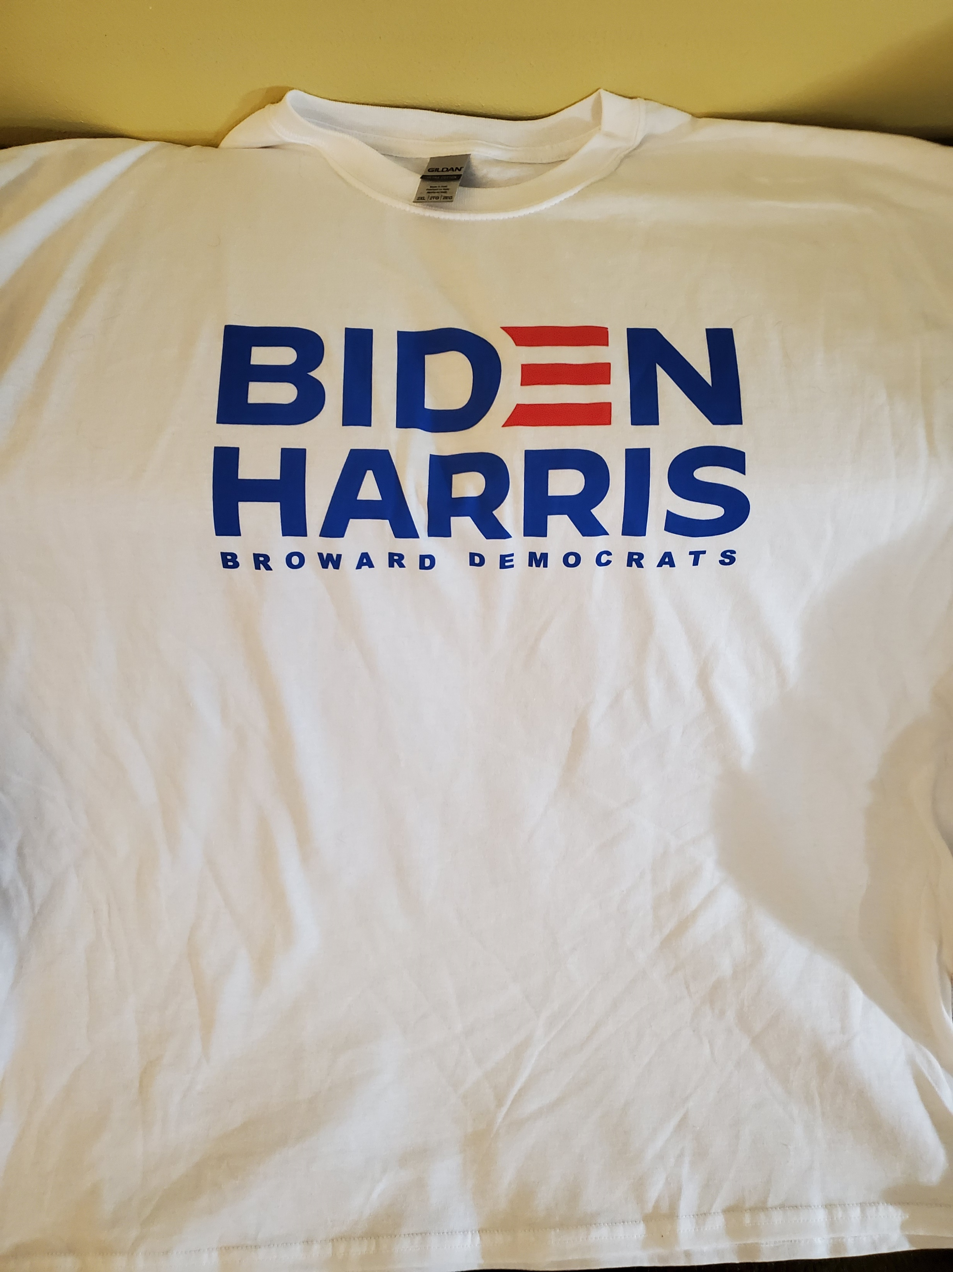
Biden Harris Campaign

Slide 13
2020 Florida Primary Stats
Vote Totals
Democrats | Republicans
1,404,474 (297,995) | 1,106,479
297,995 more Democrats voted
https://countyballotfiles.elections.myflorida.com/FVRSCountyBallotReports/AbsenteeEarlyVotingReports/PublicStats

Slide 14
Broward No VBM ballots
https://countyballotfiles.elections.myflorida.com/FVRSCountyBallotReports/AbsenteeEarlyVotingReports/PublicStats

Slide 15
Broward VBM ballots
114,661 more Democrats voted by mail.
https://countyballotfiles.elections.myflorida.com/FVRSCountyBallotReports/AbsenteeEarlyVotingReports/PublicStats

Slide 16
Broward VBM ballots
22,136 more Democrats voted early.
https://countyballotfiles.elections.myflorida.com/FVRSCountyBallotReports/AbsenteeEarlyVotingReports/PublicStats

Slide 17
2020 Broward Primary Election
https://enr.electionsfl.org/BRO/2703/Summary/Scrolling/Banner/

Slide 18
2014 Broward Primary Election
In 2014, the Primary Election turnout was 10.9%
https://www.browardsoe.org/Election-Information/Voter-Statistics/District-Voter-Turnout-Report

Slide 19
2016 Broward Primary Election
In 2016, the Primary Election turnout was 16.9%
https://www.browardsoe.org/Election-Information/Voter-Statistics/District-Voter-Turnout-Report

Slide 20
2018 Broward Primary Election
In 2018, the Primary Election turnout was 23.8%
https://www.browardsoe.org/Election-Information/Voter-Statistics/District-Voter-Turnout-Report

Slide 21
2020 Broward Primary Election
43,122 more voters than in 2018.
https://enr.electionsfl.org/BRO/2703/Summary/Scrolling/Banner/

Slide 22
State Attorney
https://enr.electionsfl.org/BRO/2703/Summary/Scrolling/Banner/

Slide 23
Public Defender
https://enr.electionsfl.org/BRO/2703/Summary/Scrolling/Banner/

Slide 24
State Senator
https://enr.electionsfl.org/BRO/2703/Summary/Scrolling/Banner/

Slide 25
State Representative
https://enr.electionsfl.org/BRO/2703/Summary/Scrolling/Banner/

Slide 26
Clerk of the Court
https://enr.electionsfl.org/BRO/2703/Summary/Scrolling/Banner/

Slide 27
Sheriff
https://enr.electionsfl.org/BRO/2703/Summary/Scrolling/Banner/

Slide 28
Supervisor of Elections
https://enr.electionsfl.org/BRO/2703/Summary/Scrolling/Banner/

Slide 29
School Board
There will be a runoff on Nov 3, 2020.
https://enr.electionsfl.org/BRO/2703/Summary/Scrolling/Banner/

Slide 30
2020 Florida Elections
https://dos.myflorida.com/elections/for-voters/election-dates/

Slide 31
2020 Florida Elections
https://dos.myflorida.com/elections/for-voters/election-dates/

Slide 32
2020 Florida Elections
https://dos.myflorida.com/elections/for-voters/election-dates/

Slide 33
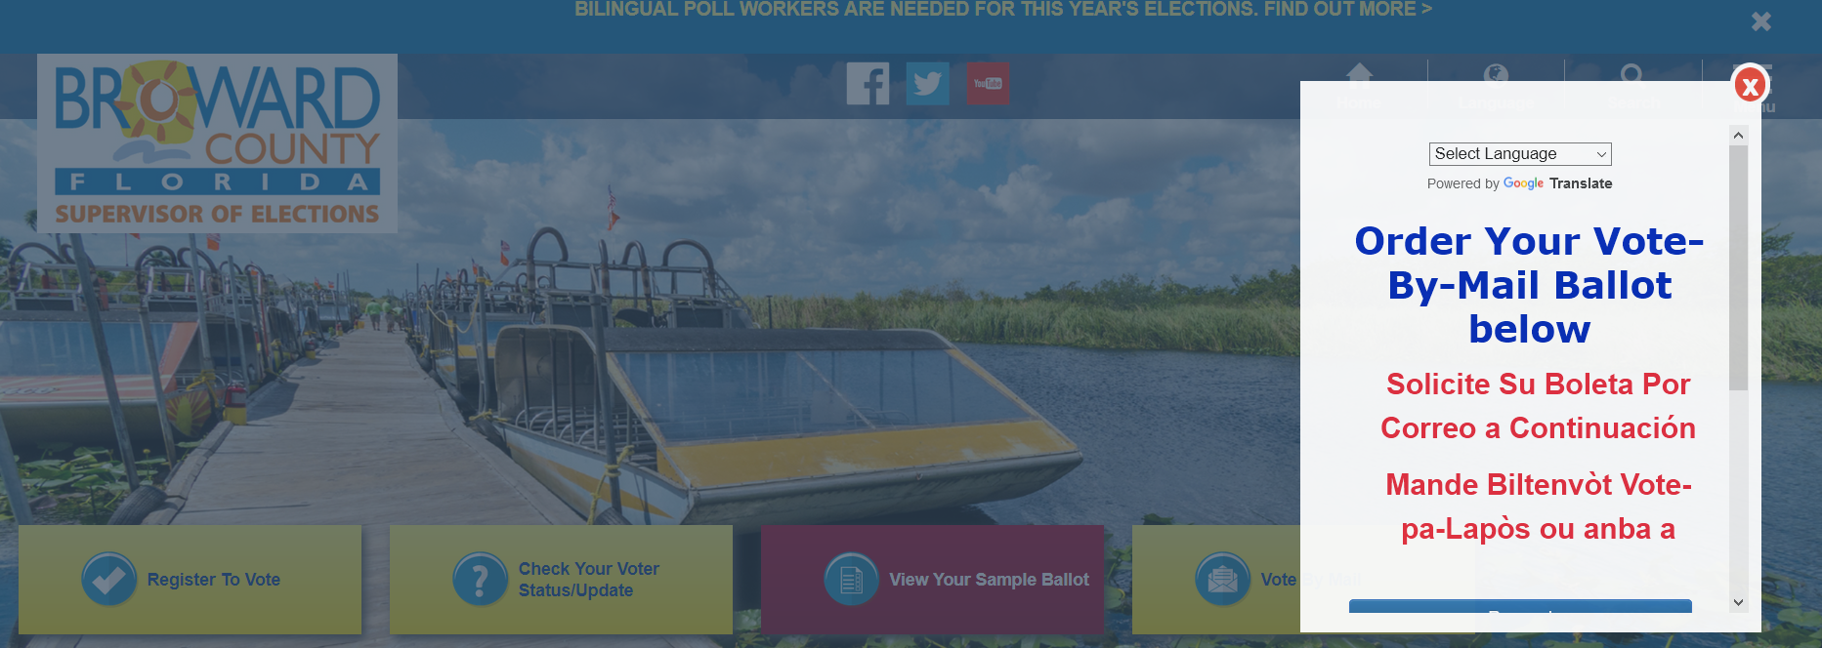
Broward Supervisor of Elections
www.browardsoe.org/

Slide 34
Broward Supervisor of Elections
https://www.browardsoe.org/

Slide 35
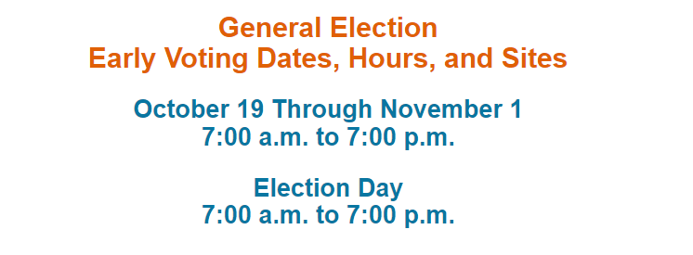
Broward County
There are 14 days for early voting.
https://www.browardsoe.org/

Slide 36
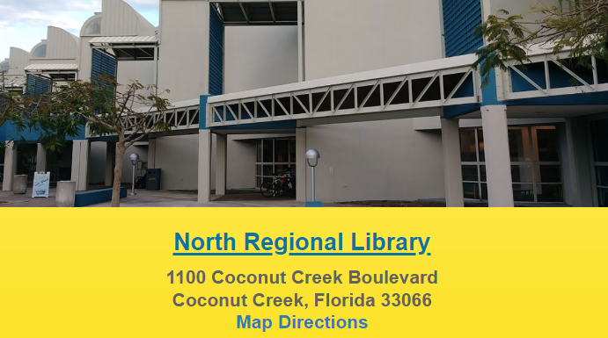
Broward County Early Voting
There are 22 early voting sites in Broward County.
https://www.browardsoe.org/

Slide 37
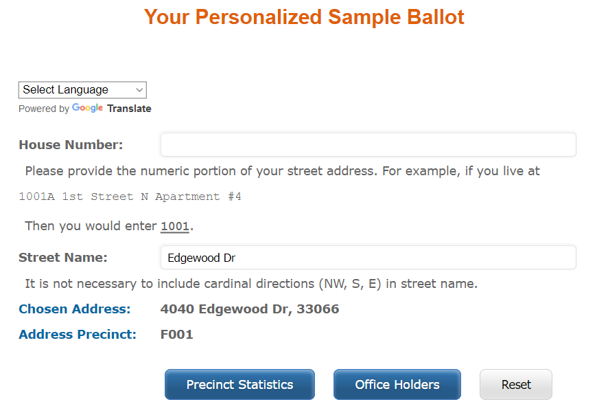
Sample Ballot
https://www.browardsoe.org/

Slide 38
Sample Ballot
On election day, you can only vote at your polling location.
https://www.browardsoe.org/

Slide 39
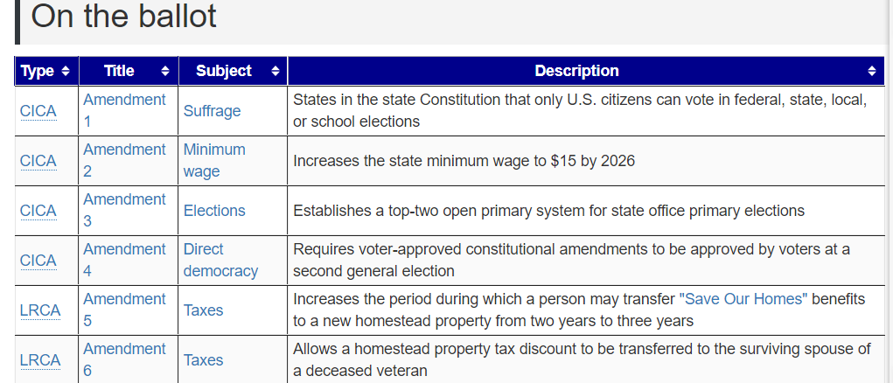
Constitutional Amendments
https://ballotpedia.org/Florida_2020_ballot_measures

Slide 40
City Charter Amendments
1 | Scheduling of seating of commissioners and expiration of terms of office
2 | Term limits for City Commissioners
3 | Timing and selection of Mayor and Vice-Mayor, and designation of temporary chairperson
4 | Clarification of City Commission voting requirements
5 | Clarification of duties and authority of the City Commission
6 | Process for filling a vacant Commission seat
7 | Make Charter consistent with state laws and county requirements
8 | Emergency ordinances and requirements for Commissioners to be physically present to participate and vote
9 | Limitations imposed on selection of independent auditor
https://www.google.com/url?sa=t&rct=j&q=&esrc=s&source=web&cd=&ved=2ahUKEwjz-dCF8tXrAhXDmVkKHb-XAqcQFjACegQIARAB&url=https%3A%2F%2Fcoconutcreek.net%2Fdocs%2Fdefault-source%2Fclerkdocs%2F2020-referendum-questions.pdf%3Fsfvrsn%3De7ecc18a_2%3D&usg=AOvVaw1G_O9QaGWqu057cjocilZK

Slide 41
City Charter Amendments
10 | Clarification of actions requiring an ordinance
11 | City Manager residency and removal procedures
12 | Amendment and clarification of procedure for designation of short-term acting City Manager
13 | Amendment and clarification of duties of the City Clerk and Deputy City Clerk
14 | Organization of boards and committees
15 | Lapse of appropriations
16 | Initiative, referendum, and recall
17 | Charter Review Board
18 | Redistricting Board
https://www.google.com/url?sa=t&rct=j&q=&esrc=s&source=web&cd=&ved=2ahUKEwjz-dCF8tXrAhXDmVkKHb-XAqcQFjACegQIARAB&url=https%3A%2F%2Fcoconutcreek.net%2Fdocs%2Fdefault-source%2Fclerkdocs%2F2020-referendum-questions.pdf%3Fsfvrsn%3De7ecc18a_2%3D&usg=AOvVaw1G_O9QaGWqu057cjocilZK

Slide 42
Questions

Slide 43
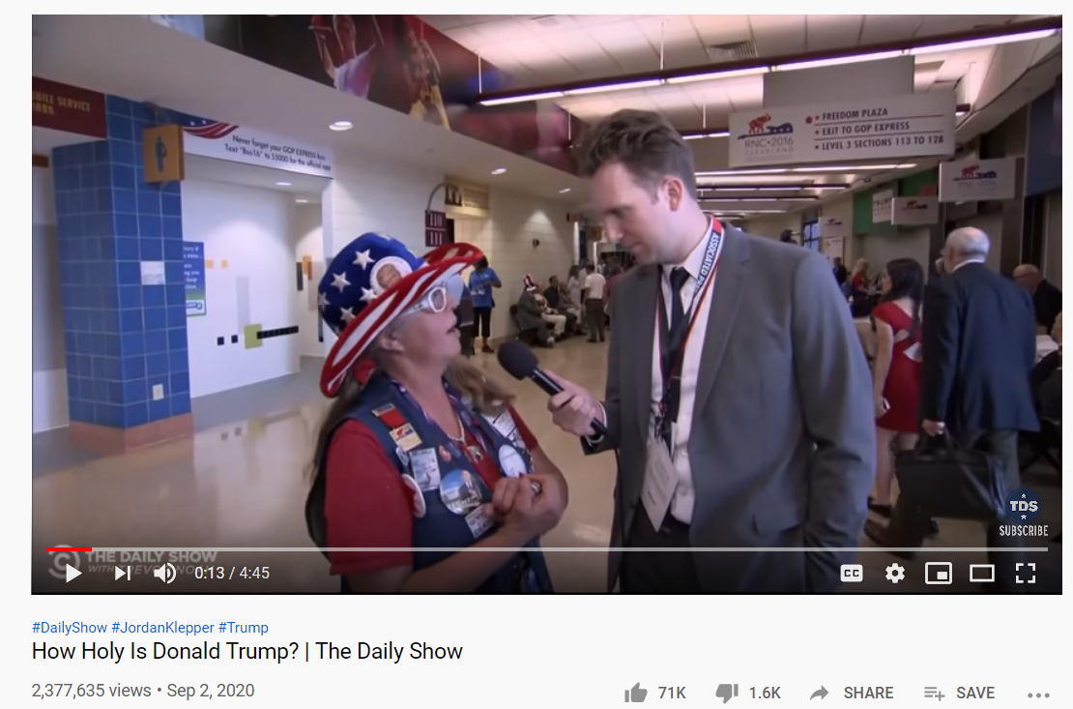
Goodnight
https://www.youtube.com/watch?v=kAgTZSJ4jo8

