Slide 1

RSAI Region Meeting
NE Region
May 25, 2021
Thanks to our Hosts
Central Rivers AEA

Slide 2

RSAI Team
Nick Trenkamp, Central, NE Region Rep
Barb Schwamman, Riceville/Osage, Legis Rep
Dan Peterson, At-Large Rep, Central DeWitt
Jen Albers, Administrator
Larry Sigel, ISFIS Partner
Margaret Buckton, Professional Advocate
Dave Daughton, Legislative Advocate

Slide 3
Agenda:
Introductions
RSAI Overview and Processes
Election of Legislative Committee Rep
Discussion of RSAI Proposed Bylaws
Review of the 2021 Legislative Session
NE Region Priorities for 2022 Session

Slide 4
Introductions
Name ____________________________________
District Role ____________________________________
One Sentence: What’s the biggest challenge you face in your school district today?
________________________________________________________
________________________________________________________
________________________________________________________

Slide 5
History of RSAI
The Rural School Advocates of Iowa began with a few rural school leaders getting together in 2013 to discuss many things:
  Why were rural school voices not represented in statewide decision-making?
  Why did funding formulas not recognize transportation and sparsity factors?
  Why did state policy always seem to have a “one-size-fits-all” approach that left little flexibility to rural schools?
  What could rural school leaders do to change this situation to benefit students in rural schools?

Slide 6
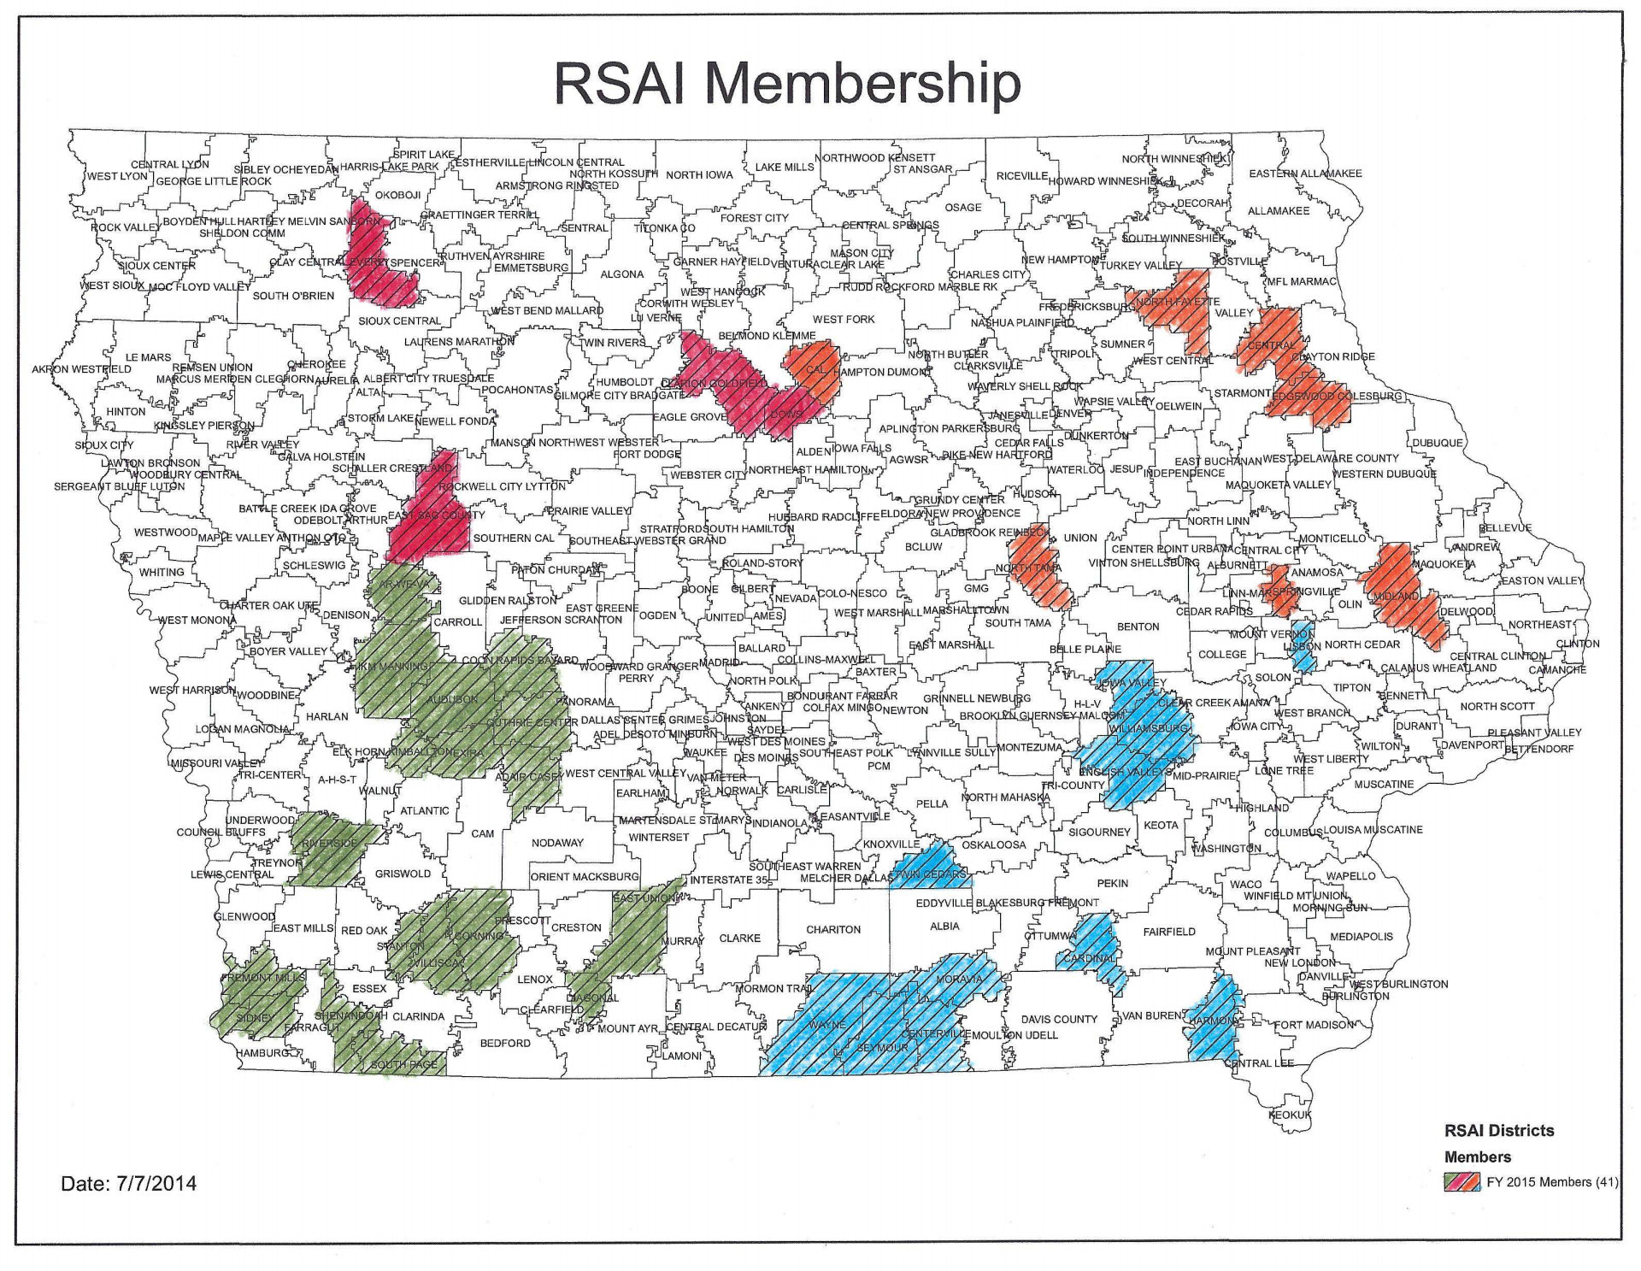
July 1, 2014

Slide 7

Why RSAI?

Slide 8
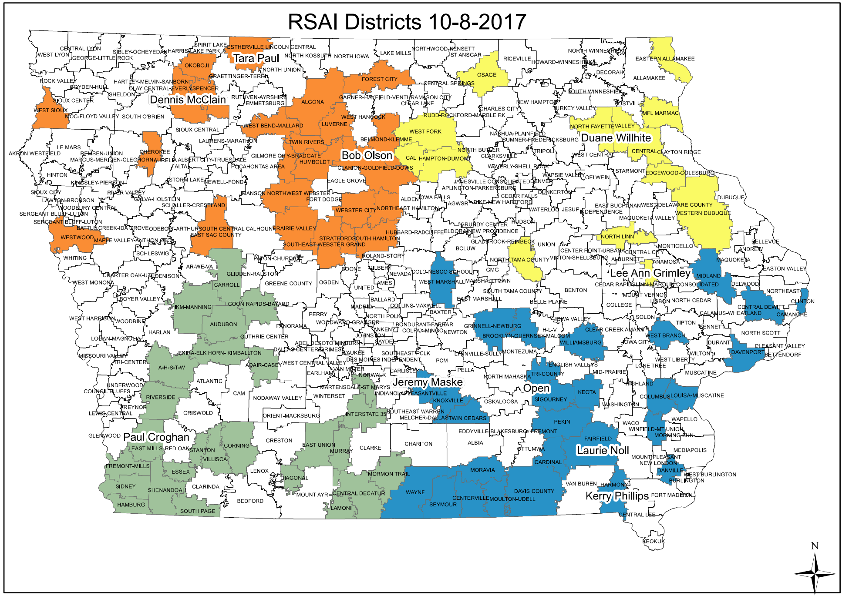
91 members

Slide 9



RSAI Networking Grows
RSAI is recognized as the Iowa affiliate of the National Rural Education Association (NREA) connecting members to rural school leaders nationwide, an annual conference focused on the needs and successes of rural schools
Lends Iowa’s voice to a collective effort in our nation’s Capitol through membership in the Rural Schools Collaborative.
Joins the Iowa Rural Development Council to network and collaborative with rural leaders across all areas of economic development.

Slide 10
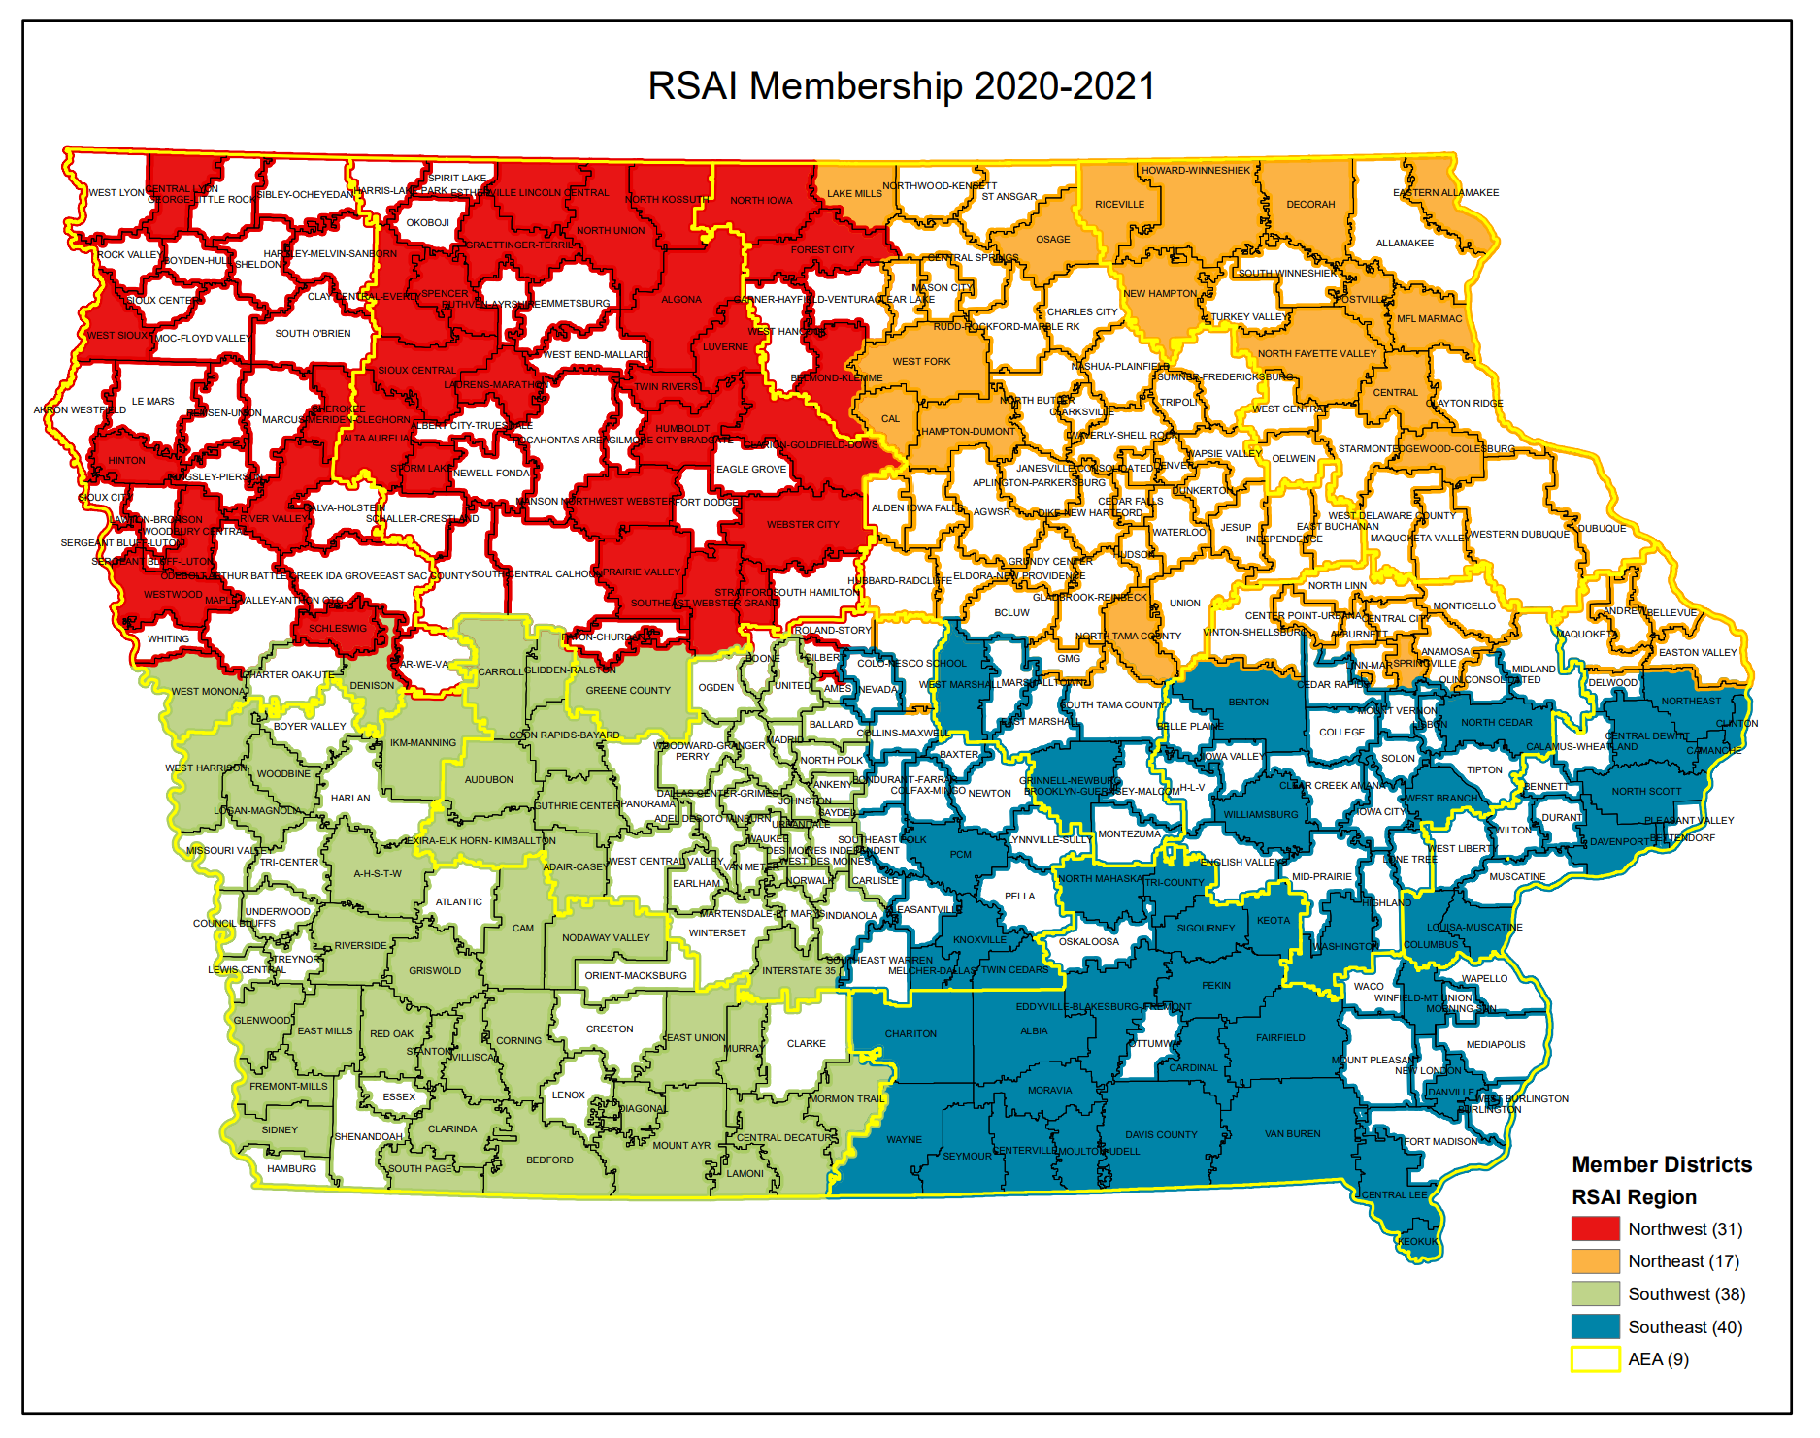
126 Member Districts plus AEA partners

Slide 11
Member Benefits
Advocacy presence at the Iowa Capitol focused on RSAI priority issues
Weekly legislative update reports and recap videos to share the latest news from the statehouse and calls to action when needed
A voice to advocate with the executive branch and represent rural schools on various task forces and stakeholder committees convened by DE.
Advocacy resources for local leaders to use, including position papers, advocacy tool kits, talking points, maps, and school finance estimates
Assistance with communications, letters to the editor or sample letters to legislators
Easy to share information, such as RSAI Legislative Priorities Video, to inform school boards, staff, and stakeholders.
RSAI is the state affiliate of the National Rural Education Association, which brings access to NREA research, updates about happenings in Washington, networking
Free Summer regional meetings and RSAI annual conference in October.
Authentic grassroots development of legislative priorities in a one district one vote democratic process.
Free access to NASDTEC teacher licensure checks with your RSAI membership. Learn more about the program here.
Discount on ISFIS Policy-hosting Service
Collective purchasing power as a group, attracting needed supports at discounted prices
Networking, Sharing, Best Practice Connections with other like districts

Slide 12

www.rsaia.org/corporate-sponsors

Slide 13
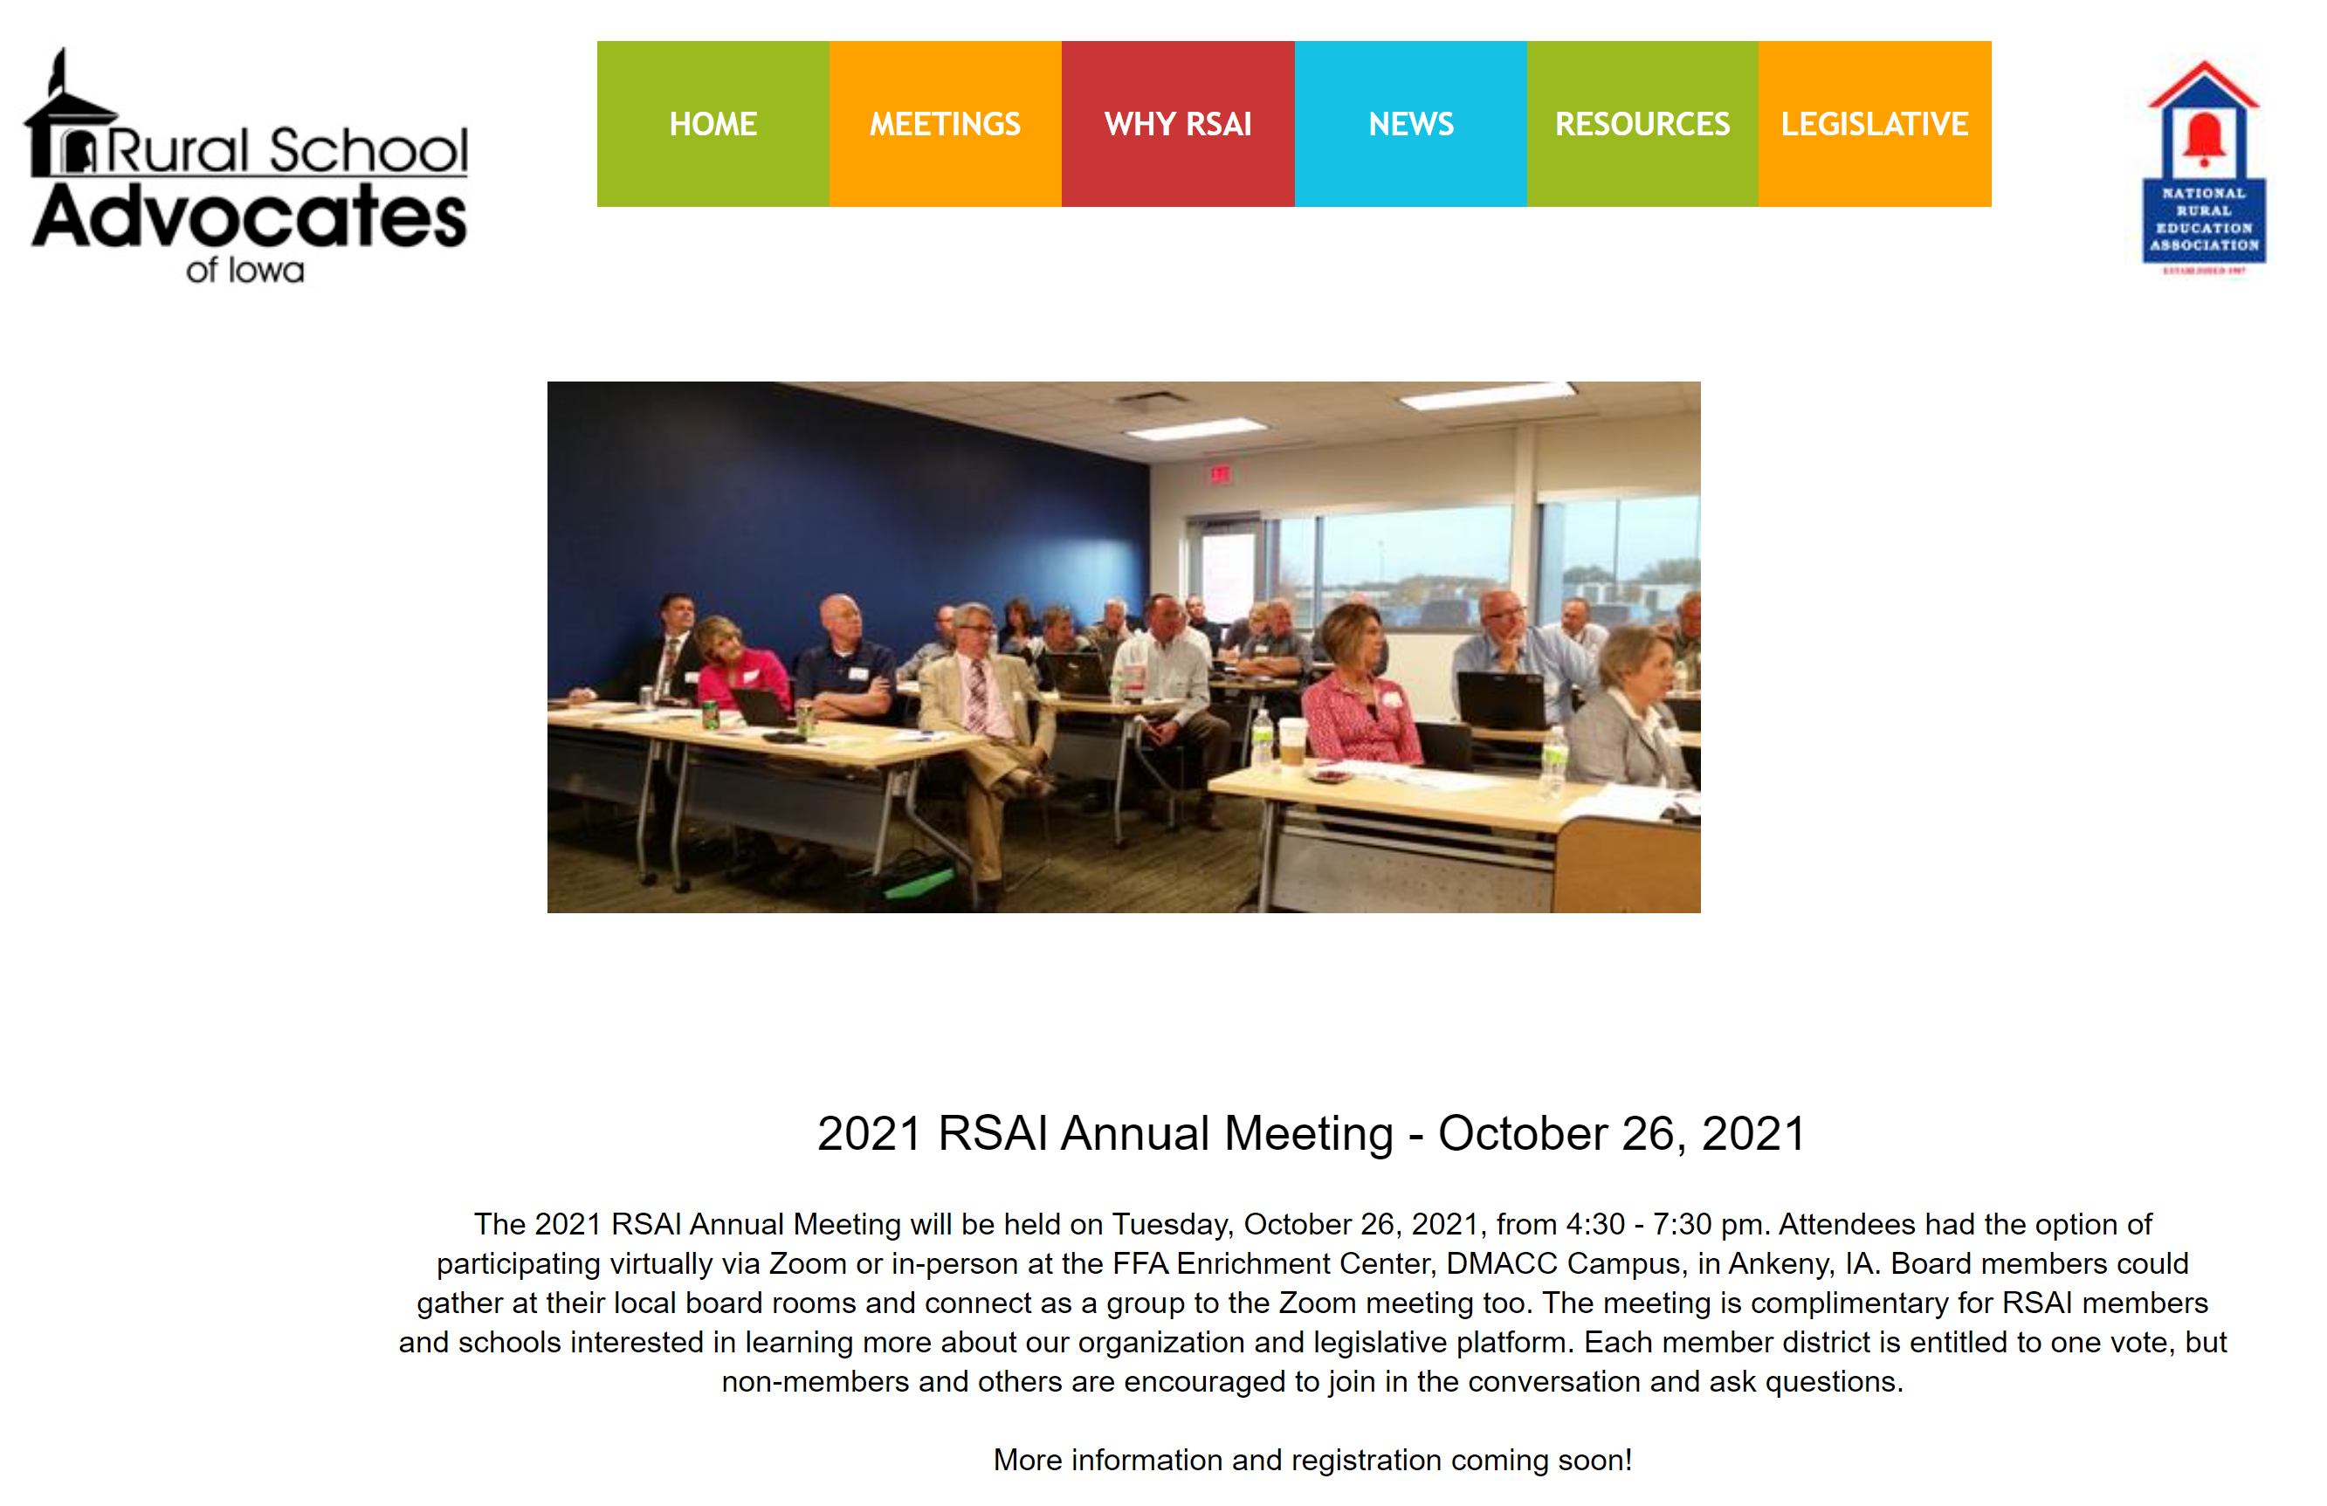
https://www.rsaia.org/annual-meeting.html

Slide 14
Election of RSAI Regional Representative to the Leadership Group.
Ongoing office is a 3-year term.
Since this term expires this year, this election is for service through 2024.

Slide 15
Election of RSAI Regional Representative to the Legislative Committee.
Office is a 1-year appointment.
Thanks to Barb Schwamman, Riceville and Osage, for serving during the 2021 Session!
Representative attends Legislative Committee Meeting in Des Moines during August (date TBD), attends the Annual Meeting in Ankeny, October 26, and supports legislative advocacy efforts during the 2022 Session.

Slide 16
Consideration of Proposed Amendments to RSAI Bylaws
Redline Version in your packet

Slide 17
Small Group Discussion
What is the value to RSAI of recruiting more leadership voices from membership? The Leadership Group discussed both increasing reach/influence with legislators and aiding recruiting of RSAI membership. Do you agree? Are there other benefits you can think of? Any downsides?
What are the pros and cons of this bylaws proposal to appoint at least one but potentially more Legislative Committee members from each region with a goal of at least one per AEA?
Is there a better way to accomplish this goal?
Other thoughts?

Slide 18
Summary of 2021 Legislative Session
RSAI Priority Action

Slide 19
Themes of Rural School Needs
Resources:
  $$$$$$$$$$$$$$; state, local, federal, other
  STAFF; recruiting, retaining, certification, economies of scale for accreditation
  Rural economic development investments or rural decay impact community capacity
Flexibility: One size does not fit all. Especially in rural schools, staff wear many hats. Strict expenditure and legal requirements do not always work with very small economies of scale. School board authority to decide what’s best for students.
Connections: to Internet, Services, Partnerships and Internships, connecting students and staff to content and supports. Distance to experiences and relevant connections for students (and staff).
Student needs: Changing demographics; poverty, mental health, immigration and aging resident population, transportation and other barriers to participation, population sparsity

Slide 20
Recent Accomplishments Benefiting Rural Districts
Before 2018:
  Management fund authority to pay for retirements over age 65 and costs of arbitration
  PPEL flexibility to pay for repairs over $1,500
  DoP Flexibility
  Home Rule Statute
  Categorical Fund Flexibility
In 2018 Session
  Even more DoP Flexibility
  Even more Categorical Fund Flexibility
  Staff Flexibility – CTE options for hard-to-staff content and local offerings of on-line learning
  Progress on Transportation (grants) and Formula Equality
  Extension of Operational Sharing Incentives

Slide 21
Recent Accomplishments Benefiting Rural Districts
In 2019 Session
  Transportation in the Formula
  Formula Equity
  Extension of WGS/reorganization Incentives
  State Penny Extension
  Teacher shortage flexibility: Praxis waiver, concurrent enrollment STEM offer and teach, online learning flexibility
In 2020 Session
    Transportation in the Formula Continued (all the state average)
    Formula Equity – another $10 per pupil
    2.3% SSA (highest in 10 years)
    Mental Health: Telehealth services at school, Therapeutic Classroom Pilots, $2.1 million AEA funding for MH First Aid Training
    Staffing Flexibility: Online allowed for financial literacy, world languages and computer science to meet O&T, Praxis eliminated as entrance test to teaching, AA degrees for some CTE teachers, Licensure reciprocity with other states.
    Poverty: bill through House Education to study poverty weightings did not advance further

Slide 22
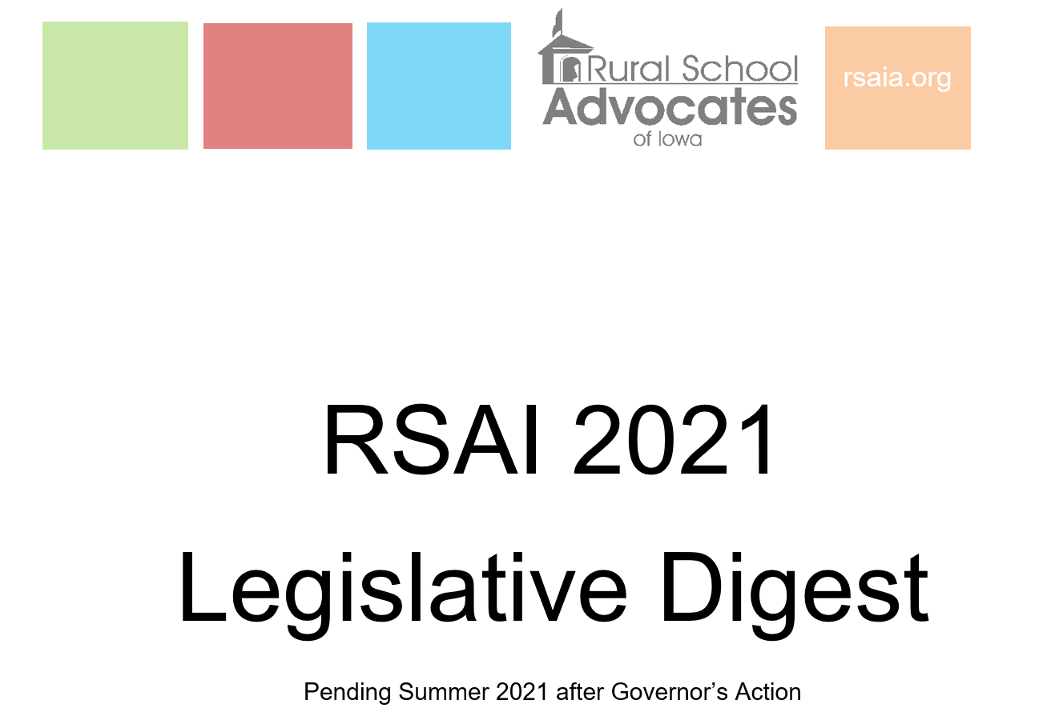

Slide 23
2021 Priority Language
Adequate School Resources: the increase in SSA should be no lower than anticipated growth in state revenue, not lower than 3.75% in FY 2022 due to abundant FY 2020 state surplus, maintain balanced state and local resources, be predictable, and assure adequate time for budget planning and staffing.

Slide 24


Adequate School Resources
SF 269 School Funding
SSA rate set at 2.4%, for both regular program district cost and categorical supplements (second highest in 12 years)
increases the base to promote formula equity by $10 per student (either more spending authority or property tax relief for your district)
includes property tax replacement by which the state assumes what would otherwise be a property tax increase due to the state cost per pupil increase
appropriates additional funds for transportation equity to reimburse all school districts for transportation costs above the state average.
House passed the bill 56-36, Senate passed it 31-18. Governor signed it on Feb. 23, 2021.

Slide 25
Adequate School Resources
HF 532 Qualified Instructional Supplement and PK Growth Funding (Senate Amendment) languished in the Senate – died as the Session concluded.
  still pending for 2022 Session, $27.2 million based on students served (balance to Title I distribution formula for federal funds)
  federal funds for PK enrollment growth for Fall 2021 in included in Education Appropriations HF 868
  Total $28 million, still well short of the $95 million annual state funding average for public schools over the last decade.
$36.5 M SSA
-15.0 M AEA cut
+ 5.8 M Formula Equity
+ 0.7 M Transportation
$28.0 Million
Due to nearly 6,000 student enrollment decline, SSA increase doesn’t cost the state much.
Concerns about PK: no on-time funding or budget guarantee.

Slide 26
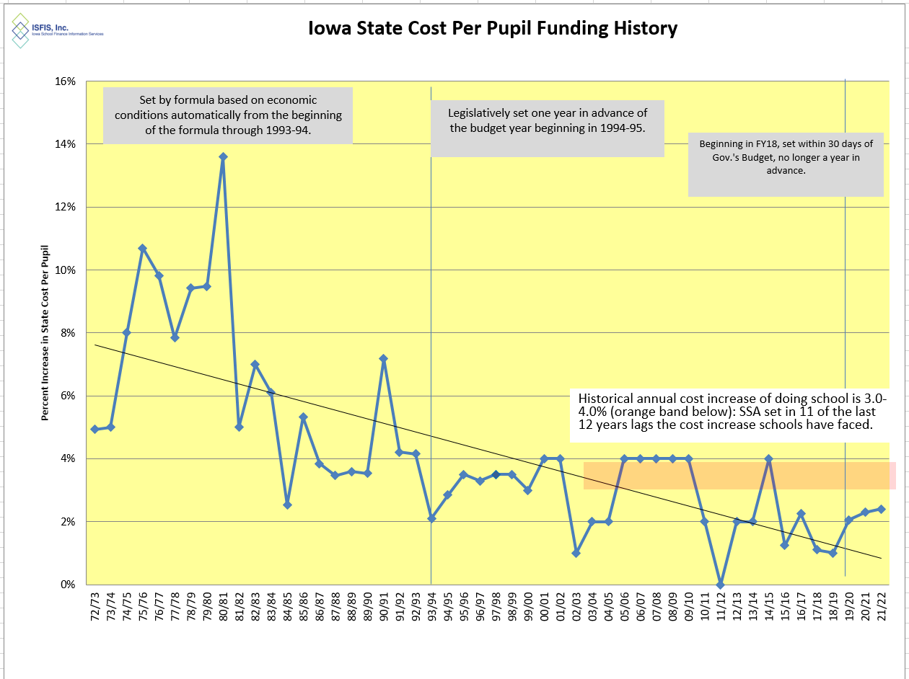
2.4% is the second highest since 2009-10.

Slide 27
Question of the day:
How many of our other RSAI legislative priorities would fall off the list if schools had been adequately funded in the past or were adequately funded going forward?

Slide 28

Student Mental Health

Slide 29
2021 Priority Language
Assessing and Addressing Staff/Student Social, Emotional and Behavioral Health: access to funded mental health services for children and supports for staff. Address the shortage of mental health professionals and provide resources over the next two years for local districts to train school staff based on a local needs and community capacity to collaborate for a collective solution.

Slide 30

Action Comments
SF 2360 in 2020 Classroom Management/Therapeutic Classrooms mirrors federal law in Least Restrictive Environment and sets up a grant process for additional therapeutic classrooms.
$2.1 million to start the pilots is in HF 868 Education Appropriations.
Increase to $3.2 million to the AEAs mental health training and student support and services in HF 868. Of that, $83,936 goes to DE to collaborate with a statewide nonprofit health care organization a children’s grief and loss rural pilot program ( submit report about expenditures and outcomes by Sept. 30, 2022.
SF 619 Telehealth Parity and State $ to replace property taxes for MH system
HF 868 MH Professional with SPR added to operational Sharing
Federal ARP and ESSER Funds may diminish urgency in the short term, but will not meet the needs of students over the long term.
Chipping away at it but this issue isn’t going to go away
Can school invest some ARP funds for a few years and make a difference to document what services can be provided at what cost that will benefit students?

Slide 31
2021 Session:
How did COVID closure impact mental health needs of students?
How about staff?
What about resources?
Do systems set up collaborative process for education, mental health, family and community stakeholders to assess and address mental health needs?
Can our federal investments in mental health show some success, to build upon the urgency for state action?

Slide 32
2021 Priority Language
Educator Shortage and Quality Instruction: maximum flexibility to hire staff to provide great instruction, including several strategies to attract and retain quality staff; flexibility to meet offer and teach requirements, loan forgiveness programs, a special education generalist credential, creation of a Public Service CTE strand, hire retirees without IPERS impact, and elimination of barriers to licensure.

Slide 33


Educator Shortage and Quality Instruction
HF 2627 in 2020 required licensure reciprocity with other states with 1 year of experience. BOEE rules process for implementation.
SF 466 Occupational Therapists can provide concussion services for extracurricular events – signed by Governor
SF 532 Licensed Behavior Therapists and Mental Health Professional Statement of Professional Recognition by BOEE. Pending Governor’s Signature.
HF 675 Substitute Authorization: allows AA degree for substitutes, process to extend beyond 10 days assignment to one classroom under certain circumstances.
HF 770 PD counts for ½ CEUs, either work on individual PD plan or courses offered by BOEE approved provider (AEAs, MISIC, etc.)

Slide 34
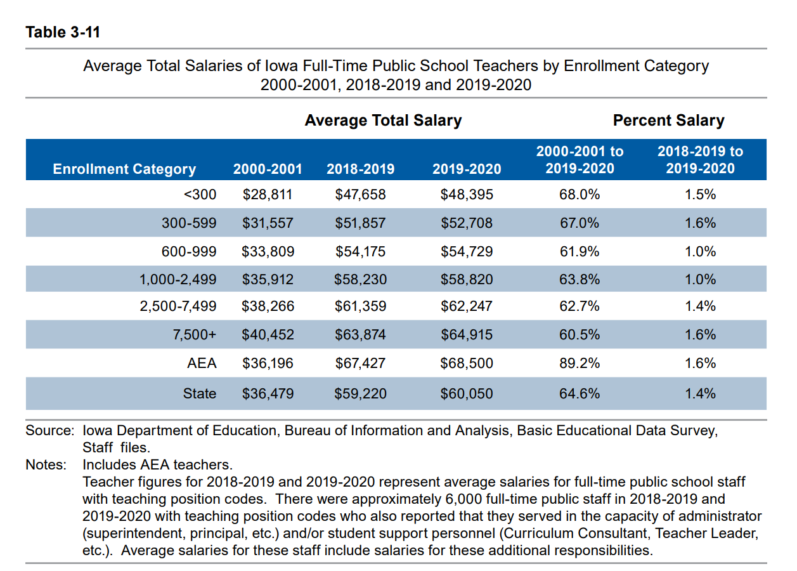
DE’s Annual Condition of Education Report shows average salary by school size (which is a good but not perfect predictor of rural districts), showing a growing difference in pay between the averages of the smallest and largest category of school size, now at $16,520, and more than $12,000 below the state average.
Rural schools tend to have younger teachers and lower class sizes, both of which can contribute to lower pay.

Slide 35
Geography and Sparsity Impacts Recruitment and Retention
Young teachers are not always willing to locate in a community with long commutes to amenities, so something has to make up for the lack of access to entertainment, housing, and other services.
Recent college graduate debt requires a high enough starting pay or other resource to help offset young teachers’ student loan payments.
Multiple preps and wearing many hats (teaching, coaching, etc.) may make it hard to keep young teachers drawn to other districts by higher salaries and fewer responsibilities.
Need for multiple certifications may require additional coursework, which can be a heavy lift for a new teacher/administrator

Slide 36
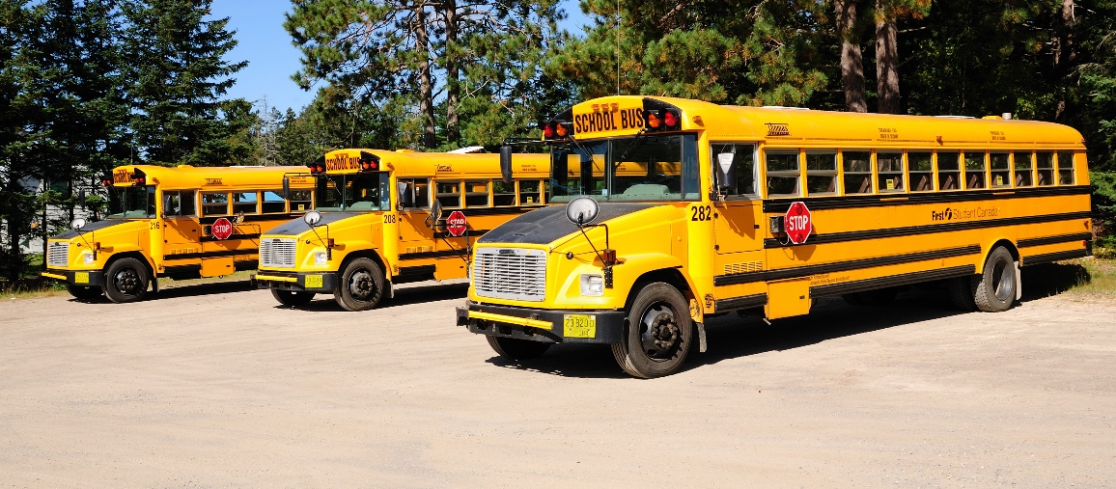
Transportation and Formula Equity

Slide 37
2021 Priority Language
Formula and Transportation Equity: formula equity, closing the state and district per pupil gap within ten years and continued transportation equity support without burdensome reporting requirements.

Slide 38
Transportation and Formula Equity
Included in the SSA bill this year, so done earlier and adequately funded.
Will grow by SSA rate annually (unless the legislature votes otherwise)
Another $10 drop in the equity gap – now moves to $145 per pupil statewide.
Set up for 2022: How does COVID interruption impact the annual transportation expenditures and report for the 2020-21 school year?

Slide 39
Opportunity Equity for At-risk Students/Poverty

Slide 40
2021 Priority Language
Opportunity Equity: resources based on at-risk need, in addition to enrollment. All school boards should have 5% dropout prevention funding. School districts should be granted spending authority for FRPL waived fees and Iowa should study the impact of poverty on educational outcomes.

Slide 41

Student Inequities and At-risk Needs
Despite the School Finance Interim Committee recommending and the House Education Committee approving a bill, HF 2490, the study of the impact of poverty on education and funding formula options to meet the needs of students did not advance out of House Appropriations Committee in 2020.
No bill was moved forward in either the House or Senate in 2021, taking a step backwards in the policy discussions.
FYI: Children from families with incomes at or below 130% of the poverty level are eligible for free lunch those 130-185% eligible for reduced lunch.

Slide 42
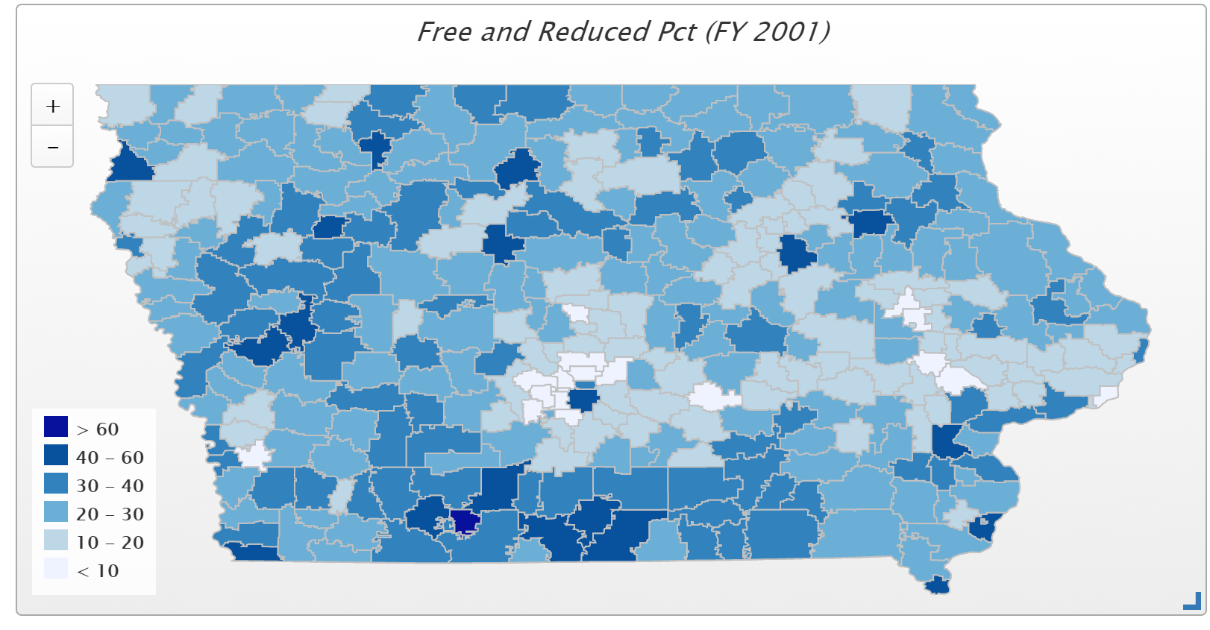
In 2001, only 4 districts had more than 50% of students eligible for FRPL (Waterloo, Keokuk, Wayne and Diagonal. Diagonal was the state high at 60.2% and the only district above 60%)

Slide 43
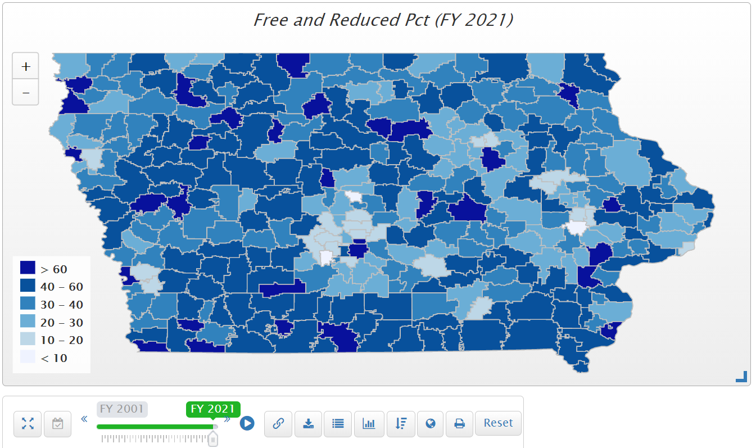
In FY 2021, of the 78 districts with more than half of their student on FRPL, 69 are rural. 30 districts have more than 60% of students eligible for FRPL. Those above 70% include Stratford, Postville, Rock Valley, LuVerne, Des Moines, Waterloo, Marshalltown, Denison, Clay Central-Everly, Storm Lake, Hamburg, South Page, Sioux City and Council Bluffs.

Slide 44
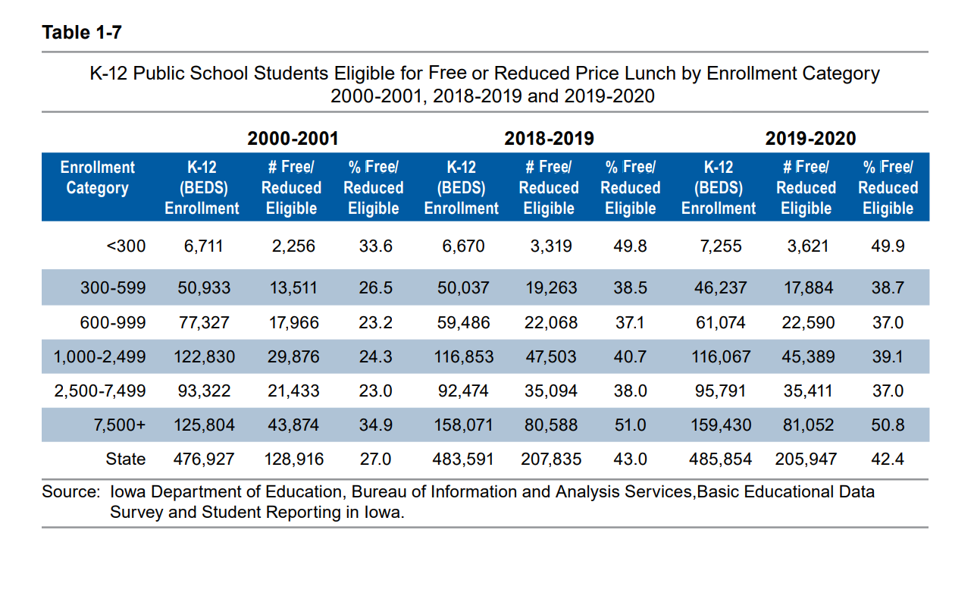
Districts in the largest and smallest enrollment categories had the highest percentage of students eligible for free or reduced price lunch (Table 1-7).

Slide 45
Poverty Concentration & $$
The McCourt School of Public Policy, Georgetown, FutureEd, State Education Funding; The Poverty Equation, March 2020, states,
  “What’s more, when poverty is concentrated in a school—that is, when a significant portion of students in a school come from low-income households—the impact on performance is compounded.
  A body of research suggests that there is a ‘tipping point,’ somewhere between 50 to 60 percent of a school’s students living in poverty, where performance for all students there drastically declines.”
Nevada Study in Oct. 2018 studied successful school systems and costed out the staffing models of instruction and other services to determine the appropriate weighting commensurate with the programs needed at around .35 (would equate to $2,467 per low-income student in Iowa’s 2021 formula)
Nevada School Finance Study, Augenblick, Palaich and Associates, Education Commission of the States, Picus Odden and Associates October 22, 2018

Slide 46
Funding Formulas in Iowa and Other States
Iowa’s formula provides a total of $148.9 million in 2020-21 for at-risk and dropout prevention programs
  Dropout Prevention MSA: $131.8 million
  At-risk weighting in the formula: $17.1 million
Total funding equates to $743 per Iowa low income student, except that funding is distributed to all districts with little weighting for low income.
  Dropout Prevention is between 2.5% and 5% of regular program district cost, based on enrollment and history.
  At-risk funding is partially based on FRPL percentage of the state’s total FRPL enrollment and partially based on total enrollment.
  If it were all allocated to low income students, it would equate to 10.6% weighting, less than half of the 26 state’s average commitment to at-risk students in 2012.
  By 2018, 47 states now provide at-risk funding based on poverty or other metrics, for a national average weighting of .22.

Slide 47
Iowa’s Resources are Enrollment Driven
Comparison of Van Meter and Cardinal funding for at-risk and dropout prevention per low income student exemplifies the formula:
School District | 2020-21 Enrollment | % FRPL eligible | FRPL Eligible Students | At-risk $$ | DoP$$ | Total $$ | $ per Low Income Student
Van Meter | 929 | 7.16% | 71 | $ 13,445 | $100,500 | $ 113,945 | $ 1,605
Cardinal | 949 | 55.22% | 522 | $ 22,215 | $146,132 | $ 168,347 | $ 323
Weighting of .35 = $2,467 in 2021, so even Van Meter’s funding is below the experts’ recommendations of resources to close the gap.

Slide 48
2021 Priority Language
Sharing Incentives/Efficiencies: extension of Whole Grade Sharing, Reorganization and Operational Sharing Incentives. The 21-student cap should expand to allow access to any new flexibility.

Slide 49
Reorganization and Whole Grade Sharing Incentives Extension
HF 847 Flexibility/Education Provisions adds a work-based learning coordinator position for operational sharing at 3 student weighting and adds a special education director position at 3 student weighting.
HF 868 Mental Health Professional who holds SPR issued by the BOEE as an allowable operational sharing position at 3.0 student weighting
The bill lowers all 3-student weighted positions to 2 and all 5 student-weighted positions to 4, for the remaining three years of the program (FY 2022-24). This bill was amended in the Senate and sent back to the House.
SF 156 would have added an information technology position to operational sharing and SF 74 would have added a School Resources Officer position. Both died in Senate Committees.

Slide 50
Reorganization and Whole Grade Sharing Incentives Extension
  2018: Extension of Operational Sharing Incentives through budget year beginning July 1, 2024
  2019: Extension of WGS and Reorganization Incentives for reorgs effective no later than July 1, 2024
  Incentives provide an impetus for districts to work together to deliver greater educational opportunities for students through WGS, either one-way, which 43 districts used in the 2019-20 school year or with two-way agreements, which 14 districts used. Three districts that previously participated in whole grade sharing were reorganized effective July 1, 2019, lowering the total number of school districts in Iowa to 327.
  In the 2020-21 school year, 255 districts also received operational sharing supplementary weighting. Of those, 101 districts qualified for the full 21 student weighting, or $148,008 per district.

Slide 52
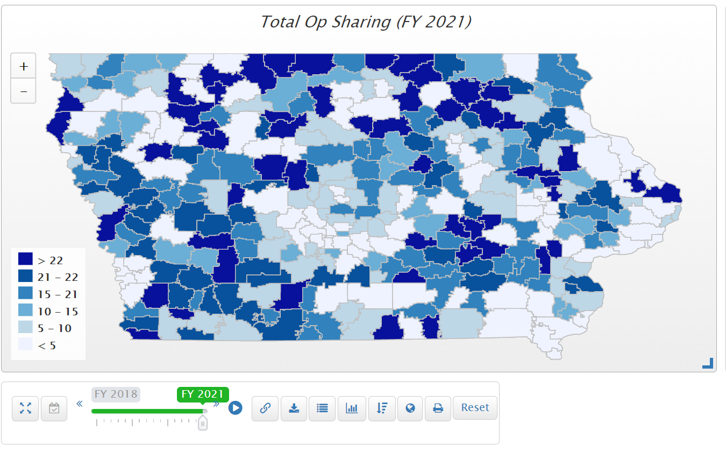
255 districts receive operational sharing incentives in the 2021 fiscal year. $26.9 million total.

Slide 53

Quality Preschool

Slide 54
2021 Priority Language
Quality Preschool: funding of quality PK at the 1.0 per pupil cost and formula protections against budget and program impacts of PK enrollment swings (budget guarantee/on-time spending authority).

Slide 55
Quality Preschool
HF 318 would allow districts to serve and count young 5-year-olds in PK, was approved by the full House, Senate Education Committee and Senate Appropriations Committee, but died on the Senate Calendar.
HF 532 Senate Amendment allows districts with increased PK enrollment to apply to SBRC for MSA. Will grant automatically if the PK ending balance for the prior year is less than 25%. Will allow a request and appearance to explain why it’s necessary if the balance is greater than 25%. As that bill did not move forward, the PK language was amended on to HF 868 Education Appropriations and was approved.
COVID-19 Impact: PK enrollments lower in Fall 2020. PK does not have an on-time funding component or budget guarantee, so next year’s PK budget will be based on this Fall’s enrollment count. Also, DE guidance prohibits school districts from using general fund for PK expansion. Note: Federal ESSER or ARP funds could be used for PK if funding from HF 868 process is not sufficient.
President Biden’s American Family Plan announced last week of April includes $200 billion universal 3- and 4-year-old PK. Details to be forthcoming but two things of import: $15 an hour minimum pay and state commitment for a portion of the cost will both be part of the deal. Not at all sure if it will get through the Senate, but it’s on the table.

Slide 56
2021 Priority Language
School Safety: school safety investments, including additional funding for security personnel and training to protect against emergency situations.
Bonding Capacity: a simple majority, 50% plus 1, voter approval for school bond issues and calculation of debt limit excluding debt backed by the SAVE.

Slide 57
School Safety
SF 74 would have added a School Resources Officer position to operational sharing, but did not advance out of the Senate Education Committee.
SF 258 would have allowed an increase in ISL funding for the costs of a School Resource Officer (SRO) position, was approved by Senate Education Committee, but did not move forward out of the Ways and Means Committee.
Identical “Safe and Sound at School” bills, authored by the Department of Public Safety, were introduced in both chambers SSB 1070 and HF 585. Would have set up a 24-hour anonymous hotline for tips, managed by the DPS, but would have created some expectations for schools to monitor and address complaints without any additional funding. RSAI opposed those bills.

Slide 58
Bonding Capacity/Simple Majority
No bills proposed to lower vote requirement for school bond issue from 60% supermajority to a simple majority (50% +1)
HF 568 Elections Omnibus: requires entities requesting the public measure on a special election date (not the school board election in November) to mail notifications to all households that include a registered voter eligible to vote on the public measure. The notification must include 1) Election date. 2) Hours during which the polls will be open. 3) Information on finding the voter’s polling place. 4) Internet site and telephone number of the county commissioner of elections. 5) Internet site of the State commissioner of elections.
House amendment S-3243 strikes this provision, but was sent to the Governor on the last day of Session, May 19. We have yet to analyze the enrolled version, which is not yet available to verify any other impacts.

Slide 59
2021 Priority Language
Internet Connectivity and Access: expanded access to high-speed Internet for all Iowans including incentives, investments, and creative solutions to close the technology gap for students, businesses and community members in rural Iowa. Low income should not be a barrier to internet access.

Slide 60
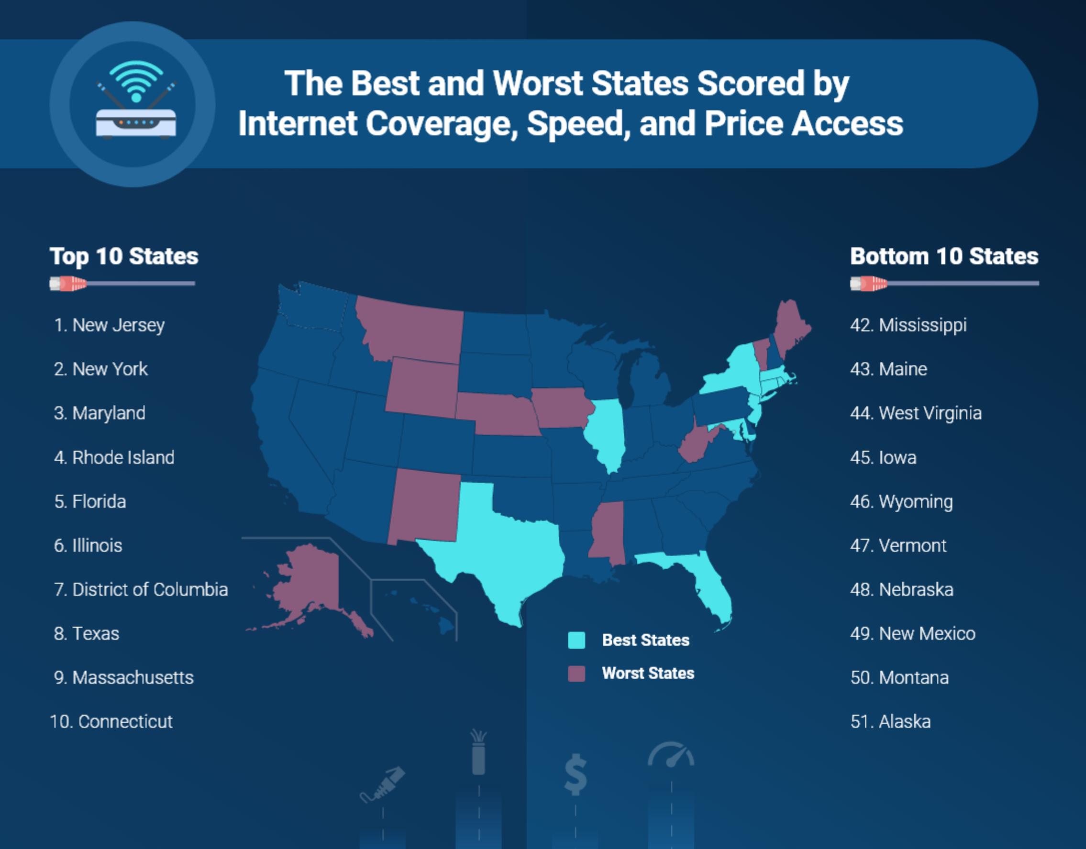
https://broadbandnow.com/research/best-states-with-internet-coverage-and-speed

Slide 61
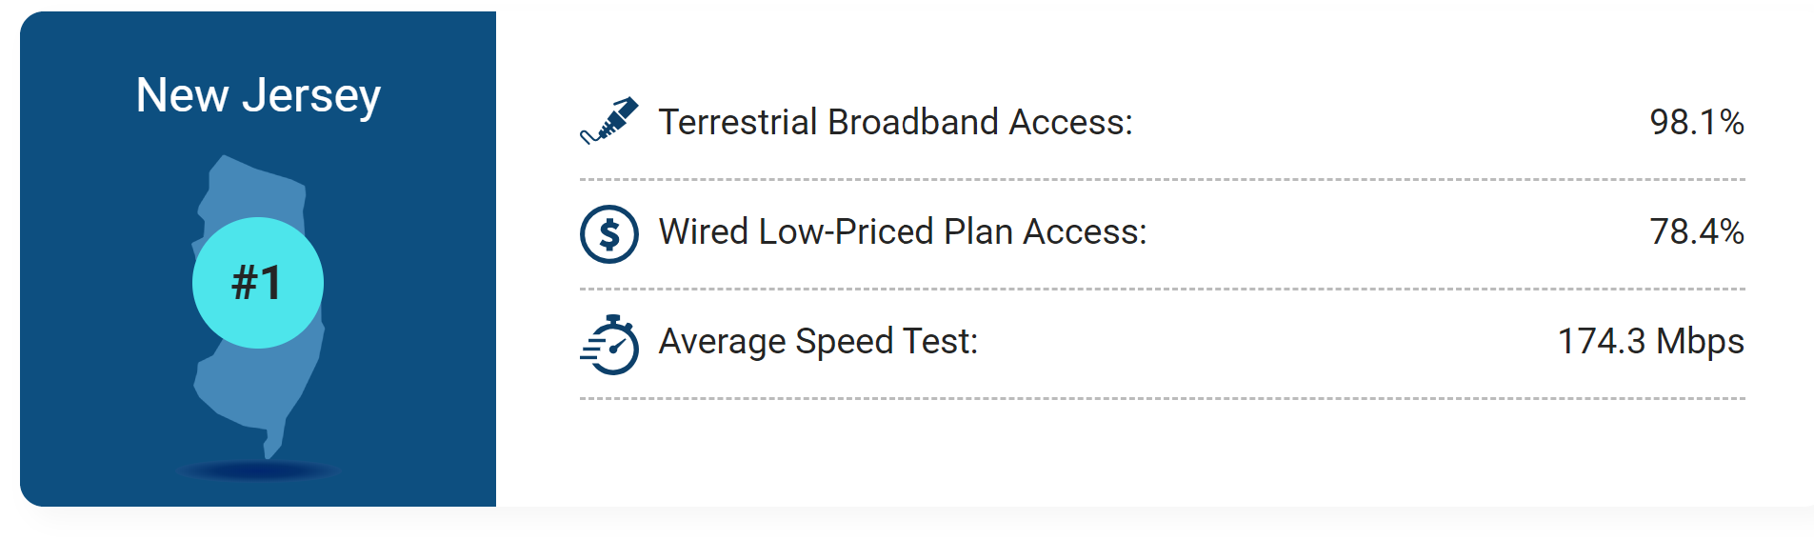
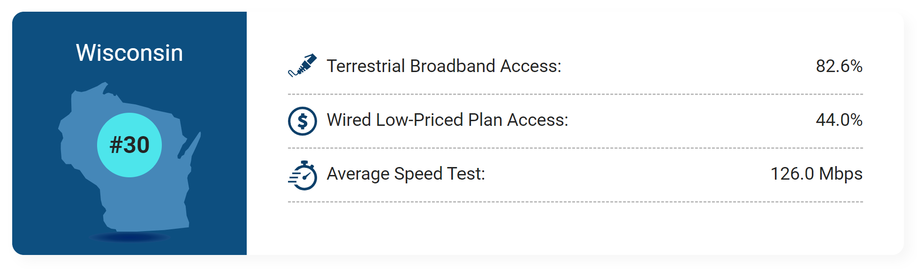
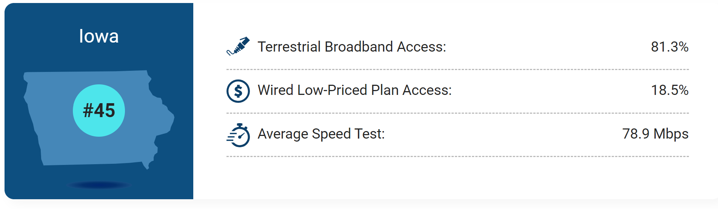
Access
Price
Speed

Slide 62
High-Speed Internet
ABC News, 4/28/21 https://khqa.com/news/local/governor-reynolds-bill-signing
Iowa has the second slowest broadband speed in the nation.
On Wednesday lawmakers committed $100M to expanding broadband access.
Broadband internet access has proven valuable for tele-health services, first responders and education.
16% of Iowa households do not have an internet subscription and more than 60% of Iowans live in areas with only one provider.
Governor Kim Reynolds says the goal is for providers to increase download and upload speeds to 100 megabits per second in area most in need.
Reynolds says, "In any case, areas of the least connectivity will soon experience a significant improvement in high speed internet and gain access to high tech and high touch services that come with it."

Slide 63
2021 Priority Language
Remote Learning and Instructional Time: local authority to determine when school should close, for emergency situations/safety, counting instructional time toward minimum instructional days or hours as long as engagement in virtual learning is required and needs of all students are anticipated and met.

Slide 64
2021 Priority Language
Local School Board Authority: locally elected leaders closest to the community are in the best position to determine the interest of students, staff and stakeholders. District leaders need maximum flexibility to provide a great education to all students. The Legislature, the Executive Branch and the courts should follow Iowa Code 274.3 and liberally construe statute to effectuate local control.

Slide 65
2021 Action
Governor’s interpretation of SF 2310 was the opposite of respecting local control. It inserted a step for DE approval rather than allowing school boards to make the best decision for their districts.
SF 160 Instructional Time was signed by the Governor Jan. 29. Required schools to offer parents a 100% in-person option beginning Feb. 15. 100% virtual or hybrid less than 50% only allowed by waiver from the DE due to COVID outbreak.
SF 467 On line Learning and Snow Days, was approved in the Senate but died the House Education Committee.
HF 847 Mask Unmandate: included a last minute amendment prohibiting schools (and cities and counties) from requiring masks unless it was otherwise required by law.
Many bills were stopped from moving forward due to unfunded mandates and intrusion on local control.
DE Rules for Online learning are moving forward. There is no mandate that virtual learning must be provided, so local control determines that offering.
However, RSAI has a long way to go before we operate under a value system that demonstrates the legislature believes school leaders know best for their communities.

Slide 66
Time to Discuss Legislative Priorities
On your agenda see the 2021 list or on the RSAI website https://www.rsaia.org/2021-legislative-session.html
    1. Are there any that need to be removed?
    2. Any that need to be added?
    3. Any significant (or suggested) wording changes on those already on the list?
We can go through them one at a time or consider the whole list with one vote. It’s completely up to the attendees to decide how to proceed.

Slide 67
RSAI 2022 Legislative Priorities
See the RSAI website meeting tab for more information such as RSAI Legislative Digest, Position Papers which will be updated after language is finalized during the process, Legislative Priorities, and this PPT and meeting minutes on the Regional Meeting tab. More information about the Oct. 26 Annual Meeting Coming later this Summer!
http://www.rsaia.org/

Slide 68
THANK YOU FOR YOUR VOICE on behalf of rural students!
Watch for RSAI Legislative Digest
RSAI Priority Survey later this Summer
Stay connected through the Interim
Let us know what you need to beef up your advocacy efforts.
See you at the Oct. 26 Annual Meeting!
Professional Advocate
Margaret Buckton, margaret@iowaschoolfinance.com
1201 63rd Street, Des Moines, IA 50311 (515) 201-3755 cell

