Slide 1

HO-1
This is the handout as well as the slides. Take notes on this document

Slide 2
Alzheimer’s disease is the 6th leading cause of death
1 in 3 seniors die with dementia
From 2000 to 2018 deaths from Alzheimer’s increased 146%
Alzheimer’s Association
HO-2

Slide 3
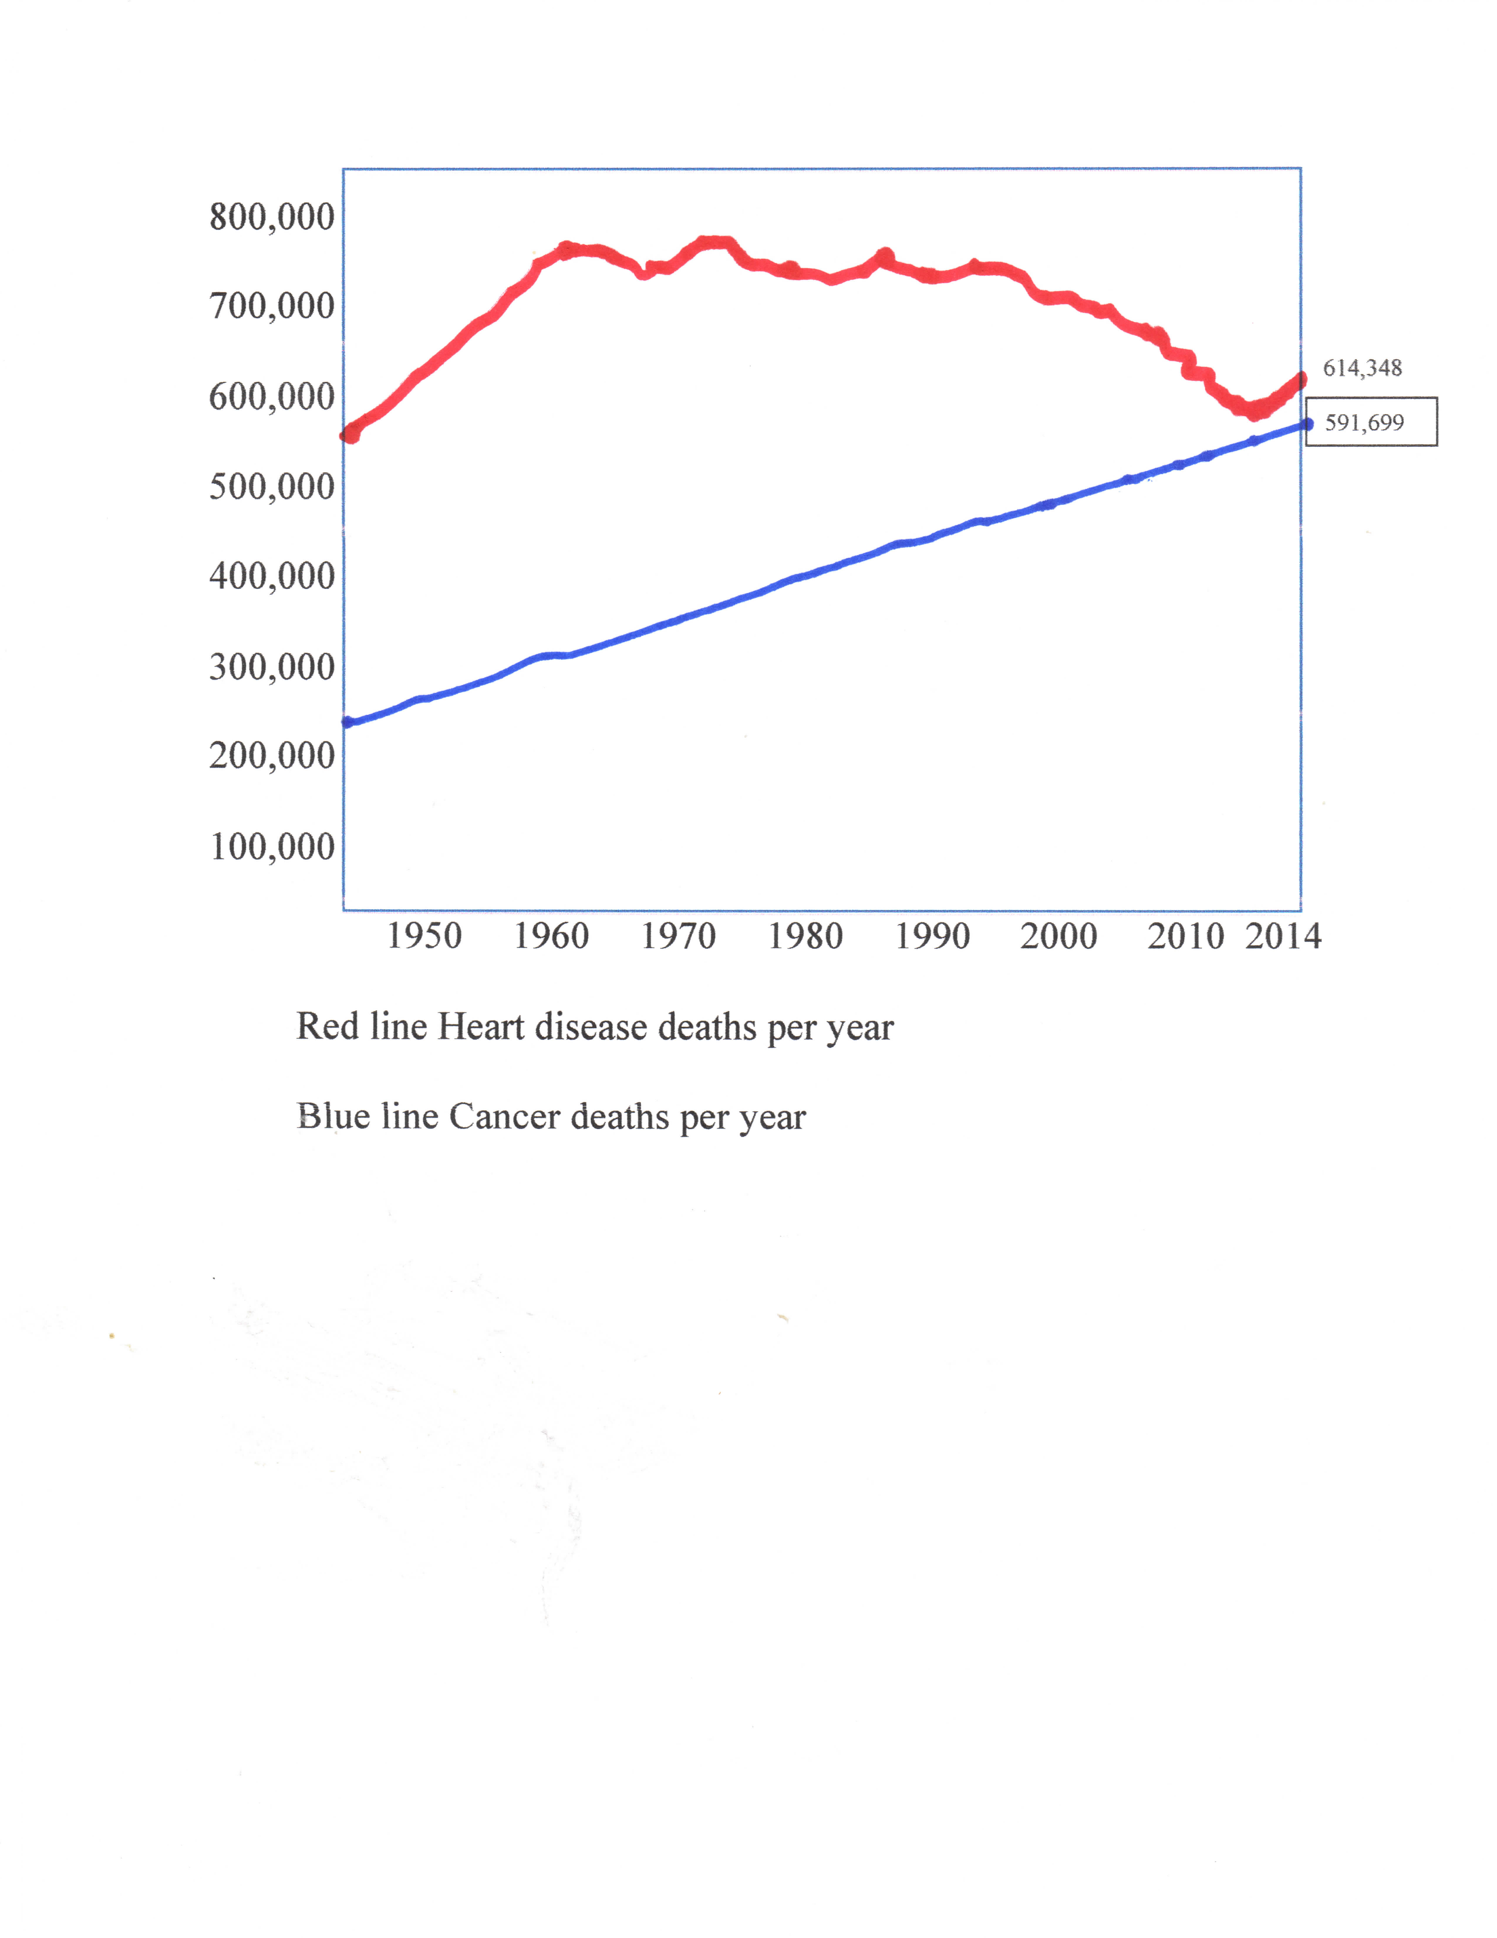
2020 statistics
Heart disease 647,000 ----
Cancer 606,000 -------
Data from CDC
HO-2

Slide 4
Total: 34.2 million people have diabetes (10.5% of the US population)
Total: 88 million people aged 18 years or older have prediabetes (34.5% of the adult US population)
88% of the adult population have at least one metabolic marker. (Low HDL,
High Blood Pressure, high A1c, loss of insulin sensitivity.)
From the CDC 2019
HO-2

Slide 5
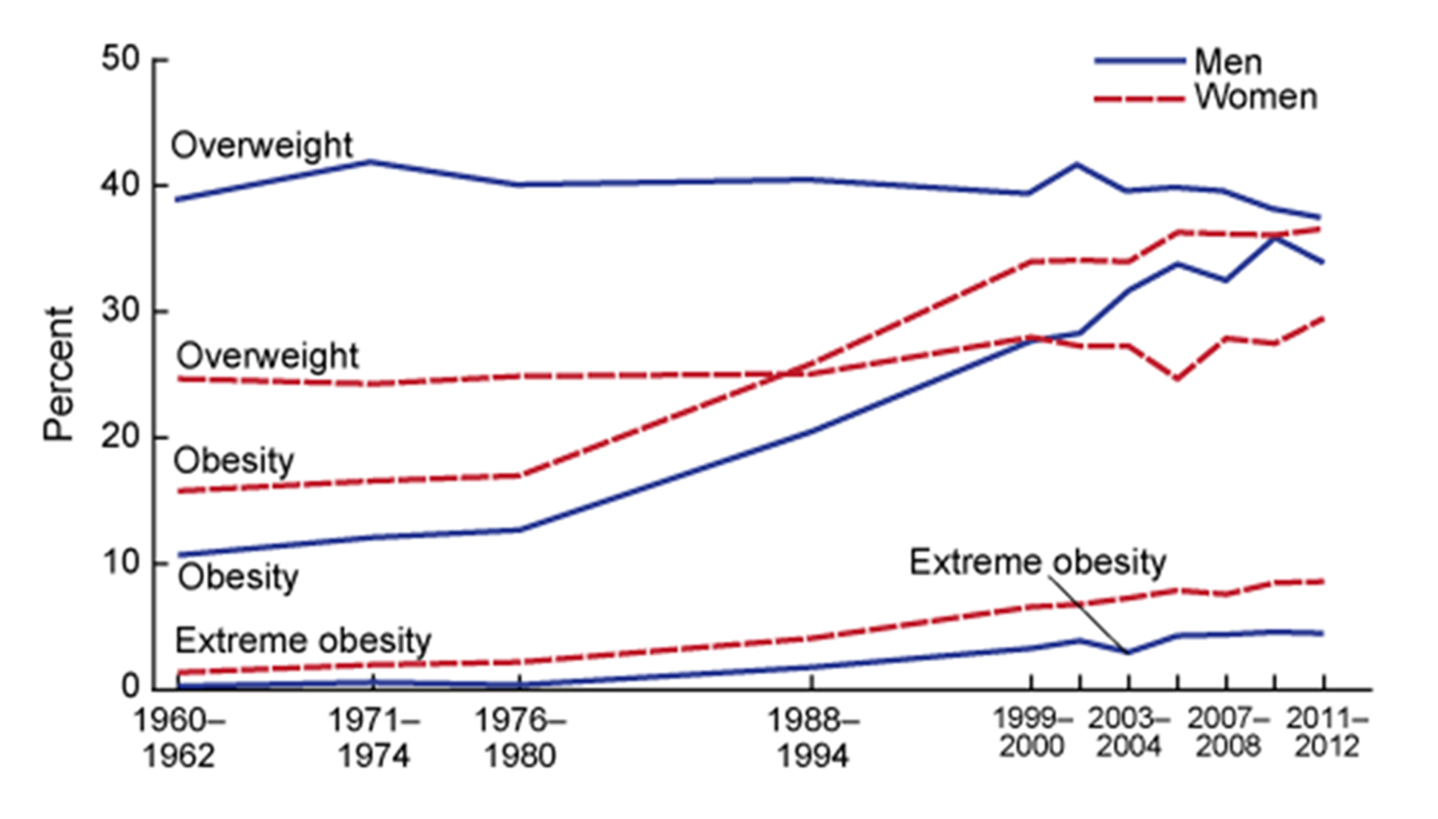

Slide 6
What has changed?
Social media
Video Games
Pornography
24-Hour news
Decrease in smoking
Sugar consumption
Saturated fats to omega 6 oils
Cleaner air
Cleaner water

Slide 7

List in approximate order describing a trip through a short and unhealthy life.
  Visceral fat, fatty liver and fatty pancreas.
HO-3
Laos May 2016

Slide 8
  Metabolic syndrome Low HDL, high A1c, high blood pressure
  Obesity
  Reduction in activity
  Problems with mobility, knee and hip problems
  Stroke or heart attack
  Fall fractures
  Diabetes
  Cancer
  Amputations caused by diabetes
  Alzheimer’s

Slide 9
Causes of Inflammation:
Anxiety
Anger
High levels of insulin
Toxins
Inactive proteins in cells
Damaged mitochondria
Fatty liver
Fatty Omentum
Sleep deprivation
Excess proteins
Omega 6 oils
Trace element deficiency or excess
Wrong intestinal bacteria

Slide 10
What inflammation causes:
Damage to the heart
Damage to tissue that causes cancer
Buildup of damaged tissue in the brain (Alzheimer’s)
Liver damage that frees more toxins for further damage
Immune system damage
Improper immune system activation that causes allergies
Improper immune system activation that causes autoimmune diseases
Loss of bone mass that leads to broken bones
Type 2 and type 1 diabetes

Slide 11
How did we get here?
Ansel Keys fish biologist. (K rations)
FDA is now run by the soft drink and food companies

Slide 12
Big food- Kraft Heinz, Cargill, General Mills, Coca Cola …
$↓
↓
FDA, American Diabetes Association, Medical schools, Researchers, etc.
Big food controls research!
Lesser, L. I., Ebbeling, C. B., Goozner, M., Wypij, D., & Ludwig, D. S. (2007). Relationship between funding source and conclusion among nutrition-related scientific articles. PLoS Medicine, 4(1), 0041–0046. https://doi.org/10.1371/journal.pmed.0040005

Slide 13
Sugar consumption per person
1814 2 pounds per year
1970 123 pounds per year
2014 152 pounds per year
Consuming 152 pounds of sugar in one year is nearly 3 pounds per week
(NH Health, 2014)

Slide 14

Bad advice
Eat less (calorie restriction)
Exercise
Low fat
laxatives
Diet pills
Advice that worked
Low Carbohydrates
High fat, No dairy
Washed down with wine was not part of the advice but it worked
5 feet 5 inches 200 pounds to 156 pounds in one year
William Banting 1864

Slide 15



Slide 17
Sugars and starches → Disassembly → Glucose
↓ ↓
┌← ← ← ← ← ← ←┘ blood
↓ ↓
↓ Insulin →→ ▼
↓ ↓
↓ Energy or Glycogen or Fat
↓
Fructose →→→ Brain causing glycation damage
↓ and increasing hunger hormone.
↓
Liver→ Fat → (Fatty liver Disease, Cancer)
Fat → Omentum (Metabolic Syndrome)
Fat → Pancreas (Damage or Possible Cancer)
Fat → Small particles of fat in the blood (possible clots)

Slide 18
BMI Group MetS Sample Pre-Incidence of HF, n (%)
Normal No 109 17 (15.6)
Normal Yes 68 43 (63.2)
Overweight No 127 18 (14.2)
Overweight Yes 107 51 (47.7)
Obese No 43 4 (9.3)
Obese Yes 96 52 (54.2)
Sucrose (Table sugar) is approximately 45% Fructose and 55% Glucose.
High fructose corn syrup is approximately 45% Fructose and 55% Glucose.
The sugar in fruit Juice is approximately 45% Fructose and 55% Glucose
The sugar in soft drinks is approximately 45% Fructose and 55% Glucose
Honey is approximately 56% fructose to 44% glucose,

Slide 19
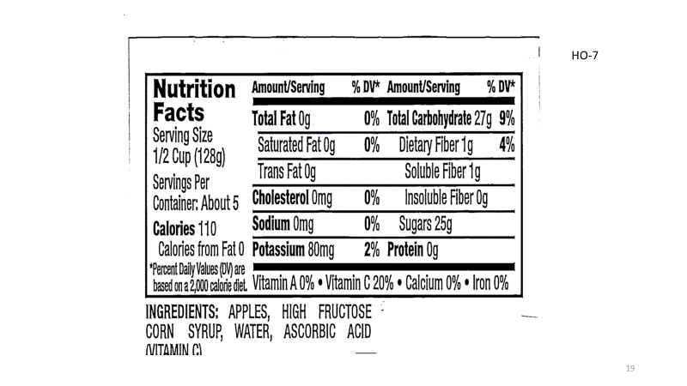

Slide 20
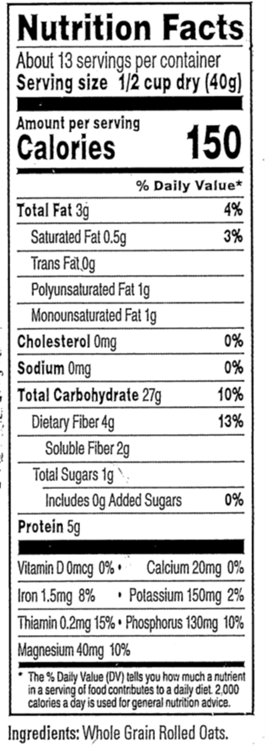
When checking labels assume a 2,000-calorie diet with 1,000 or less carbohydrates.
6 grams of fiber for 150 calories would be 40 grams of fiber for 1,000 calories.
Sugar is from processing and is unlikely to be fructose.
Ripe fruits use fructose to encourage animals to eat them thereby spreading the seeds
5grams of protein for 150 calories is 33 grams in 1,000 calories.

Slide 21
Recommended protein consumption per day for an active person
Weight in pounds
Age 100.0 120.0 130.0 140.0 150.0 160.0 170.0 180.0 190.0 200.0
18-60 49.9 59.9 64.9 69.8 74.8 79.8 84.8 89.8 94.8 99.8
60-70 59.0 70.7 76.6 82.5 88.4 94.3 100.2 106.1 112.0 117.9
70-80 68.0 81.6 88.4 95.2 102.0 108.8 115.6 122.4 129.2 136.1
80-90 77.1 92.5 100.2 107.9 115.6 123.4 131.1 138.8 146.5 154.2
90-100 81.6 98.0 106.1 114.3 122.4 130.6 138.8 146.9 155.1 163.3
Required to avoid sarcopenia Required consumption in grams

Slide 22
Fats do not make you fat. It is quite the opposite fats help you become thin.
Fats from plants are any length and are mostly unsaturated.
Unsaturated fats can become oxidized in blood lipids and not able to be used by tissue.
These fats can form plaques on arteries.
Fats from plants contain inflammatory Omega 6 fatty acids.
Fats from animal sources (butter, lard, tallow) are mostly saturated.
They are on average shorter chain than plant fats and contain less omega 6 fatty acids.
Consumption of saturated fats reduces the risk of stroke.
Omega 3 fatty acids are anti-inflammatory, they are required by the metabolic system.
Frying with unsaturated fats produce cacogenic aldehydes

Slide 23
U curve
Caffeine: Not required
Alcohol: Best in moderation
Trace elements and supplements: from a multi vitamin
Calcium: 1,500 mg are need.
Magnesium: 500 mg are needed most are deficient.
Iodine: 150 mg are needed. Do not use sea salt. (Mental retardation)
Vitamin D: 1,000 IU are needed.
Potassium: 4,500 mg is recommended most are deficient.
Sodium: Natural consumption is from 3,000 to 5,000 mg. (Birth defects)
Vitamin C: 100 mg + Vitamin C is not stored by the body.
Turmeric: Use a supplement for 2,000 mg
Folate: Reducing carbohydrates may reduce folate. Use a supplement
HO-11

Slide 24
Exercise is not a weight loss strategy. Exercise is a health strategy.
Diet alone 8.5% weight reduction
Exercise alone 2.4% weight reduction
Both 10.8% weight reduction
Control No weight reduction
Use some aerobic high intensity intermittent for circularly health. Use weight bearing for bone and muscle strength to reduce tears and fractures. One hour per day is enough.
Modest exercise has little to do with overall daily metabolic rate. Basal metabolism is most of calories used.
Modest exercise is best. There is a U curve.
Jim Fix died at age 52 of a heart attack.
High intensity long duration causes arterial calcification.

Slide 25
Sleep
Schedule 9 hours if possible.
Don’t worry about not falling asleep.
Don’t do any activities, watch exciting TV or engage in activities that increase heart rate before bed time. https://www.healthline.com/
Light from Electronics
Blue light tells brain it is morning, Red light says it is night
Warm White is red shifted. Cool white is blue shifted.
Artificial sweeteners
Avoid Splenda® (Sucralose). It is chlorinated sugar. It is bad for you and the environment.
The others are OK.
Erythritol is good because of two of its side effects It protects the cells that line the artery from excess sugars. It also decreases blood pressure by both the arterial protection and by dilation of blood vessels. It is a laxative in large quantities.
HO-13

Slide 26
Fasting
Autophagy
Ghrelin and circadian rhythm
Ketosis
Reduction of seizures
Cures type 2 diabetes
Diet Considerations
Dairy hormones,
Eggs have carbohydrates
HO-13,14

Slide 27
Vegetables and seeds do not want to be eaten
Show: http://www.ijrap.net/admin/php/uploads/1490_pdf.pdf
Fruits want to be eaten by a vector when ripe and seeds survive vector digestive system. Strategies
Dairy: Casein, Lactose
Gluten
Carnivore diet and variations
Intestinal biome
Antibiotics
Probiotics, Prebiotics

Slide 28
Stay hydrated not overhydrated
Eliminate unsaturated vegetable fats like corn oil, soybean oil and other seed oils.
Use saturated fats Lard, Butter, Coconut oil, Palm oil or Tallow.
Eliminate all added sugars. Bliss point
Limit Carbohydrates
Cruciform vegetables
Schedule sleep and eliminate blue light at least two hours before bedtime.
Use a multivitamin, magnesium, calcium with vitamin D, Turmeric, vitamin D3 and vitamin C supplements.
Omega 3
Exercise aerobic, weight bearing and three short periods of high intensity exercise.
Intermittent fasting
Fiber from vegetables
Protein
Limit fruit

Slide 29
Lifelong Plan for a long and healthy life:
• Kick the caffeine habit and only use Caffeine for times when extra physical or mental demands are expected.
• It is important to stay hydrated without drinking to excess and losing too many minerals.
• Everyone should eliminate unsaturated vegetable fats like corn oil, soybean oil, and other seed oils.
• Everyone should eliminate all added sugars. No sugar soft drinks, no cookies, no candy, no sugar-containing cereals, no packaged foods with any sugar, no fruit juice, no ketchup, no salad dressing with sugar.
• Limit Carbohydrates to 25% of calories or less.
• Use MCT oil or olive oil for salads only. Cook with saturated fats Lard, Butter, Coconut oil, or Tallow.
• Eat at least one serving of cruciform vegetables at least 2 times each week.
• Schedule at least 8 hours of sleep and eliminate blue light at least two hours before bedtime.
• Use a multivitamin, magnesium, calcium with vitamin D, Turmeric, vitamin D3, and vitamin C supplements.
• Consume some fish or take an Omega 3 supplement or both.
• Exercise at least three times a week. This exercise should include aerobic, weight-bearing, and three short periods of high-intensity exercise.
• Do some intermittent fasting at least twice a week.
• Consume at least 20 grams of fiber per day.
• Consume the recommended amount of protein as shown in the tables
• Limit fruit to one serving a day or less. Berries are the best. (least fructose)
For someone that is not diabetic, prediabetic, or obese simply doing what is suggested above should be all that is necessary for leading a long life without unnecessary infirmities.
For diabetics and stopping Alzheimer’s restrict carbohydrates to 10% or less.

