Slide 1
How the MCCPTA Pieces Fit in the MCPS Puzzle . Cynthia Simonson, VP of Educational Issues

Slide 2
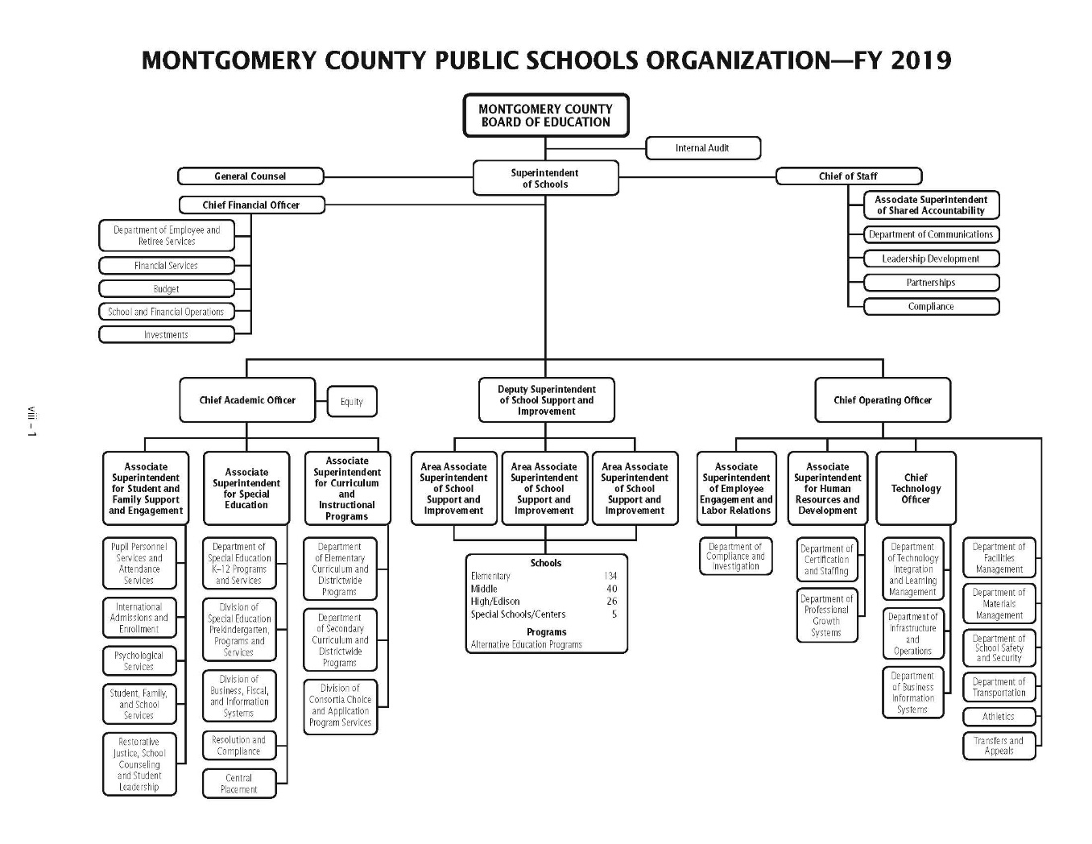
https://www.montgomeryschoolsmd.org/uploadedFiles/departments/FY2019-OrgChart.pdf
Notes:
MCPS Org chart -- https://www.montgomeryschoolsmd.org/uploadedFiles/departments/FY2019-OrgChart.pdf

Slide 3
Basic Structure – How We Fit
MCPS
MCCPTA
Executive Level
Smith, Statham, Navarro, Zuckerman
Associate and Area Superintendents
Brice, Lowndes, Collins (interim), Morris, Williams, Dyson, Cevenini
OSSI Directors
Sirgo, Wilson, Zarchin, Morrow, Moran, etc.
Executive Committee
Pres, VPs, Treasurer, Secretaries
Committee Chairs and Area Vice Presidents
H/S, Curriculum, GCC, SPED, ESOL, CIP, North, Central, etc.
Cluster Coordinators
25 clusters throughout the county
Notes:
At the “Executive Level” – we are often talking about impacts of federal and state mandates, funding issues, and school wide concerns. Examples:
Assessment requirements of ESSA vs. MSDE implementation (PARCC)
Graduation requirements of MSDE and integration into MCPS pathways (e.g., timing of tech credit)
Funding for security measures – priority schools and schedule for those renovations
Assoc/Area Sups and Committees – discusses “big topics” and what our parent might expect going forward. It is raising key concerns (often citing items put on the elists or passed along by cluster coordinators). Examples:
Safe Tech meeting with Cevinini and getting those insights leads to Lisa putting items out on elists for everyone’s benefit.
SPED raises concerns to Lowndes regarding parents having difficulty getting reports – can notify parents “if you ask for a report, they should provide”
Area VPs talking to Area Associate Sups about schoolwide implementation concerns – where implementation is uneven, how communications work
OSSI Directors and Cluster Coordinators – On the Ground concerns – these may be cluster wide or school-by-school.

Slide 4
Director/Cluster – Conversations
This is the conversation about what is happening in our schools!
Directors
Principals
Cluster Coordinator
PTA Presidents
Notes:
School Level Accountability –
Directors and Cluster Coordinators work collectively to ensure the school is functioning well.

Slide 5
Why BOD Reports Are Important
Look at Cluster Reports (and submit yours each month) so we can learn from each other!
Are there questions, opportunities, events, or concerns that we want to raise or implement in our cluster?
Review the Committee Reports to see what is being talked about in the Committee-Assoc Sup Meetings
Helps identify concerns (or opportunities) being discussed countywide, creates opportunity to discuss intersecting committee interests, and fosters school-level discussions.
Review the Executive Committee Reports to see the “high level” conversations and where the system is being steered
Can provide ideas about what is coming but also help clusters and committees understand how all the pieces fit together!

Slide 6
Like, in this month’s reports --
RM Cluster – Asking for a library inventory, Reading Level/Lexile Changes (Huh... Something about Lexile in Curriculum Report too – I should ask my elem schools)
Wootton and RM both mention “Cluster Meetings”
QO -- Creating a local officer e-list (Effective!)
Paint Branch CCs – Attend local PTA meetings (Hmmm)
Curriculum Report -- AP/Grade correlation, Course Issue Trajectory Concerns – Note to raise with OSSI
Operating Budget – Save dates and put on locals radar
VP of Ed – Well, that is just FULL of BRILLIANT info!

