Slide 1
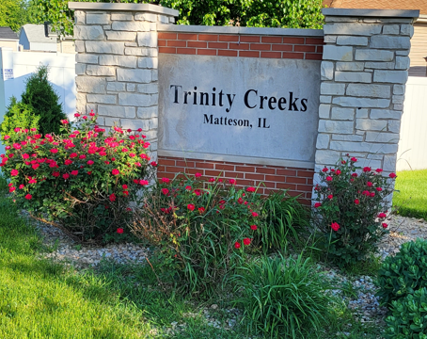
Trinity Creeks
HOA General Meeting
3-19-2025
7:00pm-8:00pm
Zoom Meeting

Slide 2
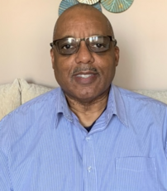
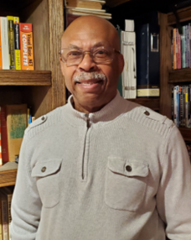


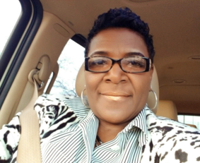
2025 Trinity Creeks HOA Board Members
Willie Johnson
President
708-267-2008
Kevin Richard
Treasurer
708-355-1609
Melody Seaton
Director
773-550-1681
Victoria Hill
Secretary
773-576-7736
Regina Brown
Director
773-368-8186
Patrick Peterson
Director
312-388-9661
Notes:
If there’s an emergency
Have a question

Slide 3
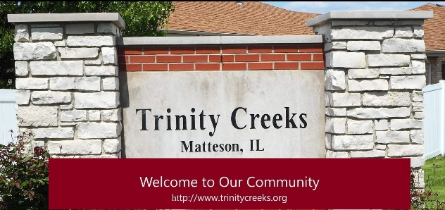
Trinity Creeks Homeowners Association
General Meeting
Match 19, 2025
Agenda
Welcome and Introduction of Guests Willie Johnson
Trinity Creeks Park Updates Village of Matteson
Village of Matteson Updates Village of Matteson
Wetland Discussion Regina Brown
2025 Garage Sale Victoria Hill
Beautification Committee Victoria Hill
Financial Update Kevin Richard
Question & Answer Willie Johnson

Slide 4
Thank you
Community is not just where we live; it's where we belong, where we connect, and where we thrive together!

Slide 5
Trinity Creeks Homeowners Association Mission Statement
The mission of the Trinity Creeks Homeowners Association is to promote a resident friendly neighborhood, where residents enjoy an enhanced quality of life, and assures that the value of their homes will be protected. Through the administration of the Declaration of Covenants and applicable local ordinances, the Homeowners Association seeks to collaborate with its members now and in the future toward common goals.
Declaration of Covenants, Conditions and Restrictions – Trinity Creeks Subdivision Matteson, IL
Article V, 5b
Purpose and Use of Assessments: All assessments levied by the Board shall be for the purpose of insuring high standards of maintenance, repair and replacement of the entrance signage monument and adjoining landscaping. Such purposes and uses of such assessment shall include (but are not limited to) the costs of the Association of all legal, insurance, repair, replacement, maintenance and other charges by this Declaration of Covenants, Conditions and Restrictions, or that the Board of Directors of the Association shall determine to be necessary or desirable to meet the primary purpose of the Association.
Notes:
Proposed mission from Willie…
The mission of the Trinity Creeks Homeowners Association is to promote a resident friendly neighborhood, where residents enjoy an enhanced quality of life, and assures that the value of their homes will be protected. Through the administration of the Declaration of Covenants and applicable local ordinances, the Homeowners Association seeks to collaborate with its members now and in the future toward common goals. This is our Mission Statement and listed below are some of the projects for a grant.
Improvements to the Community such as Landscaping, Outdoor Summer Events and indoor Winter Events to bring the community together, park renovations, and helping Seniors with snow removal. Improvement in Infrastructure such as streets and driveways and security cameras in the neighborhood.

Slide 6
Agenda Details
Welcome Willie, President
  Welcome everyone, happy holidays, and thanks for joining.
Park Updates Willie, President
  The gazebo has been ordered and is currently stored in the Village garage per Edgar who is working in Gordon’s absence.
  The original builders were expected to complete the park but did not follow-through.
  We plan to purchase a shed to store items needed for block parties and park events. Security options are being explored to ensure the items remain secure.
  The HOA will manage park access and determine who is allowed to use the space. The Village will handle the property’s maintenance and cover the taxes.
  Willie will send a letter to the Mayor in January to ensure progress continues and maintain open communication.
Holiday Party Feedback Willie, President
  Willie thanked the committee for all of the hard work. The purpose of the party was to get to know our neighbors and have fun.
  Smitty and his wife enjoyed the party and felt that everyone who attended had a great time.
  Judson shared that he felt the event hours (6pm – 11:30pm) were too long. He also noted the music was too loud for conversations, the raffle was boring, and the party wasn’t perfect.
  Diane suggested asking residents what activities they would like to see in the future. This will be included in the survey being sent to the residents who attended the party.
  Melody said the party was fantastic, thanked everyone for their hard work, and said everyone did a great job.
  As a reminder, we had an open bar, dinner, saxophonist, comedian, DJ, dancing, picture taking, and raffle prizes,
  A few pictures can be found on pages 5 – 10, showcasing Dexter’s great photography work. If you’d like to see all of the pictures, visit our Trinity Creeks Facebook page or text Victoria at 773-576-7736.
Garage Sale Wille, President
  We need to select a date for the garage sale when the weather is warm.
  A dumpster will need to be rented, and a sign should be attached to indicate it is for Trinity Creeks use only, not for general dumping.
  It was suggested that we start the garage sale earlier, around 7:00am, as that’s when most people attend those types of events.
Financials Kevin, Treasurer
  Late Fee Amendment – Effective January 1, 2025, a $25 late fee will be charged per quarter for overdue assessment dues. However, residents who establish a payment plan will not be required to pay late fees.
  Residents who are not current on their assessment dues will not be issued permits for home repairs.
  The amendment was sent to all households via U.S. mail and has been filed with Cook County.
  Holiday Party Budget – only $786 of the $2,000 holiday party was spent.
  If would like a copy of Trinity Creeks’ Expense/Income sheets, please contact our Treasurer, Kevin Richard.

Slide 7
Agenda Details
Q & A Willie, President
  We need volunteers to help put up the Christmas decorations in the future.
  Can we send reminders to residents about securing their garbage to prevent it from blowing around? It may also be helpful to look into placing signs around as reminders.
  We should ask the Village to flush the fire hydrants annually to ensure they are functioning properly. Also, the hydrants need to be painted.
  When residents park on both sides of the street, it limits space for vehicles, especially emergency vehicles, which could cause a safety issue. It was clarified that the Village Police Department allows parking on both sides of the street for special occasions when residents have many guests. Guests can contact the Police Department to request parking permission. Once approved, it is considered legal and only happens occasionally.
  Stay Connected
    Join our Trinity Creeks HOA Facebook page to stay updated on all community news.
    To review monthly board meeting minutes or general meeting minutes for Trinity Creeks HOA, visit our website at www.TrinityCreeks.org and check the minutes tab.

Slide 8
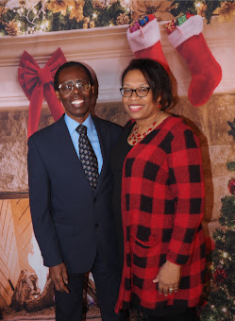
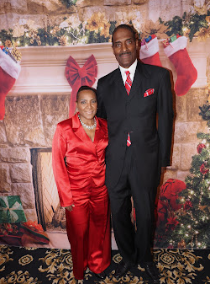
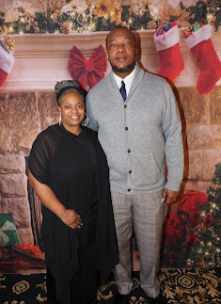
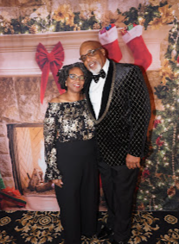
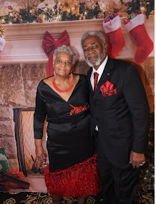

Slide 9
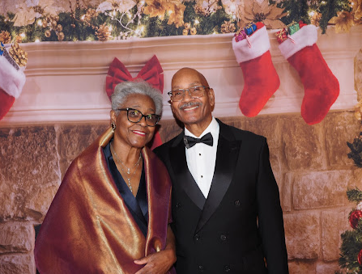
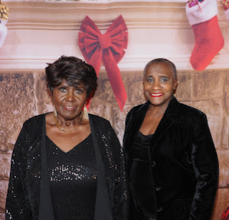
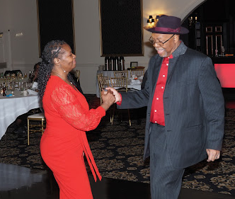
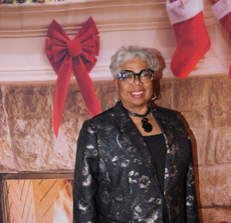
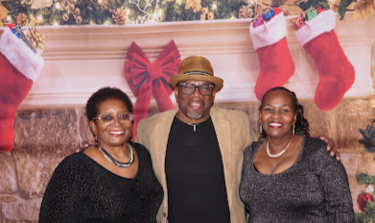

Slide 10
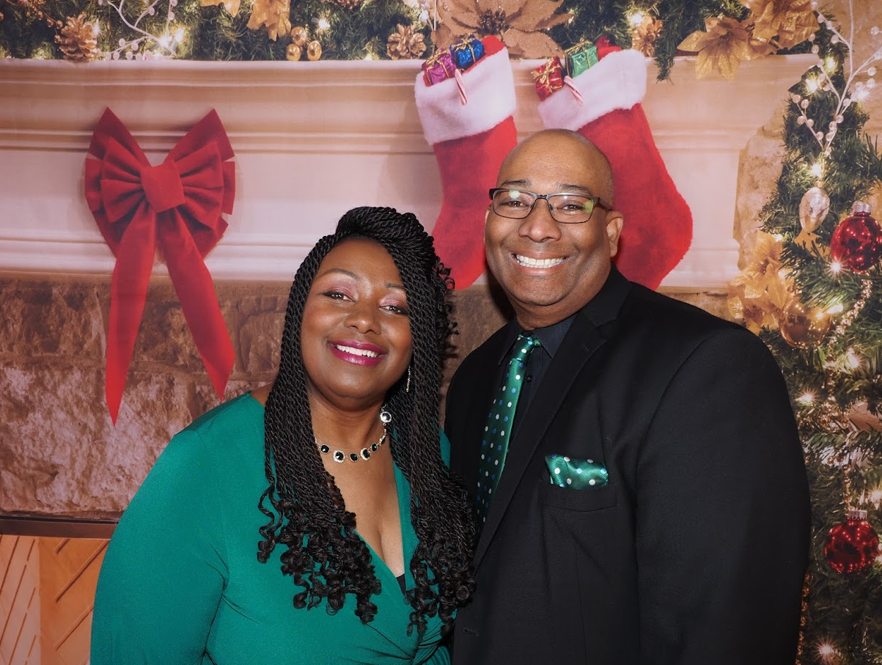
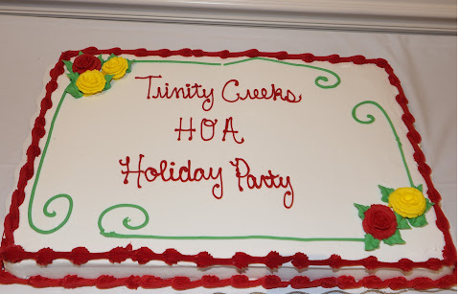
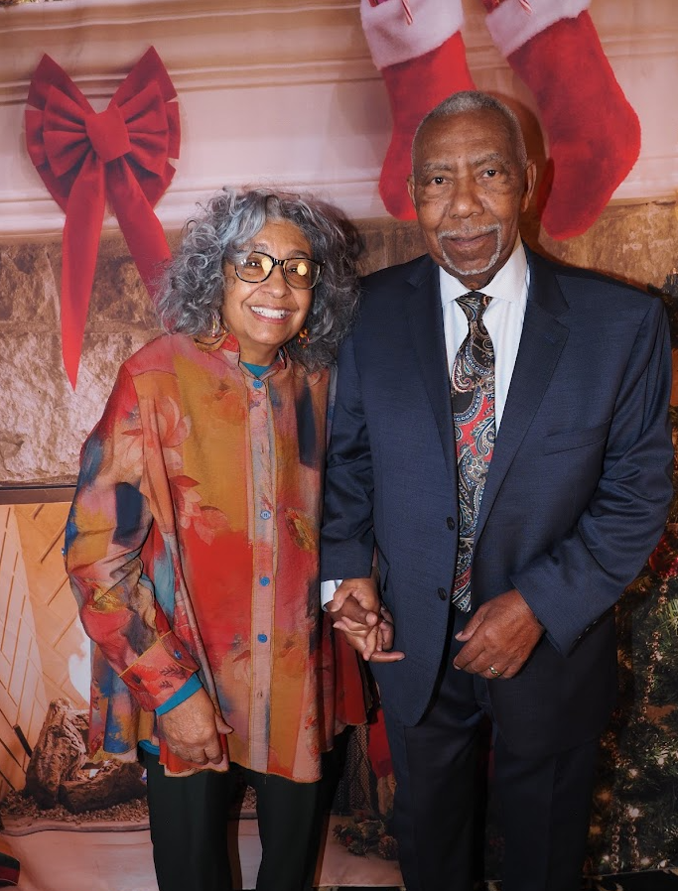
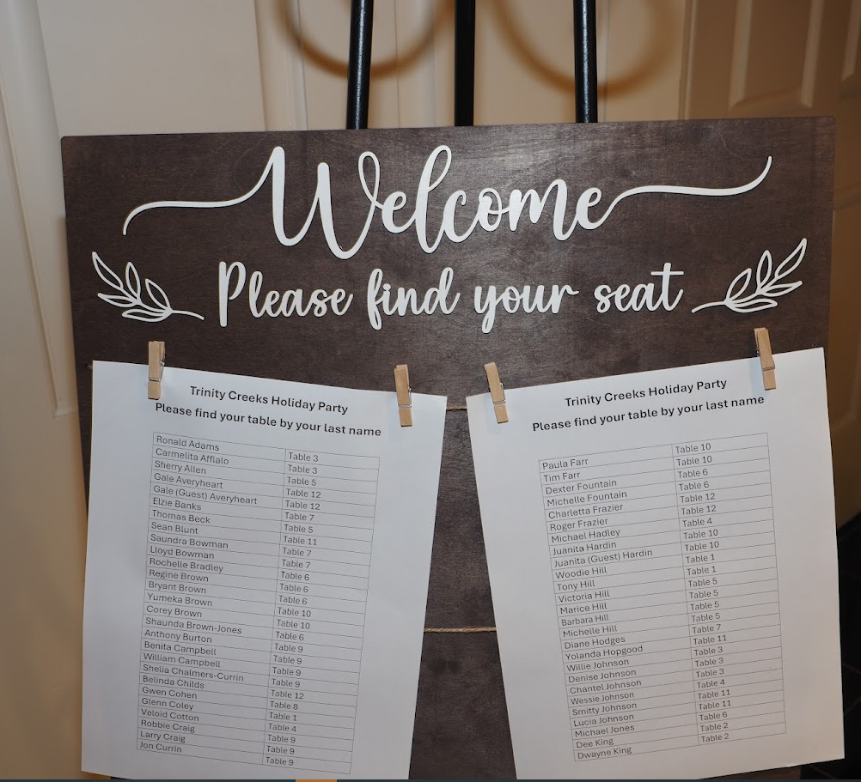
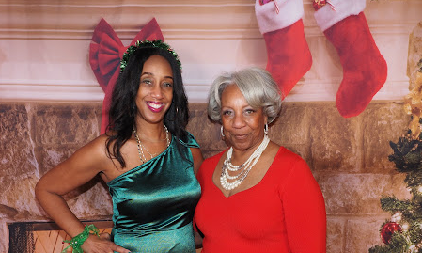

Slide 11
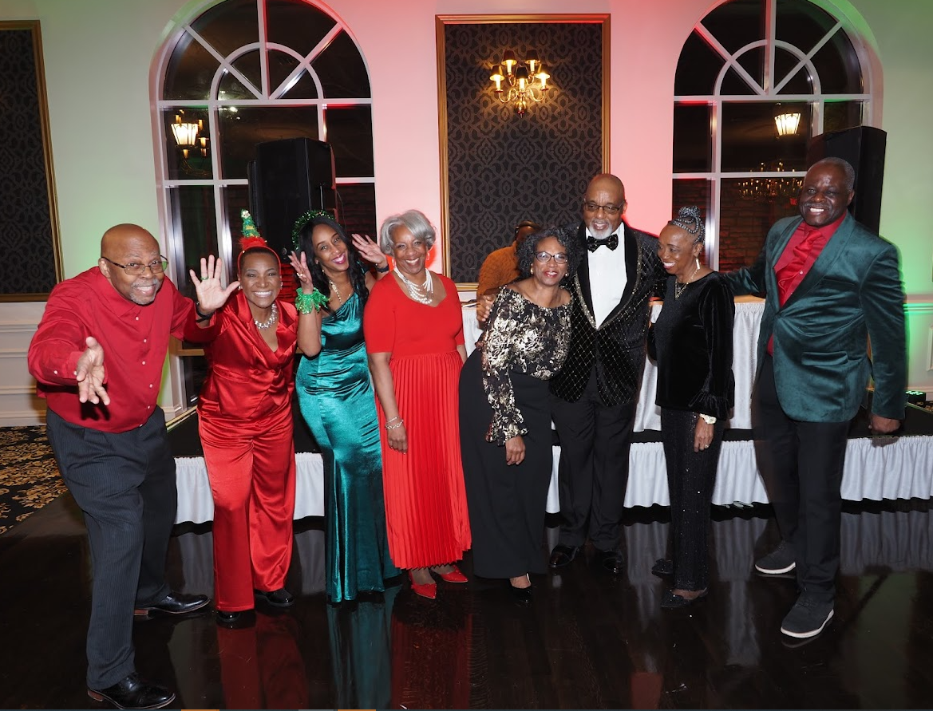
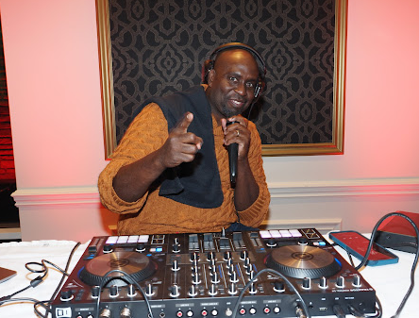
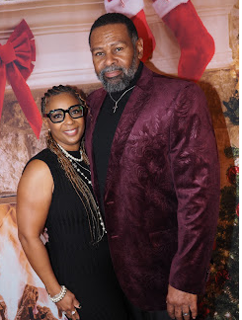
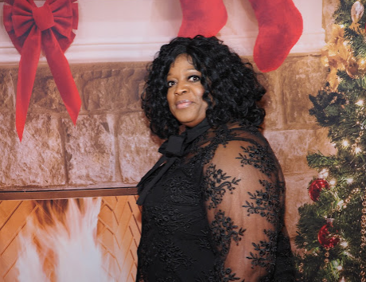
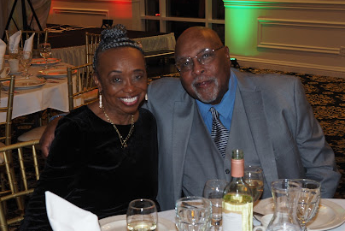

Slide 12
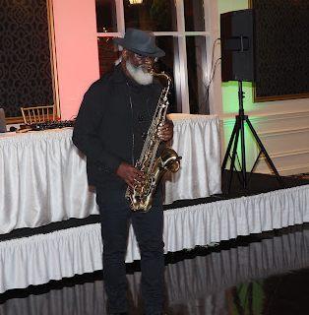
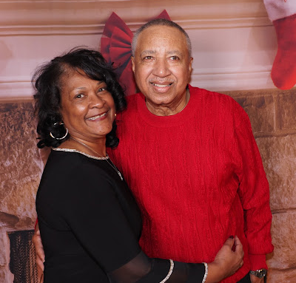
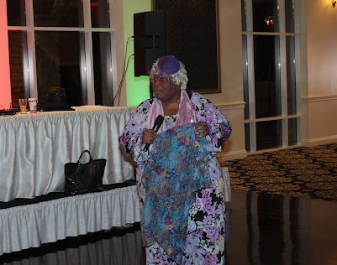
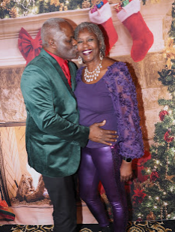
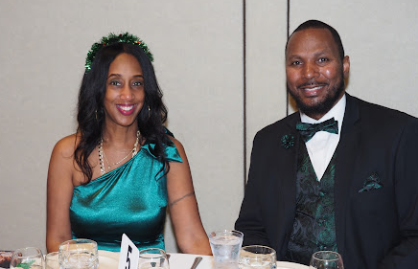
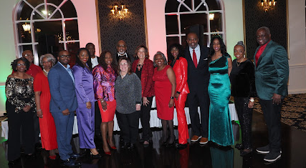

Slide 13
