Slide 1
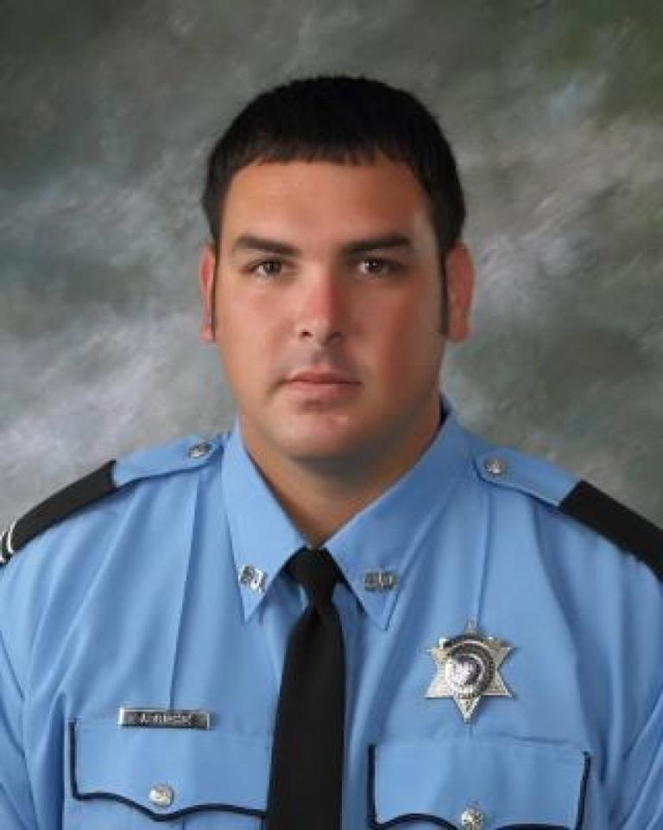
DEPUTY JEREMY TRICHE 9TH ANNUAL
SPOTS AND DOTS FISHING TOURNAMENT
Saturday June 7, 2025
COCO MARINA Cocodrie, LA
Food, Drinks, Music, Raffles, Auction
T-Shirts and more
Adult and Youth Division
Entry Fee $50 per Adult
16 and under free with paid adult
Free T-Shirt with paid entry
For more information contact:
Mike Triche 985-212-4313
Edie Triche 985-212-0601
Jared Triche 985-212-0059
Lee Dupepe 985-703-2370
Law Enforcement, First Responder and Military Discounts
Tournament Sponsorships Welcomed
OR VISIT
www.jeremytrichehero.org

