Slide 1
Marijuana: Impacts on the Opioid Crisis and the Workforce
Garth Van Meter
Vice President of Federal Affairs, SAM
Note: This presentation is not intended to provide legal advice of any kind. For legal advice, please contact a lawyer in the appropriate jurisdiction.

Slide 2
Agenda
Who we are
Marijuana and Opioids
Marijuana and the Workplace
The marijuana lobby & employees
Conclusions
1
2
3
4
5

Slide 3

SAM promotes an evidence-based approach to marijuana policy that prioritizes public health
SAM takes an evidence-based, scientific approach to marijuana policy that rejects the false dichotomy that we must either lock up marijuana users OR legalize pot
We are non-partisan, and work with Democrats, Republicans, and independents
Board members and supporters include:
  American Society of Addiction Medicine
  American Academy of Pediatrics
  American Academy of Child and Adolescent Psychiatry
  Over 30 state affiliates

Slide 4
Agenda
Who we are
Marijuana and Opioids
Marijuana and the Workplace
The marijuana lobby & employees
Conclusions
1
2
3
4
5

Slide 5


Why talk
POT
During an opiate epidemic?

Slide 6
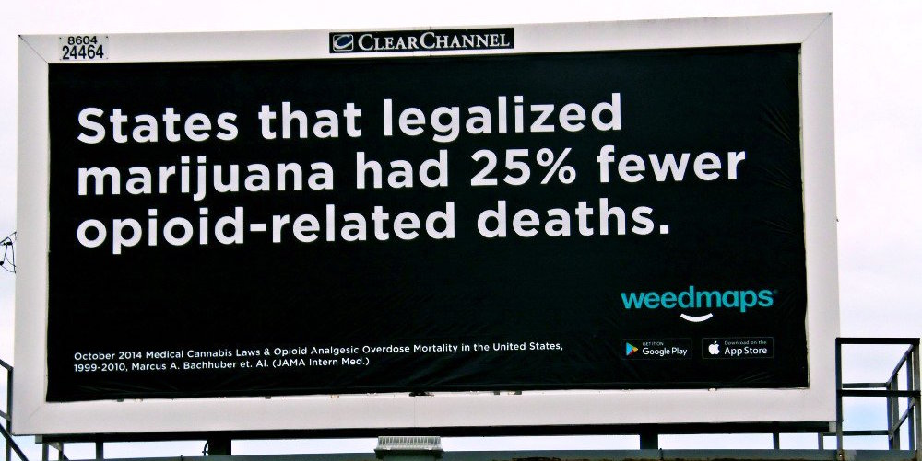
The Marijuana Industry Sees a Business Opportunity
https://media.jamanetwork.com/news-item/lower-opioid-overdose-death-rates-associated-with-state-medical-marijuana-laws/

Slide 7
Something doesn’t add up…
In the 2014 JAMA Study:
The raw data showed that medical marijuana states had higher rates of opioid deaths until the authors introduced four possible reasons.
The study lumped together highly restricted states with highly permissive states.
The study left out critical alternative explanations, like expanded Medication Assisted Treatment programs or expanded Naltrexone use.

Slide 8
Marijuana use goes hand-in-hand with increased prescription opioid abuse
Source: Olfson M., et al. Cannabis Use and Risk of Prescription Opioid Use Disorder in the United States. Am J Psychiatry 2017. https://doi.org/10.1176/appi.ajp.2017.17040413.

Slide 9
Agenda
Who we are
Marijuana and Opioids
Marijuana and the Workplace
The marijuana lobby & employees
Conclusions
1
2
3
4
5

Slide 10
Surveys keep telling us…
The pool of reliable unskilled labor is way too small
It’s very hard to find someone who can pass a drug screen

Slide 11

Marijuana use is forcing CO employers to hire out-of-state employees
“Jim Johnson [construction company GE Johnson’s CEO]...said his company has encountered so many job candidates who have failed pre-employment drug tests because of their THC use that it is actively recruiting construction workers from other states.”
Source: The Gazette, March 24, 2015 (http://gazette.com/drug-use-a-problem-for-employers/article/1548427)
Do you have permission to use the image and logo here?

Slide 12
Marijuana use is rising across the board, since legalization laws became common
Percentage of population ages 12 and up who used
marijuana in the past month
CAGR = 4.5%
“Medical” marijuana legalized in 13 states
“Recreational” legalization in CO & WA
Source: NSDUH

Slide 13
Positive workplace marijuana test rates have tripled since the year Colorado legalized recreational pot
230% increase since 2011
Source: Quest Diagnostics

Slide 14
Accidents, injuries, absenteeism, and disciplinary problems among pot users all increase costs
Source: Zwerling et al (1990)

Slide 15
Even when controlling for alcohol use, pot users are:
40%
106%
more likely to have missed at least one day of work in the last month due to illness/injury
more likely to have missed at least one day of work in the last month because they “just didn’t want to be there”
Source: National Survey on Drug Use and Health (2014)

Slide 16
The state loses, too: in RI, estimates of just a few costs outweigh projected revenues by over 25%
1
Source: SAM study

Slide 17
Agenda
Who we are
Marijuana and Opioids
Marijuana and the Workplace
The marijuana lobby & employees
Conclusions
1
2
3
4
5

Slide 18

The marijuana industry has vowed to make employee “rights” to pot use a priority
In 2014, the Colorado Supreme Court established that employers can fire employees for off-the-job marijuana use, even within the context of a state medical marijuana program (Coats v. Dish Network, LLC, No. 13SC394, 2014 Colo. LEXIS 40 (Colo. Jan. 27, 2014)
In response, the marijuana industry mobilized to fight for a right for employees to use pot
“[We should not] permit an employee to be fired simply because they elect to use marijuana legally under state law, without a showing of actual on-job impairment.
…
[T]hat is simply unfair, and it cannot be allowed to stand.”
Keith Stroup, founder of NORML
15 June 2015
Note: This presentation is not intended to provide legal advice of any kind. For legal advice, please contact a lawyer in the appropriate jurisdiction.

Slide 19
The highest court in Mass. says that firing a medical marijuana user can be discrimination
Massachusetts’ handicap discrimination law protects an employee that uses marijuana to treat a “debilitating medical condition” and has a MA medical marijuana card
Tolerating medical marijuana use is NOT a per se unreasonable accommodation, even though marijuana is not FDA-approved and is a Schedule 1 drug
Expansive dicta indicates that state laws declaring certain substances as “medicine” override FDA determinations
Same logic would apply to hallucinogenics, cocaine, and other drugs.
Source: Barbuto vs. Advantage Sales & Marketing, Inc., SJC-12226 (slip opinion). NB: This presentation is not intended to provide legal advice of any kind. For legal advice, please contact a lawyer in the appropriate jurisdiction.

Slide 20
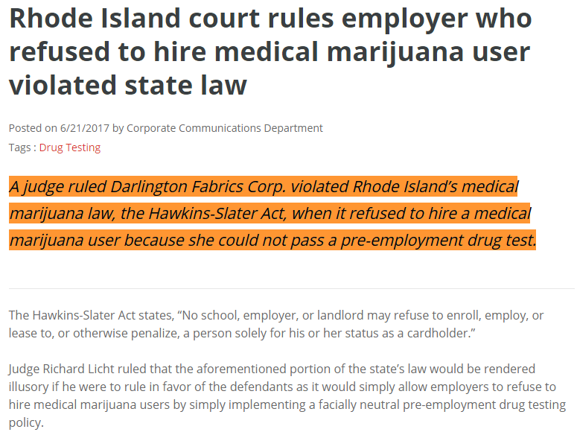
A Rhode Island trial court recently extended protections to a medical marijuana user

Slide 21
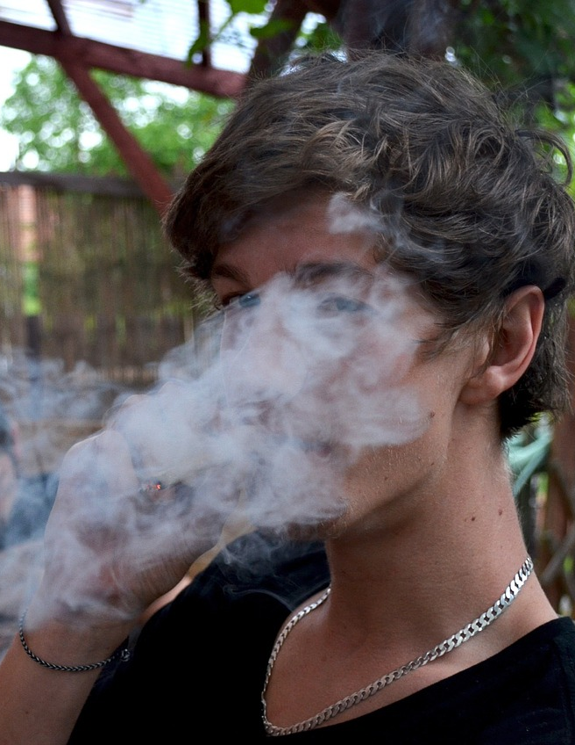
New Mexico courts force companies to pay for employees’ marijuana use
New Mexico: a series of appellate court decisions require companies to reimburse employees’ for “medical” marijuana use, ignoring employers’ arguments that doing so would violate federal law:
  Vialpando v. Ben’s Automotive Services, 331 P.3d 975, cert. denied, 331 P.3d 924 (2014)
  Maez v. Riley Industrial, 347 P.3d 732 (2015)
  Lewis v. American General Media, 2015 N.M. App. LEXIS 74 (June 26, 2015)
Note: This presentation is not intended to provide legal advice of any kind. For legal advice, please contact a lawyer in the appropriate jurisdiction.

Slide 22
Agenda
Who we are
Marijuana and Opioids
Marijuana and the Workplace
The marijuana lobby & employees
Conclusions
1
2
3
4
5

Slide 23
Conclusions
Are you ready to respond to claims that marijuana will solve the opioid crisis?
Is it good that the marijuana industry is lobbying hard to undermine workplace drug testing laws?
Who will pay for the long-term costs of marijuana use -- if not insurance companies and the state?

Slide 24
SAM Action is Active in Your State
Over 30 State Affiliates
Grassroots organizing through SAM Action App
(text SAM to 797-979)
The Marijuana Industry has failed at nearly every legislative attempt in States and Congress this year.
”We were gaining momentum. But now that's flipped and we're more on the defensive.” – Rep. Dina Titus (D-NV), one of the biggest marijuana supporters in Congress.

Slide 25
Thank you!
garth@learnaboutsam.org
http://learnaboutsam.org
Note: This presentation is not intended to provide legal advice of any kind. For legal advice, please contact a lawyer in the appropriate jurisdiction.

