Slide 1
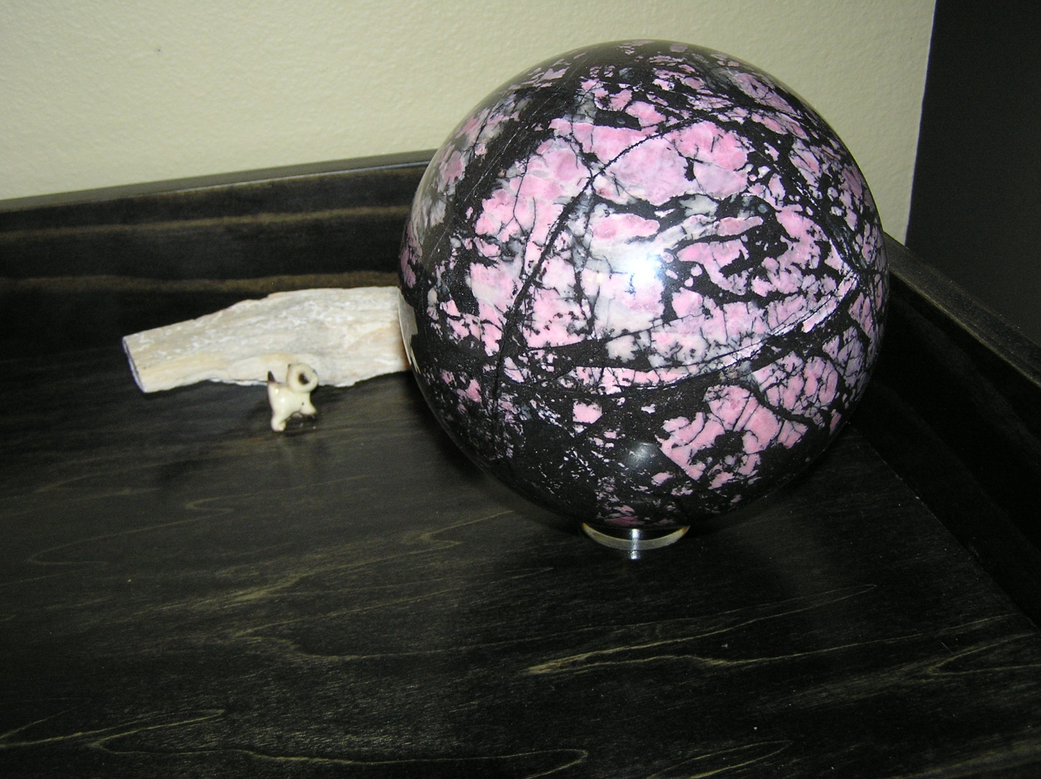
YOU can make spheres!!

Slide 2
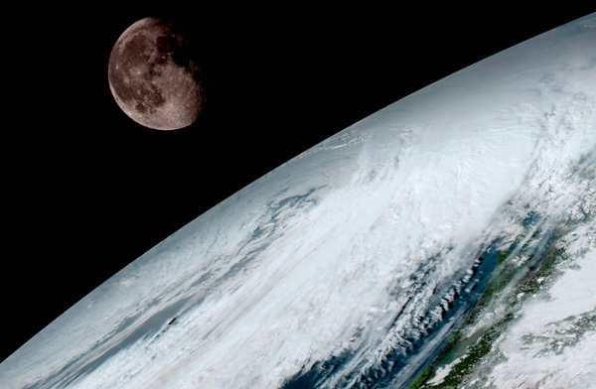
The perfect shape

Slide 3
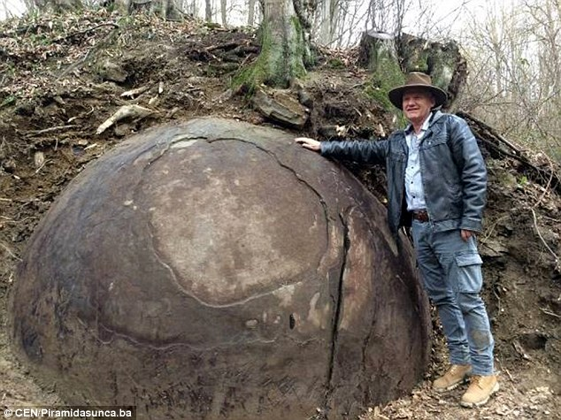

Slide 4
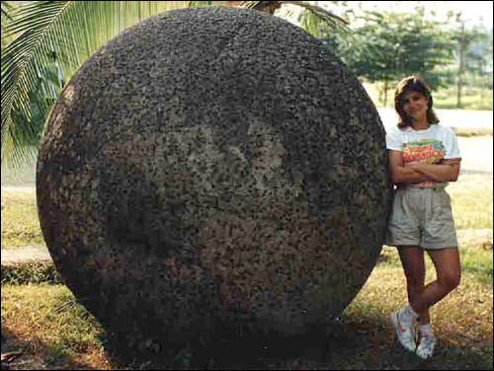

Slide 5
What do I need to make a sphere?
A reasonably round rock to start with (preform)
Something harder than the rock to wear it down (grinding medium)
Time
A machine is not necessary…..but it sure makes the job quicker

Slide 6
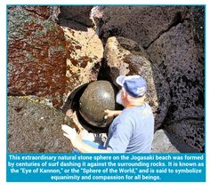

Slide 7
What do I need to make a sphere?
A Sphere Machine is very nice!!
- random motion wears down high spots faster than low spots
- grit on grinding heads wears down the rock
- water from drip washes away the grindings
2) Won’t I need a lot of money?

Slide 8
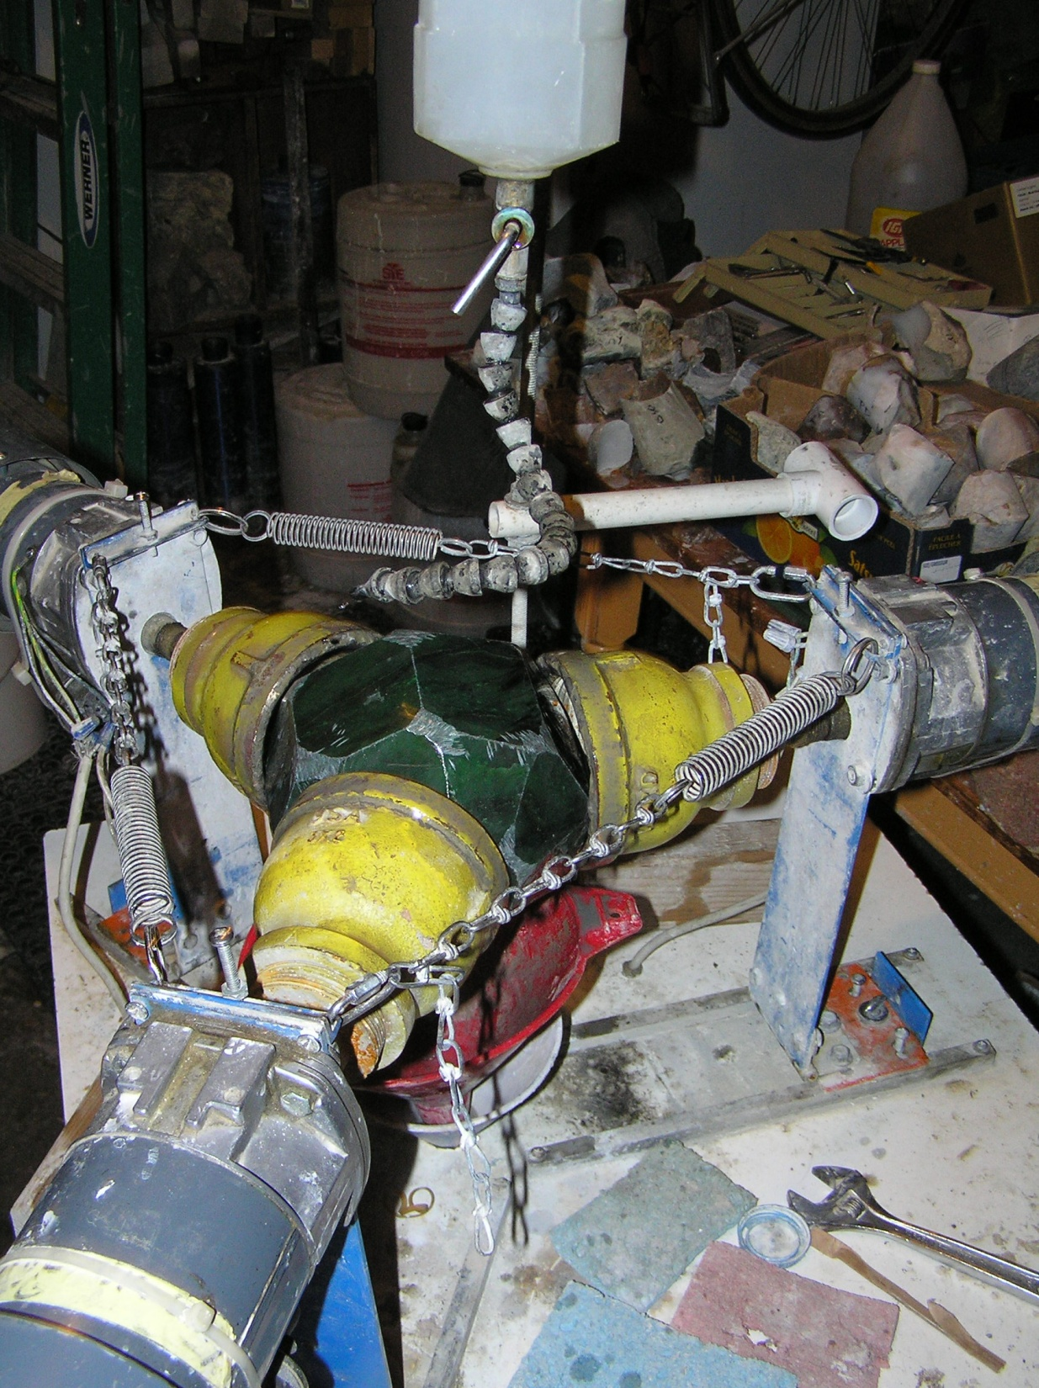

Slide 9
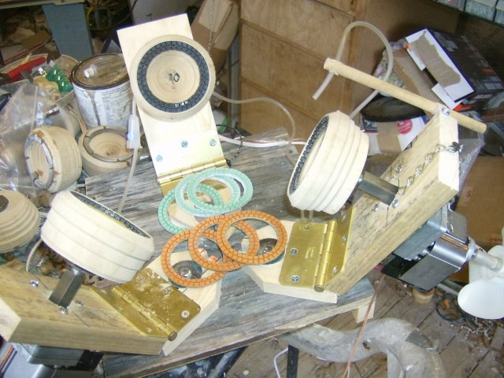
Mac’s Shop Spheres

Slide 10
Mac’s Shop Spheres
$215 including shipping

Slide 11
Mac’s Shop Spheres
$215 including shipping

Slide 12
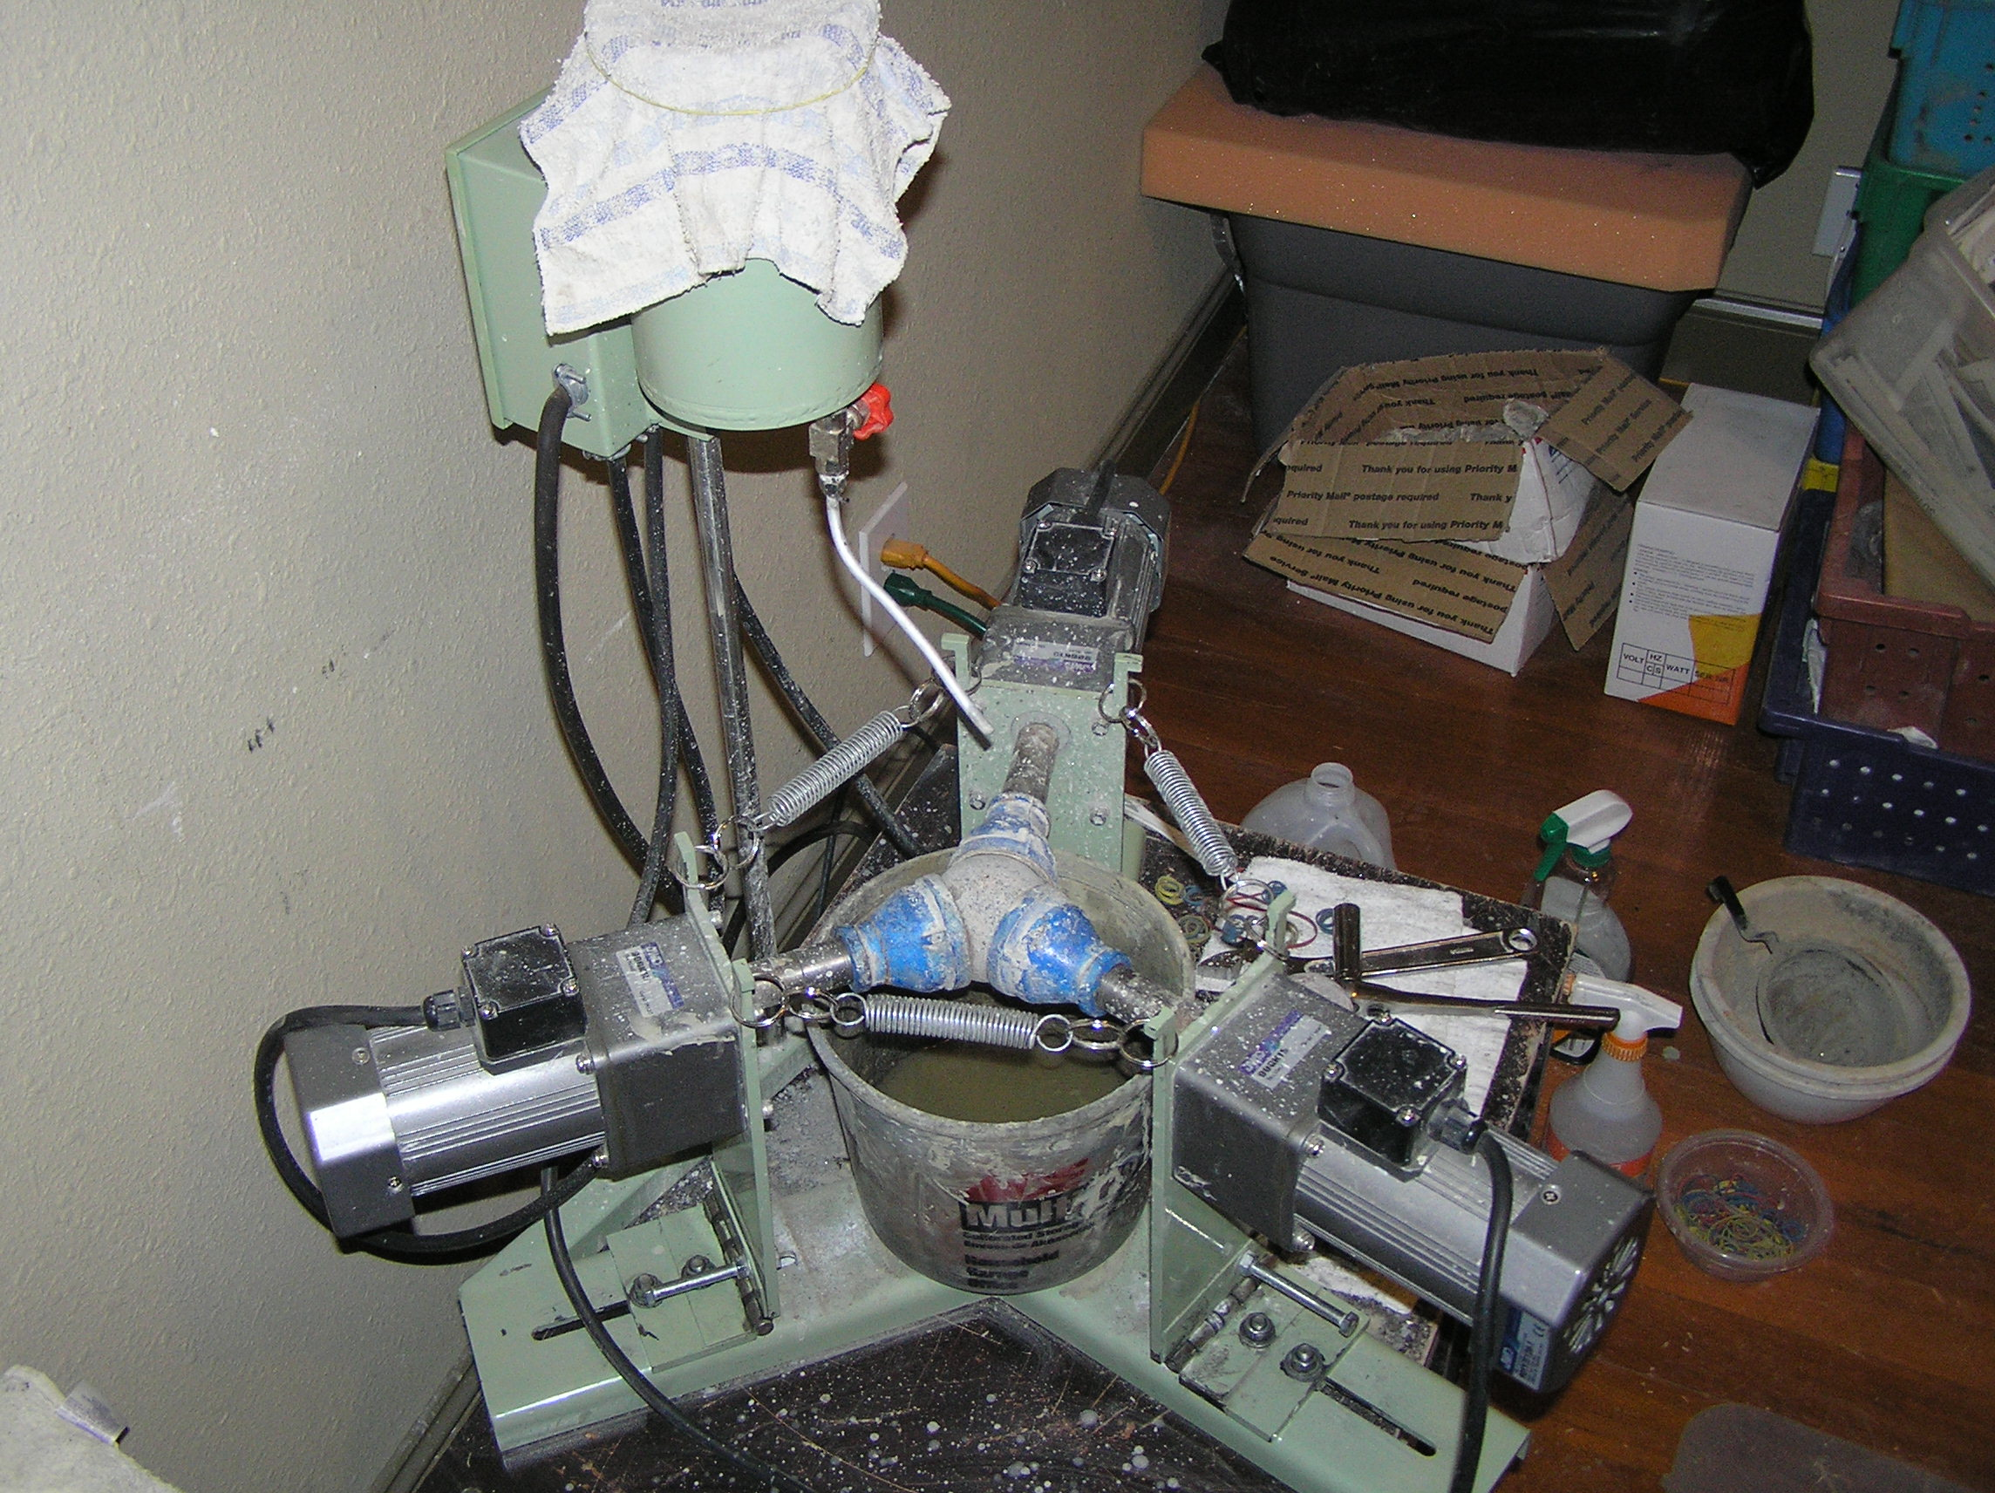
Highland Park

Slide 13
Highland Park
$825 including shipping

Slide 14
What do I need to make a sphere?
A Sphere Machine
A preform
A rock saw to shape the preform?? A core drill?
A grinder to round the preform
Time

Slide 15
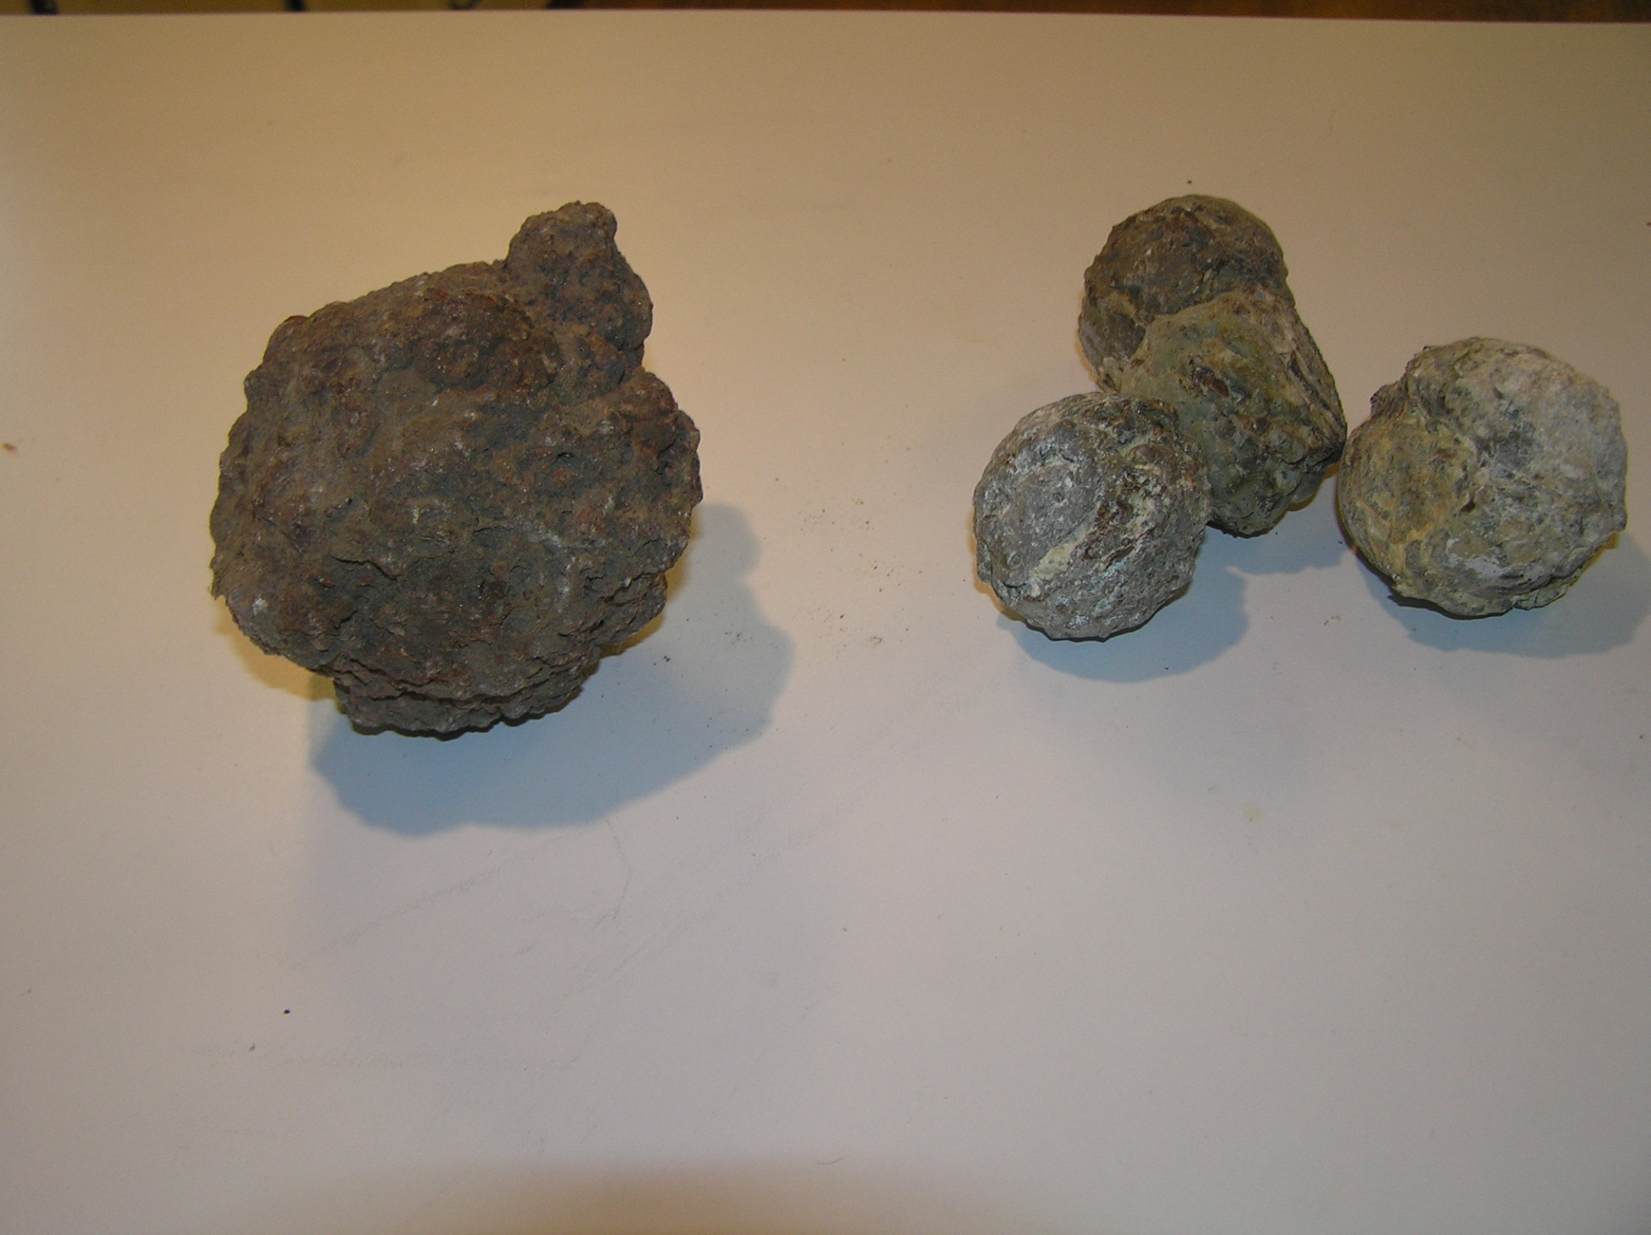
Preforms

Slide 16
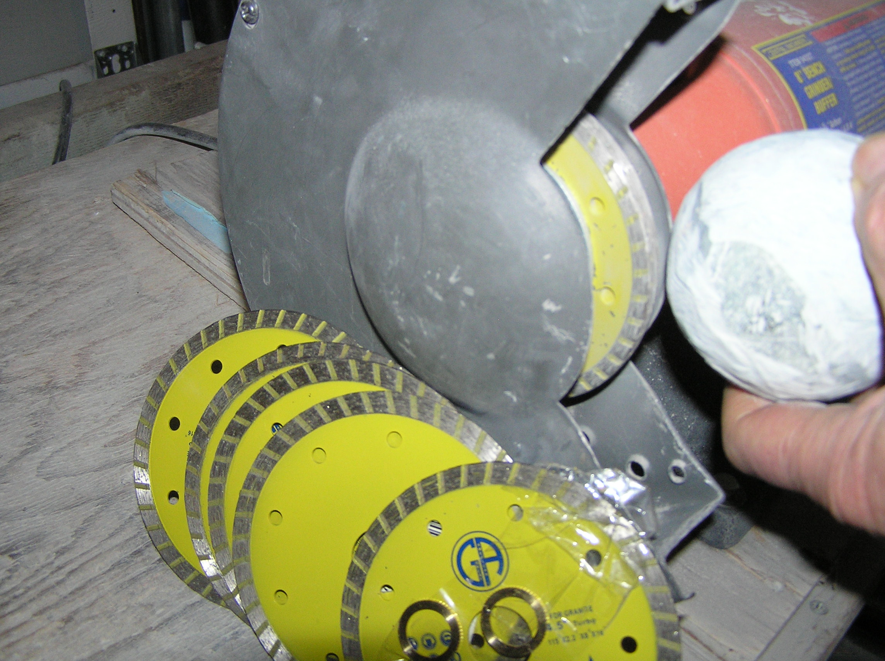
McGill’s Warehouse

Slide 17
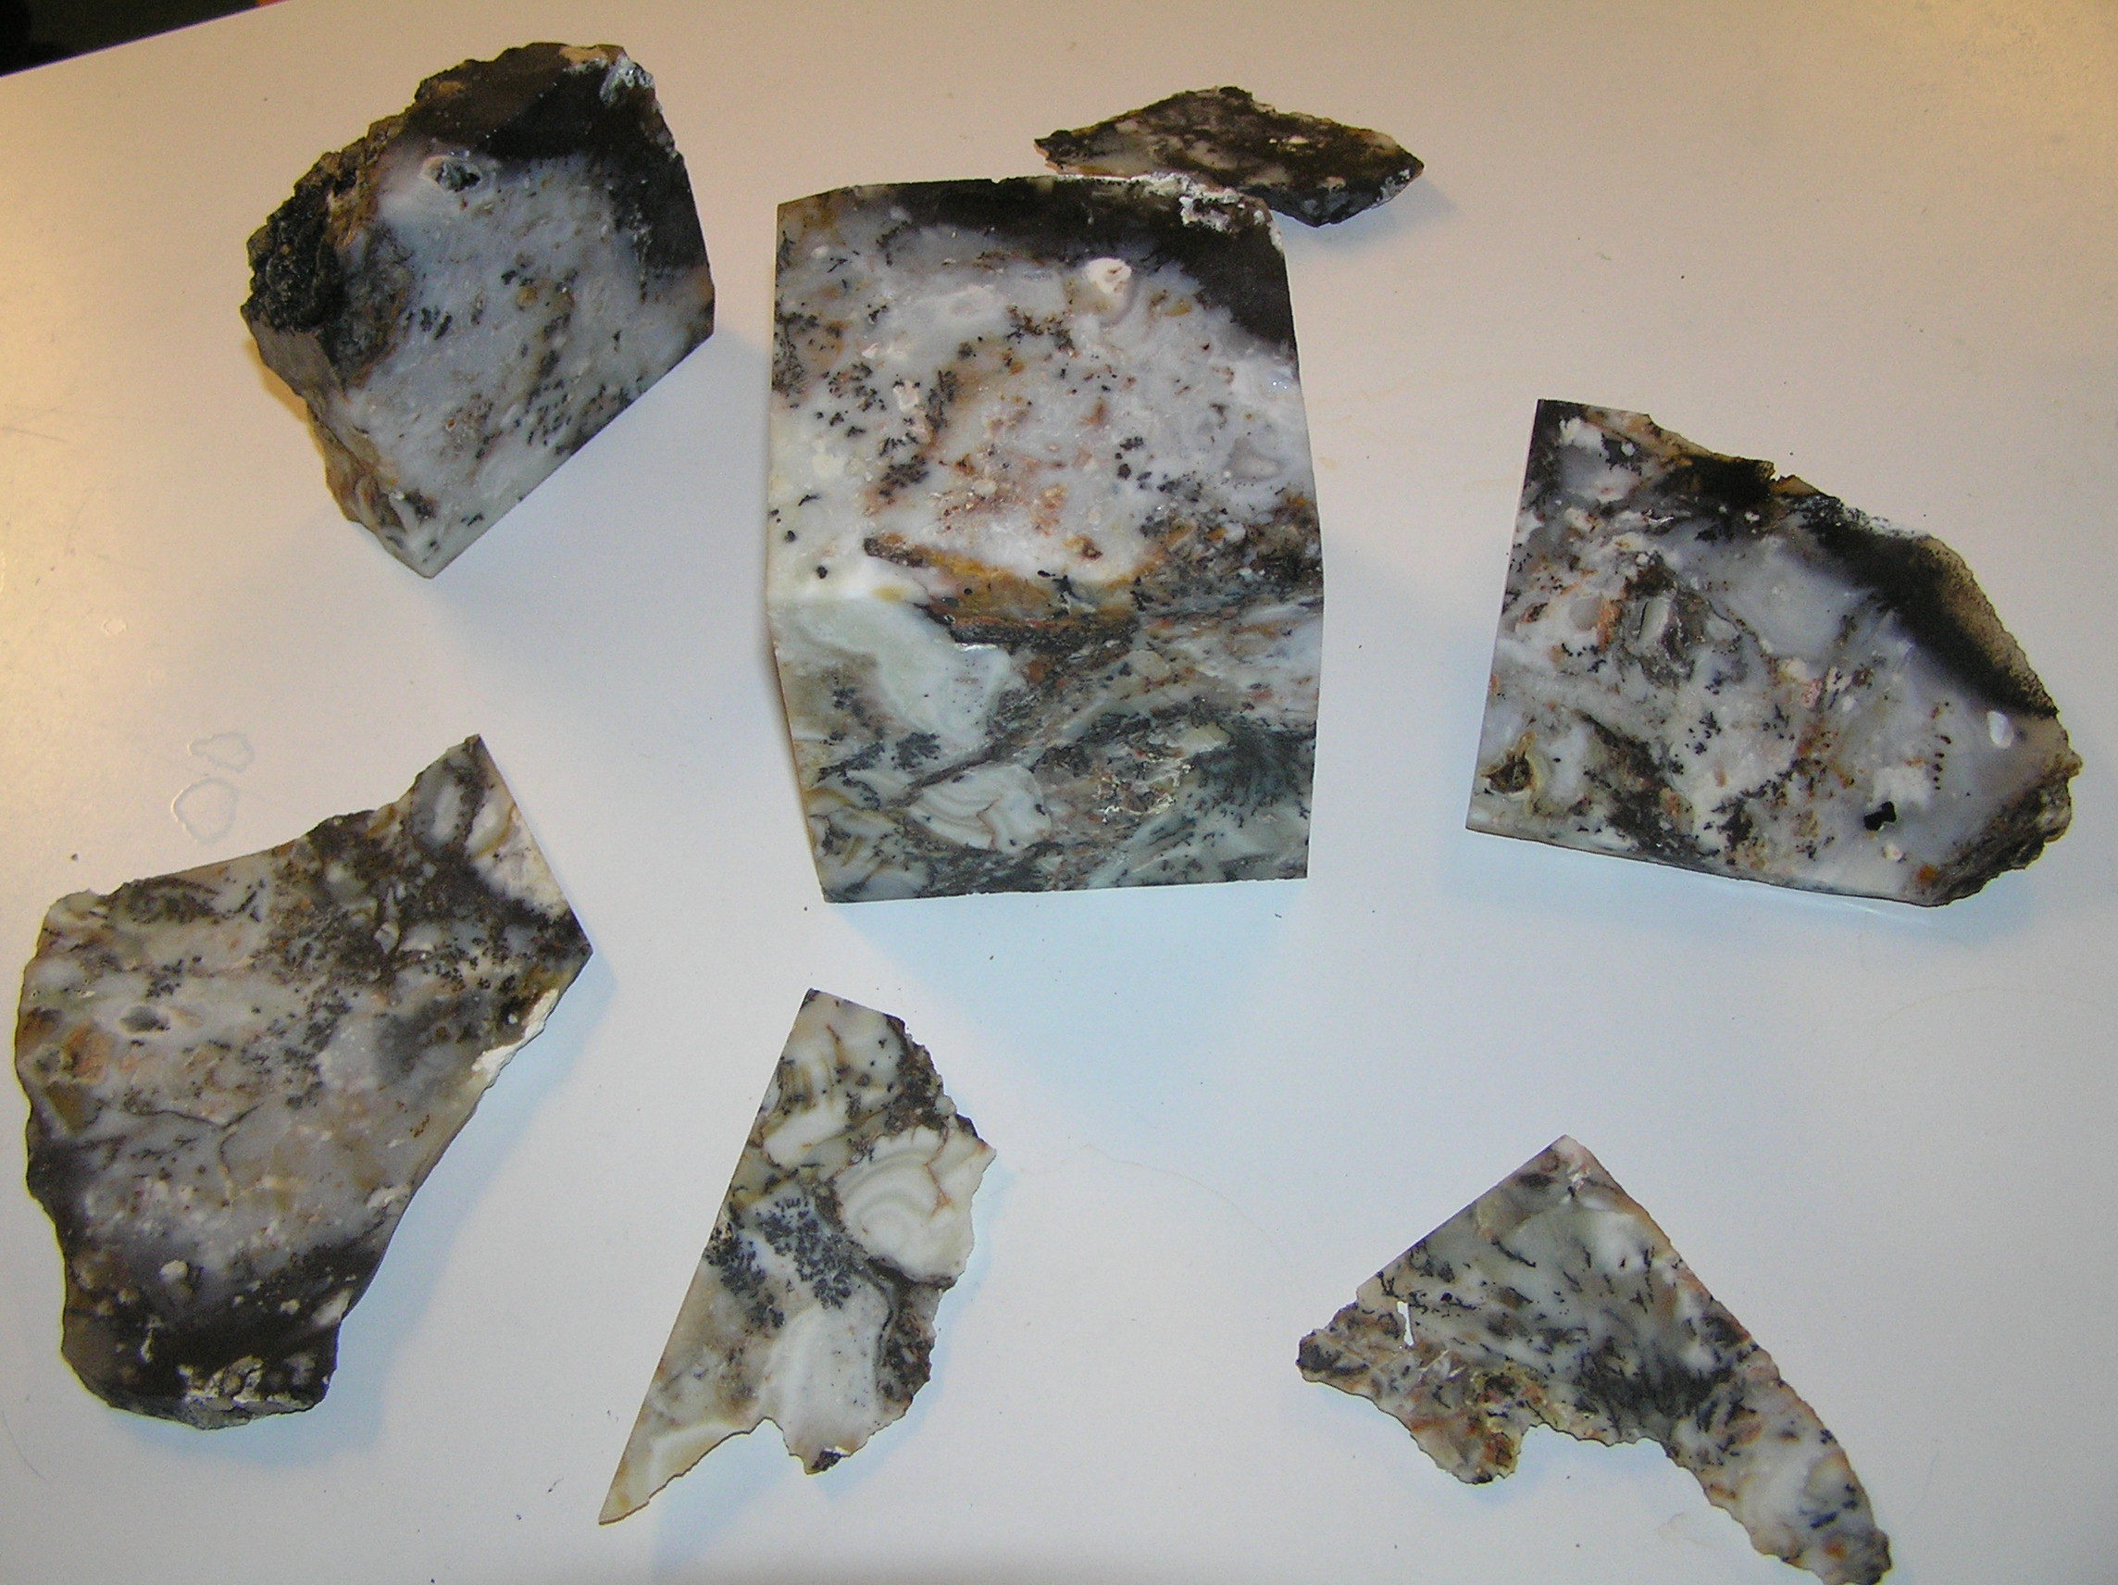
6 cuts - cube

Slide 18
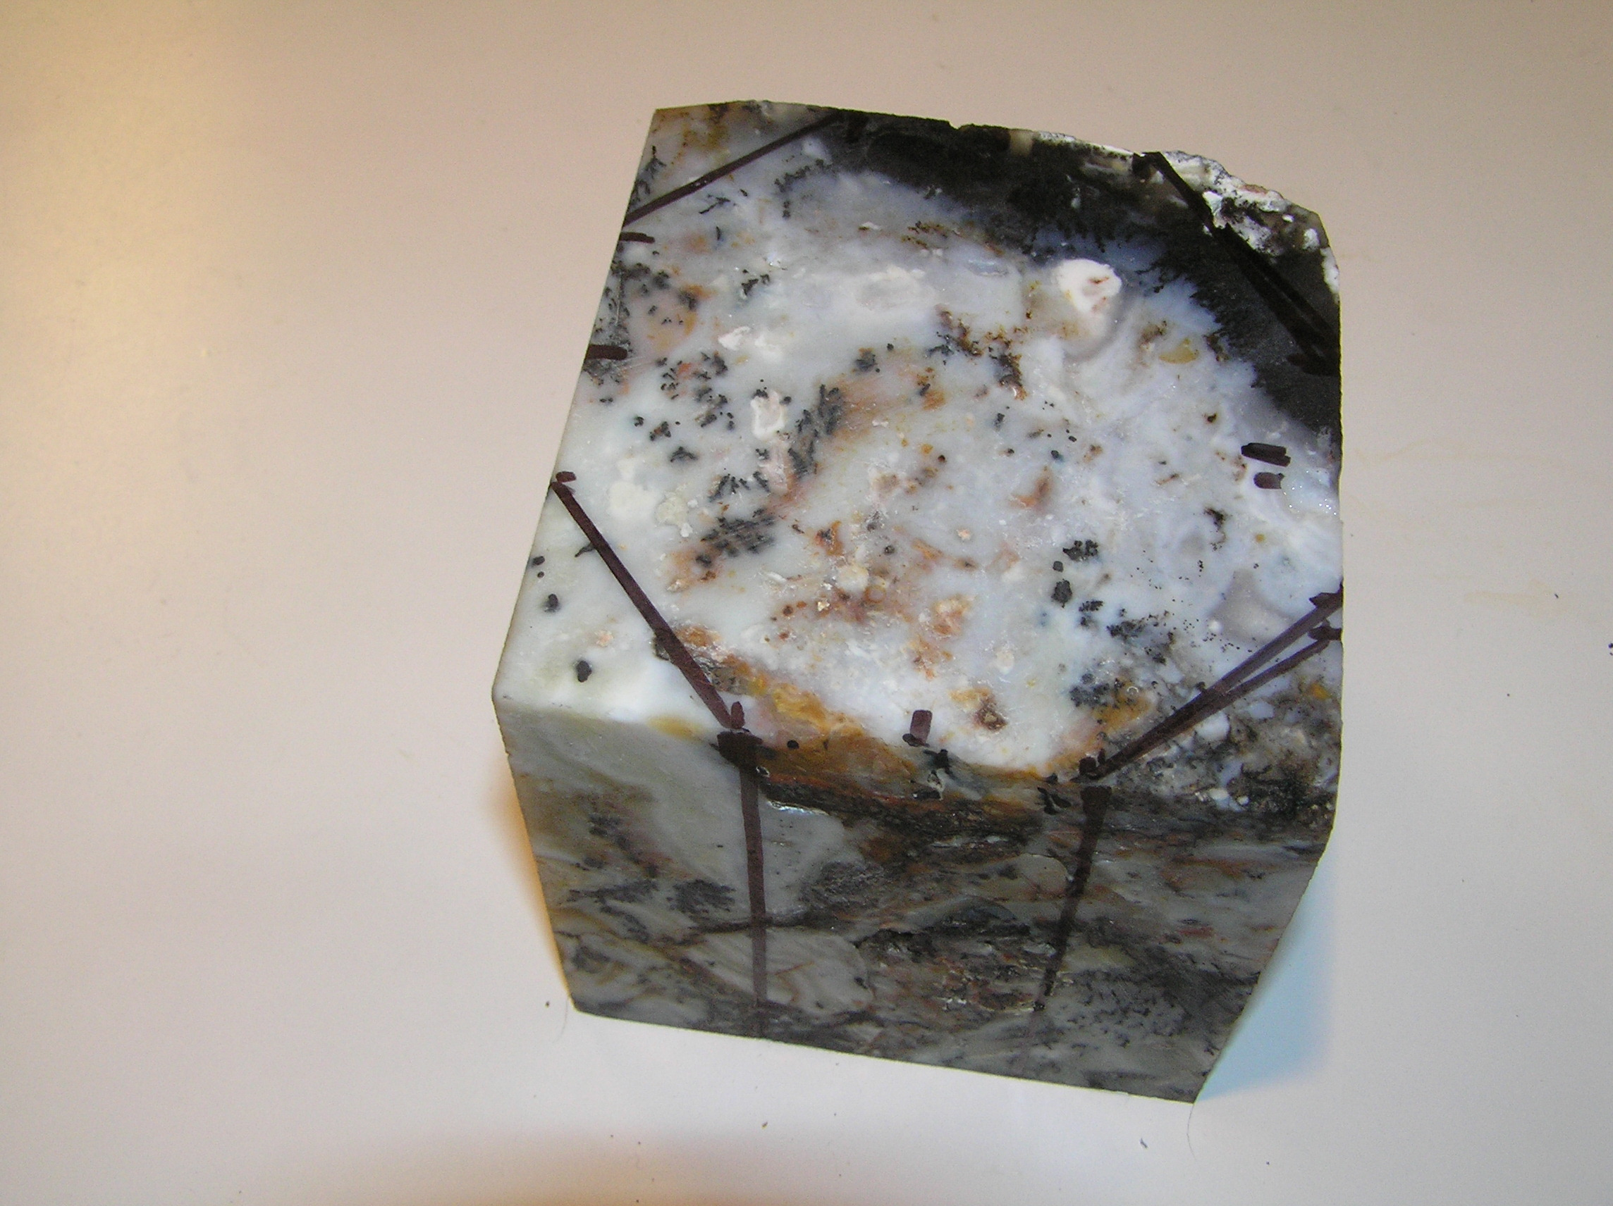

Slide 19
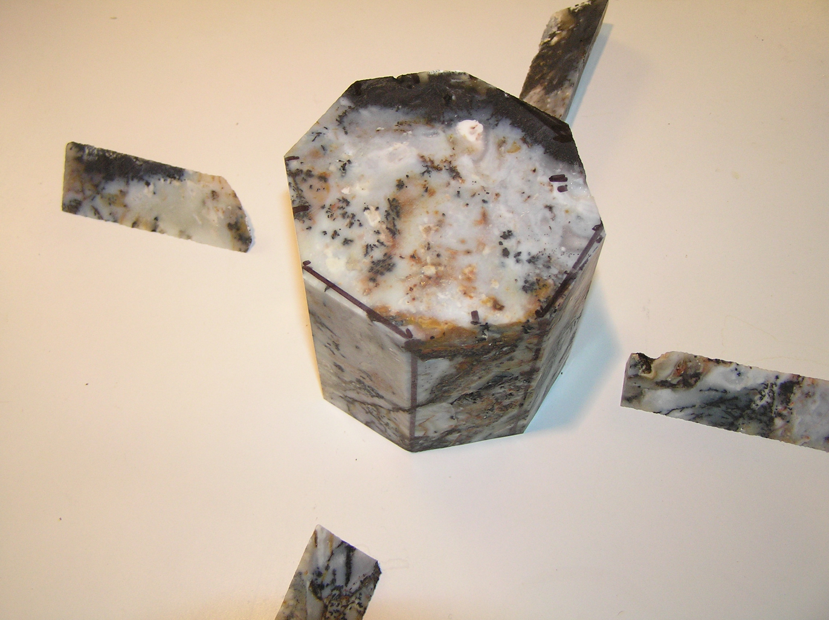
10 cuts

Slide 20
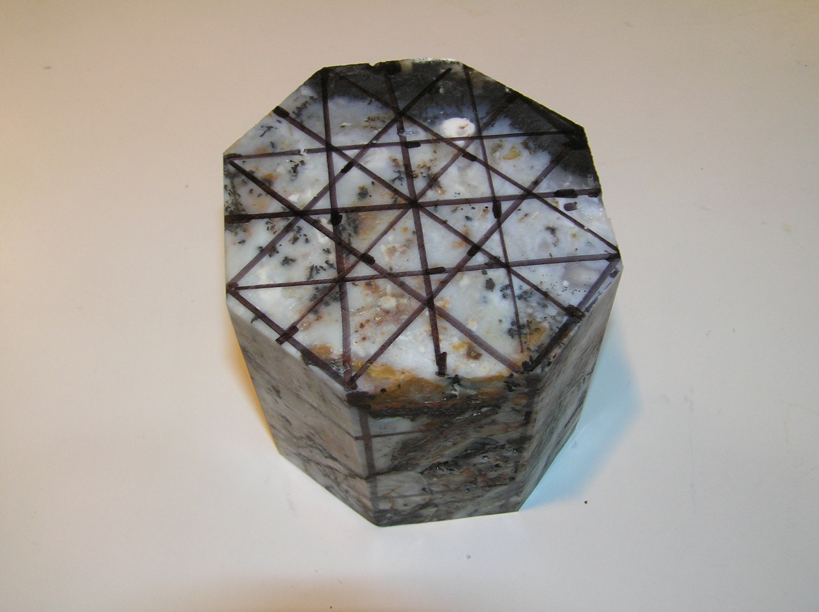

Slide 21
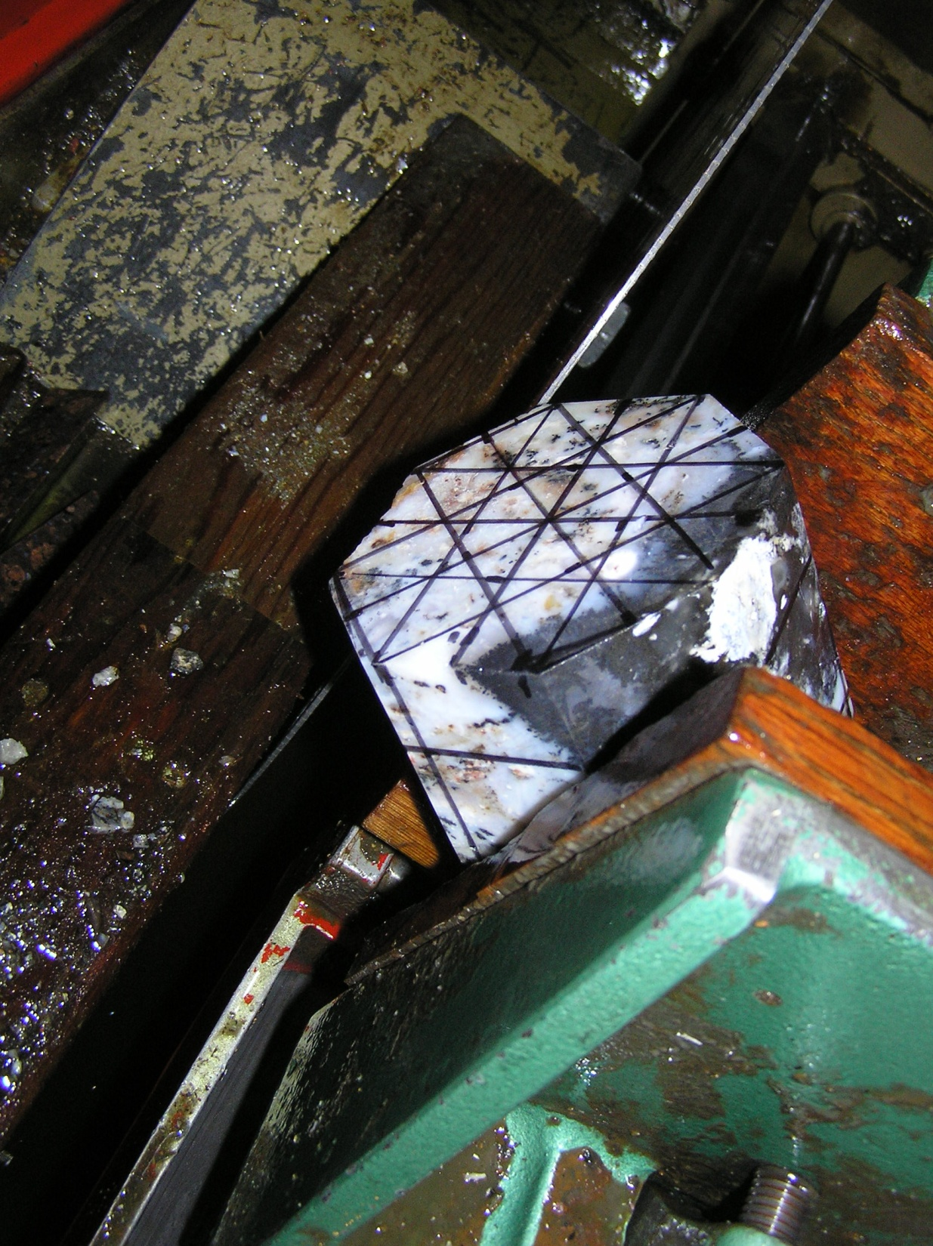

Slide 22
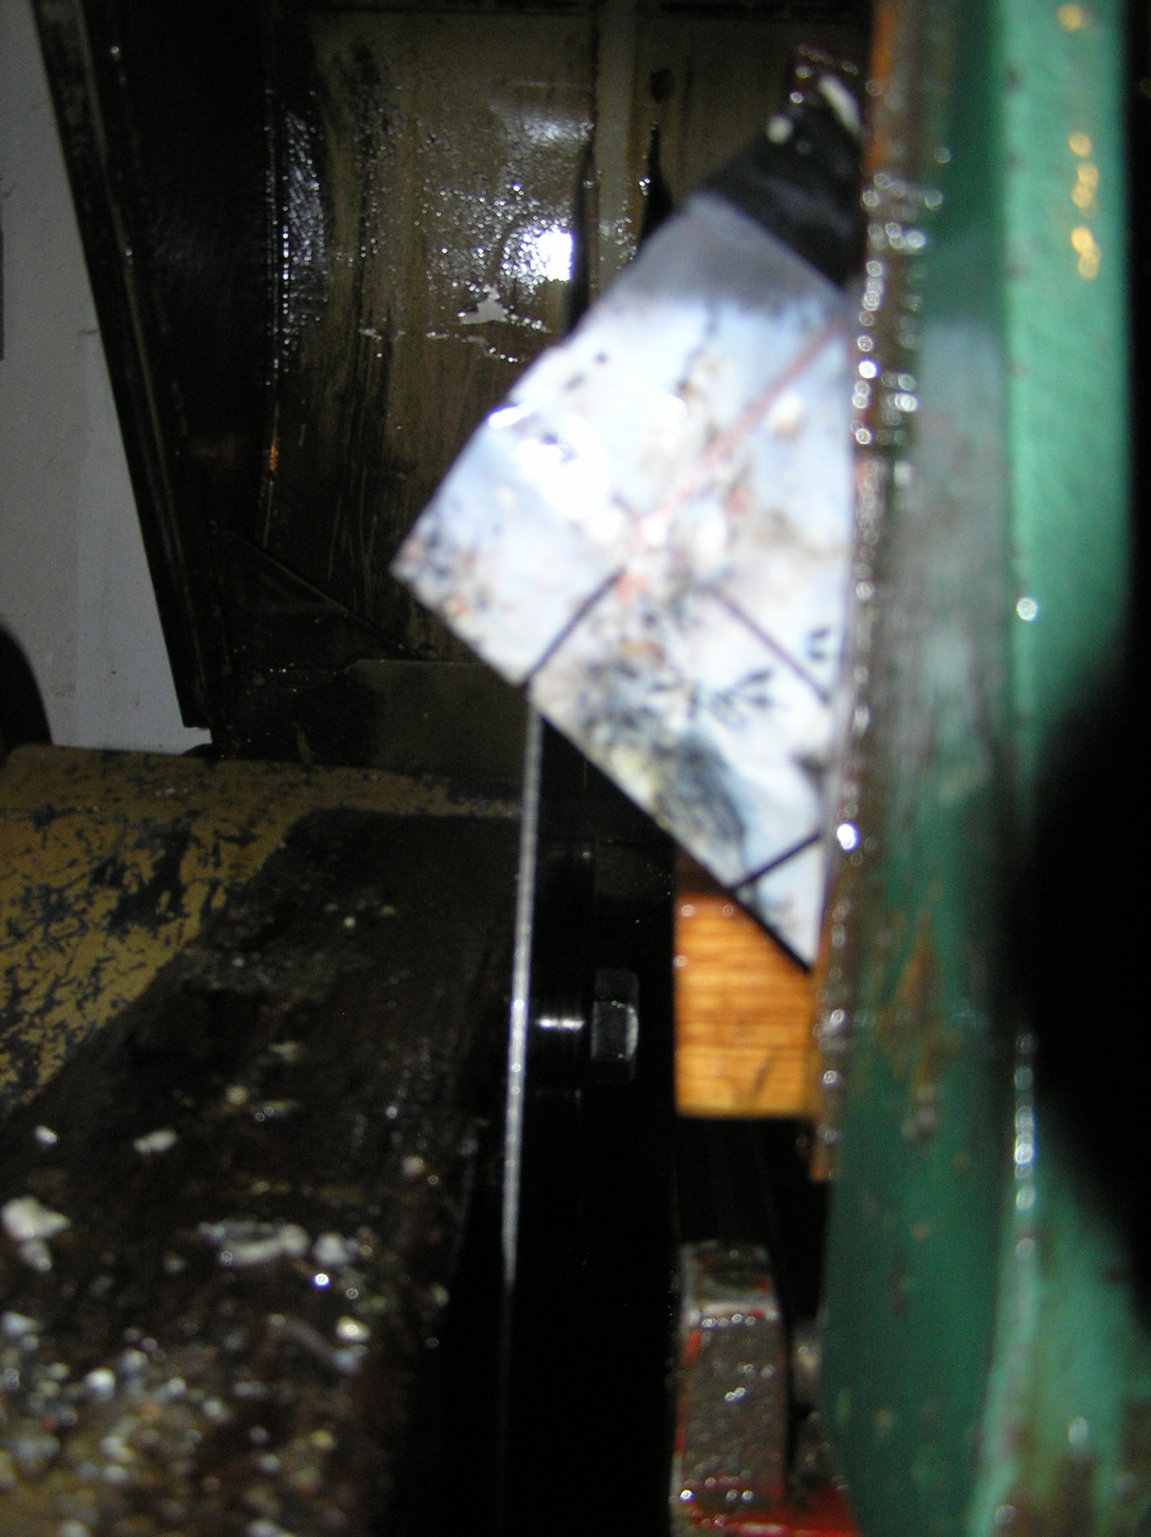

Slide 23
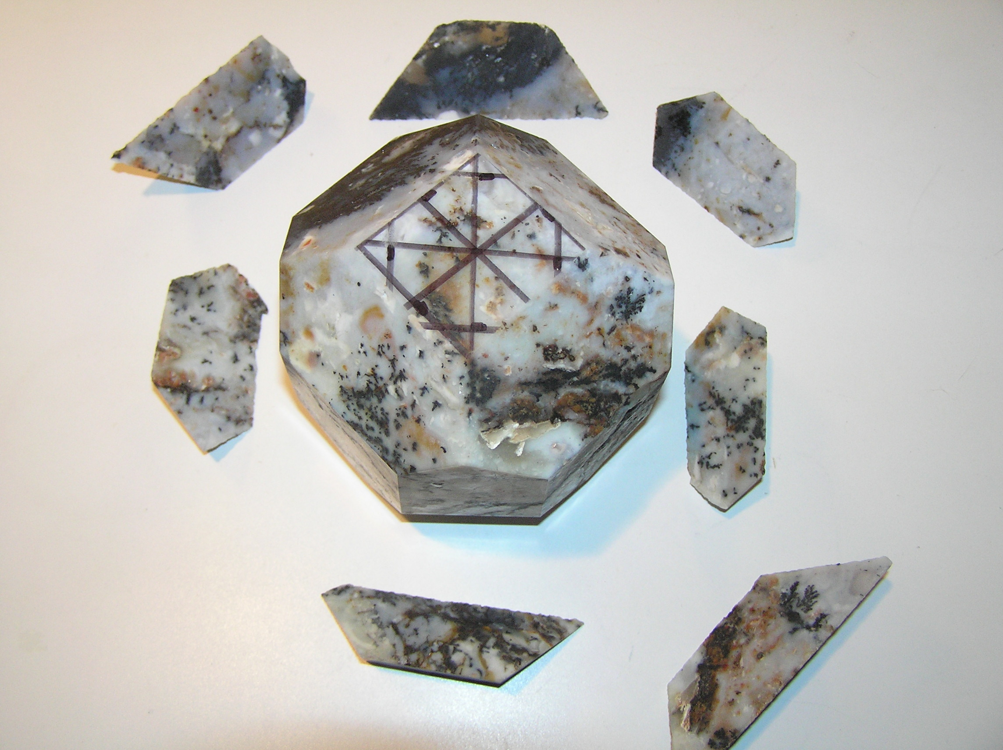
18 cuts

Slide 24
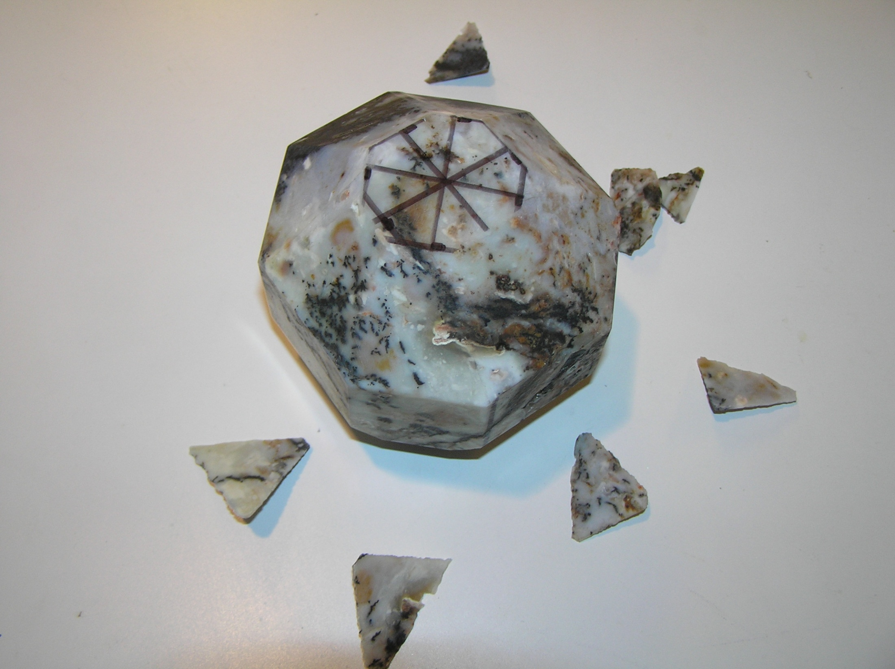
26 cuts

Slide 25
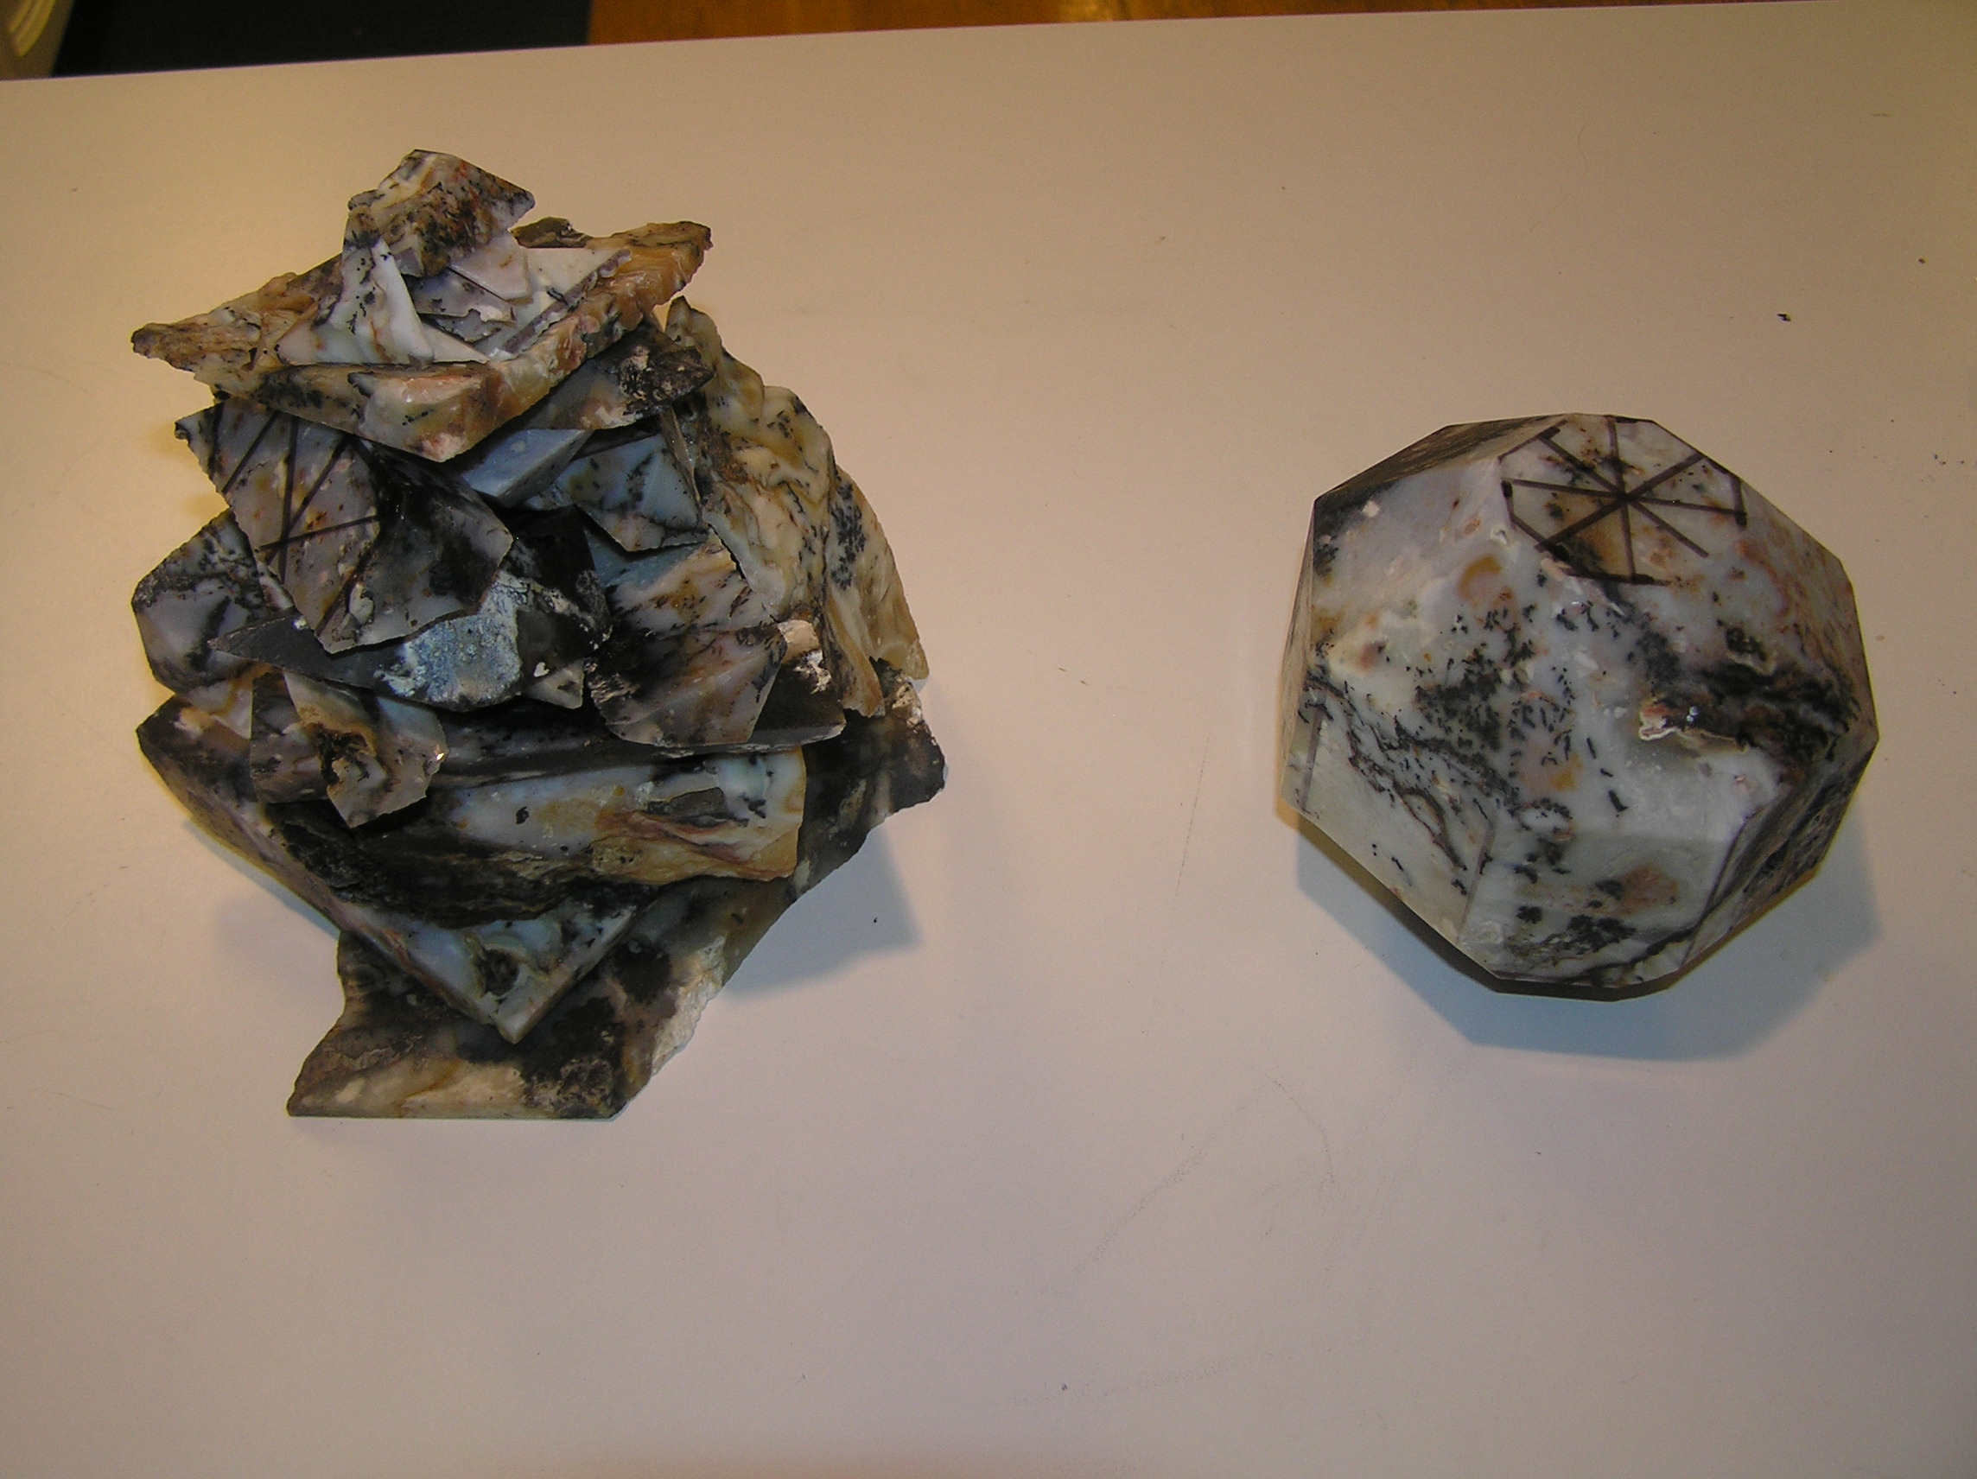

Slide 26
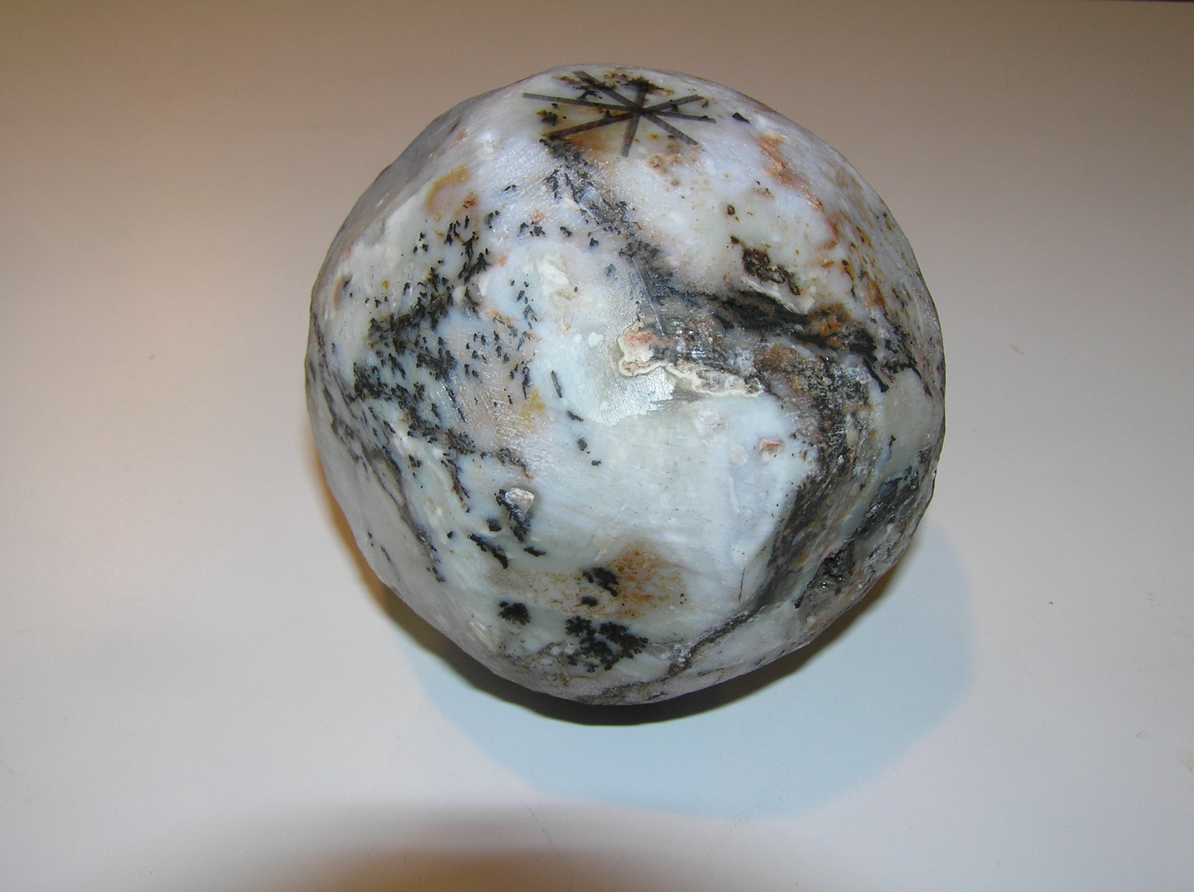

Slide 27
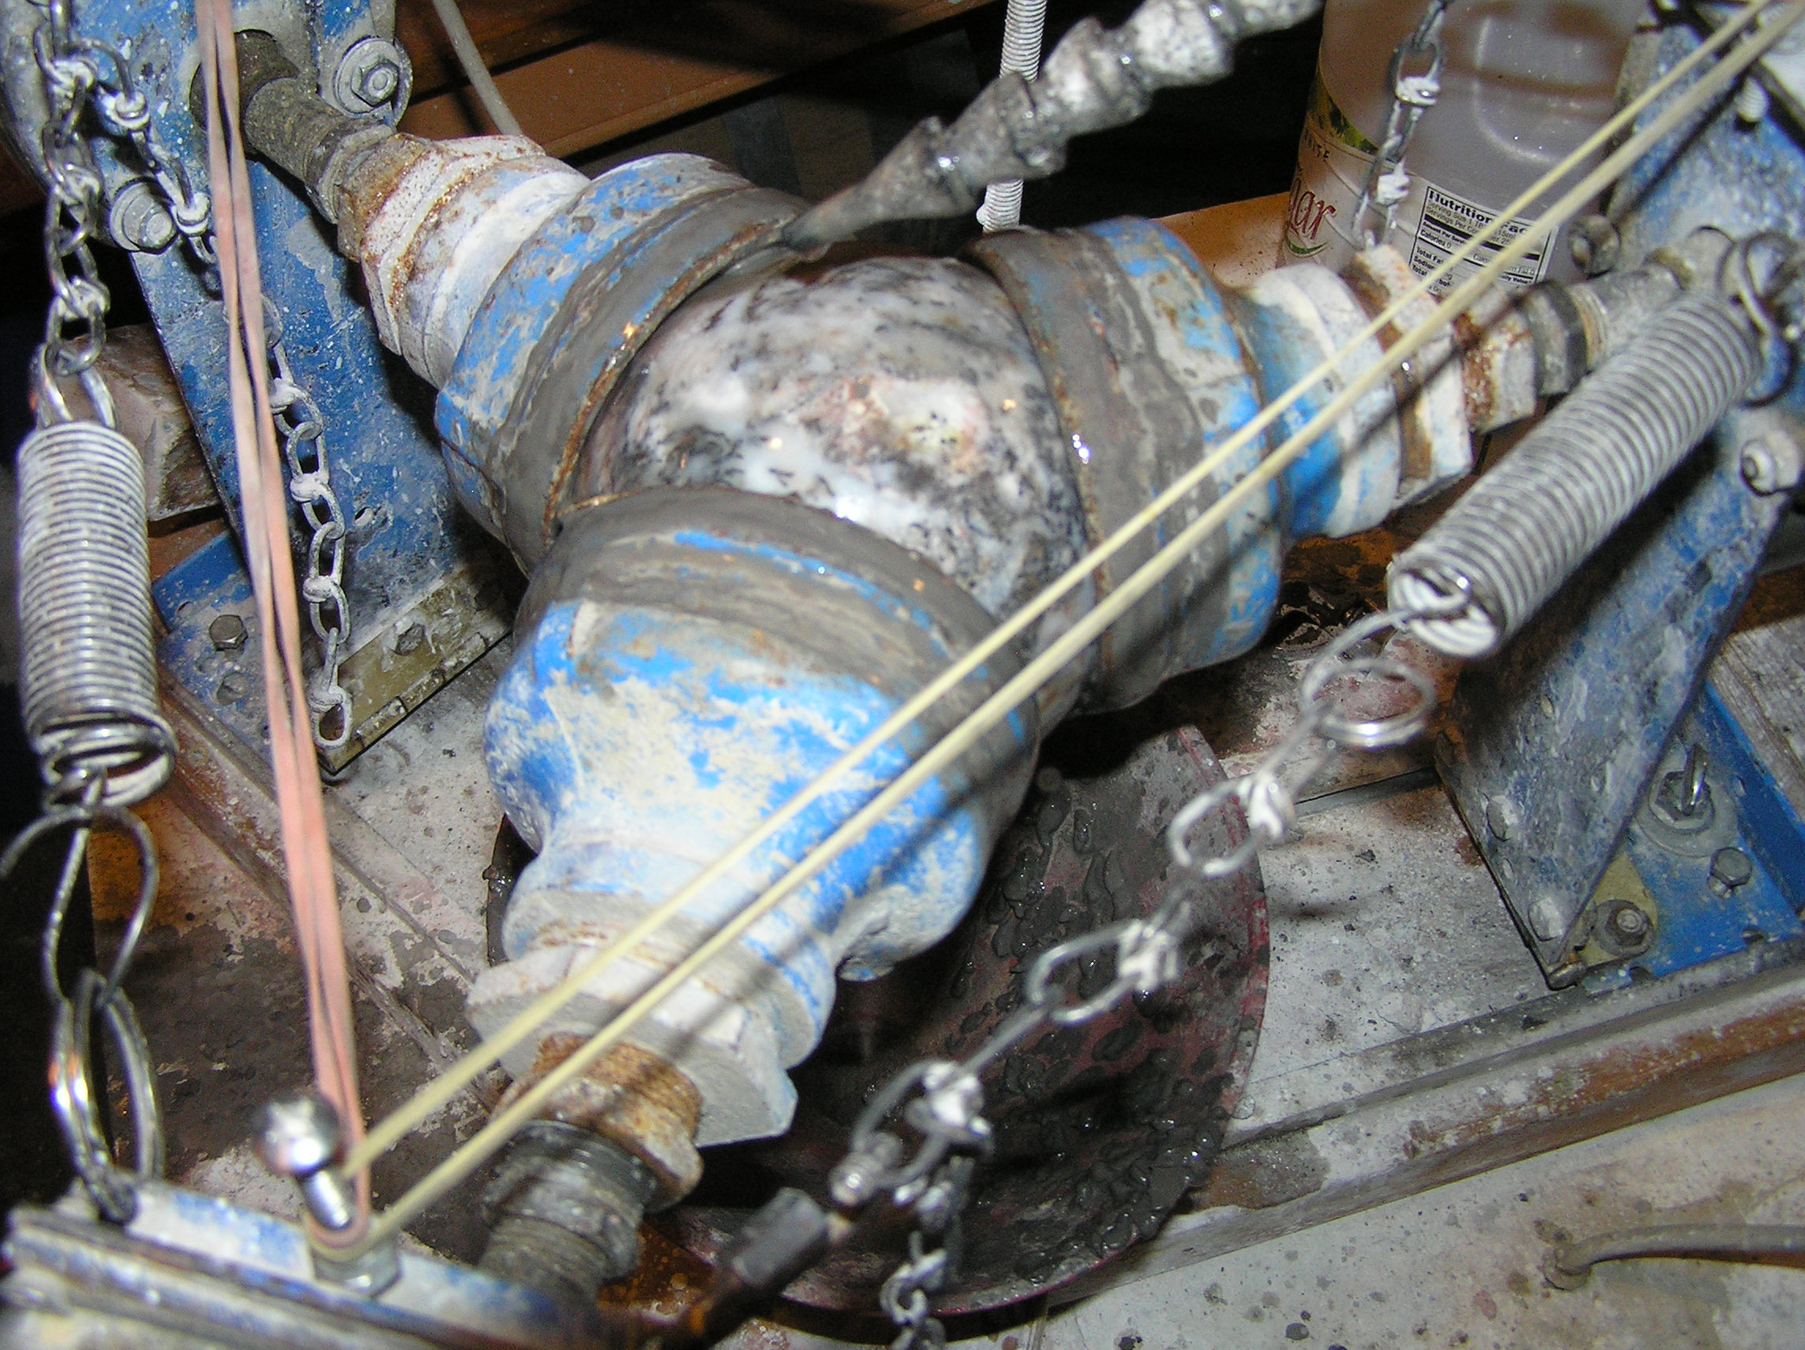

Slide 28
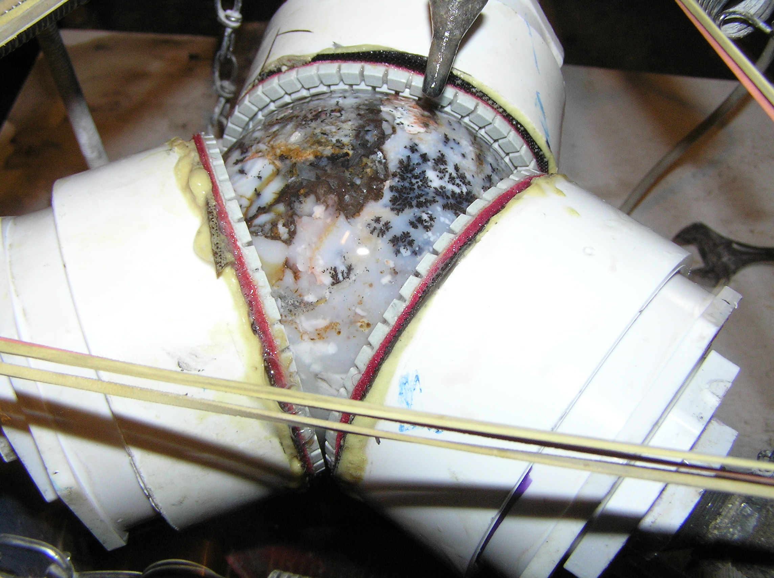

Slide 29
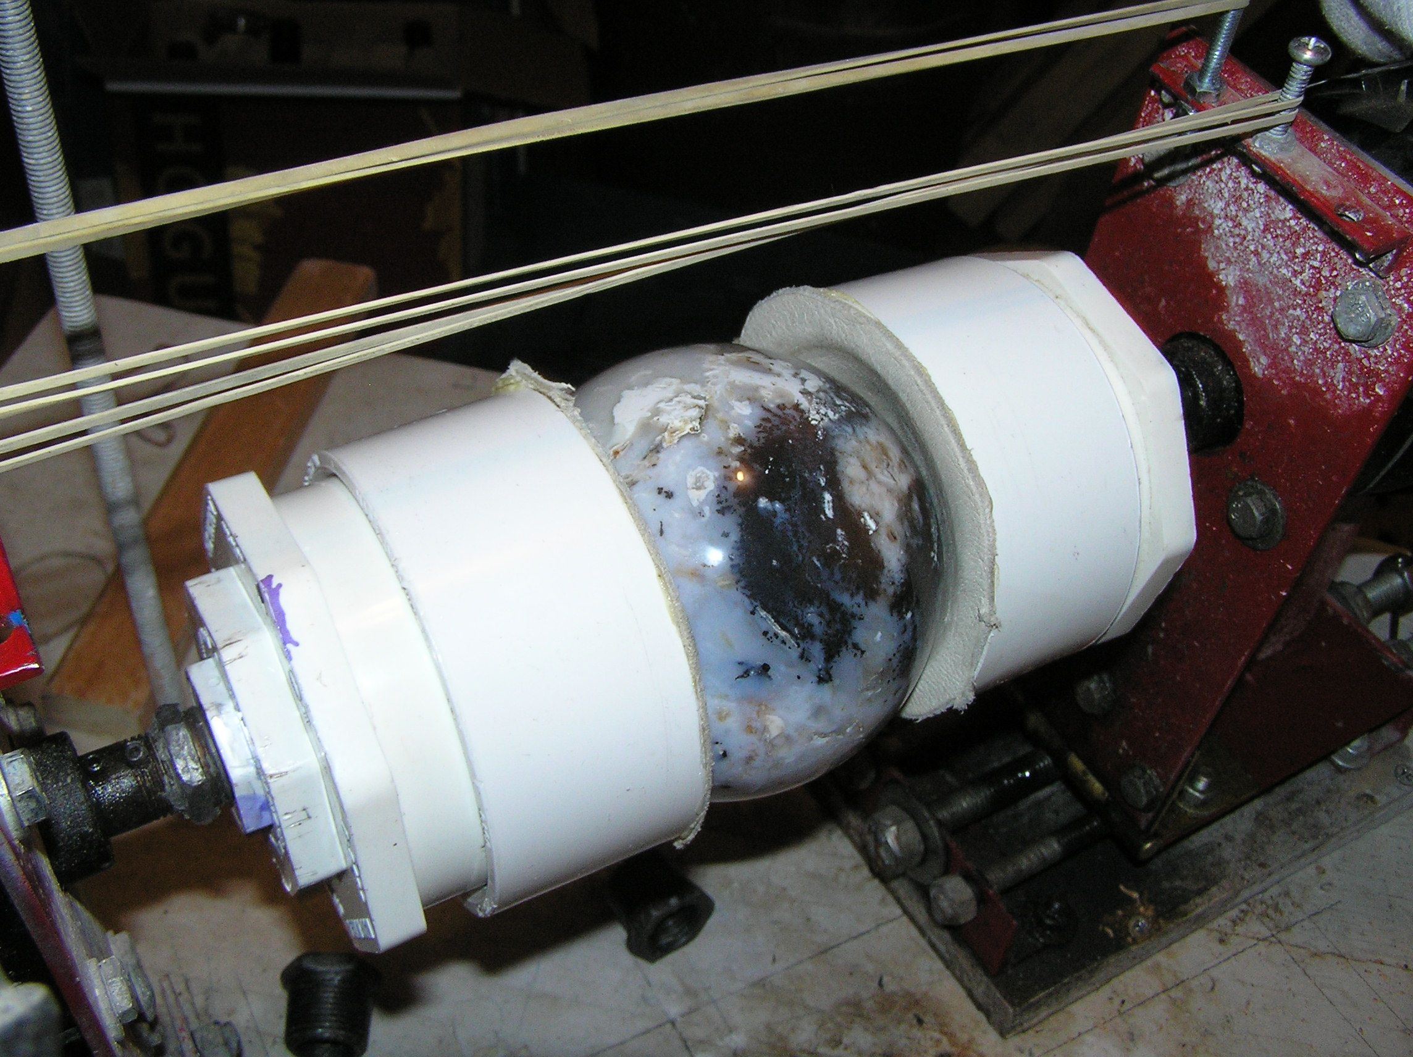

Slide 30
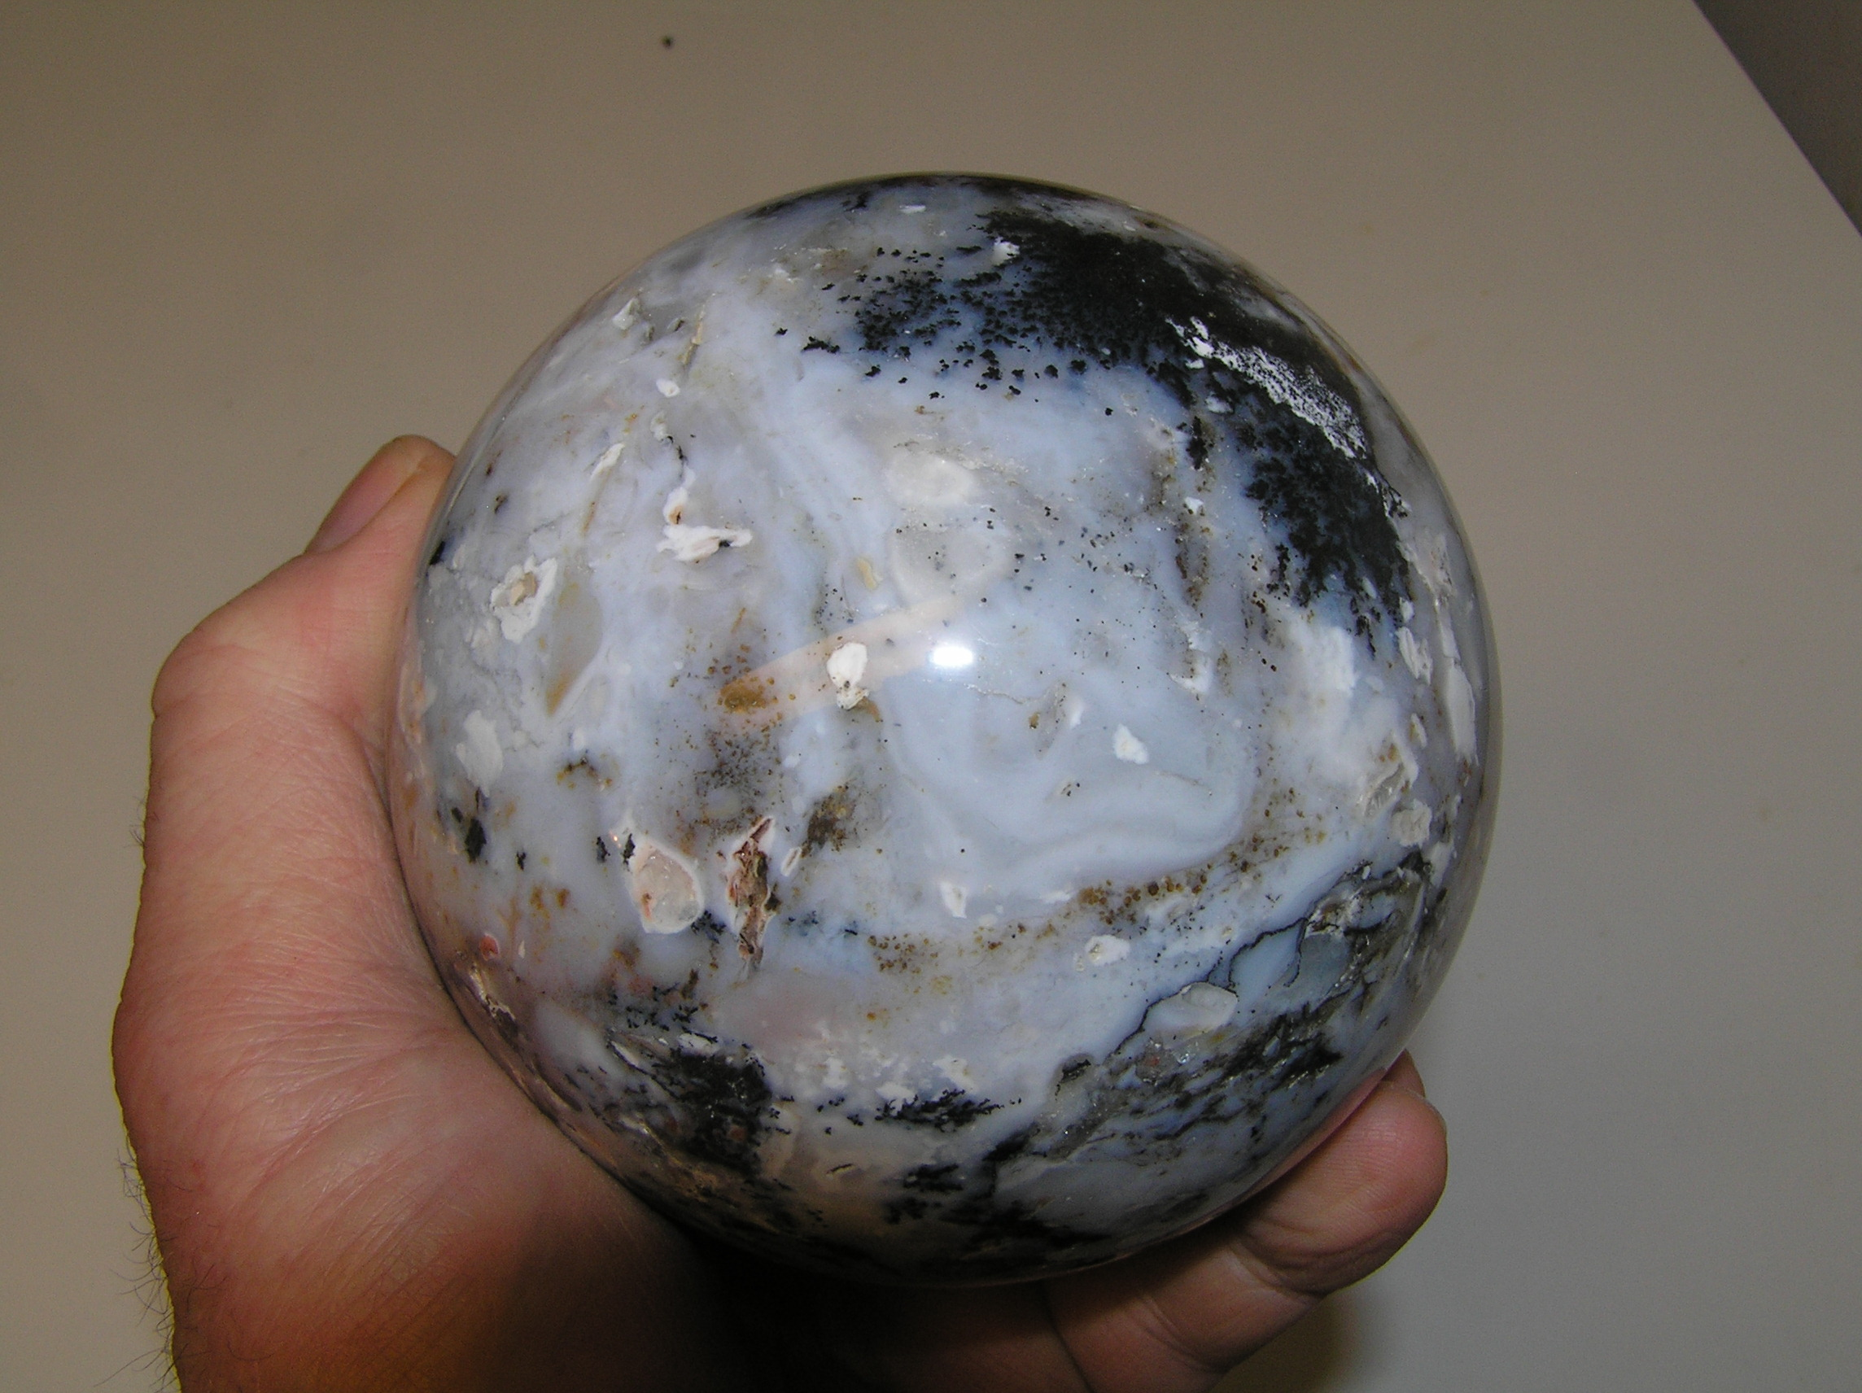

Slide 31
What do I need to make a sphere?
A Sphere Machine
A rock saw to shape the preform?? A core drill?
A grinder to round the preform
$$$ - how many depends on your choices
Time – we all have the same amount; it is just how we use it!

Slide 32
Detailed instructions on how to make a sphere machine, and where to buy supplies and materials, will be posted on the club web site!
Thank you for your interest.

