Slide 1
Wellness for Teams and Team Leaders
David A. Rogers, MD, MHPE
UAB Medicine Chief Wellness Officer

Slide 2
Objectives
Describe the relationship between stress, burnout, resilience and engagement
Describe some of the unique causes and outcomes of burnout
Outline an approach to team wellness
Review resources to help the healthcare team to reduce stress and improve resilience

Slide 3
David A. Rogers, MD, MHPE
Disclosure Information
I have no financial relationships or affiliations to disclose.
AND
I will not discuss off label use and/or investigational use in my presentation.

Slide 4
The Optimal State
Dodge R, Daly AP, Huyton J, Sanders LD. The challenge of defining wellbeing. Int J Wellbeing. 2012;29;2(3).

Slide 5
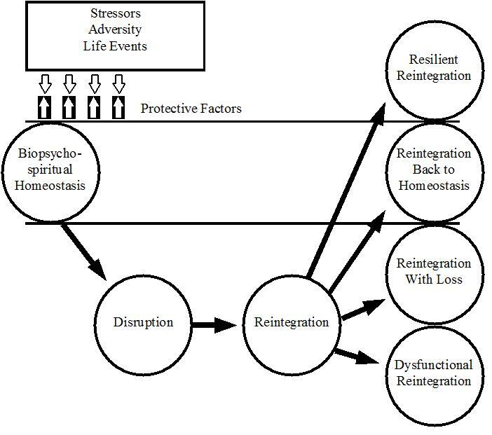
Richardson, G. E.(2002). The metatheory of resilience and resiliency. Journal of Clinical Psychology, 58, 307-321.

Slide 6
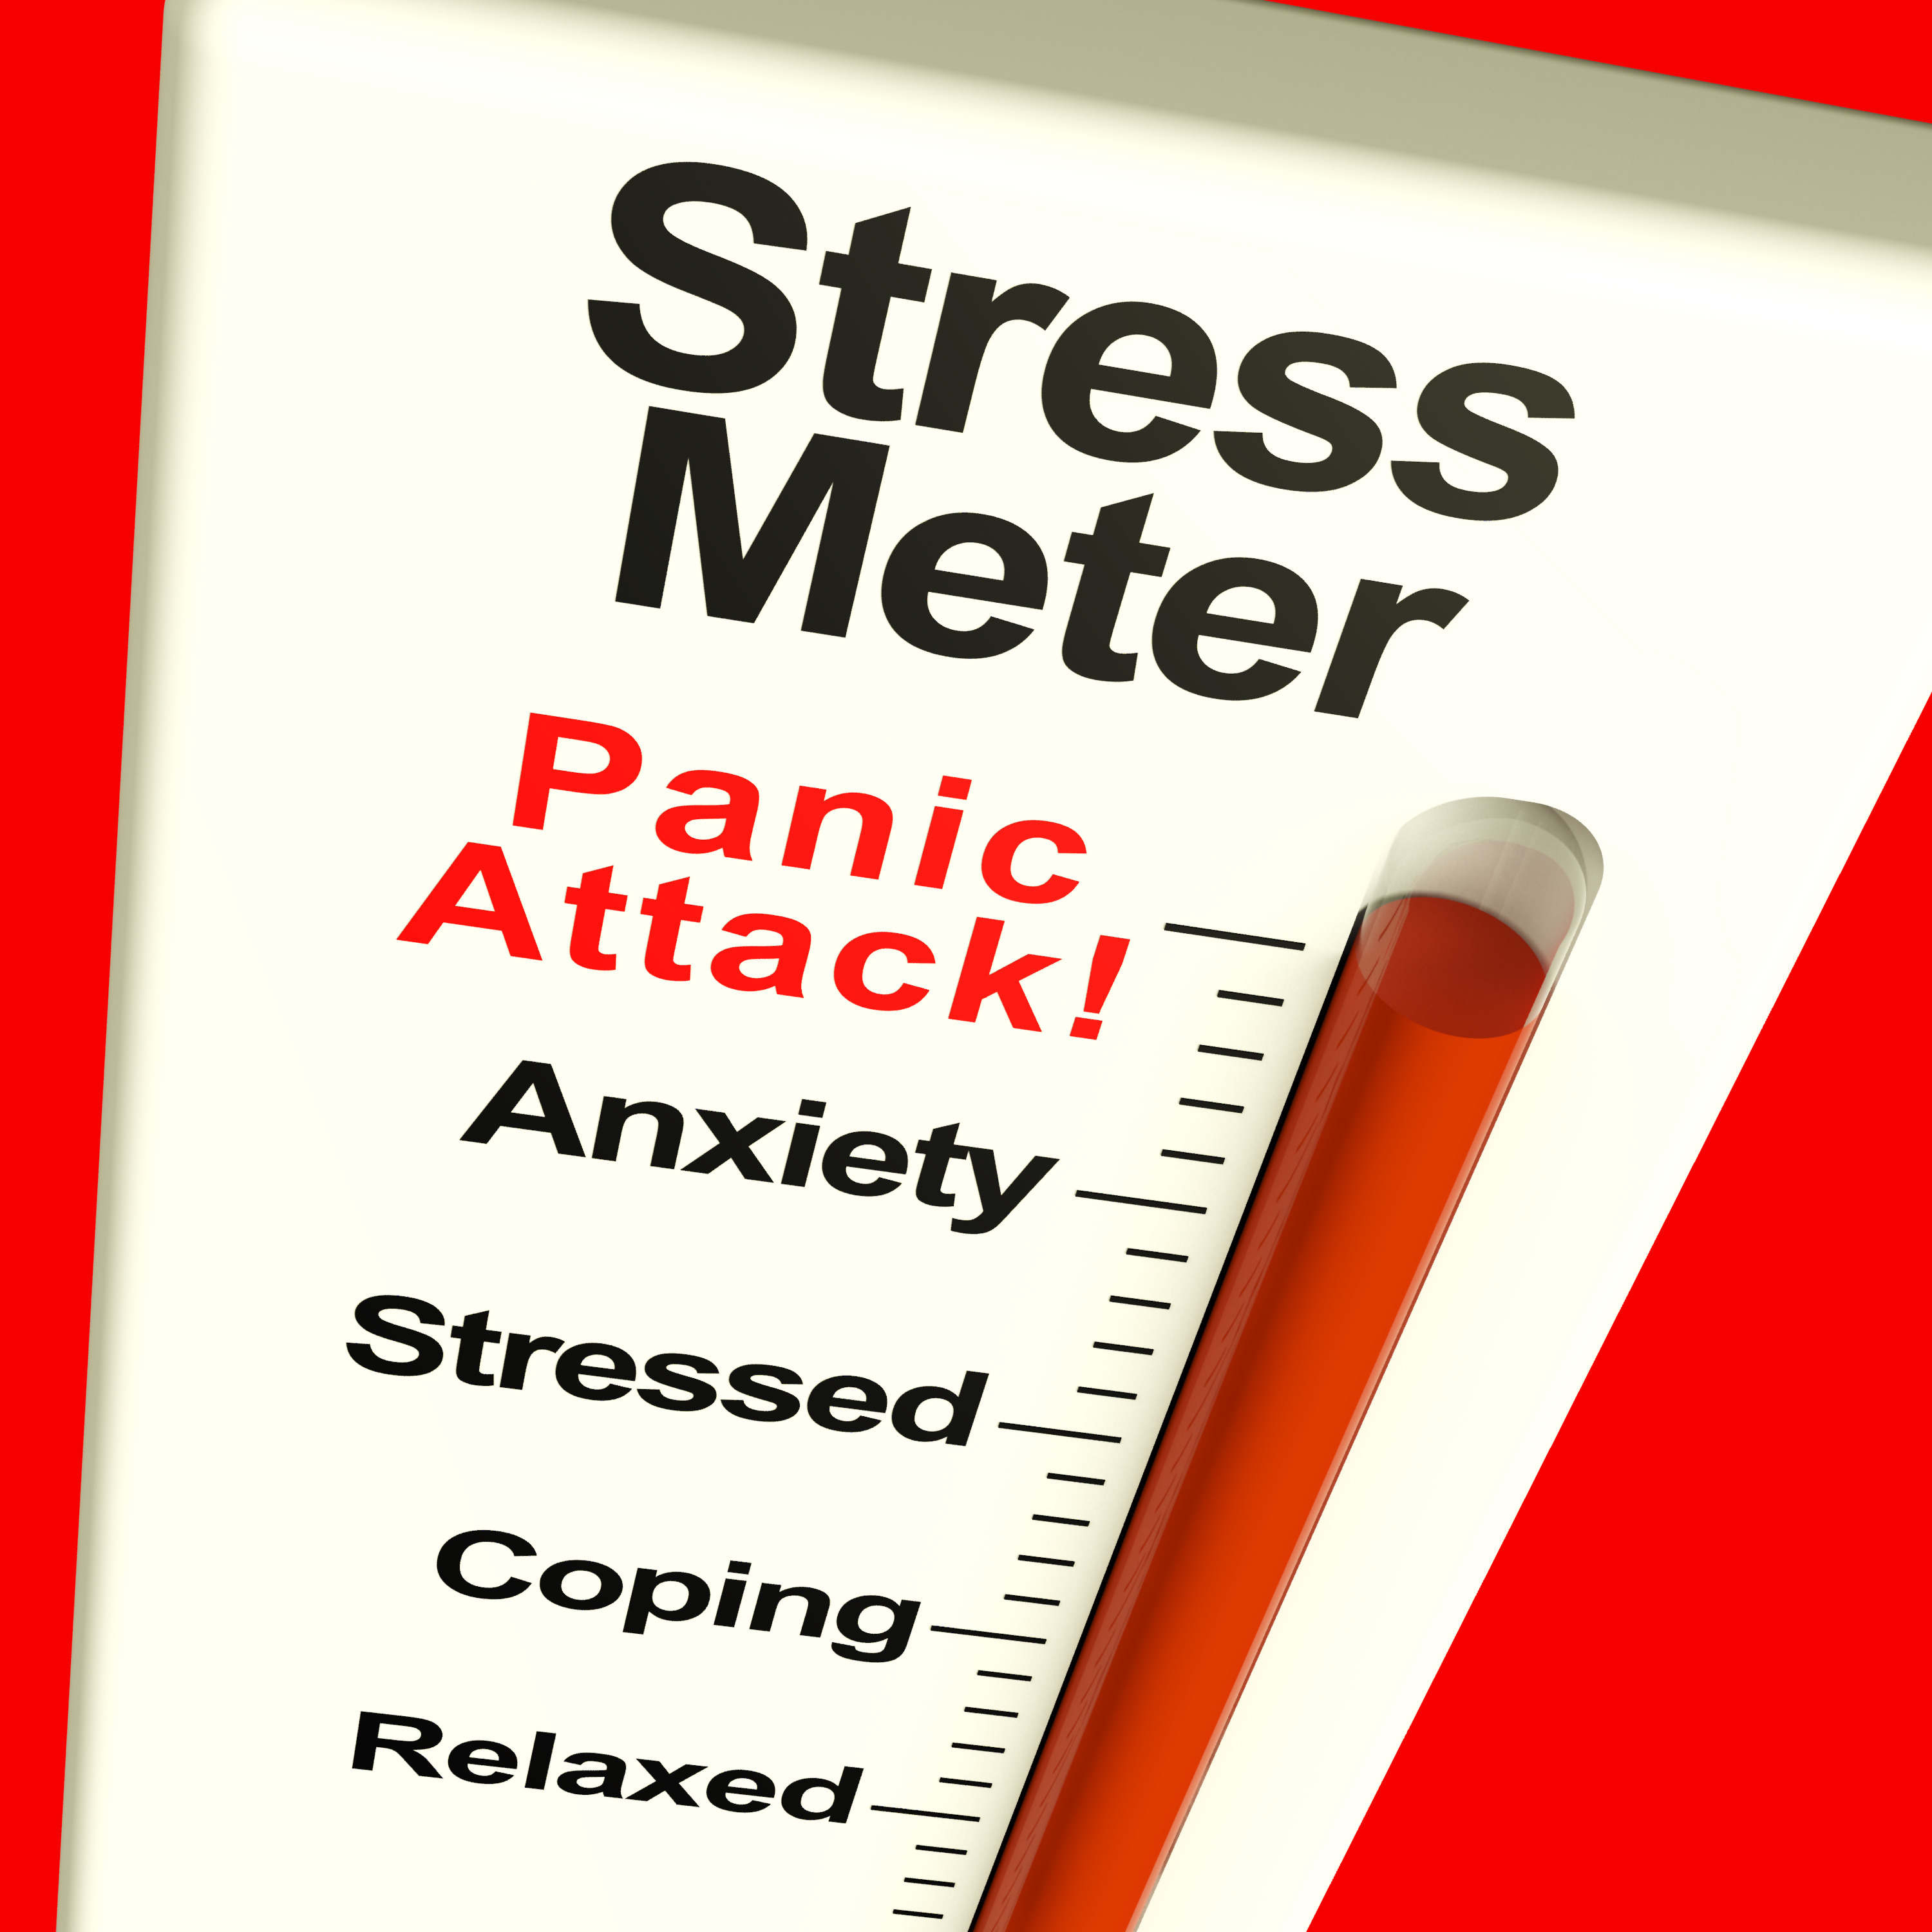
Stress
“A state of mental or emotional strain or tension resulting from adverse or demanding circumstances.”
https://en.oxforddictionaries.com/definition/stress

Slide 7
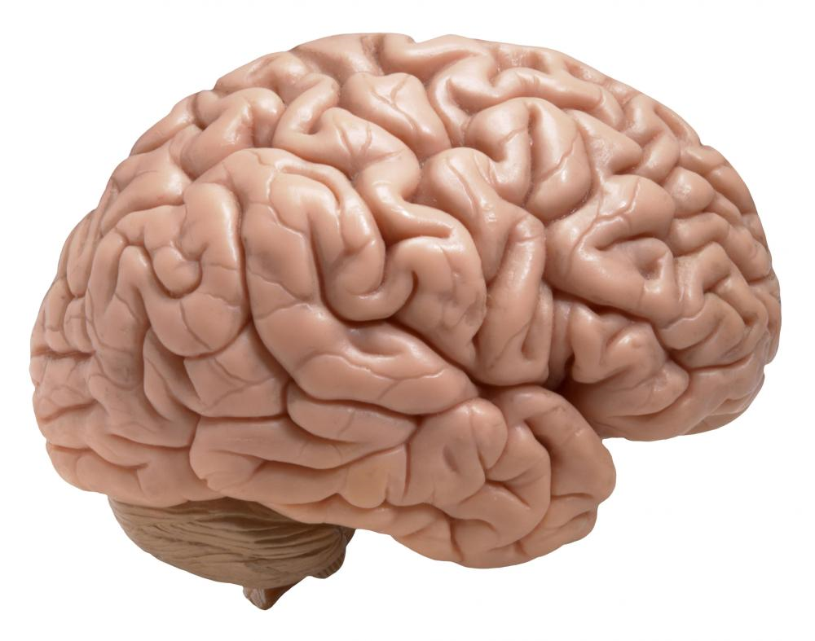
The Neural Effects of Chronic Stress
Less able to react effectively to stressors
Long term personal and professional consequences

Slide 8
Salvagioni DA, Melanda FN, Mesas AE, González AD, Gabani FL, de Andrade SM. Physical, psychological and occupational consequences of job burnout: a systematic review of prospective studies. PloS one. 2017 Oct 4;12(10):e0185781.

Slide 9
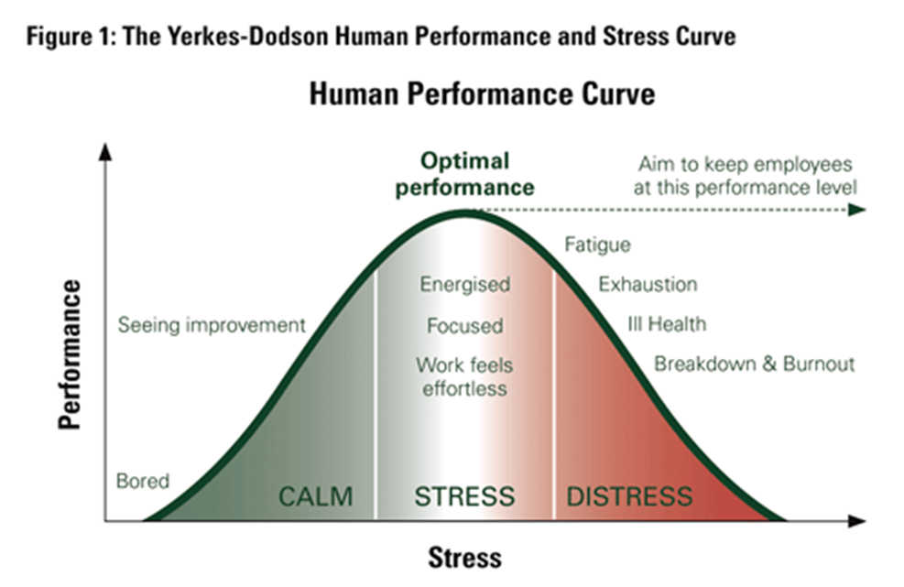
Stress and Burnout
http://www.thinkadvisor.com/2012/08/21/stressed-for-success-pt-2-helping-employees-to-per

Slide 10
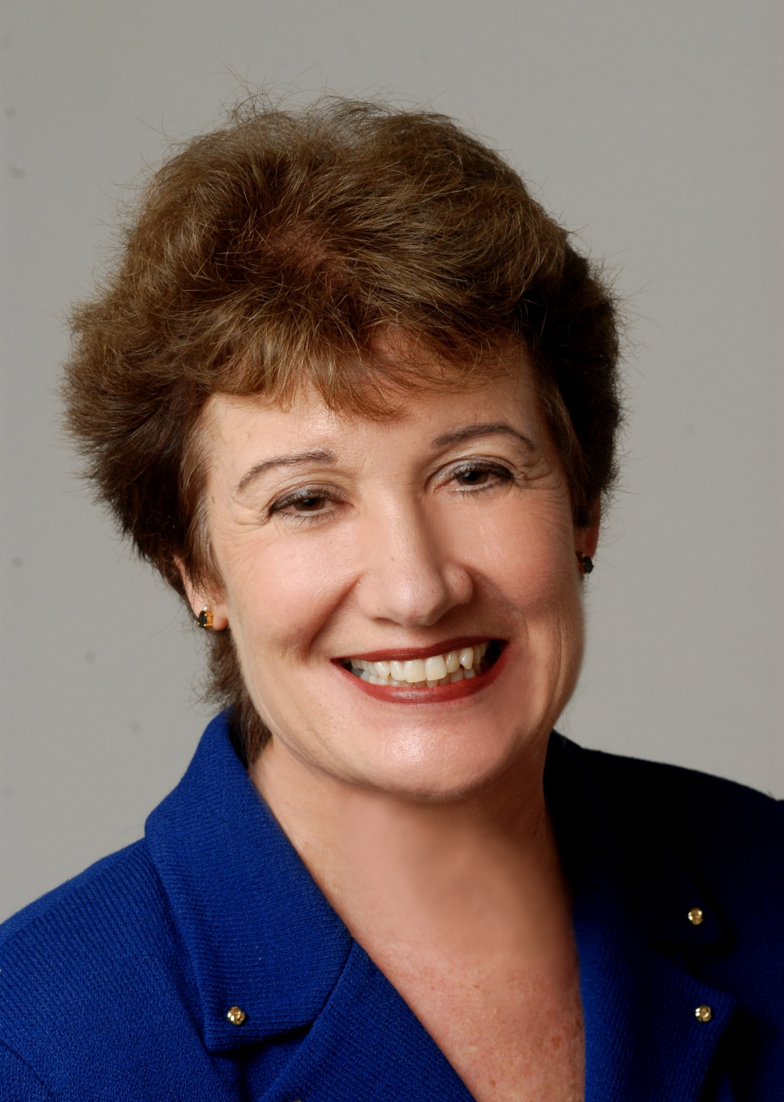
Burnout
Job burnout is as a state characterized by emotional exhaustion, low self-efficacy and depersonalization of others.
Maslach C. Burnout: The cost of caring. Ishk; 2003.

Slide 11
Engagement and Burnout
Burnout |  | Engagement
Emotionally exhausted | Energy | Vigorous
Depersonalizes others | Involvement | Connected
Abiding sense of failure | Efficacy | Confident
Day A, Leiter MP. The good and the bad of working relationships. Burnout at work. A psychological perspective. Psychological Press, London. 2014 Apr 24:56-79.

Slide 12

Resilience
“The process of adapting well in the face of adversity, trauma, tragedy, threats or significant sources of stress”¹
‘‘…a process to harness resources in order to sustain well-being.’’²
1. https://www.apa.org/helpcenter/road-resilience.aspx
2. Panter‐Brick C, Leckman JF. Editorial commentary: resilience in child development–interconnected pathways to wellbeing. Journal of child psychology and psychiatry. 2013 Apr 1;54(4):333-6.

Slide 13
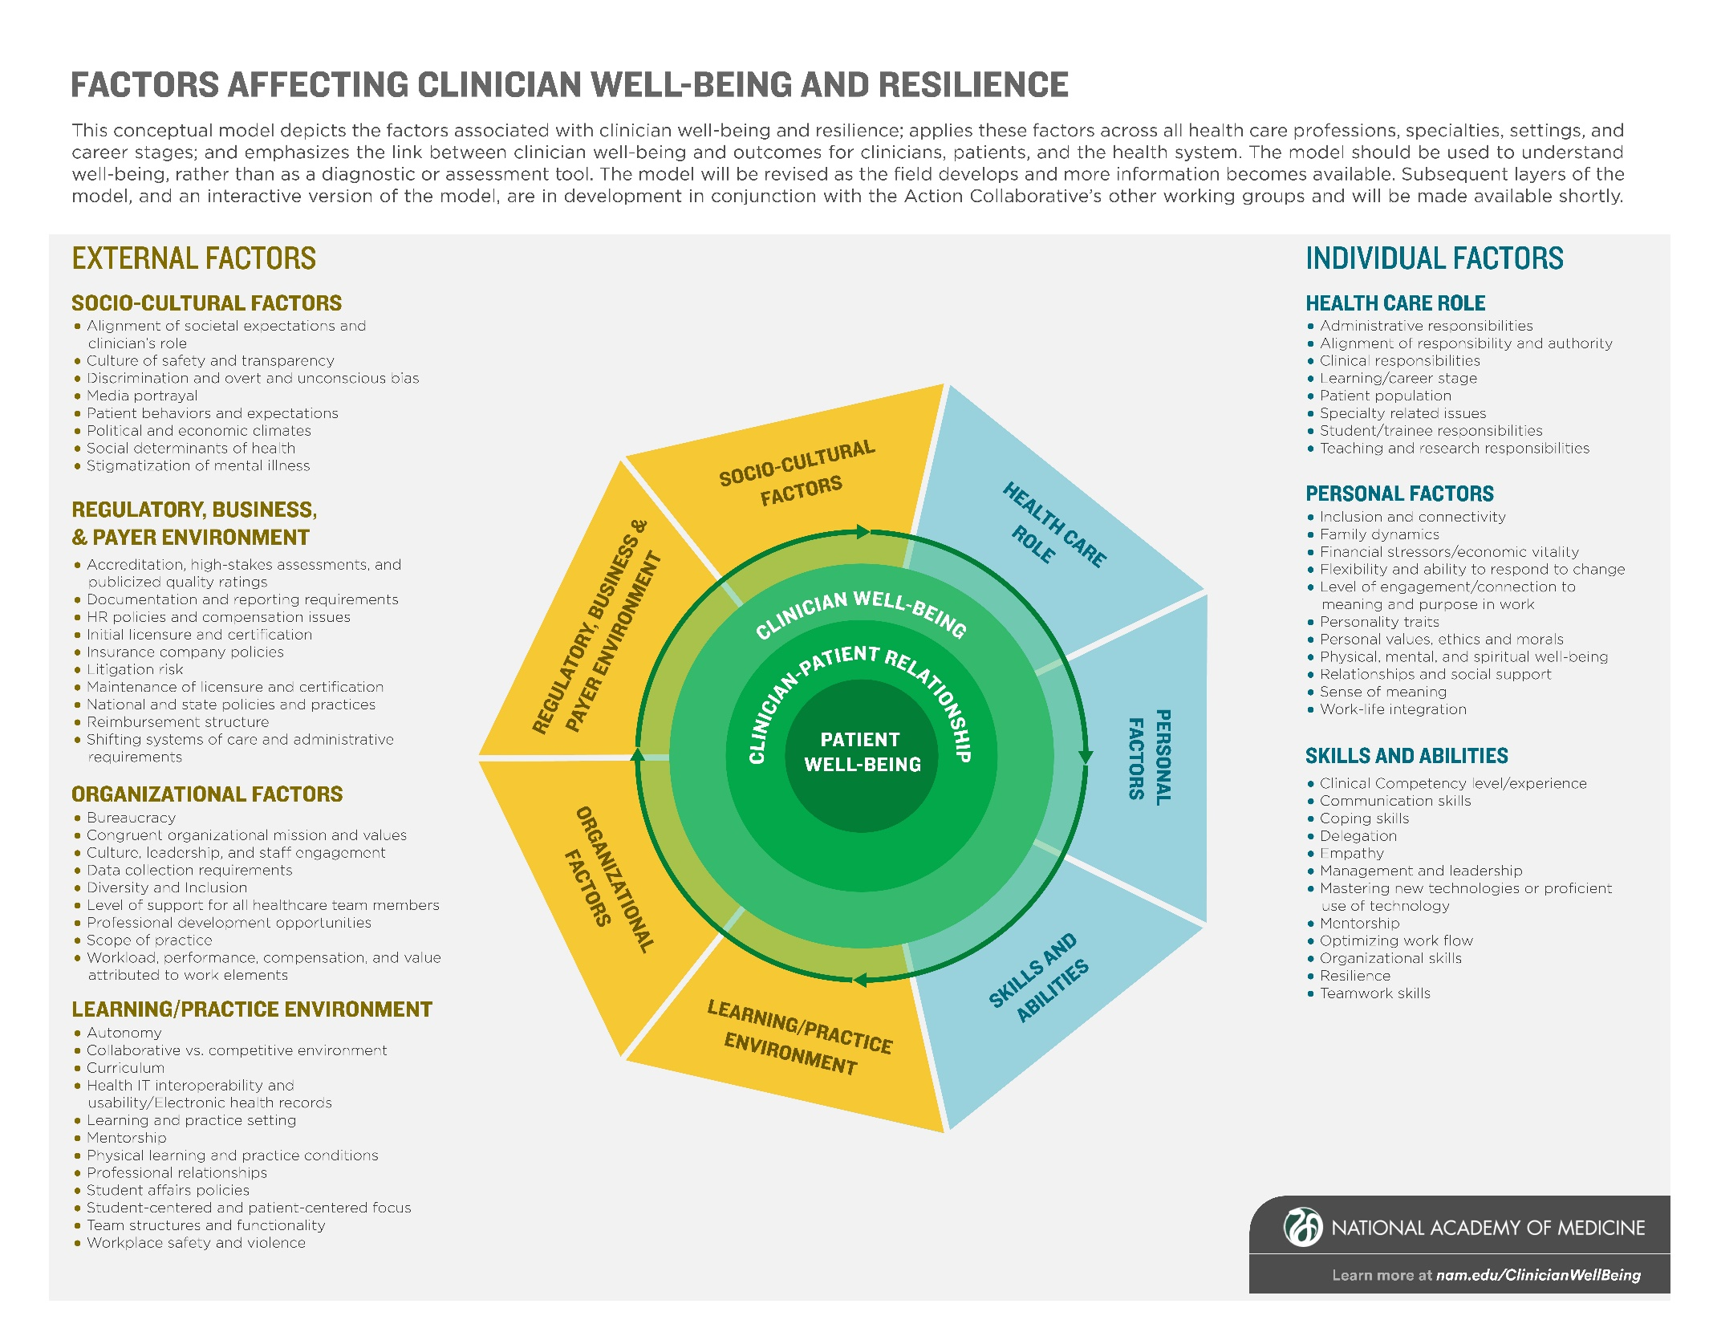

Slide 14
Regulation
Rothenberger DA. Physician burnout and well-being: a systematic review and framework for action. Diseases of the Colon & Rectum. 2017;60:567-76.

Slide 15
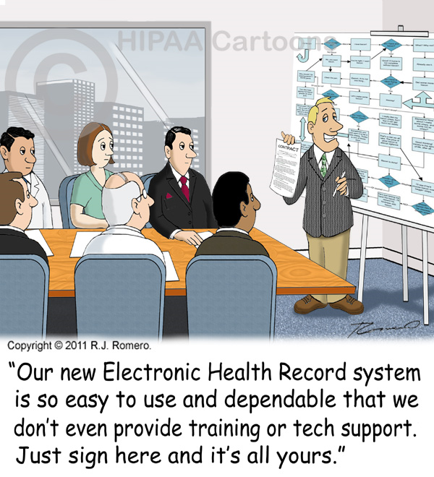
The Electronic Health Record

Slide 16
The Critical Importance of Front-Line Leaders
Grus, Catherine, and Sandeep P. Kishore. "A Multifaceted Systems Approach to Addressing Stress Within Health Professions Education and Beyond." (2017).

Slide 17
The Impact of Leaders on Their Teams
“Gallup estimates that the manager accounts for at least 70% of the variance in employee engagement scores across business units.”
https://www.gallup.com/services/182138/state-american-manager.aspx

Slide 19
Nursing Work Environment
Managerial support for nursing
Responsiveness of management to correcting problems in care at the bedside identified by nurses
Doctor nurse relations
McHugh MD, Kutney-Lee A, Cimiotti JP, Sloane DM, Aiken LH. Nurses’ widespread job dissatisfaction, burnout, and frustration with health benefits signal problems for patient care. Health Affairs. 2011 Feb 1;30(2):202-10.

Slide 20
Recommendations for Improving Team Wellness
Monitor your own well-being
Engage in self-care
Develop your own leadership capacity
Challenge your team
Promote team compassion

Slide 21
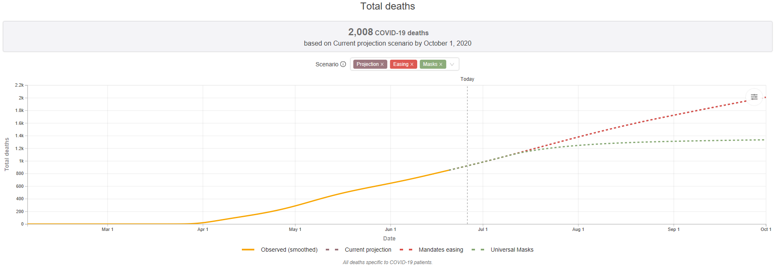
Not That You Were Wondering….
https://covid19.healthdata.org/united-states-of-america/alabama

Slide 22
Tracking Your Own Well-Being
Dyrbye LN, Satele D, Shanafelt T. Ability of a 9-item well-being index to identify distress and stratify quality of life in US workers. J Occup Environ Med 2016;58:810-7.

Slide 23
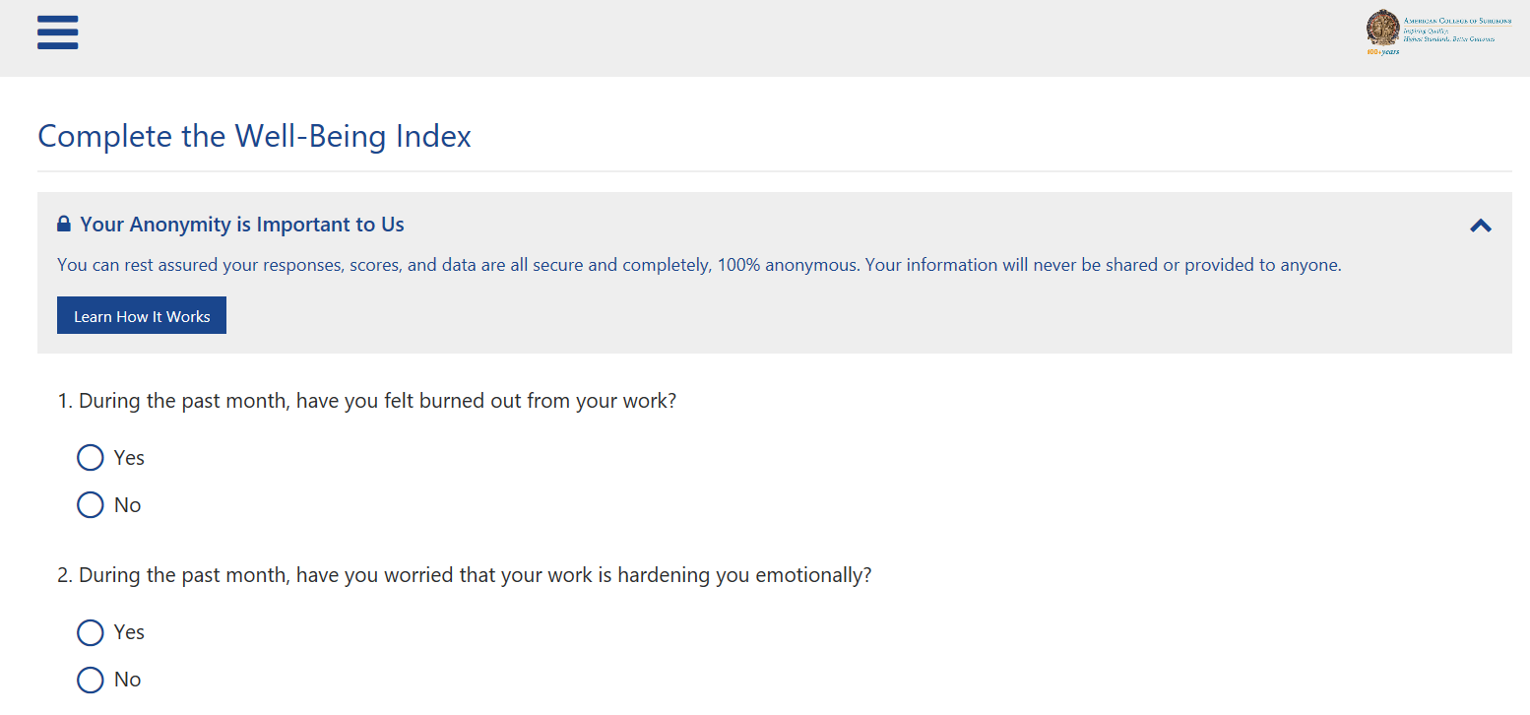

Slide 24
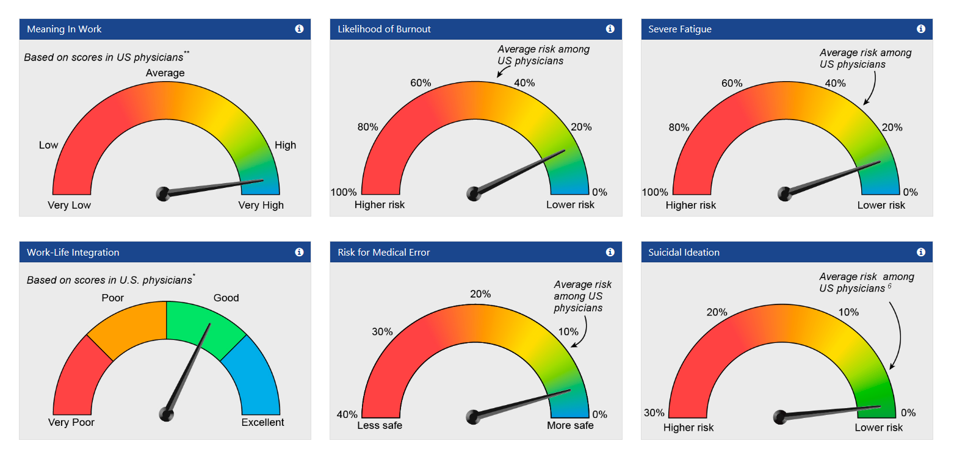

Slide 25

Alternative Tracking

Slide 26
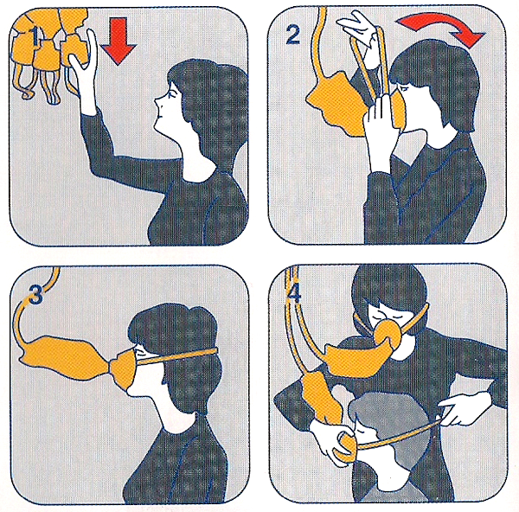
Leader Wellness Self-Care

Slide 27
Cognitive Behavioral Approaches
Regehr C, Glancy D, Pitts A, LeBlanc VR. Interventions to reduce the consequences of stress in physicians: a review and meta-analysis. J Nerv Ment Dis. 2014 May;202(5):353-9.

Slide 28
SMART Model
Day of the Week | Theme
Monday | Gratitude
Tuesday | Compassion
Wednesday | Acceptance
Thursday | Meaning
Friday | Forgiveness
Saturday | Celebration
Sunday | Rest and reflection

Slide 29

Gratitude
Seligman ME, Steen TA, Park N, Peterson C. Positive psychology progress: empirical validation of interventions. American psychologist. 2005 Jul;60(5):410.

Slide 30

“The first crop paid off their debts and was bought by farmers seeking to change to peanut farming. Cotton was grown again, but farmers learned to diversify their crops, a practice which brought new money to Coffee County.”
https://en.wikipedia.org/wiki/Boll_Weevil_Monument

Slide 31



Slide 32
Overall Leadership Approach

Slide 33
Leadership Behaviors
Shanafelt TD, Gorringe G, Menaker R, et al. Impact of organizational leadership on physician burnout and satisfaction. Mayo Clin Proc 2015;90:432-440.

Slide 34

A Wellness Team Challenge

Slide 35
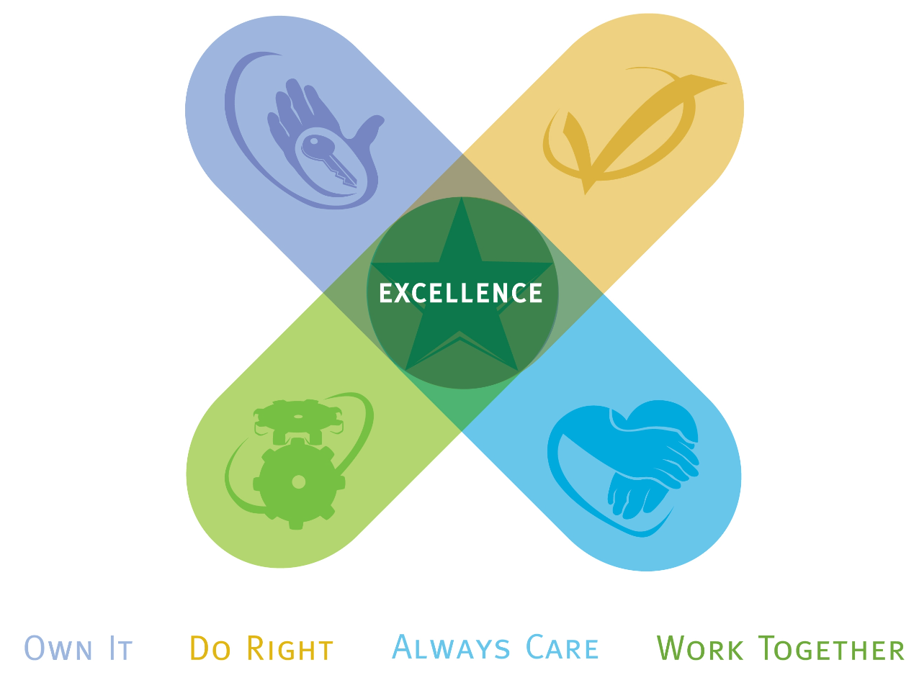
Promote Compassion

Slide 36
Suicide Prevention
Take the person seriously
Stay with them
Help them remove lethal means
Call the National Suicide Prevention Lifeline: 1-800-273-8255
Text TALK to 741741 to text with a trained crisis counselor from the Crisis Text Line for free, 24/7
Escort them to mental health services or an emergency room
https://afsp.org/find-support/when-someone-is-at-risk/

Slide 37
Advocating for Team Support Systems
“It is important that healthcare organizations develop formal systems to provide support for providers emotionally traumatized by an adverse patient event.”
Marmon LM, Heiss K. Improving surgeon wellness: the second victim syndrome and quality of care. In Seminars in pediatric surgery 2015 Dec 1 (Vol. 24, No. 6, pp. 315-318). WB Saunders.

Slide 38
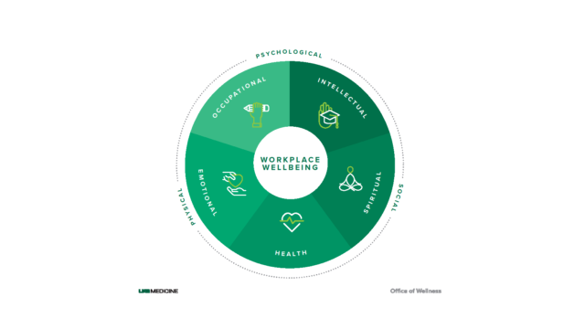
darogers1@uabmc.edu

