Slide 1
SOUTHWYCK – ANNUAL MEETING, 2020
Introduction and reading of the minutes from last annual meeting – KATHY DOOLEY
Election of Directors – HELEN BILYEU
  Nominations from the floor
  Introduction of known candidates - ** Please keep introductions down to no
  more than 2 minutes.
  John Fisher - Scarlett Kutch - Sam Prentice
  Turn in ballots for count
Master and boards responsibilities – SANGEETA BAKSHI
State of the Association/How you can participate – HELEN BILYEU
Financials – KATHY DOOLEY
2020 Possible Projects – JOHN FISHER
Q&A While votes counted – VANESSA WILLIAMS
** Please keep comments down to no more than 2 minutes.
Election Results – KATHY DOOLEY
Door Prize giveaway – SYLVIA NGUYEN

Slide 2
SOUTHWYCK – ANNUAL MEETING, 2020
Welcome & Introduction – KATHY DOOLEY
  Community Manager – Kathy Dooley
  President – Helen Bilyeu (2020)
  Vice President –John Fisher (2019)
  Secretary –Vanessa Williams (2021)
  Treasurer – Sangeeta Bakshi (2021)
  Director – Sylvia Nguyen (2020)
  Attorney – Trisha Farine

Slide 3
SOUTHWYCK – ANNUAL MEETING, 2020
Master and boards responsibilities – SANGEETA BAKSHI
  Collection of assessments and distribution of each section’s portion of
  the assessments which they set each year. Interest on the section’s late
  payments.
  Landscape maintenance including but not limited to mowing, edging,
  blowing, plantings, mulching, pest control, irrigation system and
  watering of 18 entrances and 2 parks.
  All costs associated with the lighting & irrigation for all 18 entrances
  and 2 parks.
  Tree trimming.
  Repair/replacement of all perimeter fences.

Slide 4
SOUTHWYCK – ANNUAL MEETING, 2020
Master and boards responsibilities (continued) – SANGEETA BAKSHI
  Play equipment, sun shades, picnic tables, benches, swings,
  water fountains & foot washing station, volley ball court, sand box,
  trash cans and doggy stations in our 2 parks.
  Upkeep of the lake & fountain with cost sharing with Silverlake.
  Upkeep of covered structures and the 2 patio structures at our 2 parks.
  Power washing of entrances, fences, play equipment, patios/pavilions
  and graffiti removal.
  Casualty insurance for master and sections at no charge to sections.
  Directors and officers liability insurance for the master board.

Slide 5
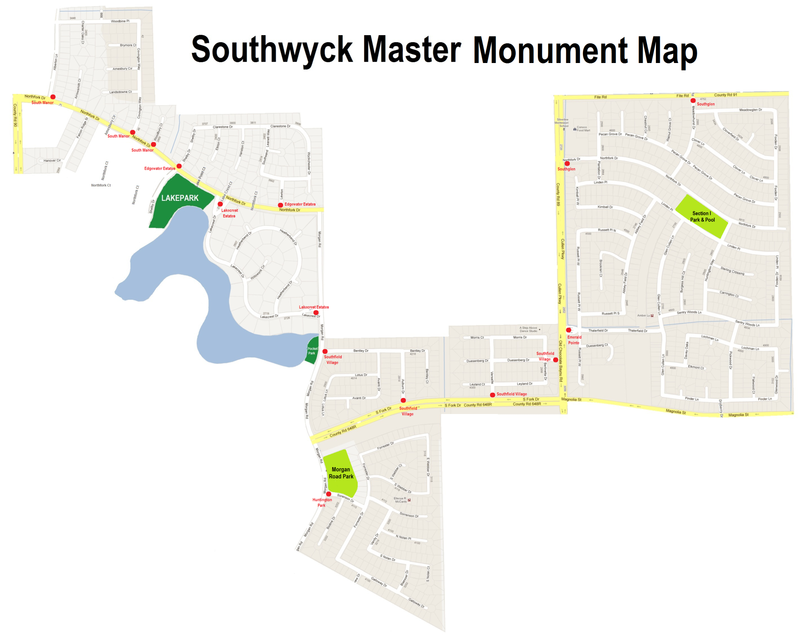
Southwyck Community Association – 1673 homes
Section I – 4 monuments, 4 entrances,
1 pool & pool house, 1 open field, 2 playgrounds
Section IV – 10 monuments, 14 entrances,
1 pool & pool house, 1 baseball field,
1 playground
Section V – 2 monuments, 2 entrances,
1 fishing pier
Master – 2 monuments, 1 open field, 1 playground,
2 pavilions & 1 patios
Emerald
Pointe
Section I – Southglen & Emerald Pointe (865)
Section IV– South Manor, Edgewater Estates,
Southfield Village & Huntington Park (755)
Section V – Lakecrest Estates (53)
Entrances in Southwyck (18)

Slide 6
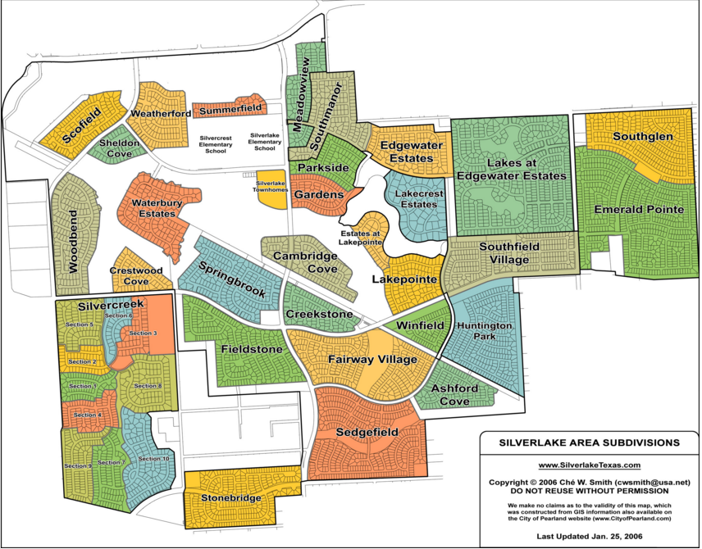
Southwyck, Edgewater Estates and Silverlake Villages
Getting to know your Villages

Slide 7
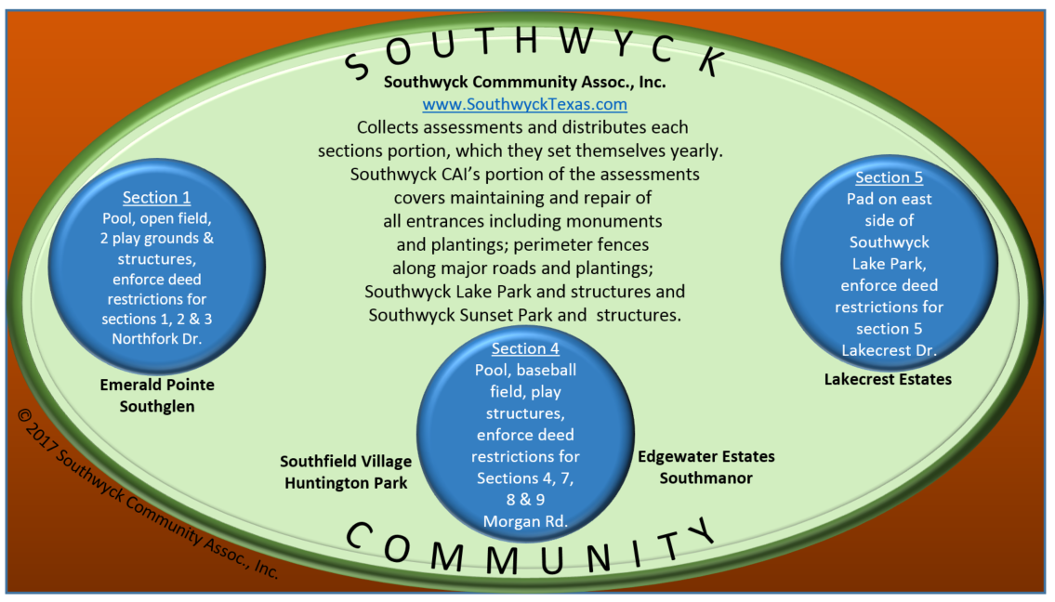
SOUTHWYCK – ANNUAL MEETING, 2020
** Magnets available to homeowners

Slide 8
SOUTHWYCK – ANNUAL MEETING, 2020
State of the Association – HELEN BILYEU
  Homeowner participation at monthly board meetings. Thank you for helping our association by attending and providing your input.
  Southglen entrance repairs and upgrade completed. Homeowners helped to approve final design.
  Additional fountain at the Southwyck Sunset Park.
  Replace drinking water fountain and foot washing station at Southwyck Lake Park.
  Repair of wooden fences – Huntington Park for those homeowners who gave permission for us to enter their back-yard property in order to make these repairs safely.
  Quarterly power washing of all play equipment and picnic tables in both parks.

Slide 9
SOUTHWYCK – ANNUAL MEETING, 2020
State of the Association (continued) – HELEN BILYEU
  Completed the 2019 audit.
  Continued displaying of Patriotic flags with participation from the Boy Scouts.
  Replace rules and contact signs at both of our parks.
  Aggressive tree trimming and removal of some dead or dying trees around our perimeter fences and at each park.
  Community events at Southwyck Lake Park twice this year. Cost of porta potties offset by vendor market.
  Website kept up-to-date and relevant with News & Event page usually being updated shortly after our monthly board meetings.

Slide 10
SOUTHWYCK – ANNUAL MEETING, 2020
State of the Association (continued) – HELEN BILYEU
  In 2019 Silverlake continues to share expenses for Southwyck Lake Park lake maintenance by helping with chemical treatments and fountain upkeep.
  Southwyck Lake Park are used for soccer and t-ball practice, volleyball games, exercise and meditation groups, triathlon, weddings, birthday parties, family reunion, community outreach groups, Boy Scout ceremony and elementary schools end of year activities and community events.

Slide 11
SOUTHWYCK – ANNUAL MEETING, 2020
How you can participate in our association – HELEN BILYEU
Community Events – assist in finding opportunities where we can get our communities to come together. We are looking for low cost/no cost events and not the Disney World experience.
Projects – throughout the year we have projects that we work on where we would like homeowner input. That could be anything from input on fencing, tree replacement, entrance management to adding additional equipment at our parks or repairs to existing.
Report – vandalism or damage to our property, malfunction of lights at parks, fountains in lake, drinking fountain, irrigation leaks by emailing to directors@SouthwyckTexas.com.
Southwyck Community Association believes that running a successful association requires teamwork. We are once again looking for input/help from our homeowners. If you are looking for a way to actually make a difference in our community, please consider volunteering. The Southwyck CAI board reserves the right to approve all volunteers.

Slide 12
SOUTHWYCK – ANNUAL MEETING, 2020
Financials – Kathy Dooley
2020 Budget
* Percent in parentheses is 2019 amount

Slide 13
SOUTHWYCK – ANNUAL MEETING, 2020
2020 – Possible Projects – JOHN FISHER
(Order is not order of priority)
  Huntington Park monument repairs.
  Continuing fence repair.
  Continued power washing program revolving entrances and fences.
  Update patio structure at Northfork at Lakecrest.
  Additional tree/bush planting.
  Additional electrical outlets added in at Southwyck Lake Park.
  Community events at Southwyck Lake Park.
  Explore engineering of clubhouse.
  ** Should I mention the bulkhead and who actually does these repairs?
  MUD? KATHY to ask.

Slide 14
SOUTHWYCK – ANNUAL MEETING, 2020
Q&A while votes counted – VANESSA WILLIAMS
Election Results – KATHY DOOLEY
Door prize giveaway – SYLVIA NGUYEN
Reminders:
  Board meetings are
1st Thursday of every month at 6:30 PM
at Calvary Baptist Church. Next meeting February 6th.
  Check our website for updates, especially News & Events page.
  We need volunteers for short time periods throughout the year.
  Email directors@SoutheyckTexas.com if you would like to help.
GET INVOLVED with your community association either at the
section level or master level. We need your input!

Slide 15
SOUTHWYCK – ANNUAL MEETING, 2020
DOOR PRIZE GIVEAWAY!
The Southwyck CAI board thanks you for attending our annual meeting!
  President – Helen Bilyeu (2020)
  Vice President –John Fisher (2019)
  Secretary –Vanessa Williams (2021)
  Treasurer – Sangeeta Bakshi (2021)
  Director – Sylvia Nguyen (2020)
We challenge homeowners to try to make it to at least a couple of our monthly
meetings a year or to at least stay informed by checking out website,
www.SouthwyckTexas.com News & Events page which is updated shortly after
every board meeting to help you stay informed. The first 30 minutes of each
meeting is for homeowner input.
If you have questions about Southwyck CAI, please email us at
directors@SouthwyckTexas.com and we will try to answer any question you have.

