Slide 1
Testimony of John Holland, Pres. Equine Welfare Alliance in the matter of the application of Valley Meat Company for Ground Water Discharge Permit Renewal, DP-236 GWB 13-05 (P)

Slide 2
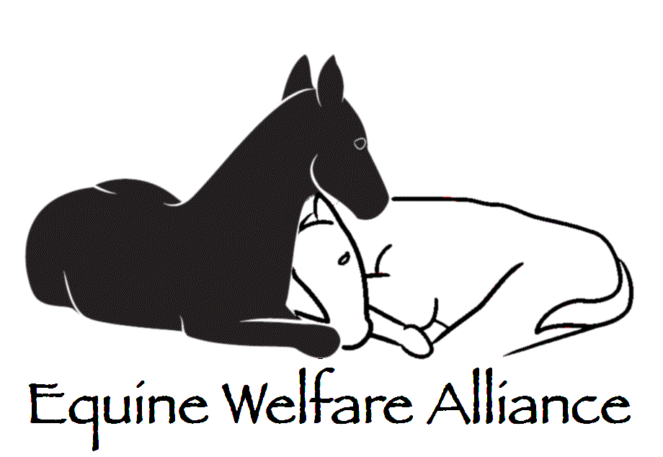
Non-profit 501(c)(4) corporation.
290 member organizations and partners in 21 countries.
Provides research and investigation in matters of equine welfare.
Our studies, data and investigations are available to law makers, law enforcement and the public.
EWA is staffed entirely by volunteers, and is not affiliated with any other party testifying at this hearing.

Slide 3
John Holland (equine experience)
Owned horses for 40 years
Operate small sanctuary
Founding officer of EWA
Specialize in statistical studies
Widely published on subject of equine welfare and horse slaughter, including a recent paper in the KY Journal of Equine, Agricultural and Natural Resources Law.

Slide 4
John Holland (technical career)
BSEE Virginia Tech. 1968
40 years of experience in fiber optics, industrial control systems and autonomous robotics
12 patents, 3 books
Worked for DOE, DOD and other agencies designing robotic survey and decontamination/remediation systems.
Currently consultant in knowledge based control systems.

Slide 5
Remediation Projects
Caused by a poor decision making up front
Exacerbated by political/budget pressures
Often involved cover-ups and scandals
Remediation costs are always high
All have long term environmental consequences

Slide 7
Lessons Learned from Past Horse Slaughter Operations
There is no established market for the byproducts of equine slaughter.
Systems designed to treat liquid wastes from cattle slaughter operations don’t work for horses.

Slide 8
Cavel International (Velda NV) DeKalb, IL

Slide 9
Cavel
Old plant burned down Easter 2002
Rebuilt to most modern standards
Reopened in Summer of 2004

Slide 10
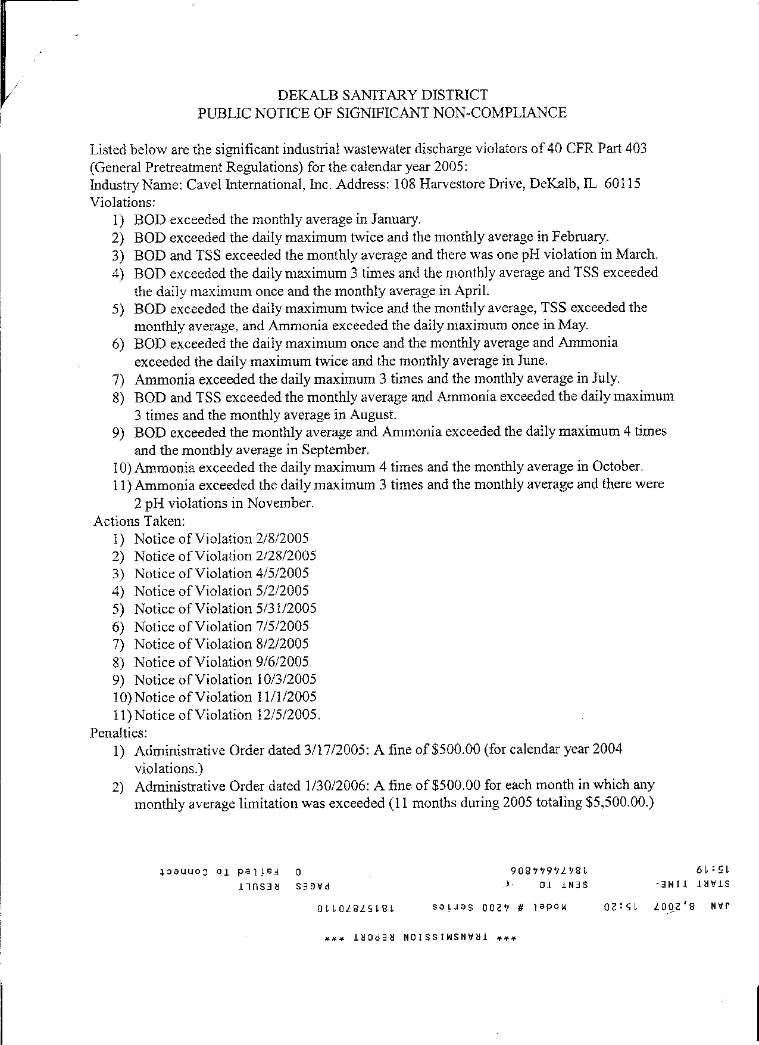
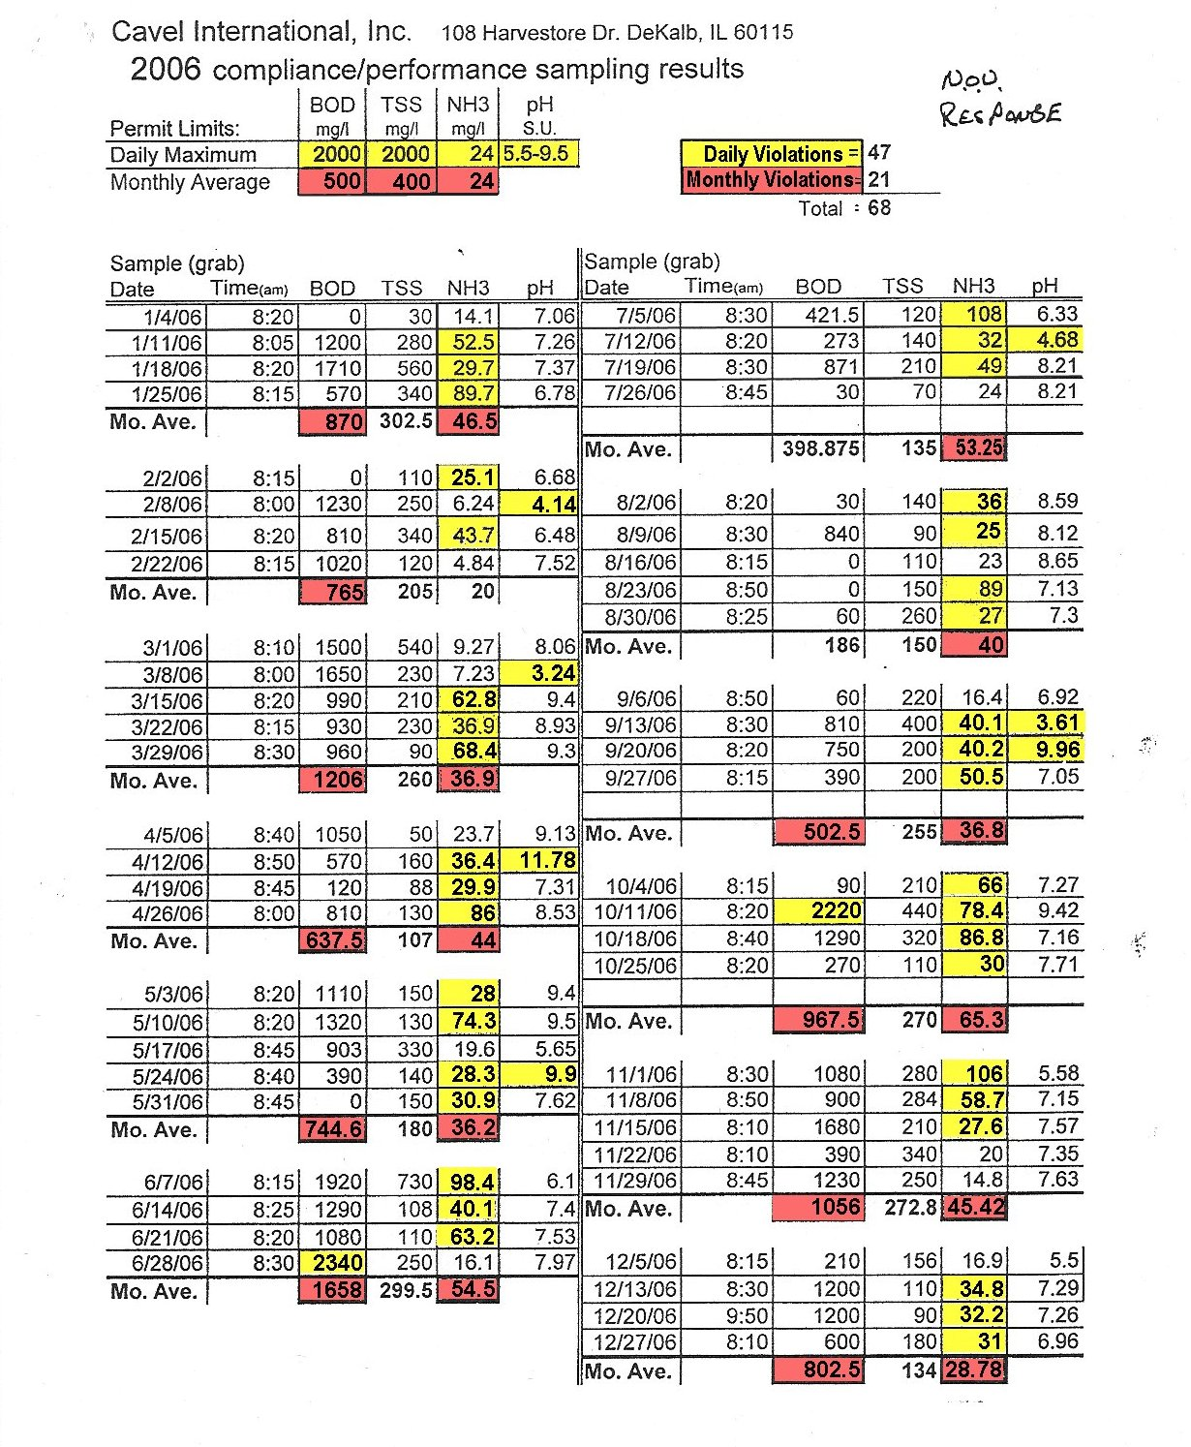
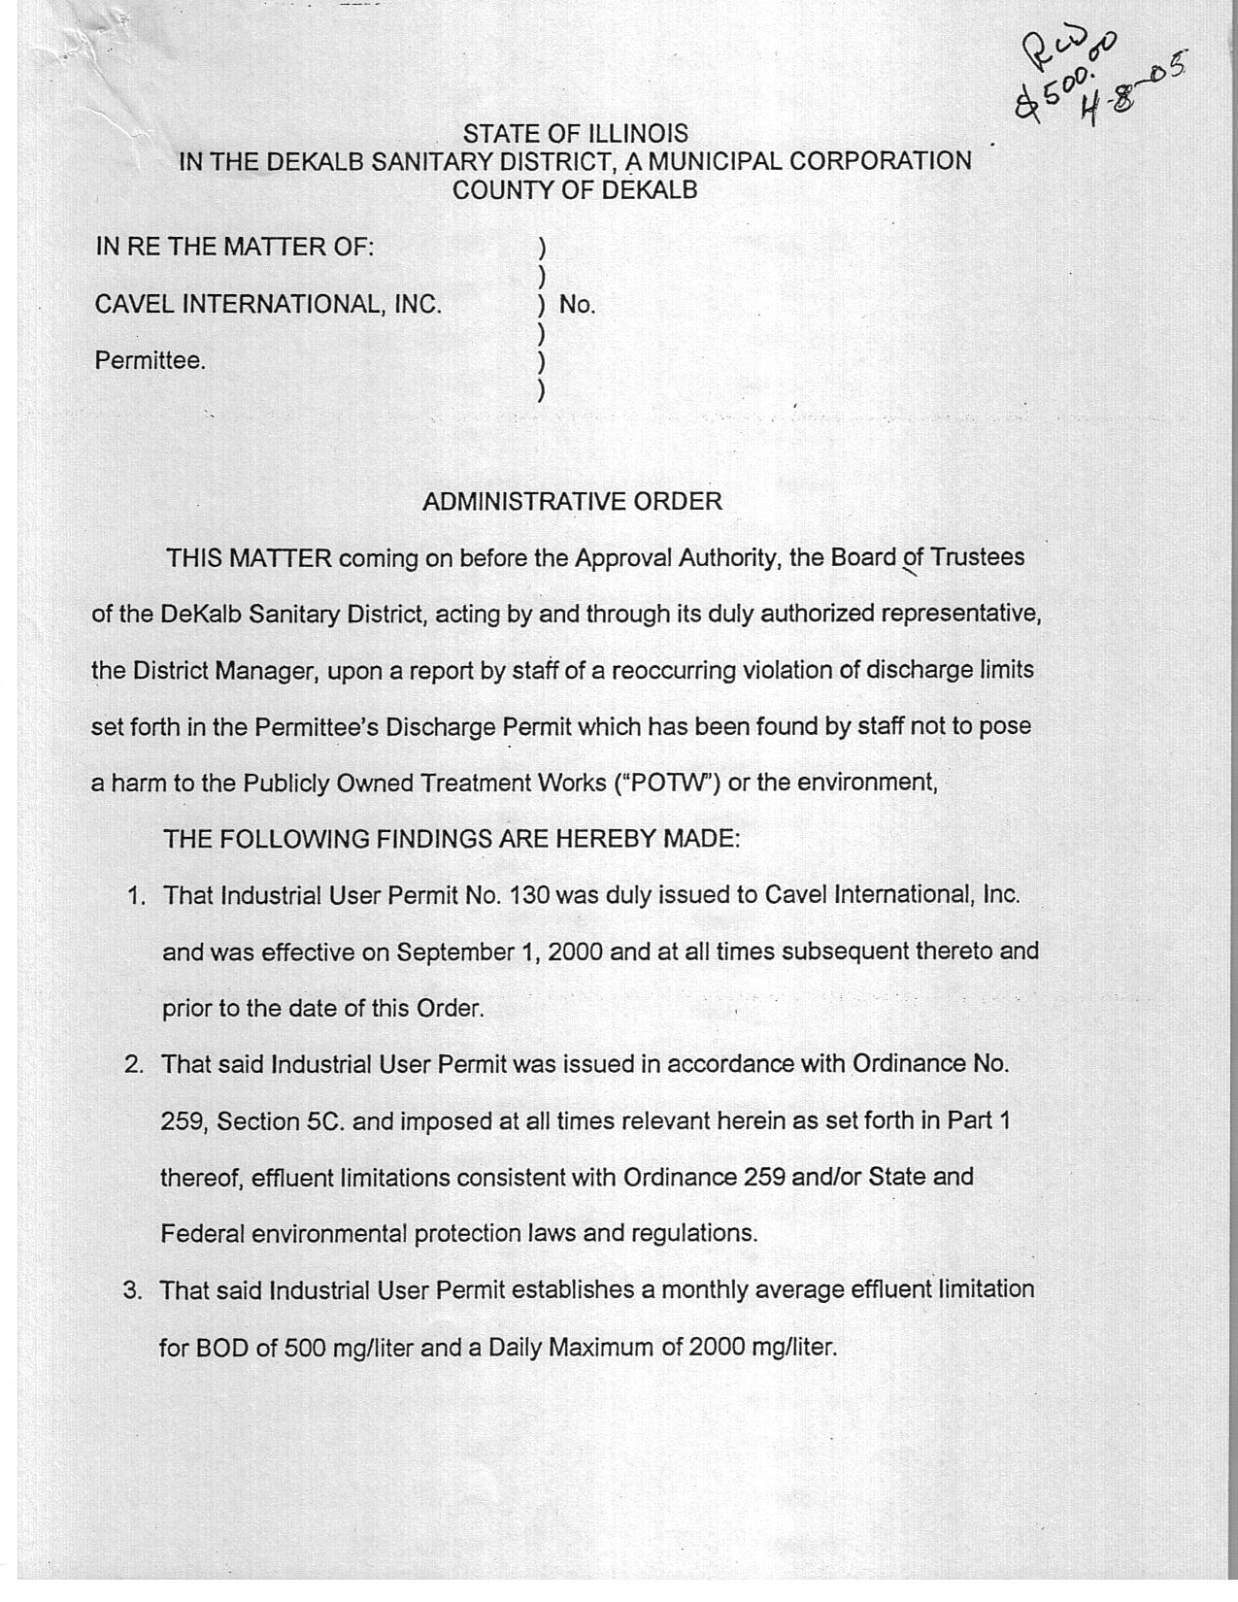
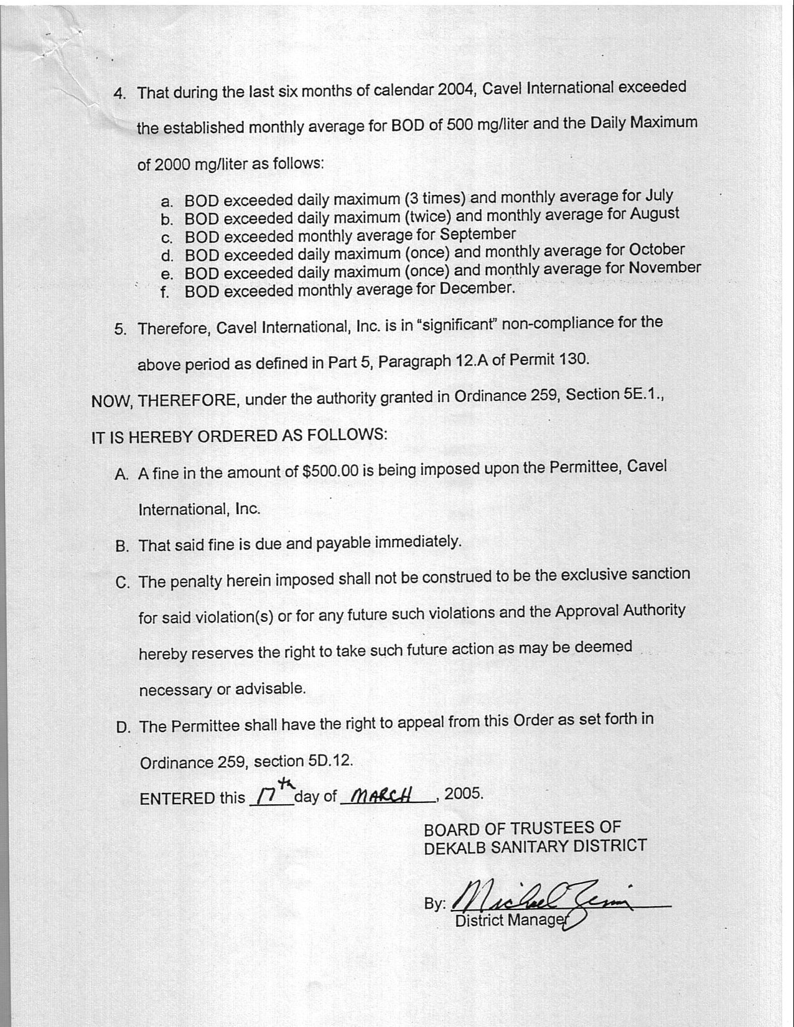
Cavel operated for 3 years without meeting discharge requirements a single month

Slide 11
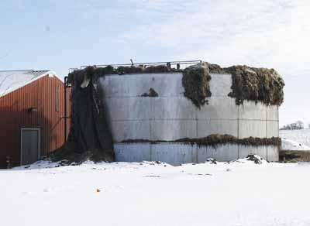
Pretreatment Tank at Cavel (Mar. 06)

Slide 12
History of Dallas Crown owner: Chevideco, NV (Kaufman, TX)

Slide 13
Dallas Crown
“We will operate in accordance with the pretreatment requirements of the state and for disposal of waste …”, Kaufman Herald, Jan. 16, 1986.
On March 10, 2006, Kaufman Board of Adjustments ordered Dallas Crown closed.
Plant challenged town in court, insisting each violation be tried separately.
Converted from cattle to slaughtering horses in 1986.

Slide 14
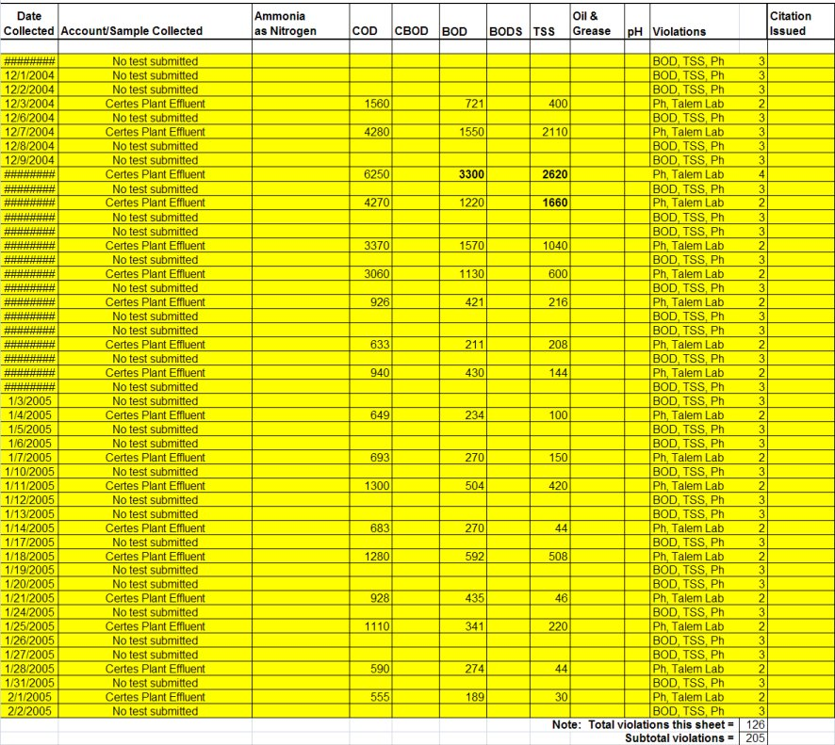
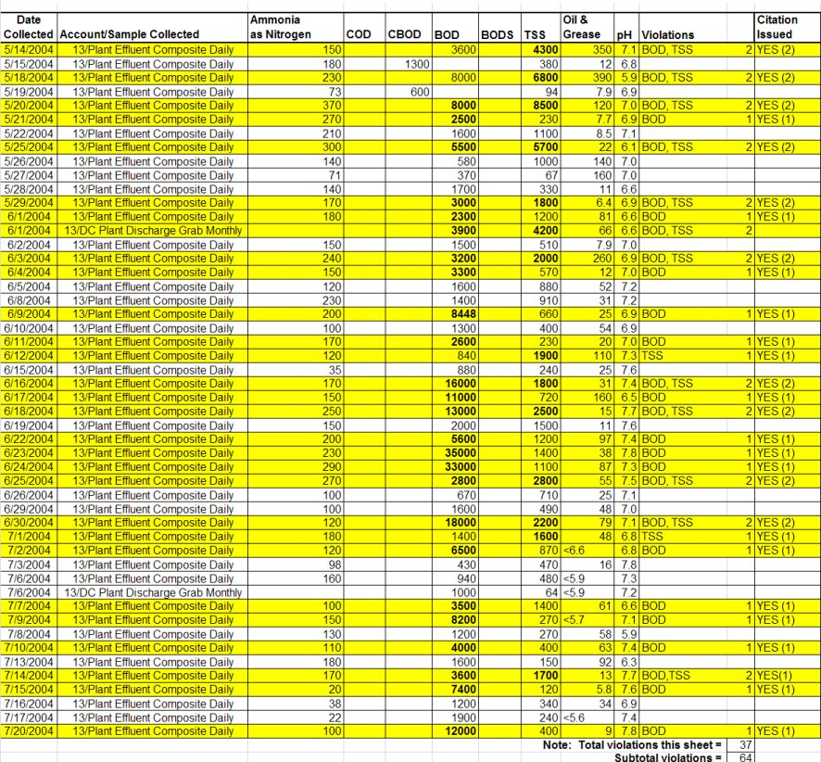
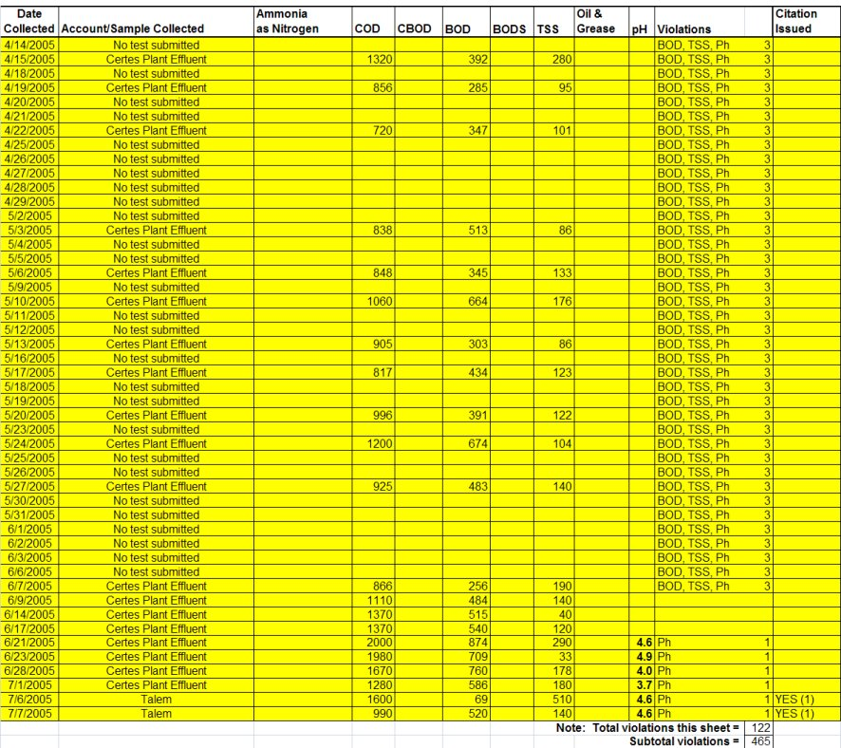
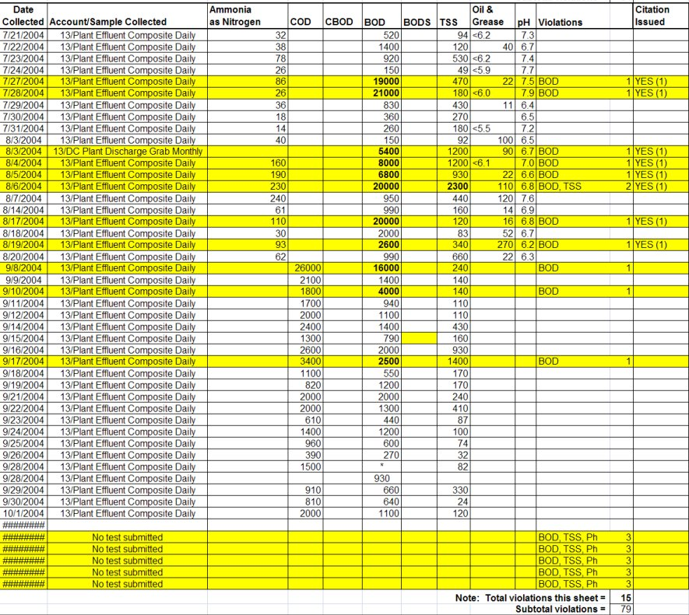
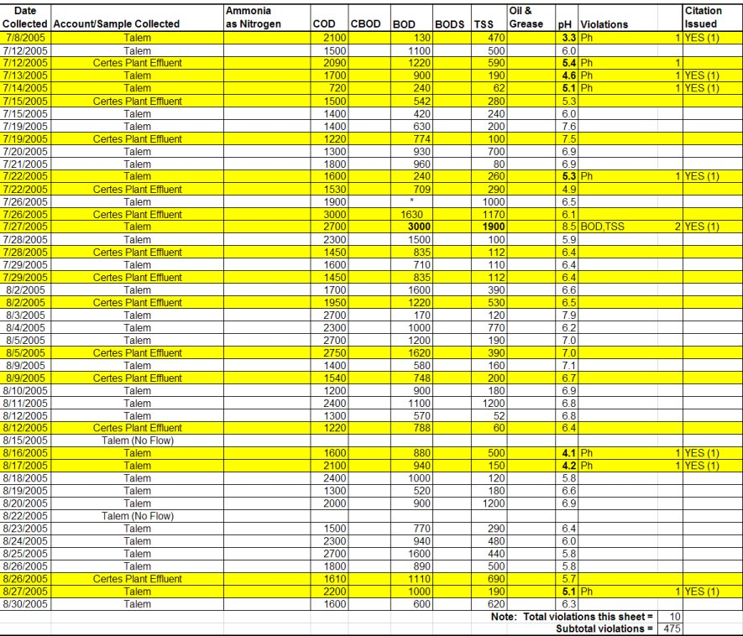
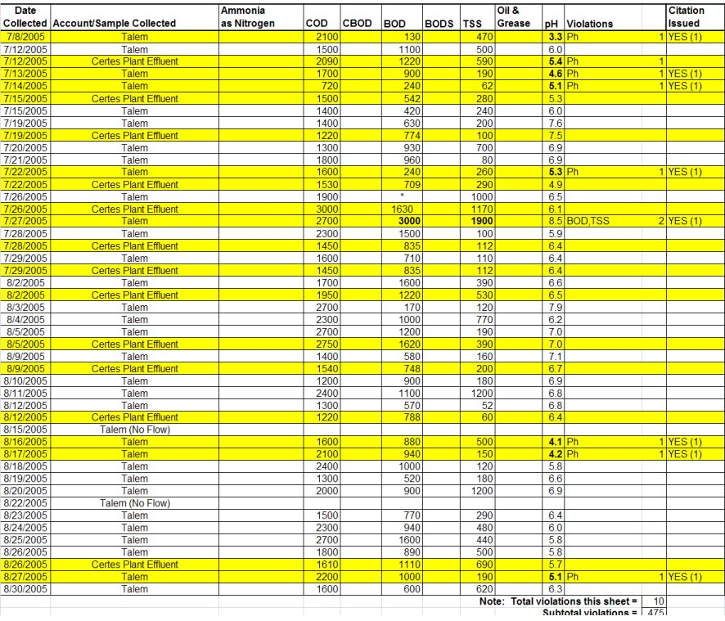
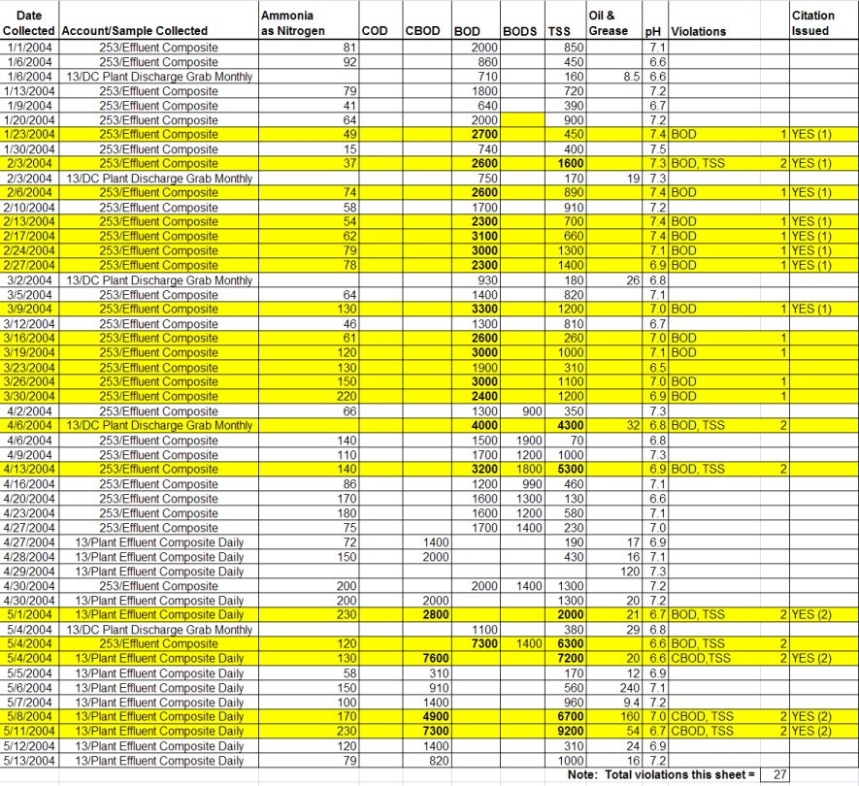
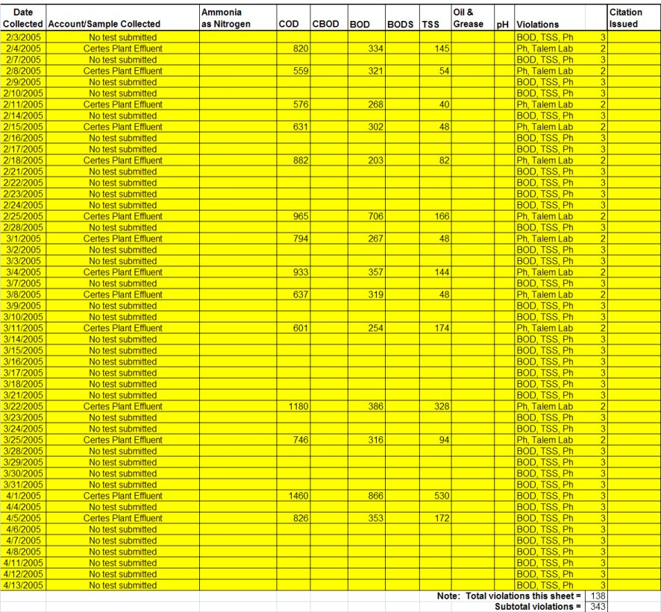
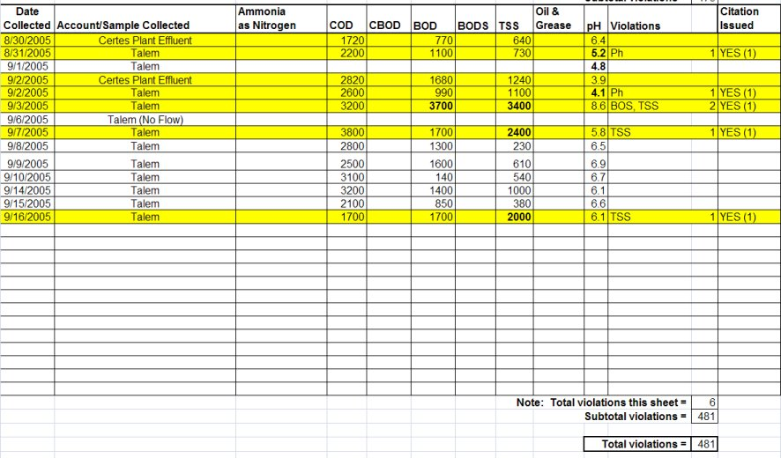
In one 19 month period of operation Dallas Crown committed 481 violations.

Slide 15
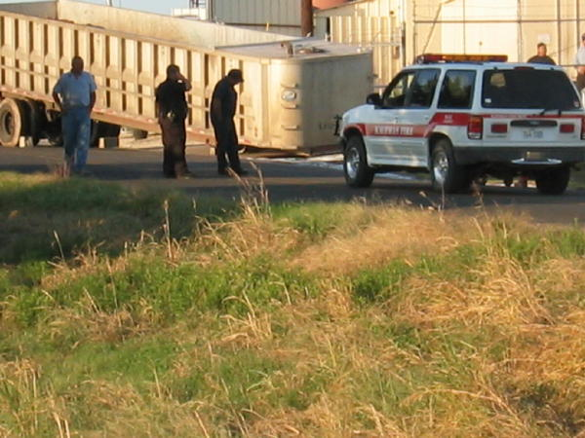
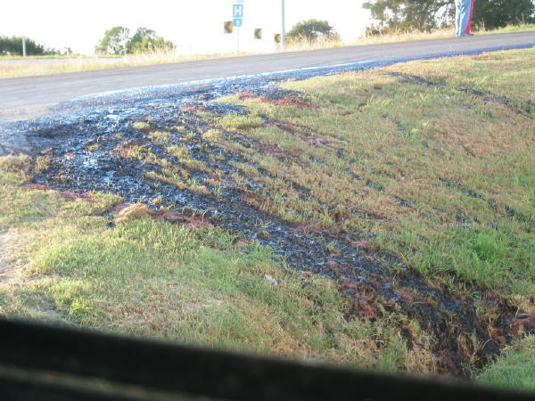
Blood spill at Dallas Crown

Slide 16
Natural Valley Farms Neudorf, SK, Canada
Constructed with private and public funds as a cattle slaughter house in 2005.
Contracted to slaughter horses for Cavel/Velda when the DeKalb plant closed (2007).
Used an evaporation pond supplemented by “muck and truck” disposal.
Ordered closed by CFIA.
Went bankrupt in 2009 with losses of $42M.

Slide 17
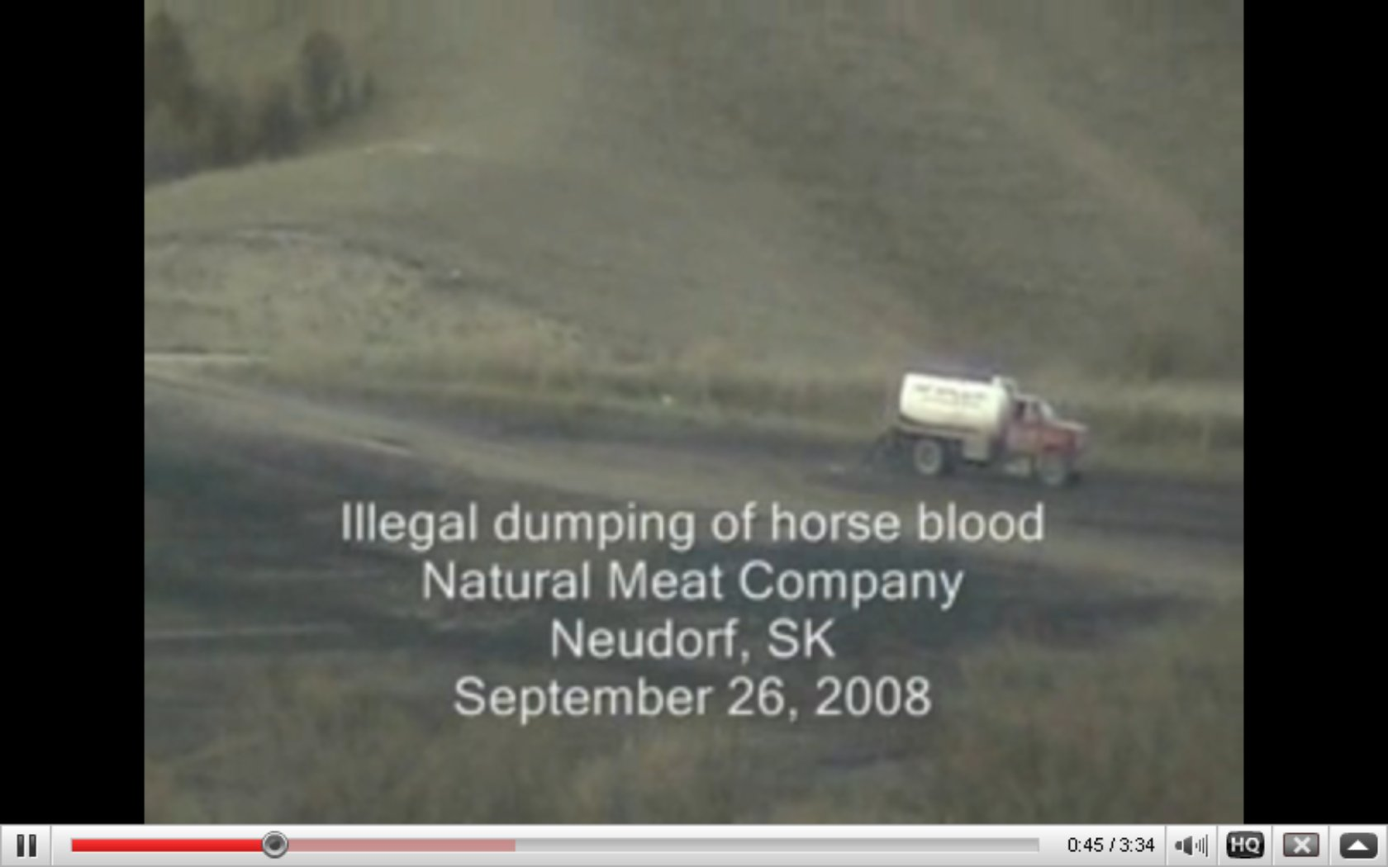
“Muck and Truck” at NVF

Slide 18
Organ disposal at Natural Valley Farms

Slide 19
Conclusions
These three examples prove that: There is a fundamental problem treating equine waste, and there is no market for the byproducts.
The most feasible cause of treatment problem is drug residues, especially antibiotics.
There is no reason whatever to believe Valley Meats will be any better than its predecessors.
The residence of the Roswell area will suffer the consequences if operations are permitted.

