Slide 1
Adult Inpatient Diabetes care – Collaborative working across the Trust Safety agenda and with ITU
Dr Kath Higgins
Lead Clinician Adult Inpatient Diabetes Care
kath.higgins@uhl-tr.nhs.uk
Helen Atkins
Advanced Nurse Practitioner and Lead DSN for Inpatient Diabetes care
helen.atkins@uhl-tr.nhs.uk

Slide 2
Adult Inpatient Diabetes Care
Engaging the Executive team
Patient safety
Use of technology
Embracing new roles
Engaging and Educating the workforce
Examples of how we work in collaboration with ITU / critical care team

Slide 3
Engaging the Executive team
CQUIN 2014/16 – delivery of ThinkGlucose to 81 clinical areas – 1WTE DSN
CQC key line of enquiry – inpatient diabetes
NaDia data
Funding secured on back of CQUIN outcomes
£82,000 – 2PA consultant, 1WTE DSN, 0.6WTE project manager

Slide 4
UHL Strategy for the Safe Use of Insulin
Education and leadership – skills and knowledge, developing effective influencers of good care
Improving patient experience – ability to deliver care in the way patients would expect
Patient safety – systematic approach to improve and maintain quality of care, empower staff to recognise, challenge and take action to resolve poor practice or patient experience

Slide 5
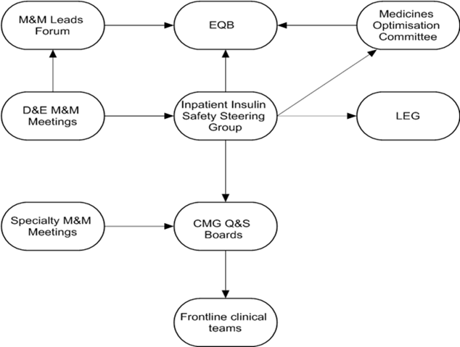
Governance structure – diabetes inpatient safety
Clinical lead
Lead DSN
Nurse consultant
Pharmacist
Dietician
CMG representatives
Pt safety lead

Slide 6
Governance structure – diabetes inpatient safety

Slide 7
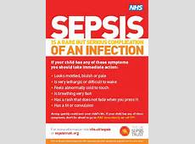
Patient Safety
REACT diabetes – robust pathway for reviewing diabetes related DATIX at monthly M&M
“Rapid Response” targeted education with shared learning
Represent diabetes throughout the organisation
Investigation of SI’s /moderate harm incidents – Patient Safety team
Nursing Exec team meetings
Deteriorating adult patient board

Slide 8
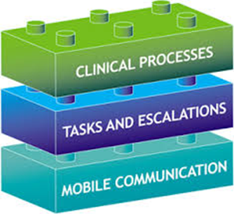
Mobile Clinical Workflow platform
Clinical noting and handover system
Electronic observations
Task management and instant messaging
Assessment criteria
“Patient at a Glance”
Tasks input / automatically generated
Immediate alerts – to nurse/doctor
Overdue reminders
Cascading escalations

Slide 9
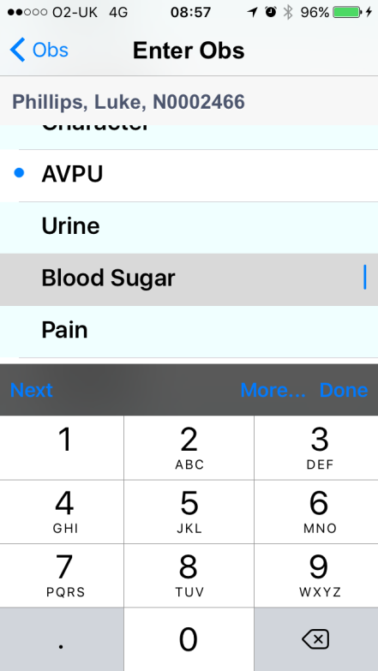
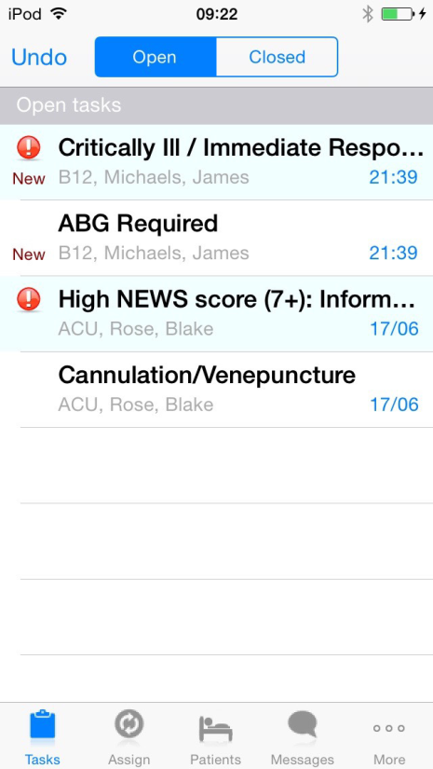
Nurse mobile device
Doctor mobile device

Slide 10
Task management and decision support system
Allows ability to in build “forced functions” (NaDia 2016 – management errors)
Eg, in hypoglycaemia – prompt to rpt CBG in 15mins
If rpt CBG remains <4.0mmol/l – immediate alert to nurse in charge to review
If rpt CBG remains <4.0mmol/l – immediate alert to doctor for medical review
Audit trail for responsive and interventions
Eg, if CBG >11.0mmol/l >2 consecutive readings – task generated for medical review of diabetes medication and titration
We are developing specific condition related recommendations for diabetes and also mandating a diabetes checklist within the clinical noting module

Slide 11
How can we develop this further?
Linking networked CBG meters to NerveCentre task management
What are the measurable indicators of good quality care for inpatients with diabetes?
Leicester Electronic Inpatient Diabetes Dashboard
LRI Ward 29 Diabetes Dashboard

Slide 12
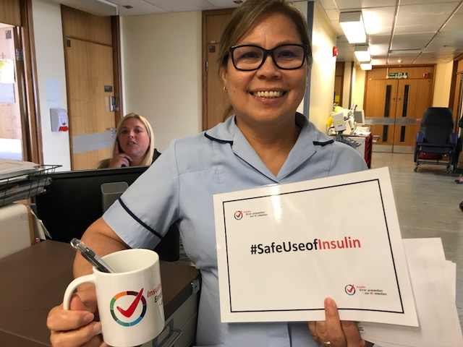
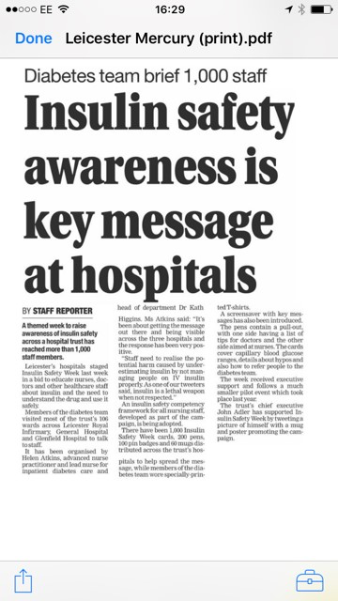
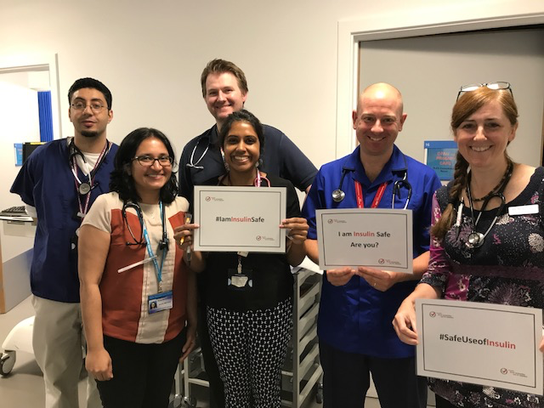
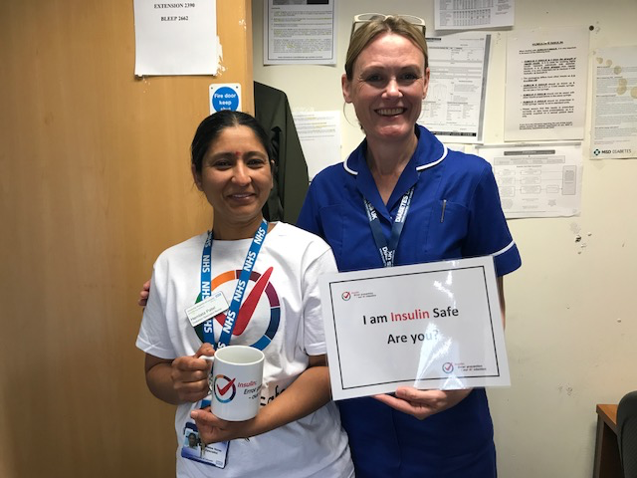
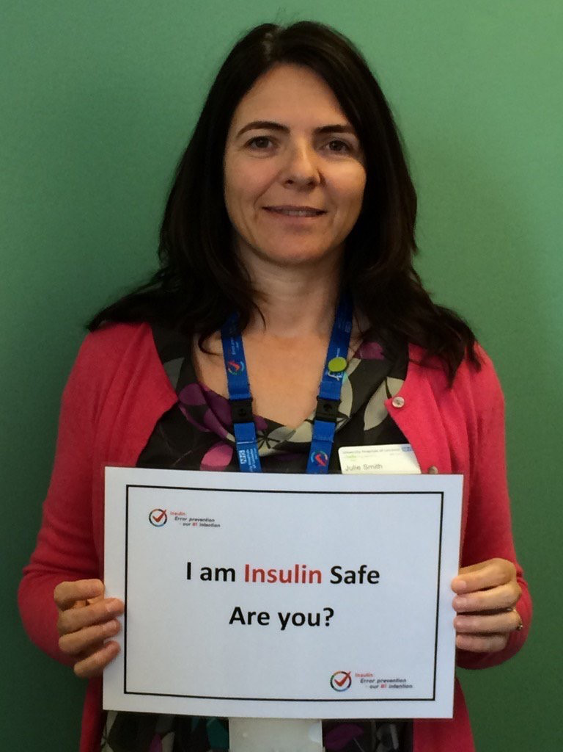
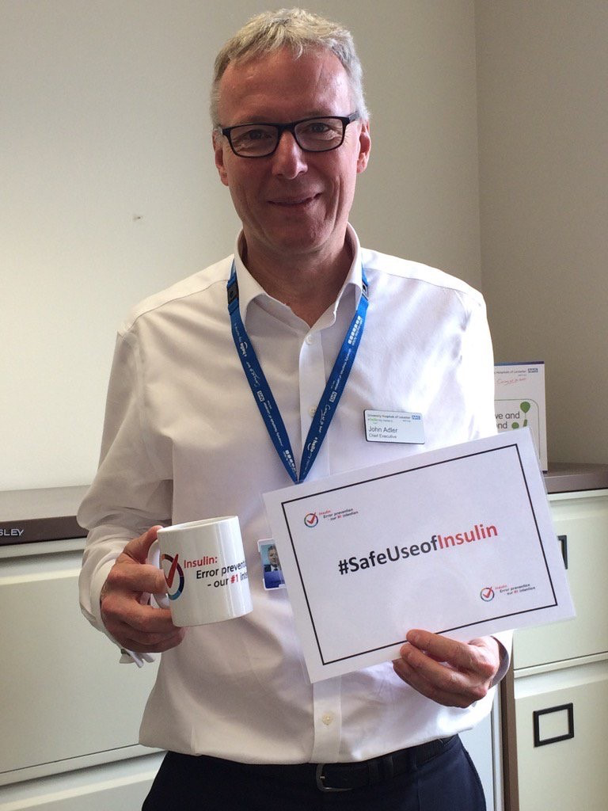
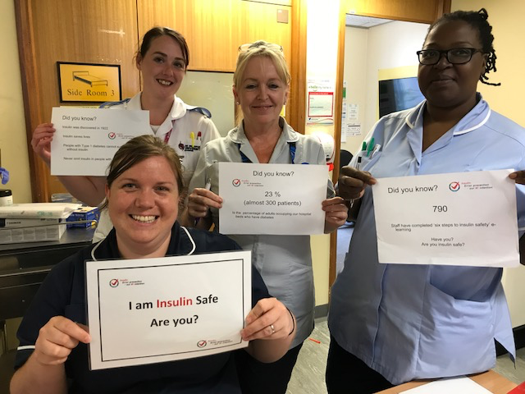
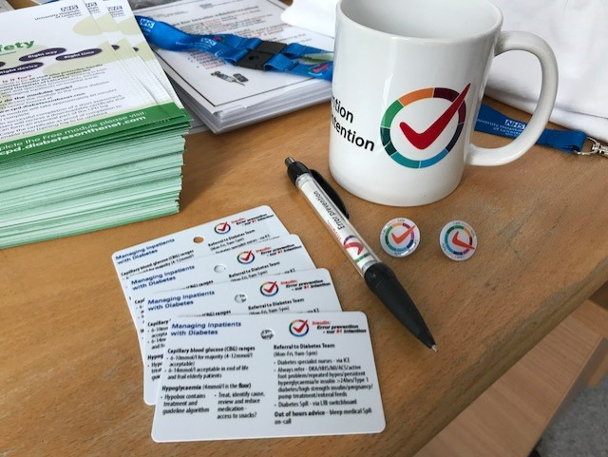
Engaging and educating the workforce
Insulin Safety roadshows #insulinsafety

Slide 13
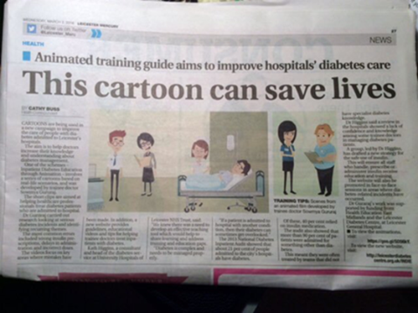
Engaging and educating the workforce
Innovative education tools
Diabetes SIM scenarios
“Rapid Response” targeted education with shared learning
Med students
FY1, CMT, SpR
Nursing staff
HCA’s
Housekeepers
Postgrad Adult Inpatient Diabetes MSc
IDEA - link

Slide 14
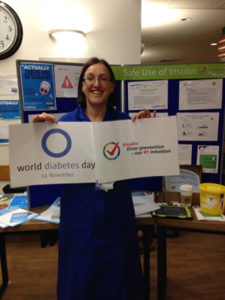
Embracing new roles and developing the team
Diabetes Advanced Nurse Practitioner
Direct clinical care – ED, DKA pathways, supporting discharge process
Leadership and collaboration
Improving quality
Developing self and others
FY2 leadership and management trainees
Clinical fellowships
Diabetes Specialist pharmacist
Inpatient specialist Dietician
Nursing champions inc HCAs

Slide 15
Collaboration with ITU
Representation on DISC
DSN visits to ITU
DSN in-reach to ED inc resusc
Guidance and support for transfer of pts
Building relationships

Slide 16
Thank you
Please feel free to contact:
UHL Adult Inpatient Diabetes
team to find out more
kath.higgins@uhl-tr.nhs.uk
helen.atkins@uhl-tr.nhs.uk

