Slide 1

Mr. McSymphony™’s
Sponsored by “ the Steinway Society of Riverside”
It’s All About
MUSIC OF ANCIENT
CIVILIZATIONS
A Mr.McSymphony™ Program
©2015 all right reserved
1

Slide 2
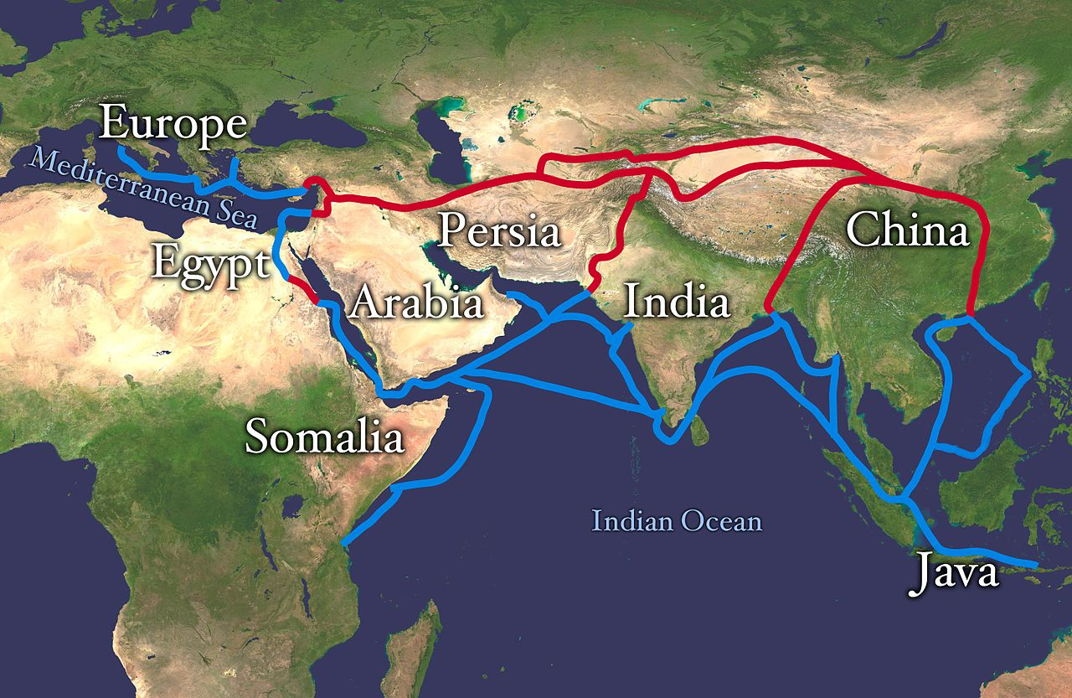
THE SILK ROAD
2

Slide 3
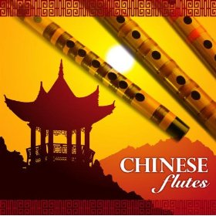


Music of Old China
“CRAB AND THE EGRET”
3

Slide 4
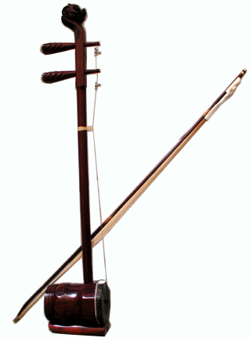
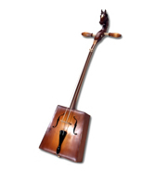
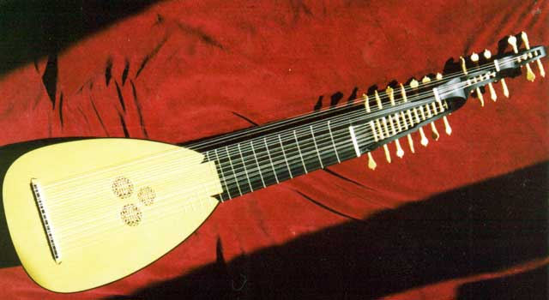
SOME INSTRUMENTS OF CHINA
4
ERHU
HORSE HEAD FIDDLE
LUTE

Slide 5
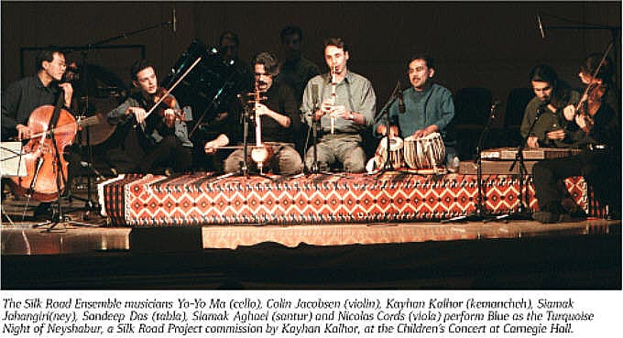
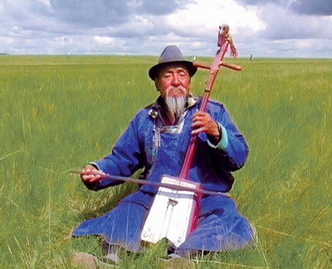
Music –”Mido Mountain”
Along the “Silk Road
The Horse Head Fiddle
5

Slide 6
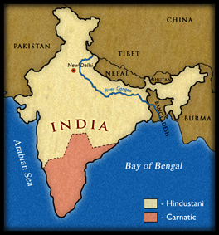
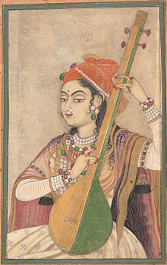
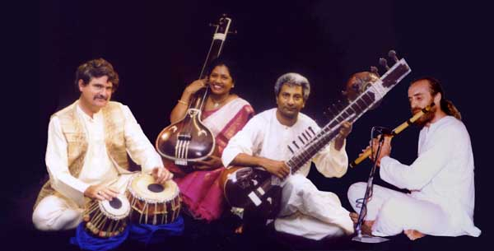
MUSIC OF INDIA
“Morning Raga”
6

Slide 7
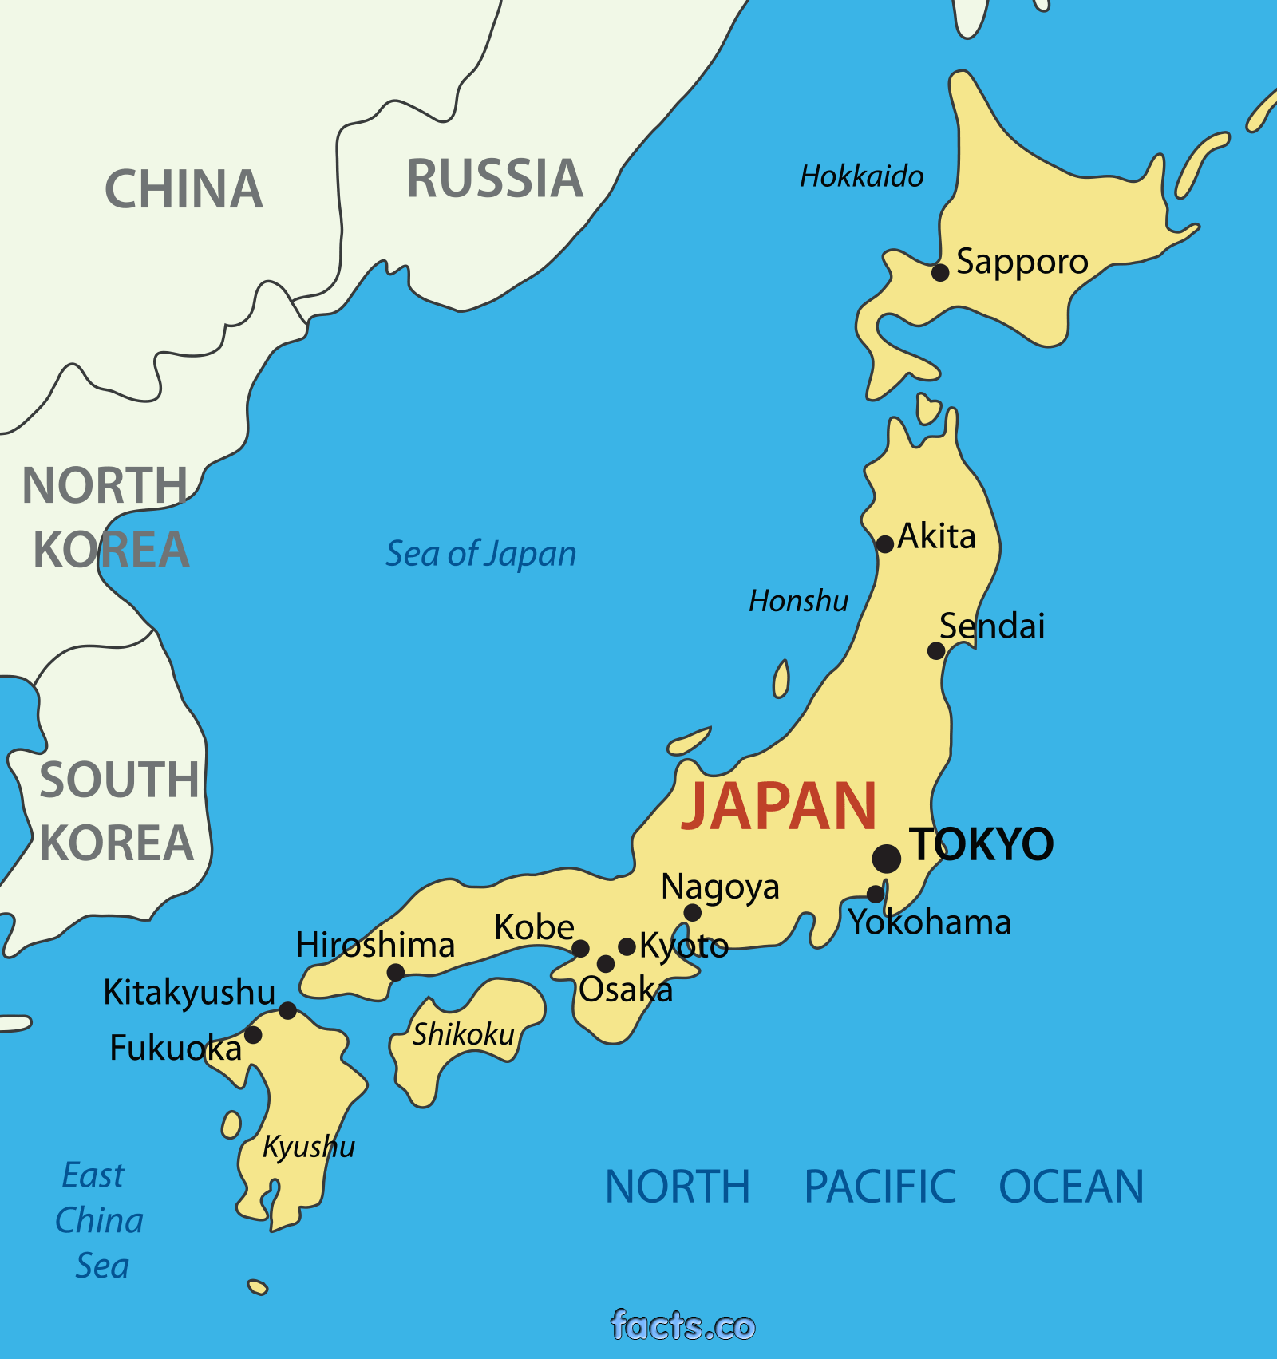
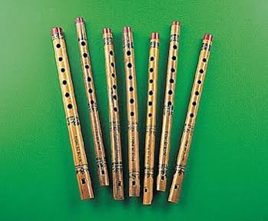
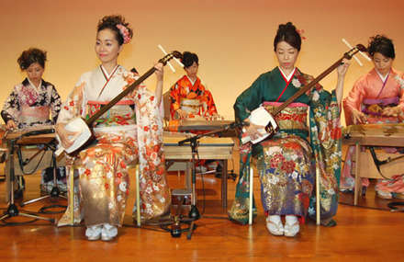
MUSIC OF JAPAN
“Autumn Sorrow”
7

Slide 8
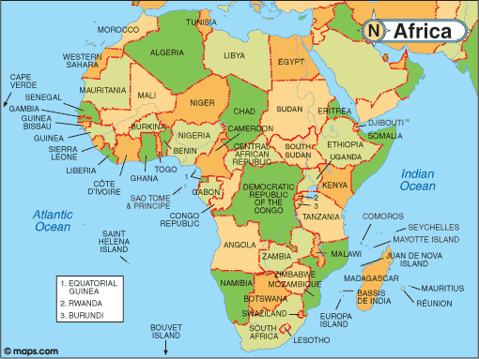
MUSIC OF AFRICA
8

Slide 9
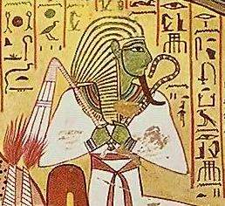
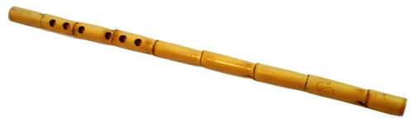
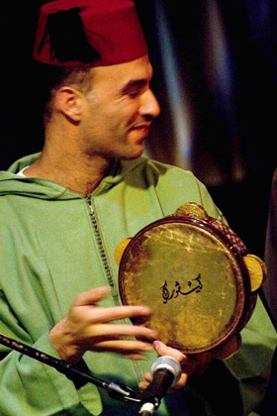
EGYPT
“Hymn to Osiris”
A six hole “Nay” Flute
Osiris an Egyptian god
A Tambourine called “RiQQ”
9

Slide 10
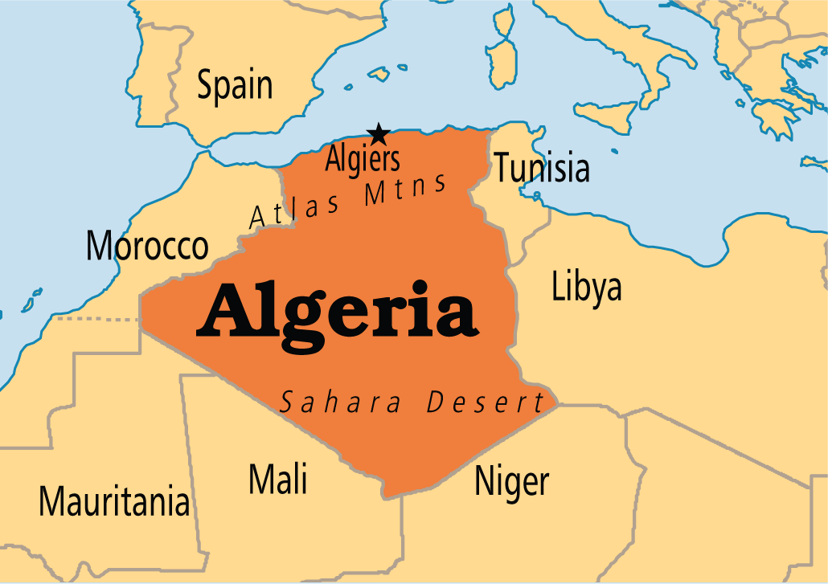
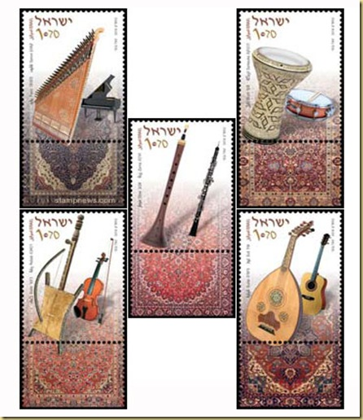
DESTINATION - ALGERIA
INSTRUMENTS OF ALGERIA
10

Slide 11
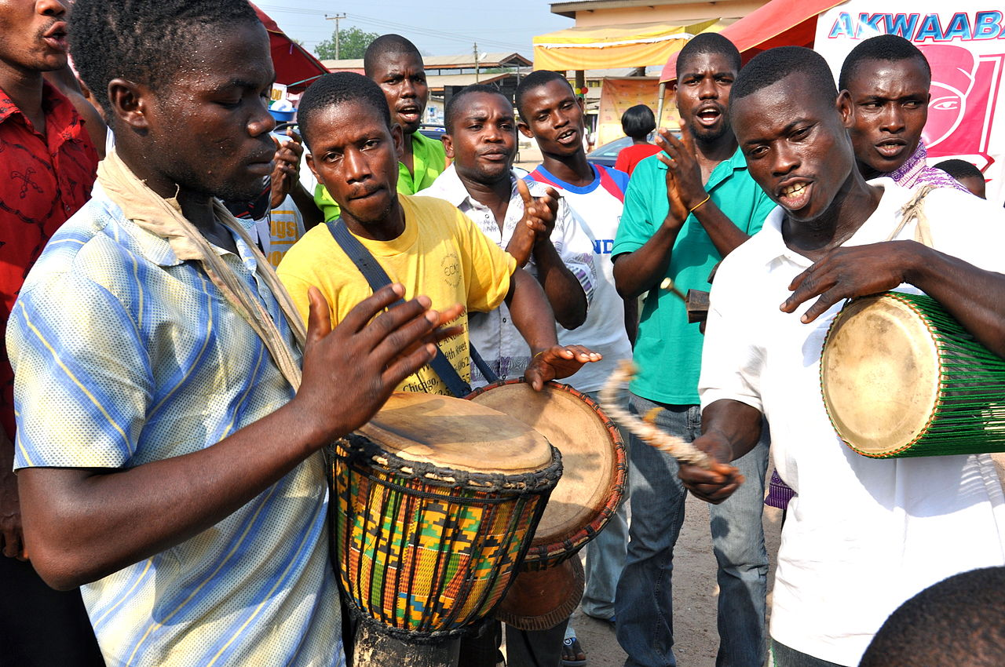
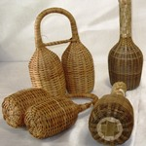
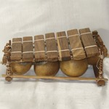
AFRICAN TRIBAL MUSIC
SHAKERS
PERCUSSION
11

Slide 12
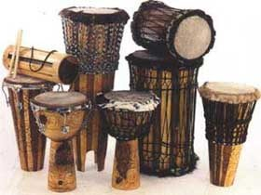
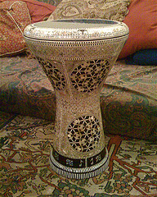
AFRICAN DRUM MUSIC
12

Slide 13
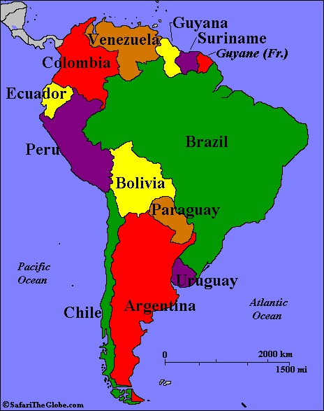
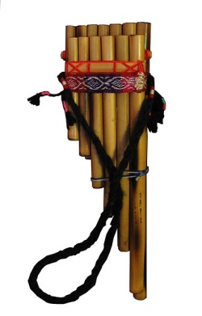
MUSIC OF SOUTH AMERICA
Bamboo Panpipes or Pan Flutes
13

Slide 14
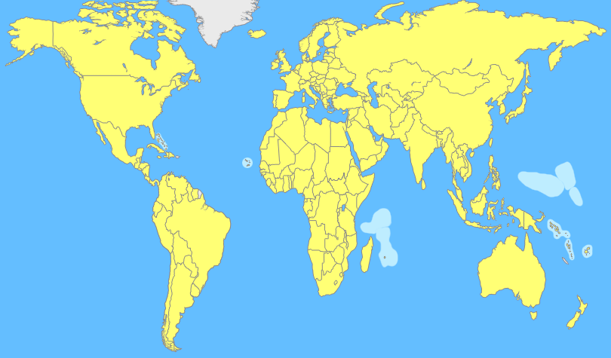
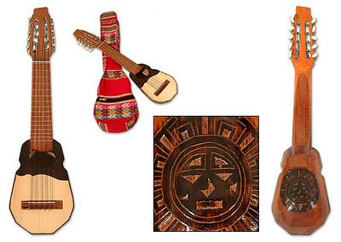
SPAIN AND THE GUITAR
Various Peruvian Guitars
14

Slide 15
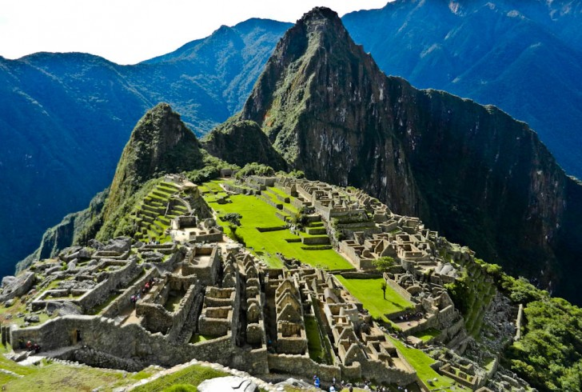

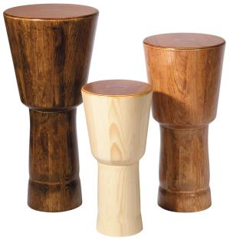
PERU
MUSIC OF THE INCA’S
15
Machu Picchu
Various Peruvian drums

Slide 16
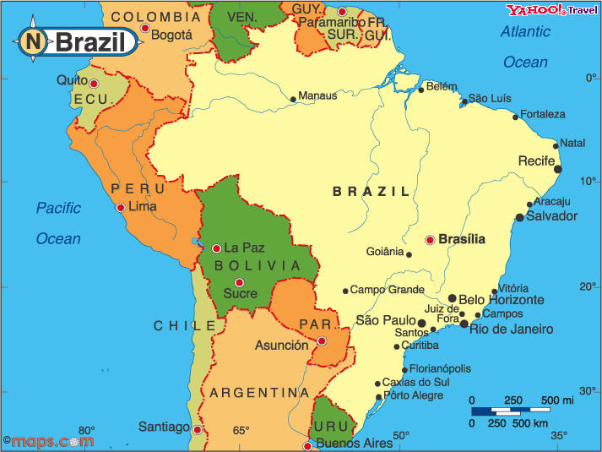
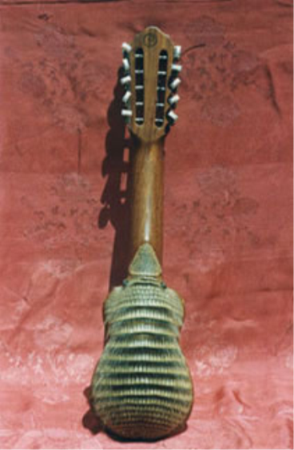
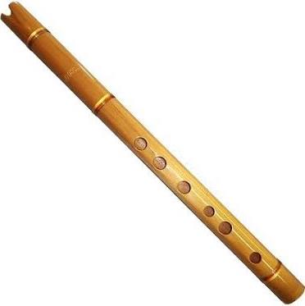
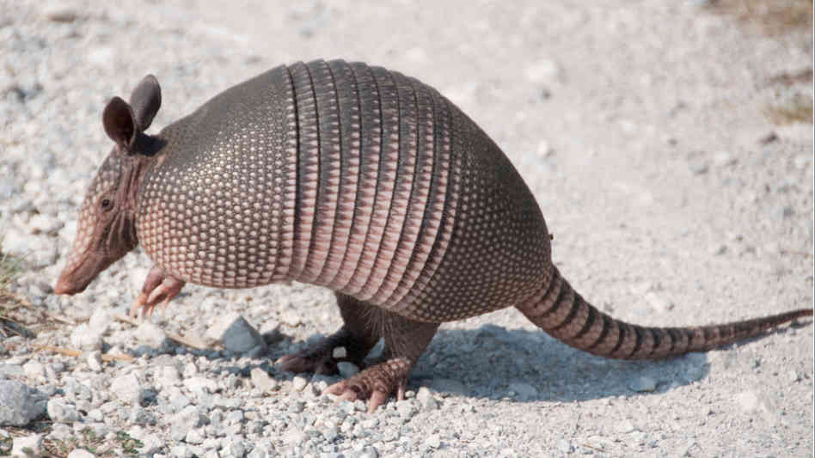
BOLIVIA
FOLK MUSIC
Armadillo
flute
16
Armadillo guitar

Slide 17
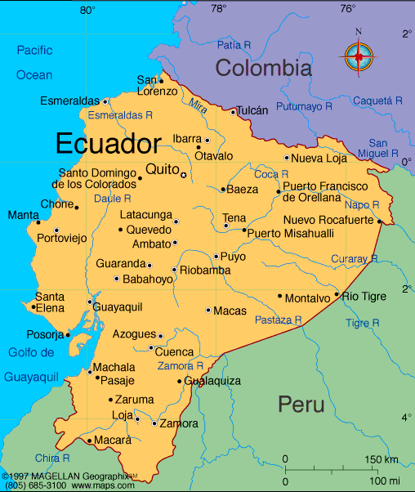
ECUADOR
SOUNDS OF THE ANDES
Was part of the Inca Empire in 1463. Music and language was similar. Instruments mostly influenced by the Inca’s and the Spanish.
17

Slide 18
THE END

