Slide 1
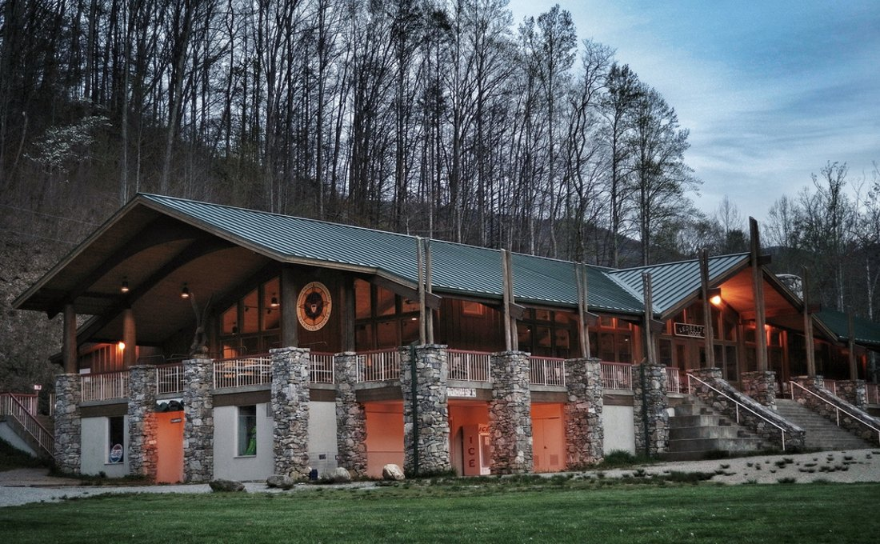

CAMP DANIEL BOONE
Canton, North Carolina
June 21 - 27, 2026

Slide 2

Location – Canton, North Carolina

Slide 3
Travel Schedule
Saturday, June 20, 8:30 PM: Leave MDUMC
Sunday, June 21: 3:30 PM Arrive at Camp Daniel Boone
Saturday, June 27, 9:00 AM Depart Camp Daniel Boone
Sunday, June 28, 2:00 AM Arrive MDUMC
18 HOUR BUS RIDE!!

Slide 4
Important Dates & Contact Info
February 3rd
  Deposit Due $350
March 3rd
  Second Payment Due $350
March 24th
  Merit Badge Selections Due
  Rafting Waiver Due
April 7th
  Final Payment Due $350 Estimate, Final Amount TBD
  Form C Health Form Due
Aaron Coulter
Summer Camp Asst. Scoutmaster
713-494-9802
aaron.ellis.coulter@gmail.com

Slide 5
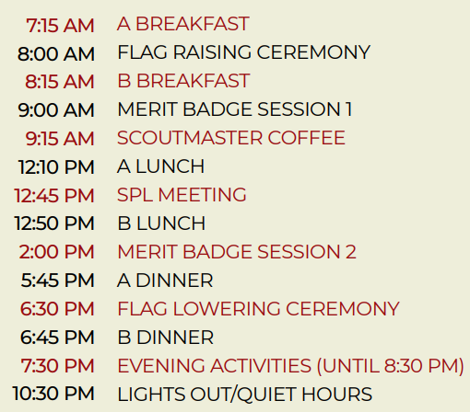
Daily Schedule

Slide 6
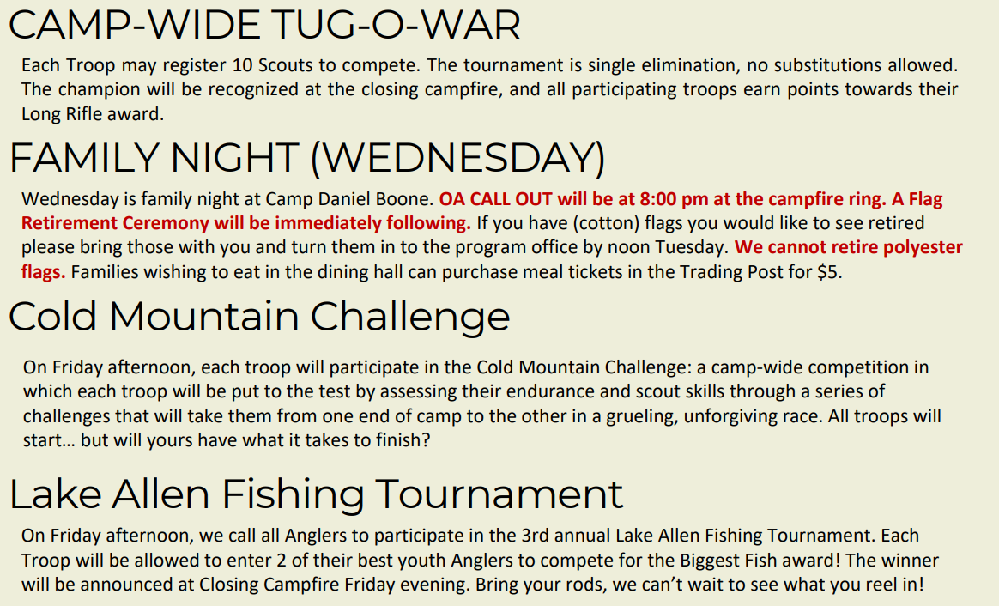
Other Activities

Slide 7

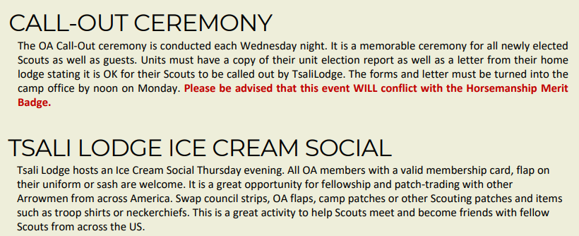
Order of the Arrow

Slide 8
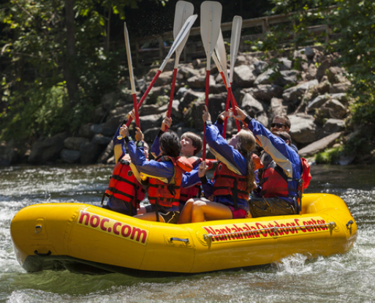

Rafting Trip - Nantahala River
Final Numbers are due with Merit Badge Selections
Waiver Due with Merit Badge Selections
Swim Test Must Be Passed at Camp Daniel Boone

Slide 9
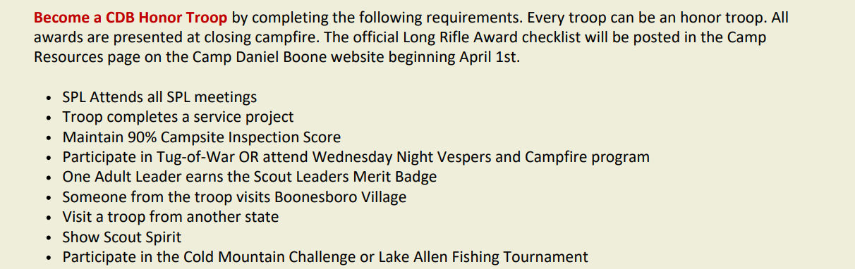
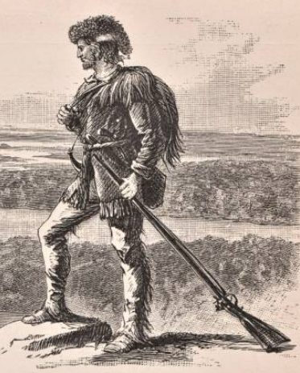
The Long Rifle Award

Slide 10
Links
Merit Badges:
  https://www.scouting.org/skills/merit-badges/all/
Rafting Waiver:
  https://www.campdanielboone.org/files/55525/noc-waiver
SPL & Parents Guide:
  https://www.danielboonecouncil.org/files/58547/2026-cdb-spl-&-parent-guide

Slide 11

Merit Badges 1 of 6
Full Day
2x Full Days
2x
$10
$20
$10
12 Years Old +
14
12
13
13 Years Old +
14
14 Years Old +
$20
$20
$25
14
Waterfront Prerequisites: All
Handicraft Prerequisites: Art, Woodcarving

Slide 12

Merit Badges 2 of 6
Full Day
2x Full Days
2x
12 Years Old +
13
13
13
12
13
13 Years Old +
14
14 Years Old +
Prerequisites: CIT Nation, Communication, Music/Theater, Personal Fitness, Public Health

Slide 13



Merit Badges 3 of 6
Full Day
2x Full Days
2x
$20
$30
$15
12 Years Old +
13
12
12
13
13 Years Old +
14
14 Years Old +
Prerequisites: None
13
13
2x
Prerequisites: None

Slide 14

Merit Badges 4 of 6
Full Day
2x Full Days
$8
2x
13
12 Years Old +
12
13
13 Years Old +
14
14 Years Old +
13
Prerequisites: Oceanography, Fishing, Reptile/Amphibian Study

Slide 15

Merit Badges 5 of 6
Full Day
2x Full Days
2x
12 Years Old +
12
13
13 Years Old +
14
14 Years Old +
2x
2x
Prerequisites: Camping, Cooking, First Aid, Orienteering, Search/Rescue, Wilderness Survival, Scouting Heritage, Emergency Preparedness

Slide 16

Merit Badges 6 of 6
Full Day
2x Full Days
2x
12 Years Old +
12
13
13 Years Old +
14
14 Years Old +
New!
Details TBD
Prerequisites: Photography

Slide 17

Stockton Farms – Horsemanship
$100

Slide 18

Stockton Farms – Animal Science
$100

Slide 19
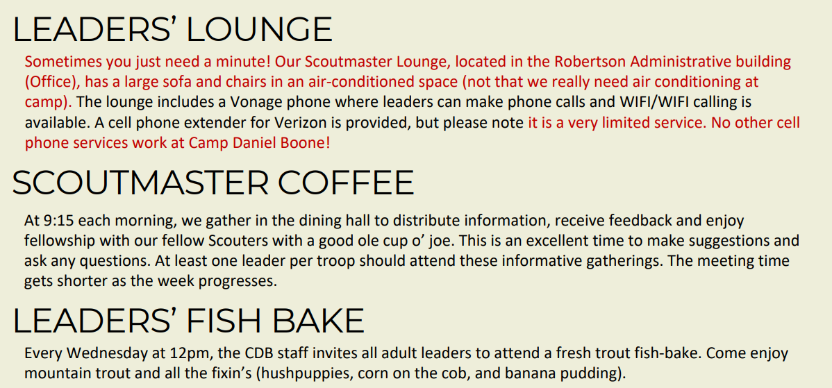
Leader Activities – All Adults

Slide 20


Leader Competitions

Slide 21

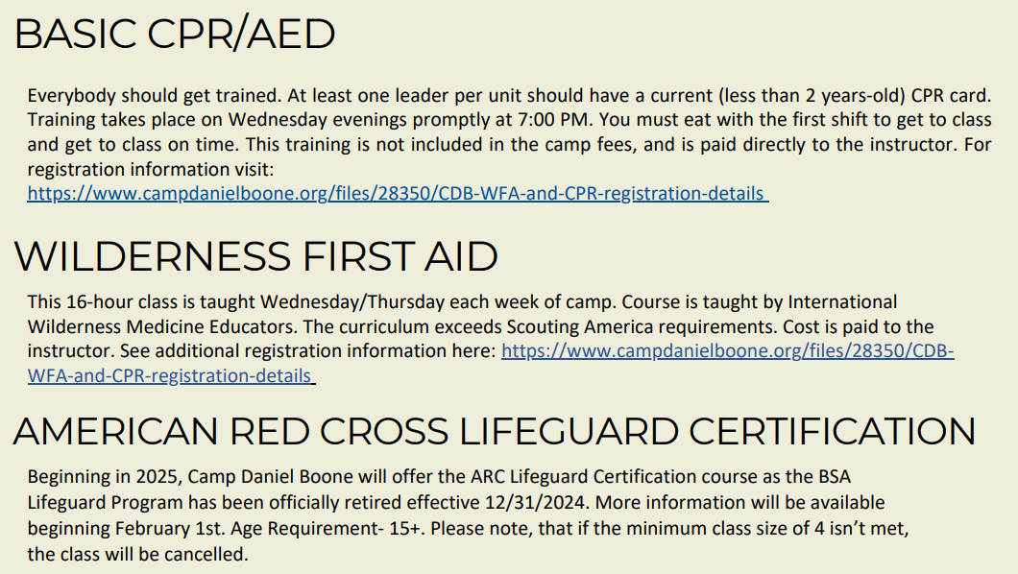
Leader Training 1 of 2
https://www.campdanielboone.org/files/28350/CDB-WFA-and-CPR-registration-details
https://www.campdanielboone.org/files/28350/CDBWFA-and-CPR-registration-details

Slide 22


Leader Training 2 of 2

