Slide 1

Amputation Stand Down 2021
Case studies reflection and Recourse
Presented By: Jamie L. Becken, Senior Safety and Health Inspector, PESH
and Jennifer Puerner, Senior Safety and Health Inspector, PESH

Slide 2

Outline
Intro to New York State Public Employee Safety & Health
Amputation Reporting and Recordkeeping
Amputation Case Studies –
Applicable Regulations
Machine Guarding Implementation & The Hierarchy of Controls
Available Assistance NYSDOL PESH Consultation & On-site Consultation

Slide 3
PESH Program
Occupational Safety and Health Act of 1970
New York State Plan Created January 1980
Enforces the provisions of the PESH Act and the safety and health standards promulgated under the Act

Slide 4
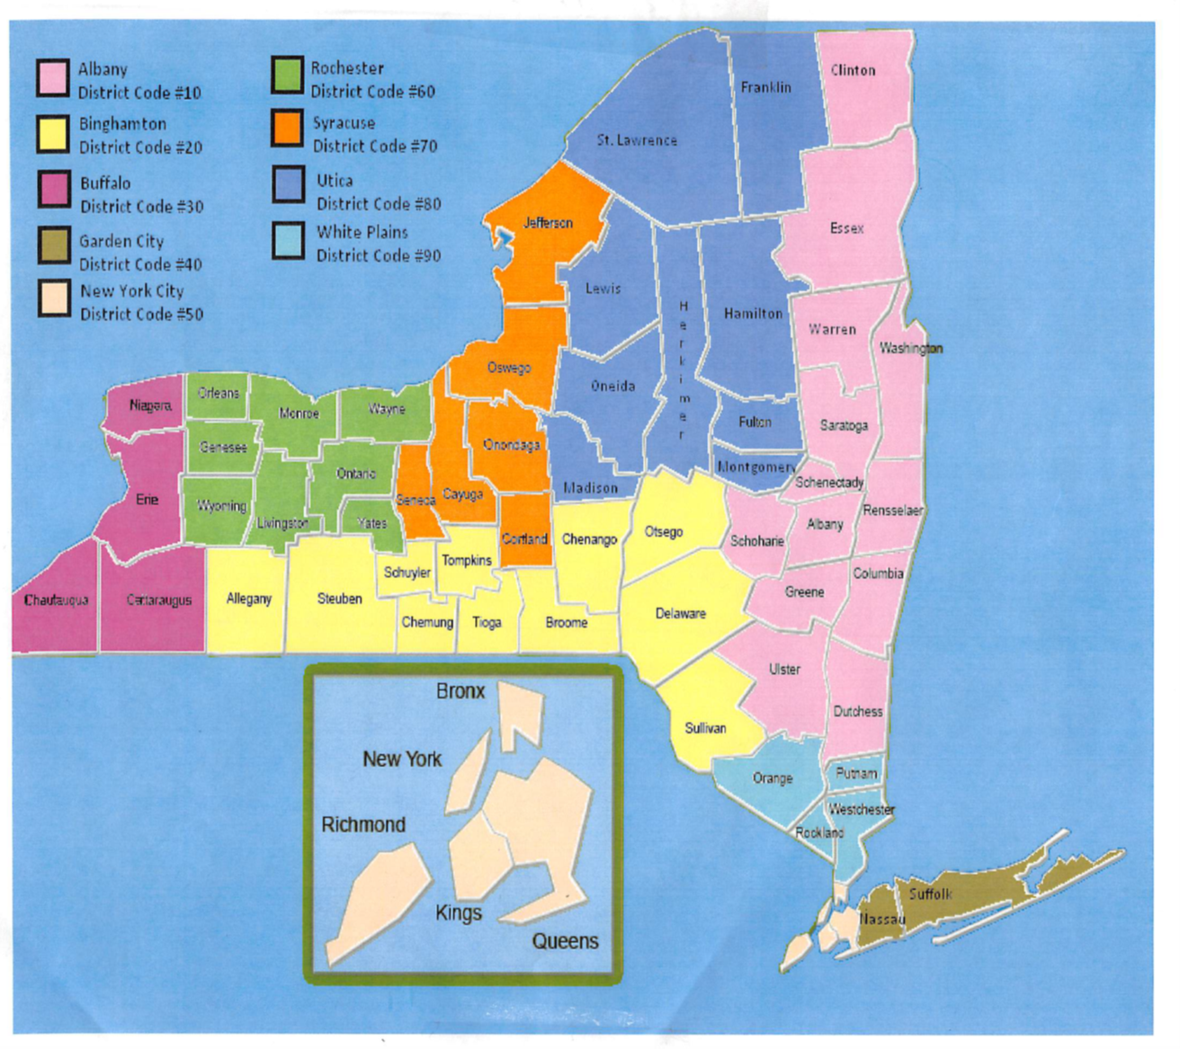
PESH Bureau consists of about 60 safety inspectors and hygienists in 9 district offices

Slide 5

Who Is Covered NYSDOL –PESH?
Public sector employers include:
  State
  County
  Town
  Village governments
  Public Authorities
  School Districts
  Paid and Volunteer Fire Departments

Slide 6


What is Enforced?
PESH enforces all OSHA standards (pending adoption) and additional NYS standards
Many consensus standards are incorporated by reference and enforced by PESH and OSHA

Slide 7
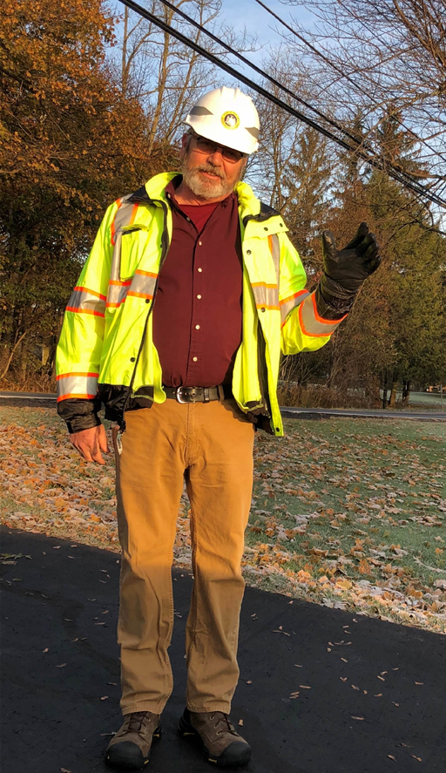
Worker protection is the goal!
Not just enforcement…
Provide consultation services to Public Employers
Provide educational services to Employee Organizations
Resource materials, training materials, and template programs
Provides technical assistance during statewide emergencies

Slide 8
Strategic Planning Teams
Past Strat Plan
  Highway
Developing Strat Plan
  Water/Wastewater
Comprised of Enforcement & Consultation Staff
Current Strat Plans
  Fire
  Law Enforcement
  Health Care
Strat Plan Goals
  To provide industry specific resources and assistance to contribute to the practical safeguarding of employees

Slide 9
Amputation
Reporting and Recordkeeping

Slide 10
OSHA: 1904.39 (a)- Reporting fatalities, hospitalizations, amputations, and losses of an eye as a result of a work-related incidents to OSHA
Current Requirement:
Report within 8 hours any work-related fatality
Report within 24 hours
  After the in-patient hospitalization of 1 or more employees
  Amputation
  Loss of an eye

Slide 11

PESH: 12 NYCRR Part 801.39 – Reporting fatalities and multiple hospitalization incidents
Current Requirement:
  Report orally within 8 hours any work-related fatality or incident involving 2 or more in-patient hospitalizations
  The 2015 OSHA reporting requirements have not yet been adopted for NY public employers.

Slide 12
Amputation Definition (1904.39(b)(11))
An amputation is the traumatic loss of a limb or other external body part. Amputations include a part, such as a limb or appendage, that has been severed, cut off, amputated (either completely or partially); fingertip amputations with or without bone loss; medical amputations resulting from irreparable damage; amputations of body parts that have since been reattached.

Slide 13
Injury & Illness Recordkeeping
For most inspections injury and illness records for the last 3 years (2018-2020) will be requested – PESH SH-900 and SH-900.1 forms or OSHA Form 300 and 300A:
  PESH Form SH-900– Log of Work-Related Injuries and Illnesses
  PESH Form SH-900.1 – Summary of Work-Related Injuries and Illnesses
  *(Must be
  posted Feb-Apr)
Hindsight Insight Foresight

Slide 14
Amputation Case Study #1

Slide 15
Consultation Request
2018
Limited Safety Consultation
Requested by Coordinator of Environmental Health & Safety
Employer: High School
Location: Wood Shop
Employee: Wood Shop Teacher

Slide 16
Employee Injury
Planing ¾” material
Amputation of multiple fingertips

Slide 17
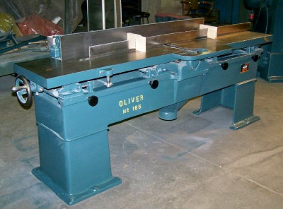
Machine Involved
Oliver No. 166 DD Wood Planer & Jointer
Manufactured in 1958
20” wide bed

Slide 18
Factory Guard vs Guard Being Used
Guard being used on the planer was not factory designed, built, nor installed by the manufacturer

Slide 19
Factory Installed Guard:
Designed to freely move away from the cutting head by the piece of wood being machined
During operation, the guard is designed to maintain coverage over the rotating cutter heads to reduce the chance of accidental contact by the operator
Has a spring that keeps the guard in contact with the wood being milled and allows for automatic return to the original position when the wood is removed

Slide 20
Existing Guard:
Did not allow free unobstructed movement when contacted with the piece of wood intended to be milled
This design forces the operator to move the guard out of the way prior to milling, which negates the intended purpose of the safety guard
Did not travel smoothly over the equipment’s bed and it does not stay in contact with the wood being milled

Slide 21
Risk Factors
Replacement guard was homemade, not spring loaded and did not function as designed
Jointer was not properly maintained, some of the oil cups were dry, making adjustments to the work fence difficult
Work fence was not properly adjusted for working with thinner material
Owner’s manual was not available
More info on manual
Follow manufacturers instructions
Installing guards
20” jointer was too large for planning ¾” material- a 4” or 6” jointer would have been a safer choice

Slide 22
OSHA Standard
1910.213 (j)(3) Each hand-fed jointer with a horizontal cutting head shall have an automatic guard which will cover all the section of the head on the working side of the fence or gage. The guard shall effectively keep the operator’s hand from coming in contact with the revolving knives. The guard shall automatically adjust itself to cover the unused portion of the head and shall remain in contact with the material at all times.

Slide 23
Serious Violations
The manufacturer’s automatic guard for the cutting head was replaced with a homemade guard that did not perform as designed.
A hand-fed jointer with a horizontal cutting head did not have an effective guard which covered all of the head on the working side of the fence and did not keep the operator’s hand from coming in contact with the revolving knives.

Slide 24

Other Issues
Teacher was new to the wood shop
The woodshop was equipped with 4 emergency stop buttons, one on each wall. One of the stop buttons was hidden by storage.
Designated storage and reducing clutter was a general concern in the wood shop

Slide 25
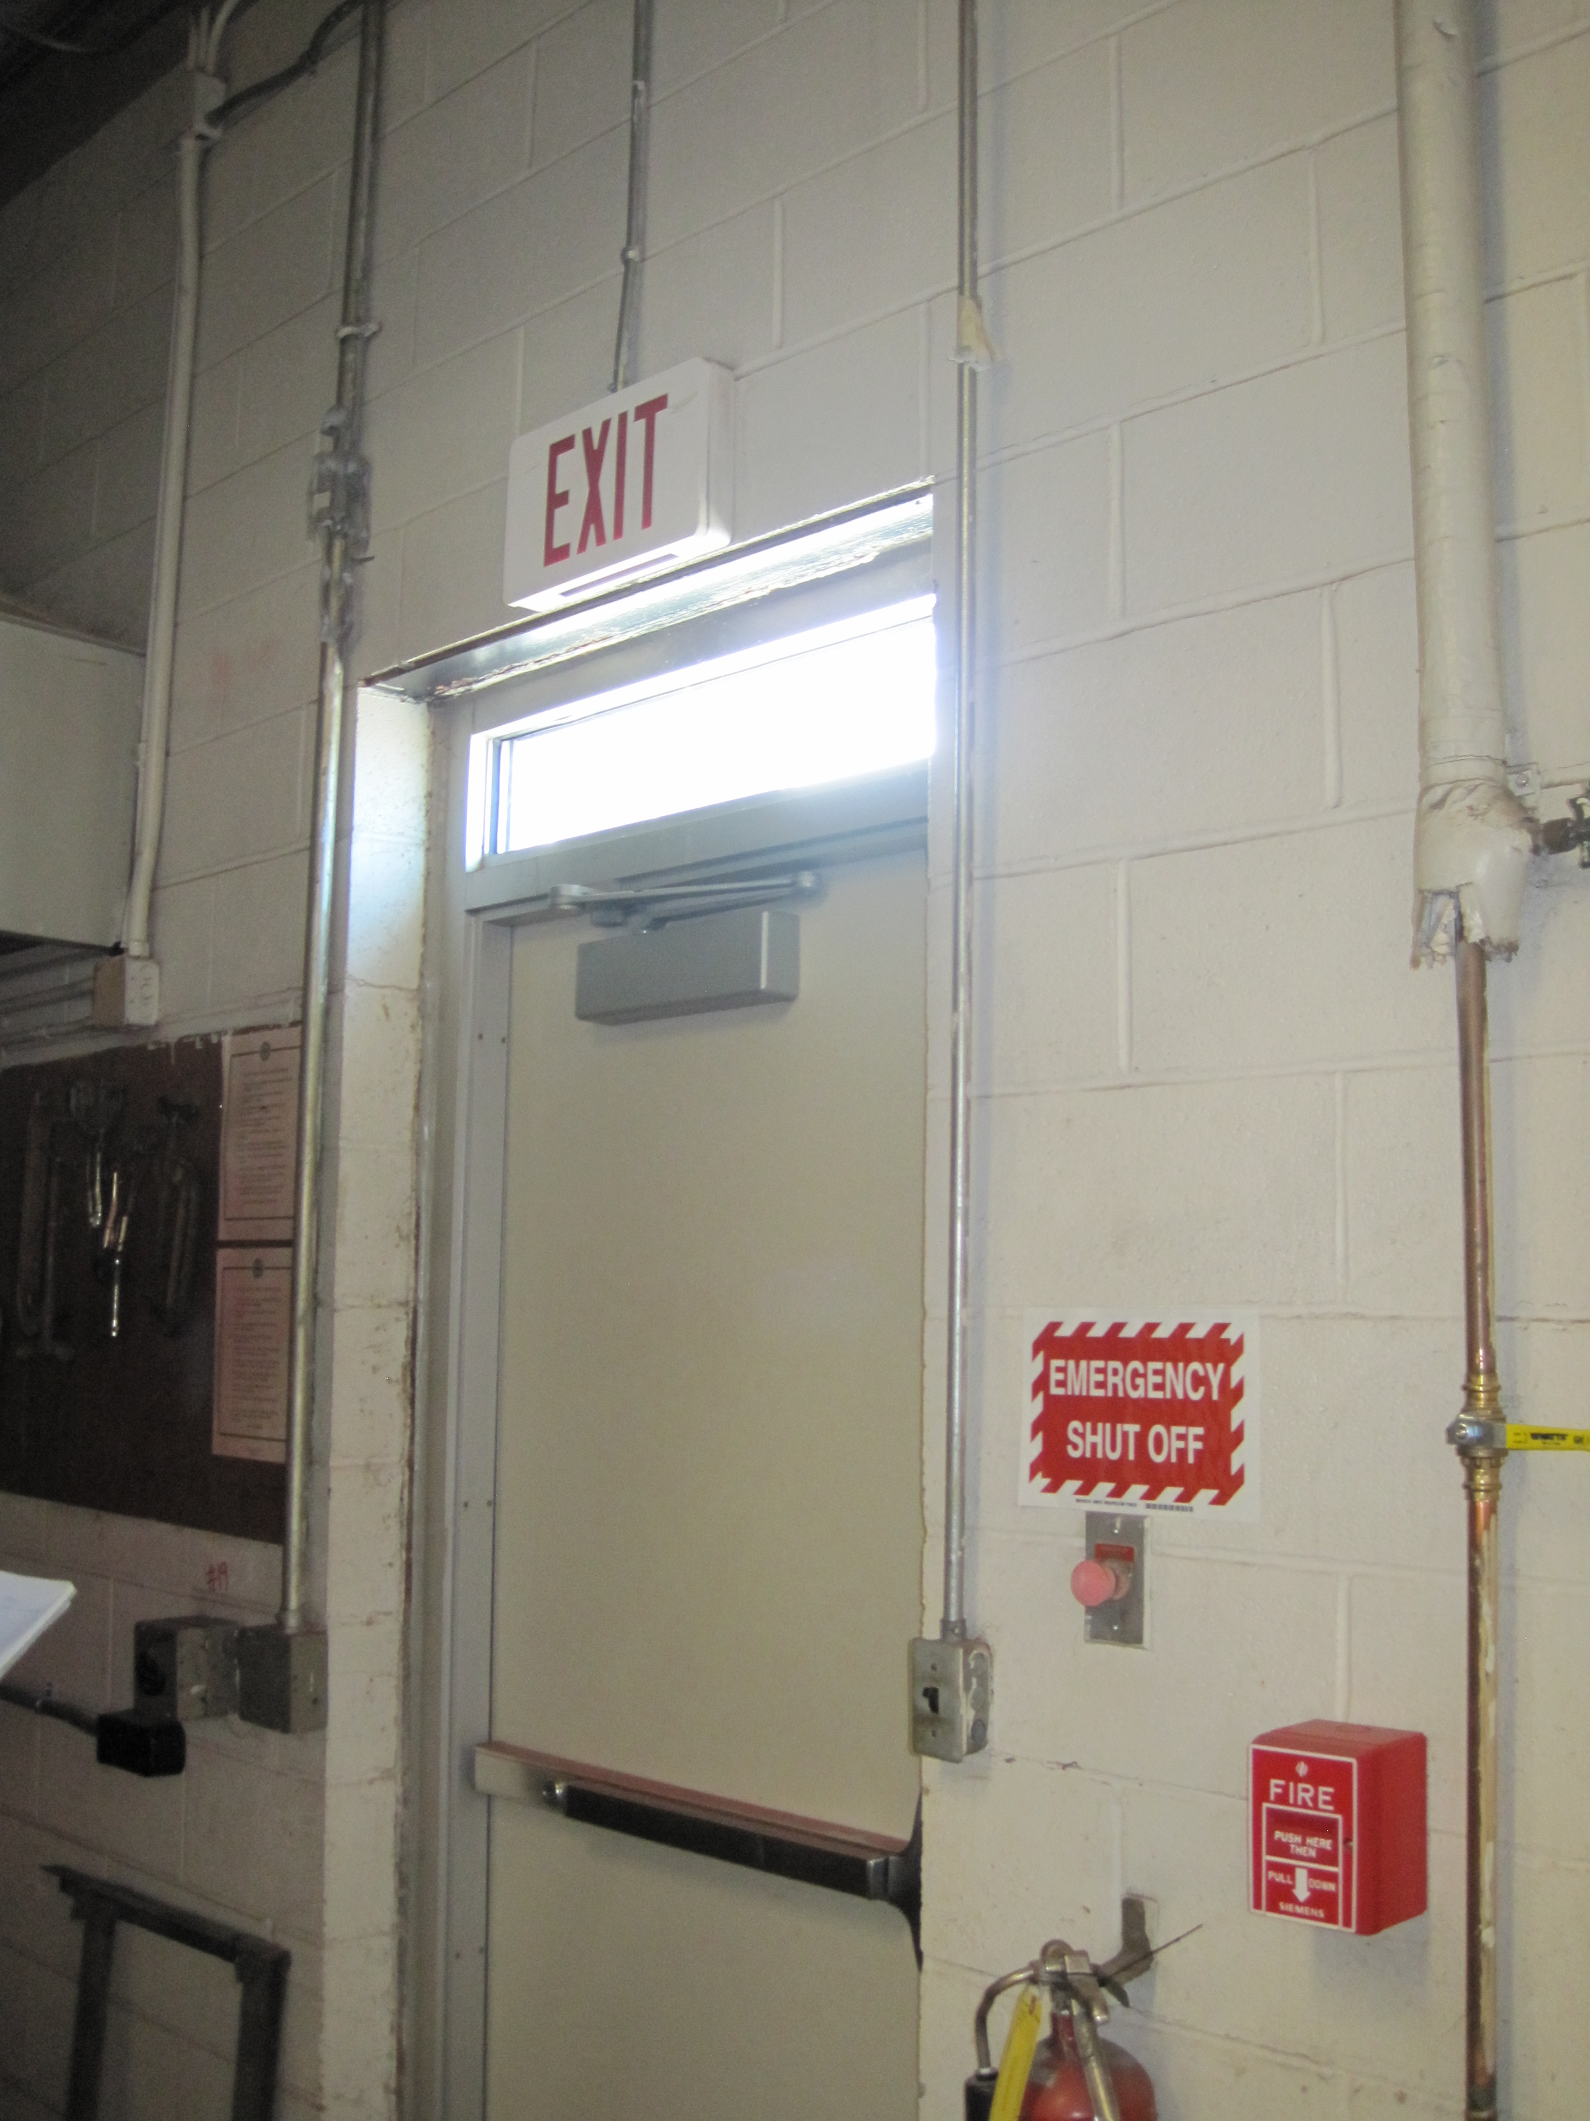
1910.144 (a)(1)(iii) Emergency stop bars on hazardous machines such as rubber mills, wire blocks, flat work ironers, etc., shall be red. Stop buttons or electrical switches which letters or markings appear, used for emergency stopping of machinery shall be red.

Slide 26
Lessons Learned
Make sure the operator is properly trained on the equipment
  Proper training would have helped the operator recognize the problems with the jointer
Asses the condition of the equipment to be used

Slide 27
Employer Action Taken
Equipment taken out of service and locked out until the operating manuals can be located.
The equipment will be inspected and proper guards will be installed prior to future use
Staff will be trained on the proper use of equipment

Slide 28
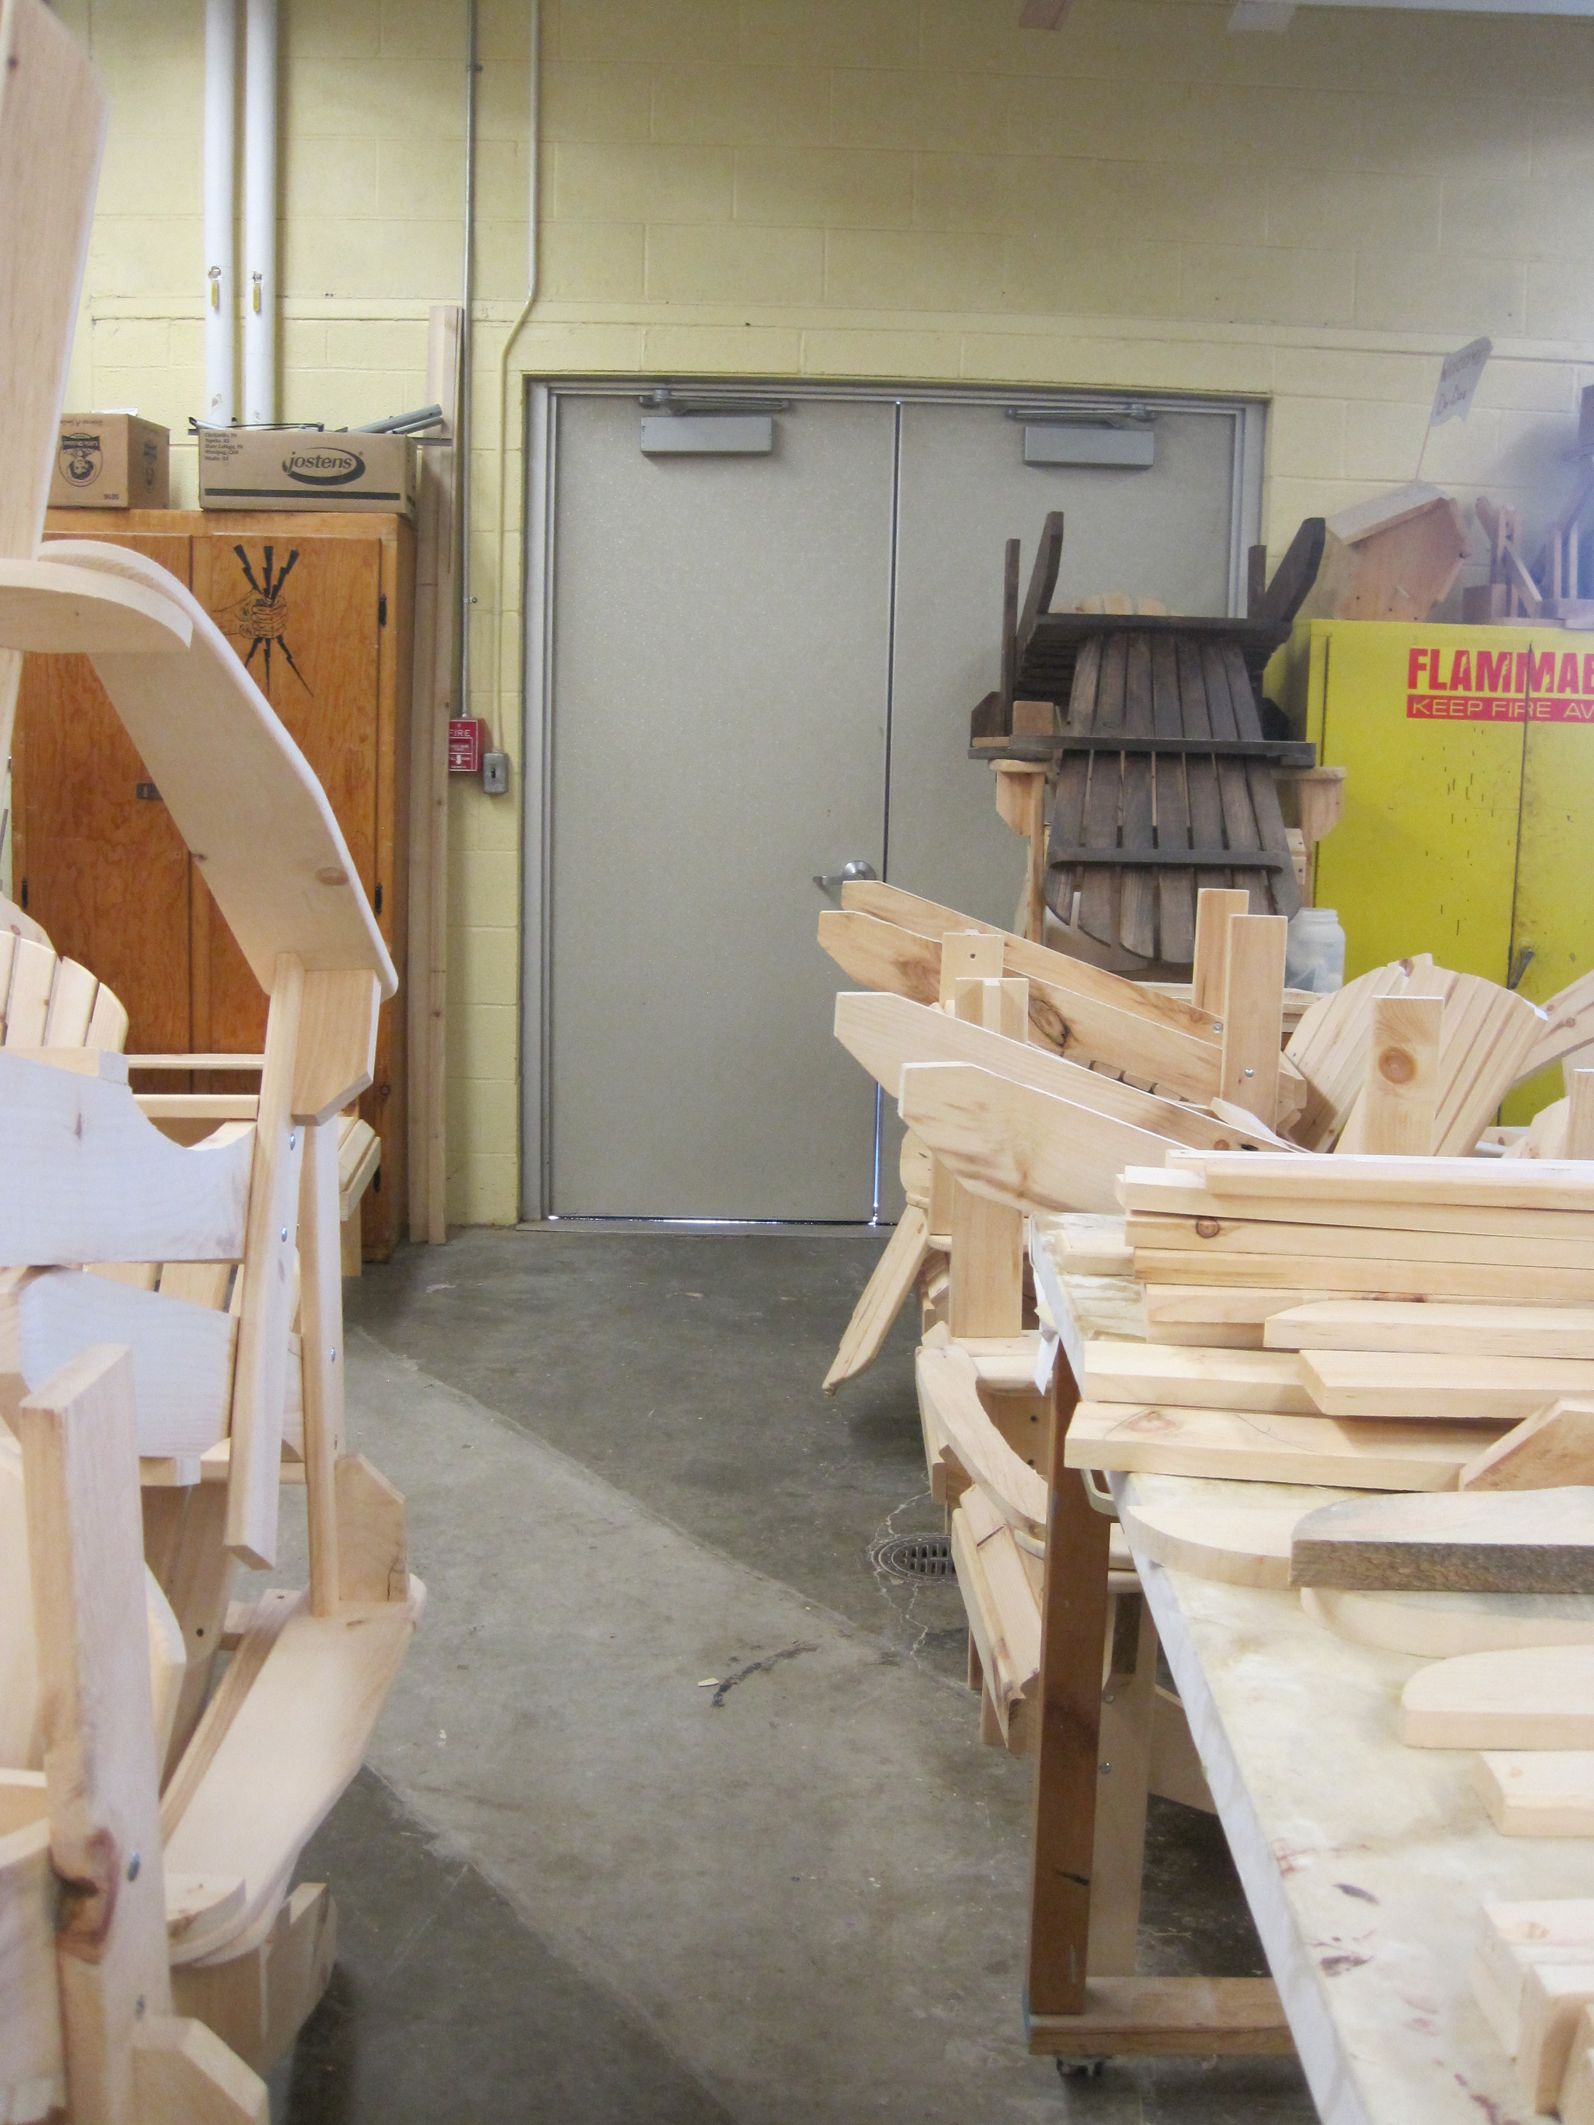
Housekeeping Standards
1910.22 (a)(1) All places of employment, passageways, storerooms, service rooms, and walking-working surfaces are kept in a clean, orderly, and sanitary condition.
1910.22 (d)(1) The employer must ensure walking-working surfaces are inspected, regularly and as necessary, and maintained in a safe condition.

Slide 29
Amputation Case Study #2

Slide 30
Enforcement Inspection
Employee replacing exhaust fan motor on the return section of an air handling unit
  the belts on the fan motors are replaced every 6 months
Fingers got caught in the fan belt
Sustained amputation of 2 fingertips

Slide 31
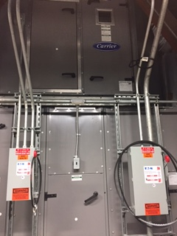
8 feet high

Slide 32
Work being done
Return fan motor was broken
Employees replaced the motor the day before
Belt got twisted during motor installation
Incident
Employee reached into fan compartment with the intention to clean up garbage and tools
The belt started free-wheeling
Employees left hand got caught in the belt, resulting in the partial amputation of 2 fingers

Slide 33
Machine Guarding
The belt and pulleys were not guarded because:
  They were guarded by location (located 8 feet from the floor)
  The door to the fan compartment is closed, providing additional guarding
The belts and pulleys would need to be guarded in the following instances:
  working in the fan compartment but not on the belt and pulleys *which was not the instance in this accident*
The belt and pulleys are not able to be guarded:
  when employees are working on the belt and pulleys LOTO would need to be used.

Slide 34
Electrical
The supply and return fans are separately powered by the main breaker panel
The fans are not mechanically or electrically connected, they operate as 2 independent fans
The return fans operate on duct pressure
LOTO Issues
The return fan was electrically locked out.
The belt and pulleys for the fan did not have a block being used for LOTO.
Return fan had 2 sources of energy: Electrical & Mechanical
The return fan was not mechanically locked out.

Slide 35
Serious Violation
1910.147 (c)(4)(1): procedures shall be developed, documented, and utilized for the control of potentially hazardous energy when employees are engaged in activities covered by this section

Slide 36
Amputation Case Study #3

Slide 37
Winds of Change
University maintenance mechanic with twelve years of experience replacing control in a large air handling unit (AHU) in a mechanical penthouse.
Fan motor had been deenergized by opening and then attaching his issued lock and tag to the disconnect, and verified by testing
The outside air intake louvers were open
Wind moving through the AHA caused the fan impeller to rotate, completely severing one of the worker’s fingers
Lesson learned: In addition to the electrical power to the fan, air movement can cause movement of fans and mechanical parts through what is known as ‘windmilling’. Procedures must be developed to safeguard employees from this energy source, such as closing air entry points and securing parts from moving, and employees need to be trained on the hazard and control procedures.

Slide 38
Enforcement inspection

Slide 39
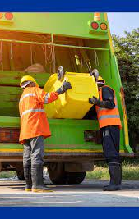
Struck-by – Refuse Collection
March 23, 2021, two employees collecting trash from side of the road on a steep sloping hill plus the driver
Truck was stopped on hill, all lights were working
Employees were wearing appropriate PPE (vests, etc.)
The side of the truck closer to the road was full so employees were loading side toward middle of road
Time of Day was approximately 7:30 AM.
A driver came over the hill and struck the employee toward the middle of the road and the refuse vehicle

Slide 40

Reflection
Employee was 32 years old
Employee had worked at DPW
for approximately 6 months
Employee had no formal training
Left leg was amputated above knee
Sun glare, according to driver, may have been an issue
Situational awareness

Slide 41
Wage and Hour Division of DOL
Hazardous Occupations Order No. 12 (HO 12), generally prohibits minors less than 18 years of age from loading, operating, and unloading power-driven paper processing machines, including all balers and compactors, guillotine paper cutters or shears, platen printing presses, and envelope die-cutting presses. Prohibited balers and compactors include scrap paper balers and paper box compactors that process only paper materials as well as those compactors and balers that also process such things as trash, foam rubber, metal, food waste, plastic, and fabric.

Slide 42
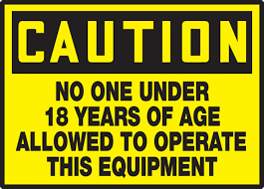

Labeling
1910.242 (a) Each employer shall be responsible for the safe condition of tools and equipment used by employees, including tools and equipment which may be furnished by employees.
Condition related to labeling: faded, missing, and deteriorated warning labels.
Assign one or more qualified persons to inspect and tag all hand and portable powered tools before first on-the-job use and periodically thereafter, and to repair, replace, or ensure replacement of defective tools. Defective tools and equipment should be tagged as hazardous and removed from service immediately. Employers are responsible for ensuring the safe condition of all tools and equipment used by employees, including those furnished by employees.

Slide 43
Available assistance

Slide 44
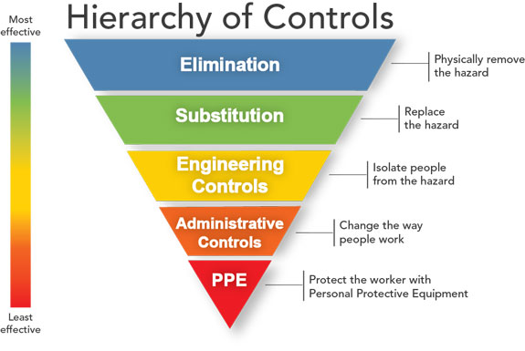
Consider ALL levels in the Hierarchy of Controls

Slide 45
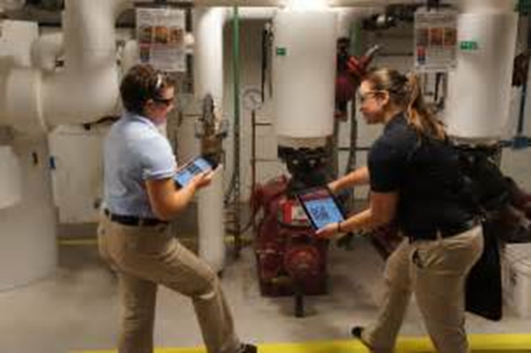
Consultation Assistance
Obligation to correct identified hazards
Types of Assistance
  Hazard Surveys
  Abatement Assistance
  Program and Training Assistance
Free and confidential
Separate from Enforcement
Management request
Limited vs. Comprehensive
Employee involvement
encouraged

Slide 46
For free consultation assistance, contact your local Public Employee Safety & Health (PESH) Bureau:
District Office | Consultants
Albany District Office State Office Campus, Building 12, Room 158, Albany, NY 12240 Tel. 518-457-5508 FAX 518-485-1150 Counties Served: Albany; Clinton; Columbia; Dutchess; Essex; Greene; Rensselaer; Saratoga; Schenectady; Schoharie; Ulster; Warren; Washington | Health – Contact Joseph Fuller Joseph.Fuller@labor.ny.gov Safety – Joseph Cook Joseph.Cook@labor.ny.gov
Binghamton District Office 44 Hawley Street, 9th Floor, Binghamton, NY 13901-4409 Tel. 607-721-8211 FAX 607-721-8207 Counties Served: Allegany; Broome; Chemung; Chenango; Delaware; Otsego; Schuyler; Steuben; Sullivan; Tioga; Tompkins | Health –Pete Moles Peter.Moles@labor.ny.gov Safety - Jamie Becken Jamie.Becken@labor.ny.gov
Buffalo District Office 65 Court Street, Buffalo, NY 14202 Tel. 716-847-7133 FAX 716-847-7108 Counties Served: Cattaraugus; Chautauqua; Erie; Niagara | Health – Charles Riley Charles.Riley@labor.ny.gov Safety – Jennifer Puerner Jennifer.Puerner@labor.ny.gov
Garden City District Office 400 Oak Street, Suite 101, Garden City, NY 11530 Tel. 516-228-3970 FAX 516-794-7714 Counties Served: Nassau; Suffolk | Health – Emily Henderson Emily.Henderson@labor.ny.gov Safety – Contact Matt Setteducati Matthew.Setteducati@labor.ny.gov
New York City District Office One Hudson Square, 75 Varick Street (7th Floor), New York, NY 10013 Tel. 212-775-3548 FAX 212-775-3542 Counties Served: Bronx; Kings; New York; Queens; Richmond | Health – Contact Alex Hippolyte Alex.Hippolyte@labor.ny.gov Safety – Kwo Lam Kwo.Lam@labor.ny.gov
Rochester District Office 109 South Union Street, Room 402, Rochester, NY 14607 Tel. 585-258-4570 FAX 585-258-4593 Counties Served: Genesee; Livingston; Monroe; Ontario; Orleans: Wayne; Wyoming; Yates | Health – Charles Riley Charles.Riley@labor.ny.gov Safety – Jennifer Puerner Jennifer.Puerner@labor.ny.gov
Syracuse District Office 450 South Salina Street, Syracuse, NY 13202 Tel. 315-479-3212 FAX 315-479-3451 Counties Served: Cayuga; Cortland; Jefferson; Onondaga; Oswego; Seneca | Health – Pete Moles Peter.Moles@labor.ny.gov Safety – Jamie Becken Jamie.Becken@labor.ny.gov
Utica District Office 207 Genesee Street, Room 701, Utica, NY 13501 Tel. 315-793-2258 FAX 315-793-2303 Counties Served: Franklin; Fulton; Hamilton; Herkimer; St. Lawrence; Lewis; Madison; Montgomery; Oneida | Health - Contact Joseph Fuller Joseph.Fuller@labor.ny.gov Safety - Joseph Cook Joseph.Cook@labor.ny.gov
White Plains District Office 120 Bloomingdale Road, Room 250, White Plains, NY 10605 Tel. 914-997-9514 FAX 914-997-9528 Counties Served: Orange; Putnam; Rockland; Westchester | Health – Emily Henderson Emily.Henderson@labor.ny.gov Safety – Contact Matt Setteducati Matthew.Setteducati@labor.ny.gov

Slide 47
21d Consultant Contact Information
Albany | (518) 457-2810
Binghamton | (607) 721-8019
Buffalo | (716) 847-7166
Garden City | (516) 228-3959
New York City | (212) 775-3526
Rochester | (716) 847-7166
Syracuse | (315) 479-3205
Utica | (315) 793-2319
White Plains | (914) 997-9511

Slide 48


Slide 49
Contact Information
Jamie L. Becken – Jamie.Becken@labor.ny.gov
  NYS DOL / Syracuse
  450 South Salina Street, Room 202
  Syracuse, NY 13120 ( 315-479-3311 )
Jennifer Puerner – Jennifer.Puerner@labor.ny.gov
  NYS DOL/Buffalo
  290 Main Street, Mezzanine
  Buffalo, NY 14202 ( 716-847-7603 )

Slide 50


