Slide 1


UHNM Adult Critical Care Unit – Delivering a Transformation Programme
Dr Chris Thompson
04/07/2017

Slide 2
Content
Background
What is Transformation?
How to deliver change?
How do you sustain change?
Is it working?

Slide 3
Recent challenges for UHNM
2014/15 saw many challenges for UHNM that impacted on critical care.
Dissolution of Mid-Staffordshire NHS Foundation trust and restructuring of services affected UHNM, Wolverhampton and Walsall - October 2014.
Significant changes in service provision for critical care team
  Level 3 care goes to RSUH
  4 Level 2 beds remain at County HDU
  No emergency surgery at County Site; other services move.
  Cardiothoracic team increasing workload.

Slide 5
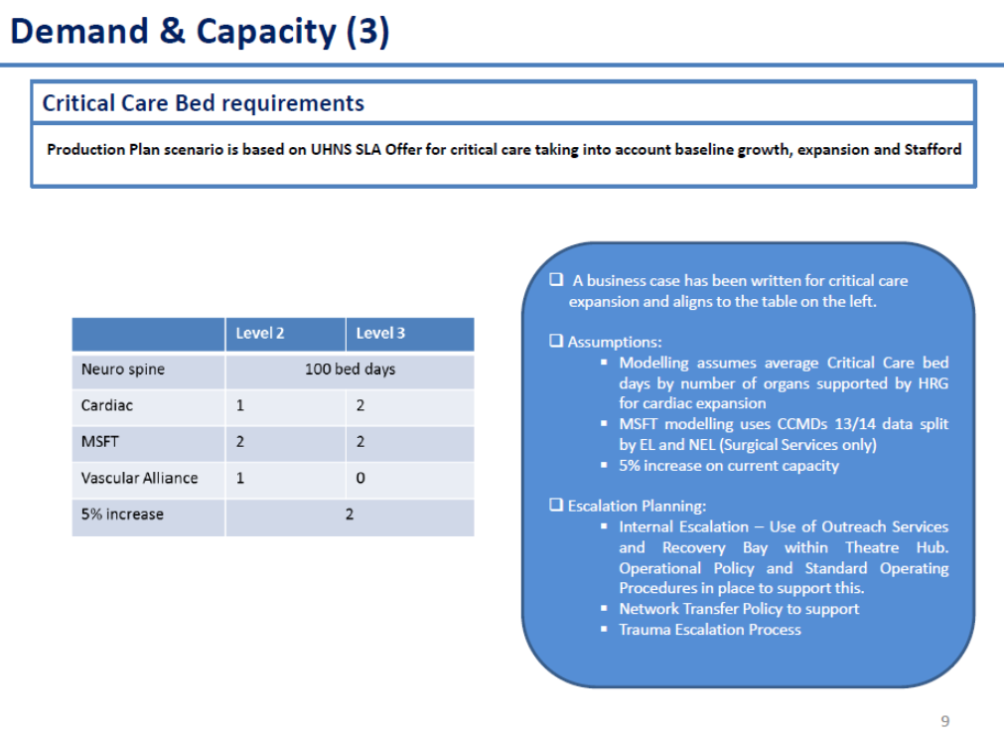
14/15 Capacity plan for Trust board

Slide 6
Baseline data 2015
Information is always important when you try to make change:
Independent external
Network Peer review March 2015 - Dr Nick Sherwood\Angela Himsworth
Teeside University Excellance in Practice Accreditation Scheme March 2015
  External Critical care reviewer Dr Sanjoy Shah from Bristol.
  Silver award accredited.
CQC Report April 2015

Slide 7
CQC Report April 2015
Report
Why such a problem with responsiveness?
Outreach pulled 50% of time. Team threaten resignation.
38 admissions/month to Critical care, admitted to recovery prior to bed being available with stays of up to 24 hours in March 2015.
High levels of transfers out.
95% of activity NEL pathways.
Poor staff retention.

Slide 8
We have a PROBLEM!
We knew we had a problem but Exec team did not recognise the issues.
Dr C Thompson - Clinical lead 07/14
Matron C Hughes – Matron Critical Care 09/14
No Directorate manager
CQC report show we definitely need to change. EPAS demonstrated we had capacity to change.

Slide 9
Capacity review 04-06/2015
It was clear that with significant changes and critical care activity in recovery that baseline modelling of activity was required. Without this data we would not be able to meet the Trusts’ strategic plan for the delivery of an effective, efficient critical care at UHNS, meeting the planned needs of all specialities by 2019/20.
The process of capacity planning required that data was collated from sources which had not previously been used in capacity modelling. Recovery data and cancelled operations data had not previously been included.
The result of this review is that Critical care capacity is currently not commissioned to required levels to deliver the trust’s business plan. Required capacity is summarised below.
This gave a gap in level 3 capacity of 6 beds according to this model.
Section | Level 1 | Level 2 | Level 3 | Level 1, 2, 3
2) 14/15 Royal Stoke Level 2 and Level 3 |  | 31.0 | 31.0 | 62.0
3) 14/15 Royal Stoke Level 1 | 3.5 |  |  | 3.5
4) 14/15 Royal Stoke – Effect of cancellations |  | 0.4 | 1.0 | 1.4
5) 15/16 Royal Stoke Growth requirements |  | 1.5 | 1.5 | 3.0
6) Beds required – previous County activity | 0.8 | 3.7 | 4.5 | 9.0
Total | 4.3 | 36.6 | 38.0 | 78.9

Slide 10
Proposed Critical care bed requirements from review
Section | Level 1 | Level 2 | Level 3 | Level 1, 2, 3
2) 14/15 Royal Stoke Level 2 and Level 3 |  | 31.0 | 31.0 | 62.0
3) 14/15 Royal Stoke Level 1 | 3.5 |  |  | 3.5
4) 14/15 Royal Stoke – Effect of cancellations |  | 0.4 | 1.0 | 1.4
5) 15/16 Royal Stoke Growth requirements |  | 1.5 | 1.5 | 3.0
6) Beds required – previous County activity | 0.8 | 3.7 | 4.5 | 9.0
Total | 4.3 | 36.6 | 38.0 | 78.9
Total beds required above includes NIV delivering 12.5 beds and County provision now delivering 4 level 2 beds.
Actual number across the critical care floor therefore is 78.9 - 12.5 - 4 = 62.4
Cancelled operations requirements for Cardiothoracic service is 1.0 Level 3 bed equivalent to moving current neurosurgical activity out of Pods 1&2.
The proposed capacity plan below will, if all the bed spaces are commissioned ( 52 beds across Pods 1-6) with additional equipment provided within Pod 6, allow a flexible use of beds for level 2 and level 3 capacity. The workforce model required to deliver this means that more level 2 beds can be opened at times of need by conversion of level 3 beds to level 2 beds and vice versa within the staffing envelope.
According to the modelling above there is a gap in level 3 capacity of 6 beds but over capacity in terms of level 2 beds. Patients’ transition between the two levels of care the below model is believed to be fit for purpose.
To correct the deficit the conversion of 4 level 2 beds to staffing for level 3 beds is required. This is an increase in dependency equivalent to opening 2 additional Level 3 beds.

Slide 11
How to expand capacity?
Vacancies
New Physical Capacity
60 wte across all bands of nursing staff.
County staff now moved to RSUH
High Locum requirements
Critical care had been built 12 bedded critical care area delivered in April 2015.
Pulled 2 Critical care beds from SSCU.
Created capacity in Cardiac ICU and allowed for transfer of Level 3 capacity from County Hospital and delivered 1 additional bed for ACCU.
Physical space to open 2 beds in SSCU and Pod 6 remained.

Slide 12
What else to consider?
Expected growth 2 years
Efficiency Gains
Current gap in provision large.
Expect further NEL growth
Other workload eg Emergency Laparotomy pathways suboptimal.
Current 2014/15 length stay for survivors 10days significantly longer than national average
Ventilated patients on unit 65%

Slide 13
What is Transformational change?
Transformation describes radical change from which there is no going back
  Transformation is a deliberate, planned process that sets out a high aspiration to make dramatic and irreversible changes to how care is delivered, what staff do (and how they behave) and the role of patients, that results in substantial, measurable improvement in outcomes, patient and staff satisfaction and financial sustainability.
Transformation is a dynamic process, with distinct phases
  A process that usually takes 2 or more years, it has a defined end point when process becomes part of normal business.

Slide 14
Transformation Programme
CT attends Aspires “Managing Successful Programmes 3 day Foundation Course” April 2015
Core team pulled together July 2015 and a Vision Statement drafted.
UHNM Critical Care will be a patient and family focussed service that provides high quality care at times of Critical illness.
We will provide safe and timely care from being identified as becoming Critically ill through to recovery, maximising individual outcomes.
We will achieve this by being true to our values and beliefs focusing on:
  The needs of our patients and families
  A research and evidence based culture
  High standards of education and training for the MDT
  Fostering innovation and creativity within our team.

Slide 15
Strategy
Critical Care Without Walls – A review of all services that have interaction with the critically ill patient external to the Critical Care Unit.
Building Critical Care – A comprehensive review of care provided to critically ill adults in all critical care areas, inclusive of process and equipment
To A Better Recovery – Implementation of a robust rehabilitation strategy commencing within critical care and beyond.
Patient Data Management System - To benefit patients, staff and the trust in providing patient focused quality care, improved patient safety and live accurate data capture

Slide 16
Transformation Programme
Key Steps at start.
Set up Project teams to work under the Critical care Transformation Programme Board.
GPICS Standards & NICE CG83 benchmarking
Get Divisional\Executive support for change
Allocated a Transformation Project manager
Produce a Programme Initiation Document
Ensure you have the right story for trust – aim to sort capacity out. We need to be more EFFICIENT.

Slide 17
Business case Approved 11/11/15 – Dependancy 30wte (Delivering capacity April 2016/17)
 | POD 1 | POD 2 | County Critical Care
Specialty Allocation | Elective Cardiothoracic Surgery 8 x L3 beds | Elective Cardiothoracic 2 x L3 beds & 6 x L2 beds | Adult Critical Care 4 x L2 beds
Clinical Management | Cardiothoracic Surgeons/anaethetists | Cardiothoracic Surgeons/anaethetists | Consultant Intensivist’s
 | POD 3 | POD 4 | Pod 5 | Pod 6
Specialty Allocation | Adult Critical Care 4 x L3 beds & 4 x L2 beds | Adult Critical Care 8 x L3 beds | Adult Critical Care 8 x L3 beds | Adult Critical Care 6 x L3 beds & 4 x L2 beds
Clinical Management | Consultant Intensivist’s | Consultant Intensivist’s | Consultant Intensivist’s | Consultant Intensivist’s

Slide 18
Business case Approved 11/11/15
Equipment gap bridged to open additional beds
Additional staffing required (ref1):
Equivalent of Additional 2 Level 3 beds (Pods 3-6) converts 4 level 2 to level 3
Nursing staffing required is Band 6 - 2.0 WTE, Band 5 - 9.24 WTE and a band 2 1.0 WTE
Physiotherapy Technician Band 3 - 1.0 WTE
Dietician Band 7 - 0.20 WTE
Pharmacy Band 8a - 0.20 WTE
Speech & Language Therapy Band 7 – 0.20 WTE
Occupational Therapy Band 7 – 0.20 WTE
PDN Band 6 – 0.5 WTE
Clinical Support Technician – Band 6 – 0.01 WTE

Slide 19
UHNM Adult Critical Care Unit – Delivering a Transformation Programme
Delivering and sustaining change

Slide 20
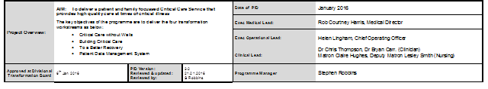
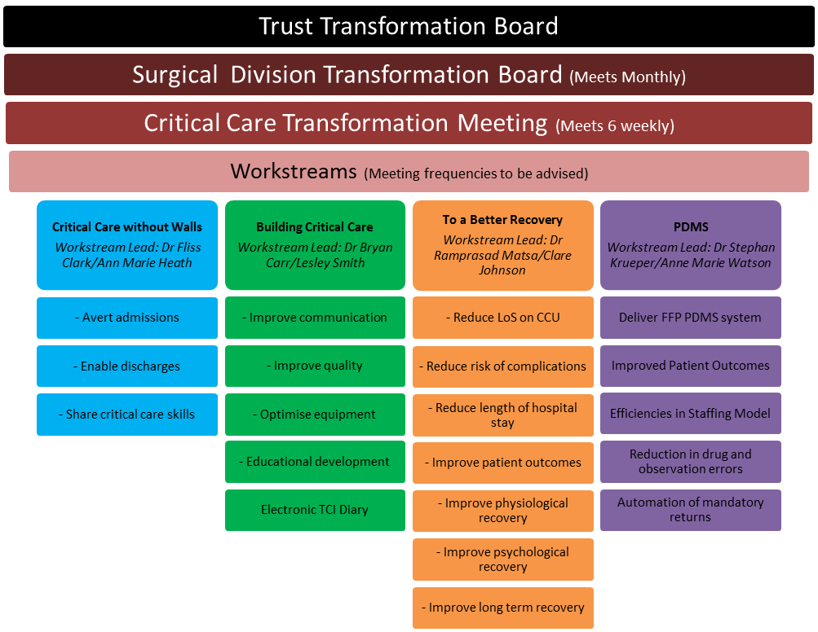

Slide 21
Transformation Programme
Critical Care Transformation Board
  Regular meeting supporting each workstream
  Information gathering to support business cases
  Ownership within the team
CCDG (monthly) and CCSG (Quarterly)
  Reporting progress to Delivery group
  Strategy group helped to support change required at corperate level rather than just need more beds.

Slide 22
CCSG 03/16
 | No. | Item | Responsible person
14:00 | 1. | Procedural Items
 | 1.1 | Apologies & review previous minutes | SM
14:15 | 2. | Critical Care Transformation Programme | CT/CH
 | 3. | Divisional 5 year IBP Presentations (max 20mins per division)
14:45 |  | Specialised Division | Julie Regan\Lyndsey Bowman\PTH
15:05 |  | Surgical Division | Kathryn Gaulton
15:25 |  | Medical Division | Amanda Wilding
15:45 |  | Womens & Childrens Division – Maternal HDU Plan | Lesley Hurst
16:00 | 4. | Review of Existing Data Reports (all to be provided pre-meeting)
 |  | Trust/Divisional Business plans relating to or from critical care Critical care delivery group (CCDG) minutes Monthly report cancelled operations\procedures NIVU activity report Critical care dashboard 6 monthly performance review ICNARC reports TARN data 6 & 12 monthly activity – YEAR ON YEAR ACTIVITY INCREASE Trauma Network Report on referral patterns & activity National Emergency Laparotomy data Research activity | See above CH JR/Martin Allen CH CT Ellie Fairhead Mr Tsiamis CT
16:15 | 4. | Discussion of Strategy for safe provision and meeting growth requirements in critical care provision. | All
16:45 | 5. | Action plan | SM/HL
 |  | Produce Trust IBP for Critical Care capacity 17/18,18/19
16:55 | 6. | Any of the business
17:00 | 6. | Date and time of the next meeting\Close
 |  | 3rd June 2016
Discussion re Action Plan
CT summarised additional capacity requirements identified in the Meeting.
370 bed days to improve outcome and pathways for emergency laparotomy (based on Median length of stay)
108 bed days hyper acute stroke pathway business case
75 bed days year on year increase for trauma total for 3 years 225 additional bed days predicted to be needed.
There is a 1% year on year increase on non-elective pathway work trust wide, equating to another 12 admissions per year, with an mean length of stay currently of 10 bed days per admission, so that is another 120 for the 1% increase year on year. Total 360 additional bed days required over 3 years.
CT advised that in terms of the next 3 years the additional activity that we need to take on over and above what we put into the Business Case for the expansion of Critical Care last year which has not been realised yet, then we are talking about approximately 1,100 bed days of additional activity that we will need to find over the next 3 years, equating to additional 4 beds.

Slide 23
Development of Business cases to support Transformation
3 successful business cases in 12 months.
  Capacity BC-0194 opening additional 2 level 3 beds and equipment for Pod6 to flexibly use un-commissioned capacity with more L2 v L3 at times of need. (09/11/15)
  Rehabilitation pathway BC-0235
  Critical care Patient Data Management system BC-0233

Slide 24
Rehabilitation BC-0235
Benefits Profile (KPI’s)
Benefit Description | Measures/Indicator Current State | Measures/Indicator Future State | When
Reduced length of stay (mean LoS in days) | 10 days | 9 days | Year end 2017/18
CPAx Measurements on patients being discharged from hospital leading to evidence improved outcomes | Not measured | >85% of all appropriate discharges | Apr 2017
Increased measurement of delirium incidences to enable more effective treatment and improved patient outcomes | Sporadic measurement less than 50% of applicable patients | >85% of patients identified at risk of delirium measured and treated | Dec 2017
Increased number of admissions per bed per year demonstrating improved turnover and reduced LoS | Currently 1,260 admissions per annum | 1,310 admissions per annum | March 2018

Slide 25
Patient Data Management System
Benefits Profile (KPI’s)
Benefit Description | Measures/Indicator Current State | Measures/Indicator Future State | When
Automation of ICNARC and other mandatory returns | Manually collected | Automated with subsequent staffing CIP | Sep 2017
Reduction in medication errors | 15 per day | <8 per day | Post Implementation
Improvement in number of sedation holds on identified patients | Less than 50% of identified patients have sedation holds | 95% of all appropriate patients have holds | Post Implementation
Improved recording of Critical Care Periods and Levels of Care ensuring robust information to optimise income | 0.5% coding errors | 0% coding errors | Post Implementation
Improved Patient Safety | 12 patients per year harmed as a result of drug error | <6 patients per year harmed as a result of drug error post implementation | March 2018
Recognising potential for poor coding, resulting from transcription error or failure to record organ support helped ensure we were successful in justifying the implementation costs.

Slide 26
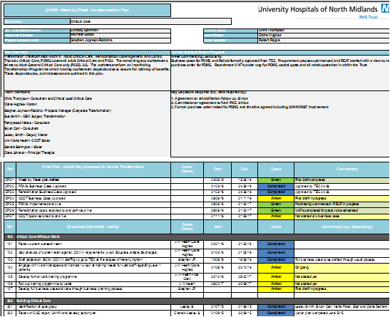
Gant Chart
Monitoring progress and measuring inter-dependancies
Task allocation
Time line
Issues register
Risk register
RAG rated

Slide 28
Performance?
Recovery activity for patients admitted to Adult Critical Care Units Pods 3-6.
Sustained performance ongoing

Slide 29
Outreach Activity 2016/17

Slide 30
County Hospital and Transfers
County Level 3 beds moved 30/03/15.
County Hospital HDU activity has been low with a 43.8% occupancy with level 2 activity. Additional activity with level 0/1 care a further 19.8% occupancy. Transfers have now been established for 2 years, at a rate of approximately 1/week.
The second year data demonstrates transfer is not increasing risk of death above expected, with all deaths reviewed in M&M.
Transformation programme has been delivered across both sites.
2016/17 Total of 4 transfers out in 12 months 2 from RSUH and 2 from County (see below) to other trusts as non-clinical transfers.
From | To | n | Mortality | % Mortality
County HDU | RSUH CCU | 28 | 8 | 28.5
County A&E | RSUH CCU | 20 | 3 | 15
County A&E/HDU | Other CCU | 2 | 0 | 0
County A&E/AMU | RSUH non CCU | 10 | 4 | 40
 | Total | 60 | 15 | 25

Slide 31
Length of stay
ICNARC data
Projected improvements
Mean length of stay for unit survivors from ICNARC
  2014/15 was 10 days
  2016/17 was 8.6 days
  When this is broken down the NEL pathway survivors mean length of stay has decreased to 9 days.
Improved access to outreach and ACCU beds has influenced this to date.
Further gains are likely from the Rehabilitation BC-0235 with additional bed day gains predicted of 750 bed days.
Delayed discharges account for 360 days delay per annum equivalent to an additional bed.

Slide 32
Staff Retention, Human Factors and Training
RGN Staffing lost/month
  2014/15 average 5/month due to staff dissatisfaction
  2016/17 average 1/month now reasons relocation or promotion
Recruitment massive
  Total head count RGN’s
  May 2016 Band 5-7 No. 151
  Total head count RGN’s
  June 2017 Band 5-7 No. 216
In House training programme.
  Resuscitation training
  Mandatory training
  ICU STEPS fully adopted
  Increased access to Critical care post graduate course
  Simulation training with Band 6 team
  Away days for team
Human Factors course 2 days Foundation course
  Whole MDT
  3 courses run with 69 trained

Slide 33
ICNARC Admission numbers
2014/15 – County 431 RSUH 817 total 1248
2015/16 – County 182 RSUH 1176 total 1358
2016/17 – County 178 RSUH 1385 total 1563
Occupancy rates – last year 88.8% improved from 94% at time of CQC despite increased activity

Slide 34
Rehabilitation
NICE CG 83 internal metrics should be met be Q4 2017\18
Follow up PICS clinic business case has gone to CCG’s for funding. Passed CPAG prioritisation stage.
Audit compliance Q4 2017/18.

Slide 35
Patient Data Management System
PDMS business case approval 24/08/16 at Trust executive committee. GE Critical Care Centricity system implemented and gone live 12/06/2017.
Truly amazing commitment from Team
On going learning to adapt to system and improving data accuracy and compliance
Implementation process went live with 80% staff trained. Business continuity plans very important early on.

Slide 36
Transformation close out
Last Programme Board meeting on 13/07/17
  Review potential close out period
Handover to directorate team to continue to deliver project implementation.
KPI’s and monitor operational performance as part of normal business.

Slide 37
On-going challenges
Using data effectively
Infection control issues as part of normal operations mean that we needed to deliver a plan to tackle unit acquired blood stream infections. This has now been delivered with significant drop in rates.
Data quality needs to be more robust – PDMS hopefully will deliver.

Slide 38
Get ready for next Quality Improvement Plan

Slide 39

The Team
Stephen Joynson-Robbins
Claire Hughes Lesley Smith David Cartlidge Bryan Carr
Felicity Clarke Nehal Patel Stephan Krueper Ram Matsa
Clare Johnson Sandra Barrington Anne Heath
Ann-Marie Watson John Alexander (PICU) Jill Bogucki
Lucy Powell Emily Brownsill Joache Reeves
Kevin Pugh Thomas Potts Kathyrn Gaulton

