Slide 1

Welcome
Office 365 stock​
Notes:
If there are no relevant financial relationships to disclose, all disclosures required for accredited education are included in the course registration email that each student receives.
Course directors: insert disclosure slide AFTER this slide if you or any of your instructors have a relevant financial relationship to disclose. ENA will send the slide to each instructor as needed based on the annual financial relationship disclosure form submission.
Housekeeping to include videoconferencing instructions as needed.
We will not be making you sit all day. Throughout the class we have activities where you will work with your classmates and short stress busters where you will be encouraged to move around. Each of you will lead at least one of 8 simulated patient scenarios. It might be uncomfortable at first, but the more everyone joins in, the more everyone will get out of the class. Your instructors have some great information to share, but we want to help you apply this content to your practice setting and cannot do that without your participation.

Slide 2
What do you hope to learn?
How do you recharge?
Notes:
To help us get to know each other, tell us who you are, and let us know if there is anything specific you are hoping to learn. We hope you are recharged by attending this class. What else do you do to recharge?
Other instructors present can BRIEFLY introduce themselves. Learning from the experiences of others outside the patient care environment is a great way to professionally recharge. Additional “get to know you” questions or icebreakers may be used, but focus on what the learners will gain from participating.

Slide 3
Initial Assessment
Notes:
BOLD FONT – information or questions for instructors to read aloud
Regular font – potential learner responses, not all inclusive, encourage participation by accepting a variety of responses and provide gentle redirection for incorrect information
Italic font – animations, activity instructions, or instructor information, not intended to be read to the students
This discussion includes content from Chapter 4, Prioritization; Chapter 5, Initial Assessment; and Chapter 7, The Child in Need of Stabilization.
Objectives
Determine if a patient is sick, sicker, or sickest using the Pediatric Assessment Triangle (PAT).
Use the PAT and patient presentation to determine patient priority.
Verbalize the initial steps of pediatric advanced life support.
Identify the required skill step criteria for the Pediatric Nursing Process (PNP).
Correlate primary survey interventions with goal-directed therapy for inadequate tissue perfusion.

Slide 4
Pediatric Prioritization
Preparation and safety
General impression
  Appearance, Work of Breathing, Circulation to Skin
  Reprioritize to C-ABC?
    Unresponsiveness/apnea OR uncontrolled bleeding
    Start chest compressions or control hemorrhage
Rapid focused assessment and history
Determination of acuity with a validated triage system
Notes:
We are going to learn how to apply the Pediatric Nursing Process (shortened to PNP) to help us prioritize our care.
Have your PNP for Students and provider manual available for reference throughout the class. The provider manual’s Appendix is another version of the PNP for Students.
Pediatric preparedness is explored at length in Chapter 2 of your provider manual. In the PNP, preparation includes donning PPE, recognizing other safety concerns, and gathering necessary equipment. You may consider mobilizing other resources depending on the child’s initial presentation or prehospital report. You will form a general impression using the PAT. If you notice unresponsiveness or apnea you may need to check a pulse while looking, listening and feeling for normal breathing to determine if you need to reprioritize to C-ABC and perform chest compressions. If you notice uncontrolled bleeding in the PAT, you will reprioritize by controlling it. Otherwise, you will move on to the primary survey.
Often, we need to determine which patient is the highest priority. Instead of performing the entire initial assessment, we will perform a rapid focused assessment and history to determine who needs to be seen first.

Slide 5
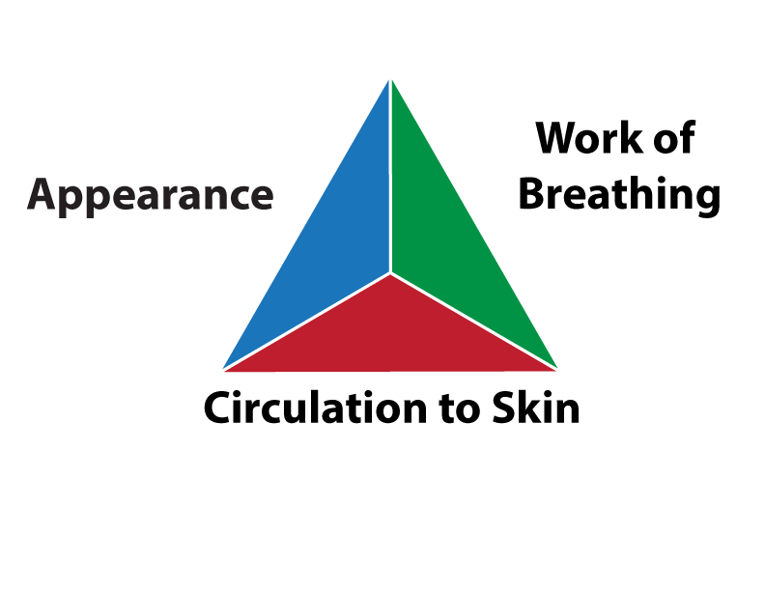
The Pediatric Assessment Triangle (PAT)
ENA
Notes:
What did you learn about the PAT in the pre-course module?
Based on visual and auditory cues
Reliable tool for identifying acutely ill and injured infants and children
Standardized method to evaluate physiological instability and set priorities
Used with every pediatric encounter
Now we will break down each part of the triangle.

Slide 6
PAT
Tone
Interactiveness
Consolability
Look/gaze
Speech/cry
Notes:
Does anyone remember the mnemonic for or components of general appearance? What does each letter stand for?
TICLS
CLICK for answers
Give me some examples of a concerning finding in each component.
Limp, flaccid, decreased movement, no head control if over 3 months of age
Not drawn to sounds or people, not interested in toys or caregiver interaction, does not engage, listless, no response to movements or sounds
Not comforted easily with caregiver attention, familiar objects (toys, pacifier, blanket), or reassurance
Staring into space, unfocused
Weak cry or speaks with effort

Slide 7
PAT
Tachypnea
Stridor
Grunting
Retractions
Nasal flaring
Head bobbing
Tripoding
Accessory muscle use
Notes:
Who can tell me some signs of increased work of breathing? Remember these are VISUAL or AUDITORY assessments only.
CLICK for answers
What is the significance of these findings?
Indicate attempts to compensate for ineffective oxygenation, ventilation, or perfusion

Slide 8
PAT
Pallor
Mottling
Cyanosis
Notes:
What are we looking for in circulation to the skin? Remember these are VISUAL assessments only.
CLICK for answers
Uncontrolled bleeding is an acceptable answer
What causes mottling?
Vasoconstriction, a compensatory mechanism for inadequate perfusion (shock)
Other than compensation for shock, what can cause mottling?
Cold, medications (albuterol, epinephrine)
It is always safest to assume that mottling is due to inadequate perfusion until proven otherwise.
What does cyanosis indicate?
Significant hypoxia, considered a late and ominous sign of impending cardiopulmonary failure

Slide 9
Sick, Sicker, Sickest
NO alterations in the PAT = sick
Alteration in ONE component = sicker
Alteration in TWO or more components = sickEST
Notes:
When should you use the PAT?
EVERY time you see a pediatric patient. This is a quick assessment that can alert you to a change in patient condition just by peeking into the patient’s room.
PAT only generalizes patients into 3 categories: sick, sicker, sickest. Why are all emergency department patients at least “sick” even without abnormalities in the PAT?
The caregivers were concerned about something that prompted them to bring the child in for evaluation.
This is NOT same as a triage acuity rating. However, it may indicate that the patient needs to be brought directly back to a room OR help determine which patients the triage nurse should evaluate first.

Slide 10

“My stomach hurts.”
Photo by Kat J on Unsplash
Notes:
Let’s try it out. We see an 8-year-old child with abdominal pain. The PAT reveals the child is:
Crying but interactive
Regular breathing
Skin is pale
Is this child sick, sicker, or sickest?
What triage acuity is likely and why?
Sicker – alteration in circulation only
Will need more information to see what the acuity will be, as abdominal pain is not a simple presentation.

Slide 11
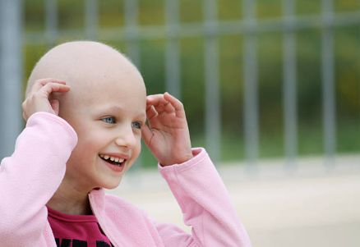
“Doesn’t feel good.”
Notes:
Now we have a 6-year-old child whose caregiver reports “doesn’t feel well.” The PAT reveals the child is:
Smiling and interactive
Respirations equal and even with no increased work of breathing
Laughs occasionally, can see moist pink mucous membranes
Sick, sicker, or sickest?
Patient is sick until proven otherwise. There are no alterations to her PAT, but it is likely that she has undergone medical treatment that caused hair loss.
What acuity is likely?
More urgent, may be immediately brought to room depending on facility policy and room availability. Will minimally need a mask.
Why?
High risk, potential for neutropenia

Slide 12

“Out of control”
Office 365 stock
Notes:
Finally, we have a 14-year-old child with aggression. The PAT reveals the child is:
Verbally/physically threatening and aggressive
Respirations even and easy with no increased work of breathing
Baseline skin color
Sick, sicker or sickest?
This patient is sicker with an alteration to appearance/behavior.
What acuity is likely? Why?
He will be an emergent acuity because of safety risks for the patient and others in the waiting area.

Slide 13
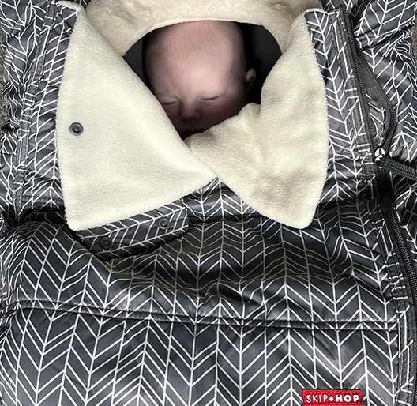
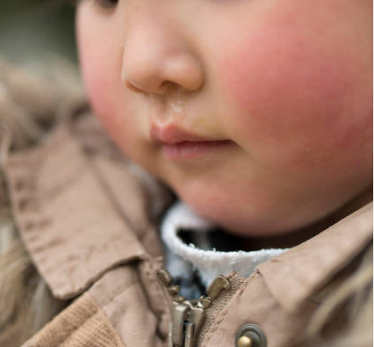
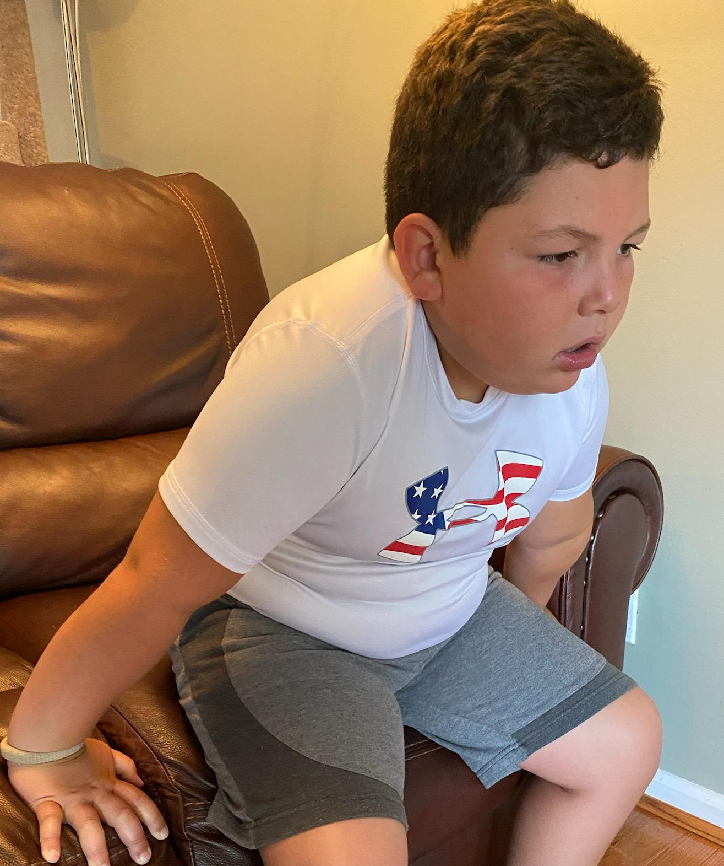
Maggie
Sam
Jack
Photo Courtesy Emily Rheaume
Photo Courtesy Christa Phelps
Notes:
Now everyone is busy with other patients and these three patients present at the same time.
Based on these images, who will you triage first?
Teaching point – Jack may appear more urgent but the infant needs to be uncovered
Maggie in an infant carrier: Not responding to parent, difficult to see respirations, pale
Sam: Looking around, respiratory rate normal with rhinorrhea but no increased work of breathing, flushed cheeks
Jack: Anxious, tripoding with a tight cough, baseline skin color
Maggie will bypass triage and go directly to a resuscitation bed
Jack is sickest and will be the first to triage
Sam is sick and will be the last to triage

Slide 14
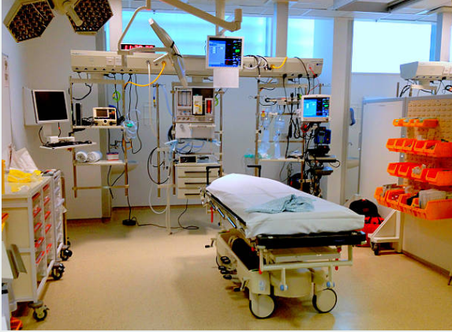
Notes:
You do not like how Maggie looks and bring her directly back to a room while calling for help. Maggie is 24 days old. She does not open her eyes or otherwise respond as you take her out of the infant carrier.

Slide 15
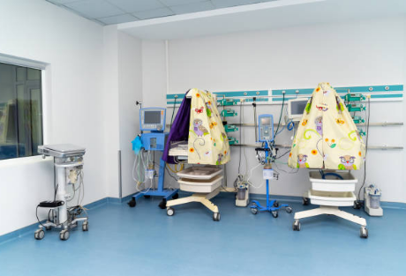
Notes:
If you have an infant warmer with a built-in scale readily available, this would be a great time to use it. How do you call for help, and who responds at your facility?
We know that Maggie is 24 days old, so technically she is a neonate. When do you follow the steps of neonatal vs pediatric advanced life support (PALS)?
Neonatal resuscitation is primarily intended for the newly born as they transition from intrauterine to extrauterine life. While there may be some exceptions in a neonatal intensive care unit, following the PALS guidelines is appropriate.

Slide 16
Initial Steps of Resuscitation
Call for help
Look/listen/feel for normal breathing and a pulse
  Where do you assess a pulse?
If no pulse, begin chest compressions and ventilations
  What is the ratio for compressions and ventilations?
  When is the recorder role assigned?
Apply defibrillator pads to assess rhythm
  Ventricular fibrillation or pulseless ventricular tachycardia
    Defibrillate at 2 joules/kg and immediately resume compressions
  PEA/asystole
    Resume cycles of compressions and ventilations
    Administer epinephrine as soon as possible
    Rhythm check and switch compressors at 2 minutes
Consider and treat reversible causes
Notes:
Talk through the initial steps of resuscitation, may ask students to verbalize each step, minimally ask students questions on the screen.
Brachial pulse check
Compression/ventilation ratio of 15:2 with 2 rescuers (big difference from neonatal resuscitation – ratio for infants making the transition to life is 3:1)
What are the H’s and T’s?
Hypovolemia, hypoxia, hydrogen ion (acid-base), hypo/hyperkalemia, hypothermia
Tension pneumothorax, tamponade (cardiac), toxins/tablets, thrombosis (pulmonary embolism), thrombosis (coronary)
Your coworkers take over and you can go back to the patients waiting to be seen.

Slide 17
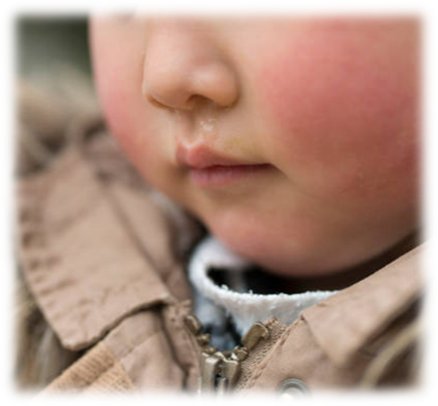
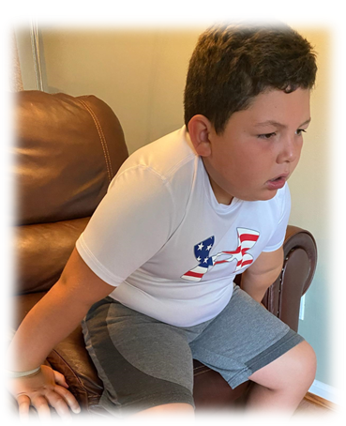
Who’s Next?
Sam
Jack
Photo Courtesy Christa Phelps
Notes:
If you recall, we had Sam the toddler who is attentive to surroundings, with rhinorrhea, a normal respiratory rate with no visible increased work of breathing, and flushed cheeks.
Jack the school-aged child is anxious and tripoding with a tight cough and baseline skin color.
This is a more obvious decision. Just remember that not all “sickest” patients will present as dramatically as Jack.

Slide 18

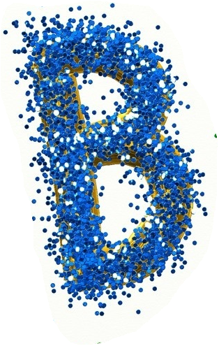
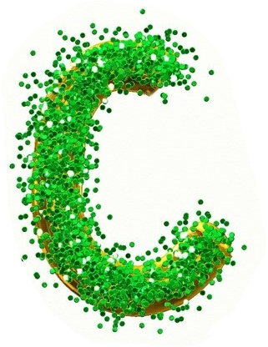
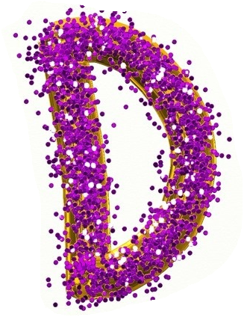

Primary Survey
AVPU
Cervical stabilization
Bony deformity
Edema
Fluids
Foreign objects
Loose or missing teeth
Sounds
Tongue obstruction
Vocalization
Breath sounds
Depth, pattern, rate
Work of breathing
Wounds/deformities
Skin color
Spontaneous breathing
Subcutaneous emphysema
Symmetrical chest rise
Capillary refill
Skin color, temperature, and moisture
Pulse
GCS
Pupils
Blood glucose if altered
Exposure
Environment
Image: Pixabay/Prawny
Notes:
Now we will talk through the PNP, which you were introduced to in the pre-course module. Refer to your Pediatric Nursing Process for Students.
What are we assessing for in each letter?
What interventions might be needed?
CLICK for criteria, one click per letter
These assessments and interventions are meant to identify and manage any life-threatening conditions.

Slide 19
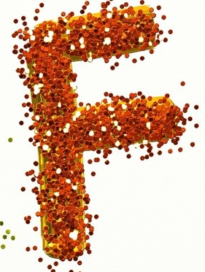


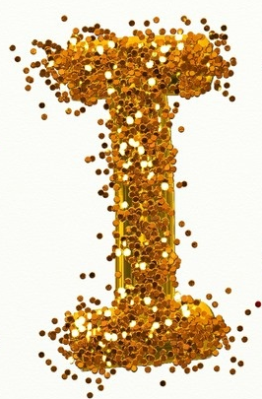
Adjuncts and Secondary Survey
Full set of vital signs
Family presence
Labs
Monitor
Naso- or orogastric tube
Oxygenation
Pain assessed and managed
History
Head-to-toe exam
Inspect the posterior
Image: Pixabay/Prawny
Notes:
F and G are adjuncts to the primary survey, H and I will help us complete a thorough assessment and identify all abnormalities that need to be addressed to determine what the patient needs for definitive stabilization.
What are we assessing for in each letter?
What interventions might be needed?
CLICK for criteria, one click per letter

Slide 20
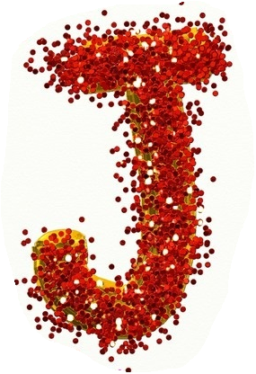
Just Keep Reevaluating
What interventions or diagnostics do you anticipate for this patient?
What findings will you continue to reevaluate while the patient is in your care?
What is the definitive care for this patient?
Image: Pixabay/Prawny
Notes:
The A-I of the initial assessment happens pretty quickly. The J, for Just Keep Reevaluating, guides your care while the patient awaits disposition. If at any point the patient’s condition deteriorates, you may need to go back to the ABC’s.
Consider what was wrong, what we corrected, and what still needs to happen before the patient is admitted, transferred, or discharged.

Slide 21
VIPP
Vitals
Identified abnormalities/Interventions
Primary survey
Pain
Notes:
This is a mnemonic you can use at the end of your PNP to tell the instructor what findings you will continue to evaluate while the patient is in your care.

Slide 22

Types of shock
Causes of each type
Goal-directed therapy for each type
Click to Start
TIMES UP
Notes:
Most of our primary survey is looking for and managing inadequate tissue perfusion. There are 4 main types of shock, although one type of shock has 3 different varieties. Form a group of no more than 4 learners and elect a spokesperson. Take no more than 10 minutes to discuss and write down your answers.
In groups of no more than 4, the students will use a blank piece of paper, whiteboard, or large sticky note to record answers. Discuss answers after 5-10 minutes (listen to students to see when conversation is straying and redirect if necessary). Refer to pages 101-111 of the provider manual

Slide 23

Initial Assessment
Notes:
The initial assessment using the PNP will be reinforced in 8 teaching stations. Does anyone have any questions?

Slide 24
Two-minute recharge
Notes:
At the end of each group discussion, we are going to do something that promotes resilience in the face of any kind of stress. There are many examples that you can incorporate into your daily life. Some are physical, some are mental, and some are a combination of both. Participate to the extent you are comfortable. Closing your eyes and focusing on your breathing is always acceptable.
As we pull up the next presentation, please stand up. If you are not comfortable raising your arms or bending at the waist, inhale to the count of 4, hold your breath for another count of 4, and exhale for a count of 4. Pause for a count of 4 before your next breath in.
If you are comfortable raising your arms and bending at the waist, take a deep breath in while raising your arms over your head. Then let your arms drop and fold forward, letting your arms dangle as you exhale. Take a deep breath as you straighten out, raising your arms over your head again.

