Slide 1
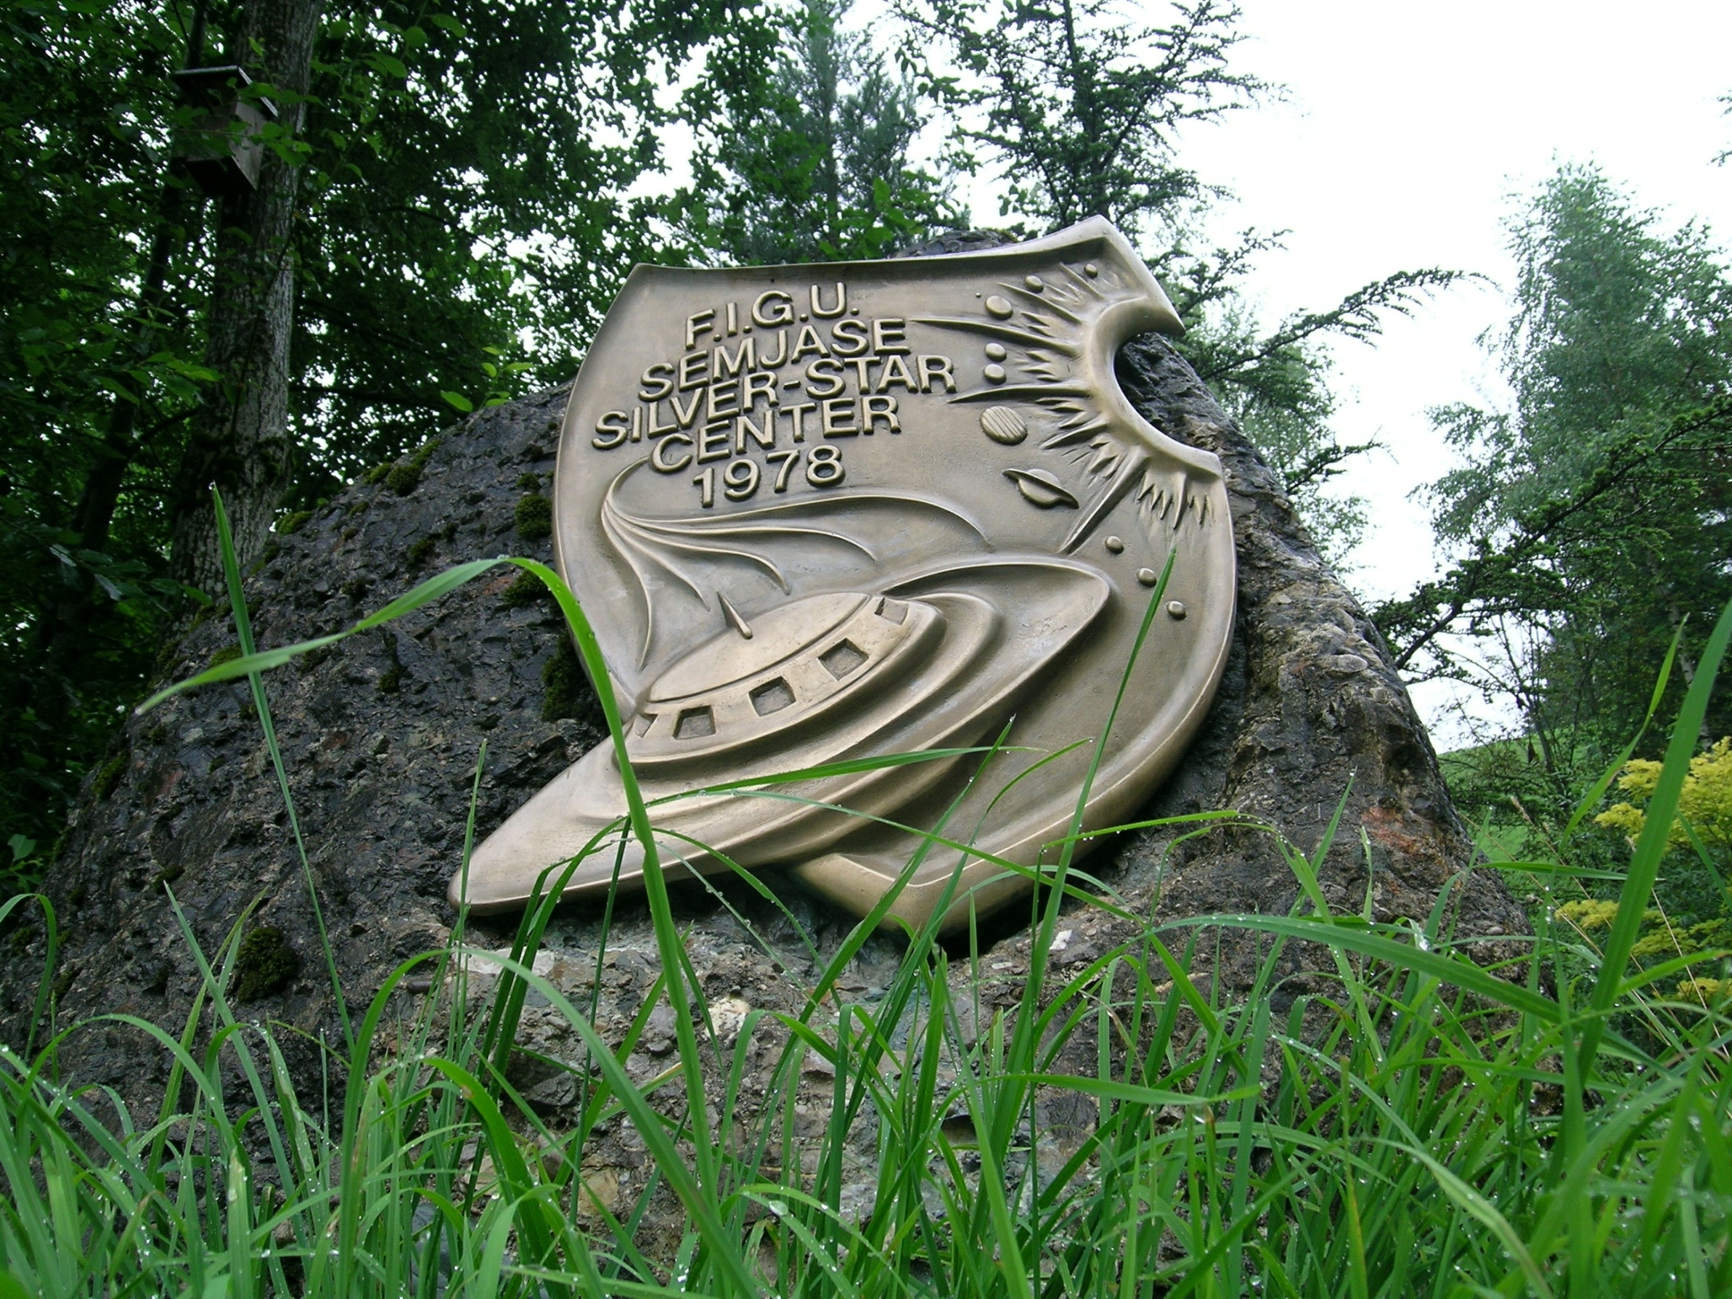

Slide 2
erziehen
Ahd. irziohan =
zu etwas anleiten,
= To instruct someone in something
jemandes Geist und Charakter bilden und seine Entwicklung fördern
= to form somebody‘s spirit and character and to promote his development.

Slide 3
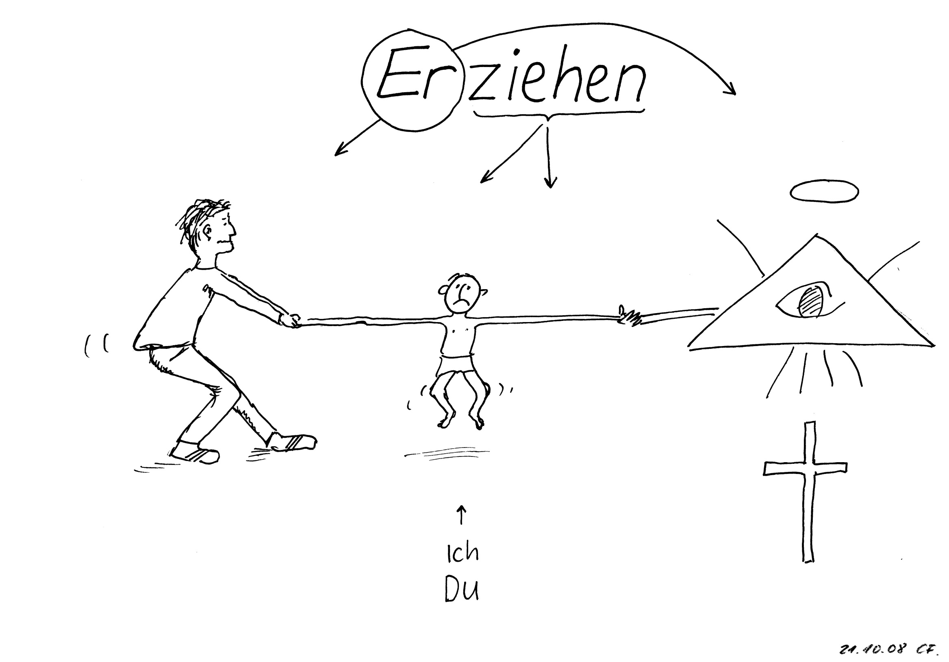

Slide 4
Kelch der Wahrheit
„Each human being may gain virtues, and in truth it is also his duty to form his character and his virtues, which means, that he must educate himself. And the process of learning the virtues and forming the character is one's own self-education, which may never end as long as the human being lives.“

Slide 5
The 7 main virtues of the human being
Moderation
2. Steadfastness
3. To be hard-working
4. Honesty
5. Discretion
6. Caution
7. Benevolence

Slide 6
The 7 foundations of being human in the real and true sense
1. Modesty
2. Anti-materialism
3. Perseverance
4. Patience
5. Peace
6. Universal love
7. Understanding

Slide 7
The 7 main faults of the human being
1. Carelessness
2. Obstinacy
3. Fearfulness
4. Submissiveness
5. Presumptuousness
6. Indolence
7. Selfishness

Slide 9
If the human being is thinking and acting correctly and is correctly educated, and when he brings his self-education in order, then result seven special values:
Die Art zu leben, page 17

Slide 10
10
At the age of ten, the human being‘s sense is turned toward life.
.

Slide 11
20
At the age of twenty,
the human being grasps the power of his abilities.

Slide 12
30
At the age of thirty,
the human being is assured in his thinking and acting.

Slide 13
40
At the age of fourty,
the human being has left his doubts behind regarding the truth and knowledge.

Slide 14
50
At the age of fifty, the human being knows the essential creational- natural laws and recommendations, and follows them.

Slide 15
60
At the age of sixty, the human being has completely opened his consciousness for the truth.

Slide 16
70
At the age of seventy, the human being can accede to his wishes, without ever again going beyond the boundaries of what is right and decent.

Slide 17
This is the true development of the human being during
seventy years of life, if he lives and prevails according to law, recommendation and regulation of creational- natural character.

