Slide 1
experience
A key component in realizing your dreams

Slide 2
What is Experience?
Experience is the knowledge or mastery of an event or subject gained through involvement in or exposure to it.

Slide 3
We all have it?
Most of the time we hear the word experience and we immediately began to think of something we may not have. However, we all have experience in something. Life has given us a multitude of experiences on daily basis. We have look within and leverage those experiences that we have.

Slide 4
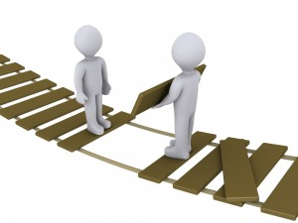
Our Dreams vs Our experience gap
As we look to empower, enlighten and expand ourselves in our efforts to achieve our dreams we will definitely see that there are somethings that we are lacking or fall short on. It is called the “gap”. The gap is the difference in our current state and our future state (the realization of our dream. Through empowerment, being enlighten, and expansion we find ways to close the gap. Closing the gap does not happen overnight. It is a process.

Slide 5
Gap closures
Gap closure come in many forms. Education, hands on experience, being mentored, failure and just living. However, gaps don’t just close themselves, it takes an effort. That effort starts within you.

Slide 6
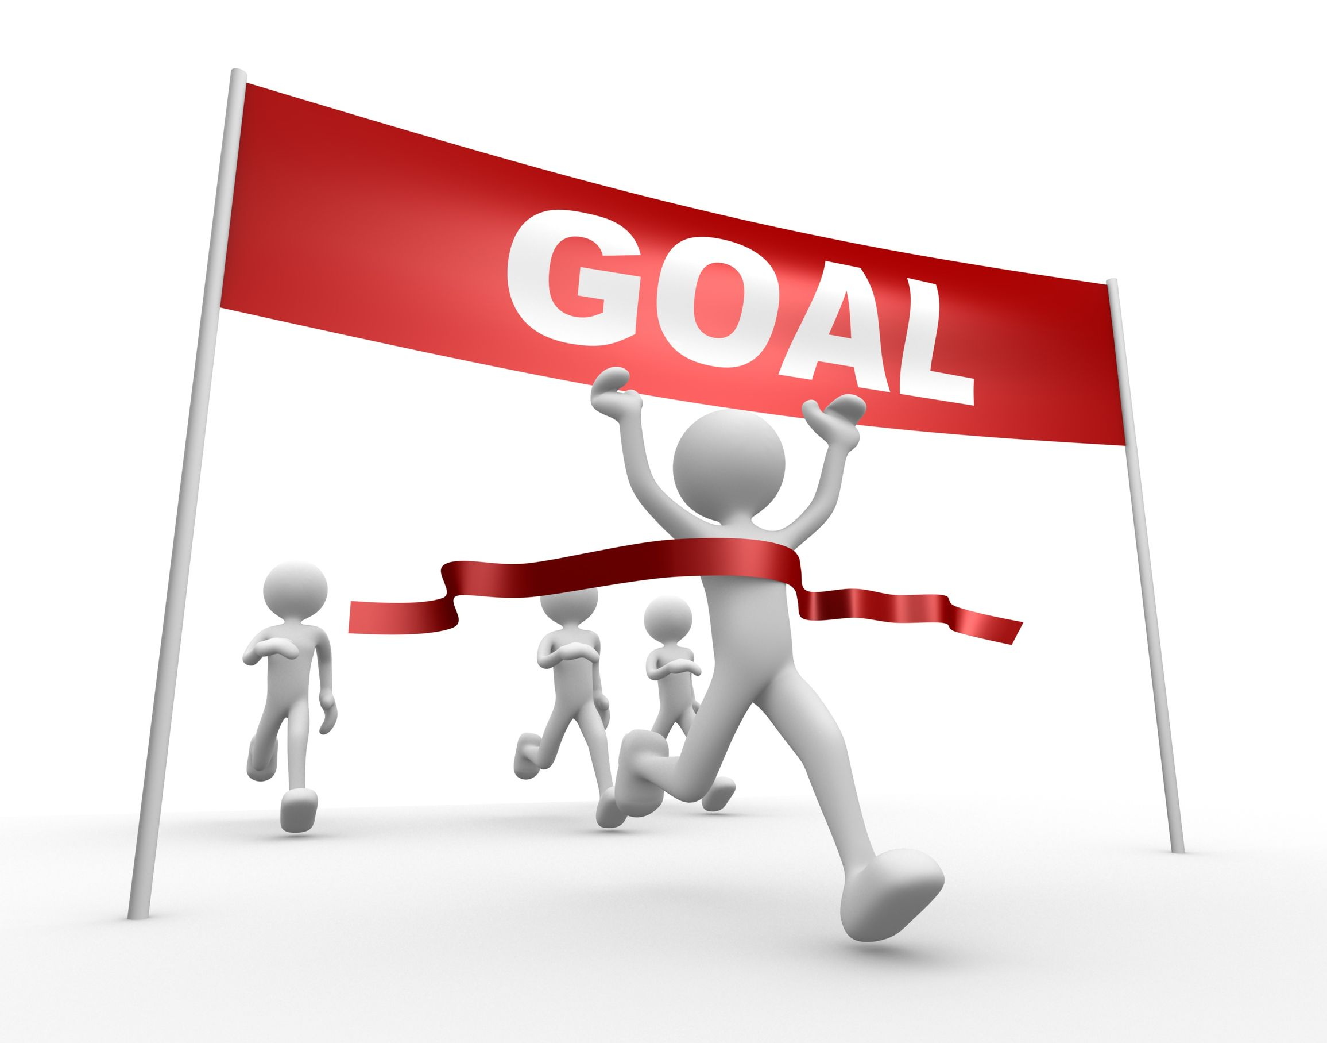
You control your experience
Take control of how you want your experience to be. Make it a part of your to do list and achieve your dreams and goals.

Slide 7
https://bbv2m-brothersbrooksvision2missionllc

