Slide 1


Resume Recommendations
R&R

Slide 2
Substance and Style
Substance trumps Style when it is an eye test
Unfortunately Style gets you noticed
Style is seen before the Substance is Recognized

Slide 3
Your Resume
Your resume is a snapshot of Who You Are.
Either
Biography of Who you are
Or
Personal Branding Statement to entice someone to by your brand (You).

Slide 4
Biography Resumes
Biography type resumes list:
Companies worked for
Positions held
Accomplishments
Education

Slide 5
Personal Branding Statement Resumes
Personal Branding Statement Resumes
Shows the individual’s relevant key attributes (Industry Experience, Similar Positions, Key Education and Training, Key Achievements/Results, etc.) that he or she posse in relation to the position and opportunities the Company or Organization is offering
Personal strengths and behaviors aligned with the Company or Organization's Capabilities and Core Values

Slide 6
Your Style
Does not matter if your resume is in a biography style or it is your personal branding statement; it still has to be validated through your interview (in-person or phone) and background check.
Resumes should be a true representation of who you are.
You have to be comfortable with your resume style since it is an extension of who you are.
Very few, if any, are hired based on a resume alone!!!
Unfortunately, your resume will have only five minute review in the initial screening process.

Slide 7
Some Key Tips
There is a ton of great information tips on resume writing. Here are some that I recommend based on my Career Experience:
One Page Resume vs Multiple Pages (It all depends on the substance you are offering and the role you are applying for)
Eliminate Confusion, maintain a Consistent Structure (Do not write your resume in a way that leads to someone having to search for a chronological order or having to interpret dates)
Proofread and Have Others Proofread your resume.

Slide 8
Some Key Tips Continued
Write a Career Interest/Objective or Introductory Statement that relates to the position or organization that you are seeking an opportunity with. This is definitely important for those with limited work experience or the strength of experience they have may not on face match the position. For others it may not be necessary. (Company’s and Organizations receive thousands of resumes that are unsolicited. Make sure your resume is not one that is never reviewed)
Cover Letters – Not as relevant as in the past. Utilize your career interest/objective or introductory statement on your resume if needed.
Grade of Paper – Nice sturdy grade of quality paper is important. You definitely do not want ink smudges on your resume or your resume to seem blurry. Of course electronic resumes eliminate this need.

Slide 9
Your Choice
As you research various tools to help you develop your resume, you will find that one person or group says its red and another say its blue.
Recommendations and Tips are just that: Recommendations and Tips. They (including me) are not the final authority. We are all providing advice based on our research and experience.
It all starts with you, understanding yourself and the organization that you may be seeking an opportunity with.

Slide 10

Universal Fact
The most important decision an organization can make is hiring the right people. All other decisions are contingent on that decision.

Slide 11
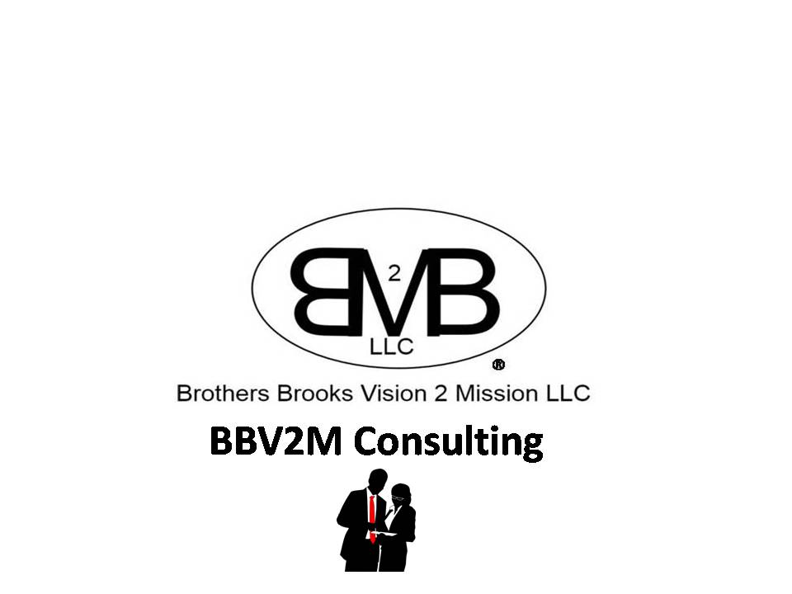
BBV2M-BrothersBrooksVision2MissionLLC.com
BBV2MLLC@gmail.com

