Slide 1
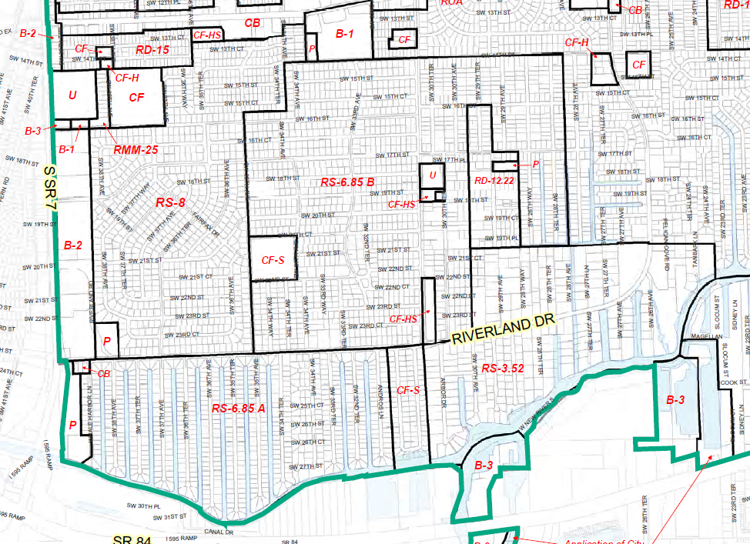
Annexed Area Height Limit
Annexed Area
2002 – Annexed
2009 – City Adopted Broward Zoning Code Adopted

Slide 2
Annexed Area Height Limit
Proposed Zoning Code Amendment
The proposed amendment was initiated based on a communication sent by the City’s Board of Adjustment (BOA) to the City Commission to request the “City take a look at the height and zoning requirements in the annexed areas”.
The current code is confusing and subject to interpretation.
The proposed amendment will clearly state the height limits and remove the uncertainty of future interpretations by staff.

Slide 3
Annexed Area Height Limit
Proposed Zoning Code Amendment
Current staff proposal is 35 feet to maintain consistency with other neighborhoods. For every foot over 22 feet, the building must be set back one additional foot on each side.
Lauderdale Isles residents can recommend a different height limit.

Slide 4
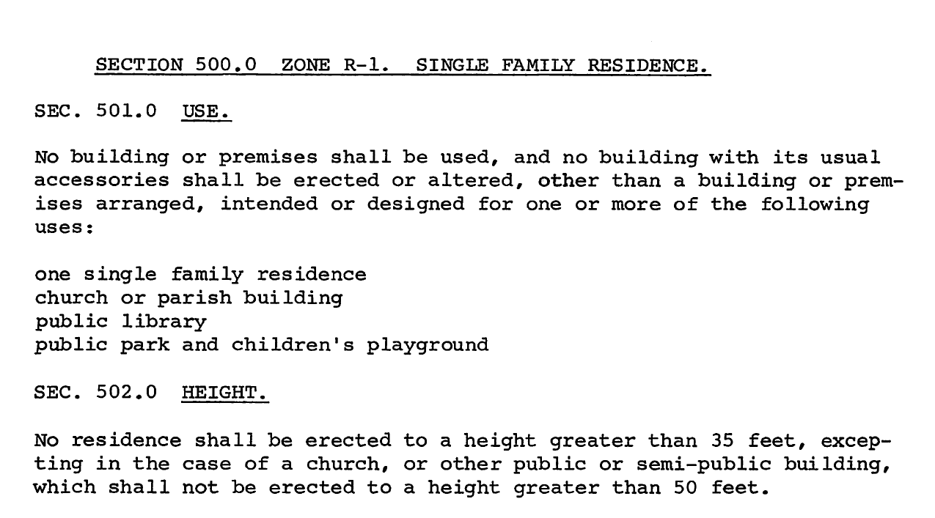
Annexed Area Height Limit
Broward County Zoning History
In the 1950’s, when the Melrose Park and Riverland areas were developed, the height limit was 35 feet.
1952 Zoning Code

Slide 5
Annexed Area Height Limit
Height Limits in Broward County
Fort Lauderdale - Most zoning districts maximum height of 35 feet
  RS-8A – 28 feet
  Historic Preservation District (Sec. 47-16.5.A.1)
    2 stories or 25 feet
Broward County – 2 stories not to exceed 35 feet
Coconut Creek – 25 feet
Cooper City – 2 stories and 30 feet

Slide 6
Annexed Area Height Limit
Height Limits in Broward County
Coral Springs – 35 feet
Dania Beach – 2 stories and 25 feet
Davie – 35 feet
Deerfield Beach – 35 feet
Hallandale Beach – 2 stories or 30 feet
Hillsboro Beach – 35 feet
Hollywood – 30 feet not to exceed 2 stories
Lauderdale-By-The-Sea – 2 stories not to exceed 33 feet
Lauderdale Lakes - 2 stories or 30 feet
Lauderhill – 35 feet
Lighthouse Point – 2 stories and 27 feet to 34.5 feet
Miramar – 35 feet
North Lauderdale – 2 stories or 25 feet

Slide 7
Annexed Area Height Limit
Height Limits in Broward County
Oakland Park - 2 stories and 27 feet
Parkland – 2 stories or 35 feet
Pembroke Park - 2.5 stories or 35 feet
Pembroke Pines - 2 stories or 35 feet
Plantation – 35 feet
Pompano Beach – 35 feet
Sea Ranch Lakes – 35 feet
Southwest Ranches – 35 feet
Sunrise – 2 stories or 25 feet
Tamarac - 2 stories and 30 feet
West Park – 35 feet – Incorporated 2005
Weston – 35 feet – Incorporated 1996
Wilton Manors – 2 stories not to exceed 30 feet

Slide 8
Annexed Area Height Limit
Andros Lane
31’ Top of Roof
23’ 4.5” to Trusses

Slide 9
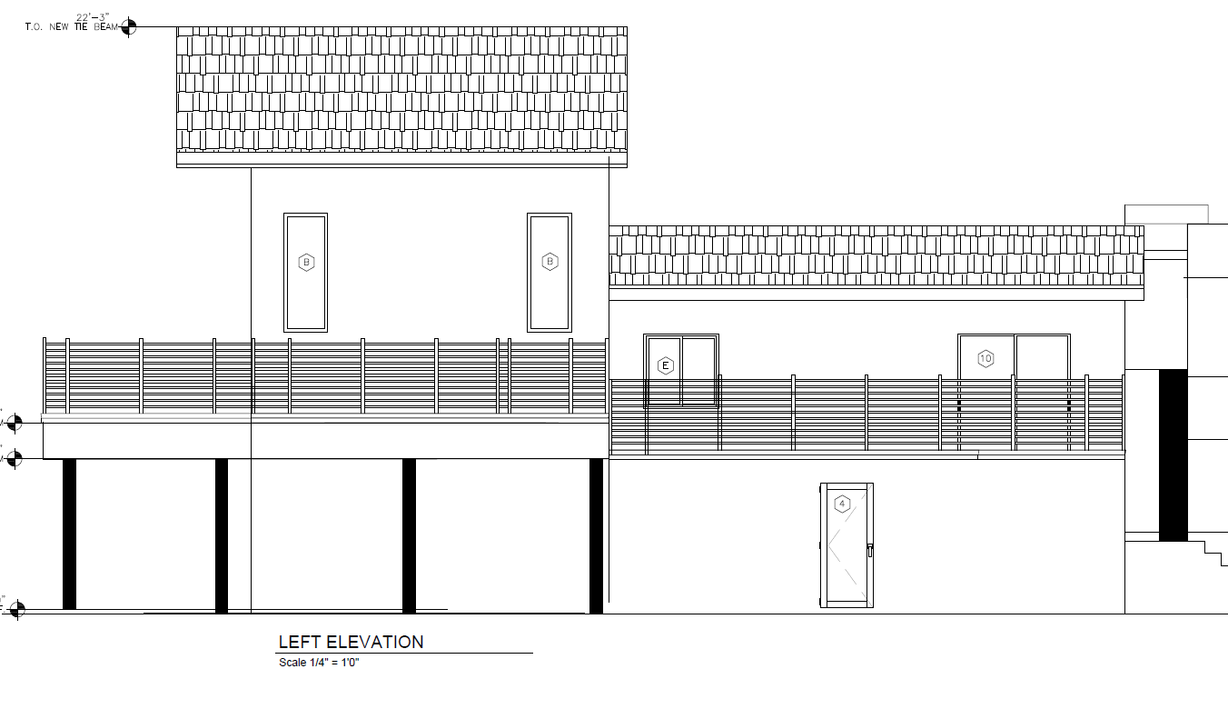
Annexed Area Height Limit
Sugarloaf Lane
22 feet 3 inches

Slide 10
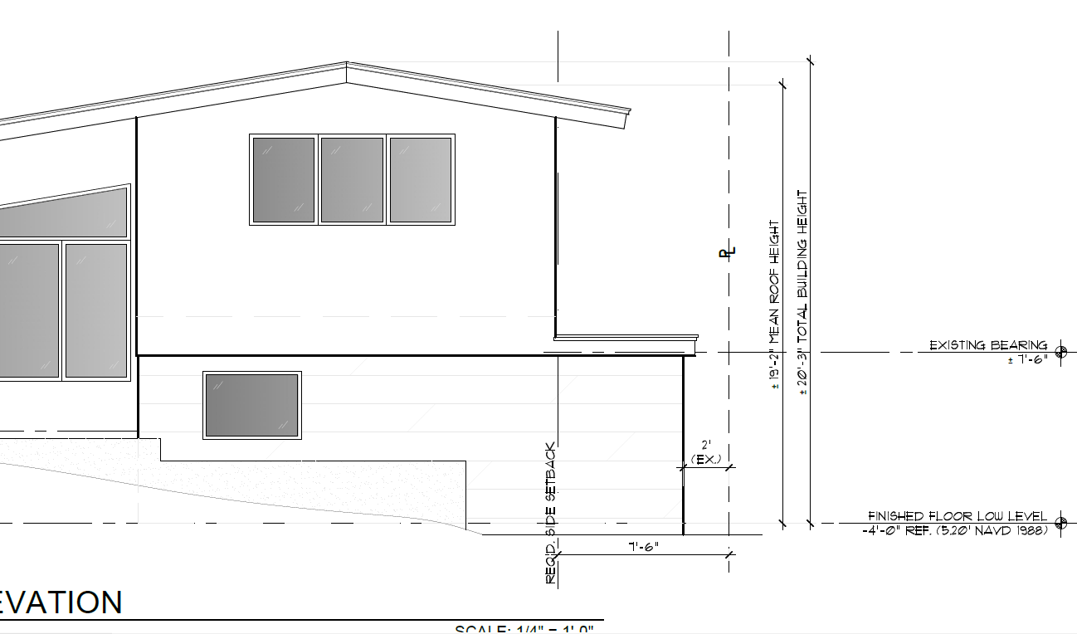
Annexed Area Height Limit
Okeechobee Lane
20 feet 3 inches

