Slide 1
Patient-Reported Outcomes, Clinician Response and Self-Care Interventions During Cancer Therapy
R01 NR008726
Donna L. Berry, PhD, RN, AOCN, FAAN
Notes:
When given the opportunity to tell stories of cancer diagnosis and experience during and after treatment, our patients recount powerful points. The stories inform some of the biggest challenges facing our patients. Can we listen well enough to individuals with cancer to facilitate tailored information and the best supportive care? In this presentation we will review carefully collected and summarized experiences of patients with a variety of cancer types and stages.

Slide 2
Bottom line first
  Creating opportunities (and an environment) for individuals with cancer to fully express themselves regarding healthcare issues and participate fully in their own healthcare

Slide 4


Slide 5
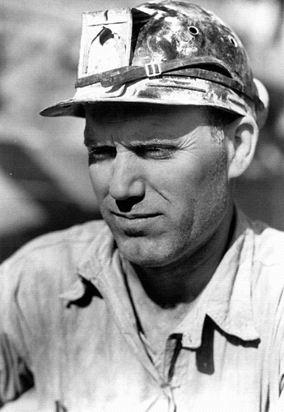
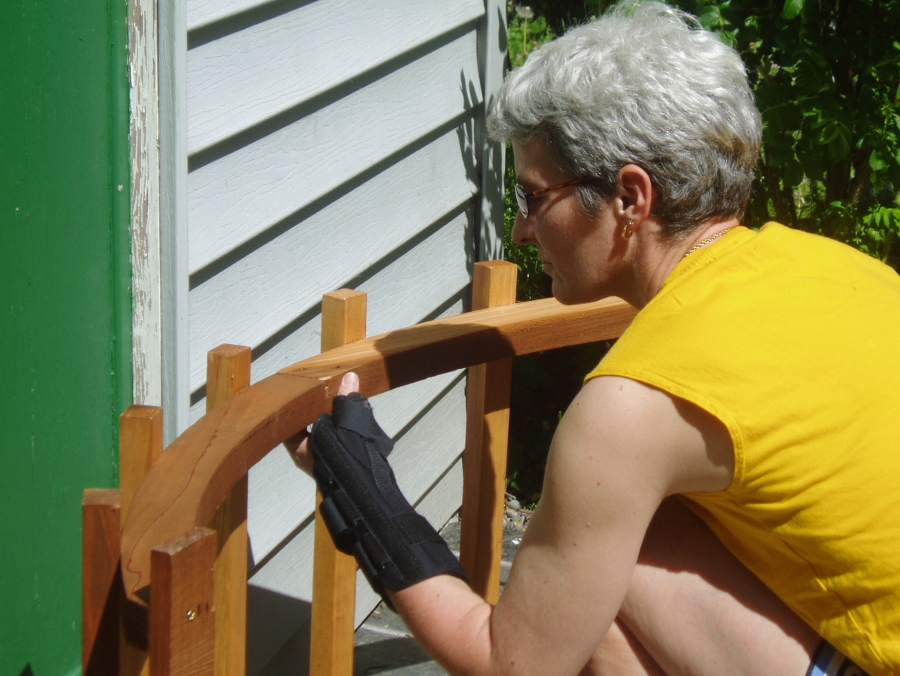

Slide 6
Woman with recurrent cancer
(audio-recording)
I haven’t slept well for three to four years.
And your cough?

Slide 7
What’s Happening?
The Electronic Self Report Assessment and Intervention for Cancer
Clinicians are faced too often with shrinking resources, removing opportunities for comprehensive, interpersonal interactions with patients. And yet….
The patient’s experience, symptoms and quality of life (SxQOL) concerns, are essential components of the information on which a complete clinical assessment, diagnosis and treatment plan is based.
When clinicians are unaware of SxQOL, particularly treatment-related toxicities, there is danger of higher morbidity and even mortality related to unintentional over-dosing.

Slide 8
What’s Happening?
The Electronic Self Report Assessment and Intervention for Cancer
Barriers to communication
  Patient-oriented issues:
    reluctance to verbalize problems
    recall of SxQOL experiences in between visits
    time limitations during the visit
  Clinician-oriented verbal behaviors:
    use of close-ended (versus open-ended)
    queries and interruptions of patient symptom descriptions
    changing the subject after a patient verbally reports a SxQOL issue
  Clinician beliefs that quality of life issues are other clinicians' responsibility

Slide 9
The interview (history; review of systems)
OR the questionnaire

Slide 10
Clinician:
How about your energy level?
The best clinician inquires and yet there is a lot of interpretation….
Patient:
I’m getting around fine; mostly

Slide 13
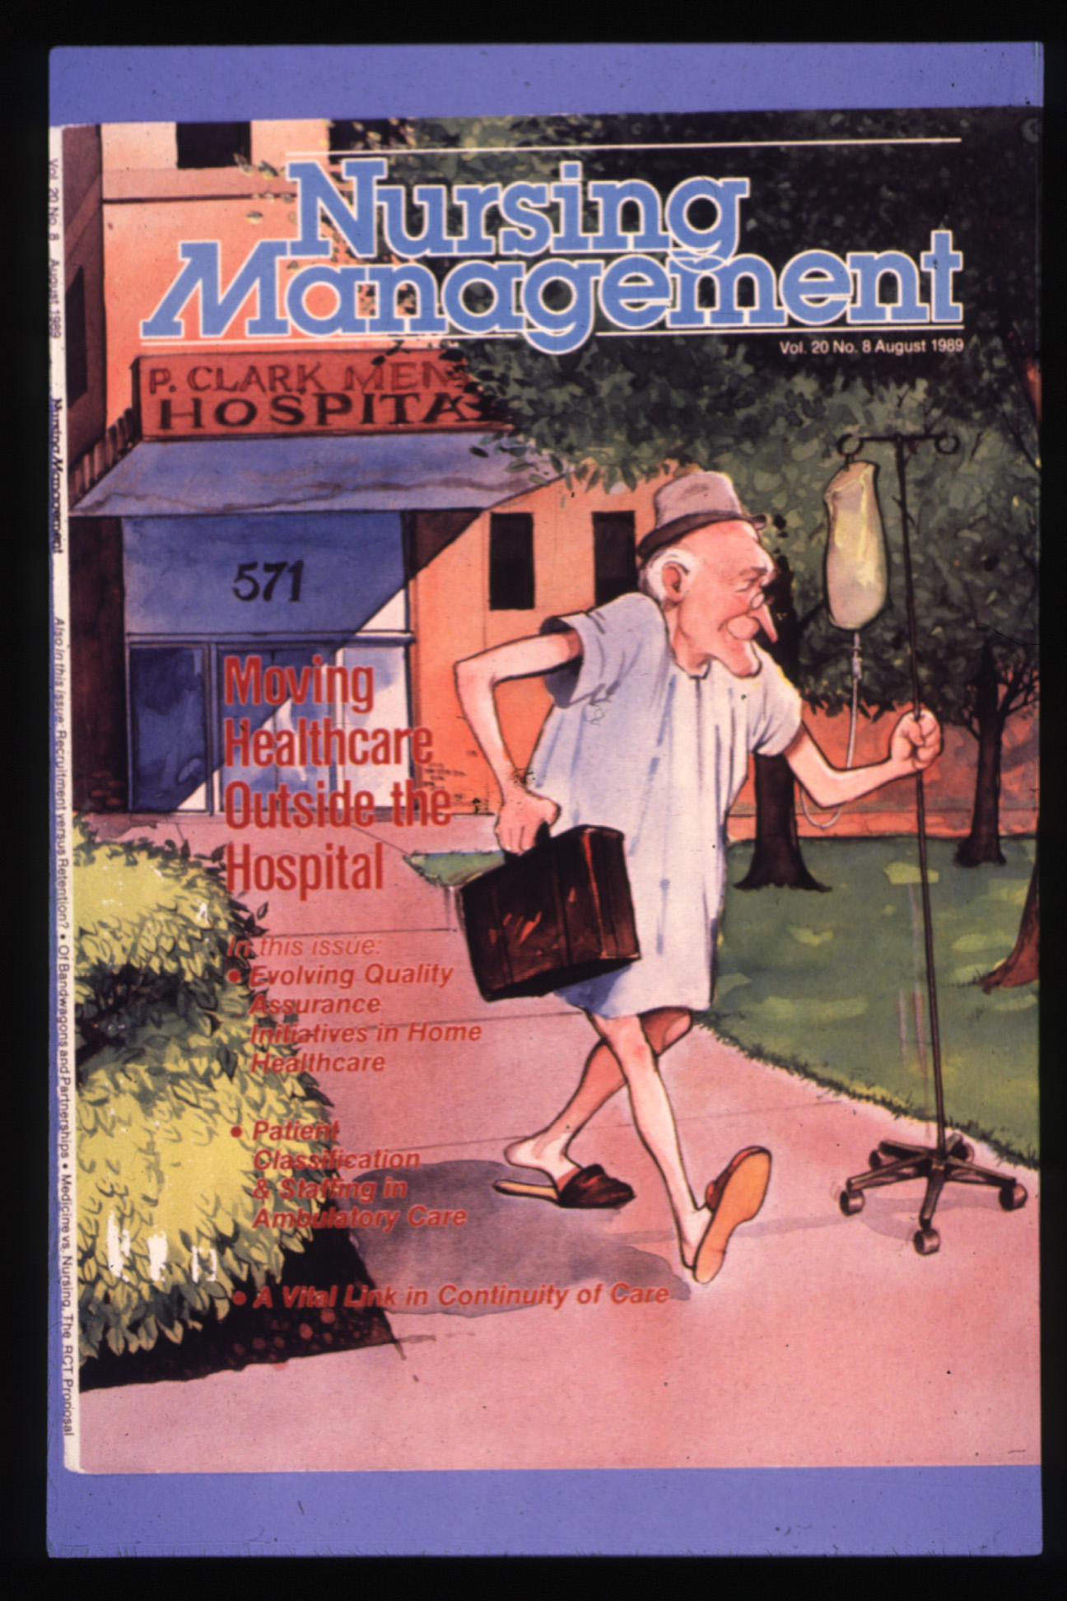

Slide 14
Clinician asks appropriate, probing questions and scores
Pros
  Allows customization to individual patient
  Allows clinician to read non-verbal responses
  Allows clinician to speak to others (e.g., spouse)
  Backfiring… “That’s not right, honey! You do dribble in your underwear. I see it in the laundry.”
Cons
  Dependent on clinician interview skills
  Patient hesitancy to describe sensitive problem areas
  Time consuming (discussion of non-problem areas)

Slide 15
Questionnaire
Pros
  Patient generated data
    Direct from the source
    Eliminates some communication barriers
    Little clinician influence on answer
  Builds a searchable database of patient condition
Cons
  Often a limited number of questions (time)
  If paper, not customized to the patient
    (e.g., night watchman asked how many times he gets up at night to urinate)
  Doesn’t allow addition of other questions the patient feels is important to him/her

Slide 16
“Patient-Reported Outcomes”
PROs
This phrase first appeared in health literature regarding payment and outcomes between MDs and NPs-1976
Nothing again until the 1990’s
Finally, in 1999, urologists published PRO differences in patient-reported outcomes for radical prostatectomy or external beam radiation for localized prostate cancer.

Slide 17
Symptoms & Side Effects
Practically every attempt to compare clinician scoring vs patient scoring, the result is the same
Clinicians underestimate symptoms and side effects

Slide 18
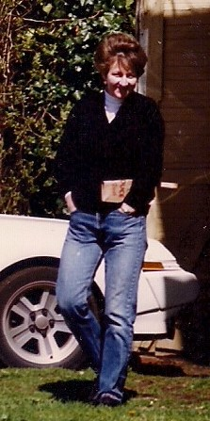

History-1980s!

Slide 19
A solution requested from direct care oncology nurses at University of Washington Medical Center
Improve our ability to capture the patients’ experience
Timely and accurately
Efficient

Slide 20
Electronic Self-report
Assessment-Cancer (ESRA-C)
Early project funded by the ONS Foundation
Randomized trial funded by National Institute of Nursing Research
A series of complex clinical trials and analyses

Slide 21
Adapted Quality Health Outcomes Model* & study variables
*Mitchell, et al., 1998

Slide 22
Methods
Purpose: Compare the clinical impact of ESRA-C output to usual care in stem cell transplant, medical oncology and radiation oncology services with regard to patient provider communication during a regular clinic visit.

Slide 23
Study Enrollment
Setting and Participants
  All ambulatory patients throughout the Seattle Cancer Care Alliance and UWMC clinics, with cancers of all stages who had never been treated or were starting a new regimen, were eligible
    Recruited 2 patients per provider per month
  Data collected from Spring of 2005 through Summer 2007
  Full IRB approval through the Fred Hutchinson Cancer Center CC-IRB

Slide 24
Study sequence
Baseline ESRA-C assessment (T1) administered prior to any treatment.
At the first clinic appointment after hospital discharge for transplant or about 6 weeks from T1 for MedOnc and RadOnc, a 2nd ESRA-C assessment was obtained, and patients were randomized:
  Control group, no summary page is generated
  Intervention group, summary page is delivered to clinical team on the chart prior to exam
Both groups- the T2 visit is audio-recorded

Slide 25
Questionnaires
Symptom Distress Scale
EORTC QLQ-C30 – quality of life
PHQ-9 – depression scale
SSQ – subjective significance scale
  How things have changed for patient
2 single items: impact on sexuality and pain intensity numerical

Slide 26
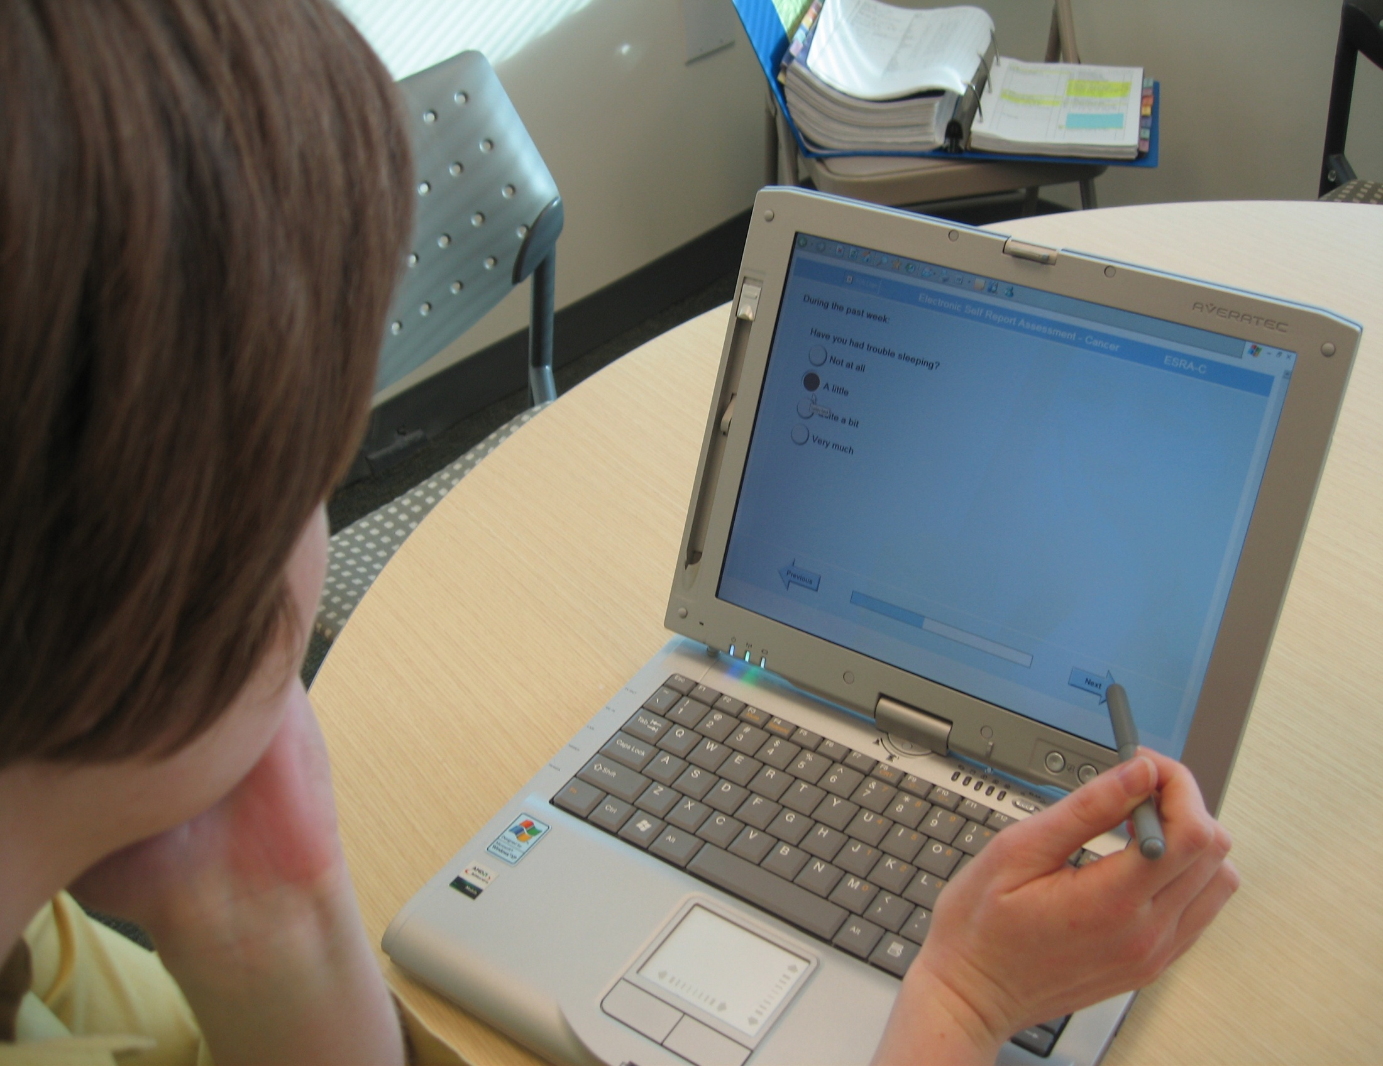
Notes:
Participants answered a series of validated cancer-specific questionnaires including Ruth McCorkle’s SDS, a quality of life scale and a depression screening scale, plus one open text box query

Slide 27
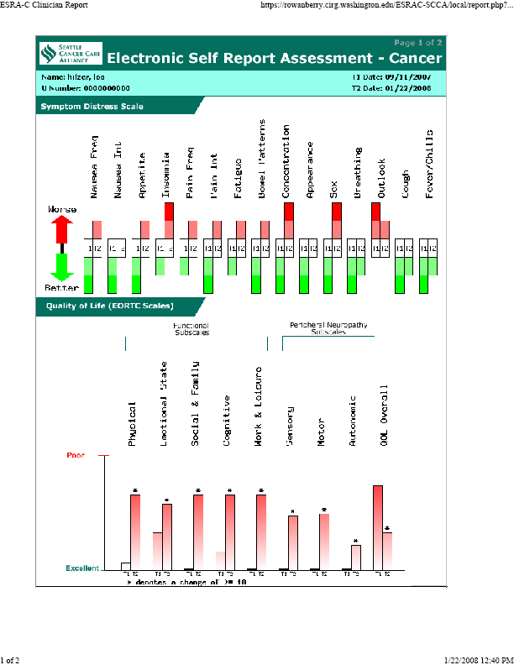

Slide 28
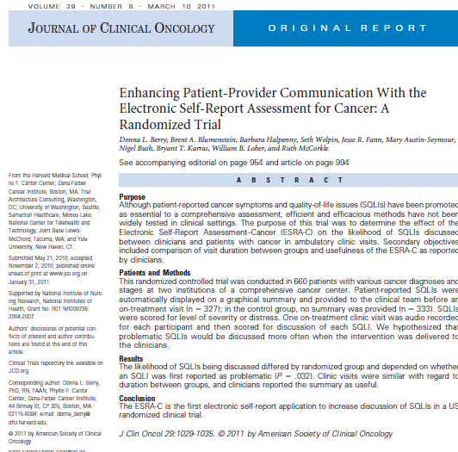
Our results
Symptoms and quality of life concerns were addressed significantly more often when the ESRA-C summary was available to clinicians
We could indeed improve awareness of the patients’ experiences and improve communication in a real clinic visit

Slide 29
Which symptom had more attention?

Slide 30
Which symptom had more attention?

Slide 31
Reported as problematic, discussed and first by whom

Slide 32
Other lessons from ESRA-C
  Financial concerns of transplant patients were very prevalent and may have interfered with patient teaching pre-transplant (Kennedy Sheldon, et al., 2012)
  Cognitive dysfunction issues were rarely attended to by clinicians (Machol, 2007)
  Sleep disturbances were only attended to about half the time (Siefert et al., 2013)
  Expression of emotional distress was typically unexplored by clinicians (Kennedy Sheldon et al, 2011)

Slide 33



How could we help with issues not addressed by clinicians?

Slide 34
Purpose
34
Compare the impact of the Electronic Self Report Assessment-Cancer (ESRA-C) assessment and clinician summary plus patient intervention to the ESRA-C assessment/clinician summary alone on:
    End of study symptom and quality of life issues (SQI)
    Communication in clinic visits
    Patient adherence and self-care strategies for SQI management
Notes:
34

Slide 35
Methods & Procedures
All outpatients with cancer who could read English
Implemented at DFCI
  GU, GI, sarcoma, H & N, breast, lymphoma
  Radiation Oncology
Implemented at Seattle Cancer Care Alliance
  Stem cell transplant service
Offer to as many patients as we could accommodate to complete ESRA-C prior to new therapy
  Routine screening with summary provided to clinician
Invitation to participate in randomized trial presented on-screen immediately after completion of baseline assessment and then in person
If interested, randomized to intervention or control after meeting study staff for written consent
Data collected before throughout the course of therapy (4 points)
  Immediately pre-treatment; 3-6 weeks on treatment, 2 weeks later and 2-3 weeks after end of treatment

Slide 36
The ESRA-C II Intervention
Access to web-based….
  Self-monitoring of all SQI; graphed over time
  Teaching tips on how to manage key SQI and how to communicate each SQI to the clinical team
    Voluntary and scheduled at on-treatment study time points (3)
  Red box warnings for critical levels of pain, depression and overall symptom distress (call clinic right away)
  Opportunity to journal or annotate SQI graphs
  Opportunity to share graphs with anyone who has Internet
  Color graphic summary of patient-report delivered to provider prior to face-to-face clinic visit

Slide 37
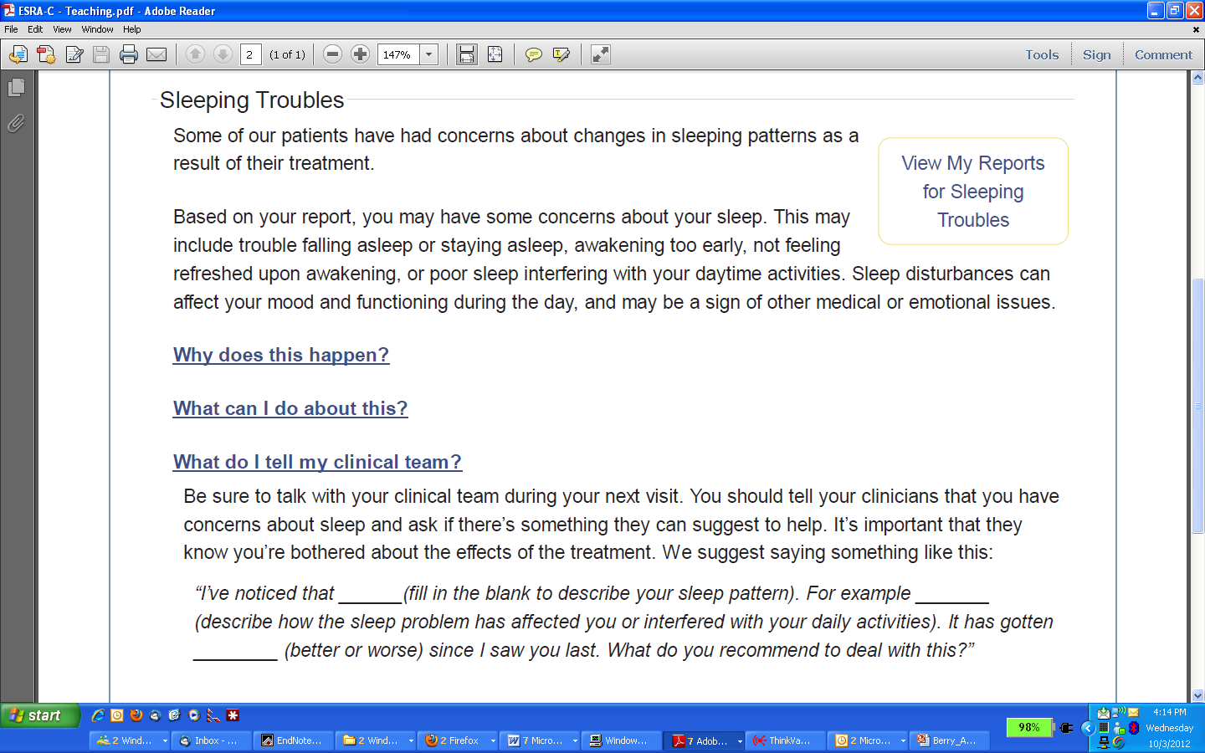
Teaching tip exemplar: Participant reported threshold insomnia

Slide 38
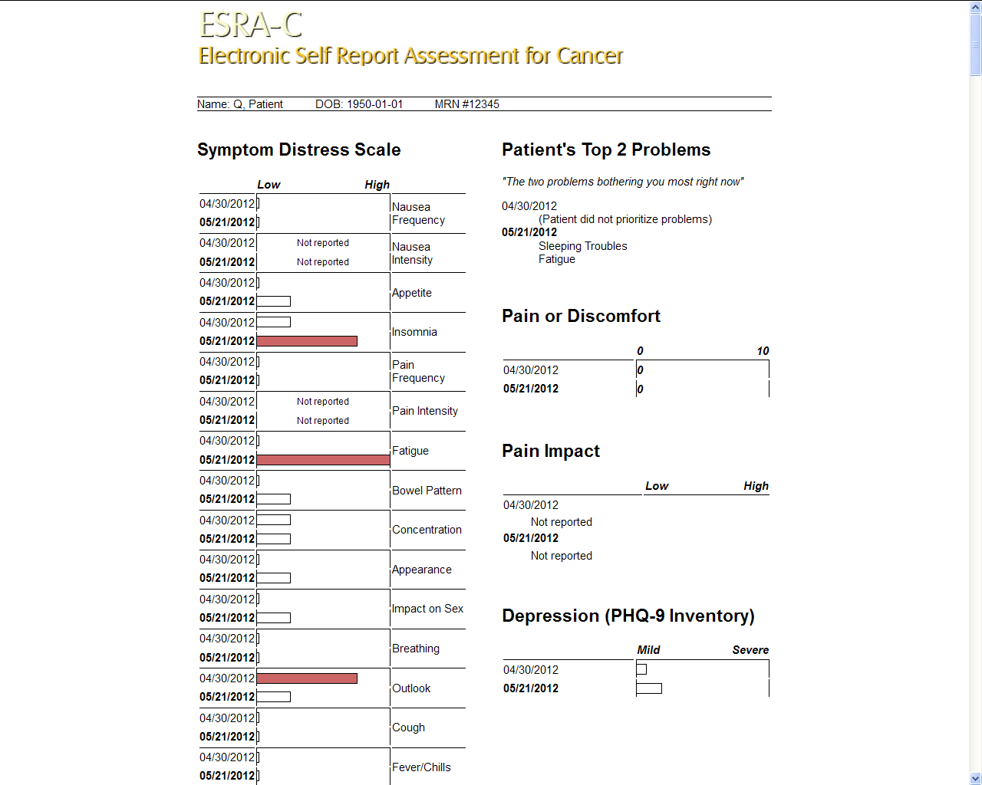
Both groups
Color graphic summary of patient-report delivered to provider prior to face-to-face clinic visit
Usual patient education

Slide 39
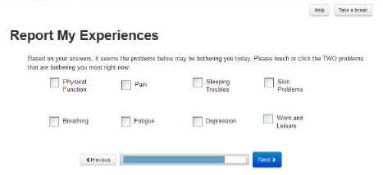
Choose Two

Slide 40
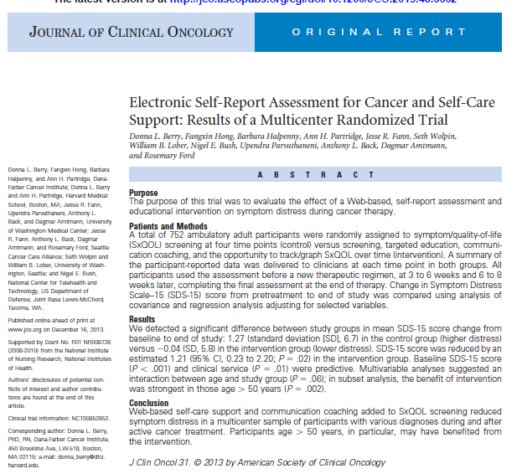
ESRA II results
The ESRA-C intervention significantly reduced symptom distress over the course of ambulatory cancer therapy
Problematic symptoms and quality of life issues were reported with at least one verbal statement as coached in the intervention group significantly more often in the control group

Slide 41
Choose two results
Significantly (p < .0002) more patients reported moderate-to-severe distress after treatment initiation for 8 of 13 symptoms.
81% and 89% of patients reported one, and 56% and 69% reported multiple, moderate-to-severe symptoms at T1 and T2, respectively.
Impact on sexual activity and interest, pain, fatigue, and insomnia were the most frequently reported moderate-to-severe symptoms
Fatigue, pain and insomnia were most commonly reported as bothersome
(Hong et al, 2016)

Slide 42
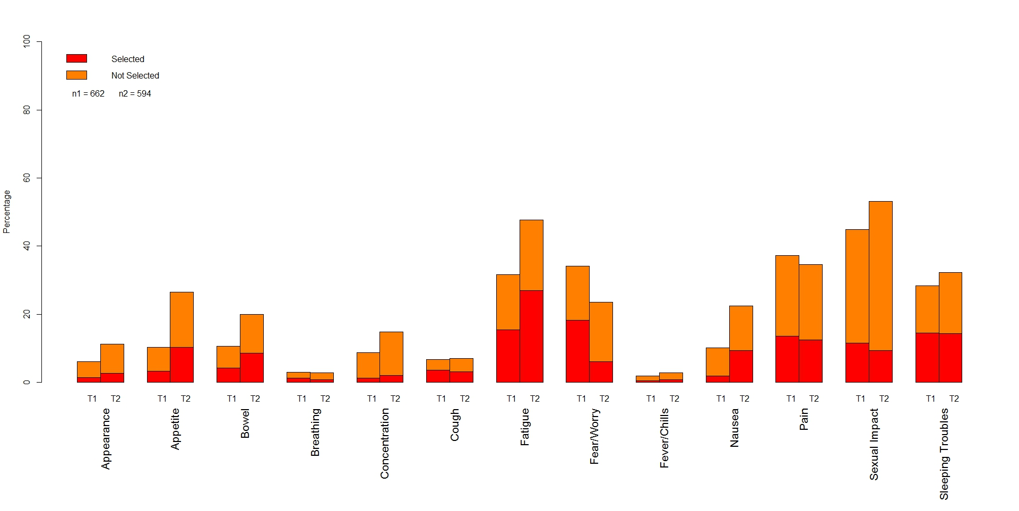
Percentage of SQIs reported as problematic and then selected or not as “most bothersome” at pretreatment and 4-6 weeks into treatment (Hong et al, 2016)

Slide 43
Clinician response
Appropriate use of therapies and referrals; intervention vs control groups
  For concerns discussed that were over threshold, were they “treated” or “referred” and were those under-threshold, not “treated” or “referred?”
    Only significant difference was the match on Physical Function: 76.6% (n=226) match in control, 84.1% (n=248) match in intervention (p=.03).
  Study not sized to address this and clinicians in both groups received the patient-report summary

Slide 44
Dose of the intervention
Method
Results
Overall and voluntary intervention use were defined as having ≥2 exposures, and one non-prompted exposure to the intervention, respectively.
Associated factors explored
Propensity score matching was used to select a sample of control participants similar to intervention participants who used the intervention.
ANCOVA compared change in Symptom Distress Scale scores from pre-treatment to end-of-study by groups in the matched sample.
Radiation oncology participants used the intervention, overall and voluntarily, more than medical oncology and transplant participants.
Participants who were working and had more than a high school education voluntarily used the intervention more. The SDS-15 score was reduced by an estimated 1.53 points (P=.01) in the intervention group users compared to the matched control group
Berry et al., 2015

Slide 45
Peripheral Neuropathy Outcomes
Individuals on neurotoxic chemotherapy randomized to receive the ESRA-C intervention reported significantly less severe physical functioning impairments (p=0.01) and depression (p=0.005)
Knoerl & Berry, 2018

Slide 46
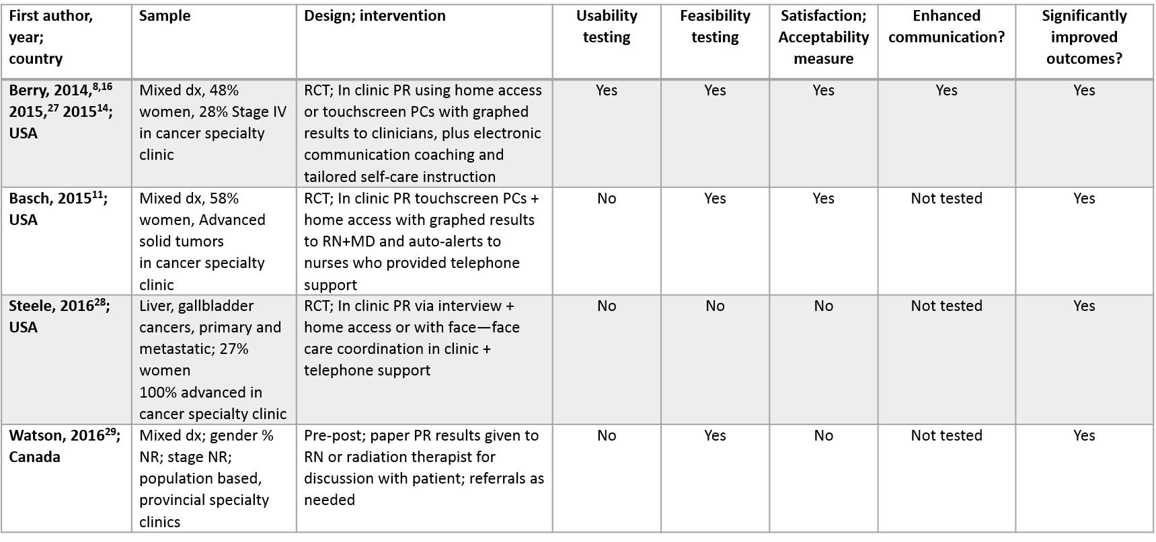
Cancer symptom/quality of life assessment and intervention studies with multi-symptom PRO outcome evaluation in patients with cancer at point of service during active curative or palliative treatment; 2014-2016
Presented by: Donna Berry, PhD, RN, FAAN, AOCN

Slide 47
Want Higher Patient Satisfaction?
Univ of Pittsburgh Medical Center
  Simply collecting patient-reported outcomes is not sufficient — clinicians must also discuss the responses during visits.
  On average in 2017, patients who reported that their patient-reported outcome responses were discussed during a visit provide higher ratings for doctor communication and shared decision-making.
  Physicians may need training to discuss patient-reported outcome results with patients.
Freel, Bellon, Hanmer, 2018

Slide 48
Implementation Issues
Workflow
Equipment
Vendors
Usability

Slide 49
Implementation Issues
Workflow
  Traditional roles do not include personnel to proactively encourage integrated PROs
  Triage nurses “re-act” only when the patient/caregiver makes a call.

Slide 50
Implementation Issues
Equipment
  Not everyone has remote Internet access and even when they do, daily use is not a habit.
  Point of service access
    Secured equipment
    Touch screens
    Wireless

Slide 51
Implementation Issues
Vendors
  Patient portals an after-thought. Not where the profit lies
  Little pre-deployment testing
As reported by Politico (7 Aug 2017), VP Biden asked Judy Faulkner, CEO of medical record vendor Epic Systems, why patients shouldn't have access to their medical records.
Faulkner reportedly responded: "Why do you want your medical records?" There are a thousand pages of which you understand 10."

Slide 52
Implementation Issues
Usability
  Requires real time/real people testing
    In all socio-economic groups, not just the savvy elite patients

Slide 53

Bring it back
We are a practice discipline and everyday oncology nurses are face-to-face with people who have great needs
It’s not enough to just learn about it
We must provide concrete actions to place into care
What to do with these findings to MAKE a DIFFERENCE?

Slide 54
Finally
Knowing is not enough; we must apply
Willing is not enough; we must do
Von Goethe

Slide 55
Pilot (ONS)
ESRA-C I
(NINR)
Ellen DeBondt, Mary Galligan, Stephanie Martin, Lisa Trigg, W Postkanzer
ESRA-C II
(NINR)
Mary Austin-Seymour, BT Karras
Lisa Hales, Kyra Freestar, Deb Nagusky, Jesse Fann, Nigel Bush, Ruth McCorkle, Brent Blumenstein, Joseph Tariman, Jose Perez-Avila, Weiwen Wu, Erika Machol, Cindy Klein
F Hong, Q Wang, L Kennedy-Sheldon, M Kazmi, A Partridge, U Parvathenani, K Amtmann, T Saunders, D Gonzalez, M Melendez, J Bruyere, J Wisocky, R Cavalier, ML Siefert, B Valcarce, K Winn, T Harrison, T Hendel, R Ford
D Berry, W Lober, J McReynolds
B Halpenny S Wolpin

