Slide 1
EMERGENCY RESUSCITATIVE THORACOTOMY FOR PENETRATING TRAUMA- a new course

Slide 2
How did this start ?
A clinical problem involved a team with a large number of skilled practitioners at a MTC with a patient who arrived in with an output (and talking) after a chest stabbing
The situation did not have a good result !!

Slide 3
How did this start ? (2)
The SUI demonstrated a number of issues
Human factor issues
Equipment issues
Lack of a ‘guideline’

Slide 4
WHY CALS
CALS designed to deal with such problems
Human factor issues
Equipment issues
Lack of a ‘guideline’

Slide 5
THE PROBLEM
Penetrating trauma causing arrest is relatively rare in the UK
It can present at a large number of MTCs and MTUs
It has a high mortality and often occurs in young people
There is very little expertise available in most centres to deal with it
No specific instrument packs, etc designed for it
There are multiple potential guidelines
ATLS – will only take you so far
There are educational courses teaching some of the surgical skills associate with it BUT NONE TEACHING A TEAM

Slide 6
HUMAN FACTORS

Slide 7
NOT WHAT WE WANT !!!

Slide 8
WHAT WE WANT How to work together
An extension of ATLS
Integrate with Surgeons
Reproducible at any level 1 Trauma Centre
Identify key personnel

Slide 9
PRINCIPLES
TEAM LEADER
RESOURCE CO-ORDINATOR
THESE PEOPLE ARE NOT TASK FOCUSED
A SHARED MENTAL MODEL
PRACTITIONERS WITH SPECIFIC ROLES

Slide 10
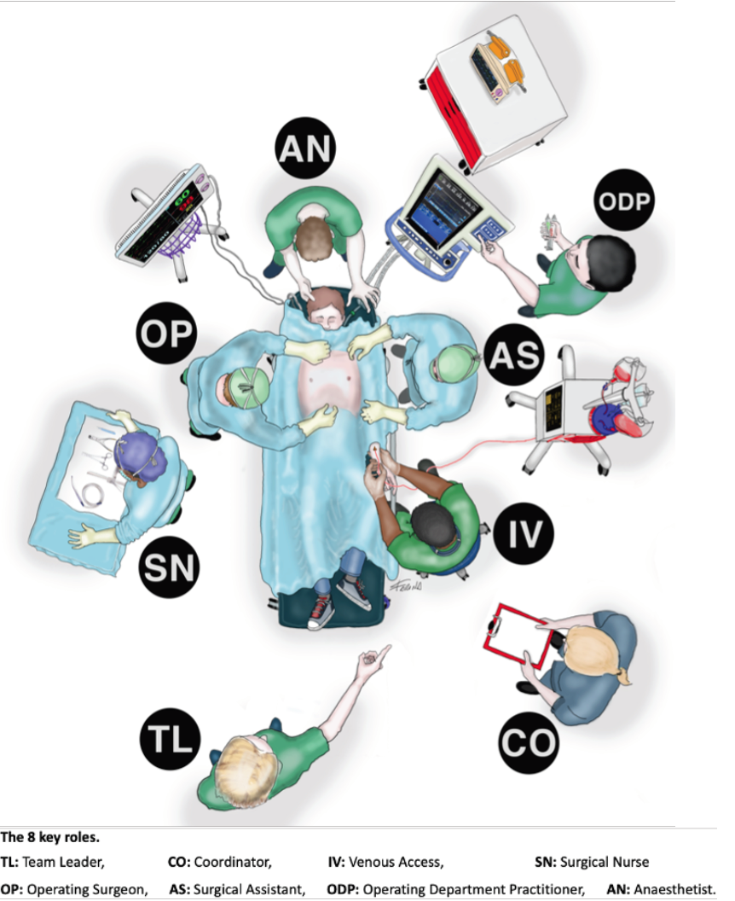
TEAM
The Team Leader
Anaesthetist
ODP / Nurse assistant for the anaesthetist
Doctor allocated to vascular access
Surgeon
Surgical Assistant
Surgical Nurse
Resource Coordinator

Slide 11
EQUIPMENT

Slide 12
EQUIPMENT - PRINCIPLES
Sets that you can produce anywhere (not only MTCs with CT surgery)
2 Trays
RT1 to get into the chest
RT2 equipment that you will need when you are there

Slide 13
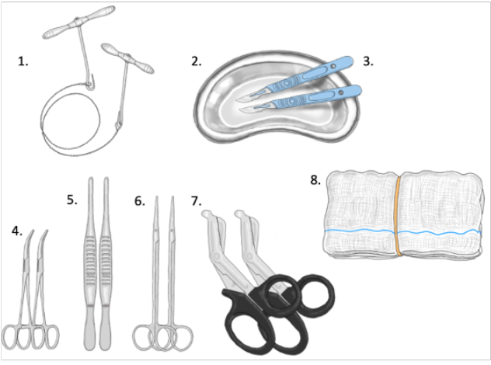
Emergency Room Thoracotomy sets RT1 – OPEN FIRST RT2 – OPEN SECOND
2 Scalpels ( Size 24 blades) RT1
2 x plaster shears RT1
Gigli Saw RT1
2 x Metzenbaum Scissors RT1
2 x Long debakey forceps RT1
5 large swabs or packs RT1
2 x Spencer Wells artery forceps RT1
Kidney dish for sharps RT1

Slide 14
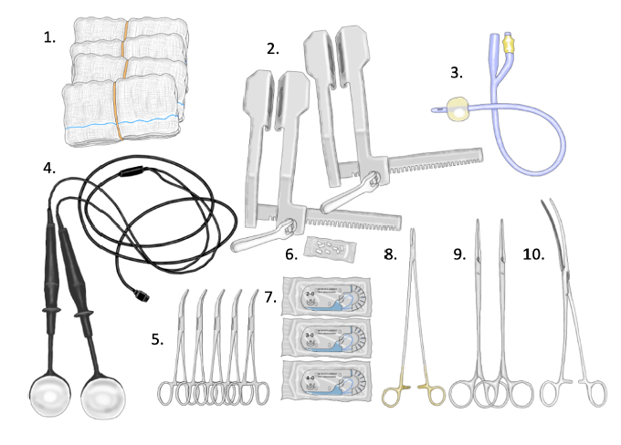
Long needle holder RT2
5x Artery forceps RT2
2x Roberts forceps RT2
5x 2/0 Prolene, 5x 3/0 Prolene , 5x 4/0 Prolene RT2
20x medium swabs RT2
Internal defibrillator RT2
2x Finochietto retractors RT2
Long vascular clamp RT2
Foley catheter RT2
Teflon Pledgets RT2
Emergency Room Thoracotomy sets RT1 – OPEN FIRST RT2 – OPEN SECOND

Slide 15
THE GUIDELINE

Slide 16
The Guideline - PRINCIPLES
TEAM LEADER:
Will make the decision to perform the Emergency department thoracotomy
Will guide all clinicians including surgeons
Will ensure allocation of roles and performance of member tasks
RESOURCE CO-ORDINATOR
Coordinates equipment, major haemorrhage protocol
Ensures Thoracotomy set is available and prepared
Liaison with the operating room or ambulance staff
ARRIVING STAFF BRIEFED AND INTRODUCED TO TEAM
10 MINUTE TIMEOUT- to ensure progress and coordination
STAFF MINIMISATION

Slide 17
THE PROTOCOL

Slide 18
The guideline
First draft written
Agreed involvement with ERC + ?? Trauma body

Slide 19
THE COURSE

Slide 20
THE COURSE - PRINCIPLES
Has to be a half day course
Multi-disciplinary team
Taught at the institution involved !!!!
Your own staff
Practical and moulage based –PRE-COURSE ELEARNING
Practical and moulage based –MANNIKIN
Practical and moulage based –MANUAL
Train the Trainer course run

Slide 21
SCHEDULE

Slide 22
THE COURSE - Learning OBJECTIVES
To create a structured approach for Emergency Resuscitative Thoracotomy for standby traumatic arrests, arrests in the resus room and standbys after thoracotomy in the field.
To create a structured approach to patients with penetrating chest trauma who do not arrest.
To understand the equipment needed to perform a resuscitative thoracotomy
To create transfer protocols once the patient has been stabilised
To understand how to perform a resuscitative thoracotomy

Slide 23
COURSE
First course late 2020
Run so far 24 times (provider) and once (TTT)
National
North East - recognized by NE Deanery
Midlands
London
South East
International
First course to be run in Adelaide in September 2022

Slide 24
QUESTIONS

