Slide 1
RESTORE Living Shoreline Project Concept
RESTORE
Advisory Committee
GHS Environmental
August 2016
Dana J. Gaydos
Peggy Mathews
GHS Environmental

Slide 2
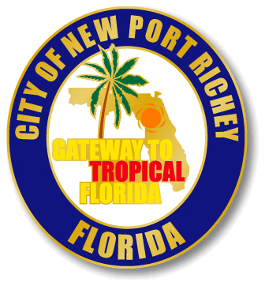
Who We Are & Why We Are Here
GHS Environmental (GHS)
Dana Gaydos
Key practice areas: Water resources, water quality,
wetlands and marine resources
Peggy Mathews – Tallahassee Office
Key practice areas: Government relations,
environmental consulting, marine resources, boating
We are here on behalf of the
The City of New Port Richey

Slide 3
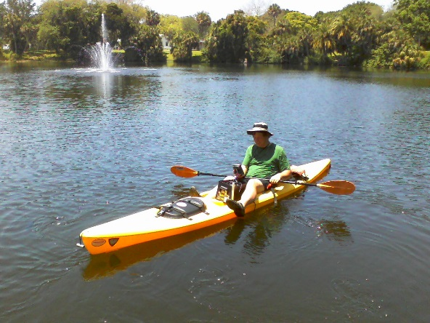
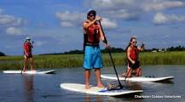
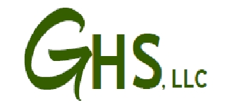
What do you think about when you think of New Port Richey?
Paddle Boarding?
Kayaking?

Slide 4
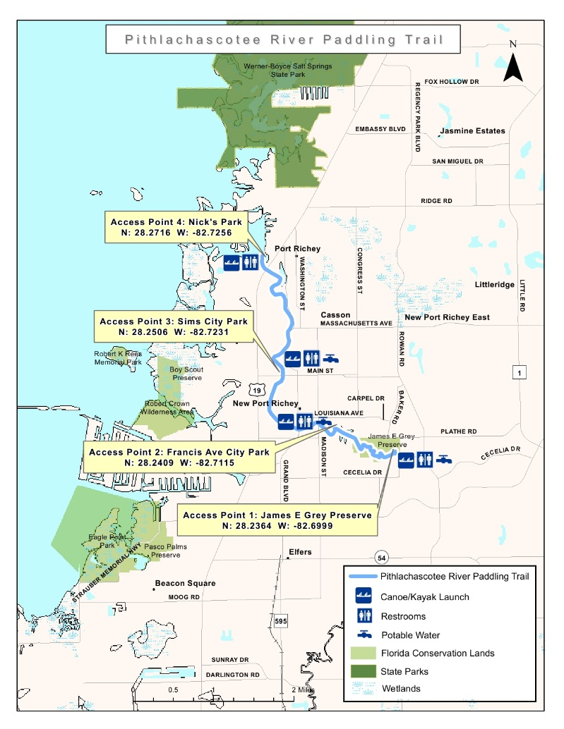
Well, New Port Richey ALREADY has all of those amenities!
Add a
LIVING SHORELINE
to extend the paddling trail and add environmental benefits.
FDEP Paddling Trail Map

Slide 5
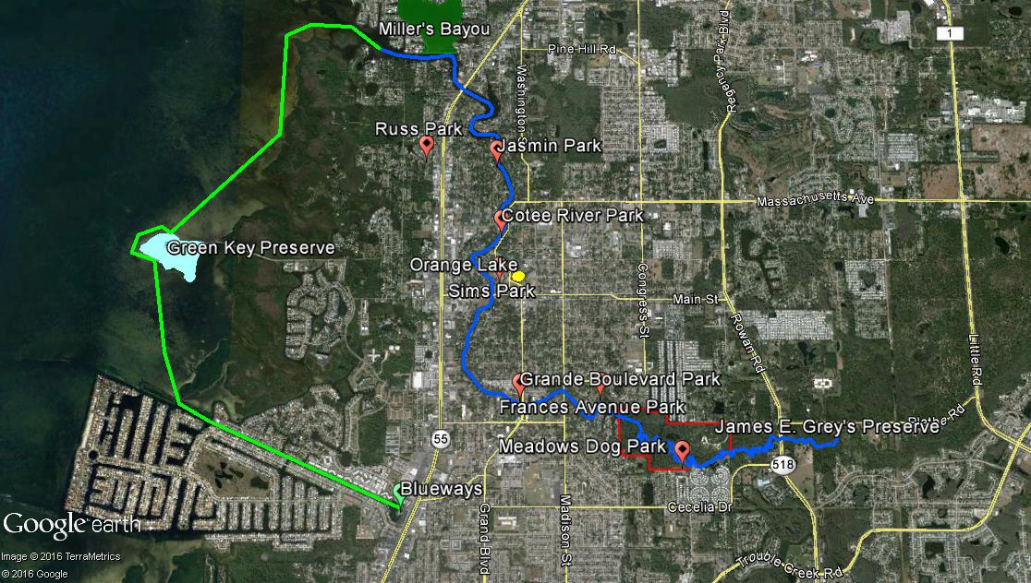
Cotee River Corridor

Slide 6
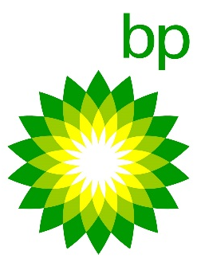
BP Settlement
$14.9 Billion
for…
Environmental and Economic
Damages
Payout begins in 2017
And continues over the
Next 15 years
$
$

Slide 7
RESTORE Act
Pot 1: Local/County Pot - Equal State Allocation Pasco => 5.4 mil over 15 years
OR 364,000 per year
Pot 2: Federal Council Pot - Gulf Coast Ecosystem Restoration Council Allocation
Pot 3: Consortium Pot - Oil Spill Restoration
Impact Allocation (Two years to plan)
Pasco => 12.5 mil over 15 years
2017 1st year
Pots 1 & 3 Environmental and Economic Projects

Slide 8
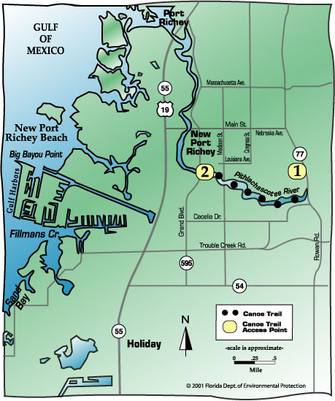
Cotee River Corridor
Includes several projects from 2013 STWMP
Focuses on Restoration
1st Phase = Orange Lake Restoration
funded by County Allocation “Pot1”
2nd Phase = River Basin Study
funded by New Port Richey
3rd Phase = Living Shorelines
funded by RESTORE pots &
Artificial Reef Grants

Slide 9
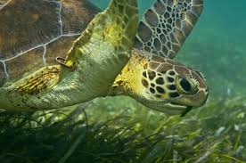
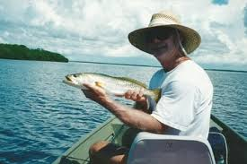
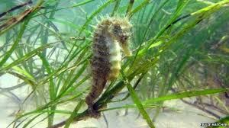
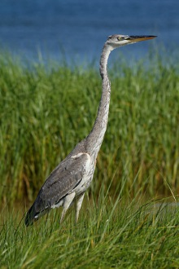
What is a Living Shoreline?
BEFORE
Project: Green Shores
in Pensacola, FL
Florida Department of Environmental Protection
AFTER
Florida Department of Environmental Protection

Slide 10
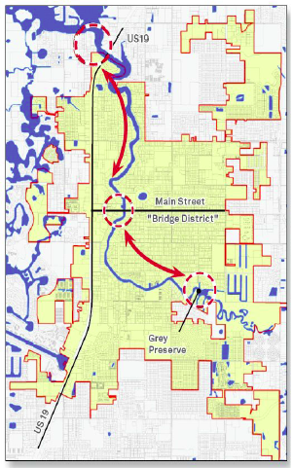
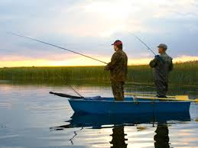
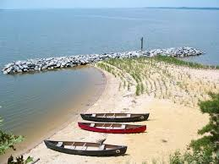
Recreational Benefits
Boating
Kayaking
Fishing
Snorkeling
Bird watching

Slide 11
Environmental Benefits
Reduce erosion and property loss
Maintain natural sediment movement
Trap sediment
Buffer storms
Reduce wave energy
Reduce stormwater velocity
Preserve coastal resilience
Improve water quality
Filter pollutants (kidneys)
Allow tidal exchange
Provide high productivity
Provide fish and
wildlife habitat
US Fish & Wildlife Service, M. Ray-Culp

Slide 12
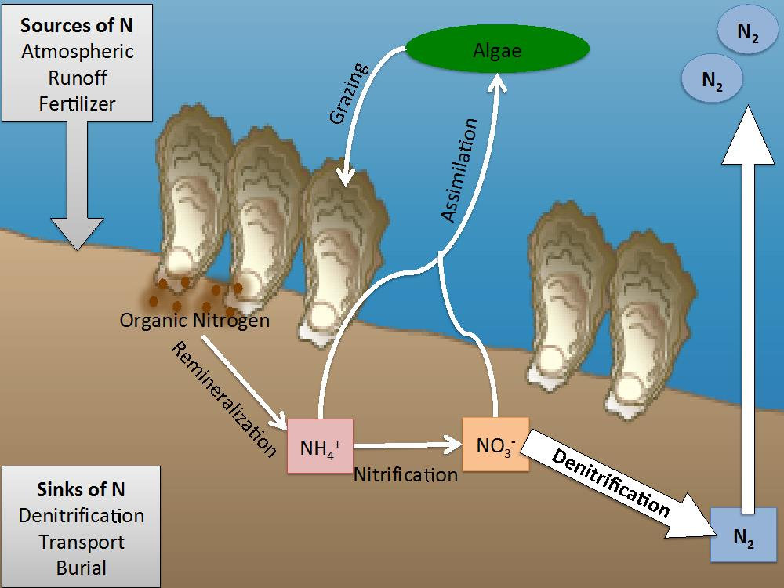
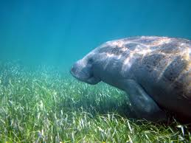
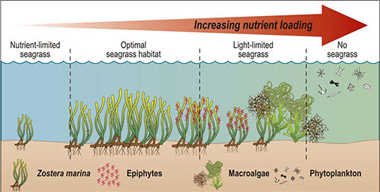
Proposed Project Components
Extension of Pier for Temporary Boat Access
Kayak and Paddle Board Launch
Weather and Marine Data Station
Historic Resource Assessment
Seagrass Assessment & Planting
Shoreline Assessment & Planting
Oyster Assessment & Bed Creation
Educational Component in collaboration
with Pasco County School Board
Long-Term Monitoring

Slide 13
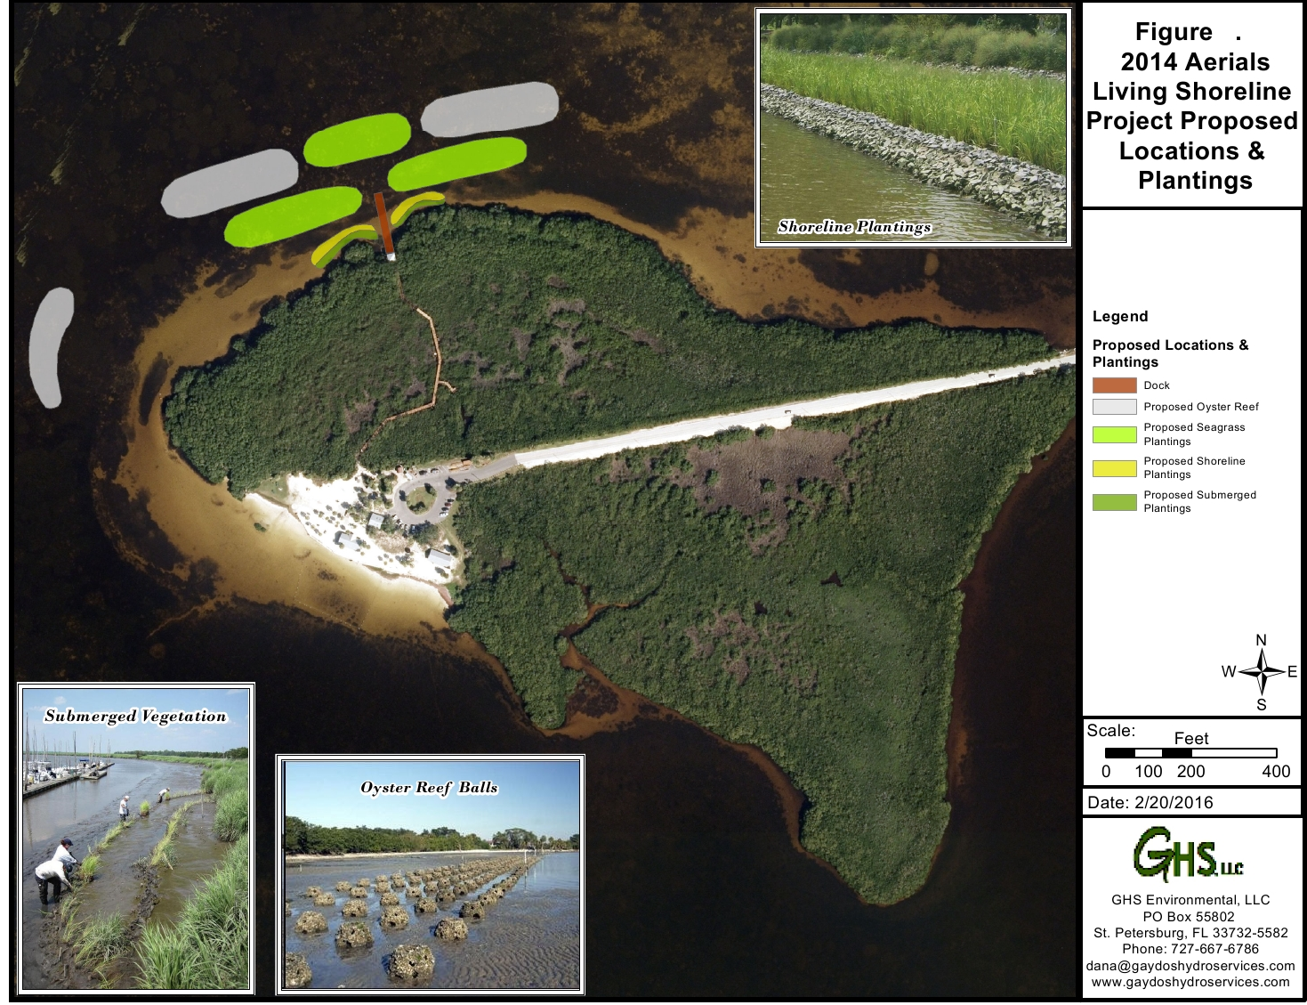
Green Key Road
Green Key Beach

Slide 14
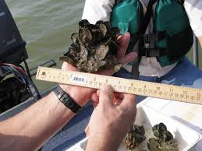
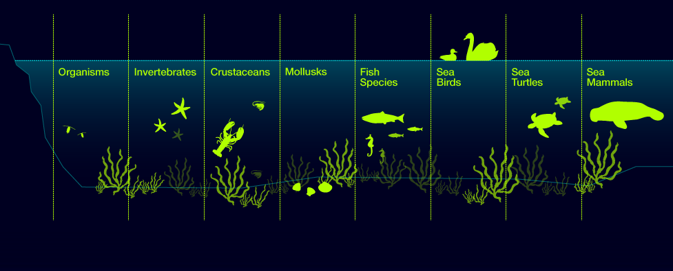
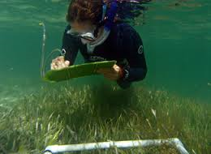
Phased Approach
Phase 1: Historical and Present Resource Assessment ($75,000)
Phase 2: Design and Engineering
Phase 3: Permitting
Phase 4: Construction of Various Components
Phase 4A: Pier Construction
Phase 4B: Oyster Reef Construction
Phase 4C: Seagrass Planting
Phase 4D: Shoreline Planting
Phase 5: Monitoring

Slide 15
Project Summary
Currently Funded Projects
Orange Lake Restoration – NPR, SWFWMD, RESTORE
River Basin Study – NPR
Other Water Quality Projects– NPR, SWFWMD
Proposed Project
Living Shorelines – Pot 1, NPR, Artificial Reef Grant
(will include Spartina, Oyster, Scallop and Seagrass)

Slide 16
Contact Information
GHS Environmental
Dana J. Gaydos Peggy Mathews
727-667-6786 850-566-6778
dana@gaydoshydroservices.com peggy@gaydoshydroservices.com
The City of New Port Richey
727-853-1021

