Slide 1
ICR DO’S AND DON’TS
IIPS Conference
July 16-18, 2012
Presented by:
Wayne Madry
Business Systems Analyst, CE

Slide 2
Institutional Class Report
(ICR)

Slide 3
D0’s
Section Building
  Membership vs Contact
  SOFF
  Accounting Method
  Census Date
  CEUs or No CEUs
  Term
Student Registration
  Status Date
  Drop vs Withdrawn vs Delete
Student Registration cont’d
  Status Changes
  Billing
Grading
  All Students Graded
  Grade Scheme
  Un-grading (?)
Understand
  Many Variables
  Gets Better with Time

Slide 4
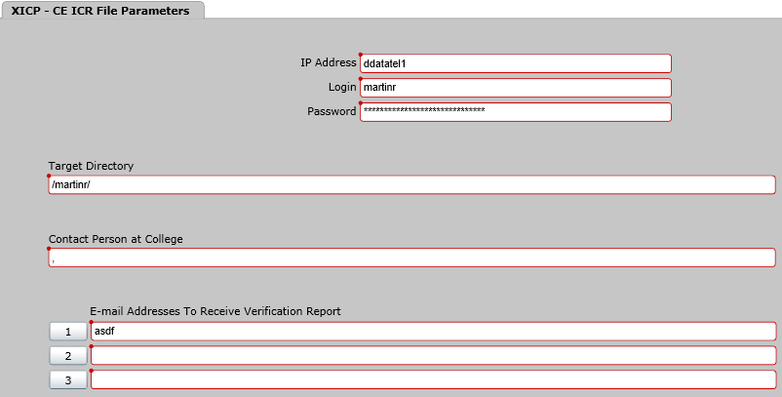
ICR FILE PARAMETERS

Slide 5
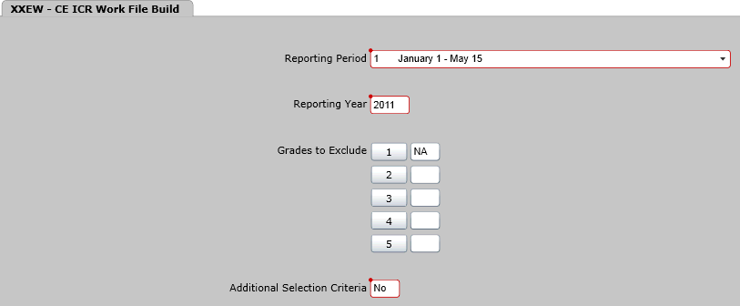
CE ICR WORK FILE BUILD

Slide 6
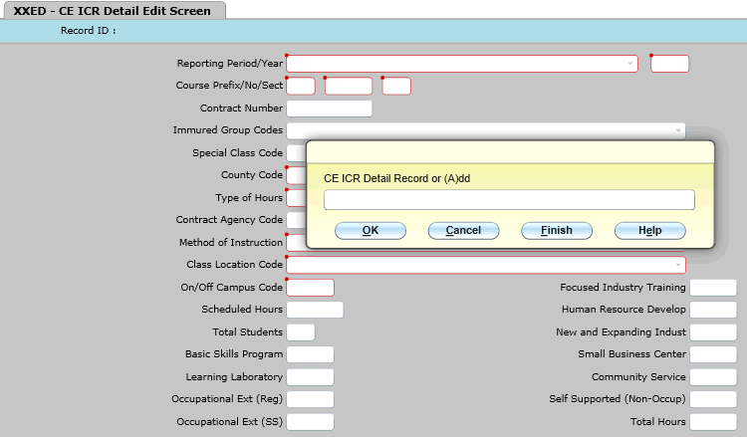
CE ICR DETAIL EDIT SECTION

Slide 7
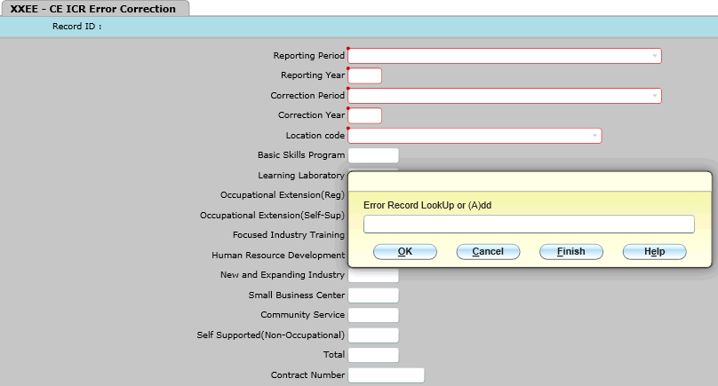
CE ICR ERROR CORRECTION

Slide 8
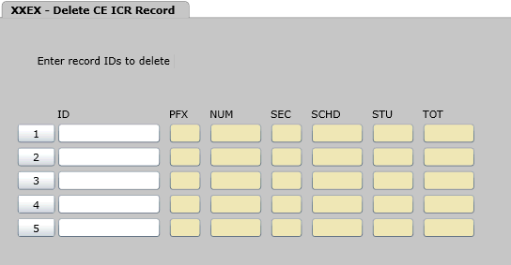
DELETE CE ICR RECORD

Slide 9
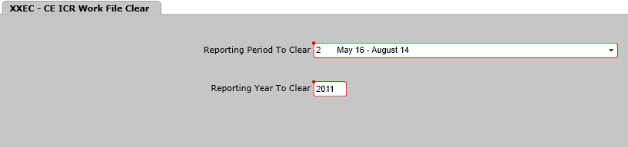
CE ICR WORK FILE CLEAR

Slide 10
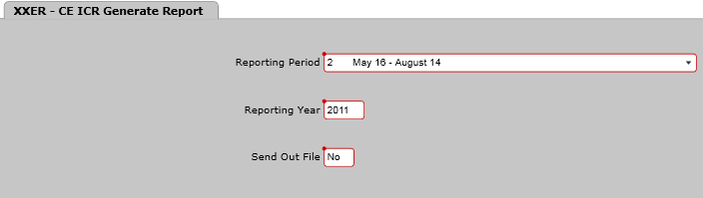
CE ICR GENERATE REPORT

Slide 11

XXEW –The CE ICR Work File Build Screen
The first step that must be performed in producing the CE ICR report is to generate a work file of records to include on the report. This work file is created in the mnemonic XXEW.
All required fields on all records must have correct and complete data before the file will be generated.
Notes:
These fields have been explained

Slide 12
Errors and Warnings
What’s the difference?
Errors - will not allow the file to be built, and must be cleared before file can be generated.
Warnings - will not prevent the file from being generated, but the associated courses may not have been included in the work file.

Slide 13
Errors
Some of the most common errors are:
Invalid funding accounting method
No meeting information found in course section
No county specified for building
No building specified for course section
No location code for building
No location type for location
No method of instruction for course section
Notes:
Class-no valid students-may need to cancel class
Basis Skills – No hours entered.

Slide 14
Warnings
The most common warnings are:
No valid students registered for course section
  Class needed to be canceled
  Students registered after the 10% point
Student did not have any attendance hours
  Basic Skills
Warning

Slide 15
How to survive your first audit using Colleague
Be prepared
  Plan ahead. It will take some extra time to process the ICR
  Allow ample time to process required reports (CC.IA)
Be organized
  Write the section number and record ID onto your roster. This will allow you to pull the roster quickly when the Auditors gives you the list of classes pulled for audit
Keep things simple
  Develop a good filing process to locate and recall information
Remember
  Colleague is date and student driven
Notes:
It takes time to write the State ID and Records ID onto the roster.
It is very easy to produce duplicate section numbers with
classes that have been Co-coed

Slide 16
DON’T PANIC!

Slide 17
Customer Support
Training Needs
http://www.nccommunitycolleges.edu/Training/CIS_Training/CISTrainingHomePage.html
CIS Documentation
http://www.nccommunitycolleges.edu/CIS_Dos/index.html
Training Needs web link accesses 90-Day Training Calendar
If you have a specific training need, contact System Office at (919) 807-7178

Slide 18
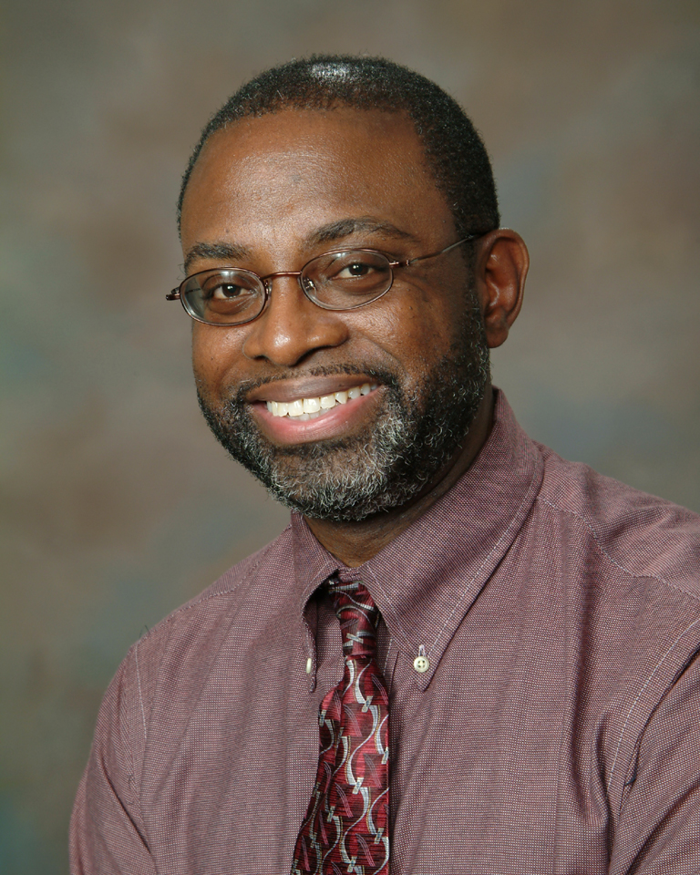
Any Questions?
Business System Analyst, CE/BSP
Mitchell Community College
(704) 978-5433
(919) 807-7178

