Slide 1

WHY ISAGENIX
AND WHY

Slide 2
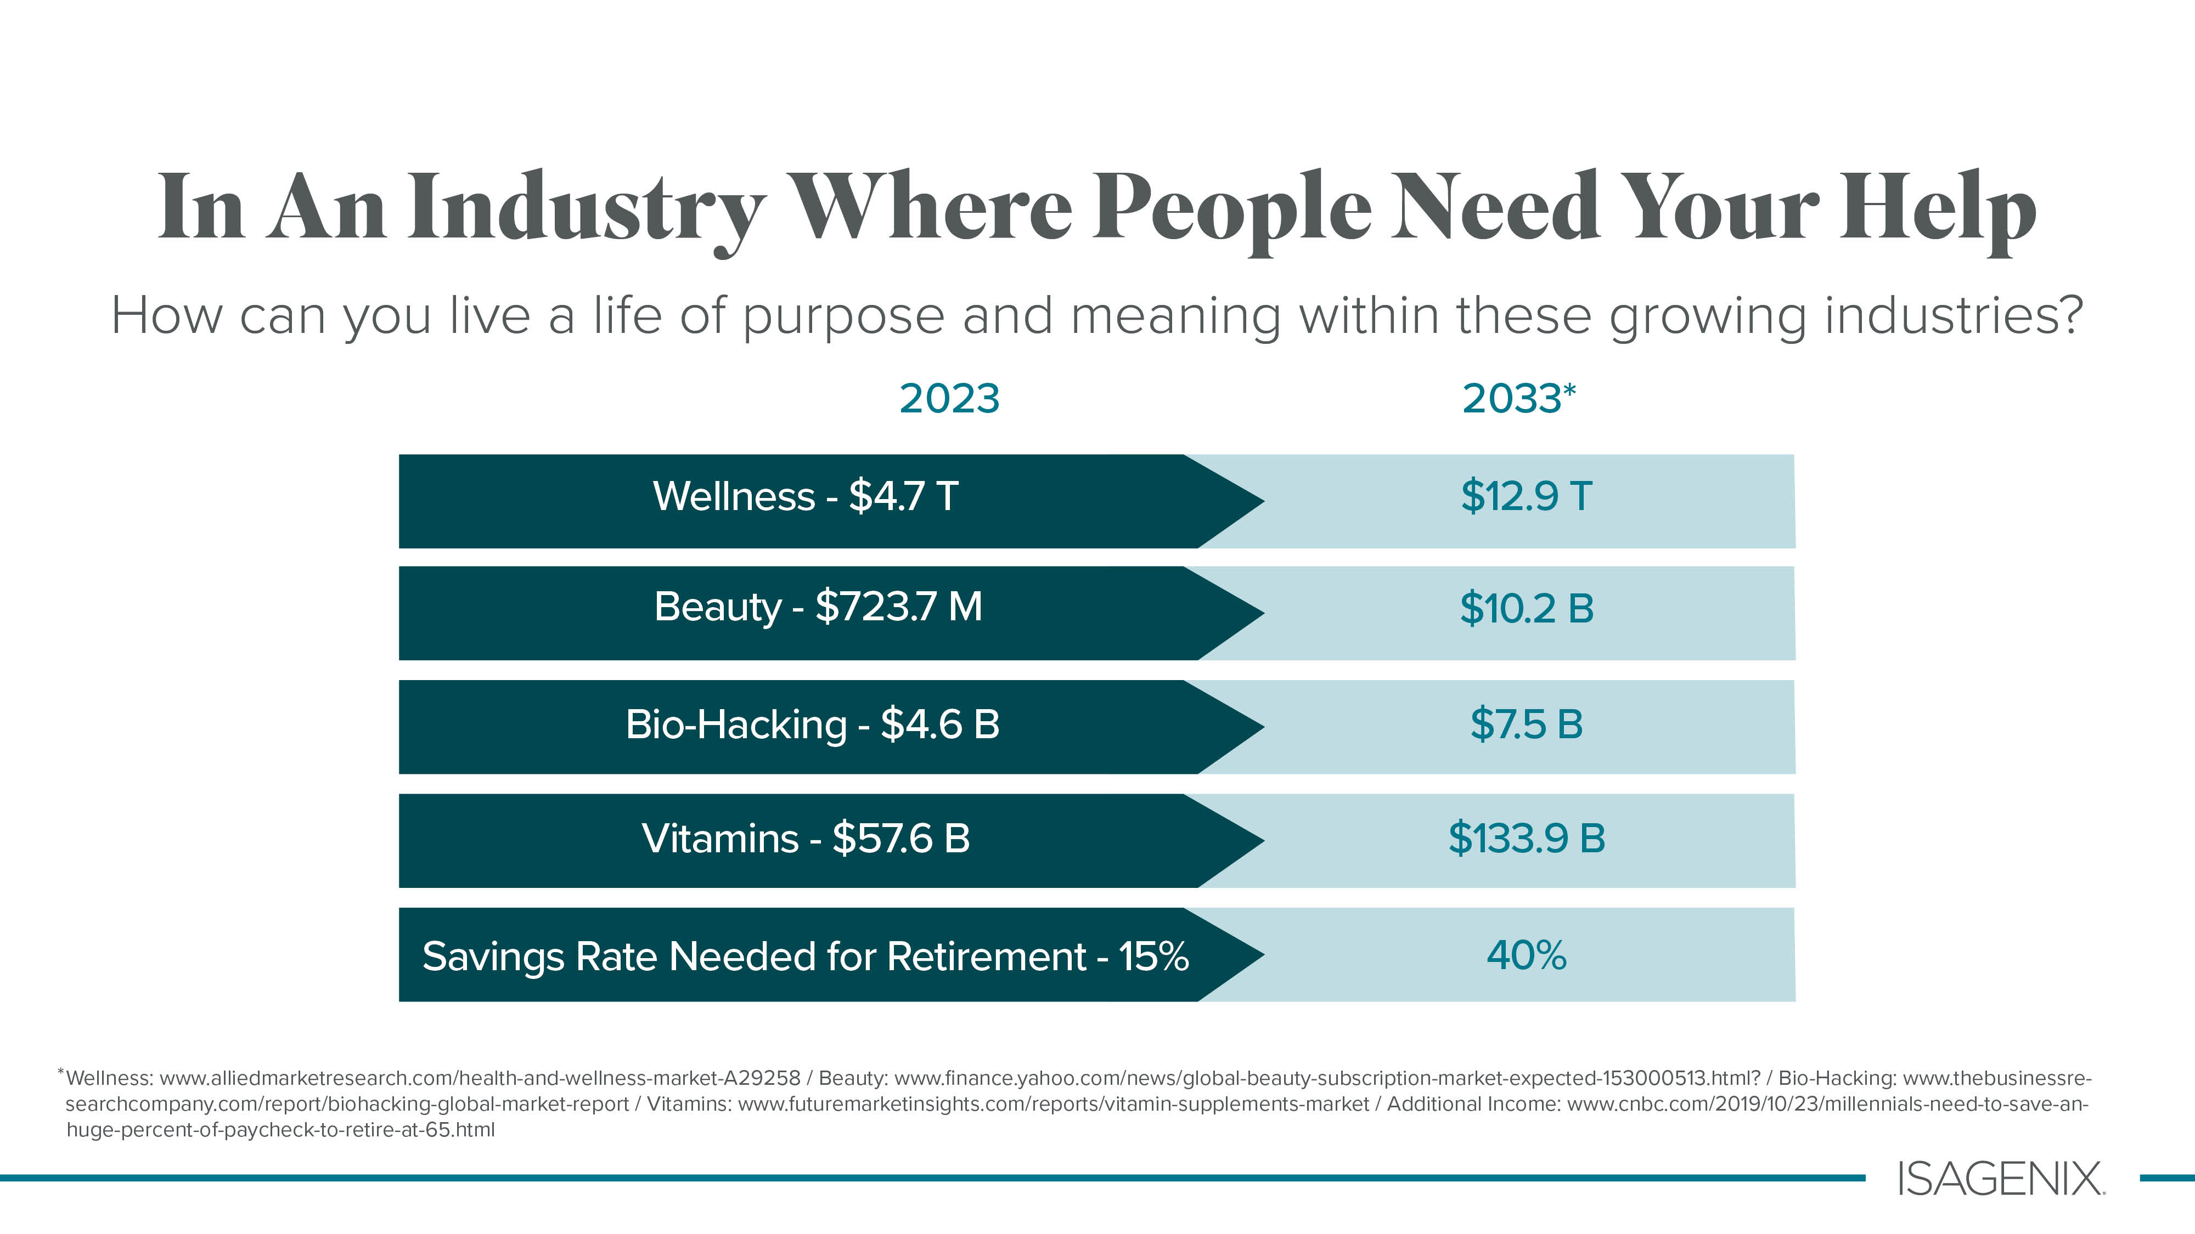

Slide 3
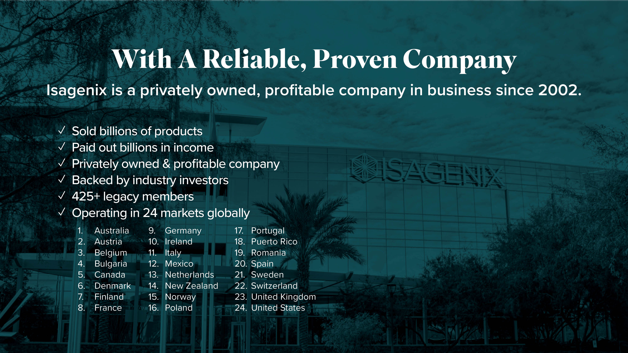

Slide 4


Slide 5
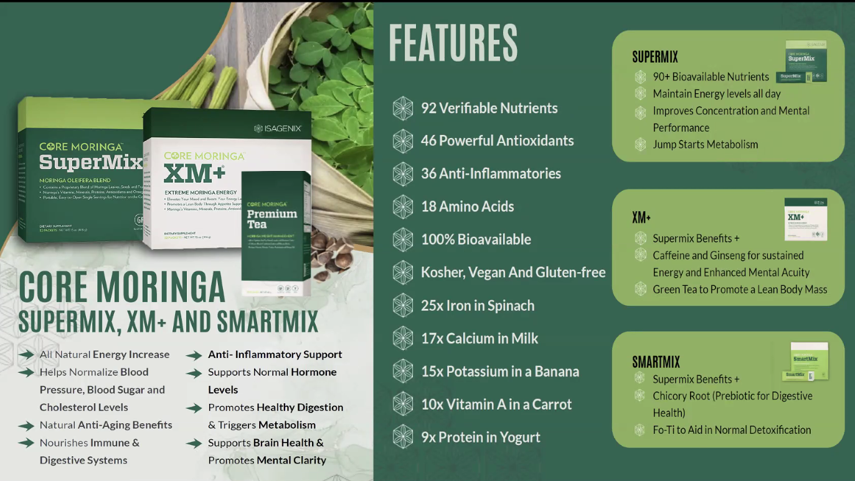
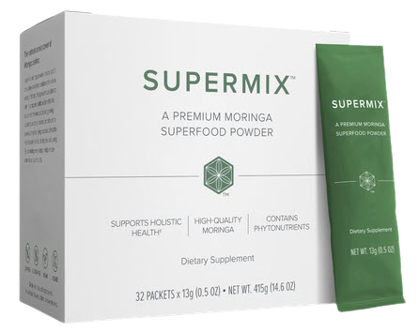
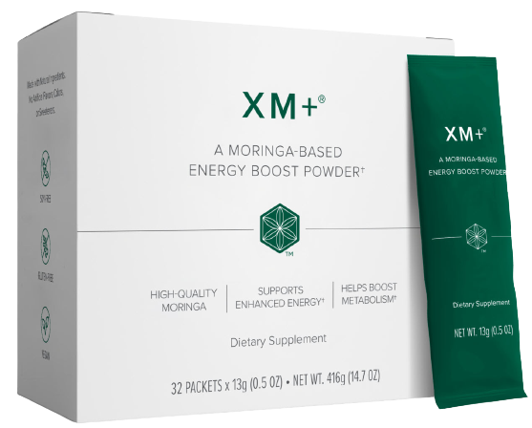
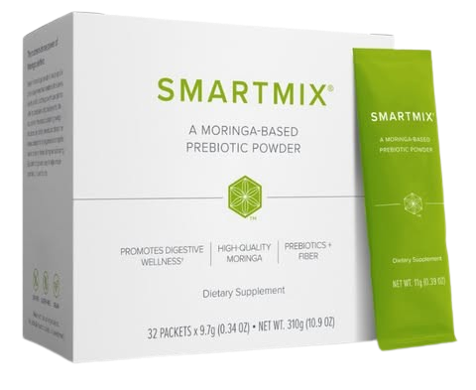

AND WHY?

Slide 6

Moringa Oleifera- Nature’s Miracle Tree
Vitamins
Vitamin A (Alpha and Beta Carotene), B, B1, B2, B3, B5, B6, B12, C, D,
E, K, Dietary Folate, Biotin and many more.
Minerals
Calcium, Chloride, Chromium, Copper, Florine, Iron, Manganese, Magnesium, Molybdenum, Phosphorous, Potassium, Threonine, Tryptophan, Valine
All 9 Essential Amino Acids
Histidine, Isoleucine, Leucine, Lysine, Methionine, Phenylelenine, Threonine, Tryptophan, Valine
10 Additional Amino Acids
Alanine, Arginine, Aspartic Acid, Cystine, Glutamine, Glycine, Histidine, Proline, Serine, Tyrosine
Other Beneficial Nutrients
Chlorophyll,Cytokines Carotenoids, Flavonoids, Omega (3,6,9) oils, Plant Sterols, Polyphenois, Lutein, Xanthins, Rutin and more
AND WHY?
Gram for gram, fresh Moringa leaves contain
17x the Calcium of Milk
10x the Vitamin A of Carrots
9x the Protein of Yogurt
15x the Potassium of Bananas
7x the Vitamin C of Oranges
25 x the Iron in Spinach

Slide 7
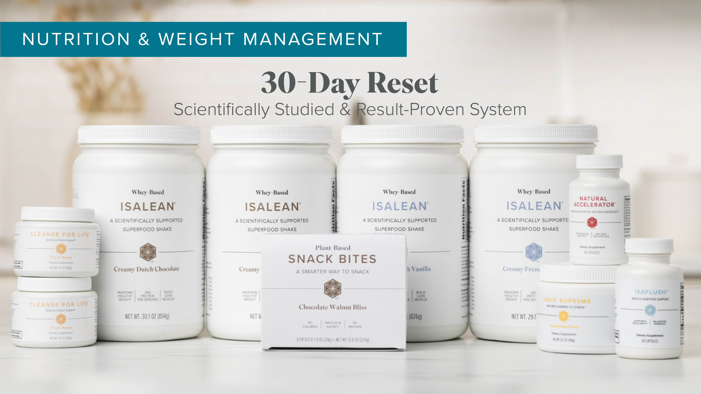

Slide 8


Slide 9

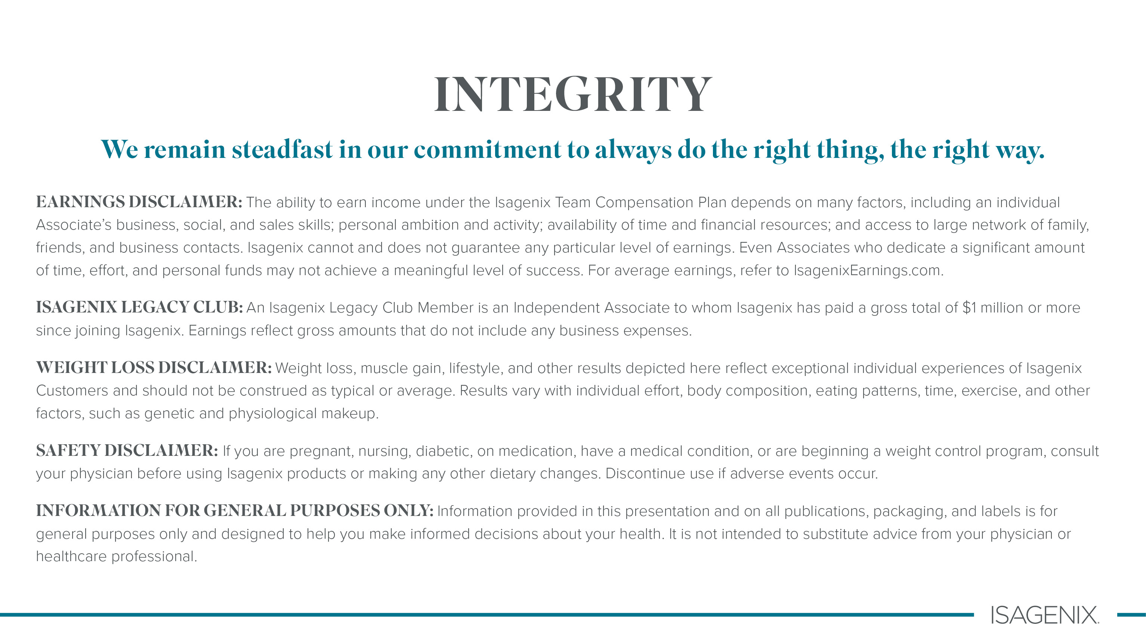


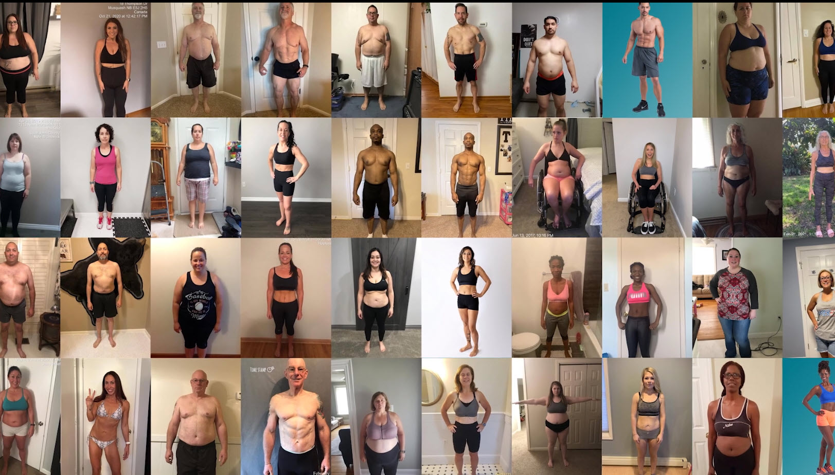


Imagine Your Ideal Life
If you want to feel better,
Isagenix can help with that.
1
YOUR OWN VIRTUAL STORE
AND WHY?
    No Storefront necessary
    No Employees
    Minimal Investment (other than reclaiming your health)
    Proven system with:
    Trainings
    Events
    Marketing
    Social media support
Real Individuals,
Real results.

Slide 10
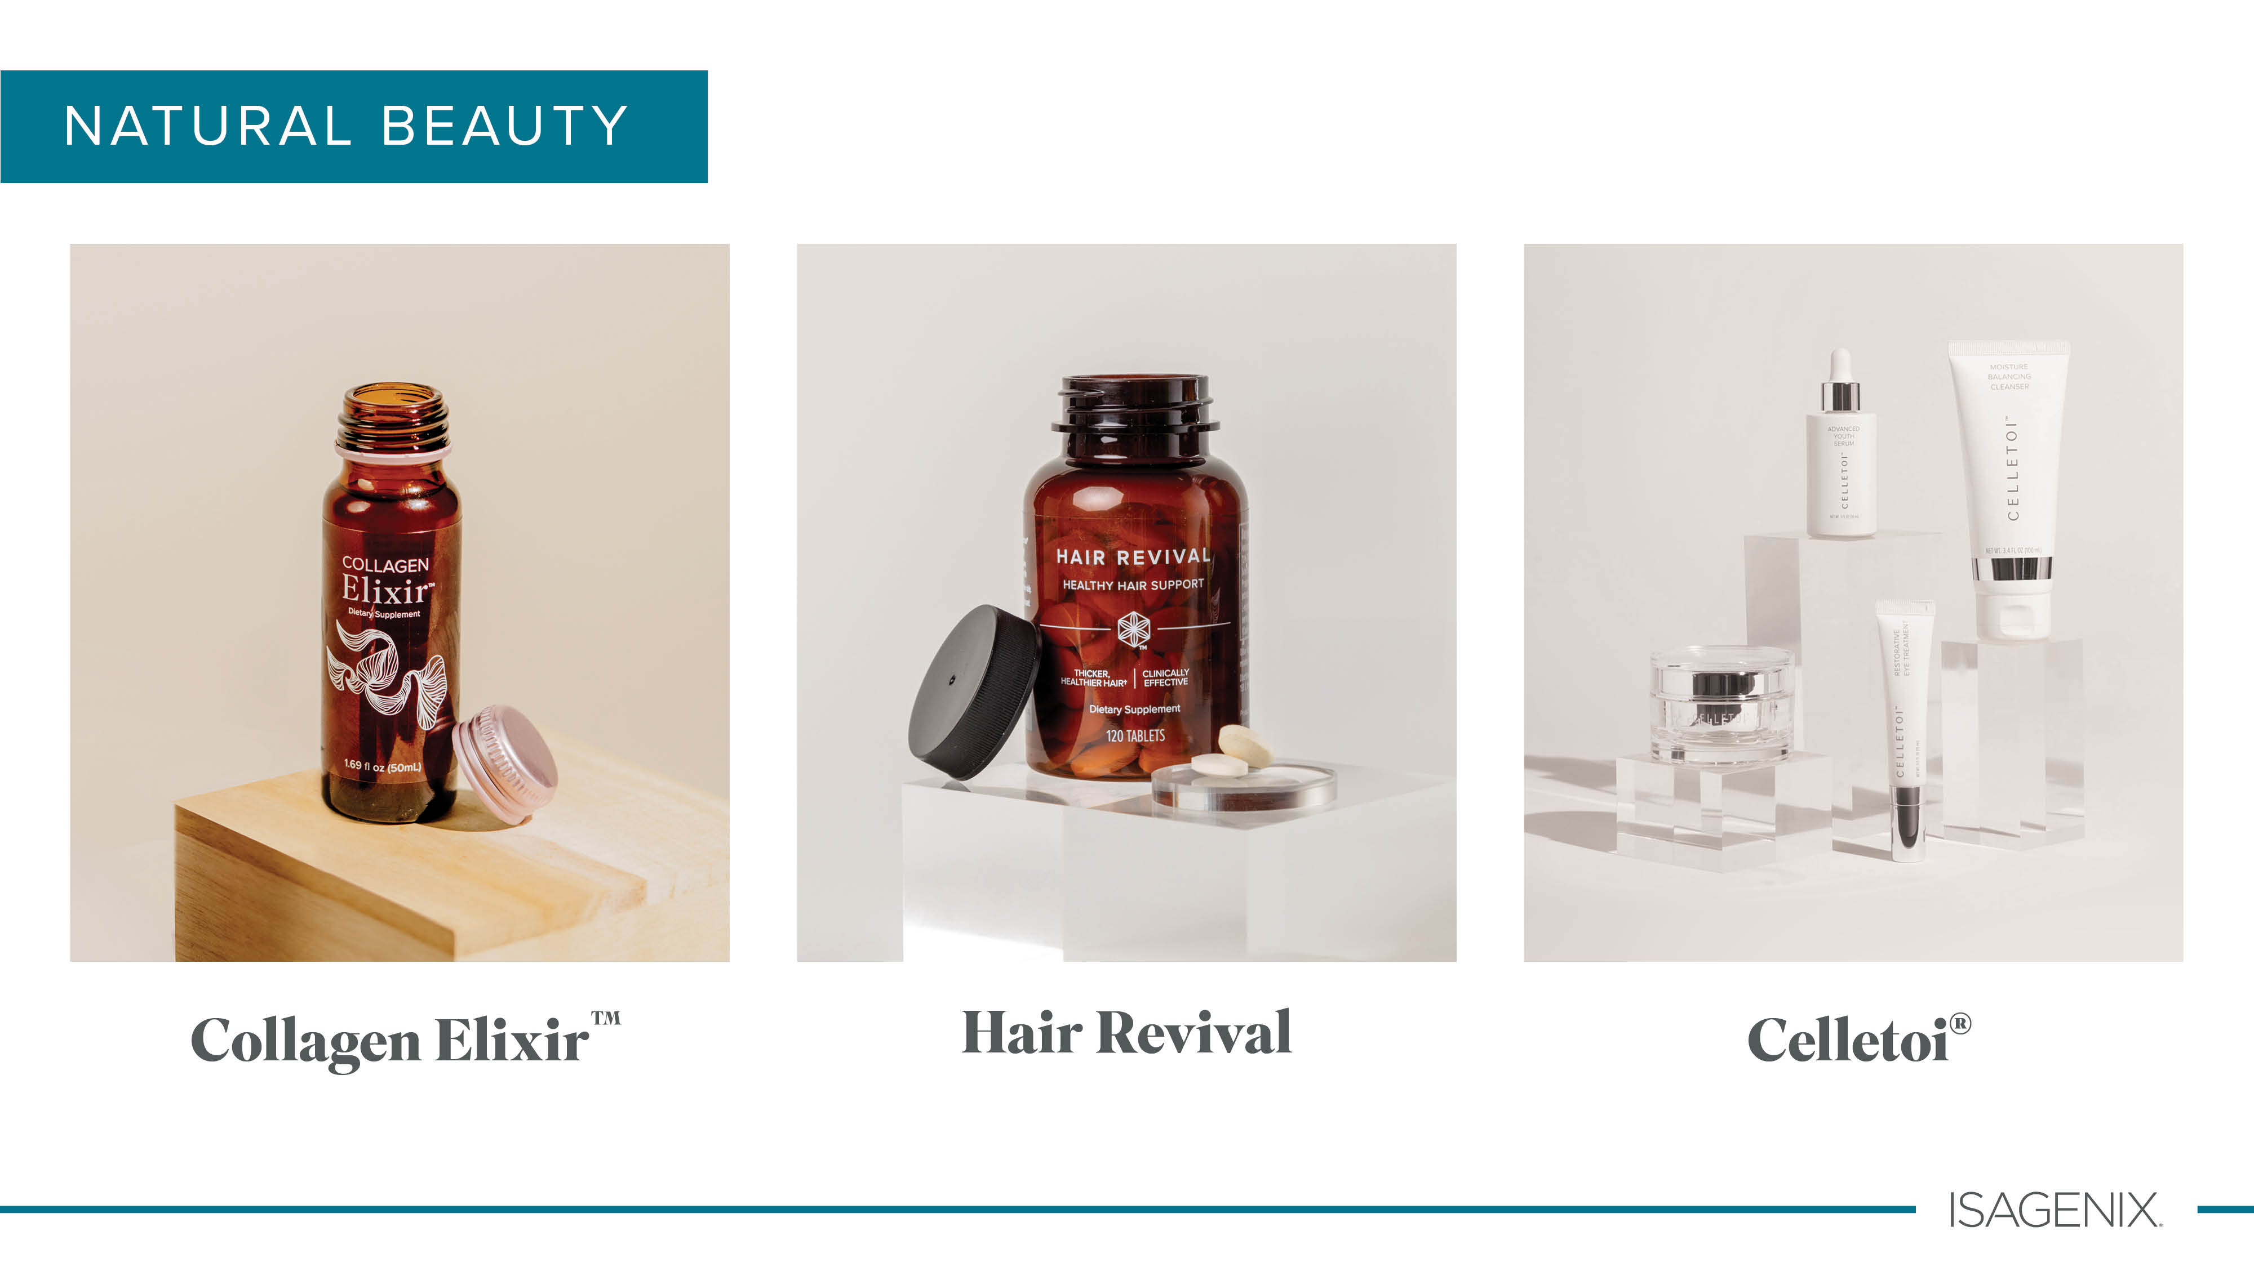

Slide 11
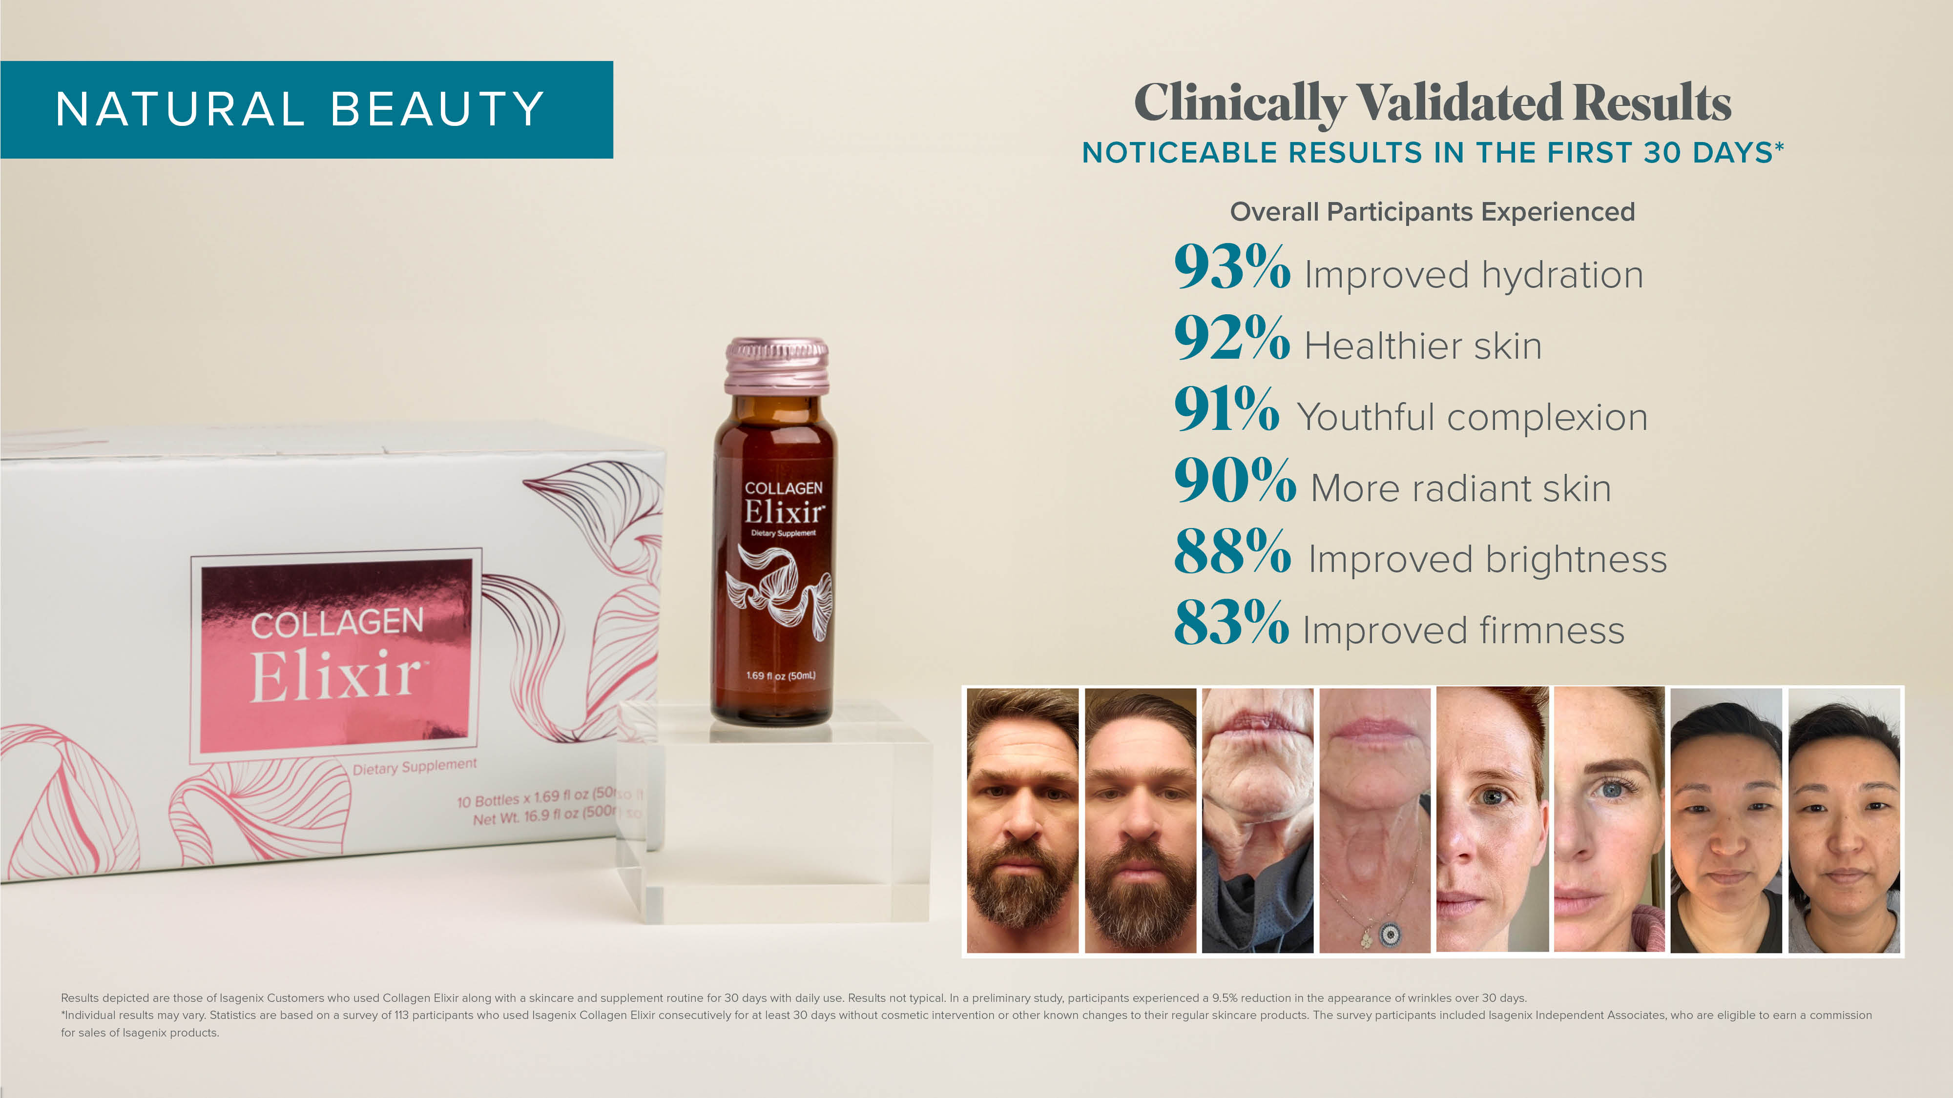

Slide 12
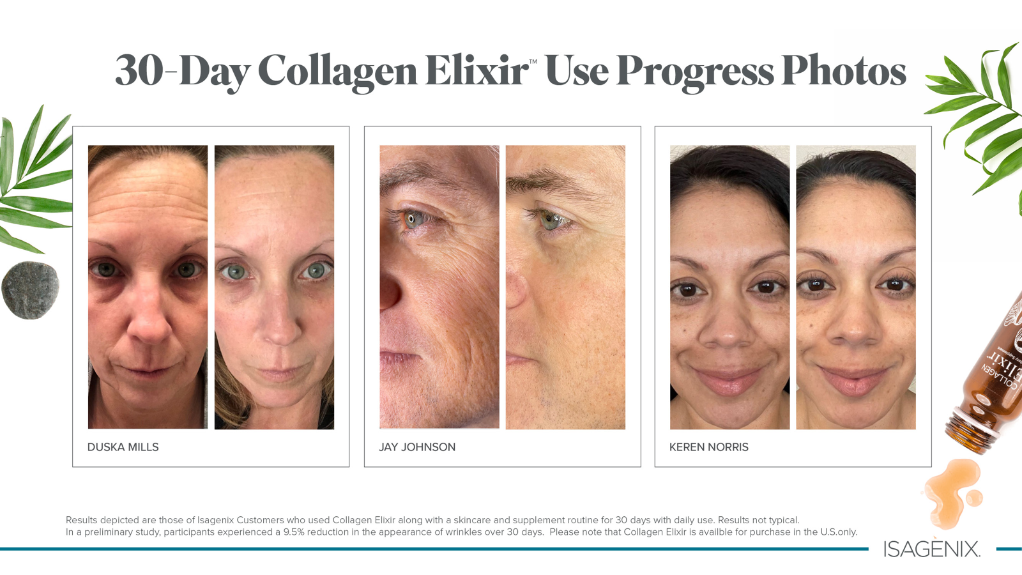

Slide 13
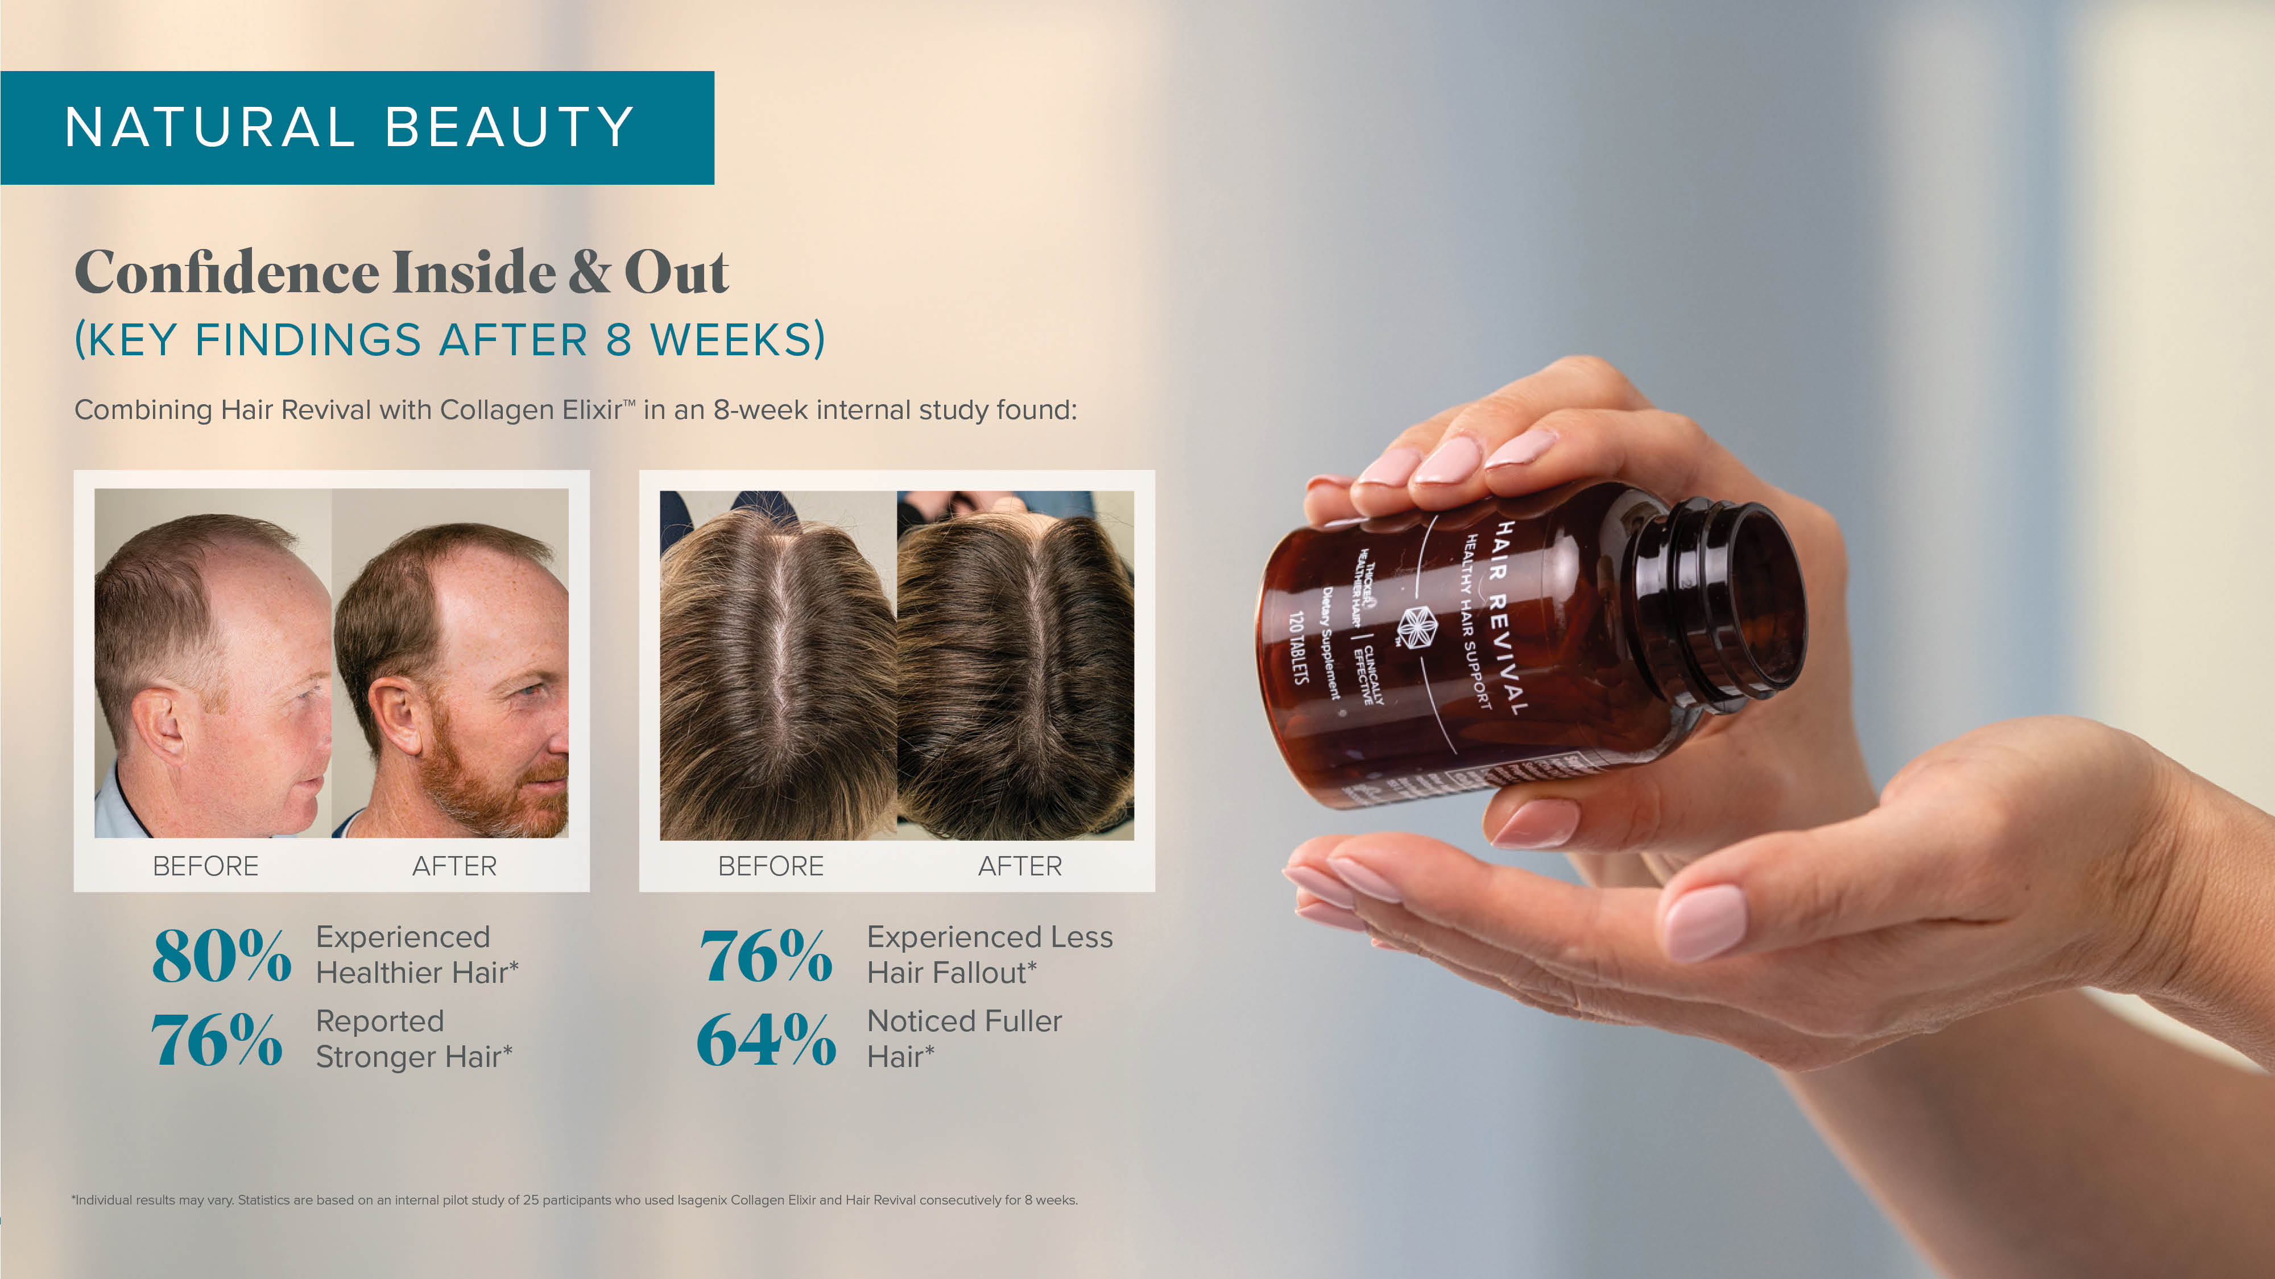

Slide 14
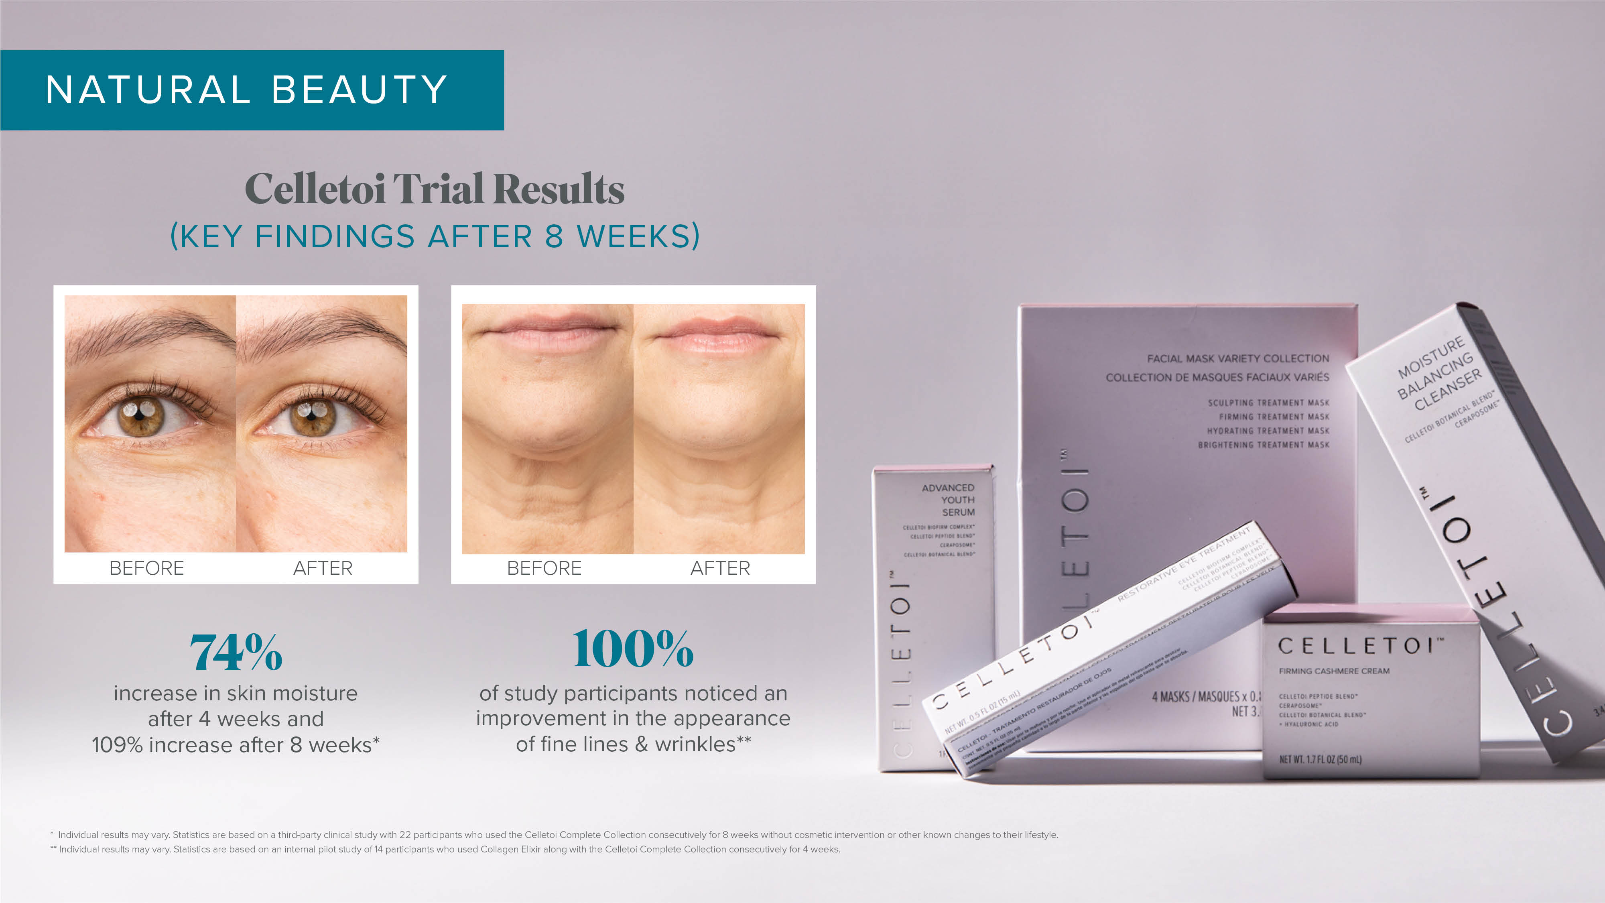

Slide 15
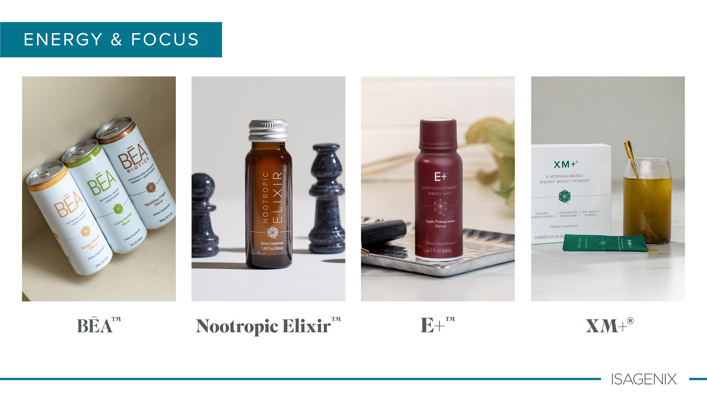

Slide 16
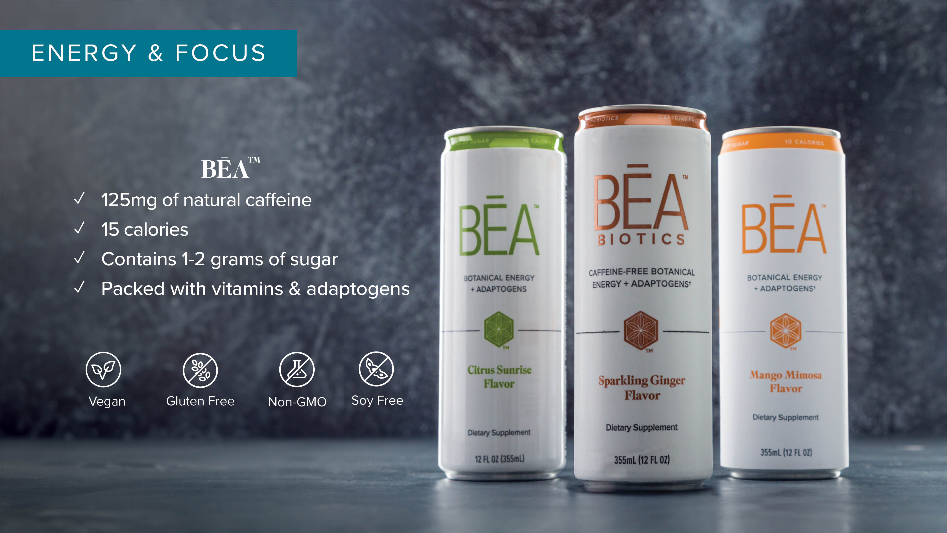

Slide 17
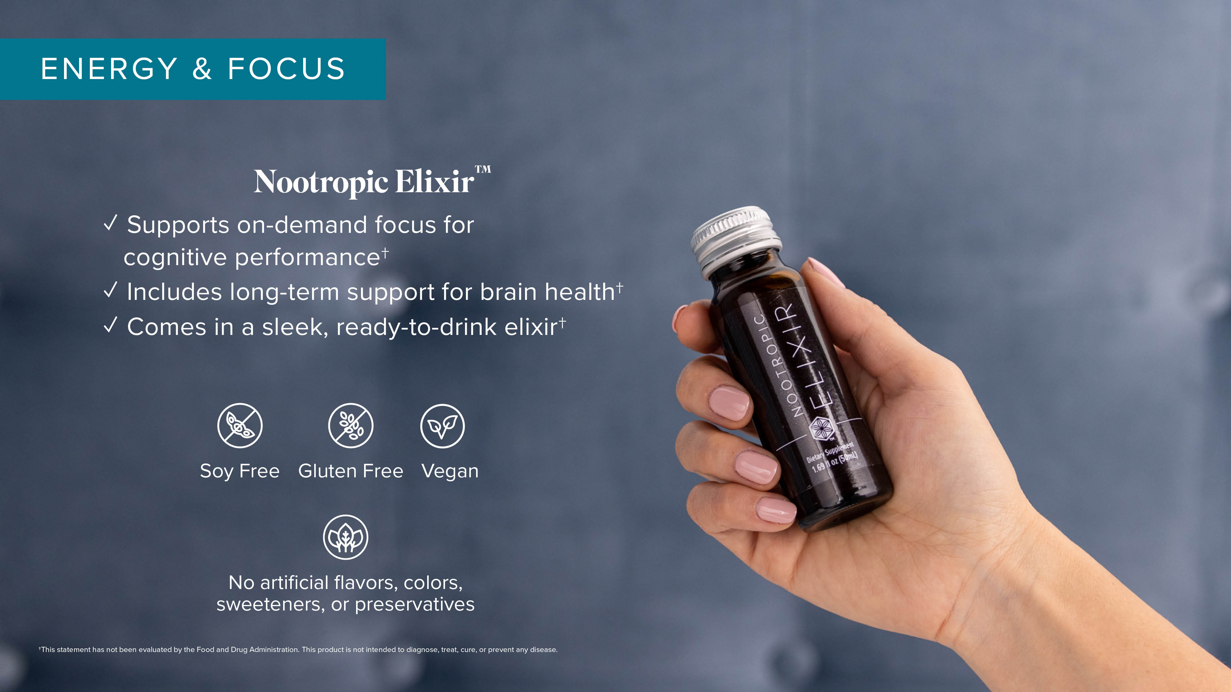

Slide 18
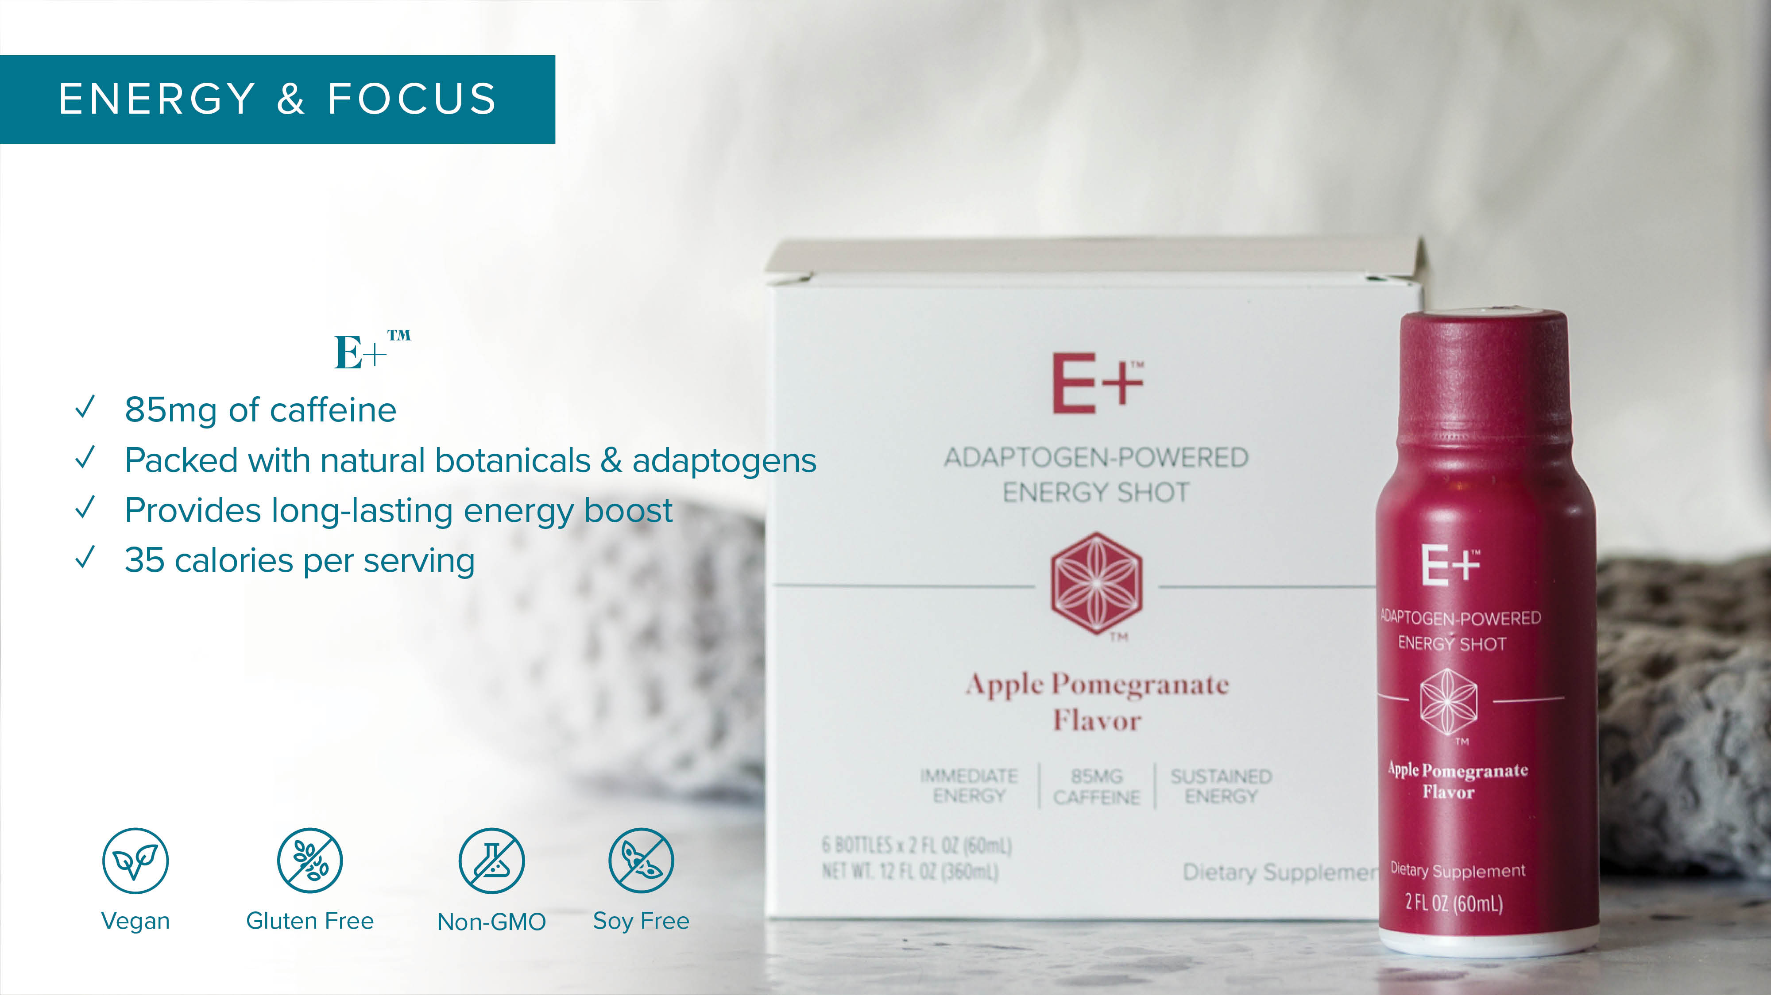

Slide 19
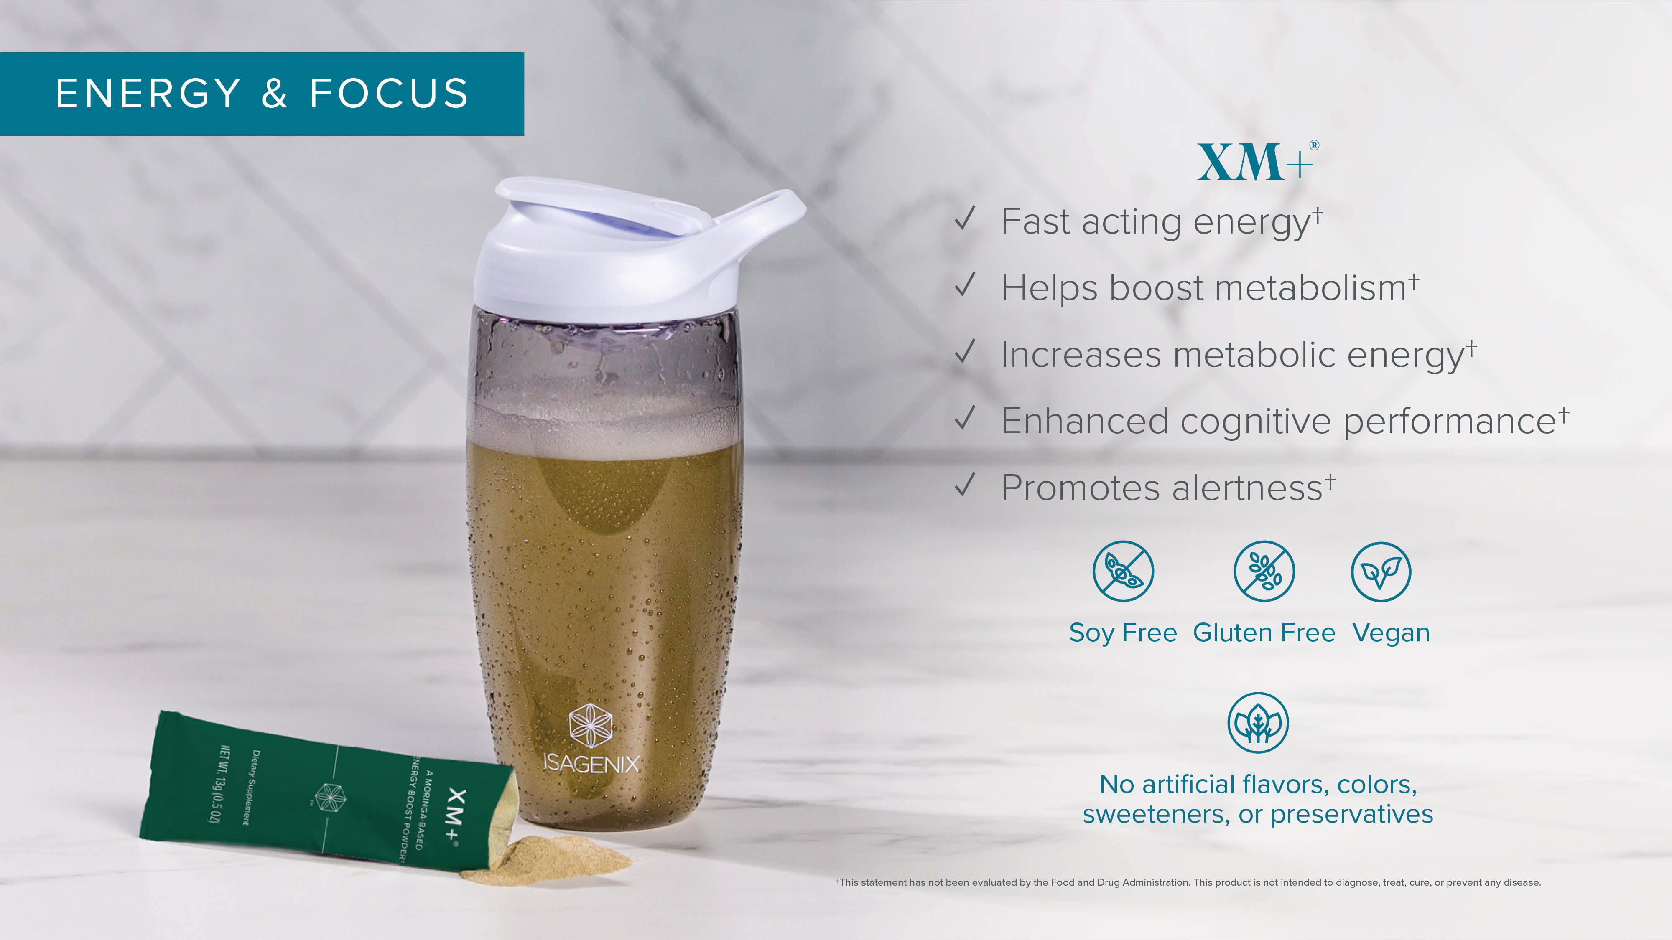

Slide 20
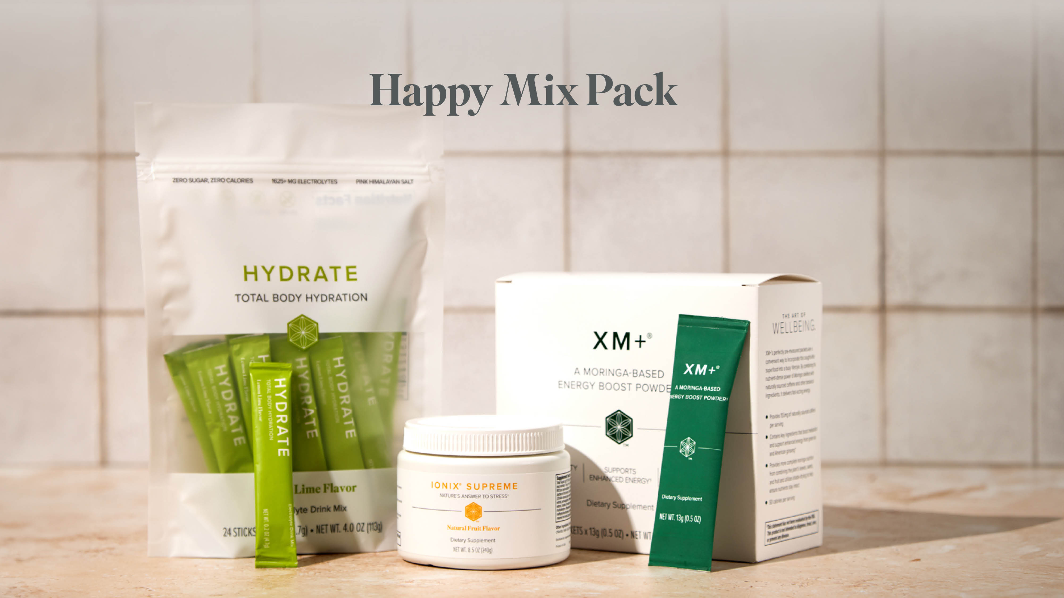

Slide 21
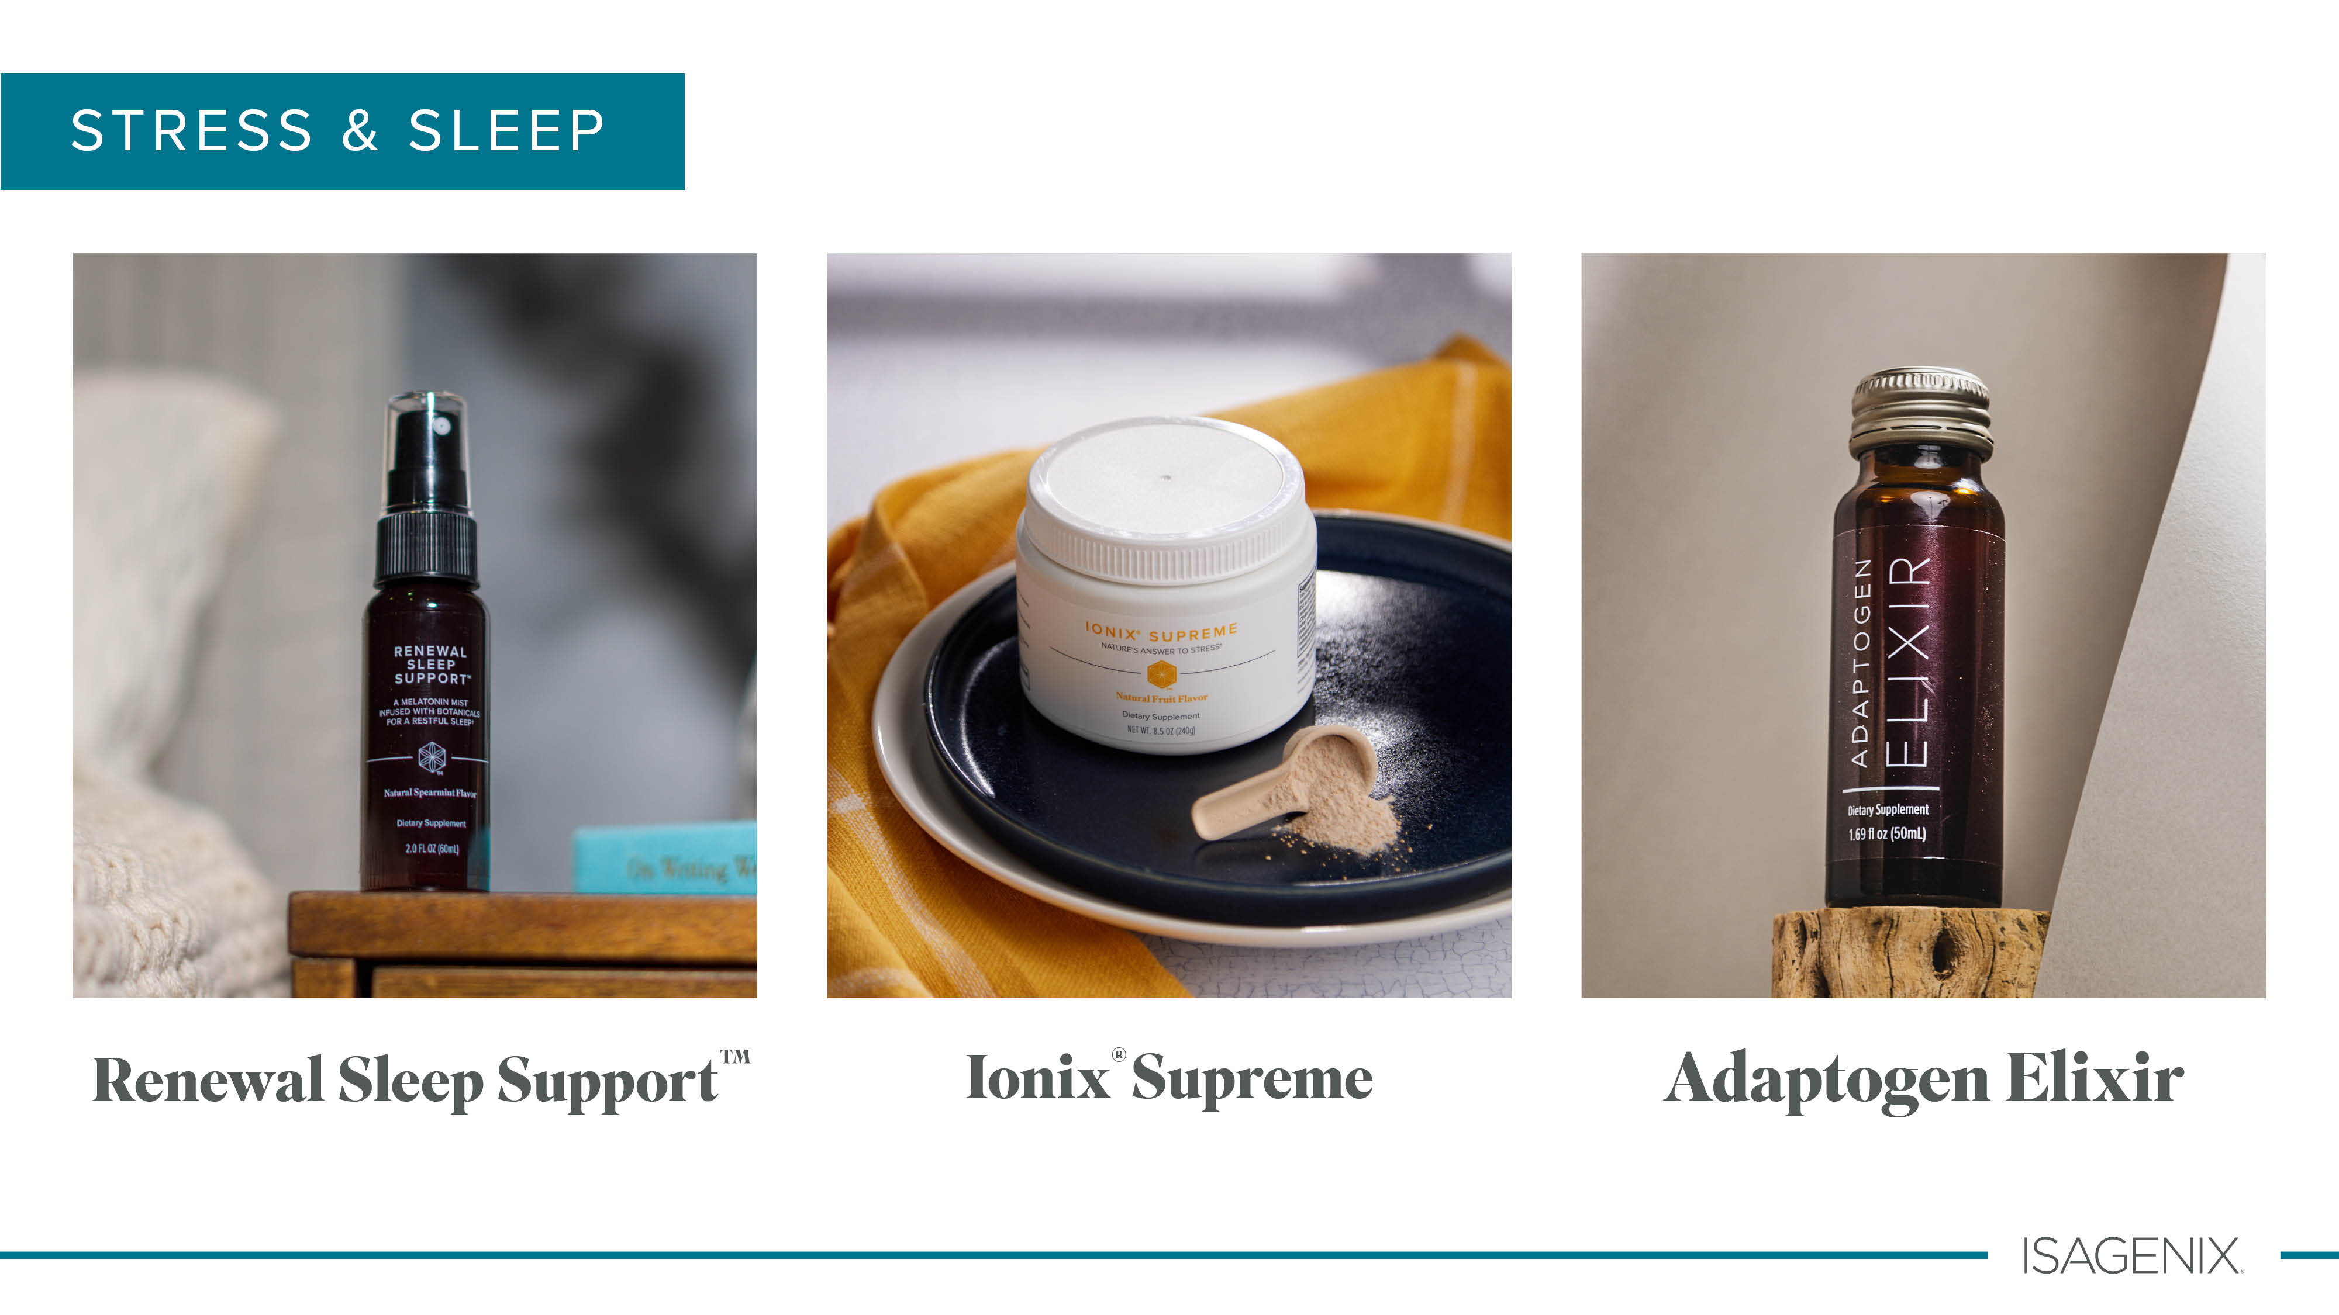

Slide 22
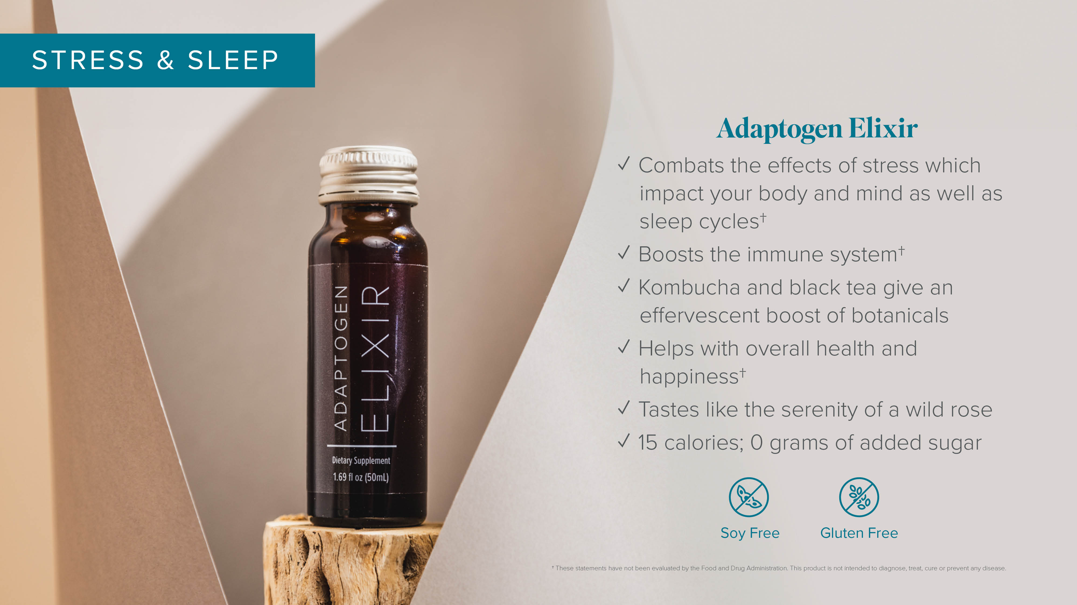

Slide 23
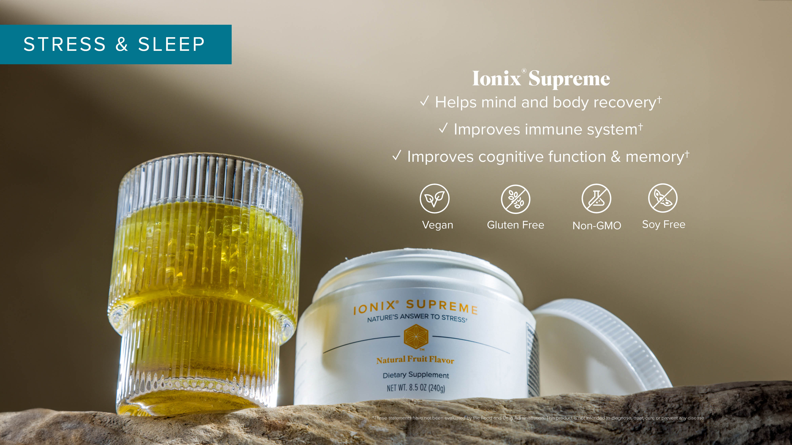

Slide 24
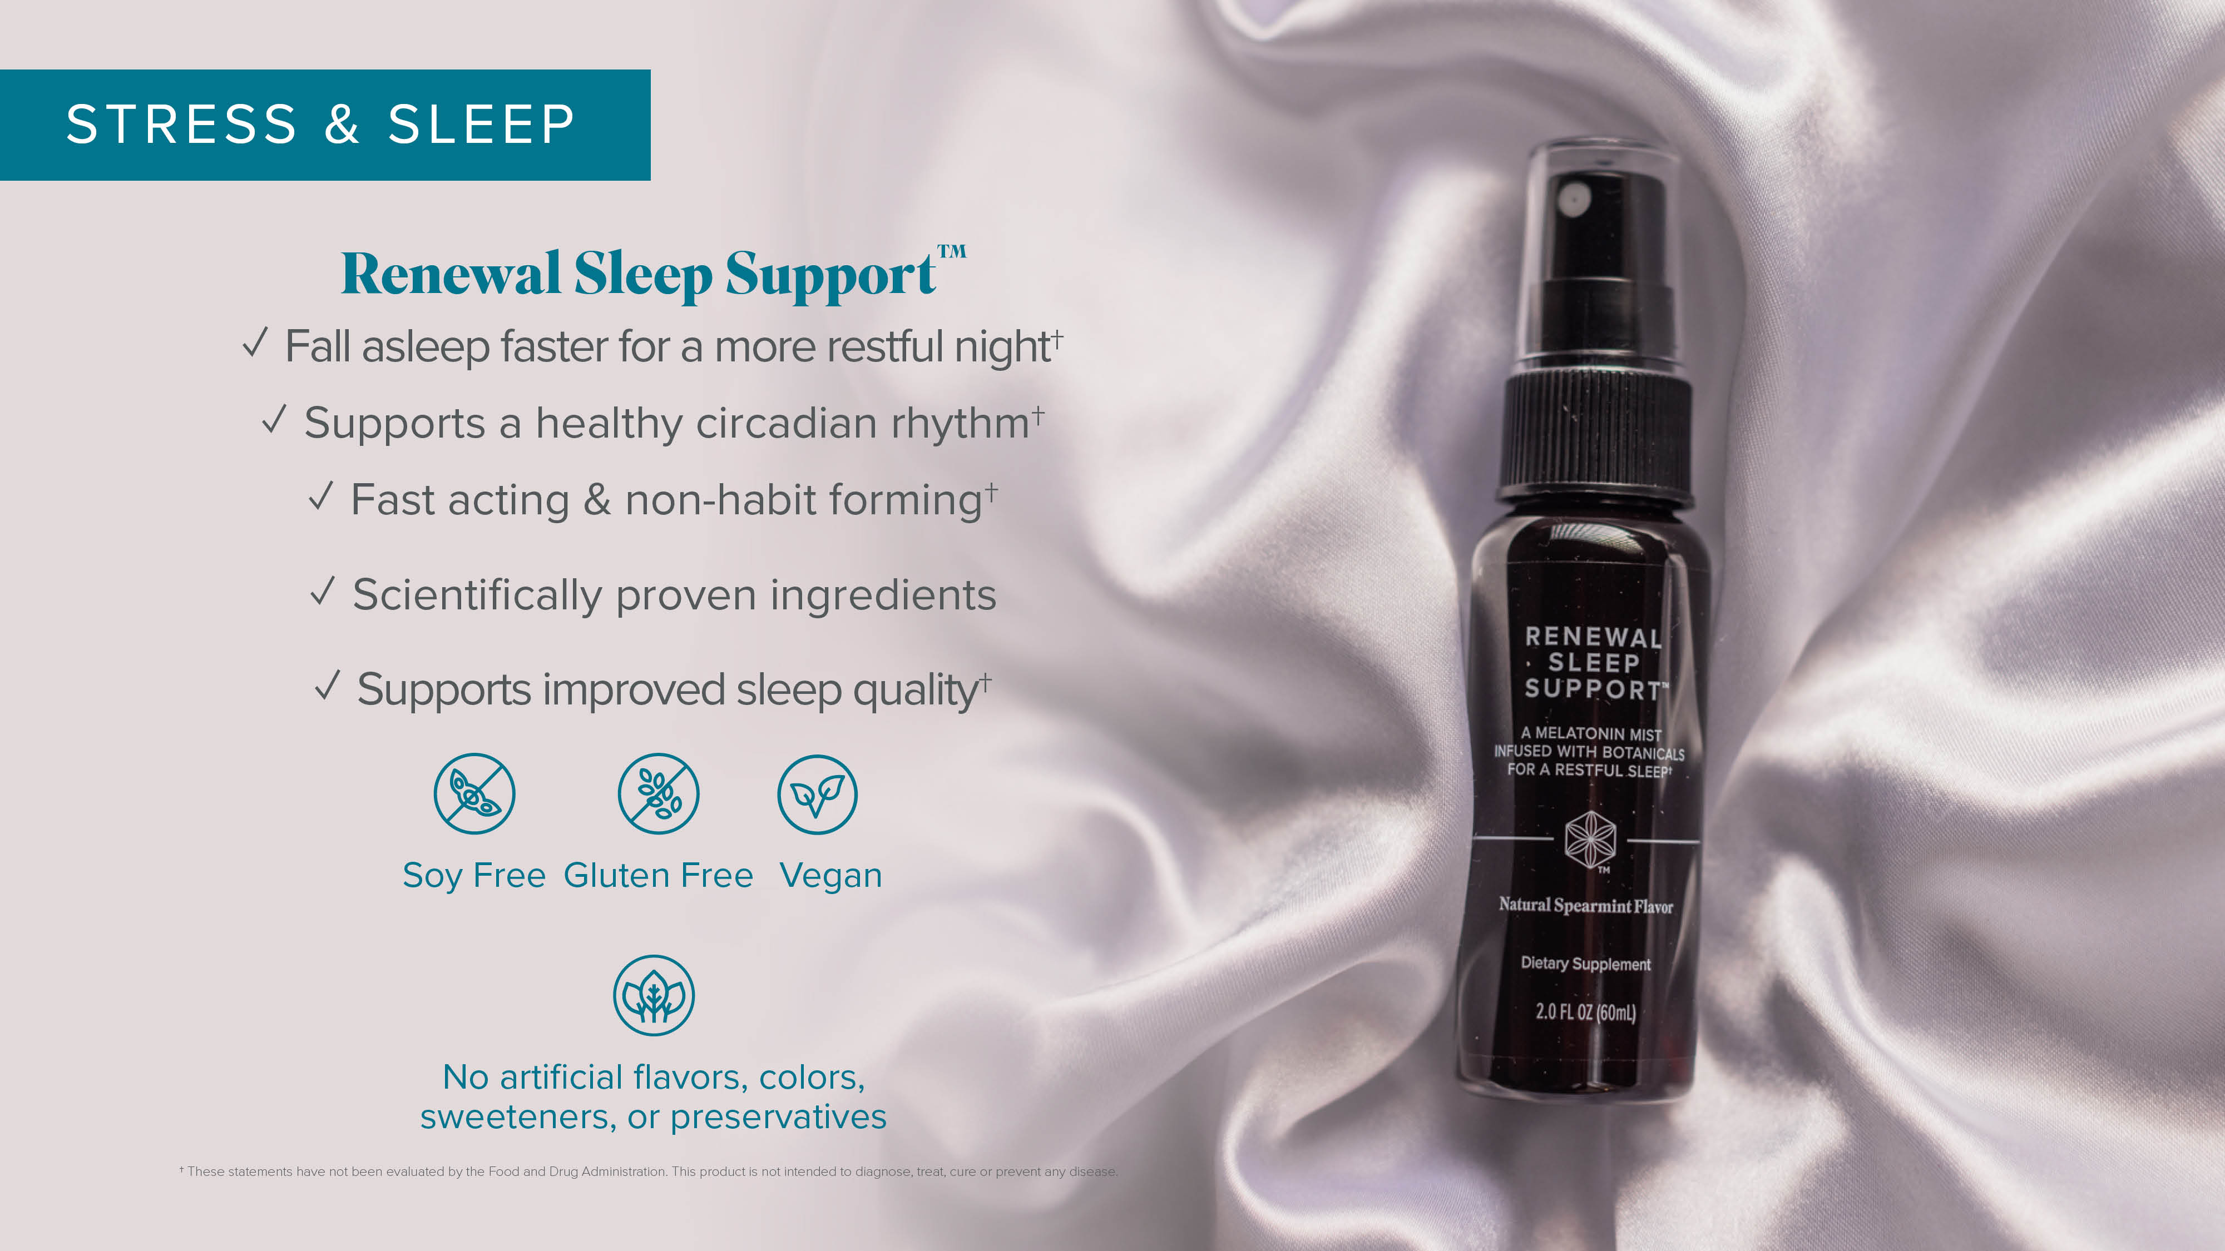

Slide 25


Slide 26
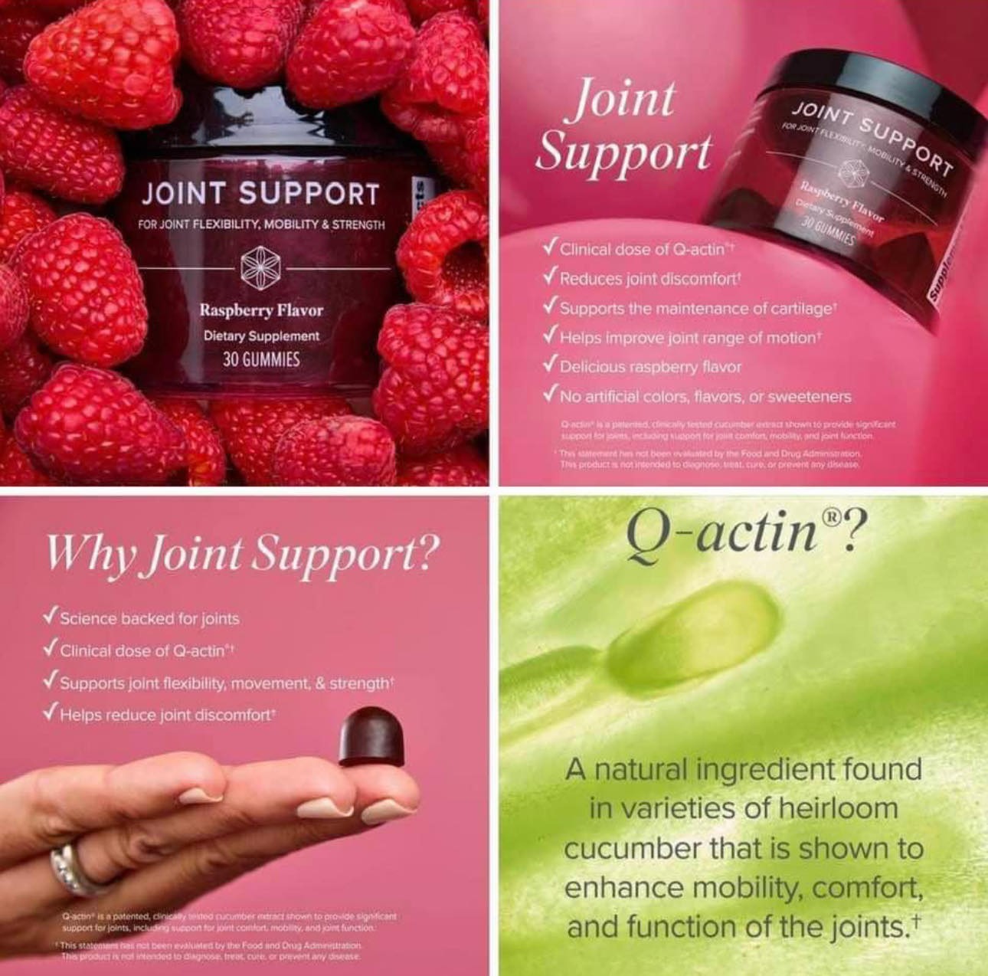
AND WHY?
PAIN RELIEF
PAIN RELIEF

Slide 27



PuraPlant 21
AND WHY?

Slide 28
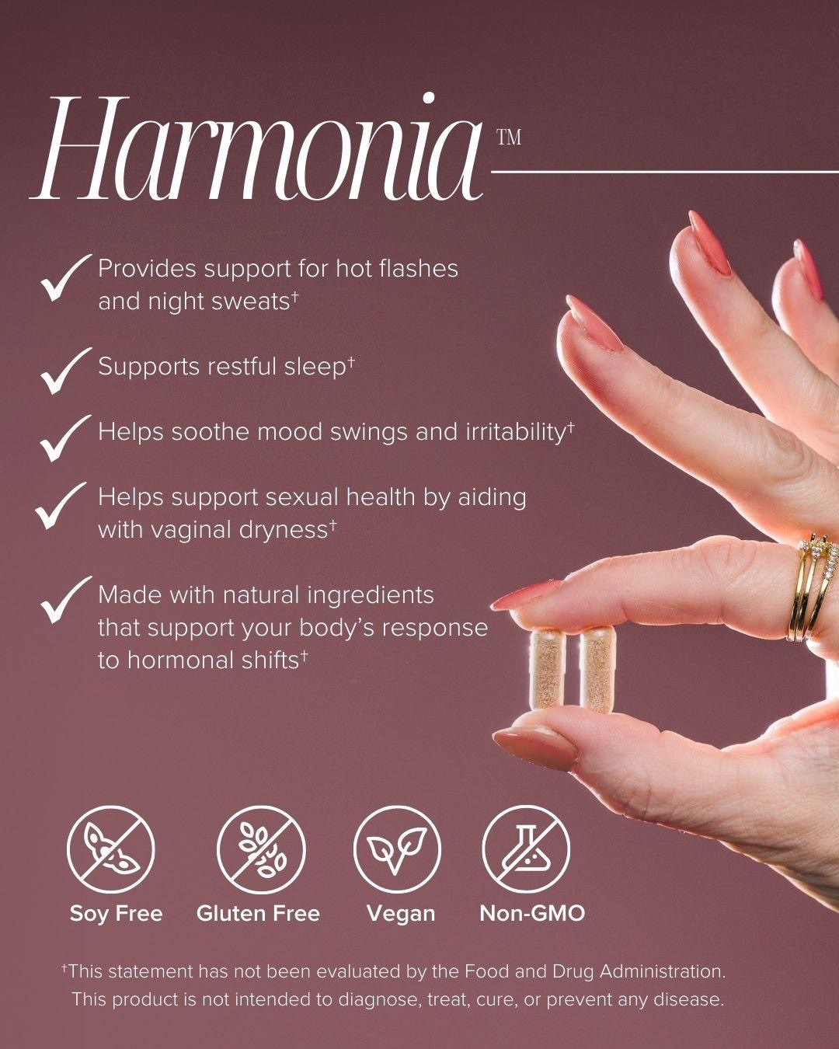
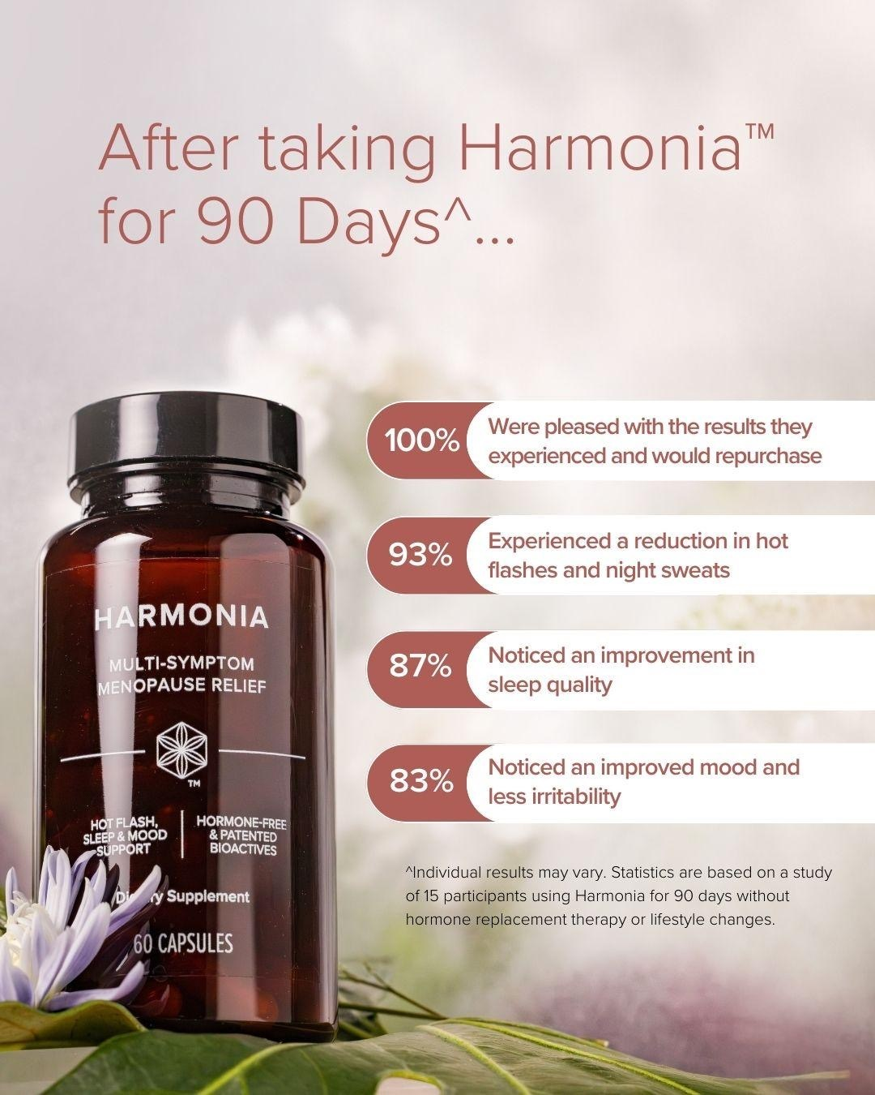
Harmonia
AND WHY?

Slide 29


Slide 30
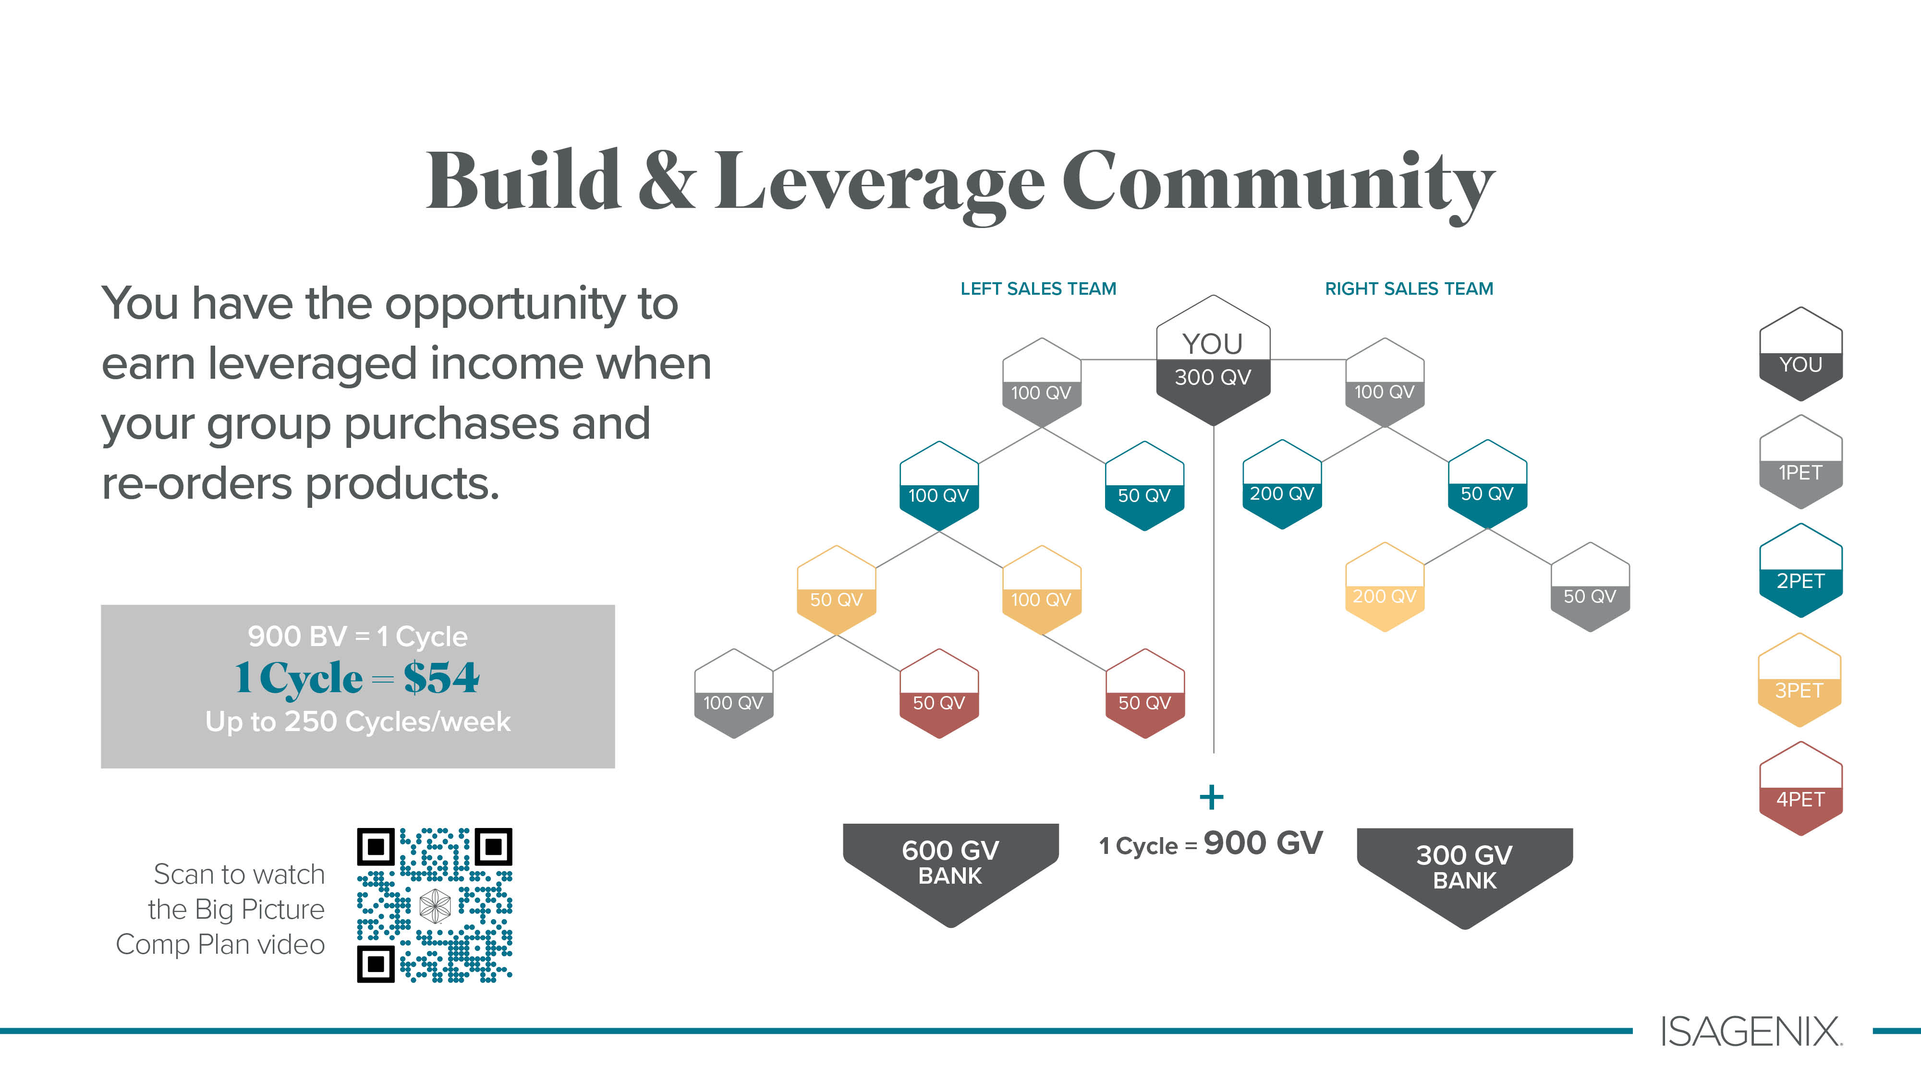
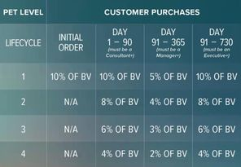
900 BV = 1 Cycle
Up to 250 Cycles/week
1 Cycle = $54
1 Cycle = $54

Slide 31
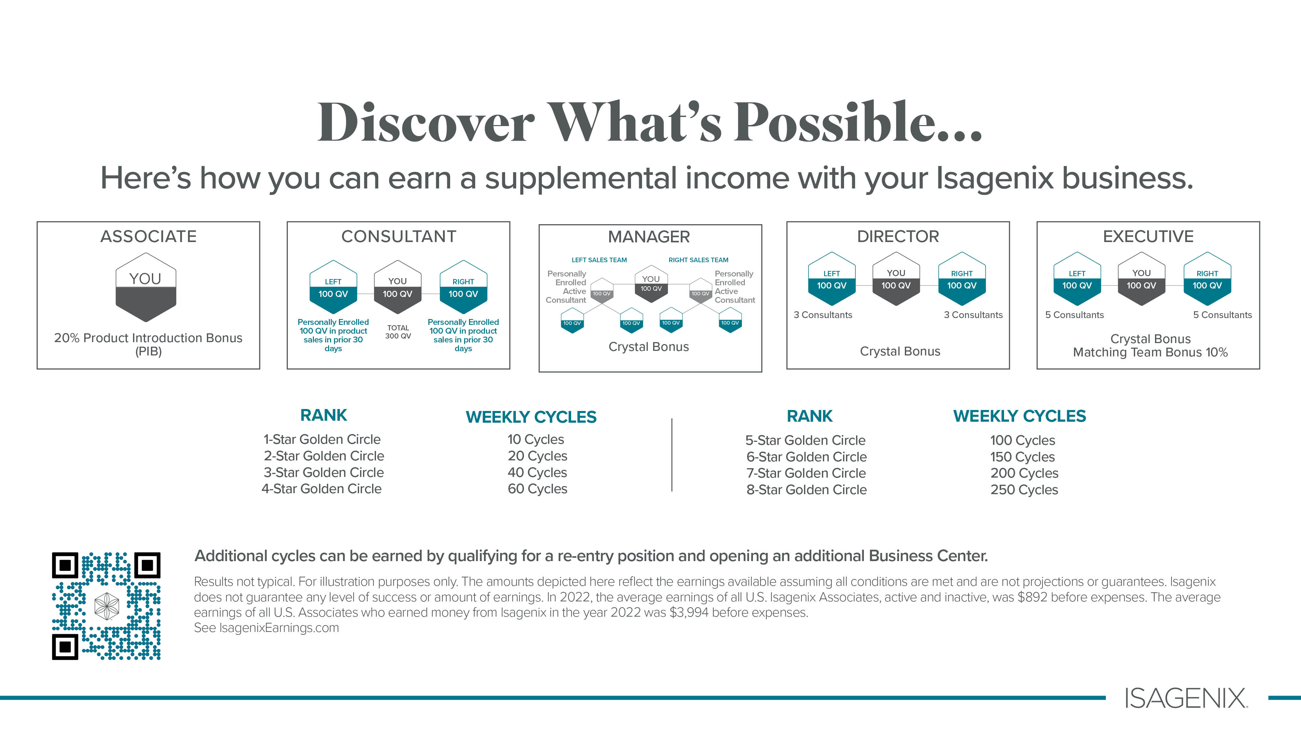
= $540
= $5,400
= $1,080
= $8,100
= $2,160
= $10,800
= $3,240
= $13,500

Slide 32

$29

Slide 33


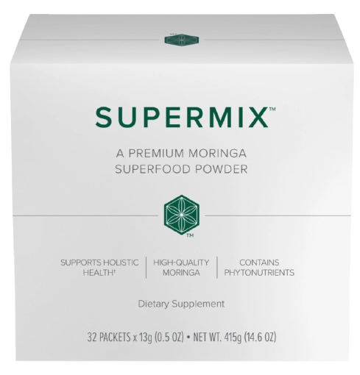



56 MEALS
AND WHY?
1 Supermix
1 Premium Tea
Total $158.00
+ Tax-- 101 BV
1 Supermix
30 Bottles of Collagen
1 Supermix
1 Natural Accelerator
1 Isa Flush
Total $161.00
+ Tax-- 100 BV
Total $253.00
+ Tax—159 BV
All Packages are priced with a subscription.

Slide 34
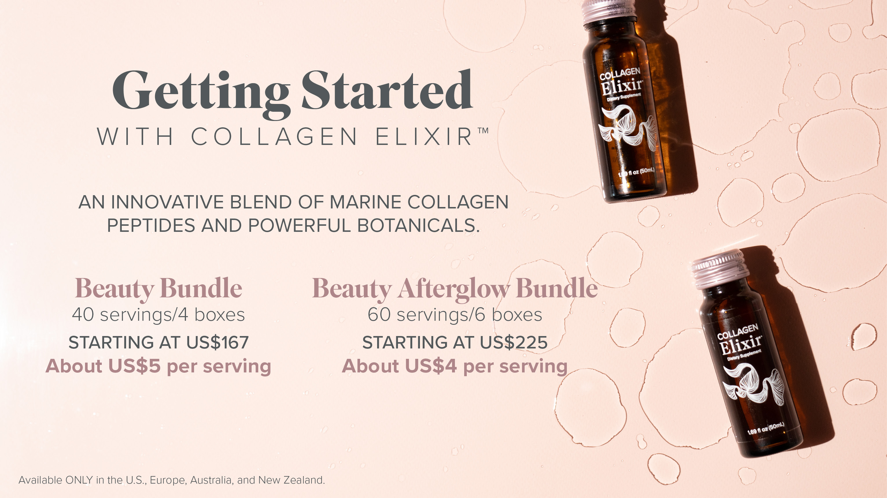
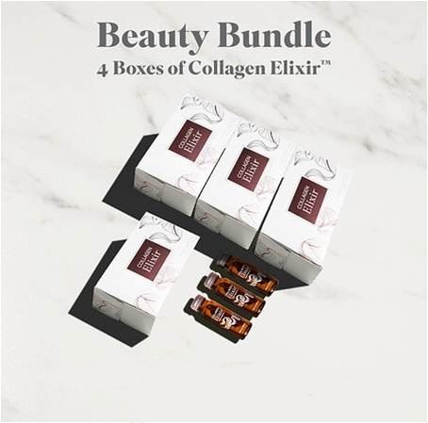


$179.00 BV 110 (with Subscription)
$240.00 BV 157 (with Subscription)

Slide 35





$$
“STAGES OF GROWTH”
AND WHY?
Global Multibillion $
Legacy Wellness Corporation
Revenue - $800 Million
2018
2020
STABILIZED
2024 * NOW
Spent Millions on Rebranding.
Product development & Strengthened
Customer & associate programs.
Hired #1 PHD Harvard Medical Dr. Plant
Hired top I.T. industry Expert
Company Founded
Acquired Zija International
Shakes & Weight loss
2002
Pioneered Intermittent Fasting
& Cleansing

Slide 36




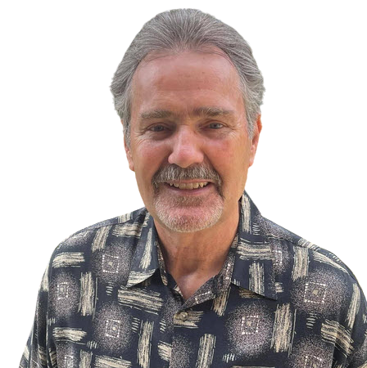





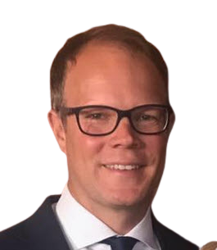

FOUNDERS
Dr. Jerry Brown
Tommy Chapa
Ruth Claybrooks
Tom Waggoner
Rich Miller
THE LEGACY DEVELOPMENT GROUP
We are a collective of top earning individuals
in the direct selling industry, some of which have been together for 30 years.
Founding members have all earned millions, some tens of millions of dollars
and have helped people all over the world with building residual income. It
is important to note that none of these people have ever quit a direct
selling company ever! They have now found themselves in a unique position. United as
one group to build at their final company, Isagenix International. They are going to help people
all over the world build and secure substantial walk away incomes for their family and leave
a LEGACY.
JoAnne McMahon
Mike Chorost
Bob DeCant
Carrie Kimball Chorost
Joel McNinch
Landon Weaver

Slide 37


Slide 38


Slide 39

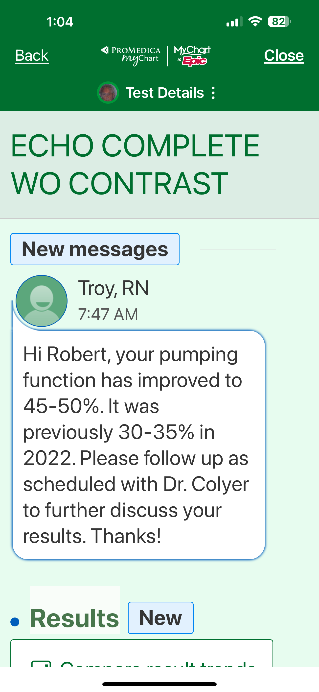

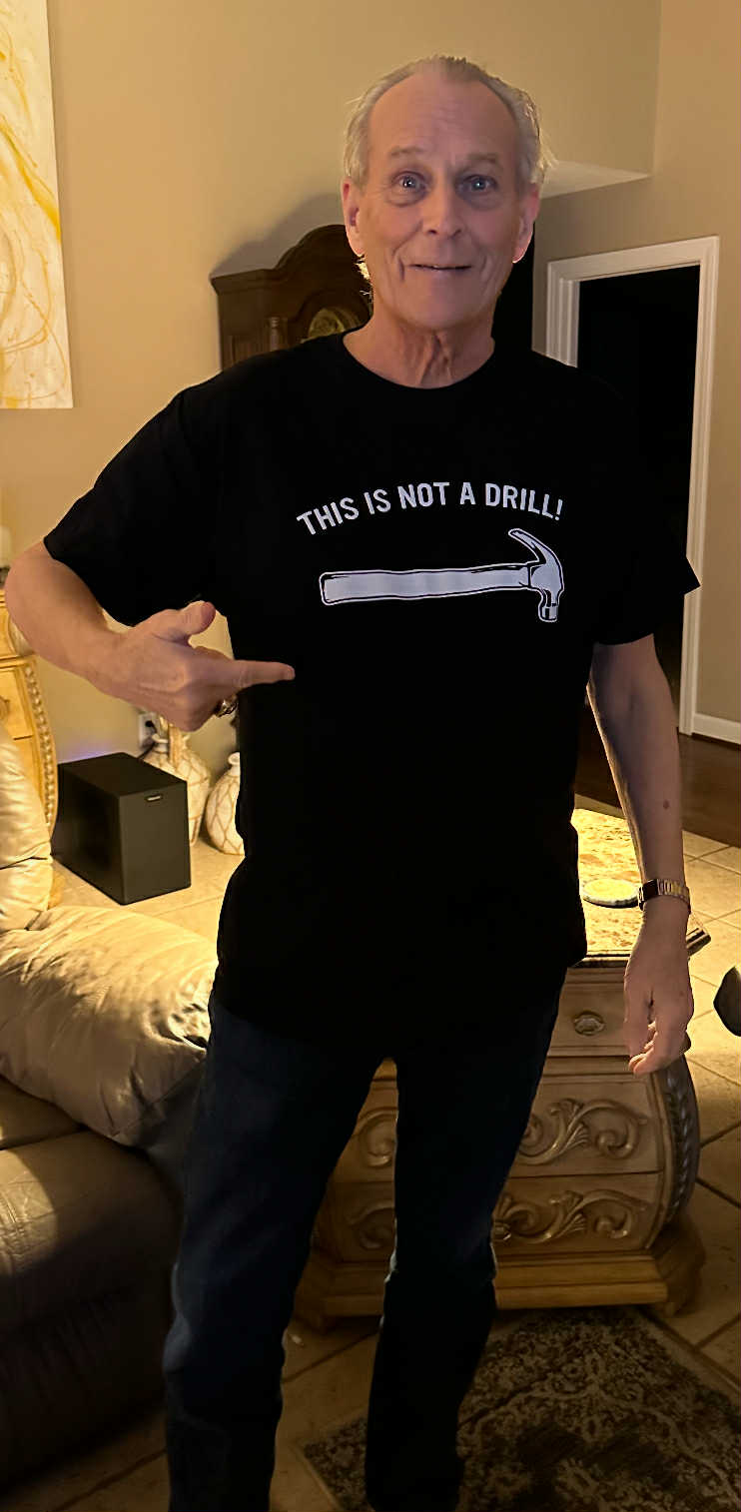
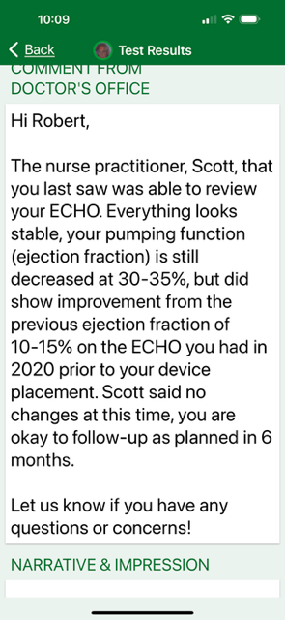
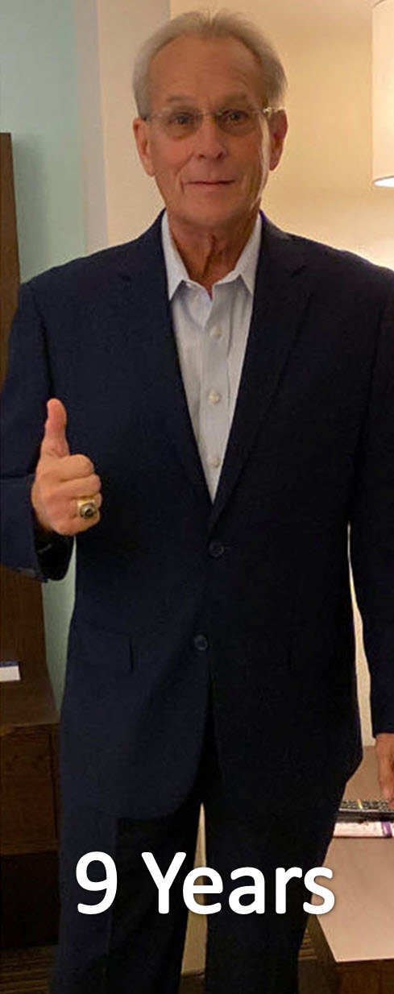
Date 05/05/2022
Date 12/14/2024
6 Months
6 Months
65 lbs
13 Years
95 lbs
12 Years
75 lbs

Slide 40


Slide 41

