Slide 1
Metastatic CRC: Personalizing Patient Care Using Current Evidence and Innovative Therapeutic Strategies
Provided by Clinical Care Options, LLC
Saturday, September 27, 2025
3:10 PM PT
Host Group: Los Angeles, CA
Supported by a grant from Pfizer Inc.

Slide 2
Presenting Faculty
J. Randolf Hecht, MD
Professor of Clinical Medicine
Director, UCLA GI Oncology Program
Carol and Saul Rosenzweig Chair for Cancer Therapies Development
Santa Monica, California
J. Randolf Hecht, MD: consultant/advisor: BeiGene, Hexagon, Parabilis, Revolution Medicine, UroGen, Xilio; steering committee: Mirati; individually publicly traded stock/stock options: Actym, Radical AI, Triumvira; researcher (paid to institution): A2, Affini-T, Ageneus, AstraZeneca, Bold Therapeutics, Camurus, CG Pharmaceuticals, Crinetics, Exelixis, Gilead, Gritstone Oncology, GlaxoSmithKline, IGM Biosciences, Janssen, Mirati, Pfizer, Regeneron, Revolution Medicine, Tizona Therapeutics, Xilio.
Notes:
This slide lists the faculty who were involved in the production of these slides.

Slide 3
Learning Objectives
Identify patients appropriate for treatment with available therapies after progression on first-line treatment for mCRC
Apply treatment strategies for the later-line treatment of mCRC based on clinical trial data, guideline recommendations, and patient- and disease-related factors
Apply guidelines and expert recommendations to identify and manage TRAEs in patients being treated for mCRC
Identify patients with mCRC appropriate for enrollment in ongoing clinical trials investigating novel therapies and immunotherapy-based strategies
Notes:
This slide summarizes the target audience, goal, and learning objectives for this CME activity.

Slide 4
Poll 1: How many people with metastatic CRC do you provide care for in a typical month?
1-4
5-10
11-15
16-20
>20
Not applicable

Slide 5
Poll 2: For those who practice in academic or community settings, please indicate your practice setting:
Academic
Community
Not applicable

Slide 6
Pretest 1: A patient was recently diagnosed with mCRC, including multiple liver lesions and retroperitoneal lymphadenopathy. Their molecular profile is: pMMR/MSS, BRAF V600E mutation, HER2 negative, KRAS wild type. What would be your recommendation for this patient’s treatment?
FOLFOXIRI + bevacizumab
Dabrafenib + trametinib
Dabrafenib + panitumumab
Encorafenib + cetuximab
Encorafenib + cetuximab + FOLFOX
Vemurafenib + bevacizumab + FOLFOXIRI
Notes:
Learning objectives: Identify patients appropriate for treatment with available therapies after progression on first-line treatment for mCRC
Correct answer: Encorafenib + cetuximab + FOLFOX
MLO: 4
Rationale: Encorafenib is currently approved by the FDA in combination with cetuximab and mFOLFOX6 for treating patients with mCRC with a BRAF V600E mutation and is approved in combination with cetuximab for treating patients with mCRC with a BRAF V600E mutation after prior therapy. Targeted therapy with encorafenib + cetuximab with or without chemotherapy has become the preferred strategy for patients with BRAF V600E mutations, and other listed options are not preferred for this patient.

Slide 7
Pretest 2: Based on current guideline recommendations, which of the following patients with mCRC could be considered for adagrasib or sotorasib + an EGFR inhibitor?
Previously untreated, RET fusion
Previously untreated, BRAF mutation
Previous FOLFOXIRI + bevacizumab, KRAS G12C mutation
Previous FOLFIRI + bevacizumab, EGFR mutation
None; these combinations are not recommended for patients with mCRC
Notes:
Learning objectives: Identify patients appropriate for treatment with available therapies after progression on first-line treatment for mCRC; Apply treatment strategies for the later-line treatment of mCRC based on clinical trial data, guideline recommendations, and patient- and disease-related factors
Correct answer: Previous FOLFOXIRI + bevacizumab, KRAS G12C mutation
MLO: 4
Rationale: Adagrasib or sotorasib + an EGFR inhibitor (cetuximab or panitumumab) are currently recommended by national guidelines as second-line or later-line therapy for mCRC with a KRAS G12C mutation.

Slide 8

Poll 3: Please take a moment to text in any questions, challenges, or barriers that you have encountered in your clinical practice when treating patients with mCRC to help guide our discussion.
Scan this QR code to text your response

Slide 9
Frontline Treatment for
Metastatic Colorectal Cancer

Slide 10
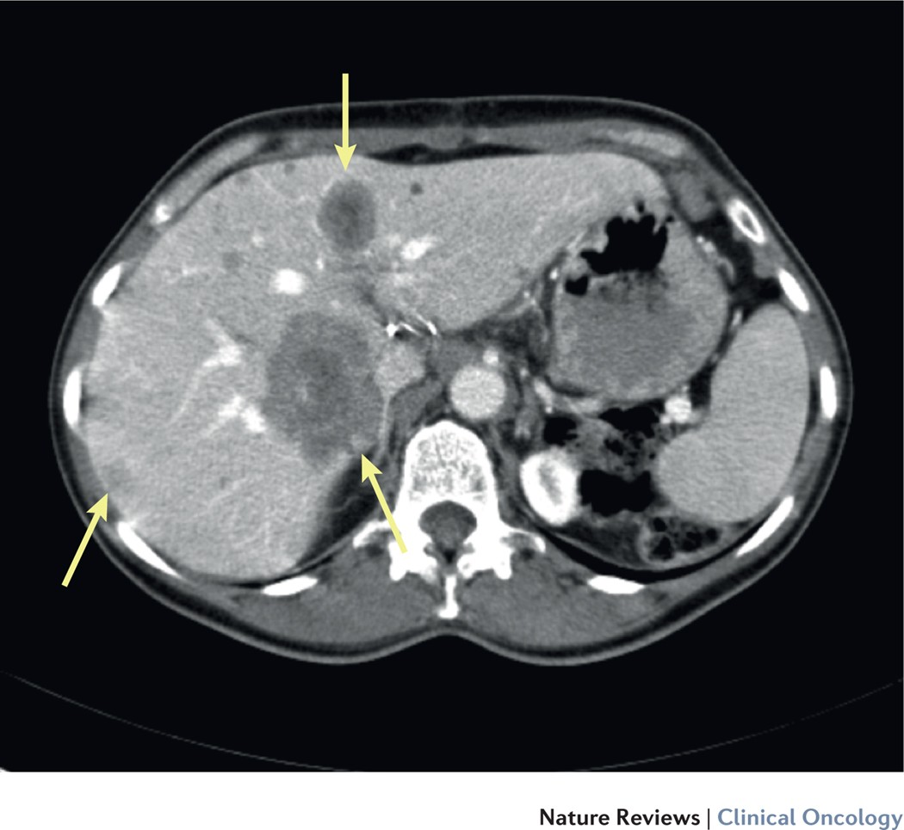
Case Presentation
59-yr-old White female with a PMH of HTN presents to her PCP with complaints of rectal bleeding for 3 mo; first only on toilet tissue but now turning toilet water red
No prior screening colonoscopy
PCP refers to GI, who performs a colonoscopy and finds a friable mass at the splenic flexure that is biopsied and returns as moderately differentiated adenocarcinoma
CT for staging shows multiple liver lesions and retroperitoneal lymphadenopathy

Slide 11
Case Presentation: What About pMMR mCRC?
Pathology sent for NGS and MMR testing
NGS reveals the patient to be KRAS/NRAS/BRAF wild-type
MMR testing shows pMMR
What should be offered for first-line therapy?

Slide 12
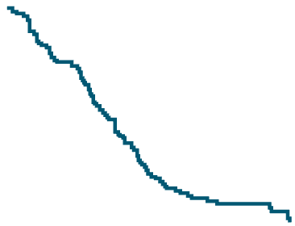
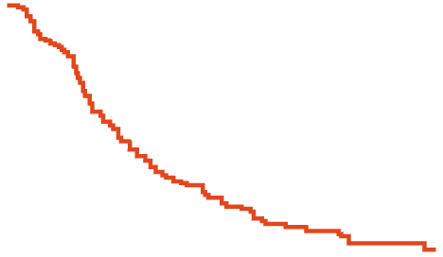
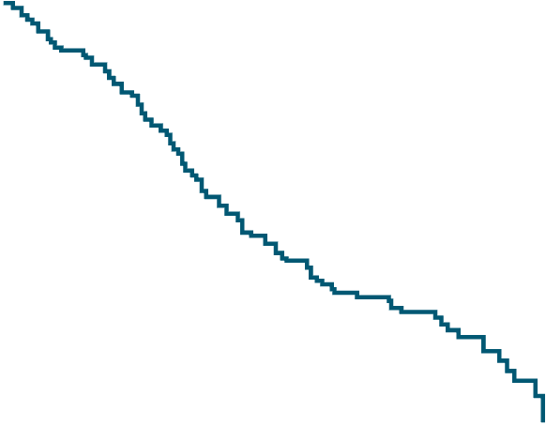
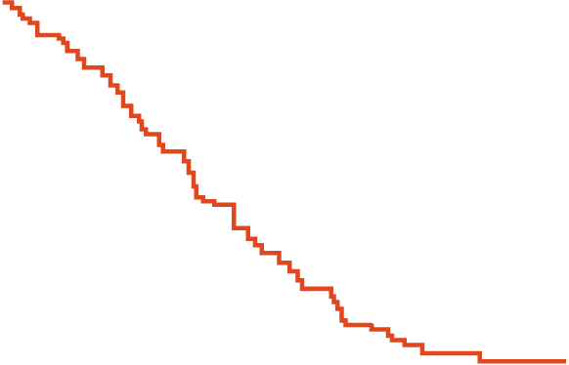
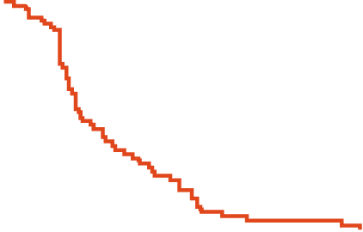

Randomized GERCOR Study: FOLFIRI Followed by FOLFOX6 vs Reverse Sequence in Advanced CRC
PFS
OS
100
80
100
FOLFIRI first line
FOLFOX6 first line
P = .26
60
Probability (%)
80
40
FOLFIRI/FOLFOX6
FOLFOX6/FOLFIRI
P = .99
20
60
0
Probability (%)
0
5
10
15
20
25
30
35
Mo
100
40
80
FOLFOX6 second-line
FOLFIRI second-line
P = .003
20
60
Probability (%)
40
0
20
0
12
24
36
48
60
Mo
0
0
2.5
5.0
7.5
10.0
Mo
Starting with FOLFIRI or FOLFOX6 does not affect survival
Tournigand. JCO. 2004;22:229.
Notes:
FOLFOX then FOLFIRI or visa versa.
FOLFOX and FOLFIRI not compared head to head. N9741 compared FOLFOX4 to IFL and FOLXO4 slightly more efficacious; thus, FOLFOX typically 1st line (1997-2004, granted FDA approval for FOLFOX)

Slide 13
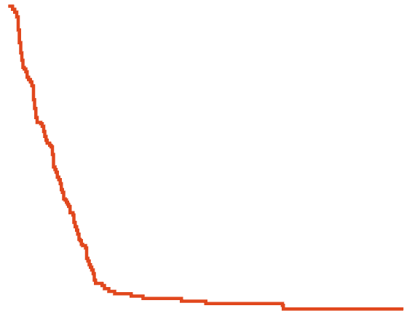
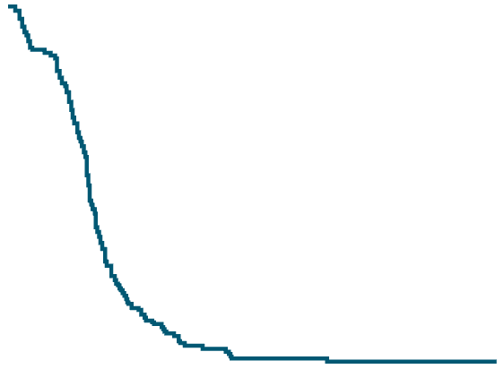
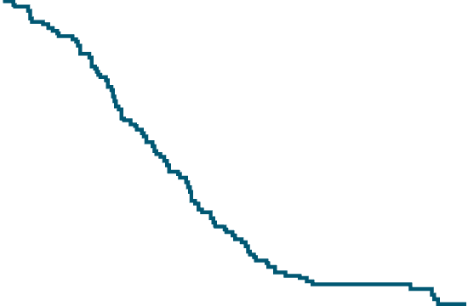
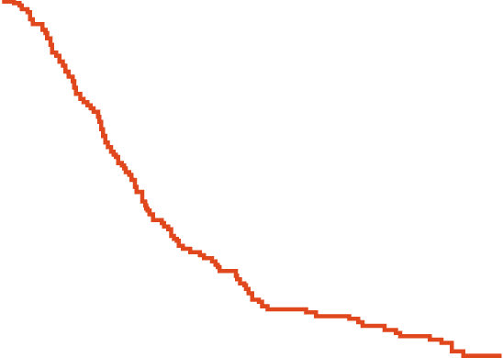
Randomized Trial of FOLFOXIRI vs FOLFIRI in
Metastatic CRC
PFS
OS
100
100
 | FOLFIRI | FOLFOXIRI
Patients, n | 122 | 122
Events, n | 112 | 104
Median OS | 16.7 mo | 23.4 mo
95% Cl | 13.8-19.4 mo | 19.8-25.6 mo
5-yr OS rate | 8% | 15%
95% Cl | 4-14 | 9-23
 | FOLFIRI | FOLFOXIRI
Patients, n | 122 | 122
Events, n | 121 | 115
Median PFS | 6.8 mo | 9.8 mo
95% Cl | 5.5-7.8 mo | 9.4-10.6 mo
5-yr PFS rate | 1% | 5%
95% Cl | 0-3 | 1-8
80
80
60
60
PFS (%)
OS (%)
40
HR: 0.59 (95% Cl: 0.45-0.76;
log-rank P <.001)
40
HR: 0.74 (95% Cl: 0.56-0.96;
log-rank P = .026)
20
20
0
0
Patients at risk, n
PFS rate (95% Cl)
0
12
24
36
48
60
Patients at risk, n
OS rate (95% Cl)
0
12
24
36
48
60
Mo
Mo
FOLFOXIRI
122
100%
39
31%
(23-39%)
12
9%
(5-13%)
7
9%
(5-13%)
5
5%
(1-8%)
3
5%
(1-8%)
FOLFOXIRI
122
100%
99
80%
(72-86%)
59
48%
(39-57%)
29
24%
(17-32%)
22
21%
(13-29%)
10
15%
(9-23%)
FOLFIRI
122
100%
23
16%
(10-23%)
6
4%
(2-8%)
4
2%
(0-6%)
2
1%
(0-3%)
2
1%
(0-3%)
FOLFIRI
122
100%
82
67%
(58-74%)
43
34%
(26-43%)
26
20%
(14-28%)
16
14%
(8-20%)
7
8%
(4-14%)
FOLFOXIRI resulted in longer PFS and OS vs FOLFIRI
Masi. J Natl Cancer Inst. 2011;103:21.
Notes:
244 patients/ FOLFOXIRI v FOLFIRI.
Improved mPFS, mOS, 5-yr survival (absolute 7% benefit), improved resectability

Slide 14

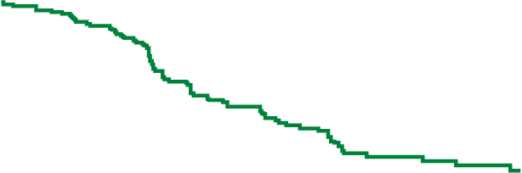


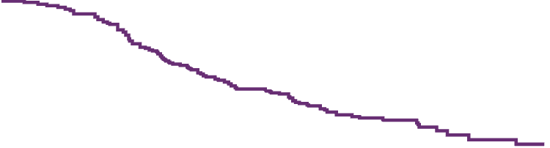
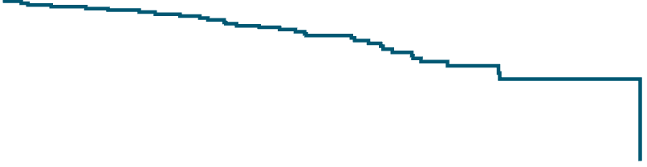
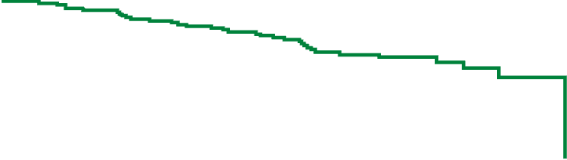
STEAM: Phase II Study of Concurrent or Sequential FOLFOXIRI-BEV vs FOLFOX-BEV as 1L Therapy
ORR: 72% vs 73% vs 62% (cFOLFOXIRI-BEV vs sFOLFOXIRI-BEV vs FOLFOX-BEV)
Liver resection rates: 17.2% vs 9.8% vs 8.4%
cFOLFOXIRI-BEV
sFOLFOXIRI-BEV
FOLFOX-BEV
Pooled FOLFOXIRI-BEV
PFS
100
100
OS
80
80
60
60
40
40
PFS (%)
OS (%)
20
20
0
0
0
3
6
9
12
15
18
21
24
27
30
33
0
3
6
9
12
15
18
21
24
27
30
33
36
Mo
Mo
Outcome | cFOLFOXIRI-BEV (n = 93) | sFOLFOXIRI-BEV (n = 92) | Pooled FOLFOXIRI-BEV (n = 185) | FOLFOX-BEV (n = 95)
Median PFS, mo (90% CI) | 11.9 (10.0-16.6) | 11.4 (9.2-13.3) | 11.7 (10.4-13.3) | 9.5 (8.1-11.2)
Stratified HR vs FOLFOX-BEV (90% CI) | 0.7 (0.5-0.9) P <.01 | 0.7 (0.5-1.0) P = .03 | 0.7 (0.5-0.9) P <.01 | --
Outcome | cFOLFOXIRI-BEV (n = 93) | sFOLFOXIRI-BEV (n = 92) | FOLFOX-BEV (n = 95)
Median OS, mo (90% CI) | 34.0 (23.7-40.0) | 28.3 (22.2-NE) | 30.7 (25.2-30.7)
Stratified HR vs FOLFOX-BEV (90% CI) | 0.8 (0.5-1.2) P = .20 | 1.0 (0.7-1.5) P = .49 | --
Hurwitz. Oncologist. 2018;24:921.
Notes:
BEV, bevacizumab.

Slide 15
CALGB/SWOG 80405 (FOLFIRI/FOLFOX + Bev or Cetuximab): OS by Tumor Location (RAS WT)
100
 | OS (95% CI), Mo |  | HR (95% CI) | P Value
 | Left | Right
Cetuximab (n = 173 vs 71) | 39.3 (32.9-42.9) | 13.7 (11.3-19.0) | 0.55 (0.39-0.79) | .001
80
Bevacizumab (n = 152 vs 78) | 32.6 (28.3-36.2) | 29.2 (22.4-36.9) | 0.88 (0.62-1.25) | .50
Event Free (%)
60
40
20
0
0
12
24
36
48
60
72
84
96
108
Mo From Study Entry
Venook. ESMO 2016. Abstr 3504.

Slide 16
Role of Maintenance Strategy in mCRC
Patients with mCRC: no benefit to continuing full induction regimen until progression without either observation or maintenance
A maintenance strategy with a fluoropyrimidine ± bevacizumab is preferred
However, given the lack of a clear OS benefit, shared decision-making should include observation as an acceptable alternative
Sonbol. JAMA Oncol. 2019;6:e194489.
Notes:
The role of maintenance strategy in mCRC: A systematic review and meta-analysis

Slide 17
Case Presentation
59-yr-old White female with a PMH of HTN presents to her PCP with complaints of rectal bleeding for 3 mo; first only on toilet tissue but now turning toilet water red
No prior screening colonoscopy
PCP refers to GI, who performs a colonoscopy and finds a friable mass at the splenic flexure that is biopsied and returns as moderately differentiated adenocarcinoma
CT for staging shows multiple liver lesions and retroperitoneal lymphadenopathy

Slide 18
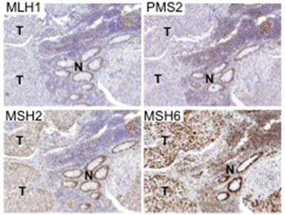
Case Presentation
Pathology sent for NGS and MMR testing
NGS reveals the patient to be KRAS/NRAS/BRAF wild-type
MMR testing shows the IHC findings shown on right
Image provided courtesy of Dr. Nilofer Azad.

Slide 19
Poll 4: In your current practice, what would be your recommendation for this patient’s treatment?
FOLFOXIRI + bevacizumab
Pembrolizumab or nivolumab monotherapy
Nivolumab + ipilimumab
Pembrolizumab + FOLFOX
Encorafenib + cetuximab + FOLFOX

Slide 20
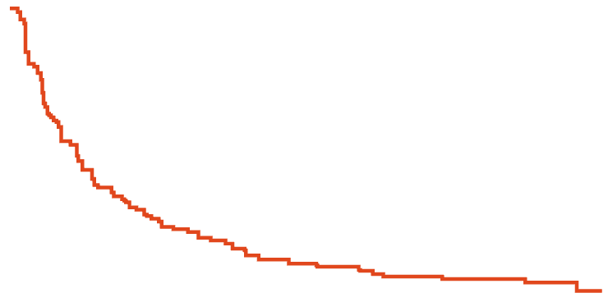
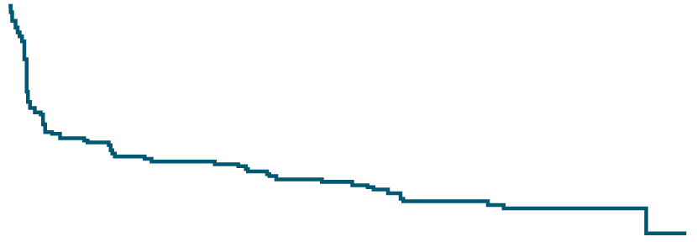
Phase III RCTs of Immunotherapy vs Chemotherapy as First-line Therapy for dMMR/MSI-H mCRC
KEYNOTE-177
CheckMate 8HW
 | Median PFS, Mo (95% CI)
Nivo + Ipi | 54.1 (54.1-NE)
CT | 5.9 (4.4-7.8)
 | Median PFS, Mo (95% CI)
Pembro | 16.5 (5.4-38.1)
CT | 8.2 (6.2-10.3)
100
100
36-mo rate
12-mo rate
80
60-mo rate
80
24-mo rate
36-mo rate
79%
60
60
74%
69%
PFS (%)
PFS (%)
42.7%
34%
40
40
22%
20
13.4%
20
11%
11%
7.6%
HR: 0.60 (95% CI: 0.45-0.79)
0
HR: 0.21 (95% CI: 0.14-0.31)
0
0
4
8
12
16
20
24
28
32
36
40
44
48
52
56
60
64
68
72
76
80
84
0
3
6
9
12
15
18
21
24
27
30
35
36
39
42
45
48
51
54
57
Mo
Andre. Ann Oncol. 2025;36:277. Andre. Lancet. 2025;405:383. Lenz. ASCO 2025. Abstr 3501.

Slide 21
CheckMate 8HW: Nivolumab + Ipilimumab vs Nivolumab for MSI-H or dMMR mCRC
Randomized phase III study of nivolumab + ipilimumab vs nivolumab for MSI-H or dMMR mCRC with or without prior treatment (no prior immunotherapy)
Patients With Centrally Confirmed MSI-H/ dMMR, % | Nivo + Ipi (n = 296) | Nivo (n = 286)
ORR* (95% CI) | 71 (65-76) | 58 (52-64)
Difference in ORR (95% CI) | 13 (5-21)
P value‡ | .0011
Best overall response*
CR | 30 | 28
PR | 40 | 30
SD | 14 | 19
PD | 10 | 19
PFS, Patients With Centrally Confirmed MSI-H/dMMR
100
12-mo rate
24-mo rate
36-mo rate
80
76%
71%
67%
60
62%
PFS (%)
55%
51%
40
Median PFS, mo
NR
39.3
20
HR: 0.62 (95% CI: 0.48-0.81); P = .0003
Median follow-up: 47.0 mo (range: 16.7-60.5 mo)
Nivo + Ipi (n = 296)
Nivo (n = 286)
0
0
3
6
9
12
15
18
21
24
27
30
33
36
39
42
45
48
51
54
57
60
Mo
mPFS benefit for Nivo + Ipi vs Nivo across all randomized patients: 54.1 vs 18.4 mo (HR: 0.64; 95% CI: 0.52-0.79)
18% of patients not MSI-H confirmed
Andre. Lancet. 2025;405:383. Lenz. ASCO 2025. Abstr 3501.

Slide 22
CheckMate 142: OS
Cohort 1
2L+ Nivo*
(n = 74)
44.2
20.9-75.1
Cohort 2
2L+ Nivo + Ipi*
(n = 119)
NR
NE
Cohort 3
1L Nivo + Ipi*
(n = 45)
NR
NE
100
Median OS, mo
95% CI
80
1L Nivo + Ipi
72%
NA†
60
71%
68%
2L+ Nivo + Ipi
OS (%)
40
49%
2L+ Nivo
46%
20
5-yr follow-up
0
0
6
12
18
24
30
36
42
48
54
60
66
72
78
84
90
Mo
*Cohorts not randomized, nor was trial designed for formal comparison. †Median follow-up for cohort 3: 47.6 mo.
Overman. ASCO 2022. Abstr 3510.

Slide 23
General Recommendations for Treatment of irAEs
Managed in outpatient/
community setting
Generally, requires
hospital admission
Steroids (PO/IV): 0.5-2 mg/kg/day prednisone or equivalent; slow taper over 4-6 wk
For some irAEs, ICI can be restarted after resolution (eg, rash)
Referral to specialist
Strong immunosuppressive tx
Oral steroids
IV steroids
Increasing intensity of treatment required
Stop treatment
Symptomatic and supportive care
Grade 1
Grade 2
Grade 3
Grade 4
Mild
Moderate
Severe
Very severe
Haanen. Ann Oncol. 2022;33:1217. NCCN. Clinical practice guidelines in oncology:
management of immunotherapy-related toxicities. v.1.2025. nccn.org.

Slide 24
Management of Immune-Related Hepatobiliary Toxicities: AST/ALT Elevations
HCPs should consider differential diagnosis for viral etiology, disease-related hepatic dysfunction, and other causes of drug-induced liver injury; consider CK, aldolase, and ferritin to rule out other cases of elevated ALT/AST, as well as abdominal ultrasound
Management Strategies By Grade
Grade 1 (<3x ULN) | Grade 2 (3-5x ULN) | Grade 3 (>5-20x ULN) | Grade 4 (>20x ULN)
Consider withholding ICI Perform liver testing with greater frequency | Withhold ICI Consider prednisone 0.5-1 mg/kg/day Perform liver testing Q3-5 days Monitor PT/INR regularly | Withhold ICI Perform liver testing Q1-5 days depending on grade and magnitude and rate of change | Discontinue ICI Perform liver testing Q1-3 days
 |  | Start prednisone/IV methylprednisolone 1 mg/kg/day Consider mycophenolate mofetil or other steroid-sparing immunosuppressant if no improvement after 1-2 days Urgent referral to GI/hepatology if no improvement after 7 days or if 2 immunosuppressants not sufficient within additional 7 days Consider inpatient tx especially if synthetic hepatic dysfunction present Monitor PT/INR regularly Consider diagnostic parenchymal liver biopsy if no contraindications
Infliximab not generally recommended for marked transaminase elevations due to rare potential for immune‐mediated hepatitis.
NCCN. Clinical practice guidelines in oncology: management of immunotherapy-related toxicities. v.1.2025. nccn.org.
Infliximab PI. Reynolds. Oncologist. 2018;23:991.

Slide 25
Case Presentation: What About BRAF V600E–Mutated mCRC?
Pathology sent for NGS and MMR testing
NGS reveals the patient to be KRAS/NRAS wild-type
MMR testing shows pMMR with a BRAF V600E mutation
What should be offered for first-line therapy?

Slide 26
Molecular Alterations in mCRC
RAS mutation ±
PIK3CA/PTEN mutation
PIK3CA/PTEN
mutation
45%
8%
1%
2%
1%
26%
2%
Gene fusion
8%
MET amp
2%
HER2 amp
2%
POLE amp
2%
MSI + other
MSI
Wild-type
BRAF non-V600
BRAF V600E
Dienstmann. Am Soc Clin Oncol Educ Book. 2018;38:231.

Slide 27
Considerations for BRAF V600E–Mutated mCRC
BRAF V600E mutations are present in 8%-12% of mCRC cases^{1,2}
  First-line chemotherapy ± biologic agent is less effective for these patients³
Encorafenib + cetuximab: FDA approved for patients with mCRC and BRAF V600E mutation after prior therapy based on BEACON study⁴
  Median OS: 8.4 mo vs 5.4 mo with cetuximab + irinotecan or FOLFIRI (HR: 0.60; 95% CI: 0.45-0.79; P <.001)
Encorafenib + cetuximab + mFOLFOX6: accelerated FDA approval for patients with mCRC and BRAF V600E mutation
  BREAKWATER: phase III study evaluating the combination of encorafenib + cetuximab ± chemotherapy vs SoC in previously untreated BRAF V600E–mutant mCRC^{5,6}
1. Tabernero. Am Soc Clin Oncol Educ Book. 2022;42:1. 2. Tran. Cancer. 2011;117:4623.
3. Cohen. J Natl Cancer Inst. 2021;113:1386. 4. Kopetz. NEJM. 2019;381:1632. 5. Kopetz. ASCO GI 2025. Abstr 16.
6. Kopetz. Nat Med. 2025;[Epub].

Slide 28
BREAKWATER: First-line Encorafenib + Cetuximab + Chemotherapy vs SoC for BRAF V600E–Mutant mCRC
International, open-label, randomized phase III trial
Stratified by region (US/Canada vs Europe vs ROW) and ECOG PS (0 vs 1)
Encorafenib + Cetuximab*†
(n = 158)
Patients aged ≥16 yr (or ≥18 yr depending on country) with BRAF V600E–mutant mCRC; no prior systemic tx for metastatic disease; ECOG PS 0/1
(N = 637)
Encorafenib + Cetuximab* + mFOLFOX-6‡ ​
(n = 236)
SoC§
(n = 243)
*Encorafenib 300 mg PO QD + cetuximab 500 mg/m² IV Q2W. †After a protocol amendment, enrollment to the EC arm was halted, and patients were randomized 1:1 to either the EC + mFOLFOX-6 or SoC arm. ‡Oxaliplatin 85 mg/m² IV Q2W + leucovorin 400 mg/m² IV Q2W + 5-FU 400 mg/m² IV bolus, then 2400 mg/m² continuous IV over
46-48 hr Q2W. §Oxaliplatin 85 mg/m² IV + leucovorin 400 mg/m² IV + 5-FU 400 mg/m² IV bolus, then 2400 mg/m² continuous IV over 46-48 hr OR irinotecan 165 mg/m²
IV + oxaliplatin 85 mg/m² IV + leucovorin 400 mg/m² IV + 5-FU 2400 or 3200 mg/m² continuous IV over 46-48 hr Q2W OR oxaliplatin 130 mg/m² Q3W + capecitabine
1000 mg/m² PO BID on Days 1-14; bevacizumab was optional in all 3 regimens.
Coprimary endpoints: ORR by BICR, PFS
Key secondary endpoints: OS, safety
Kopetz. ASCO GI 2025. Abstr 16. Kopetz. Nat Med. 2025;31:901. Elez. ASCO 2025. Abstr LBA3500.

Slide 29


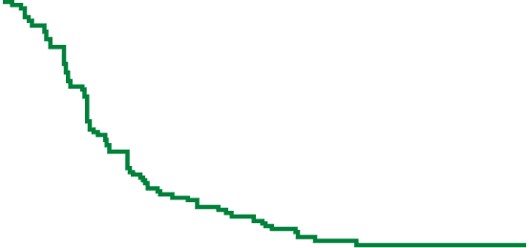
BREAKWATER: ORR With Chemotherapy + Anti-BRAF Strategy
Confirmed ORR by BICR
(95% Cl)
PFS by BICR (All Arms)
100
CR
PR
65.7%
(59.4-71.4)
 | Median PFS, Mo (95% CI)
EC+mFOLFOX6 | 12.8 (11.2-15.9)
EC | 6.8 (5.7-8.3)
SoC | 7.1 (6.8-8.5)
80
100
45.6%
(38.0-53.5)
37.4%
(31.6-43.7)
80
60
Patients (%)
60
40
Probability of PFS (%)
40
EC+mFOLFOX6
20
20
SoC
0
EC
EC
EC +
mFOLFOX6
SoC
0
0
6
12
18
24
30
36
42
No at risk
EC
EC+mFOLFOX
SoC
Mo
Data cutoff: January 6, 2025
Non-CR/PD: 7 (4.4%), 5 (2.1%), and 9 (3.7%), respectively; not evaluable: 10 (6.3%)
158
236
243
60
156
100
24
96
34
12
39
11
6
16
3
3
4
1
0
1
0
Confirmed Best Overall Response, n (%) | EC (n = 158) | EC + mFOLFOX6 (n = 236) | SoC (n = 243)
CR | 3 (1.9) | 11 (4.7) | 8 (3.3)
PR | 69 (43.7) | 144 (61.0) | 83 (34.2)
SD | 57 (36.1) | 8 (3.4) | 21 (8.6)
PD | 12 (7.6) | 8 (3.4) | 21 (8.6)
Event, n (%) | EC (n = 158) | EC + mFOLFOX6 (n = 236) | SoC (n = 243)
Patients with DoR of ≥6 mo | 29 (40.3) | 110 (71.0) | 38 (41.8)
Patients with DoR of ≥12 mo | 15 20.8 | 54 (34.8) | 16 (17.6)
Elez. ASCO 2025. Abstr LBA3500.

Slide 30
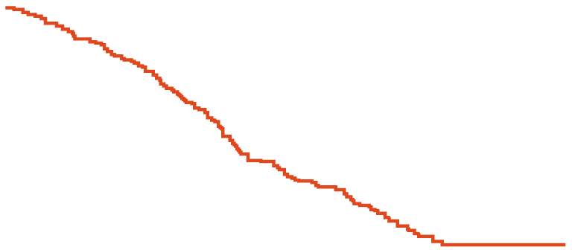
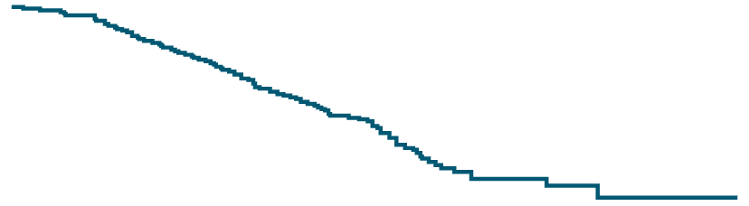
BREAKWATER: Interim OS With Chemotherapy +
Anti-BRAF Strategy
100
80
EC + mFOLFOX6 (n = 236)
SoC (n = 243)
60
OS (%)
HR: 0.49 (95% CI: 0.375-0.632)
P <.0001*
40
mOS: 15.1 mo
(95% CI: 13.7-17.7)
20
mOS: 30.3 mo
(95% CI: 21.7-NE)
0
0
6
12
18
24
30
36
42
Patients at risk, n
EC+FOLFOX6
SoC
Mo
236
243
216
202
182
147
121
64
48
27
17
9
2
0
0
0
Data cutoff: January 6, 2025. *Exceeding the threshold for statistical significance in this interim analysis.
Elez. ASCO 2025. Abstr LBA3500.

Slide 31
BREAKWATER: Most Frequent All-Causality TEAEs
EC + mFOLFOX6
SoC
EC
Grade 1/2
Grade 3/4
Grade 1/2
Grade 3/4
Grade 1/2 | Grade 3/4
19% | 1%
14% | 7%
17% | 1%
16% | <1%
13% | 1%
<1% | <1%
34% | <1%
17% | <1%
18% | <1%
16% | 1%
14% | <1%
2% | 0%
1% | 0
20% | 1%
Nausea
Anemia
Diarrhea
Decreased appetite
Vomiting
Neutrophil count decrease
Arthralgia
Rash
Asthenia
Pyrexia
Constipation
Peripheral sensory neuropathy
Neuropathy peripheral
Fatigue
3%
51%
46%
4%
15%
31%
21%
4%
1%
41%
46%
5%
2%
35%
26%
1%
4%
32%
20%
2%
19%
15%
12%
17%
3%
29%
5%
<1%
1%
29%
4%
5%
24%
14%
1%
2%
27%
15%
<1%
<1%
27%
22%
<1%
7%
20%
20%
4%
7%
19%
20%
4%
3%
24%
24%
4%
100
75
50
25
0
25
50
75
100
Data cutoff: January 6, 2025.
Frequency is based on the EC + mFOLFOX6 arm.
Patients (%)
Kopetz. Nat Med. 2025;31:901. Kopetz. ASCO GI 2025. Abstr 16.
Notes:
EC, encorafenib/cetuximab; mFOLFOX-6, modified fluorouracil/leucovorin/oxaliplatin; SoC, standard of care; TEAE, treatment-emergent adverse event.

Slide 32
Considerations for Initial Therapy of mCRC
MSS/pMMR
MSS/pMMR, Left-Sided, KRAS/NRAS/BRAF WT
MSS/pMMR, BRAF V600E Mutation Positive
MSI-H/dMMR
Patients Appropriate for Intensive Therapy
CT ± bevacizumab
CT: FOLFOX, FOLFIRI, CAPEOX, or FOLFOXIRI
CT ± Cetuximab or
CT ± Panitumumab
CT: FOLFOX, FOLFIRI, or CAPEOX
Encorafenib + cetuximab
+ FOLFOX or
Encorafenib + panitumumab + FOLFOX
Nivolumab ± ipilimumab, pembrolizumab, dostarlimab, cemiplimab, retifanlimab, toripalimab, or
tislelizumab
Patients Not Appropriate for Intensive Therapy
MSS/pMMR, HER2-amplified, RAS/BRAF WT
5-fluorouracil ±
leucovorin ± bevacizumab or
Capecitabine ± bevacizumab
Cetuximab or
Panitumumab
Pembrolizumab, dostarlimab, cemiplimab, retifanlimab, toripalimab, or tislelizumab
Trastuzumab + either pertuzumab, lapatinib or tucatinib
NCCN. Colon cancer. V3.2025. NCCN. Rectal cancer. V2.2025.

Slide 33
Posttest 1: A patient was recently diagnosed with mCRC, including multiple liver lesions and retroperitoneal lymphadenopathy. Their molecular profile is: pMMR/MSS, BRAF V600E mutation, HER2 negative, KRAS wild type. What would be your recommendation for this patient’s treatment?
FOLFOXIRI + bevacizumab
Dabrafenib + trametinib
Dabrafenib + panitumumab
Encorafenib + cetuximab
Encorafenib + cetuximab + FOLFOX
Vemurafenib + bevacizumab + FOLFOXIRI
Notes:
Learning objectives: Identify patients appropriate for treatment with available therapies after progression on first-line treatment for mCRC
Correct answer: Encorafenib + cetuximab + FOLFOX
MLO: 4
Rationale: Encorafenib is currently approved by the FDA in combination with cetuximab and mFOLFOX6 for treating patients with mCRC with a BRAF V600E mutation and is approved in combination with cetuximab for treating patients with mCRC with a BRAF V600E mutation after prior therapy. Targeted therapy with encorafenib + cetuximab with or without chemotherapy has become the preferred strategy for patients with BRAF V600E mutations, and other listed options are not preferred for this patient.

Slide 34
Posttest 1: A patient was recently diagnosed with mCRC, including multiple liver lesions and retroperitoneal lymphadenopathy. Their molecular profile is: pMMR/MSS, BRAF V600E mutation, HER2 negative, KRAS wild type. What would be your recommendation for this patient’s treatment?
RATIONALE
Encorafenib is currently approved by the FDA in combination with cetuximab and mFOLFOX6 for treating patients with mCRC with a BRAF V600E mutation and is approved in combination with cetuximab for treating patients with mCRC with a BRAF V600E mutation after prior therapy. Targeted therapy with encorafenib + cetuximab with or without chemotherapy has become the preferred strategy for patients with BRAF V600E mutations, and other listed options are not preferred for this patient.
FOLFOXIRI + bevacizumab
Dabrafenib + trametinib
Dabrafenib + panitumumab
Encorafenib + cetuximab
Encorafenib + cetuximab + FOLFOX
Vemurafenib + bevacizumab + FOLFOXIRI
Notes:
Learning objectives: Identify patients appropriate for treatment with available therapies after progression on first-line treatment for mCRC
Correct answer: Encorafenib + cetuximab + FOLFOX
MLO: 4
Rationale: Encorafenib is currently approved by the FDA in combination with cetuximab and mFOLFOX6 for treating patients with mCRC with a BRAF V600E mutation and is approved in combination with cetuximab for treating patients with mCRC with a BRAF V600E mutation after prior therapy. Targeted therapy with encorafenib + cetuximab with or without chemotherapy has become the preferred strategy for patients with BRAF V600E mutations, and other listed options are not preferred for this patient.

Slide 35
Treatment for Metastatic Colorectal Cancer
After Disease Progression

Slide 36
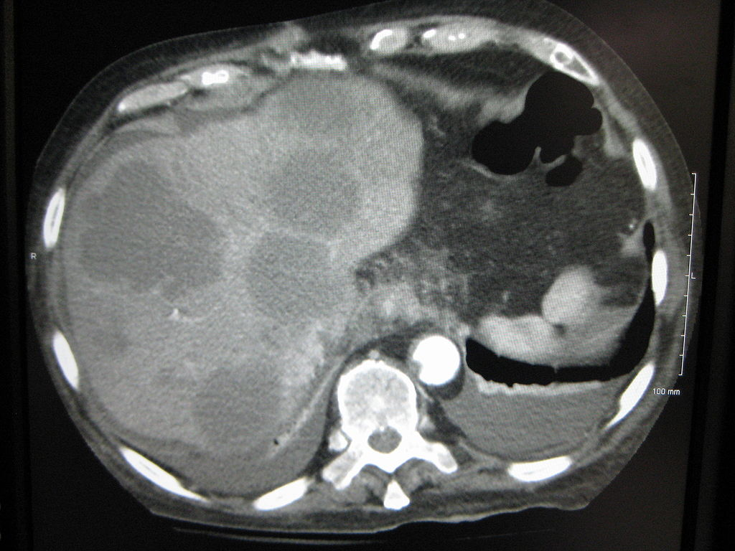
Case Presentation: What are Options at Progression?
For our patient who is KRAS/BRAF/NRAS WT:
  After 6 mo of FOLFOXIRI + bevacizumab followed by 4 mo of maintenance, the patient has progressive disease
What are options for next-line therapy?
What considerations should be taken into account when choosing next-line therapy?

Slide 37
Poll 5: In your current practice, what would be your recommendation for this patient’s treatment?
Fruquintinib
Regorafenib
TAS-102
Encorafenib + cetuximab ± FOLFOX
Pembrolizumab

Slide 38
Considerations for Second and Subsequent Lines of Therapy of mCRC
Non–biomarker directed therapy
Previous irinotecan and oxaliplatin
Previous oxaliplatin
Previous irinotecan
No previous irinotecan or oxaliplatin
(After all available regimens)
Fruquintinib
Regorafenib
Trifluridine + tipiracil ± bevacizumab
FOLFIRI or irinotecan ± bevacizumab, aflibercept or ramucirumab
FOLFOX or CAPEOX ± bevacizumab
FOLFOX or CAPEOX ± bevacizumab
FOLFIRI or irinotecan ± bevacizumab, aflibercept or ramucirumab
Irinotecan + oxaliplatin ± bevacizumab
FOLFIRINOX ± bevacizumab
If KRAS/NRAS/BRAF WT
Cetuximab or panitumumab ± irinotecan
FOLFIRI + cetuximab or panitumumab
Cetuximab or panitumumab ± irinotecan
FOLFOX or CAPEOX + cetuximab or panitumumab
Cetuximab or panitumumab ± irinotecan
FOLFIRI + cetuximab or panitumumab
Cetuximab or panitumumab ± irinotecan
Consider biomarker directed therapy, if appropriate
NCCN. Colon cancer. V3.2025. NCCN. Rectal cancer. V2.2025.

Slide 39
SUNLIGHT: Efficacy With TAS-102 (Trifluridine–Tipiracil) ± Bevacizumab
International, open-label, randomized phase III trial in patients with mCRC after 2 prior treatment regimens* with disease progression or intolerance
TAS-102 + Bevacizumab
(n = 246)
PFS
OS (primary EP)
TAS-102
(n = 246)
TAS-102 + Bevacizumab
(n = 246)
TAS-102
(n = 246)
Median OS, mo
6-mo OS rate, %
12-mo OS rate, %
100
100
10.8
77
43
7.5
61
30
Median PFS, mo
6-mo PFS rate, %
12-mo PFS rate, %
80
5.6
43
16
2.4
16
1
80
60
60
Survival Probability (%)
Survival Probability (%)
40
HR 0.44 (95% CI 0.36-0.54)
P <.001
40
20
20
HR 0.61 (95% CI 0.49-0.77)
P <.001
0
0
0
1
2
3
4
5
6
7
8
9
10
11
12
13
14
15
16
17
18
0
1
2
3
4
5
6
7
8
9
10
11
12
13
14
15
16
17
18
19
20
Mo
Mo
*Must have included fluoropyrimidine, irinotecan, oxaliplatin, anti-VEGF monoclonal antibody, and (for patients with RAS wild-type disease) anti-EGFR monoclonal Ab; could have included neoadjuvant CT if disease recurrence during treatment or <6 mo from last neoadjuvant treatment.
Tabernero. ASCO GI 2023. Abstr 4. Prager. NEJM. 2023;388:1657
Notes:
OS, overall survival.

Slide 40
FRESCO-2: Fruquintinib vs Placebo in Patients With Refractory mCRC
International, multicenter, randomized, double-blind phase III study
PFS
OS
Median PFS,
Mo (95% CI)
3.7 (3.5-3.8)
1.8 (1.8-1.9)
Median OS,
Mo (95% CI)
7.4 (6.7-8.2)
4.8 (4.0-5.8)
100
100
Fruquintinib (n = 461)
Fruquintinib (n = 461)
80
Placebo (n = 230)
80
Placebo (n = 230)
HR: 0.66 (95% CI: 0.55-0.80)
P <.0001
60
60
PFS (%)
OS (%)
40
HR: 0.32 (95% CI: 0.27-0.39)
P <.0001
40
20
20
0
0
0
1
2
3
4
5
6
7
8
9
10
11
12
13
14
15
16
17
18
19
0
1
2
3
4
5
6
7
8
9
10
11
12
13
14
15
16
17
18
19
Mo Since Randomization
Mo Since Randomization
Dasari. Lancet. 2023;402:41.
Notes:
Phase 3, multi-site, multicountry
PR on regorafenib + Lonsurf
ORR 2%, DCR 56 vs 16%, PR 2%.
mOS 7.4 vs 4.8 mo HR 0.66 and PFS 3.7 vs 1.8 mo (HR 0.32)
63% >G2 SE inc HTN, fatigue and HFS

Slide 41
CORRECT: Regorafenib for mCRC Following Progression After Standard Therapy
International, multicenter, randomized, placebo-controlled phase III trial
PFS
OS
Median PFS,
Mo (95% CI)
1.9 (1.6-3.9)
1.7 (1.4-1.9)
Median OS,
Mo (95% CI)
3.7 (3.5-3.8)
1.8 (1.8-1.9)
100
100
Regorafenib (n = 461)
Regorafenib (n = 461)
Placebo (n = 230)
75
Placebo (n = 230)
75
Progression-free Survival (%)
50
50
Overall Survival (%)
HR 0.49 (95% CI 0.42-0.58)
P <.0001
25
25
HR 0.77 (95% CI 0.64-0.94)
P =.0052
0
0
0
2
4
6
8
10
12
0
2
4
6
8
10
12
14
Patients at risk,n
Months after randomization
Patients at risk, n
Months after randomization
Regorafenib
Placebo
238 98 42 12 3
51 9 2 2 0
Regorafenib
Placebo
452 352 187 93 33 7
221 150 75 32 9 3
Disease control rate: 41% (regorafenib) vs 15% (placebo)
Grothey. Lancet. 2013;381:303.
Notes:
Regorafenib is a multikinase inhibitor blocks VEGFR1/2, PDGFR and RAF
PD within 3 months after last therapy
OS was endpoint
505 ti Reg and 255 placebo
High rates of PPE, fatigue, diarrhea, HTN and rash

Slide 42
CRC: A Molecularly Diverse Entity
RAS exon 2-4 Mutation
(45%-55%)
BRAF V600 Mutation
(8%)
dMMR (MSI-High)
(4%-5%)
Fusions (incl. NTRK)
(<1%)
HER2 Overexpressed/Amplified
(2%-4%)
KRAS 12C Mutation
(3%)
RAS Wild-Type
(40%-45%)
Raghav. Clin Cancer Res. 2022;CCR-22-0283.

Slide 43
Considerations for Second and Subsequent Lines of Therapy of mCRC
Biomarker-Directed Therapy
BRAF V600E
HER2-amplified, RAS/BRAF WT
HER2-amplified
(IHC 3+)
KRAS G12C
NTRK fusion
RET fusion
Encorafenib + (cetuximab or panitumumab) ± FOLFOX
Trastuzumab + pertuzumab, lapatinib or tucatinib
Trastuzumab deruxtecan
(Sotorasib or adagrasib) + (cetuximab or panitumumab)
Entrectinib, Larotrectinib, or
Repotrectinib
Selpercatinib
NCCN. Colon cancer. V3.2025. NCCN. Rectal cancer. V2.2025.

Slide 44
Current Data for Anti-HER2
Therapies in mCRC

Slide 45
HER2+ mCRC: A Distinct Subset
HER2: overexpressed/amplified in 2%-4% of CRC
More likely left-sided or distal CRC (OR: 0.50)
More frequent lung metastases (OR: 2.04); high incidence of brain metastases (~20%: 4x more frequent than typical in mCRC)
HER2 amplification is enriched in RAS/BRAF wild-type tumors (6%-12% vs 1%-2% in RAS mutant)
Prognostic role is still unclear
  Stage III CRC: HER2 alterations associated with shorter RFS (HR: 1.55) and OS (HR: 1.57)
  Other retrospective analyses: all stages does not show significant association with OS
HER2 amplification is a negative predictor for response to anti-EGFR therapy
Richman. J Pathol. 2015;238:562. Ross. Cancer. 2018;124:1358. Djaballah. ASCO Edu Book. 2022;42:219.
Raghav. J Clin Oncol Precis Oncol. 2019;3:1.

Slide 46
MOUNTAINEER: Tucatinib + Trastuzumab for
CT-Refractory, HER2-Positive, RAS Wild-Type mCRC
Multicenter, open-label, phase II study
Primary endpoint: confirmed ORR (cohorts A + B) by BICR
Secondary endpoints: Cohorts A + B: DoR (BICR), PFS (BICR), OS; Cohort C: ORR by Wk 12 (BICR)
Safety: cohorts A + B with any amount of treatment
Stratified by left-sided primary tumor vs other
Patients with mCRC progressing on fluoropyrimidines, oxaliplatin, irinotecan, VEGF antibody; ≥2 prior treatment lines; HER2+ (IHC/ISH/NGS); RAS wild-type; measurable disease;
ECOG PS 0-2; no prior
HER2-targeted treatment
(N = 117)
Cohort A
Tucatinib 300 mg PO BID +
Trastuzumab 6 mg/kg Q3W
(8 mg/kg cycle 1, Day 1)
(n = 45)
Cohort B
Tucatinib 300 mg PO BID +
Trastuzumab 6 mg/kg Q3W
(8 mg/kg cycle 1, Day 1)
(n = 41)
Crossover allowed on PD or if no PR/CR by Wk 12
Expansion
Cohort C
Tucatinib 300 mg PO BID
(n = 31)
Strickler. Lancet Oncol. 2023;24:496. Strickler ASCO 2024. Abstr 3509.

Slide 47
MOUNTAINEER: Efficacy With Tucatinib + Trastuzumab
Response (BICR) | Tuc + Tras Cohorts A + B (N = 84) | Tuc Alone Cohort C (N = 30) | Tuc + Tras Post Crossover (N = 28)
Best response, n (%) CR PR SD PD NA | 3 (3.6) 29 (34.5) 28 (33.3) 22 (26.2) 2 (2.4) | 0 1 (3.3) 23 (76.7) 4 (13.3) 2 (6.7) | 0 5 (17.9) 18 (64.3) 5 (17.9) 0
Confirmed ORR, % (95% CI) | 38.1 (27.7-49.3) | 3.3 (0.1-17.2) | 17.9 (6.1-36.9)
DCR, n (%) | 60 (71.4) | 24 (80.0) | 23 (82.1)
Responses to Tucatinib + Trastuzumab by Subgroup
Subgroups |  | cORR, % | 95% CI
Overall (n = 84) |  | 38.1 | 27.7-49.3
Age <65 yr (n = 72) ≥65 yr (n = 12) |  | 36.1 50.0 | 25.1-48.3 21.1-78.9
ECOG PS at baseline 0 (n = 50) 1/2 (n = 34) |  | 44.0 29.4 | 30.0-58.7 15.1-47.5
Primary site of disease Left-sided primary (n = 71) All other primaries (n = 13) |  | 42.3 15.4 | 30.6-54.6 1.9-45.4
Geographic region North America (n = 69) Europe (n = 15) |  | 39.1 33.3 | 27.6-51.6 11.8-61.6
0
20
40
60
80
100
Confirmed ORR (%)
Strickler. Lancet Oncol. 2023;24:496.

Slide 48
MOUNTAINEER: Final Efficacy Analysis
Efficacy Endpoint | Tuc + Tras Cohorts A + B (N = 84)
Confirmed ORR, % (95% CI) | 39.3 (28.8-50.5)
Median DoR, mo (95% CI) | 15.2 (8.9-20.5)
Median PFS, mo (95% CI) | 8.1 (4.2-10.2)
Median OS, mo (95% CI) | 23.9 (18.7-28.3)
Efficacy Endpoint by HER2 Status | Tissue IHC/FISH |  | Tissue NGS (PGDx) |  | Blood NGS (G360)
 | Pos (n = 60) | Neg (n = 10) | Pos (n = 44) | Neg (n = 6) | Pos (n = 59) | Neg (n = 16)
Confirmed ORR, % (95% CI) | 41.7 (29.1-55.1) | 10.0 (0.3-44.5) | 50.0 (34.6-65.4) | 0 (0-45.9) | 42.4 (29.6-55.9) | 25.0 (7.3-52.4)
Median DoR, mo (95% CI) | 16.6 (11.4-25.5) | -- | 16.6 (10.6-18.8) | -- | 16.6 (8.3-18.8) | 15.2 (11.4-NE)
Median PFS, mo (95% CI) | 10.1 (4.2-14.5) | 2.8 (1.2-6.3) | 10.9 (6.8-20.0) | 2.1 (1.3- NE) | 8.1 (3.1-10.3) | 6.3 (2.0-25.5)
Strickler ASCO 2024. Abstr 3509.

Slide 49
MOUNTAINEER: Safety
Most Common TEAEs (≥15%)
100
70
66.3
Grade ≥3
Grade 1/2
60
50
44.2
TEAEs, n (%) | Tucatinib + Trastuzumab Cohorts A + B (N = 86)
Any-grade AEs | 82 (953)
Grade ≥3 AEs | 35 (40.7)
SAEs | 20 (23.3)
Grade 5 | 0
TEAEs leading to tucatinib discontinuation | 5 (5.8)
TEAEs leading to trastuzumab discontinuation | 3 (3.5)
TEAEs leading to tucatinib dose modification Held Reduced | 25 (26.7) 23 (36.7) 9 (10.5)
Frequency (%)
40
34.9
30
20.9
20.9
20
19.8
19.8
19.8
18.6
18.6
17.4
17.4
16.3
15.1
10
0
Diarrhea
Fatigue
Nausea
Pyrexia
Arthralgia
Chills
Cough
Vomiting
Infusion-related
Back pain
Hypertension
Abdominal pain
Decreased appetite
Dermatitis acneiform
100
Most Common Tucatinib-Related TEAEs (≥3%)
70
60
52.3
Grade ≥3
Grade 1/2
50
Frequency (%)
40
30
29.1
20
18.6
17.4
10
5.8
5.8
4.7
4.7
4.7
4.7
3.5
3.5
3.5
3.5
3.5
3.5
3.5
3.5
0
Anemia
Rash
Fatigue
Myalgia
Diarrhea
Nausea
Dry skin
Pruritus
Arthralgia
Dysgeusia
Vomiting
Headache
ALT increased
AST increased
Hypertension
Decreased appetite
Dermatitis acneiform
Rash maculopapular
Strickler ASCO 2024. Abstr 3509.

Slide 50
DESTINY-CRC02: T-DXd for HER2 Amplified mCRC
International, randomized phase II study
Primary endpoint: cORR by BICR
Key secondary endpoints: cORR by investigator, DoR, DCR, CBR, PFS, OS, safety
Stratified by ECOG PS, HER2 status, RAS status
Stage 1
Stage 2
Adults with HER2+ (IHC 3+ or 2+ and ISH-amplified), RAS wild-type or mutant, BRAF wild-type, unresectable, recurrent, or mCRC
(N = 122)
T-DXd 5.4 mg/kg IV Q3W
(n = 40)
T-DXd 5.4 mg/kg IV Q3W
(n = 42)
Until disease progression, unacceptable toxicity, consent withdrawal, pregnancy, or death
T-DXd 6.4 mg/kg IV Q3W
(n = 40)
Raghav. Lancet Oncol. 2024;25:1147.

Slide 51
DESTINY-CRC02: Efficacy With T-DXd in HER2 Amplified mCRC
Endpoint | T-DXd 5.4 mg/kg (n = 82) | T-DXd 6.4 mg/kg (n = 40)
Confirmed ORR, n (%) [95% CI] CR PR SD PD NE | 31 (37.8) [27.3-49.2] 0 31 (38) 40 (49) 8 (10) 3 (4) | 11 (27.5) [14.6-43.9] 0 11 (28) 23 (58) 4 (10) 2 (5)
Confirmed DCR, n (%) [95% CI] | 71 (86.6) [77.3-93.1] | 34 (85.0) [70.2-94.3]
Confirmed CBR, n (%) [95% CI] | 37 (45.1) [34.1-56.5] | 13 (32.5) [18.6-49.1]
Median DoR, mo (95% CI) | 5.5 (4.2-8.1) | 5.5 (3.7-NE)
Median PFS, mo (95% CI) Events, n (%) | 5.8 (4.6-7.0) 54 (66) | 5.5 (4.2-7.0) 27 (68)
Median OS, mo (95% CI) Patients with events | 13.4 (12.5-16.8) 26 (32) | NE (9.9-NE) 13 (33)
Endpoint | T-DXd 5.4 mg/kg (n = 82) | T-DXd 6.4 mg/kg (n = 40)
Median follow-up, mo (IQR) | 8.9 (6.7-10.5) | 10.3 (5.9-12.7)
Median treatment duration, mo (IQR) | 5.5 (3.6-8.4) | 4.9 (2.8-8.5)
Medial total dose, mg/kg (IQR) | 37.8 (26.9-59.4) | 40.8 (25.4-66.1)
Median cycles initiated, n (IQR) | 7.0 (5.0-11.0) | 7.0 (4.0-11.0)
Raghav. Lancet Oncol. 2024;25:1147.

Slide 52
DESTINY-CRC02: PFS by BICR With T-DXd in HER2 Amplified mCRC
T-DXd 5.4 mg/kg
T-DXd 6.4 mg/kg
100
100
80
80
60
60
Progression-Free Survival (%)
Progression-Free Survival (%)
40
40
20
20
0
0
0
1
2
3
4
5
6
7
8
9
10
11
12
13
14
15
16
17
18
0
1
2
3
4
5
6
7
8
9
10
11
12
13
14
15
16
17
18
No. at risk (number censored)
No. at risk (number censored)
82 79 69 60 58 43 27 21 16 7 3 3 0 .. .. .. .. .. ..
(0) (0) (2) (4) (4) (9) (16) (18) (20) (23) (26) (36) (28)
40 38 28 25 22 15 11 8 8 5 4 4 2 0 .. .. .. .. ..
(0) (0) (6) (6) (8) (9) (9) (9) (9) (9) (10) (10) (11) (13)
Median PFS: 5.8 mo (95% CI: 4.6-7.0)
Median PFS: 5.5 mo (95% CI: 4.2-7.0)
Raghav. Lancet Oncol. 2024;25:1147.

Slide 53
DESTINY-CRC02: OS With T-DXd in HER2 Amplified mCRC
T-DXd 5.4 mg/kg
T-DXd 6.4 mg/kg
100
100
80
80
60
60
Overall Survival (%)
Overall Survival (%)
40
40
20
20
0
0
0
1
2
3
4
5
6
7
8
9
10
11
12
13
14
15
16
17
18
0
1
2
3
4
5
6
7
8
9
10
11
12
13
14
15
16
17
18
Time Since Enrolment (months)
No. at risk (number censored)
82 80 78 76 73 68 64 61 52 41 30 18 13 6 5 3 2 1 0
(0) (0) (2) (0) (0) (3) (4) (5) (14) (22) (32) (43) (48) (53) (53) (55) (55) (55) (56)
40 38 37 36 35 33 29 28 26 24 21 16 11 9 5 5 1 0 ..
(0) (0) (1) (2) (3) (3) (3) (4) (5) (5) (7) (12) (16) (18) (22) (22) (26) (27)
Median OS: 13.4 mo (95% CI: 12.5-16.8)
Median OS: NE (95% CI: 9.9-NE)
Raghav. Lancet Oncol. 2024;25:1147.

Slide 54
DESTINY-CRC02: Adjudicated Drug-Related ILD/Pneumonitis
Adjudicated as Drug-Related ILD, n (%) | T-DXd 5.4 mg/kg |  |  | T-DXd 6.4 mg/kg
 | Stage 1 n = 41* | Stage 2 n = 42 | Total n = 83* | Stage 1 n = 39*
Any grade | 4 (9.8) | 3 (7.1) | 7 (8.4) | 5 (12.8)
Grade 1 | 1 (2.4) | 0 | 1 (1.2) | 2 (5.1)
Grade 2 | 3 (7.3) | 3 (7.1) | 6 (7.2) | 2 (5.1)
Grade 3 | 0 | 0 | 0 | 0
Grade 4 | 0 | 0 | 0 | 0
Grade 5 | 0 | 0 | 0 | 1 (2.6)†
*1 patient randomly assigned to T-DXd 6.4 mg/kg was mistakenly given 5.4 mg/kg and continued in the 5.4 mg/kg safety set.
†1 adjudicated drug-related Gr 5 ILD/pneumonitis reported as respiratory failure considered unrelated to study drug per investigator.
Raghav. Lancet Oncol. 2024;25:1147.

Slide 55
Pretest 3: After progression on first-line chemotherapy + bevacizumab, a patient with mCRC starts T-DXd. On his most recent scan, his right lung shows signs of asymptomatic ILD. In your current practice, how would you manage this patient’s grade 1 ILD?
Continue T-DXd at same dose with close monitoring for symptomatic ILD
Continue T-DXd at reduced dose
Hold T-DXd until resolved to grade 0, then restart at starting dose if resolved in ≤28 days
Hold T-DXd until resolved to grade 0, then restart at reduced dose if resolved in ≤28 days
Permanently discontinue T-DXd and initiate high-dose methylprednisolone
Notes:
Learning objectives: Apply guidelines and expert recommendations to identify and manage TRAEs in patients being treated for mCRC
Correct answer: Hold T-DXd until resolved to grade 0, then restart at starting dose if resolved in ≤28 days
MLO: 4
Rationale: Recommended management for patients with grade 1 ILD (asymptomatic): hold T-DXd until resolution to grade 0; if ILD resolves in <28 days: resume with same dose of T-DXd; if ILD resolves in >28 days: reduce dose of T-DXd. Corticosteroid treatment (eg, prednisone ≥0.5 mg/kg/day) also can be considered.

Slide 56
Managing ILD/Pneumonitis With T-DXd
Monitor
Confirm
Dose Interruptions
Counsel to immediately report cough, dyspnea, fever, and/or new
or worsening respiratory symptoms
Monitor for signs/
symptoms of ILD
Promptly investigate evidence of ILD
Evaluate suspected ILD by radiographic imaging and assess as follows
Consider earlier scans to assess response and monitor for ILD
Assessments include:
High-resolution CT
Pulmonologist consult;
if indicated, ID consult
Blood culture, CBC, other blood tests as needed
Consider bronchoscopy and BAL if indicated/feasible
PFTs and pulse oximetry
Arterial blood gases,
if indicated
As soon as ILD suspected, collect 1 blood sample for
PK assessment, if feasible
Rule out other causes of ILD (eg, progression, PCP infection, other drugs, RT)
All ILD events should be followed until resolution and after drug d/c
For grade 1 (asymptomatic):
Hold until resolved to
grade 0
For grades 2-4 (symptomatic):
Permanently discontinue
Dose Adjustments
BC, NSCLC, IHC 3+ Solid Tumors*
Resume Therapy
(Grade 1 Only)
Corticosteroid Treatment
Gastric
Starting dose
5.4 mg/kg
6.4 mg/kg
For grade 1 (asymptomatic):
Consider corticosteroid treatment
(≥0.5 mg/kg prednisolone)
For grade ≥2 (symptomatic):
Promptly initiate systemic corticosteroid treatment (≥1 mg/kg prednisolone or equivalent) for ≥14 days followed by taper for ≥4 wk
If resolved in ≤28 days from onset:
Maintain dose
If resolved >28 days from onset:
Reduce dose 1 level
First dose reduction
4.4 mg/kg
5.4 mg/kg
Second dose reduction
3.2 mg/kg
4.4 mg/kg
Third dose reduction needed
Permanently discontinue
Do not re-escalate T-DXd dose after dose reduction is made!
*Who have received prior tx and have no satisfactory alternative options. Indications approved under accelerated approval.
Trastuzumab deruxtecan PI. Swain. Cancer Treat Rev. 2022;106:102378.

Slide 57
BRAF V600E–Mutated Therapy for Later Lines

Slide 58
BEACON CRC: Encorafenib + Cetuximab ± Binimetinib for BRAF V600E–Mutant mCRC
Multicenter, open-label, 3-arm, randomized phase III trial
Binimetinib 45 mg BID
Encorafenib 300 mg QD
Cetuximab 400 mg/m² → 250 mg/m² QW
(n = 224)
Patients with BRAF V600E+ mCRC with PD after 1-2 prior regimens (no prior RAF/MEK/EGFR inhibitors);
no symptomatic brain mets
Safety Lead-in
Binimetinib 45 mg BID
Encorafenib 300 mg QD
Cetuximab 400 mg/m² → 250 mg/m² QW
Encorafenib 300 mg QD
Cetuximab 400 mg/m² → 250 mg/m² QW
(n = 220)
Patients followed for OS beyond progression
Investigator’s Choice
FOLFIRI/Cetuximab or
Irinotecan/Cetuximab
(n = 221)
N = 30
Coprimary endpoints: OS and ORR for triplet vs control
Key secondary endpoints: OS and ORR for doublet vs control, triplet vs doublet; PFS; safety
Van Cutsem. JCO. 2019;10;37:1460. Kopetz. NEJM. 2019;381:1632. Tabernero. JCO. 2021;39:273. NCT02928224.

Slide 59
BEACON CRC: OS and ORR
Triplet vs Control (Primary Endpoint)
Doublet vs Control
1.0
Median OS, Mo (95% CI)
9.3 (8.2-10.8)
5.9 (5.1-7.1)
1.0
Median OS, Mo (95% CI)
9.3 (8.0-11.3)
5.9 (5.1-7.1)
Triplet (n = 224)
Control (n = 221)
Doublet (n = 220)
Control (n = 221)
0.8
0.8
HR: 0.60 (95% CI: 0.47-0.75)
HR: 0.61 (95% CI: 0.48-0.77)
0.6
0.6
Probability of Survival
Probability of Survival
0.4
0.4
0.2
0.2
0
0
0
3
6
9
12
15
18
21
24
27
0
3
6
9
12
15
18
21
24
27
Mo
Mo
Confirmed Response by BICR | Triplet Regimen (n = 224) | Doublet Regimen (n = 220) | Control (n = 221)
ORR, % (95% CI) | 27 (21-33) | 20 (15-25) | 2 (<1-5)
P value (vs control) | <.0001 | <.0001
Tabernero. JCO. 2021;39:273.

Slide 60
BEACON CRC: QoL Maintenance (EORTC QLQ-C30)
Median time to definitive deterioration
100
Median, Mo
Binimetinib + encorafenib + cetuximab
Encorafenib + cetuximab
FOLFIRI or irinotecan + cetuximab
5.55
6.24
2.83
80
60
HR (B+E+C vs control): 0.65 (95% CI: 0.52-0.80)
HR (B+E+C vs E+C): 1.05 (95% CI: 0.85-1.31)
HR (E+C vs control): 0.61 (95% CI: 0.49-0.75)
Probability (%)
40
20
0
0
2
4
6
8
10
12
14
16
18
20
22
Patients at risk
Mo
B+E+C
E+C
Control
224 169 131 91 57 33 26 16 11 5 4 2
220 177 132 102 63 39 21 10 6 2 2 1
221 108 76 50 33 21 13 7 4 3 2 0
Kopetz. ESMO Open. 2022;7:100477.

Slide 61
KRAS G12C–Mutant mCRC

Slide 62
KRAS Mutational Landscape in Colorectal Cancer
KRAS Variant | Overall Prevalence (%) | Share of KRAS (%)
G12D | 13 | 29
G12V | 9 | 21
G13D | 7 | 17
G12C | 3 | 7
A146T | 2 | 5
G12A | 2 | 5
G12S | 2 | 4
Q61H | 1 | 2
All other variants | 4 | 10
aacr.org/professionals/research/aacr-project-genie/aacr-project-genie-data/.

Slide 63
CodeBreak 300: Sotorasib + Panitumumab for Chemorefractory KRAS G12C–Mutant mCRC
Multicenter, randomized, open-label, active-controlled phase III study
Primary endpoint: PFS
Key secondary endpoints: OS, ORR, DoR, TTR, DCR, safety, QoL
Stratified by previous use of antiangiogenic therapy (yes or no), the time from diagnosis of metastatic disease to randomization (≥18 mo or <18 mo), and ECOG PS (0 or 1 vs 2)
Sotorasib 960 mg PO QD +
Panitumumab 6 mg/kg IV Q2W (n = 53)
Until disease progression, unacceptable toxicity, initiation of another anticancer therapy, consent withdrawal, or death
Adults with mCRC and KRAS G12C mutation after ≥1 previous line of therapy*; no previous KRAS G12C inhibitor
(N = 160)
Sotorasib 240 mg PO QD +
Panitumumab 6 mg/kg IV Q2W (n = 53)
SOC trifluridine–tipiracil or regorafenib
(n = 54)
*Previous line of therapy for metastatic disease must have included fluoropyrimidine, oxaliplatin, and irinotecan unless the patient had unacceptable side effects.
Fakih. N Engl J Med. 2023;389:2125. Pietrantonio. J Clin Oncol. 2025;[Epub].

Slide 64
CodeBreak 300: PFS and OS Sotorasib + Panitumumab for Chemorefractory KRAS G12C–Mutant mCRC
100
80
 | Median PFS, mos | HR (95% CI) | 2-Sided P value
Sotorasib, 960 mg plus Panitumumab | 5.62 | 0.48 (0.30-0.78) | .005
Sotorasib, 240 mg plus Panitumumab | 3.91 | 0.59 (0.37-0.95) | .036
Standard Care | 2.04
60
PFS (%)
40
ORR:
30.2% with sotorasib 960
7.5% sotorasib 240
1.9% with SoC
20
0
0
2
4
6
8
10
12
 | Median OS, mos
Sotorasib, 960 mg plus Panitumumab (n = 53) | NE
Standard Care (n = 54) | 10.3
Mo Since Randomization
100
80
60
OS (%)
40
Sotorasib 960 mg-panitumumab
Investigator's choice
20
HR: 0.70 (95% CI: 0.41-1.18); P = .20
0
0
2
4
6
8
10
12
14
16
18
20
22
Mo Since Random Assignment
Fakih. NEJM. 2023;389:2125. Pietrantonio. JCO. 2025;[Epub].

Slide 65
KRYSTAL-1: Adagrasib + Cetuximab for Chemorefractory KRAS G12C–Mutant mCRC
Open-label, nonrandomized, multiple-expansion cohort phase I/II trial
Adagrasib 600 mg BID +
Cetuximab 400 mg/m², then 250 mg/m² QW or 500 mg/m² Q2W
(n = 32)
Primary endpoint: safety
Key secondary endpoints: ORR, DoR, PFS, OS
Phase I: no available treatment options with curative intent or refusing/ineligible for SOC
Adults with mCRC and KRAS G12C mutation
Phase II: previous treatment with fluoropyrimidine, irinotecan, oxaliplatin, and a VEGF/VEGFR inhibitor
Adagrasib 600 mg BID +
Cetuximab 500 mg/m² Q2W
(n = 62)
Primary endpoint: ORR
Key secondary endpoints: DoR, PFS, OS, safety
Yaeger. ASCO GI 2025. Abstr 131.

Slide 66
KRYSTAL-1: PFS and OS Adagrasib + Cetuximab for Chemorefractory KRAS G12C–Mutant mCRC
PFS (BICR)
OS
 | Ada + Cetux (n = 94)
Events | 75
Median PFS, mos (95% CI) | 6.9 (5.6-7.4)
 | Ada + Cetux (n = 94)
Events | 61
Median OS, mos (95% CI) | 16.0 (13.3-18.8)
100
100
+
+
+
+
+
6-mo rate
88%
+
+
80
80
+
+
12-mo rate
66%
+
+
6-mo rate
57%
+
60
+
60
+
+
+
Progression-Free survival (%)
Overall survival (%)
+
+
+ Censored
+
+ Censored
+
40
+
40
+
+
+
+
+
12-mo rate
19%
+
+
+
+
+
+
+
20
20
+
+
+
+
+
+
0
+
0
0
3
6
9
12
15
18
21
24
27
30
33
36
39
42
45
0
3
6
9
12
15
18
21
24
27
30
33
36
39
42
45
48
Patients at risk, n
MO
Mo
Patients at risk, n
94
74
46
22
13
10
6
5
2
2
2
2
2
1
1
0
94
88
78
66
56
45
33
12
8
6
6
5
5
3
2
1
0
Yaeger. ASCO GI 2025. Abstr 131.

Slide 67
CodeBreak 300 and KRYSTAL-1: Safety With Sotorasib and Adagrasib in KRAS G12C–Mutant mCRC
TRAEs in ≥12% of Patients | Sotorasib 960 mg + Panitumumab (N = 53)
 | Any Grade | Grade 3/4
Hypomagnesemia | 16 (30.2) | 4 (7.5)
Rash | 15 (28.3) | 3 (5.7)
Dermatitis acneiform | 14 (26.4) | 9 (17.0)
Diarrhea | 12 (22.6) | 2 (3.8)
Dry skin | 10 (18.9) | 0
Pruritus | 10 (18.9) | 0
Folliculitis | 9 (17.0) | 0
Mucosal inflammation | 7 (13.2) | 0
Skin fissures | 7 (13.2) | 0
TRAEs in ≥20% of Patients | Adagrasib + Cetuximab (N = 94)
 | Any Grade | Grade 3/4
Any | 94 (100) | 26 (28)
Nausea | 57 (61) | 2 (2)
Vomiting | 48 (51) | 0
Diarrhea | 46 (49) | 1 (1)
Dermatitis acneiform | 45 (48) | 2 (2)
Fatigue | 41 (44) | 1 (1)
Dry skin | 33 (35) | 0
Hypomagnesemia | 27 (29) | 3 (3)
Headache | 25 (27) | 3 (3)
Rash | 21 (22) | 2(2)
Yaeger. ASCO GI 2025. Abstr 131.

Slide 68
TKIs for mCRC With Tumor Agnostic Indications
Agent | FusionTarget | Trials | Patients With mCRC, n | Key Results | Key AEs
Entrectinib¹ | NTRK | Pooled analysis of phase I/II ALKA‑372‑001, STARTRK‑1 & STARTRK‑2 | n = 10 | ORR: 20% (0 CR, 2 PR) Median DoR: 17.6 mo Median PFS: 2.8 mo Median OS: 16.0 mo | TRK inhibitors: GI disturbances, weight gain, ALT/AST increase, dizziness, and ataxia, neurologic AEs, withdrawal pain
Larotrectinib² | NTRK | Phase II NAVIGATE basket study | n = 26 | ORR: 44% (12% CR) Median DoR: 27 mo Median PFS: 7 mo Median OS: 29 mo
Repotrectinib³ | NTRK | TRIDENT‑1 (phase I/II) | Data for CRC cohort not reported N = 40 TKI‑naive N = 48 TKI‑pretreated | ORR: 58% (TKI‑naive), 50% (TKI‑pretreated); Median DoR: NE (TKI‑naive), 9.9 mo (TKI‑pretreated)
Selpercatinib⁴ | RET | Phase I/II: LIBRETTO‑001 tumor‑agnostic cohort | n = 13 (of 52) | ORR: 30.8% (0 CR, 4 PR) Median DoR: 13.3 mo Median PFS: 9.1 mo Median OS: 9.1 mo | Edema, GI AEs, fatigue, dry mouth, hypertension, rash, headache
1. Demetri. Clin Cancer Res. 2022;28:1302. 2. Qi. Eur J Cancer. 2025:220:115338.
3. Solomon. ESMO 2023. Abstr 1372P. 4. Subbiah. ASCO GI 2024. Abstr 746.

Slide 69
Posttest 2: Based on current guideline recommendations, which of the following patients with mCRC could be considered adagrasib or sotorasib + an EGFR inhibitor?
Previously untreated, RET fusion
Previously untreated, BRAF mutation
Previous FOLFOXIRI + bevacizumab, KRAS G12C mutation
Previous FOLFIRI + bevacizumab, EGFR mutation
None, these combinations are not recommended for patients with mCRC
Notes:
Learning objectives: Apply treatment strategies for the later-line treatment of mCRC based on clinical trial data, guideline recommendations, and patient- and disease-related factors
Correct answer: Previous FOLFOXIRI + bevacizumab, KRAS G12C mutation
MLO: 4
Rationale: Adagrasib or sotorasib + an EGFR inhibitor (cetuximab or panitumumab) are currently recommended by national guidelines as second- or later-line therapy for mCRC with a KRAS G12C mutation.

Slide 70
Posttest 2: Based on current guideline recommendations, which of the following patients with mCRC could be considered adagrasib or sotorasib + an EGFR inhibitor?
Previously untreated, RET fusion
Previously untreated, BRAF mutation
Previous FOLFOXIRI + bevacizumab, KRAS G12C mutation
Previous FOLFIRI + bevacizumab, EGFR mutation
None, these combinations are not recommended for patients with mCRC
RATIONALE
Adagrasib or sotorasib + an EGFR inhibitor (cetuximab or panitumumab) are currently recommended by national guidelines as second- or later-line therapy for mCRC with a KRAS G12C mutation.
Notes:
Learning objectives: Apply treatment strategies for the later-line treatment of mCRC based on clinical trial data, guideline recommendations, and patient- and disease-related factors
Correct answer: Previous FOLFOXIRI + bevacizumab, KRAS G12C mutation
MLO: 4
Rationale: Adagrasib or sotorasib + an EGFR inhibitor (cetuximab or panitumumab) are currently recommended by national guidelines as second- or later-line therapy for mCRC with a KRAS G12C mutation.

Slide 71
Posttest 3: After progression on first-line chemotherapy + bevacizumab, a patient with mCRC starts T-DXd. On his most recent scan, his right lung shows signs of asymptomatic ILD. In your current practice, how would you manage this patient’s grade 1 ILD?
Continue T-DXd at same dose with close monitoring for symptomatic ILD
Continue T-DXd at reduced dose
Hold T-DXd until resolved to grade 0, then restart at starting dose if resolved in ≤28 days
Hold T-DXd until resolved to grade 0, then restart at reduced dose if resolved in ≤28 days
Permanently discontinue T-DXd and initiate high-dose methylprednisolone
Notes:
Learning objectives: Apply guidelines and expert recommendations to identify and manage TRAEs in patients being treated for mCRC
Correct answer: Hold T-DXd until resolved to grade 0, then restart at starting dose if resolved in ≤28 days
MLO: 4
Rationale: Recommended management for patients with grade 1 ILD (asymptomatic): hold T-DXd until resolution to grade 0; if ILD resolves in <28 days: resume with same dose of T-DXd; if ILD resolves in >28 days: reduce dose of T-DXd. Corticosteroid treatment (eg, prednisone ≥0.5 mg/kg/day) also can be considered.

Slide 72
Posttest 3: After progression on first-line chemotherapy + bevacizumab, a patient with mCRC starts T-DXd. On his most recent scan, his right lung shows signs of asymptomatic ILD. In your current practice, how would you manage this patient’s grade 1 ILD?
Continue T-DXd at same dose with close monitoring for symptomatic ILD
Continue T-DXd at reduced dose
Hold T-DXd until resolved to grade 0, then restart at starting dose if resolved in ≤28 days
Hold T-DXd until resolved to grade 0, then restart at reduced dose if resolved in ≤28 days
Permanently discontinue T-DXd and initiate high-dose methylprednisolone
RATIONALE
Recommended management for patients with grade 1 ILD (asymptomatic) is to hold T-DXd until resolution to grade 0; if ILD resolves in <28 days: resume with same dose of T-DXd; if ILD resolves in >28 days: reduce dose of T-DXd. Corticosteroid treatment (eg, prednisone ≥0.5 mg/kg/day) also can be considered.
Notes:
Learning objectives: Apply guidelines and expert recommendations to identify and manage TRAEs in patients being treated for mCRC
Correct answer: Hold T-DXd until resolved to grade 0, then restart at starting dose if resolved in ≤28 days
MLO: 4
Rationale: Recommended management for patients with grade 1 ILD (asymptomatic): hold T-DXd until resolution to grade 0; if ILD resolves in <28 days: resume with same dose of T-DXd; if ILD resolves in >28 days: reduce dose of T-DXd. Corticosteroid treatment (eg, prednisone ≥0.5 mg/kg/day) also can be considered.

Slide 73
Poll 6: Do you plan to make any changes in your clinical practice based on what you learned in today’s program?
Yes
No
Uncertain

Slide 74
Poll 7: Please take a moment to enter 1 key change that you plan to make in your clinical practice based on this education.
Scan this QR code to text your response

Slide 75
Discussion
There have been significant advancements in therapeutic options for mCRC, both biomarker-directed and biomarker-agnostic; however, median OS is only ~3 yr, so better therapies are needed
  What strategies can community oncologists and HCPs apply to increase clinical trial enrollment?
  What barriers to enrollment do you typically see in your practice, and what have you done to address them?
  What factors do you consider to guide therapy selection in later-line treatment of mCRC?
  What counseling approaches and resources have you found to be most effective in educating patients and caregivers about factors that may decrease adherence to treatment, such as AEs, financial toxicity, etc?

Slide 76
Questions?

Slide 77


Scan this QR code to access the online evaluation and claim your credit.
Thank You For Attending Our Program!
Additional Program Resources
clinicaloptions.com/LocalCRC2025Program
To access the link, you must be logged in to (or create) your CCO account at clinicaloptions.com.
If any issues, please email becky.griffin@cmmglobal.com for assistance.

Slide 78
Go Online for More CCO
Coverage of Metastatic CRC!
Downloadable living slides of all the key data
CME/CE-certified on-demand webcast with expert-led presentation (coming soon)
ClinicalThought commentary on metastatic CRC management written by expert faculty (coming soon)
clinicaloptions.com

