Slide 1
Lessons from
Welfare-to-Work Experiments and Related Studies
Secretaries Innovation Group
November 15, 2016
James A. Riccio

Slide 2
Outline
Overview of major evaluations of welfare-to-work and related interventions
  Mostly pre-TANF, pre-time limits
All using randomized trials– strong evidence
The studies show:
  Some things worked
  Others did not, but offered lessons to build on
  Evidence forced re-thinking assumptions

Slide 3
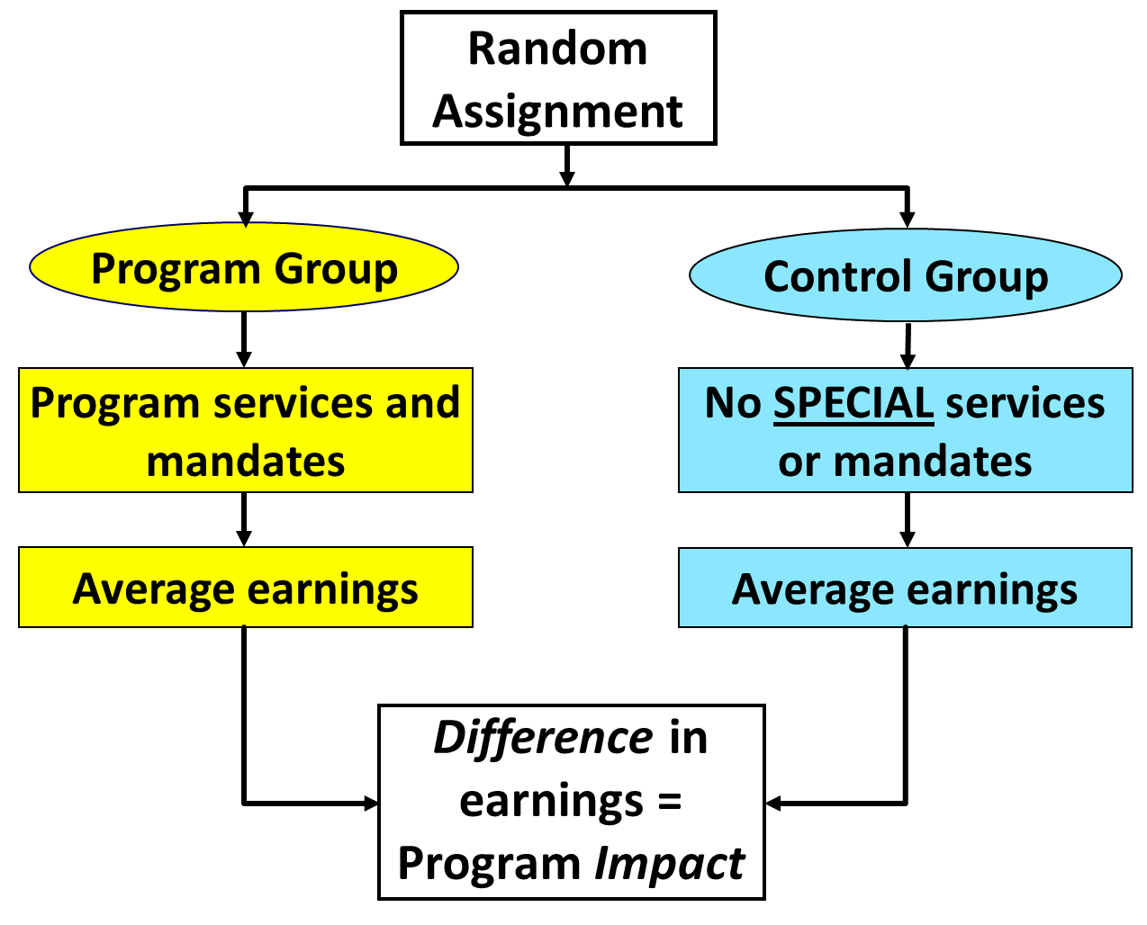

Slide 4
Mandatory Service Programs
- California GAIN program
- National Evaluation of Welfare-to-Work
Strategies (NEWWS)

Slide 5
California: GAIN Welfare-to-Work Program
(Began around 1986)
Major leap beyond simpler mandatory job search/ work experience programs of early 1980s
  Ongoing work requirement/sanctions
  Case management for support/enforcement
  Child care assistance
  Upfront basic skills (a big investment) and job search
  Other education/training/work experience
Sought to balance “mutual obligation,” human capital investment, support for work
Helped inspire Family Support Act of 1988

Slide 6
GAIN Evaluation
Six diverse counties:
- Alameda (Oakland) - Los Angeles - San Diego
- Butte - Riverside - Tulare
Core sample: 25,000 lone parents; children = age 6+
Random assignment: 78% to GAIN; 22% to control group
Control group (“Regular AFDC”)
  No participation requirements
  No welfare-to-work services
  Could get services on their own in community
Follow-up: 5-years after RA with admin records

Slide 7
Los Angeles County vs. Riverside County
Same model, different implementation
Los Angeles
  Overall, a longer-term welfare population
  Job search, but higher priority on basic skills (including ESL) for low-education group
  More expensive
Riverside
  Education, but higher priority on quick employment
  Pervasive focus on “employment goal,” even for low-education subgroup
  Less expensive

Slide 8
Los Angeles GAIN
Control group’s earnings ($)
Note: Earnings include $0 for non-workers

Slide 9
Los Angeles GAIN
5-year impacts on earnings ($)
Impact = $596 (ns)

Slide 10
Riverside GAIN
Control group’s earnings ($)
Control group
Note: Earnings include $0 for non-workers

Slide 11
Riverside GAIN
5-year impacts on earnings ($)
Impact = $5,038*** (+42%)
GAIN group
Control group
Note: Earnings include $0 for non-workers

Slide 12
Riverside GAIN
Impacts on receipt of cash welfare ($)
Impact = - $2,705*** (-15%)
Control group
GAIN group
Note: Payments include $0 for non-recipients

Slide 13
Another highly effective program: Portland, Oregon
  Used a “mixed” approach (similar to GAIN)
    Short-term education or training for some
    Job search for others (majority)
  Enforced participation requirements
  Encouraged searching for better job (above minimum wage and with fringe benefits)

Slide 14
Portland NEWWS
5-year impacts on earnings ($)
Impact = $5,150*** (+25%)
Program group
Control group
Note: Earnings include $0 for non-workers

Slide 15
NEWWS special study: LFA vs. HCD
LFA: “Labor force attachment”
    Job search as first activity
    Followed by education/training, as appropriate
HCD: “Human capital development “
    Education or training as first activity
    Usually basic education; some vocational training
    Followed job search, as appropriate
Head-to-head test in 3 sites
    Atlanta, Georgia
    Grand Rapids, Michigan
    Riverside, California

Slide 16
Head-to-head test of LFA vs. HCD
Example from Atlanta
LFA group
Welfare applicants and recipients
Random
Assignment
HCD group
Control group
16

Slide 17
Atlanta: LFA vs. Control
5-year impacts on earnings ($)
LFA Impact = $2,459*** (+14%)
LFA group
Control group
Note: Earnings include $0 for non-workers

Slide 18
Atlanta: LFA vs. HCD vs. Control
5-year Impacts on earnings ($)
LFA Impact = $2,459*** (+14%)
LFA group
Control group
Note: Earnings include $0 for non-workers

Slide 19
LFA vs. HCD: The longer-term
(10-15 years after random assignment)
LFA and HCD effects became similar in long term
  But LFA cheaper (more cost-effective)
Overall
  Both interventions increased earnings, reduced welfare relative to no intervention
  Many participants still struggled in work, remained poor, didn’t advance

Slide 20
“Make work pay” experiments
- Minnesota Family Investment Program (MFIP)
- Canadian Self-Sufficiency Program (SSP)
- Connecticut Jobs-First
- Milwaukee New Hope

Slide 21
“Make work pay” experiments
Major Lessons
Goal: Improve net income from low-wage work
  Earnings gains reduced welfare/other benefit income
  Address this through enhanced earnings disregards; wage supplements
Positive effects on employment and earnings, especially when combined with services
Did not save money for govt., but reduced poverty
Positive education effects for young children

Slide 22
Post-employment experiments
- Employment Retention and Advancement (ERA)

Slide 23
Employment Retention and Advancement (ERA) Demonstration
Focus shifted toward “post-employment”
  Prior interventions were not helping people advance
  Could services/support after job placement help them stay employed and get ahead?
ERA study: Tested 12 models in 6 states
(HHS-funded)
  Cast a wide net to test a variety of models
  Mostly for current and former welfare recipients

Slide 24
Summary of retention/advancement studies
9 models were not effective
  Offered post-employment guidance/advice, but little else
  No pattern of positive impacts among these 9
3 models did have positive economic impacts
  Offered post-employment guidance and advice
  Included other tangible features
    Examples: Incentives, employer connections, help with quick re-employment and proactive job-switching
Easier to help people to get jobs than advance

Slide 25
Sector-focused training experiments
- WorkAdvance

Slide 26
WorkAdvance Demonstration
Inspired by earlier experiment (by PPV) showing positive short-term effects of sector strategy
WorkAdvance model
  Voluntary
  Sector-focused training and placement
      Health care, computers/IT, manufacturing, transportation, environmental remediation
  Strong links to employers, who inform training
  Post-employment support

Slide 27
WorkAdvance: Initial findings
Follow-up period: 2 years so far; 5 years soon
Encouraging initial results in 3 of 4 sites
  Positive effects on employment and earnings
  Positive effects on advancement indicators (e.g., wages, benefits, job quality)
Best results so far: Per Scholas (NYC; IT training)
  In Year 2:
  26% increase in earnings vs. controls
  8.5 percentage pt. increase in earning > $20,000
  Some SNAP and TANF reductions

Slide 28
Recap / Conclusions
Mandatory programs that balanced active support and expectations increased work, reduced welfare
Did not reduce poverty or promote advancement, and encouraged rethinking approach to basic ed.
Adding financial incentives: Reduced poverty; some positive effects on young kids
Promoting advancement is difficult: Some skills-building is key; sector-focused approaches showing promise
Importance of continued experimentation
  Transitional jobs, career pathways, executive-skills-informed workforce coaching, other interventions

