Slide 1
Therapeutic Advancements in Myelodysplastic Syndromes
Bridging the Gap Between Patient Safety and Quality Care Through the Latest Science and Evidence-Based Learning in Nursing Practice
Rhonda Hewitt, MSN, ANP, AOCNP
Division of Hematology
Stanford Health Care
Palo Alto, California

Slide 2
Disclosures
Faculty/Planner
Rhonda Hewitt, MSN, ANP, AOCNP, has a financial interest/relationship or affiliation in the form of:
Consultant and/or Advisor for Amgen; AbbVie; and Incyte Corporation.
Speakers Bureau participant with Amgen; AstraZeneca; Incyte Corporation; Janssen Pharmaceuticals, Inc.; and PCYC (Pharmacyclics).

Slide 3
Housekeeping Notes
Thank you to Medical Learning Institute, Inc. and PVI, PeerView Institute for Medical Education for providing this session, and the supporters listed in the CME information for providing the educational grant for this activity.
We invite you to follow along on the slide printouts you received. In order to receive CME/MOC/NCPD/CPE credit you must complete the post-test and evaluation at the conclusion of the meeting.
Your evaluation of the program is very important in helping us to better meet your current and future medical education needs. We welcome your opinions and comments.
Please feel free to ask questions at the end of the program.

Slide 4
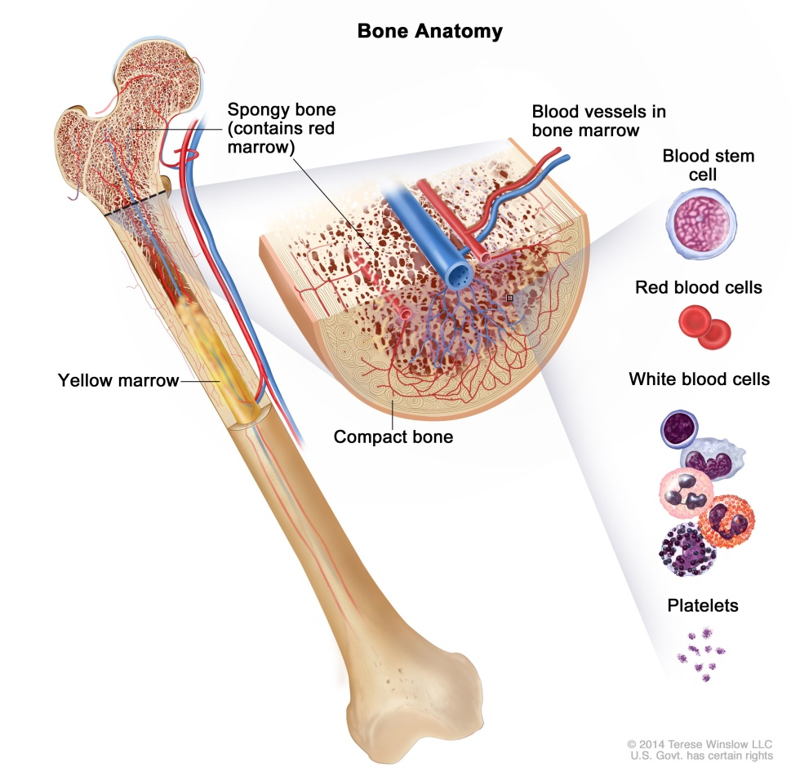
Myelodysplastic Syndromes (MDS)¹
A group of heterogeneous clonal
hematopoietic cell neoplasms
Cytopenia
Dysplasia and possible presence of blasts
Ineffective hematopoiesis
Recurrent cytogenetic or molecular abnormalities
Tendency towards AML

Slide 5
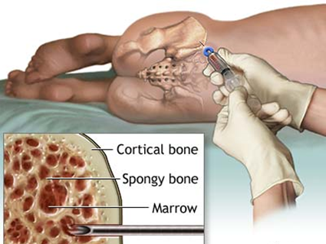
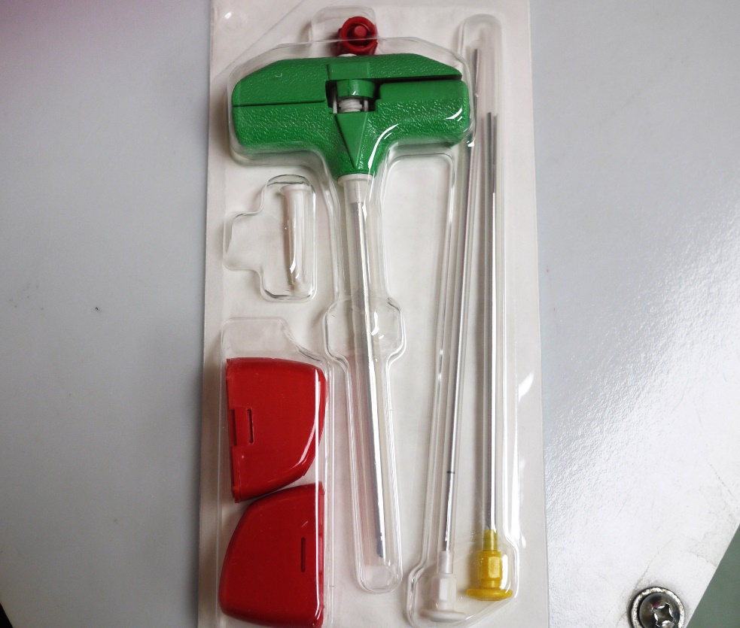
Bone Marrow Aspiration and Biopsy
Key Findings From a Bone Marrow Biopsy
Cellularity
  Ratio of hematopoietic cells to fat
  Naturally declines with age
  Subtract age from 100 = normocellular
  Most accurately taken from H&E sections of core biopsy
Hypercellular marrows
  Majority of cases of MDS
  Extramedullary cell destruction
  Leukemias
  Infection
  Hypoxia
Hypocellular marrows
  Aplastic anemia (immune mediated)
  Chemotherapy or other toxin such as radiation
  Infections
  Hypoxia

Slide 6
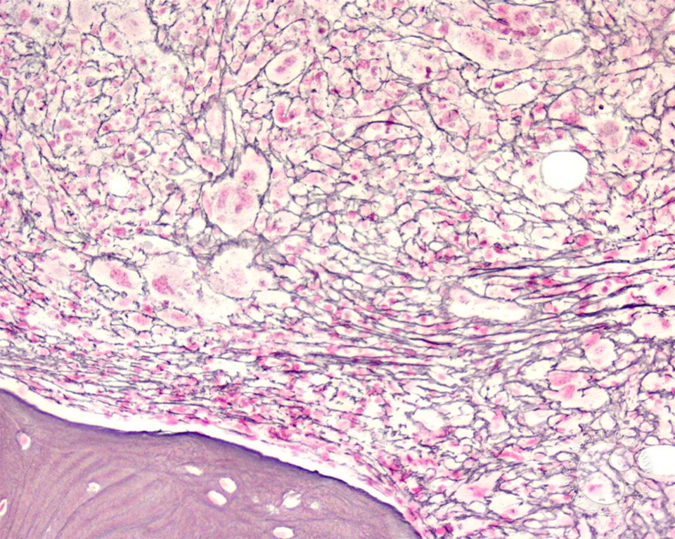
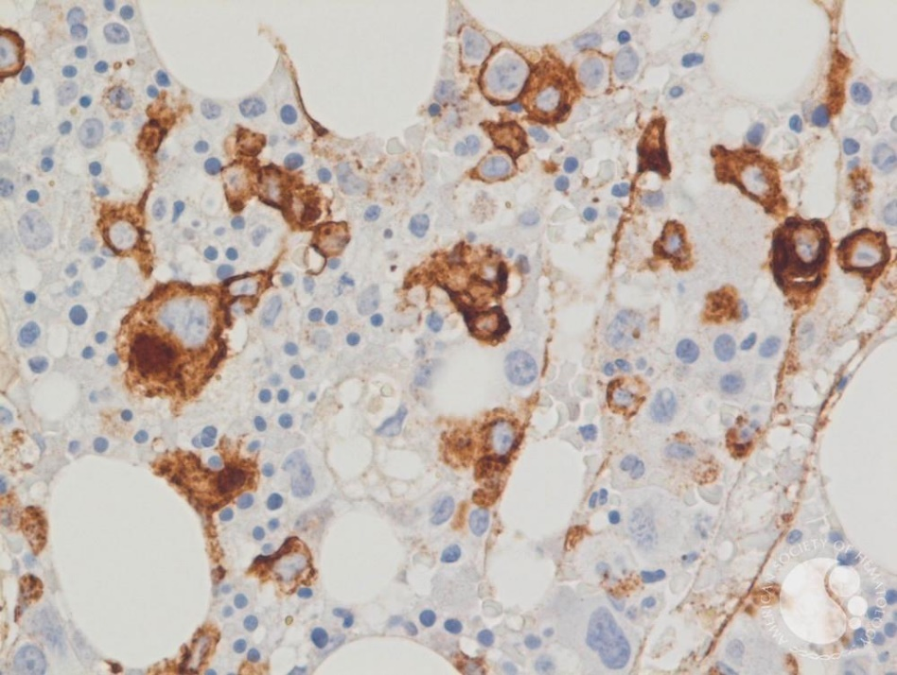
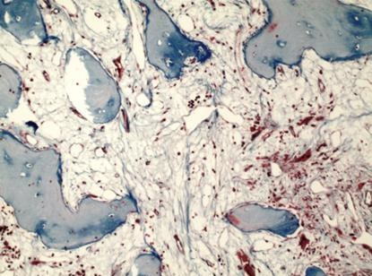
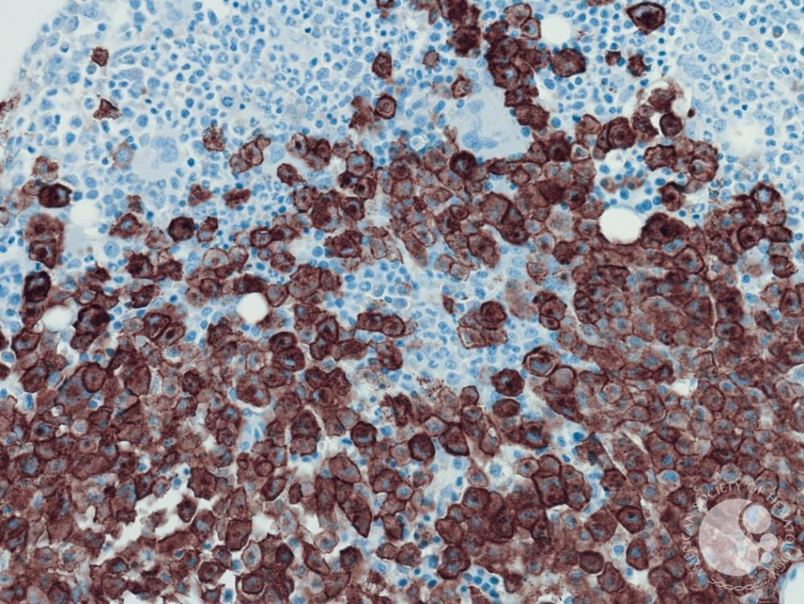
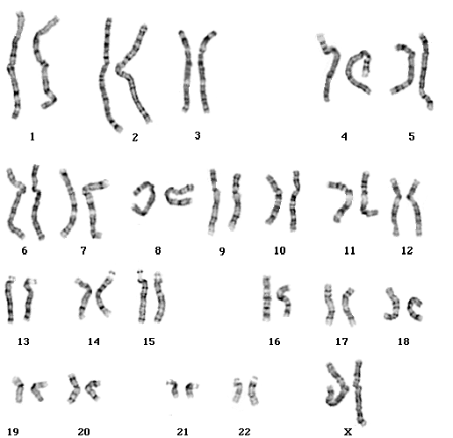
Ancillary Studies From Bone Marrow Biopsy
Immunohistochemical studies
Chromosomal analysis—cytogenetics
Fluorescence in situ hybridization (FISH) for MDS if failed cytogenetics
Molecular testing—NGS 54 gene myeloid panel

Slide 7
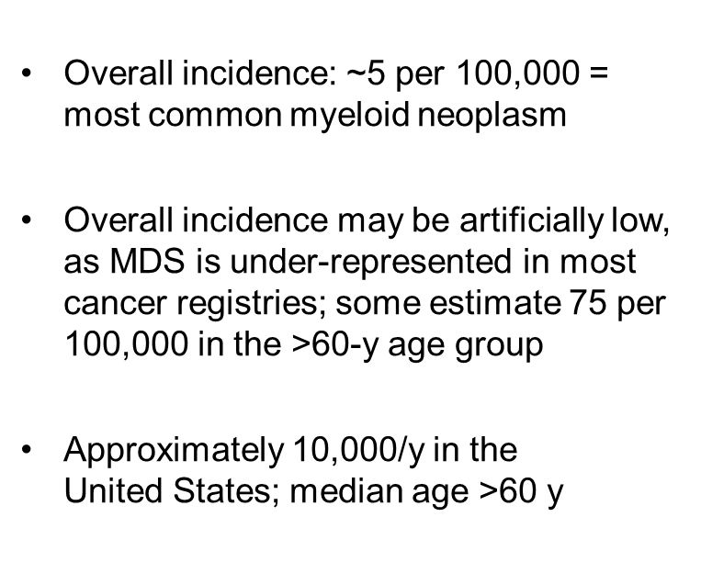
Incidence of MDS^{1,2}
MDS Cancer: SEER Incidence Rates by Age
at Diagnosis, 2013-2017ª
Observed Rates by Sex, All Races
(Includes Hispanic)
Both sexes
Female
Male
Rate per 100,000
>70 y
Age at Diagnosis, y

Slide 8
Epidemiology and Clinical Presentation^{1,2}
Median age of diagnosis is between 70—75 y
Risk factors: approximately 90% of cases occur de novo with no identifiable cause
  De novo
    Cigarette smoking
    Ionizing radiation
    Organic chemicals (eg, benzene, toluene, xylene, chloramphenicol)
    Heavy metals
    Herbicides, pesticides, fertilizers
  Secondary MDS
    Chemotherapy with alkylating agents
Presentation
  Clinical symptoms of pancytopenia (eg, anemia, bleeding, easy bruising, fatigue)
  Laboratory abnormalities: macrocytosis, neutropenia, thrombocytopenia, anemia, signs of hemolysis due to ineffective erythropoiesis

Slide 9
Patient Evaluation and Diagnosis¹
H&P
CBC, platelets, differential, reticulocyte count
Examination of peripheral blood smear
Bone marrow aspiration with iron stain + biopsy + cytogenetics by standard karyotyping
Consider testing bone marrow sample for fibrosis
Serum erythropoietin (prior to RBC transfusion)
RBC folate, serum B12
Serum ferritin, iron, TIBC
Documentation of transfusion history
TSH
LDH
Genetic testing for somatic mutations (ie, acquired mutations) in genes associated with MDS is highly recommended
Recommend additional molecular and genetic testing for hereditary hematologic malignancy predisposition in a subset of patients, particularly in younger patients
HIV testing if clinically indicated
Consider evaluation of copper deficiency in patients with GI malabsorption, severe malnutrition, gastric bypass surgery, or patients on zinc supplementation
Consider distinction from CSA
Cytopenia(s), suspect myelodysplasia

Slide 10
Diagnosing MDS According to 2016 WHO Classification¹
Observation | Sufficient to Diagnose MDS in a Patient With Cytopenia?
Dysplastic morphology (≥10%) | Yes, provided possible secondary causes of cytopenia and dysplasia are excluded clinically
Excess marrow blasts (≥5%) | Yes, provided marrow recovery and growth factor effect are excluded
Cytogenetic abnormality | Yes, provided it is on the WHO list of “approved” abnormalities (excluding +8, -Y, del[20q])
Flow cytometry abnormality | No, but can support an MDS diagnosis suspected by other observations
MDS-type mutation | No, as these can be found in normal individuals (“clonal hematopoiesis of indeterminate potential”); may support an MDS diagnosis suspected by other observations

Slide 11
Prognostic Impact of Mutations in MDS¹
Somatic Mutations and Prognostic Significance in the IPSS-Rmª
Prognostic Impact | Mutation (Frequency in MDS Patients)
Improved OS | SF3B1 (14%)
Intermediate/undefined impact on OS | TET2 (17%), DNMT3A (11%), GPR98 (8%), ZRSR2 (7%), BCOR (6%), APC (5%), SUZ12 (5%), PRP58 (4%), CUX1 (3%), DDX54 (3%), IDH1 (3%), KDM6A (3%), PHF6 (3%), SETBP1 (3%)
Inferior OS | ASXL1 (15%), STAG2 (11%), RUNX1 (10%), U2AF1 (9%), TP53 (5%), NF1 (5%), EZH2 (5%), CBL (4%), NRAS (3%)

Slide 12
Understanding Risk in MDS
Risk in MDS often refers to risk of mortality and AML transformation
Understanding risk provides prognostic information for the patients, caregivers, and treating physicians
Risk stratification serves as a decision tool to tailor therapy
  Allogeneic stem cell transplantation
  Disease-altering therapies: azanucleosides
Consider complete cytogenetics and NGS panel for all patients with MDS to understand the risk level

Slide 13
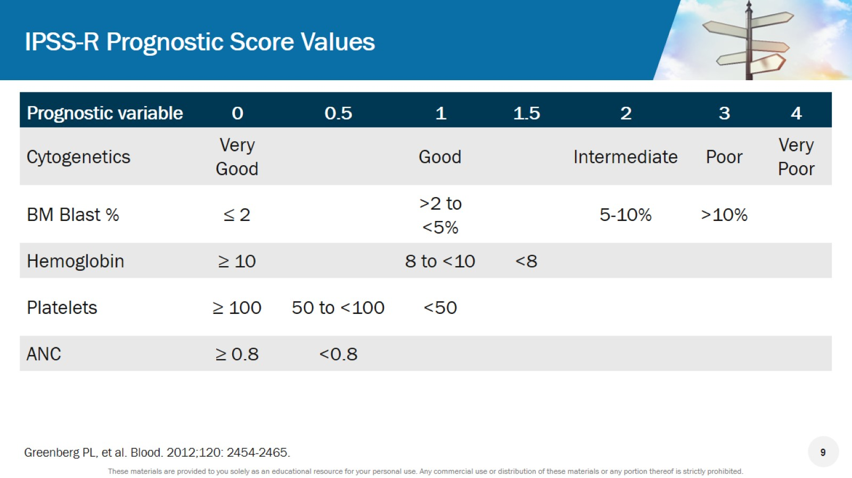
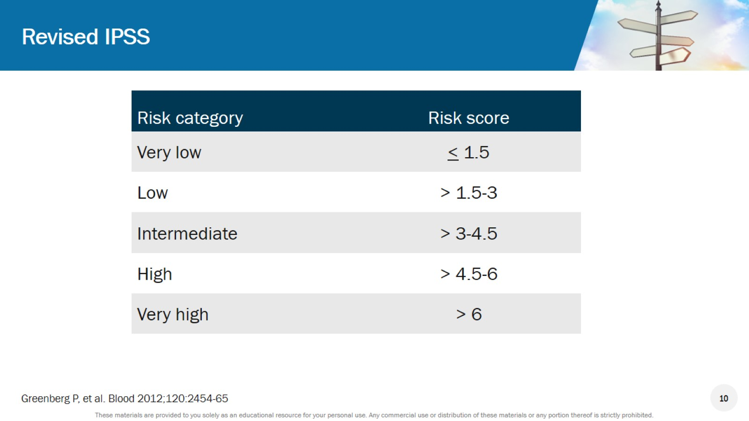
Revised International Prognostic Scoring System (IPSS-R)¹

Slide 14
IPSS-R Risk Groups: Overall Survival and
Progression to AML¹
Risk Group | Points | Median Survival, y | Time Until 25% of Patients Develop AML, y
Very low | ≤1.5 | 8.8 | NR
Low | >1.5-3 | 5.3 | 10.8
Intermediate | >3-4.5 | 3.0 | 3.2
High | >4.5-6 | 1.6 | 1.4
Very high | >6 | 0.8 | 0.73
Lower Risk
Higher Risk
Very low
Low
Intermediate
High
Very high
Patients, %
Patients, %
OS, y
Time to AML Evolution, y

Slide 15
Treatment Goals in MDS¹⁻³
MDS Type (IPSS) | Treatment Goals
Lower-risk MDS IPSS-R: Score <3.5 | Achieving RBC-transfusion independence Decreasing the symptom burden of iron overload Hematologic improvement Improving QOL
Higher-risk MDS IPSS-R: Score ≥3.5 | Overall survival and lowering the risk of transformation to AML Altering disease’s natural history Reducing the symptom burden and improving QOL

Slide 16
European Leukemia Net Study: HRQOL in Patients With LR-MDS
Compared With Age- and Sex-Matched Reference Populations¹
Patients Having Problems, %
Δ = 15%
Δ = 31%
Proportion of problems in usual activities and anxiety/depression is significantly higher in MDS patients
(P < .001)
MDS-related restrictions in the dimension of mobility were most prominent in males and in older patients (P < .001)
MDS-related restrictions from anxiety/depression in females and in younger people were prominent
(P < .001)
Patients who were newly diagnosed with IPSS lower-risk MDS experience
a pronounced reduction in HRQOL
Patients Having Problems, %
Δ = 10%
Δ = 10%
Δ = 16%
Patients Having Problems, %
EU norm <60 y
MDS patients <60 y
Δ = 8%
Δ = 9%
Δ = 21%
Pain/discomfort
Mobility
Usual activities
Anxiety/
depression
Self-care
Male
EU norm
Male
MDS patients
Patients Having Problems, %
Δ = 10%
Δ = 34%
EU norm 60-75 y
MDS patients 60-75 y
Patients Having Problems, %
Δ = 8%
Δ = 10%
Δ = 23%
Pain/discomfort
Mobility
Usual activities
Anxiety/
depression
Self-care
Female
EU norm
Female
MDS patients
EU norm >75 y
MDS patients >75 y

Slide 17
Prospective International Validation of the QOL in Myelodysplasia Scale (QUALMS)^{1,2}
Symptoms
Fatigue/tiredness (n = 16)
Weight loss (n = 6)
Shortness of breath (n = 14)
Bruising (n = 10)
Fever (n = 5)
Pain (n = 5)
Weakness (n = 13)
Loss of appetite (n = 6)
Heart palpitations (n = 5)
Bleeding (n = 9)
Infections (n = 5)
Leg cramps (n = 3)
Low energy (n = 12)
Diarrhea (n = 3)
Chest pressure (n = 1)
Rashes/red spot (n = 5)
Headaches (n = 1)
Dizziness/light head (n = 4)
Nausea (n = 3)
Blurry vision (n = 1)
Feeling faint (n = 1)
Impacts
Physical Functioning (n = 15)
Difficulty walking | n = 11 | Generally doing less | n = 7 | Difficulty walking on inclines | n = 2
Taking naps | n = 11 | Climbing stairs | n = 7 | Getting out of bed | n = 1
Sports/exercise | n = 10 | Carrying things | n = 4 | Having sex | n = 1
Needing to rest | n = 7 | Picking/lifting objects | n = 4
Generally can’t do anything | n = 7 | Generally being slower | n = 3
Sleep (n = 9)
Night time awakening | n = 7
Difficulty sleeping | n = 4
Impact of disturbed sleep | n = 4
Activities of Daily Living (n = 16)
Housework | n = 15
Shopping/errands | n = 5
Cooking | n = 5
Hobbies | n = 3
Driving | n = 3
Social (n = 12)
Social activities | n = 9
Relationship with friends/family | n = 6
Increased planning | n = 4
Avoiding crowds | n = 2
Unable to stay out late | n = 2
Work/School (n = 9)
Unable to work | n = 6
Productivity | n = 2
Reduced hours | n = 1
Emotional Wellbeing (n = 13)
Scared | n = 6 | Positive | n = 3
Sad/upset | n = 5 | Frustrated | n = 2
Unknown future | n = 4 | Anxious/nervous | n = 2
Depressed | n = 3 | Shocked | n = 2
Worried | n = 3 | Helpless | n = 1
Annoyed/irritated | n = 3 | Acceptance | n = 1
Financial (n = 3)
Reduced work hours | n = 1
Cost of hiring assistance | n = 1
Key: Both instruments; Fact-An-Only; Qualms only

Slide 18
Summary
Diagnosing MDS remains challenging but is a crucial first step
Point mutations in MDS are significant
  Large body of information confirms significant impact of mutations on prognosis
  Most data are still too immature to determine how to incorporate mutations into the existing, primarily morphologic classification
Integration of new clinical risk models and somatic mutations will refine the risk stratification in MDS

Slide 19

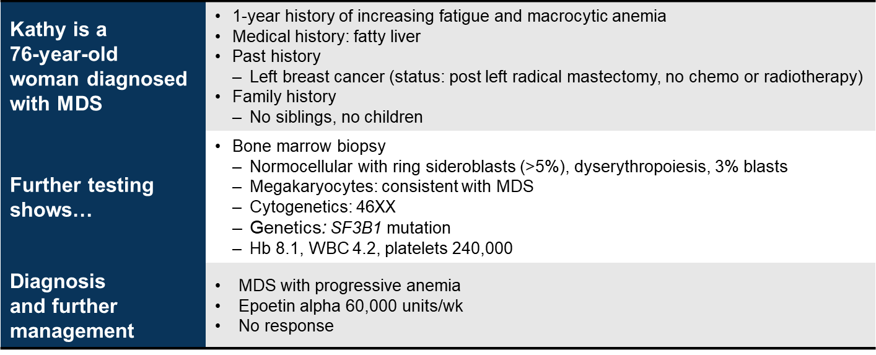
Clinical Case 1

Slide 20
Which of the Prognostic Subgroups Would Kathy Fall Into Based on the IPSS-R Staging System?
Prognostic Variable | 0 | 0.5 | 1 | 1.5 | 2 | 3 | 4
Cytogenetics | Very good |  | Good |  | Intermediate | Poor | Very poor
BM blast, % | ≤2 |  | >2 - <5 |  | 5 - 10 | >10
Hemoglobin | ≥10 |  | 8 - <10 | <8
Platelets | ≥100 | 50 - <100 | <50
ANC | ≥0.8 | <0.8
Risk Category | Risk Score
Very low | ≤1.5
Low | >1.5 - 3
Intermediate | >3 - 4.5
High | >4.5 - 6
Very high | >6

Slide 21
Nursing Implications for Managing Patients With MDS
Addressing patient concerns: Psychosocial factors influencing treatment
  Disease perception and coping with disease
  Goals of treatment, strategies for monitoring blood counts and transfusion burden
  Criteria for considering disease modifying treatment
  Patient support: family and caregivers
  Logistics of treatment, financial implications for patients
Setting expectations for symptom burden and QOL issues
  Physical: decreased strength, dyspnea, limited ability to adequately treat
  other conditions
  Emotional: anxiety, loneliness, despair
  Functional: fatigue, diminished stamina
  Social: altered role function, financial burden
  Spiritual: search for balance, renewed appreciation for life, hopelessness

Slide 22
The Burden of Transfusion Dependence in LR-MDS¹⁻⁵
Anemia is usually the most common cytopenia present in LR-MDS
Transfusion dependence is inevitable for most patients with MDS over the course of their disease
Transfusion dependence is associated with:
  A higher incidence of dyspnea, hepatic disease, infections, and cardiac events within 3 years of follow-up
  Increased risk of death (age adjusted) compared with other MDS patients
  Inferior response to disease modifying treatments when transfusion frequency is increased
  Higher health care related costs
  Inferior health related QOL
  Increased risk of iron overload

Slide 23


Iron Overload: The Burden of Blood Transfusion¹
Iron accumulation
in organs:
Intestinal absorption
Hepcidin
production by liver
Pituitary
Parathyroid
Macrophage catabolization of red blood cells
Heart
Liver
Plasma TB-Fe
Pancreas
Gonads
Saturation of transferrin
Ongoing erythropoietic signal may contribute to suppression
NTBI
accumulation
Red blood
cells
After 10-20
transfusions
Current Iron Chelation Therapies in Patients With Iron Overload Secondary to Receiving Blood Transfusions
 | Deferoxamine | Deferasirox | Deferiprone | Phlebotomy
Dosage | 0.5-1 mg per day IM 20-40 mg per day SC | 20-40 mg per day orally | 75 mg/kg per day orally | Venipuncture

Slide 24
Slow Progress in MDS Until Now…
ASTX727
(cedazuridine + decitabine)
FDA approval 2020
IPSS 1997
Lenalidomide
FDA approval 2005
Improved cytogenetic classification
Cytogenetics 1970;
chromosomes in leukemia 1979
Decitabine
FDA approval 2006
Luspatercept
FDA approval 2020
Azacitidine
FDA approval 2004
Application of NGS in MDS
???
1970s
1997
1999
2001
2003
2005
2007
2009
2011
2013
2015
2019
2020
2021
ESAs often used but not FDA approved

Slide 25
Treatment Algorithm for LR-MDS: IPSS (Score <3.5)¹
Asymptomatic
Monitor CBC every 1-3 months until symptoms or disease progression
Go to symptomatic once criteria met
Isolated anemia
Hb <10 g/dL
Transfusion dependent
> 2 u/8 wk
Supportive transfusions +/- chelation
If del5(q) (or sEPO > 500/L) start lenalidomide
If sEPO <500/L start ESA-based therapy
If NR to LEN then go to plan for EPO <500 or >500
If PD, start hypomethylating agent
If NR to ESA after 3 mo and ≥15% RS (or 5% RS/SF3B
1 mut) start luspatercept
Isolated thrombocytopenia
Platelets <20 K/L or <50 K/L with bleeding
Supportive transfusions for active bleeding, consider aminocaproic acid
Start thrombopoietin agonist (eltrombopag
or romiplostim)
Symptomatic
If NR to ESA after 3 mo start lenalidomide
Isolated neutropenia
Absolute neutrophil count <500
Rule out other etiologies (ie, LGL, PNH, cyclical neutropenia, rheumatologic)
Use of G-CSF or GM-CSF is not advised or recommended
Ensure vaccinations are up to date (pneumococcal polysaccharide, zoster, TDAP)
If repeated infections occur, consider prophylaxis antivirals/antibacterials
Multi-lineage
cytopenia
Start hypomethylating agent if symptomatic, consider BMT consultation as
appropriate (or)
Start ATG +/- cyclosporine A if hypocellular marrow (or)
Consider clinical trial (NGS testing may give the option of targeted approaches)

Slide 26
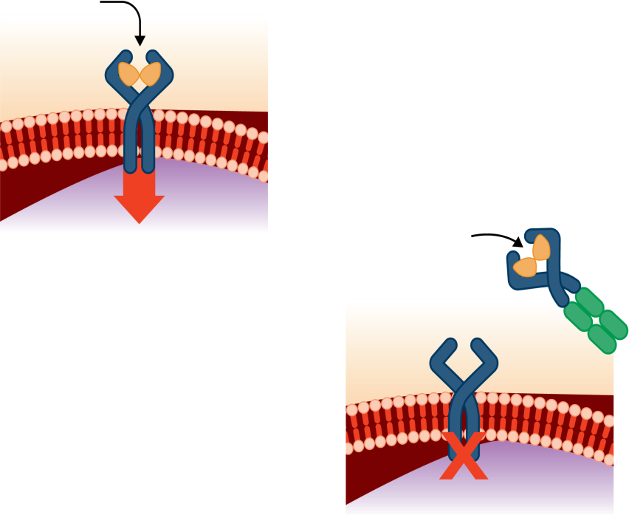
Luspatercept: Erythroid Maturation Agent¹⁻³
Ligand
Activin
receptor
RBC cell
membrane
Luspatercept
(ligand trap)
SMAD2
phosphorylation
Ligand
Inhibits RBC maturation
Inhibited SMAD2 signaling
Promotes RBC maturation

Slide 27
Phase 3 MEDALIST Study of Luspatercept in LR-MDS:
Independence From RBC Transfusion^{1,2}
P < .001
P < .001
P < .001
The most common AEs with luspatercept or placebo (of any grade and occurring in
>10% patients) were fatigue, diarrhea, asthenia, nausea, dizziness, and back pain

Slide 28
MEDALIST Study of Luspatercept in LR-MDS:
Long-Term Transfusion Burden^{1,2}
Mean Change From Baseline in RBC Units Transfused
Mean Number of Transfusion Visits in Weeks 1-24
+0.4 (-0.6 to +1.4)
10.6
9.5
8.3
6.8
5.9
5.0
3.0 (-3.9 to -2.1)
-4.9 (-5.9 to -3.9)
Placebo
Weeks 9-24
(n = 68)
Luspatercept
Weeks 9-24
(n = 128)
Luspatercept
Weeks 33-48
(n = 78)
Luspatercept
(n = 128)
Placebo
(n = 68)
The FDA approved luspatercept on April 3, 2020, for treating anemia (failing an ESA and requiring ≥2 RBC units over 8 weeks) in adult patients with very low-risk to intermediate-risk MDS with ring sideroblasts or with MDS/MPN with ring sideroblasts and thrombocytosis

Slide 29
DNA Methyltransferase Inhibitors (DNMTi)
Are the Backbone of Disease-Modifying Therapy in MDS^{1,2}
1.0
Azacitidine
Supportive care
Analyzed population = treatment-naïve MDS patients
0.8
Decitabine (n = 69)
Median EFS
20 mo
14 mo
Supportive care (n = 65)
0.6
Probability of Remaining Event-Free
Percent Alive Without AML
0.4
+
+
+
+
+
+
+
+
+
+
+
+
+
+
6 mo >
0.2
+
+
+
+
+
+
+
+
+
+
+
+
+
+
+
+
+
+
0
0
6
12
18
24
30
36
42
48
54
Time, mo
Survival Without AML, d

Slide 30
Improving Delivery of DNMT Inhibition
CC-486: oral azacitidine
ASTX727: oral decitabine + CDA
ASTX030: oral azacitidine + CDA
CC-486
Guadecitabine
Increase bioavailability
QOL/cost-effectiveness (oral therapy and
symptom control)
Hypomethylating agents (HMA)
DNA methyltransferase inhibitors (DNMTi)

Slide 31
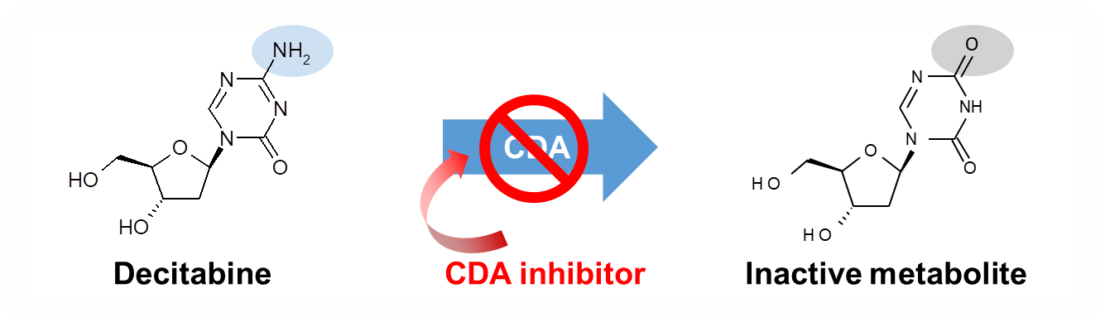
Oral Decitabine Plus Cedazuridine Combination (ASTX727)¹
Cytidine deaminase (CDA)
inhibitor
Cedazuridine is a novel, potent, and safe CDA inhibitor
When given in combination with decitabine, cedazuridine enables efficient oral availability

Slide 32
Phase 3 Study (ASCERTAIN) Trial:
Preliminary Response of ASTX727 in MDS/CMML¹⁻³
 | Evaluable Patientsª, n (%)
CR | 12 (11.9)
PR | 0 (0)
mCR | 46 (45.5)
mCR with HI | 14 (13.9)
HI | 7 (5.3)
HI-erythroid | 2 (2.0)
HI-neutrophils | 1 (1.0)
HI-platelet | 6 (5.9)
Overall response (CR + PR + HI) | 33 (31.0)
SD | 28 (27.7)
PD | 8 (7.9)
ASTX727 responses are consistent with standard DNMTi use
The FDA approved ASTX727 on
July 7, 2020 for adult patients with MDS with refractory anemia, refractory anemia with ringed sideroblasts, refractory anemia with excess blasts, and CMML in intermediate 1-2 and
high-risk IPSS groups

Slide 33
Phase 3 Trial of CC-486 (Oral Azacitidine) in RBC Transfusion-Dependent LR-MDS¹
RBC-TI, ≥56 days
The most common AEs with CC-486 or placebo were low-grade GI events
Other common grade 3-4 AEs were neutropenia, thrombocytopenia, febrile neutropenia, and anemia
Patients with severe neutropenia are at higher risk of hematologic toxicity during early treatment cycles and may benefit by modifying the dose
Management of AEs: regular monitoring, supportive care measures with dose modifications or interruptions if necessary
40
Patients (±95% Cl), %
P = .0002
30
30.8%
20
10
11.1%
0
Median number of treatment cycles
CC-486: 5 (range 1-70)
Placebo: 6 (range 1-69)
Duration of response
CC-486 vs placebo: 11.1 vs 5.0 months (P = .42)

Slide 34
Improved Options With Currently Approved Therapies
Anemia is the dominant clinical problem in LR-MDS
ESAs are standard of care
Lenalidomide is effective, especially in del(5q) MDS
Lenalidomide + ESA may resurrect anemia response
Luspatercept provides a new option for patients who fail on ESAs
HMAs are the backbone of HR-MDS therapy
HMAs improve OS, and expanded use of HMAs is vital for improving response
Novel combinations with HMAs will continue to help individualize therapy and improve outcomes
Maximizing delivery and pharmacokinetics with HMA enhances options
  ASTX727 (oral decitabine + cedazuridine) is approved by the FDA and is equivalent
  to decitabine
  Investigational agent CC-486 (oral azacitidine) has shown significant improvement in
  RBC-transfusion independence compared with placebo however CC-486 should NOT be considered equivalent to parenteral azacitidine

Slide 35
Clinical Case 1: Back to Our Patient Kathy…
What Is the Most Appropriate
Next Step for Kathy?
Azacitidine
Luspatercept
Lenalidomide
ASTX727 (cedazuridine + decitabine)
Emerging therapies such as CC-486
Immunosuppressive therapy
Allogeneic stem cell transplant
Kathy, 76-year-old woman with LR-MDS
Genetics: SF3B1 mutation
BM: normocellular, 3% blasts, ring sideroblasts (>5%)
ESA-resistant anemia
Now requiring frequent transfusion

Slide 36
Nursing Implications for Managing Patients With LR-MDS
Patient education related to transfusion burden
  Risks associated with transfusion dependence and the goal to achieve
  transfusion independence
  Goals of treatment to achieve transfusion independence
  Strategies for monitoring blood counts and transfusion burden
  Criteria for considering disease modifying treatment
Setting expectations for patients initiating disease modifying treatment (DMT)
  A minimum of 4-6 months of treatment is required to evaluate initial response
  Best response may not be evident until 6-9 months of therapy
  Myelosuppression is the most common toxicity in DMT for MDS
          Cytopenias may get worse before they get better
  Mild to moderate asymptomatic cytopenias may persist for months or years in patients responding to treatment

Slide 37
Clinical Case 2: Matthew, a Newly Diagnosed Patient With MDS
Matthew is a 65-year-old man with MDS | Presents with fatigue and anemia
Further testing shows… | Bone marrow biopsy Hypercellular (66%) Dyserythropoiesis Myeloid: blasts 7% Megakaryocytes: increased numbers, atypical Cytogenetics: del(5q), del(7q), -17 Genetics: TP53 mutation Hb decline: 7.5 RBC transfusions: 1-2 every 3-4 wk
Diagnosis and further management | MDS Categorized as high risk

Slide 38
What Are the Treatment Options for Higher-Risk MDS?
Initial Treatment | Next Options
If allo HCT is a good option and a donor is available: Allo HCT Azacitidine or decitabine, followed by allo HCT High-intensity chemotherapy, followed by allo HCT If allo HCT is a good option but a donor is not available: Azacitidine (preferred) or decitabine Clinical trial If allo HCT is not a good option or a donor is not available: Azacitidine (preferred) or decitabine Clinical trial | Depending on prior treatment, options may include: Consider second HCT or DLI Azacitidine or decitabine Clinical trial Supportive care only

Slide 39
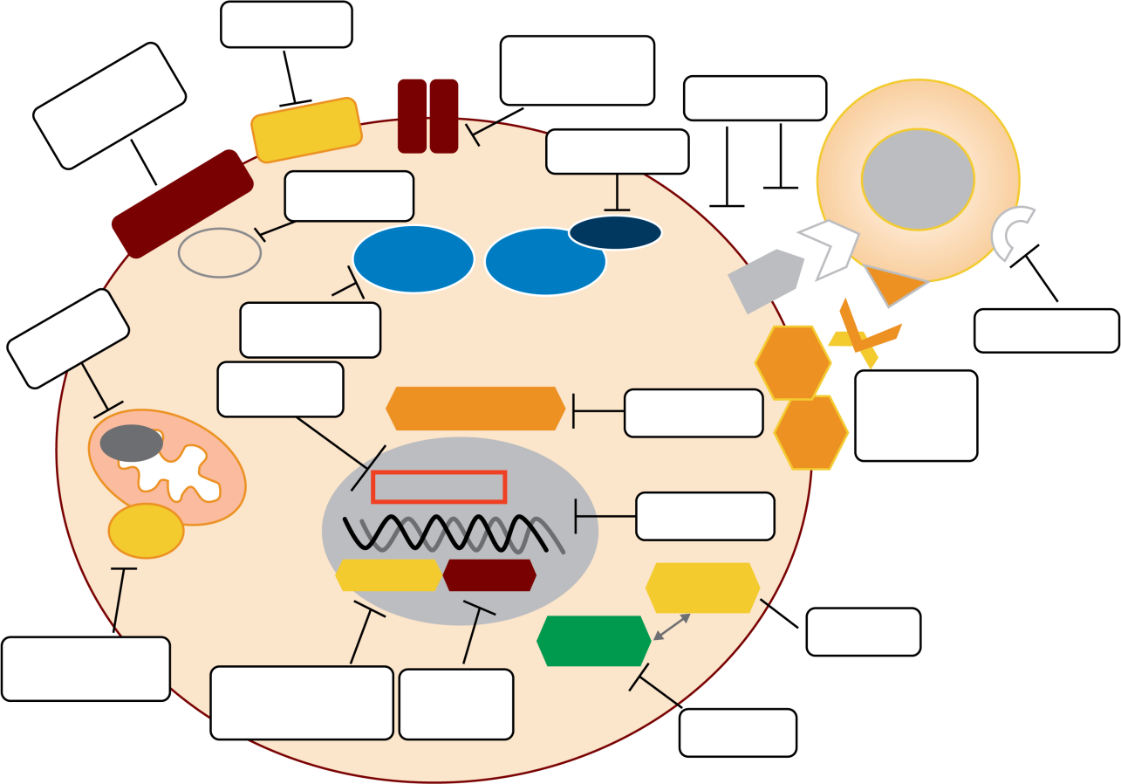
Novel Targets Under Investigation in MDS¹
Receptor
Tyrosine Kinase
Luspatercept
FLT-3/AXL/JAK
inhibitors
T cell
Growth factors
Antibodies
TGFb-R
Pevonedistat
EPO/TPO-R
Rigosertib
PD-1
CTLA4
TIM-3
RAS
E3 Ub-
ligase
NEDD8
PD-L1
NAE
CD3
Venetoclax
Lenalidomide
Antibodies
CD33
Imetelstat
Spliceosome
Antibodies
DARTs
CARs
H3-B8800
CD123
BCL-2
IDH1/2
Telomerase
CPX-351
DNMT
HDAC
P53
IDH1 inhibitor
Ivosidenib
(AG-120)
MDM2
APR-246
Hypomethylating
agents
HDAC
inhibitors
ALRN-6924

Slide 40
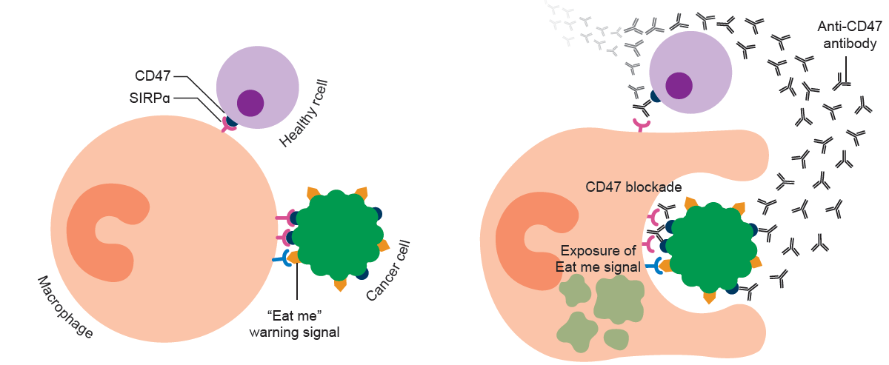
Magrolimab: Anti-CD47 Antibody¹

Slide 41
Phase 1b Study of Magrolimab + Azacitidine:
Overall Response^{1-3,a}
Best Overall Response | 1L MDS (N = 33)
ORR | 22/30 (73%)
CR | 14 (42%)
PR | 1 (3%)
HI | 7 (21%)
SD | 3 (9%)
PD | 0
Magrolimab + Azacitidine
Best Relative Change From Baseline in Bone Marrow Blast, %
Mutation Type:
TP53 WT (n = 24)
Missing (n = 4)
TP53 Mutant (n = 3)

Slide 42
Phase 1b Study: Magrolimab + Azacitidine in Patients with HR-MDS¹⁻³
Outcome, n (%) | MDS (n = 33)
RBC transfusion independence | 11/19 (58)
Complete cytogenetic response | 9/26 (35)
MRD negativity in responders | 6/30 (20)
Median DOR, mo | NR (0.03+ to 10.4+)
Median follow-up, mo (range) | 5.8 (2.0 to 15.0)
Maximum tolerated dose not reached with magrolimab + AZA
Safety consistent with AZA monotherapy
No evidence of significant cytopenias, infections, or immune-related AEs
Majority of patients had significant hemoglobin improvement and decrease in transfusion frequency over time

Slide 43
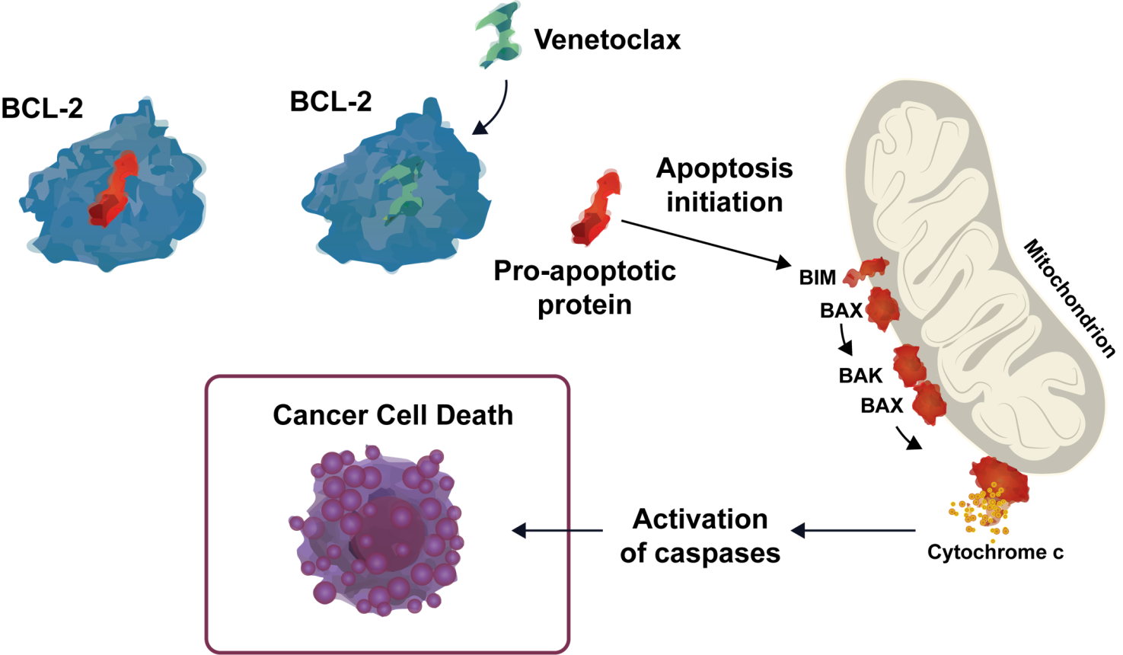
Venetoclax: BCL-2 Inhibitor¹⁻³

Slide 44
M15-531, Phase 1b Dose Escalation Study:
Venetoclax + Azacitidine^{1,a}
Median DOR: 12.9 mo (12.1-16.8)
Median DOR after CR: 13.8 mo (6.5-20.9)
Median time to CR: 2.6 mo (1.2-19.6)
For patients receiving venetoclax 400 mg (RP2D; n = 51)
  84% of patients achieved ORR
    47% achieved ORR by cycle 2
    78% achieved ORR by cycle 3
  35% of patients achieved CR
ORR
79%
Transfusion Independence Rate | n (% of N = 78)
RBC and platelet | 51 (65)
RBC | 52 (67)
Platelet | 60 (77)

Slide 45
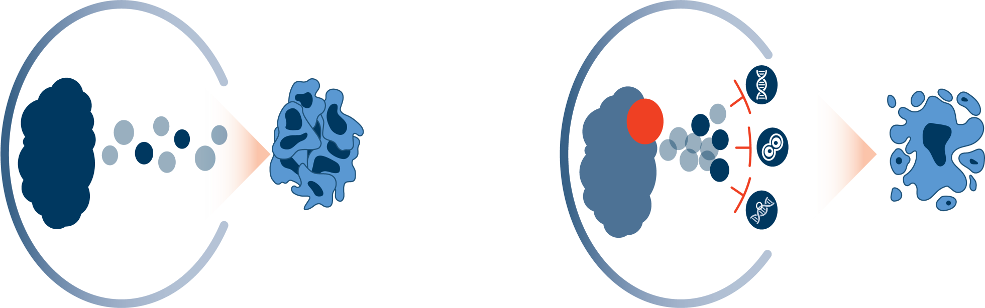
Pevonedistat: NEDD8-Activating Enzyme Inhibitor¹⁻⁵
Cancer Cell
Cancer Cell: NAE Inhibition
Pevonedistat
DNA
replication
NAE
active
NAE
inactive
Cell cycle
Ubiquitination
and degradation
of select regulatory
proteins
NF-ĸβ signaling
Regulatory
protein
accumulation
Cancer cell growth
and survival
Apoptosis and
cancer cell death

Slide 46
Phase 2 Study: Pevonedistat + Azacitidine in MDS, CMML, or Low-Blast AML^{1,2}
EFS
OS
 | Pevonedistat + azacitidine | Azacitidine
Median EFS, mo | 20.2 | 14.8
HR (95% Cl) | 0.539 (0.292-0.995) P = .045
 | Pevonedistat + azacitidine | Azacitidine
Median OS, mo | 23.9 | 19.1
HR (95% Cl) | 0.701 (0.386-1.273) P = .240
Probability of Survival, %
EFS, %
20.2 mo
14.8 mo
Time, mo
Time, mo
Pevonedistat + azacitidine
Azacitidine
Rate of transfusion independence: 69.2% (pivonedistat + azacitidine) vs 50.0% (azacitidine)

Slide 47
Pevonedistat + Azacitidine: Responses in HR-MDS¹
Response-Evaluable Patients, N = 59
34.6 mo
(95% CI, 11.53-34.60)
13.1 mo
(95% CI, 12.02-NE)
The most common AEs with pevonedistat + azacitidine were nausea, constipation, diarrhea, and fatigue;
other common grade 3-4 AEs were neutropenia, thrombocytopenia, febrile neutropenia, and leukopenia

Slide 48
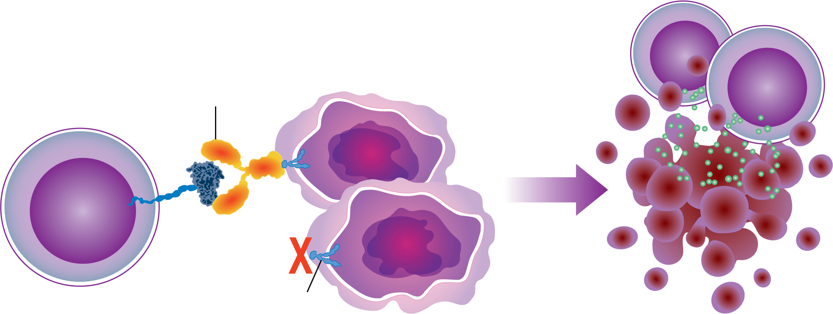
Sabatolimab (MBG453): Anti-TIM-3 Antibody¹⁻⁶
Anti-TIM-3 Antibody Prevents Inhibition of Activated T Cells
Activated T cells
Granule release
Anti-TIM-3 antibody
Immune cell activation
TIM-3
Enhanced immune effector cell responses
Activated T cell
Phosphatidylserine
Tumor cells
Immune-mediated tumor killing
1. Acharya N et al. J Immunother Cancer. 2020;8:e000911. 2. Sabatos-Peyton C et al. The Society for Immunotherapy of Cancer Annual Meeting 2020 (SITC 2020). Abstract 439. 3. Borate U et al. HemaSphere. 2020;4(suppl 1):S185; 4. Borate U et al. EHA 2020. Oral presentation.
5. Pardoll DM. Nat Rev Cancer. 2012;12:252-264. 6. Das M et al. Immunol Rev. 2017;276:97-111.

Slide 49
Phase 1b Study of Sabatolimab + DNMTi:
Antileukemic Activity and Overall Response¹
Overall Responseª
IPSS-R
H
H
VH
VH
VH
ORR
64%
(25/39^{b})
H
H
H
H
H
VH
T
H
VH
T
Median time to response, mo
SD w/HI
12.8
VH
VH
2.0
Response Rate, %
H
H
H
VH
mCR
28.2
H
VH
83.9%
Estimated percentage of patients still in response after
6 months (90% Cl, 66.7-100)
VH
mCR w/HI
15.4
H
VH
T
H
H
T
Response
EOT reason
VH
T
Estimated 12-mo PFS rate
(90% Cl, 33.6-70.3)
H
VH
T
CR
mCR
SD
PD
No response data
Ongoing
First HI
Transplant
Patient/physician decision
Death
51.9%
H
VH
T
CR 23.1
H
H
T
T
T
9
Patients proceeded to transplant
H
VH
vHR/HR-MDS
VH
H
H
Overall response
in ITT population: 61%
H
Study, mo

Slide 50
Sabatolimab + DNMTi in MDS:
Most Commonly Occurring TEAEs¹
vHR/HR-MDS
n = 41
Grade 4
Grade 3
Grade 1/2
Most common reported TEAEs were consistent with those for DNMTi alone
Discontinuation due to AEs was infrequent: 0% for vHR/HR-MDS
One patient with neutropenic colitis died of septic shock; the AE was suspected to be related to study treatment; no other treatment-related deaths were reported
Thrombocytopenia
Neutropenia
Nausea
Constipation
Anemia
Febrile neutropenia
Fatigue
Diarrhea
Decreased appetite
Pyrexia
Vomiting
Edema peripheral
Arthralgia
Headache
Dyspnea
Rash
Back pain
Hypokalemia
Dizziness
Cough
Epistaxis
Fall
Pneumonia
Hypophosphatemia
ALT increase
70%
60%
50%
40%
30%
20%
10%
0%

Slide 51
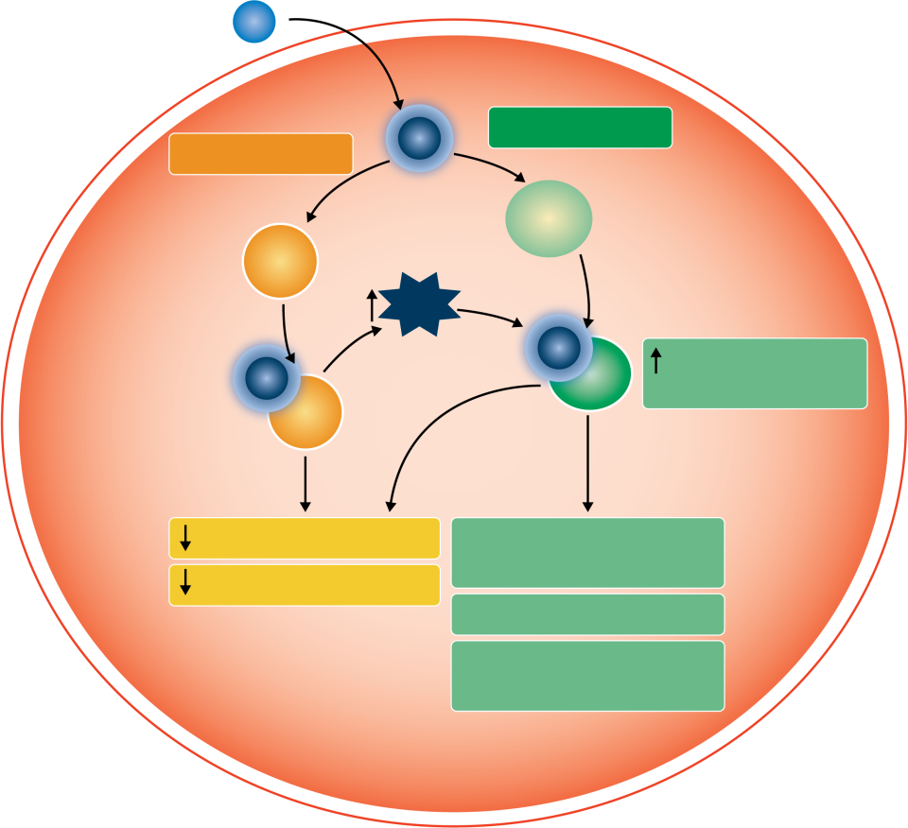
APR-246: p53 Reactivator¹⁻⁵
APR-246
MQ
p53 dependent
p53 independent
Mutant/inactive p53
TrxR1, GSH
ROS
MQ
p53 pathway
activation (eg, p21)
MQ
Proliferation
Apoptotic program
(eg, FAS/BAX)
Clonogenic capacity
MYC
FLT3 pathway (eg, FLT3
and FLT3 ligand)

Slide 52
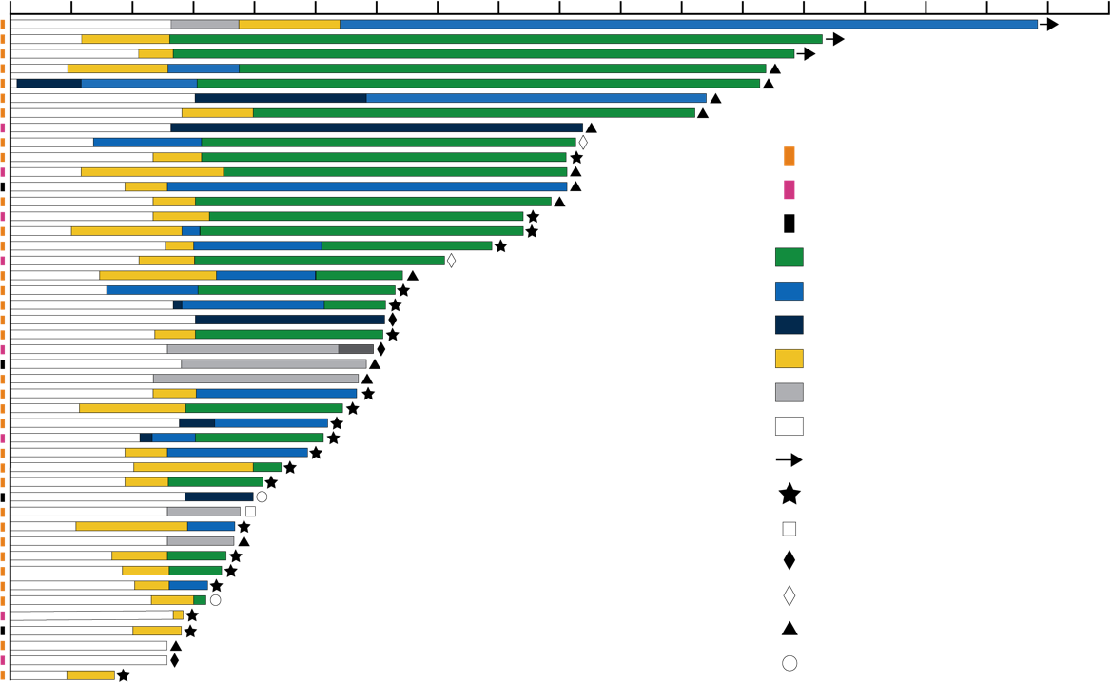
Response to Treatment in Evaluable Patients (n = 45)¹
Duration of Treatment, mo
MDS
AML
CMML/MDS-MPN
CR
mCR + HI
mCR/MLFS
HI
SD
NR/NE
Ongoing
Discontinued: Transplant
Discontinued: AE
Discontinued: Withdrawal/refusal
Discontinued: Other
Progressive disease
Death
0 | 1 | 2 | 3 | 4 | 5 | 6 | 7 | 8 | 9 | 10 | 11 | 12 | 13 | 14 | 15 | 16 | 17 | 18
Median OS: ITT = 10.8 mo and responding patients = 13.7 mo; median duration of follow-up = 10.8 mo
 | Overall | MDS | AML | MDS-MPN + CMML
Evaluable patients, n | 45 | 33 | 8 | 4
ORR, n (%) | 39 (87) | 29 (88) | 7 (88) | 3 (75)
CR rate, n (%) | 24 (53) | 20 (61) | 4 (50) | 0 (0)
Duration of CR, median mo (95% CI) | 7.3 (5.8-NE) | 7.3 (5.8-NE) | 7.0 (3.3-NE) | NE
Discontinued for transplant, n (%) | 22 (49) | 17 (52) | 4 (50) | 1 (25)

Slide 53
Clinical Take-Homes
Novel DNMTi combinations are showing encouraging results and have a potential to change SOC in the future
MDS with DNMTi failure remains a high-risk population without an established SOC with hope for some novel DNMTi combinations and targeted monotherapies for the future
Results may help inform practice and future clinical investigation in
this population

Slide 54
Back to Our Patient…
What are the emerging treatment options for patients with newly diagnosed HR-MDS?
Clinical trial
Intensive chemotherapy followed by HCT
Combination therapy
Targeted therapy
Best supportive care
Matthew, 65-year-old man with HR-MDS
Cytogenetics: del(5q), del(7q), -17
Genetics: TP53 mutation
BM: hypercellular (66%) with 7% blasts
Progressive anemia requiring RBC transfusions: 1-2 every 3-4 wk

Slide 55
Newer Targeted Therapies or Combinations:
An Option for Matthew
Clinical trials
  Magrolimab + azacitidine
  Sabatolimab + DNMTi
  Pevonedistat + azacitidine
  Venetoclax + azacitidine
  APR-246/APR-548 + azacitidine
Targeted Therapies
Enrollment in Clinical Trials
Encourage and educate patients for trial enrollment

Slide 56
Nursing Implications for Managing Patients With HR-MDS
Nurse’s responsibility in shared decision-making
  Maintaining a major influence in patient’s education about the disease and treatment
  Identifying the most appropriate therapy options for patients based on: risk factors, efficacy, AEs associated with therapies, comorbidities, and psychosocial factors
  Educating patients and care givers about disease expectations
  Routine monitoring, assessment, and management of AEs associated with treatment
  Assessing patient benefit from newer therapies
Addressing patient’s concerns about trial enrollment and novel therapies
  Counselling patient to address concerns regarding novel therapies
  Encouraging and educating patients about enrolling in clinical trials to explore newer treatment options
  Educating about current and newer treatment options to address therapy-related concerns, including financial implications

Slide 57

Audience Q&A

Slide 58
Please remember to complete and submit your Post-Test and Evaluation for
CME/MOC-ABIM/NCPD/ILNA credit.
PeerView.com/MDS-Survey-EQN
Thank you and have a good day.

Slide 59
Abbreviations
AML: acute myeloid leukemia
ANC: absolute neutrophil count
ATG: antithymocyte globulin
AZA: azacitidine
BCL-2: B cell lymphoma 2
BM: bone marrow
BMT: bone marrow transplantation
CAR: chimeric antigen receptor
CD3: cluster of differentiation 3
CD33: cluster of differentiation 33
CD47: cluster of differentiation 47
CD123: cluster of differentiation 123
CDA: cytidine deaminase
CMML: chronic myelomonocytic leukemia
CPX351: cytarabine and daunorubicin
CR: complete response
CRi: complete remission with incomplete hematologic recovery
CSA: congenital sideroblastic anemia
CTLA4: cytotoxic T-lymphocyte–associated protein 4
DART: dual-affinity retargeting
DLI: donor lymphocyte infusion
DNMTi: DNA methyltransferase inhibitors
DOR: duration of response
EFS: event-free survival
EOT: end of treatment
ESA: erythropoietin-stimulating agent
FLT-3: FMS-like tyrosine kinase 3
G-CSF: granulocyte colony-stimulating factor
GM-CSF: granulocyte-macrophage colony-stimulating factor
GSH: glutathione
H&E: hematoxylin and eosin
HCT: hematopoietic cell transplantation
HDAC: histone deacetylase
HI: hematologic improvement
HR-MDS: high-risk myelodysplastic syndrome
HRQOL: health-related quality of life
IDH1: isocitrate dehydrogenase 1
IDH2: isocitrate dehydrogenase 2
IPSS: International Prognostic Scoring System
IPSS-R: Revised International Prognostic Scoring System
IPSS-Rm: Revised International Prognostic Scoring System Molecular
IWG: International Working Group
JAK: Janus kinase
LDH: lactate dehydrogenase
LEN: lenalidomide
LGL: large granular lymphocyte
LR-MDS: low-risk myelodysplastic syndrome
mCR: marrow complete response
MDM2: mouse double minute 2 homolog
MLFS: morphologic leukemia-free state
MPN: myeloproliferative neoplasm
MQ: methylene quinuclidinone

Slide 60
Abbreviations
MYC: V-myc avian myelocytomatosis viral oncogene homolog
NAE: NEDD8-activating enzyme
ND AML: newly diagnosed acute myeloid leukemia
NE: not evaluable
NF-κB: nuclear factor kappa light chain enhancer of activated B cells
NGS: next-generation sequencing
NR: no reaction
NTBI: non–transferrin-bound iron
ORR: overall response rate
p53: cellular tumor antigen p53
PD: progressive disease
PD-1: programmed cell death protein 1
PD-L1: programmed cell death ligand 1
PNH: paroxysmal nocturnal hemoglobulinuria
PR: partial response:
RBC-TI: red blood cell transfusion independence
SC: subcutaneous
SD: stable disease
SEER: Surveillance, Epidemiology, and End Results Program
sEPO: serum erythropoietin
SIRPα: signal regulatory protein α
SOC: standard of care
TDAP: tetanus, diphtheria, acellular pertussis
TEAE: treatment-emergent adverse event
TGFb-R: transforming growth factor beta receptor
TIBC: total iron binding capacity
TIM-3: T-cell immunoglobulin and mucin-containing protein 3
TP53: tumor protein 53
TPO-R: thrombopoietin receptor
TrxR1: mammalian selenoprotein thioredoxin reductase 1
vHR-MDS: very high-risk myelodysplastic syndrome
WPSS: WHO prognostic scoring system

