Slide 1

Florida v. Jardines
These materials have been adapted, with permission from The Florida Bar Benchmarks Adult Civic Education Program, for use in Louisiana. Principal authors of the Florida Benchmarks Program are Annette Boyd Pitts and Richard Levenstein. For assistance with adaptation in other states, contact staff@flrea.org

Slide 2
What is privacy?
How would you define it?
Who do you expect privacy from?
Notes:
Ask the audience to provide their own definition of privacy. Discuss who they would expect privacy from and where they expect privacy.

Slide 3

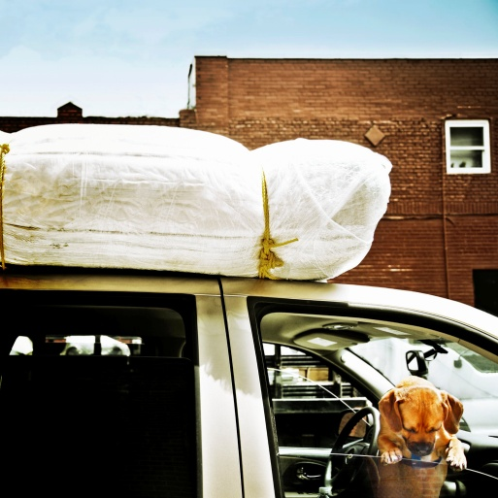




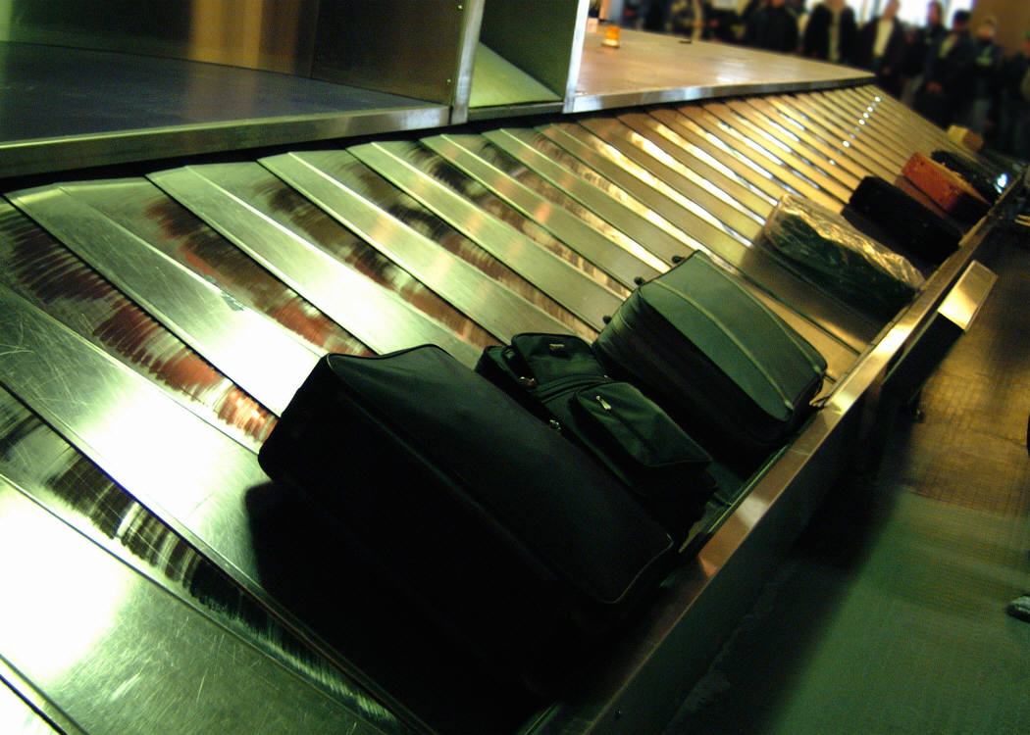

Drawing the Line
Where do you expect the most privacy? The least?
Put it on the line.
Notes:
Have participants complete Handout 1: Drawing the Line individually and then in small groups. Debrief the activity by discussing where participants placed the various locations/items on a continuum of privacy.

Slide 4
What do you think?
Is a “sniff test” by a drug detection dog conducted at the front door of a home a “search” under the Fourth Amendment?

Slide 5
The U.S. Constitution

Slide 6

The Fourth Amendment
The right of the people to be secure in their persons, houses, papers, and effects, against unreasonable searches and seizures, shall not be violated, and no Warrants shall issue, but upon probable cause, supported by Oath or affirmation, and particularly describing the place to be searched, and the persons or things to be seized.

Slide 7
The Fourth Amendment
The right of the people to be secure in their persons, houses, papers, and effects…

Slide 8
What is unreasonable?
…against unreasonable searches and seizures…

Slide 9
Do you always need a warrant?
…shall not be violated, and no Warrants shall issue…
What is a warrant?
An order approved by a judge authorizing a police officer to search or make an arrest.

Slide 10
What is probable cause?
…but upon probable cause…

Slide 11
The Fourth Amendment
…supported by Oath or affirmation, and particularly describing the place to be searched, and the persons or things to be seized.

Slide 12
Facts of the Case

Slide 13
Case Study – Handout
Facts of the Case (Handout)
Circle or highlight all relevant facts
Overview and review of facts
Trace the case through the courts
Apply the U.S. Constitution and precedent
Make a decision
Factual scenario – read and dissect

Slide 14
Case Study
Question before the Court
Is a “sniff test” by a drug detection dog conducted at the front door of a home a “search” under the Fourth Amendment?

Slide 15
How do judges make decisions?
Judges should be fair and impartial in interpreting and applying the law.
Judges must follow the law:
  US and State Constitutions
  Case law/Precedent
  Statutory Law
  Sentencing guidelines
  Court Procedures/Rules
  Code of Judicial Conduct
Notes:
Highlight the accountability of judges and how they make their decisions.

Slide 16
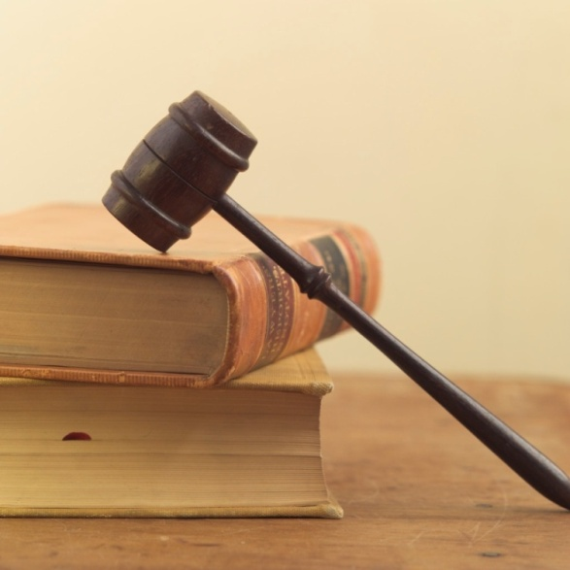
Case Precedent
You will also receive cases that will provide precedent for making your decision. Review case precedent and circle or highlight relevant facts.
Notes:
Define case precedent and discuss how judges make decisions.

Slide 17
Are these considered searches?
Search of luggage in an airport?
Search of the exterior of a car?
Search during a routine traffic stop?
Use of thermal-imaging device by police?

Slide 18
United States v. Place
Agents seized a man’s luggage at an airport without consent and later utilized a drug detection dog to perform a “sniff” test. The dog signaled for the presence of narcotics so they held the luggage for an extended period of time to obtain a warrant and ultimately found cocaine.
Did the "sniff test" by the dog constitute a search?
No. The investigative procedure of subjecting luggage to a "sniff test" by a well-trained narcotics detection dog does not constitute a "search" within the meaning of the Fourth Amendment.
Notes:
While the sniff was not a search in this case, the holding of the luggage for an extended period went beyond what was permissible under a Terry stop/detention. Review holding at https://supreme.justia.com/cases/federal/us/462/696/

Slide 19
City of Indianapolis v. Edmond
Are highway checkpoint programs, whose primary purpose is the discovery and interdiction of illegal narcotics, consistent with the Fourth Amendment?
No. The Court ruled that highway checkpoints for the primary purpose of discovering illegal narcotics are unconstitutional.
Notes:
See US Supreme Court decision at https://supreme.justia.com/cases/federal/us/531/32/case.html. Held: Because the checkpoint program's primary purpose is indistinguishable from the general interest in crime control, the checkpoints violate the Fourth Amendment. Pp. 37-48.
(a) The rule that a search or seizure is unreasonable under the Fourth Amendment absent individualized suspicion of wrongdoing has limited exceptions. For example, this Court has upheld brief, suspicionless seizures at a fixed checkpoint designed to intercept illegal aliens, United States v. Martinez-Fuerte, 428 U. S. 543, and at a sobriety checkpoint aimed at removing drunk drivers from the road, Michigan Dept. of State Police v. Sitz, 496 U. S. 444. The Court has also suggested that a similar roadblock to verify drivers' licenses and registrations would be permissible to serve a highway safety interest. Delaware v. Prouse, 440 U. S. 648, 663. However, the Court has never approved a checkpoint program whose primary purpose was to detect evidence of ordinary criminal wrongdoing. Pp. 37-40.

Slide 20
Illinois v. Caballes
Does the Fourth Amendment require a reasonable articulable suspicion to conduct a canine sniff during a lawful, routine traffic stop?
No. The Court decided that Caballes’ Fourth Amendment rights were not violated because the Constitution did not require police to have reasonable suspicion to use a drug-detection dog on a car during a legal traffic stop.
Notes:
Highlight other scenarios and examples to generate discussion about such stops including what if the drug-detection dog was delayed in arriving at the stop so the officer kept the driver from leaving until the dog arrived causing a prolonged delay in the traffic stop. Is this the same?

Slide 21
Kyllo v. United States
Does the use of a thermal-imaging device to detect relative amounts of heat emanating from a private home constitute an unconstitutional search in violation of the Fourth Amendment?
Yes. The Court ruled that because the Government used a device not available to the general public to find out details that would not have been known otherwise, the use of the device was a “search” that required a warrant, thus violating Kyllo’s Fourth Amendment rights.

Slide 22
The Case Through the Courts
Jardines Case
11th Circuit Court for Miami Dade County
Evidence was suppressed on the grounds that the dog sniff was an unconstitutional search.
Florida Supreme
Court
Third District Court of Appeal
The state appealed the lower court decision. The motion to suppress was reversed stating that the search was not illegal and a warrant was not needed to conduct the search.

Slide 23
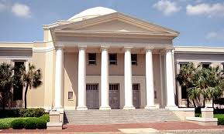
Jardines Seeks Review
Mr. Jardines sought review in the Florida Supreme Court since the decision of the Third District Court conflicted with Fourth District Court in the case of State v. Rabb.
The Florida Supreme Court granted the request.
Notes:
The Fourth District Court of Appeal in State v. Rabb, 920 So. 2d 1175 (Fla. 4th DCA 2006), affirmed the trial court‟s suppression of illicit drugs (marijuana found growing in Rabb‟s house) following a warrantless “sniff test” by a drug detection dog at the front door of Rabb‟s home. The district court based its ruling on Kyllo v. United States.
In Rabb: The Fourth District Court of Appeal ruled for the suppression of marijuana found at Rabb’s house following a warrantless “sniff test” at the front door of Rabb’s home
The dog was considered a sense-enhancer that allowed the officers to intrude into the constitutionality protected area of Rabb’s home

Slide 24

Question Before the Court
Is a “sniff test” by a drug detection dog conducted at the front door of a private home considered a “search” under the Fourth Amendment?

Slide 25

Now it is your turn to be the judge

Slide 26

Individually Answer the Question
Based on the facts of the case, case precedent, and the Fourth Amendment of the U.S. Constitution, how would you decide?
Is a “sniff test” by a drug-detection dog conducted at the front door of a private home considered a “search” under the Fourth Amendment?
If you answer YES…
You agree with Mr. Jardines
If you answer NO…
You agree with the State of Florida

Slide 27
Form Groups
Form groups of 5.
Choose a Chief Justice.
  Chief Justice maintains order
Poll each Justice.
  How did each one answer the question and why?
Come to a unanimous decision.

Slide 28
What did Each Court Decide?
Now we will look at the decision of the Florida Supreme Court

Slide 29
Florida Supreme Court
“…if government agents can conduct a dog “sniff test” at a private residence without any prior evidentiary showing of wrongdoing, there is nothing to prevent the agents from applying the procedure in an arbitrary or discriminatory manner, or based on whim and fancy, at the home of any citizen. Such an open-ended policy invites overbearing and harassing conduct. Accordingly, we conclude that a “sniff test,” such as the test that was conducted in the present case, is a substantial government intrusion into the sanctity of the home and constitutes a “search” within the meaning of the Fourth Amendment.”

Slide 30
Florida Supreme Court
Given the special status accorded a citizen’s home in Anglo-American jurisprudence, we hold that the warrantless “sniff test” that was conducted at the front door of the residence in the present case was an unreasonable government intrusion into the sanctity of the home and violated the Fourth Amendment. We quash the decision in Jardines and approve the result in Rabb.

Slide 31
The Case Through the Courts
Jardines Case
11th Circuit Court for Miami Dade County
Evidence was suppressed on the grounds that the dog sniff was an unconstitutional search.
U.S.
Supreme
Court
Florida Supreme
Court
Third District Court of Appeal
The state appealed the lower court decision. The motion to suppress was reversed stating that the search was not illegal and a warrant was not needed to conduct the search.

Slide 32
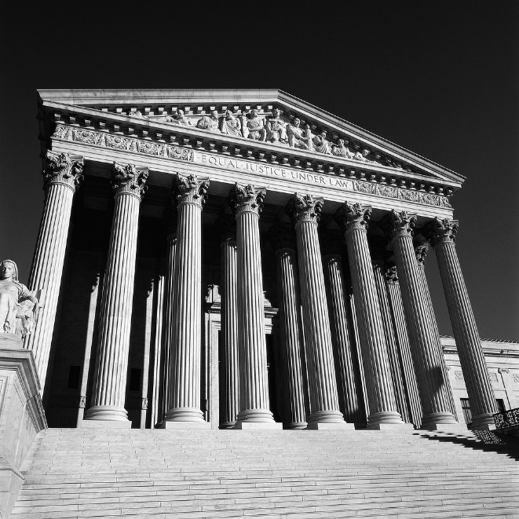
The US Supreme Court

Slide 33
From the Decision Issued in Florida v. Jardines
“…when it comes to the Fourth Amendment, the home is first among equals. At the Amendment's "very core" stands "the right of a man to retreat into his own home and there be free from unreasonable governmental intrusion." This right would be of little practical value if the State's agents could stand in a home's porch or side garden and trawl for evidence with impunity…”

Slide 34

Supreme Court, 2012
“…The government’s use of trained police dogs to investigate the home and its immediate surroundings is a “search” within the meaning of the Fourth Amendment. The judgment of the Supreme Court of Florida is therefore affirmed.”
Notes:
http://www.supremecourt.gov/opinions/12pdf/11-564_5426.pdf

Slide 35
Citations and resources
http://www.oyez.org
http://www.floridasupremecourt.org/decisions/2011/sc08-2101.pdf
http://www.supremecourt.gov/opinions/12pdf/11-564_5426.pdf

Slide 36

Peggy Cotogno
Executive Director
Peggy.cotogno@lsba.org
These materials have been adapted, with permission from The Florida Bar Benchmarks Adult Civic Education Program, for use in Louisiana. Principal authors of the Florida Benchmarks Program are Annette Boyd Pitts and Richard Levenstein. For assistance with adaptation in other states, contact staff@flrea.org

