Slide 1
Your #1 Resource for Metal Fabrication

Slide 2
RMS is a designated manufacturer for bulk and production manufacturing.
We pride ourselves on three basic principals.
Competitive Pricing / Quality Products / Unwavering Customer support - SERVICE!

Slide 3
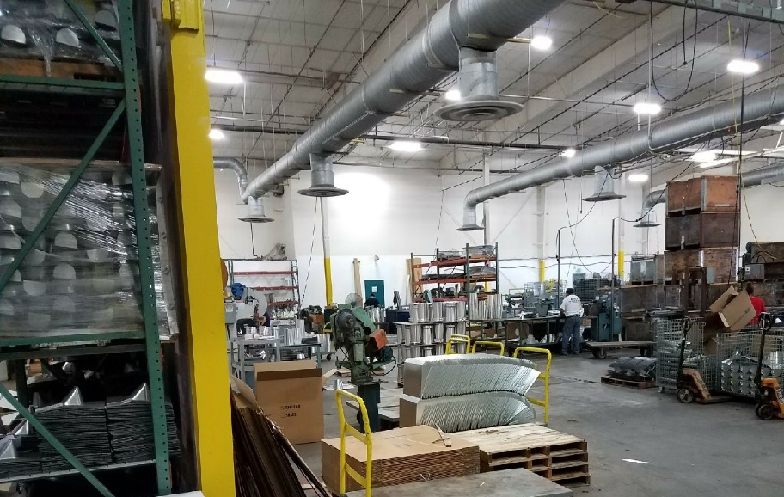
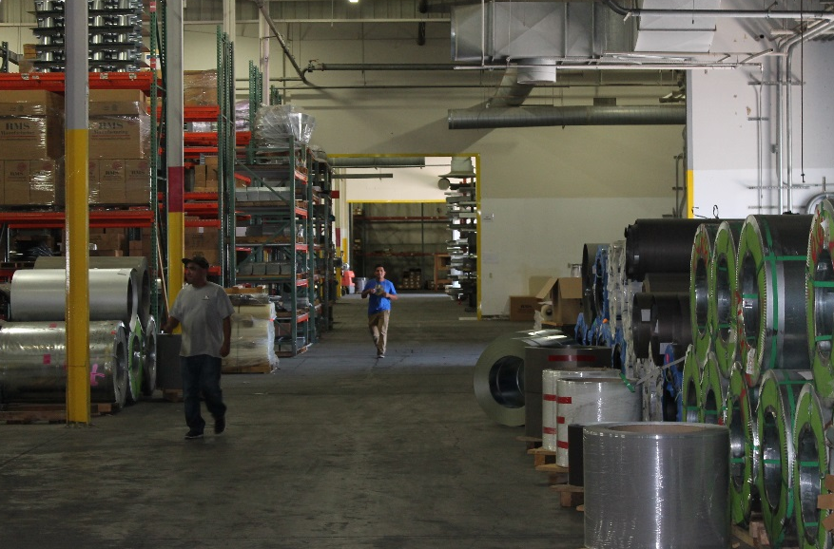
We Operate within a 100 thousand sq. ft. facility so our foot print is made for quantity production. RMS doesn’t just bend metal, WE MAKE RESULTS!

Slide 4
We are U.S. Made, U.S. Operated and U.s. Delivered!

Slide 5
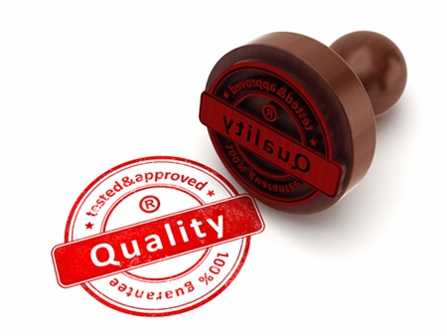
Price
Quality
Task Description
Task Description
Service
WE function as a company in Unison!
We don’t make promises we DELIVER RESULTS…
Every Day, Every Time,
Without Fail, NO Exceptions!

Slide 6
Our Business is YOUR Business, building our success with you 1 step at a time!
Relationship Building
Delivering Results
Follow Through
Accountability
Sustainability

Slide 7
“Specialist in Manufacturing, so we can become a Partner in yours”

