Slide 1
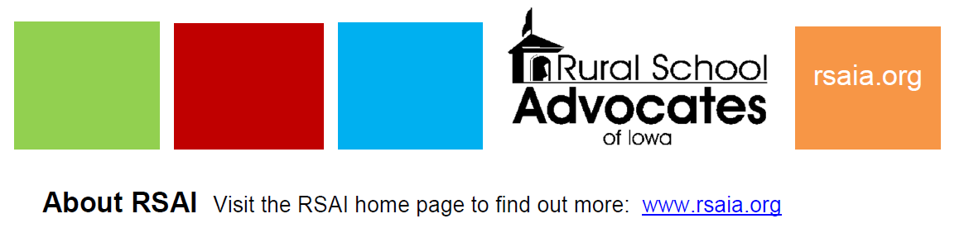
RSAI 2020 Priorities

Slide 2
Themes of Rural School Needs
Resources: $$$$$$$$$$$$$$ state, local, federal, other (partnerships, sharing, grants, incentives)
Flexibility: One size does not fit all. Especially in local schools, staff where many hats. Strict expenditure and legal requirements do not always work with very small economies of scale.
Student needs: Changing demographics have significantly impacted rural schools. Poverty, Mental Health, Immigration and Aging resident population, bigger farms with fewer kids, transportation and other barriers to participation, population sparsity

Slide 3

Priorities Status on Page 4

Slide 4
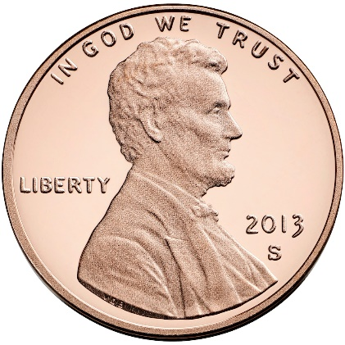
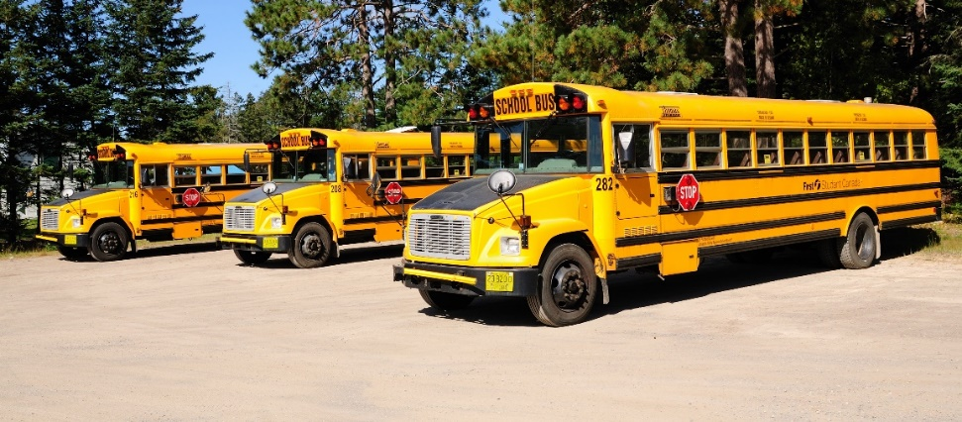
Online Learning Flexibility
Offer and Teach Flexibility
Formula Equity

Slide 5
RSAI Leadership Group and Terms
Robert Olson, Clarion-Goldfield/Dows, Superintendent, robert.olson@rsaia.org (Sept. 2020)
Laurie Noll, Fairfield, Superintendent, laurie.noll@fairfieldsfuture.org (Sept. 2020)
Dennis McClain*, Clay Central Everly through June 30, Superintendent, moves to Adair-Casey and Guthrie Center effective July 1) (Sept. 2019)
Duane Willhite*, North Fayette Valley, Superintendent, dwillhite@nfv.k12.ia.us (Sept. 2020)
Nick Trenkamp, Central, Superintendent, nicholas.trenkamp@rsaia.org (Sept. 2020)
Paul Croghan, Essex/East Mills Superintendent through June 30, 2019, and Nodaway Valley & CAM beginning July 1, 2019, Superintendent, paul.croghan@rsaia.org (Sept. 2019)
Dan Smith*, Van Buren County, Board Member, dan.smith@rsaia.org (Sept. 2021)

Slide 6
Thanks to the RSAI Legislative Group (one-year term) who supported
RSAI’s policy development prepping for the 2020 Session!
includes at large members from Leadership Group plus:
SW – Tim Mitchell / Riverside Superintendent
NE – Barb Schwamman/ Osage and Riceville Superintendent
SE – Joel Pedersen/ Cardinal Superintendent
NW – Scott Williamson/Souix Central, Clay Central-Everly and Laurens Marathon Superintendent

Slide 7
2020 Priorities: Oct. 17 RSAI Annual Meeting
Adequate Resources
Student Mental Health Services
Educator Shortage and Quality Instruction
Formula and Transportation Equity
Opportunity Equity for Low SES
Sharing Incentives and Efficiencies
Quality Preschool
School Safety
School Bonding at Simple Majority

Slide 8
Adequate Funding
RSAI supports adequate base funding. The increased per pupil cost known as SSA is especially critical to rural students due to distance from school/opportunities, economies of scale, mandates, the need for AEA support, and the ability to attract and retain staff. Rural schools depend on an investment of meaningful new resources to prepare students for a successful future.
The rate of increase in SSA should be no lower than anticipated growth in state revenue (adjusted for legislated tax cuts), should keep up with other economic factors such as personal income or state gross domestic product over the long term, should maintain a balance of state and local property taxes, provide predictability, and be set timely to assure adequate notice for budget planning and staffing.
The SSA rate for the 2020-21 school year should be set no lower than 3.75%, if the revenue adjustment controlling for tax cuts is lower than 3.75%.

Slide 9
Why 3.75%?
SSA funds regular program
  Teachers (salaries and benefits)
  Support Staff
  Administrators
  Transportation (salaries and fuel)
  Curriculum, books, instructional software, supplies
  Utilities (heat, water, electricity, phone, internet)
  Training
  Operations

Slide 10
Why 3.75%?
Caveats
  Funding is per pupil – fewer pupils means a reduction in revenue
  Unfunded mandates pop up (training for emergency plans, suicide prevention training, increased employer share of IPERS, financial literacy graduation requirement)
  This amount does not make up for several tough years
  This amount does not allow for program expansion for students

Slide 12
374

Slide 13
State Revenue Policy
School funding adequacy is a function of sufficient state revenues and mix of revenue sources for schools.
Continued property tax relief focus confuses the issue – state investment increases to make up for a reduced property tax dollar but schools don’t receive those funds as additional revenue.
Check out the Legislative Digest for additional information on tax cuts, policy decisions limiting state revenue, and increased tax credit thresholds of private school scholarships (STOs)

Slide 14
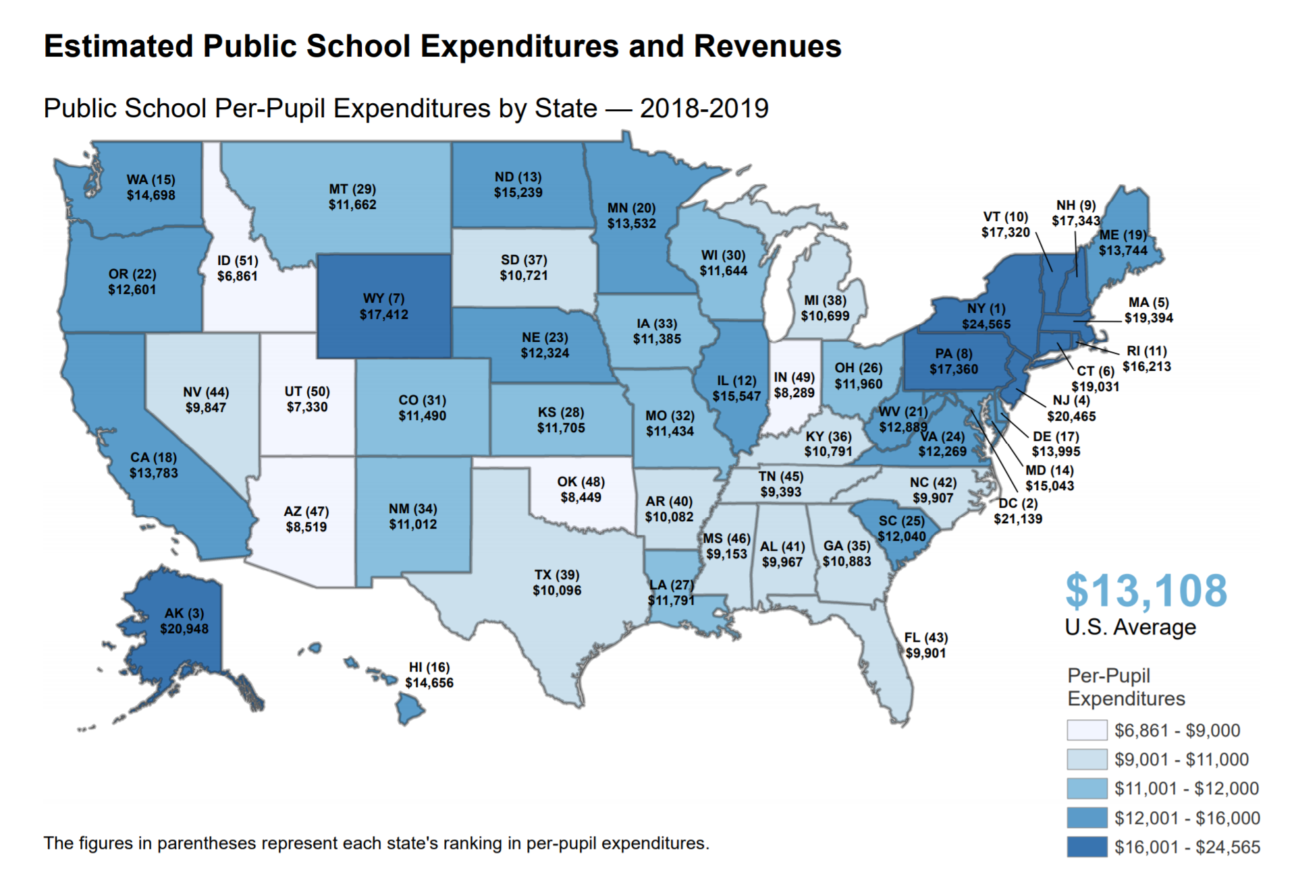
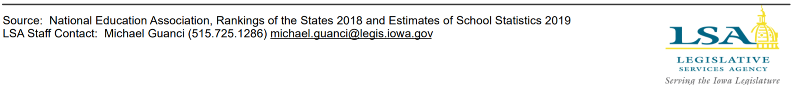
Iowa ranks 33rd, now
$1,423 per pupil behind the national average

Slide 15
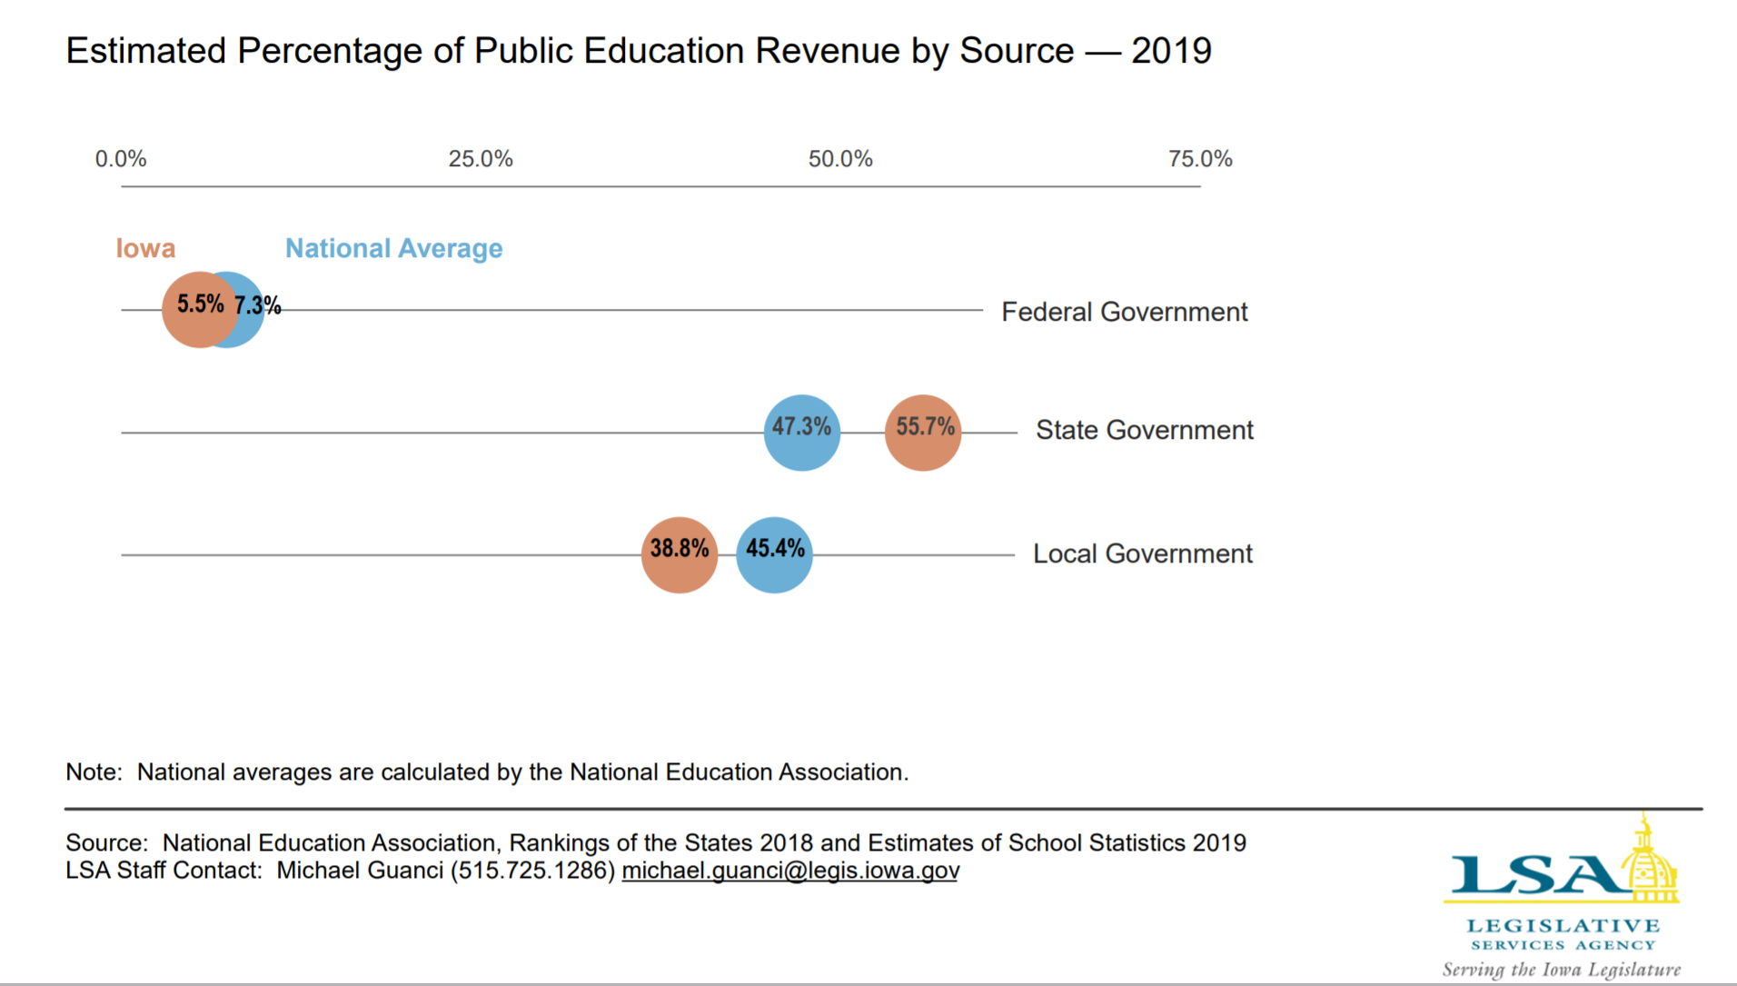
It will be hard to catch up when the state carries most of the funding burden and lowers tax revenue.

Slide 16
Some Economic Indicators
Iowa Per capita Personal Income Grew 4.6% in last 12 months June 30, 2018 to June 30, 2019 (source https://data.iowa.gov/Economic-Statistics/Personal-Income-and-Per-Capita-Personal-Income-by-/vm3e-atwp)
FY 2019 State General Fund Revenue closed up 6.4%. (SSA was 1.2%). Gov. Kim Reynolds announced Sept. 30, 2019: the State of Iowa will end Fiscal Year 2019 with a balance of $289.3 million in its General Fund. (source: https://governor.iowa.gov/2019/09/iowa-budget-closes-with-full-cash-reserves-surplus-of-289m)
Governor’s Future Ready Iowa, Iowa Grant High Demand Occupations 2019 include 11 different education/teaching positions. https://www.futurereadyiowa.gov/sites/fri/files/basic_page_files/State%20program%20list-%20updated%202019.pdf
Iowa has a 2.5% unemployment rate, which ranks us 3rd in the nation behind North Dakota (2.4%) and Vermont (2.1%) according to the Bureau of Labor Statistics August 2019. Iowa's private sector is clamoring for qualified workers.
NASBO annual expenditure report for all states. November 2018 NASBO report shows education expenditures as a percentages of all state expenditures, not just general fund. In that report, Iowa spends 16.9% of all state funds on elementary and secondary education.
Ranks Iowa 5th out of 7 states in the group called "Plains States" (group average 20.5% of all state funds spent on PK-12 education) with Iowa behind ND, MO, MN, KS and just ahead of NE and SD.
The national average is 19.5%, which also is significantly ahead of Iowa.

Slide 17
Student Mental Health
RSAI supports increased access to and funding for mental health services for children.
In addition to adequate funding for AEA services and access to other service providers, an array of services should also include telehealth services received at school.
The state, Medicaid and insurance providers should not pass on administrative or billing work to schools, and schools should not be mandated to be providers of mental health services for children.

Slide 18
Action Comments
HF 690 Children’s Mental Health System set up a system but did not provide funds.
HF 758 Education Appropriations included $2.1 million to AEAs for MH training of educators and a resource clearinghouse.
SF 376 MH content in High School health curriculum, did not get approved in the Senate.
SSB 1240 in Senate Human Resources Committee: telehealth screening and treatment in school setting.
HF 690 is a good structural start, but may not overcome the geography limitation of service location. Just like attracting teachers, there are MH services deserts without services.
AEA training is a good start, but it’s not a one-time thing. Must be ongoing.
Both SF 376 and SSB 1240 are in committee and alive for further action as the 2020 Session begins.

Slide 19
Educator Shortage & Quality Instruction
RSAI supports maximum flexibility to hire staff to provide great instruction and support to all Iowa students.
RSAI supports 1) district flexibility to meet offer and teach requirements, 2) teacher or other staff shortage loan forgiveness programs and incentives to encourage staff to work in rural schools, 3) a special education generalist credential to teach special education across all grades, 4) creation of a Public Service strand in Iowa’s CTE system to prepare Iowa’s future teaching workforce, 5) continued state support of Iowa Learning Online (ILO), 6) flexibility to hire retirees without a negative IPERS impact, 7) elimination of barriers to licensure for teachers and administrators, and 8) allow associate degree for substitutes.
The BOEE should accept evidence other than strict transcripts to show skill mastery for administrators from other states.

Slide 20
Educator Shortages
Money isn’t everything, but competitive salaries are important
Culture and climate of the school district, adequate support and good leadership also matter to teacher retention
Iowa’s Teacher Leadership and Compensation is improving retention of teachers in Iowa schools (see you own goals for retention in your TLC plan)
For young teachers, student loan debt requires a sufficient salary to make payments and young teachers are also attracted to communities with amenities.
There’s a shortage if you have not enough applicants and/or no qualified applicants

Slide 21
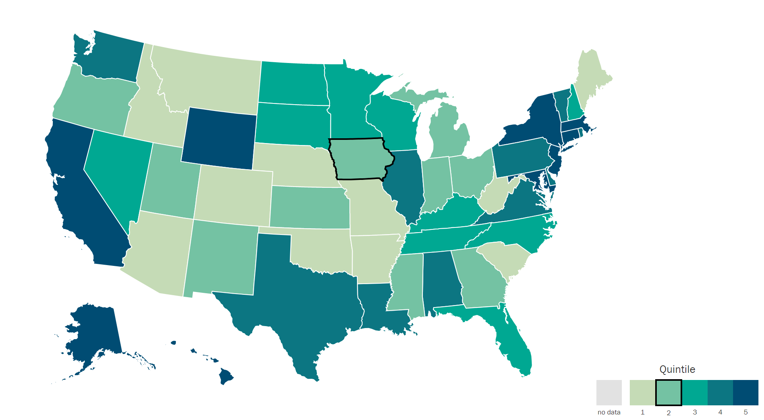
Understanding Teacher Shortages: 2018 Update
A State-by-State Analysis of the Factors Influencing Teacher Supply, Demand, and Equity https://learningpolicyinstitute.org/product/understanding-teacher-shortages-interactive
IA $35,766
SD $37,419
ND $38,032
MN $37,644
WI $36,983
IL $38,820
MO $31,842
IA is in the second to lowest quintile, ranking 30th in starting teacher pay.

Slide 22
Is there a shortage? Uncertified Teachers and Teacher Vacancies by State https://learningpolicyinstitute.org/uncertified-teachers-and-teacher-vacancies-state
The Learning Policy Institute gathered data from the 36 states which report (Iowa does not report)
  Of the 36 states that reported, there were 87,091 under-credentialed teachers, or 3.5% of teaching positions. IF that percentage holds for the remaining states, it is estimated that 108,757 teachers without the license for their position were teaching in 2016-17
  For the 36 states that reported, there were 6,424 unfilled positions at the beginning of the school year (2016-17)
What evidence do you have locally? Fewer applicants for open positions? Difficulty hiring and then retaining?

Slide 23
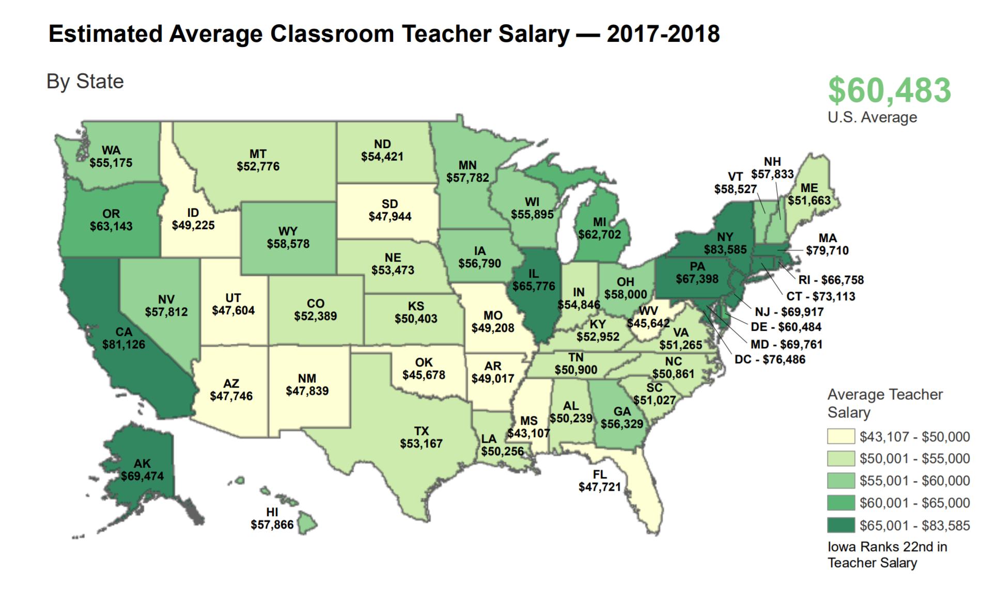
https://www.legis.iowa.gov/docs/publications/MOW/970927.pdf

Slide 24
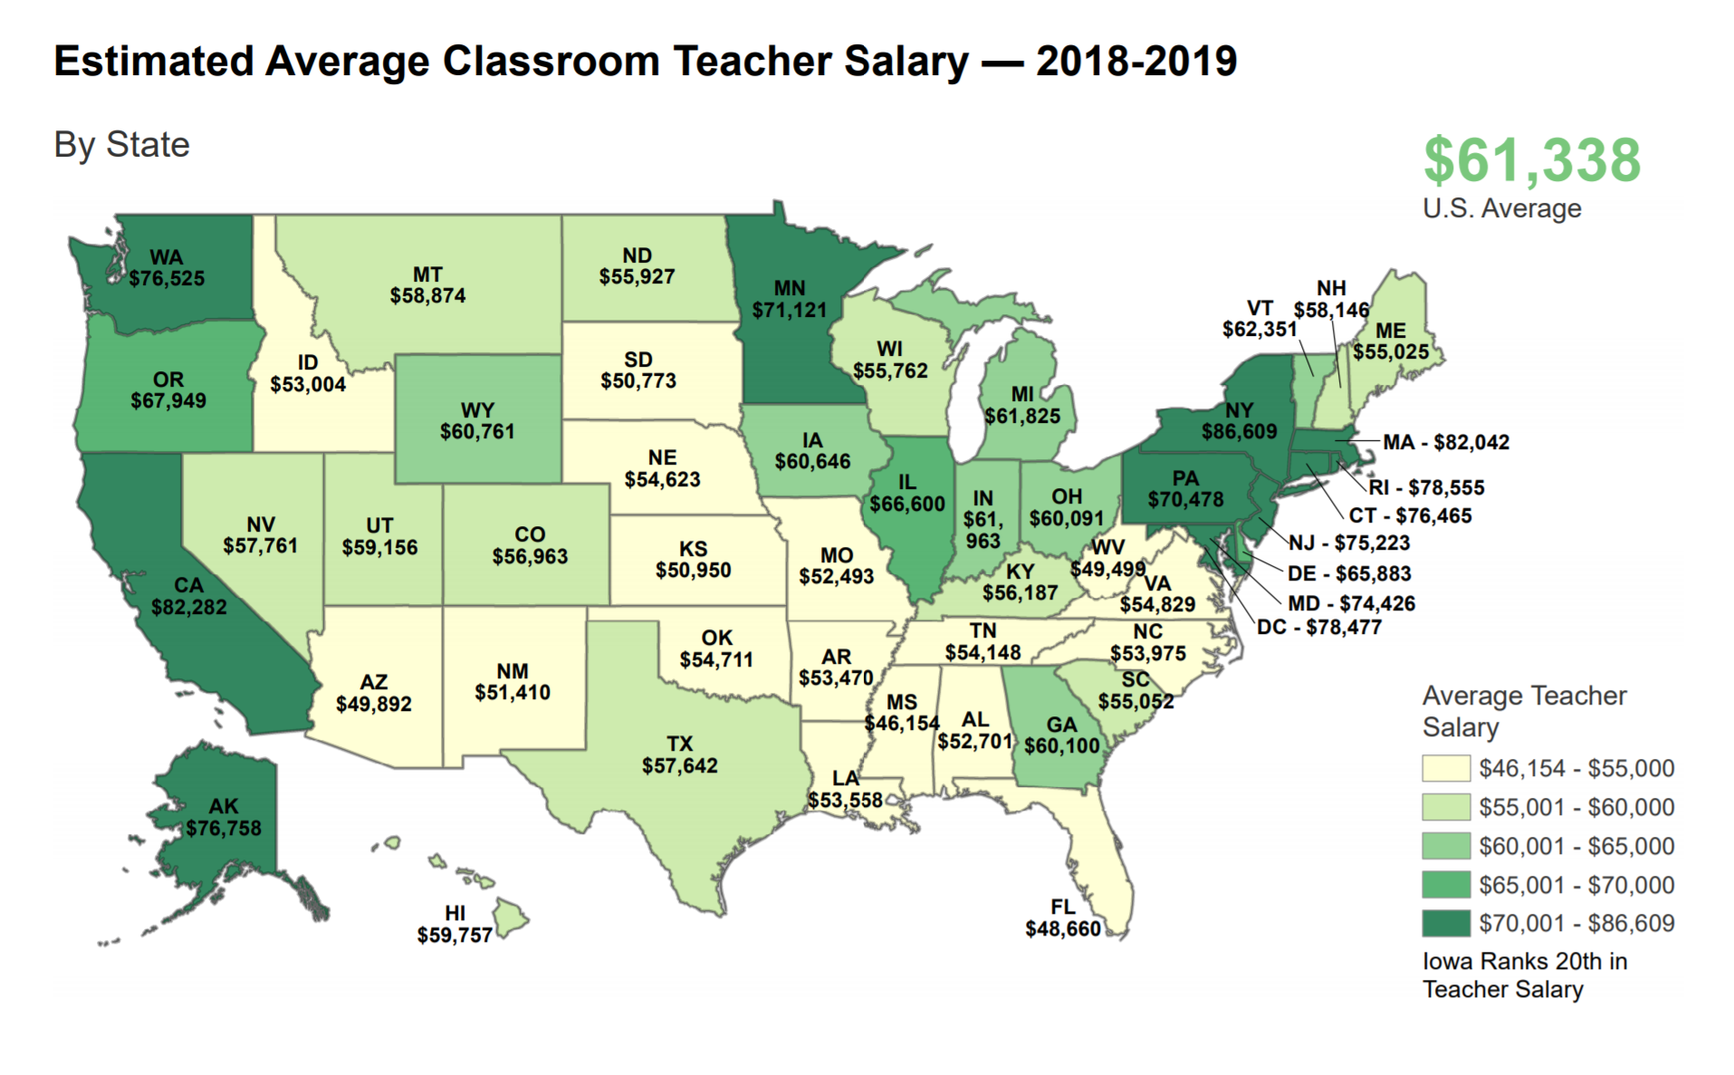
https://www.legis.iowa.gov/docs/publications/FCTA/1050019.pdf

Slide 25
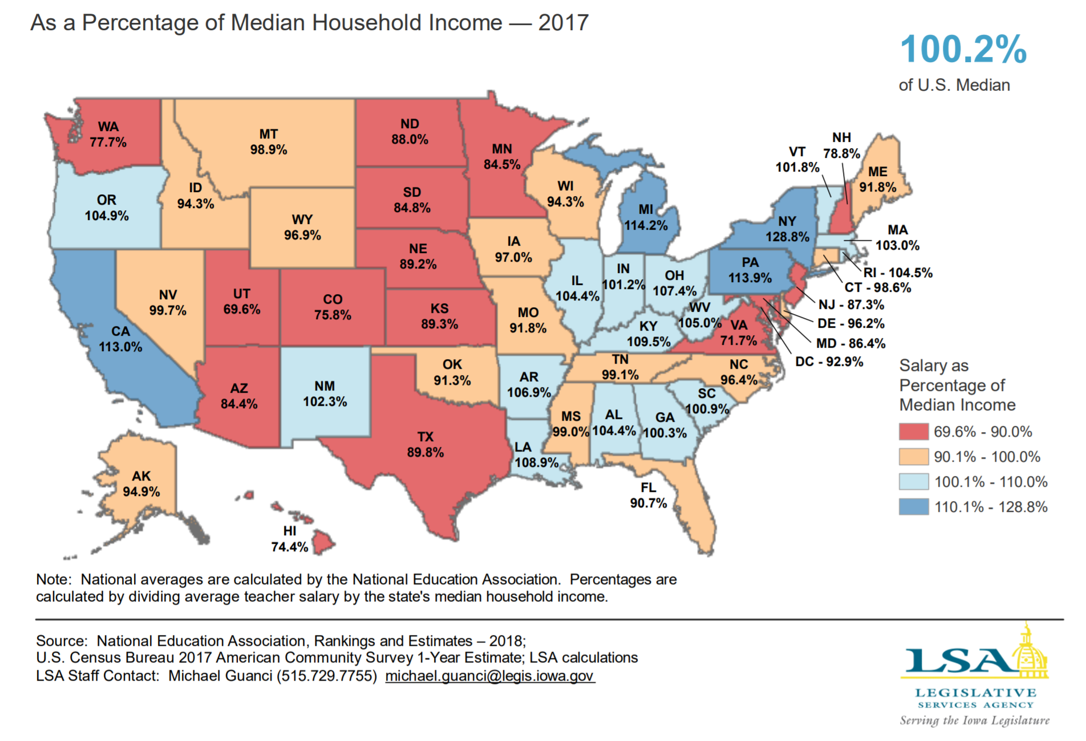
Iowa ranks 22nd in Teacher Pay as % of median Household Income

Slide 26
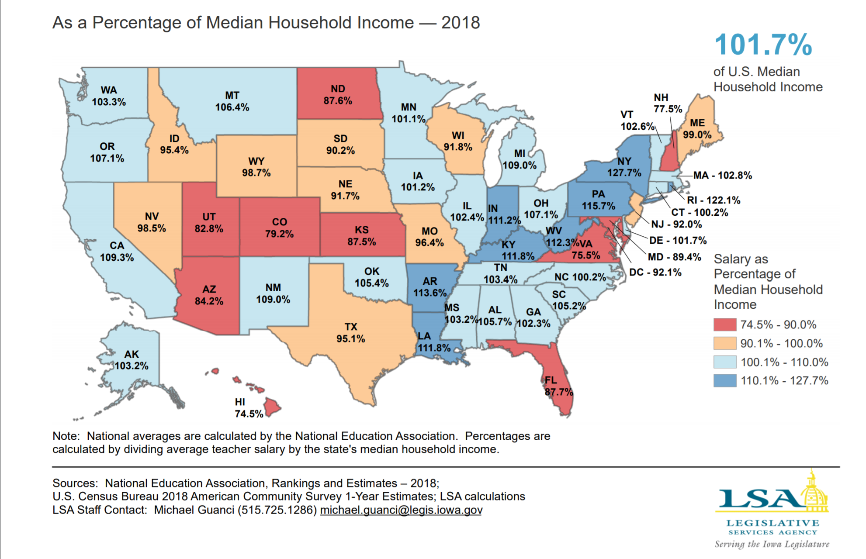
Iowa ranks 28nd in Teacher Pay as % of median Household Income

Slide 27
Educator Shortage is an Economic Market Issue
Low SSA for 9 of 10 years creates a pressure point for teacher pay.
If teacher pay is higher, the pool of qualified candidates would grow.
Ditto for administrators.
Rural schools are doubly disadvantaged.
The quality of Iowa’s workforce depends on the quality of our schools’ workforce

Slide 28
Formula and Transportation Equity:
RSAI supports formula and transportation equity. The Legislature should accelerate the commitment to close the $165 gap between the state and district cost per pupil within ten years and continue transportation equity support, bringing down all districts to no more than the state average per pupil transportation cost, without requiring burdensome reporting requirements from school districts.
$5 per pupil in each of the last 2 years. At this pace, there will be equity in 33 years.
Transportation in the formula. Will grow by SSA. Need to finish the job, to get all districts to the average transportation cost per pupil enrolled.

Slide 29
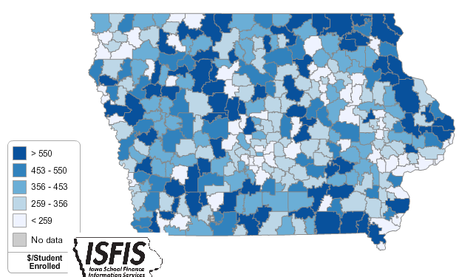

RSAI Position Paper http://www.rsaia.org/2020-legislative-session.html
The range in transportation expenditures varied from a low of $19 to a high of $ 1,197 per student enrolled.
With transportation funding in the formula, that range from high to low has been closed to $381 per pupil (state average is $330).
Square miles per district range from a low of 2 to a high of 555 square miles, and route miles range from a low of 745 to a high of 978,903 miles.

Slide 30
Opportunity Equity for Low SES
RSAI supports resources for at-risk students.
Resources should be based on need, such as the percentage of students eligible for Free and Reduced Price Lunch (FRPL), in addition to enrollment of the district. The current disparity in dropout prevention capacity, (some districts held to 2.5% and others allowed to access up to 5% of regular program district cost) is arbitrary, based on history no longer relevant to supporting student needs. All school boards should be able to realize the full 5% dropout prevention funding.
The formula must further recognize the disproportionate cost of providing equal educational opportunities to low-income students.
School districts should be granted spending authority for FRPL eligible students’ fees mandated to be waived by state and federal law.

Slide 31
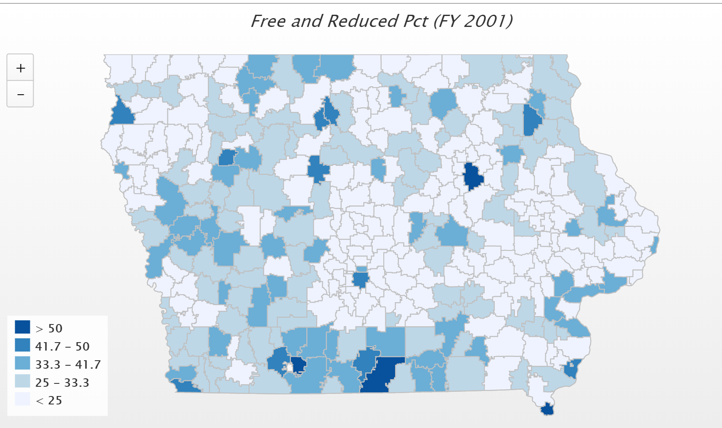
In 2001, only 4 districts had more than 50% of students eligible for FRPL. (FYI – Diagonal was the state high at 60.2%)

Slide 32
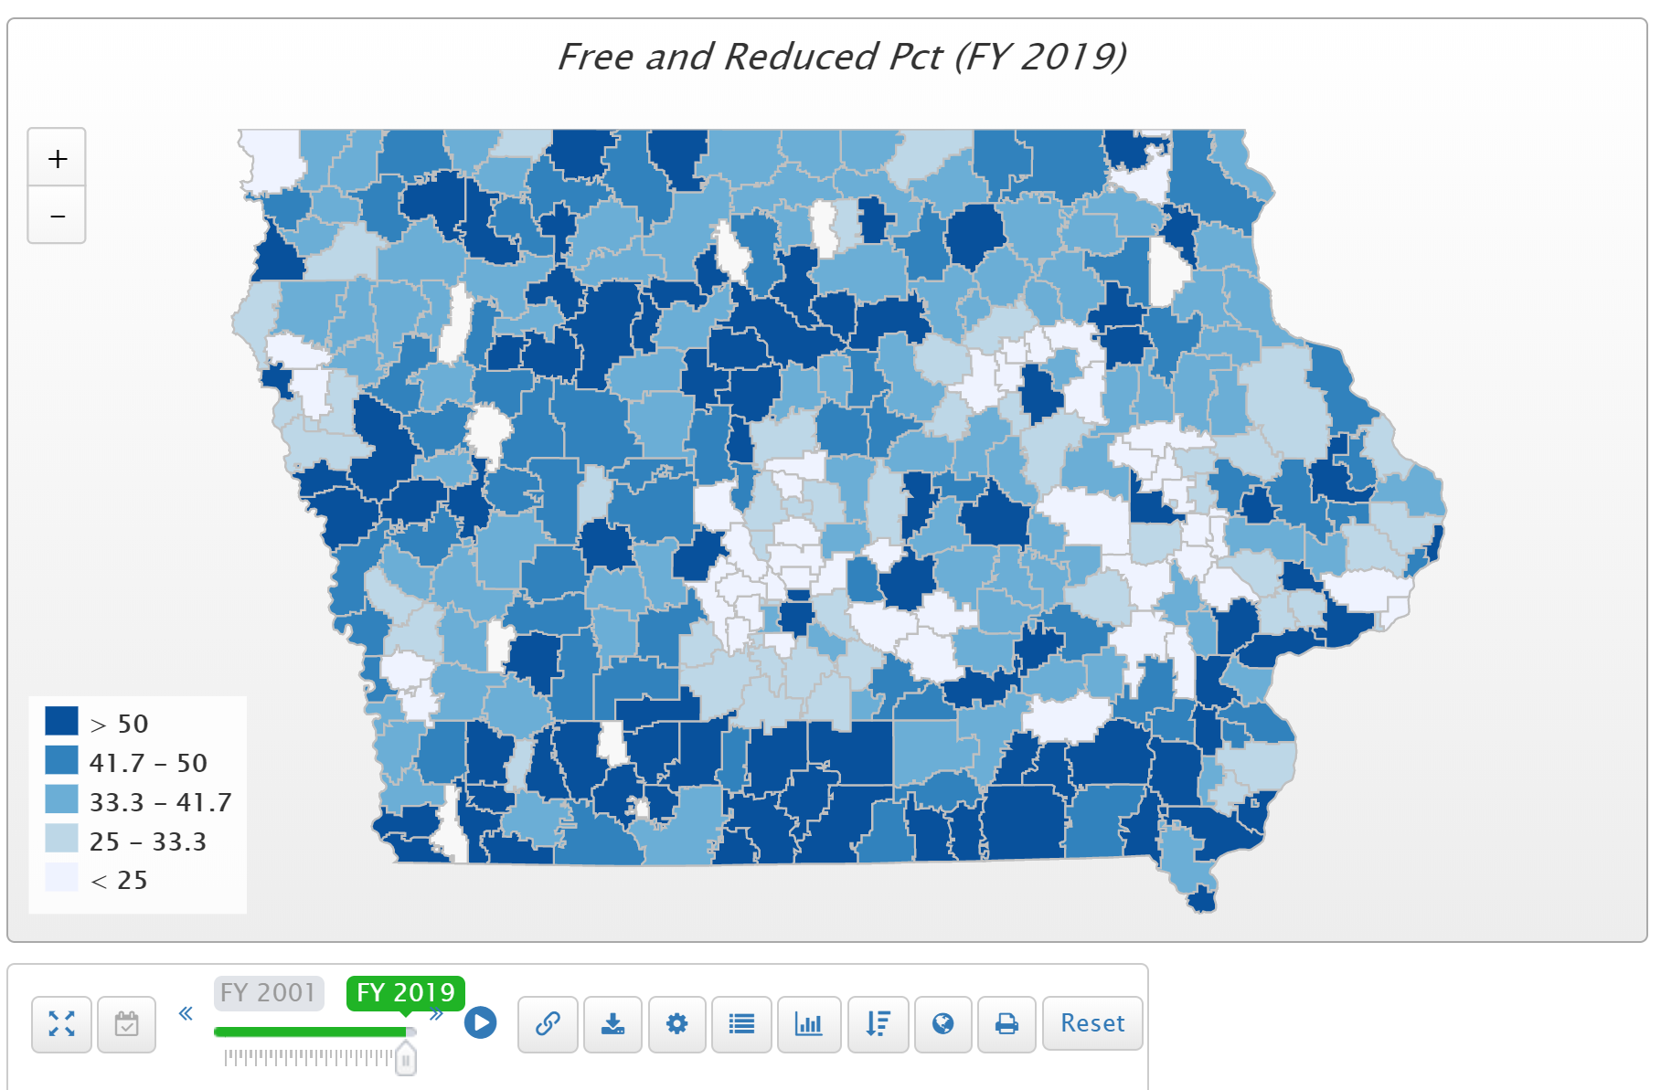
Children from families with incomes at or below 130% of the poverty level are eligible for free lunch those 130-185% eligible for reduced lunch.

Slide 33
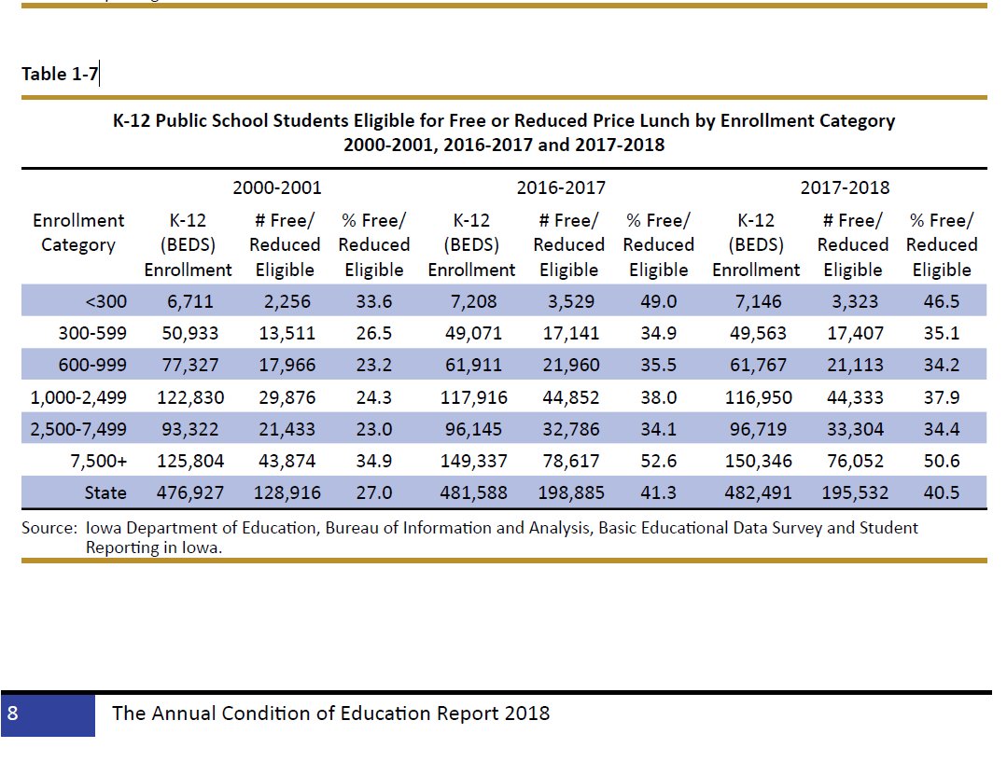

Slide 34
Rural Poverty
What does it look like?
How are students disadvantaged?
What happens to rural communities if the cycle of poverty continues?
Rural poverty is often accompanied by isolation, barriers to or nonexistent services.

Slide 35
Why Rural Matters Nov. 2019
More students in the U.S. attend rural schools than in the nation’s 85 largest school districts combined. Nearly one in six of those rural students lives below the poverty line, one in seven qualifies for special education, and one in nine has changed residence in the previous 12 months.
Many states provided a disproportionately larger share of school funding for rural districts because of the higher relative costs of running rural schools. Twelve states, however, provided disproportionately less funding to rural districts: Nebraska had the greatest disparity, followed by Vermont, Connecticut, Iowa, Rhode Island, Wisconsin, Michigan, Massachusetts, California, Ohio, Minnesota, and New Jersey.
http://www.ruraledu.org/WhyRuralMatters.pdf

Slide 36
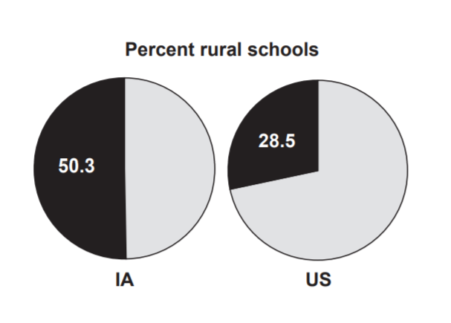
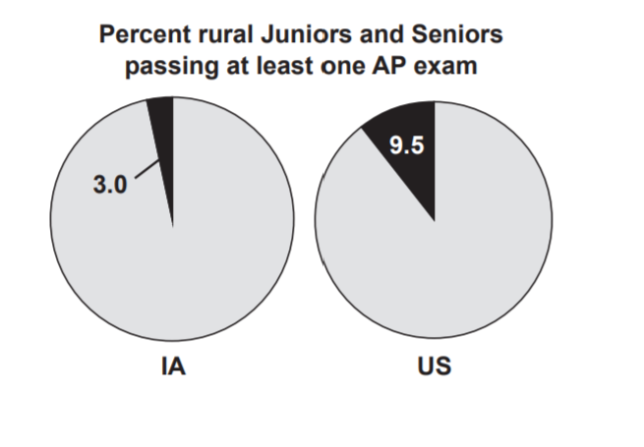
IOWA - Half of Iowa’s schools are located in rural districts, and these schools serve nearly one in three of the state’s public school students. Iowa’s rural students and families are less diverse than the national median. Funding is relatively inequitable, but instructional expenditures and teacher salaries are on par with the rest of the country’s rural districts. The most alarming indicator for rural education in this state is the academic performance gap between the state’s rural poor and their non-poor rural peers – a gap which is larger in Iowa than in the majority of the other states. In preparing for college, Iowa’s rural students are much more likely to take dual enrollment courses than their rural counterparts in other states, but less likely to pass at least one AP exam. http://www.ruraledu.org/WhyRuralMatters.pdf

Slide 37
Sharing Incentives and Efficiencies:
RSAI supports extension of sharing and efficiency incentives.
Rural students benefit from opportunities to achieve efficiencies, share capacity to operate, and redirect resources to educational programs.
Whole Grade Sharing, Reorganization, and Operational Sharing Incentives should be extended and expanded.

Slide 38
Action Comments
HF 596 extends WGS and Reorganization incentives for five years, for reorganizations effective on or before July 1, 2024.
HF 633 amended by Senate to extend incentives through June 30, 2024, added social worker and eliminated 5-year limit for a position to be shared.
5-year extension was the goal
As the leadership in the legislature becomes more urban, this will not become easier down the road.
Both the operational sharing and reorg/WGS incentives are critical to rural schools, so keep legislators apprised of the benefits along the way.

Slide 39
Quality Preschool
RSAI supports full funding of quality preschool. Due to changing demographics in rural Iowa, significant transportation costs, and lack of quality day care access, preschool should be fully funded at the regular student count at 1.0 per pupil cost.

Slide 40
Why does preschool matter?
  The Perry Preschool Project (40 years), PK saves $17 for every dollar invested.
  The majority of states now view access to high-quality PK programs as a critical long-term economic investment in the future workforce.
  Education Commission of the States, Oct. 2014, http://www.ecs.org/docs/early-learning-primer.pdf: Six Rigorous long term evaluation studies have found that children who participated in high-quality preschool programs were:
    25% less likely to drop out of school.
    40% less likely to become a teen parent.
    50% less likely to be placed in special education.
    60% less likely to never attend college.
    70% less likely to be arrested for a violent crime.
  NCSL quotes studies on long term return on investment. http://www.ncsl.org/research/human-services/new-research-early-education-as-economic-investme.aspx

Slide 41
School Safety
RSAI supports school safety investments. Rural schools need the resources, training and support necessary for Iowa student and staff safety at school, including additional funding for security personnel and training to protect against active shooter and other emergency situations presenting harm.

Slide 42
Bonding Capacity
RSAI supports a simple majority, 50% plus 1, voter approval for school bond issues.

Slide 43
A few more things to think about. . . . .

Slide 44
More Property Tax Relief?
The state’s share of the funding formula has increased dramatically in the last decade.
Over the next two decades, the State Penny for School Infrastructure will phase in about 1% of the sales tax revenue increase (if sales tax revenue grows 4%, that 1% PTR share is a quarter of the increase.) That tops out at $349 million by 2050 according to the LSA’s fiscal note.
The Taxpayer trust fund has $60 million estimated balance in FY 2020 and $127 million in FY 2021.
Here’s some proof that school property tax rates have fallen significantly:

Slide 45
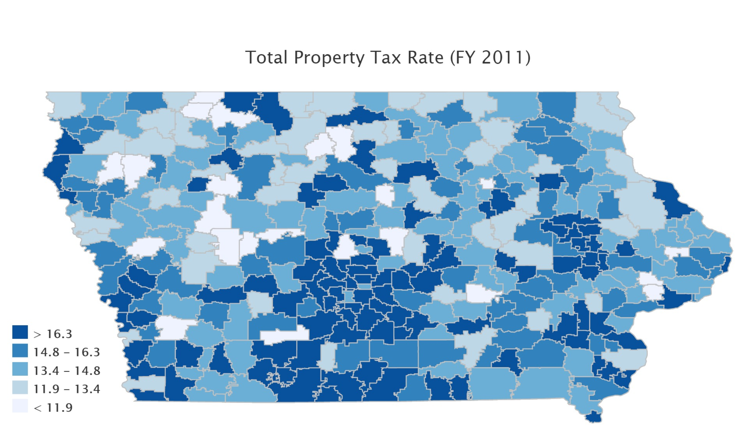
Just 9 years ago:
FY 2011 total school tax rates:
Min $8.34
Median $14.57
Mean $15.10
Max $23.63

Slide 46
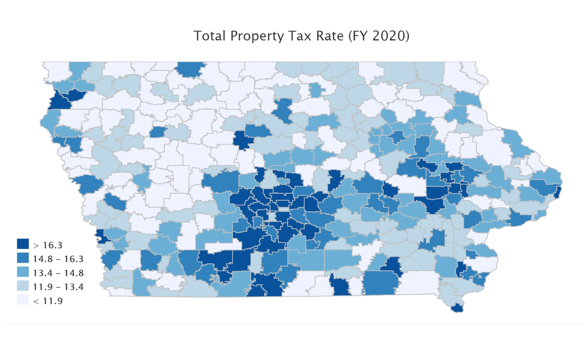
Current Fiscal Year:
FY 2020 total school tax rates:
Min $8.13
Median $13.22
Mean $13.51
Max $20.80

Slide 47
FY 2011 total school tax rates:
Min $8.34
Median $14.57
Mean $15.10
Max $23.63
FY 2020 total school tax rates:
Min $8.13
Median $13.22
Mean $13.51
Max $20.80

Slide 48
School Choice Defense
Vouchers/Tax Credits consume funds needed for public education
Bills for ESA’s/vouchers in 2018 and 2019 Sessions did not advance through a chamber, but did get through Senate Education Committee in 2019
Tax bills did expand STOs in 2018 and again 2019
Costly – tight budget applies to this issue too

Slide 49
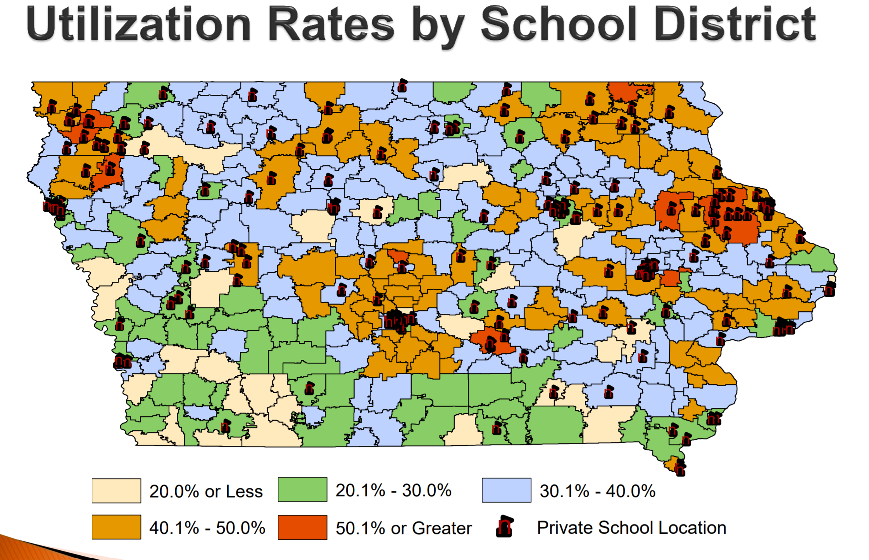
Source: Legislative tax Expenditure Committee DOR Report on Tuition and Textbook Tax Credits https://www.legis.iowa.gov/docs/publications/SD/865242.pdf (in RSAI School Choice Position Paper)
Note location of existing private schools related to legislative seats

Slide 50
Student Behavior Issues
State BOE Rules on Seclusion and Restraint – were tabled to get more input
Make it harder to ever use seclusion rooms or restrain students
Meanwhile, some Senate Education Committee leaders are working on Room Clearing practices
News media is covering school behavior issues in depth
Expect these two issues to collide
Add on mental health, school safety personnel and funding, school choice issues will be waiting in the wings.

Slide 51
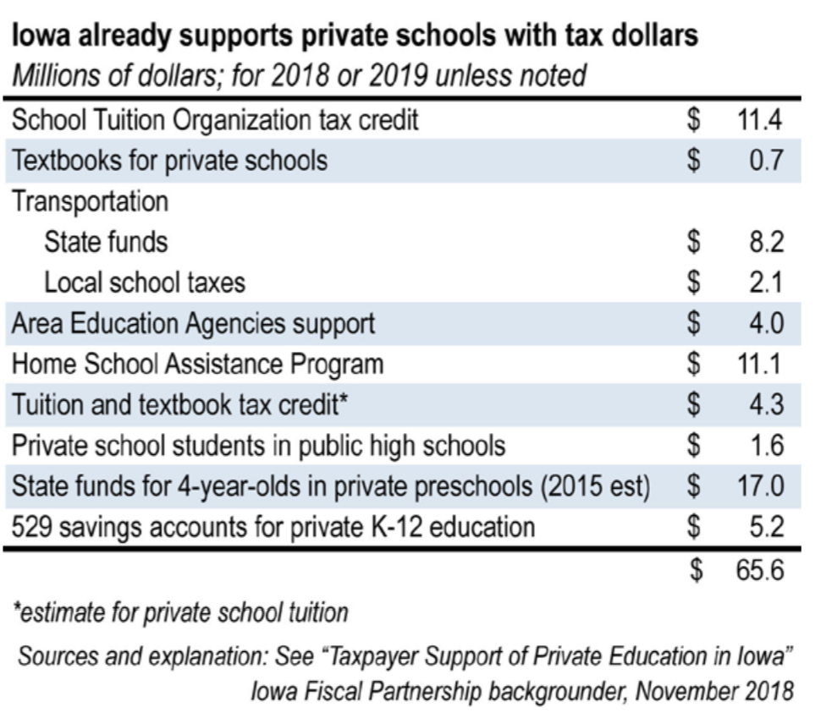
Public Dollars Already Fund School Choice: http://www.iowapolicyproject.org/2018docs/181105-roadmap-vouchers.pdf
STO’s expanded to $15 million in HF 779 Tax Changes in 2019 Session puts this number over $70 million.

Slide 52
Key Issues in Voucher Debate
Accountability: Nonpublic and home schools escape oversight. Any expansion funded with taxpayer dollars requires a level playing field.
Democracy: Taxpayers don’t get to vote for Nonpublic school boards.
Student Outcomes: Little evidence that school choice expansion improves outcomes for students, especially in a climate where strong school choice options already exist.
Competition-Iowa has it: 32,848 students attend nonpublic schools. 32,501 open enroll into another public school. Two home school options + virtual academies.
School Choice isn’t parent choice. Nonpublic schools choose who attends.
Limited Resources: Public schools have a public purpose. The state has an obligation to prioritize them first.

Slide 53
Advocacy Attitude
Start with the assumption that every senator and representative is working hard to make Iowa better.
We sometimes disagree with the way to get there, but everyone wants Iowa students to succeed.
Policy makers can’t know about the impacts of their actions on schools if we don’t tell them.
Good lobbying is: Gentle persuasion applied relentlessly. Always start and end with a thank you and be clear about what actions they can take to improve your district’s ability to educate all students to their potential.

Slide 54

Advocacy Attitude
Teamwork: we are all in this together.
Avoid pitting some schools and districts against others. Keep to the core values of local control, adequate investments in public education, respecting differences in school districts, and preserving the authority for each board to make the right choices to support education.
Find a school district represented by Legislative Leaders as a partner. Work together to meet the needs you have in common.
Where do you find willing supporters? Cross section of advocates will help you build your advocacy army.

Slide 55
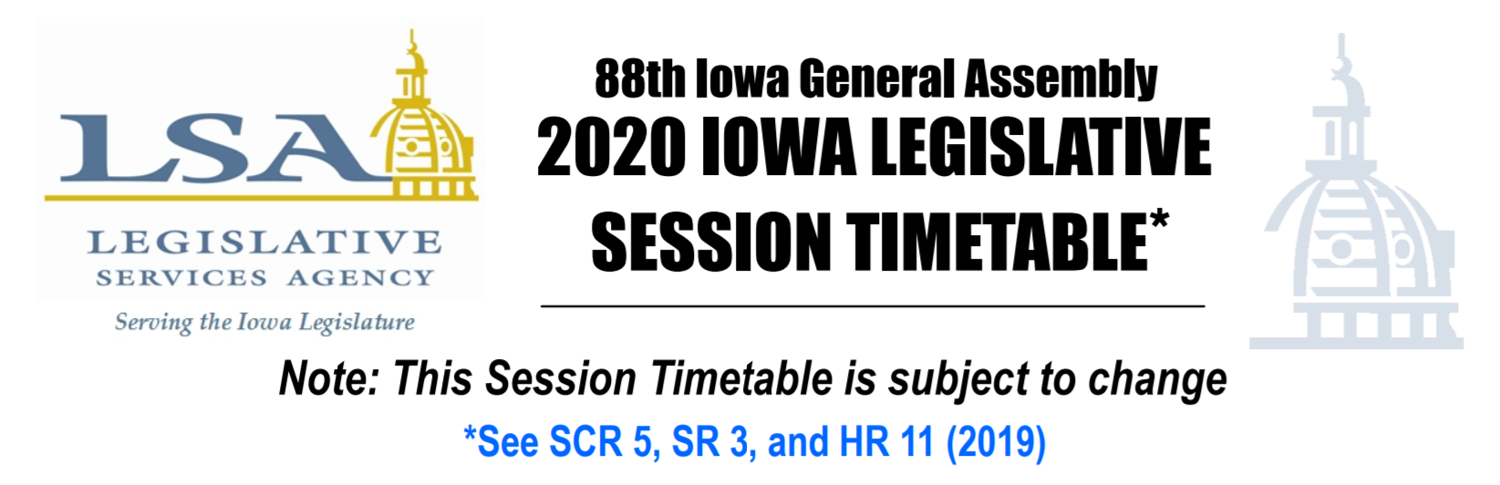
Legislative Timeline
Caucuses typically meet before the end of November to set priorities. Legislative leadership and committee member changes are important to track.
Jan. 13, 2020 First Day of Session https://www.legis.iowa.gov/docs/publications/SESTT/1061746.pdf
April 21, 2020 is the 100th day of Session when per diem ends (legislators could shorten this timeline)
Although contact during Session is important, building relationships during the Interim is critical.
Election year impact (= shortened timeline and elevated importance of connecting with voters and opinion leaders.)

Slide 56
Advocacy Supports
Oct. 2019 Videos and PPTs
Position Papers, talking points, advocacy messages
Weekly Legislative updates and Calls to Action to engage your local advocates
Testimony
Support for local legislative meetings, press releases, public forums etc.
ISFIS Staff and Capacity support to RSAI (mapping, legislative estimates, cost of school aid, impact on students, surveys of school leaders.)
Call Margaret Buckton 515.201.2755 cell or email Margaret@iowaschoolfinance.com We can talk over messages, strategy, timing, or just chat about what you might do next.
Keep your RSAI staff in the loop about what you are hearing.

Slide 57
Never doubt that a small group of thoughtful citizens can change the world. Indeed, it is the only thing that ever has.
Margaret Mead
Decisions are made by those who show up.
President Josiah “Jed” Bartlett
NBC’s “The West Wing”
If you’re not at the table, you’re on the menu.
David Lyons

Slide 58
THANK YOU FOR YOUR VOICE on behalf of rural students!
Stay connected through the Interim and into the Legislative Session
Let us know what you need to beef up your advocacy efforts.
Professional Advocate
Margaret Buckton, margaret@iowaschoolfinance.com
1201 63rd Street, Des Moines, IA 50311 (515) 201-3755 cell

