Slide 1


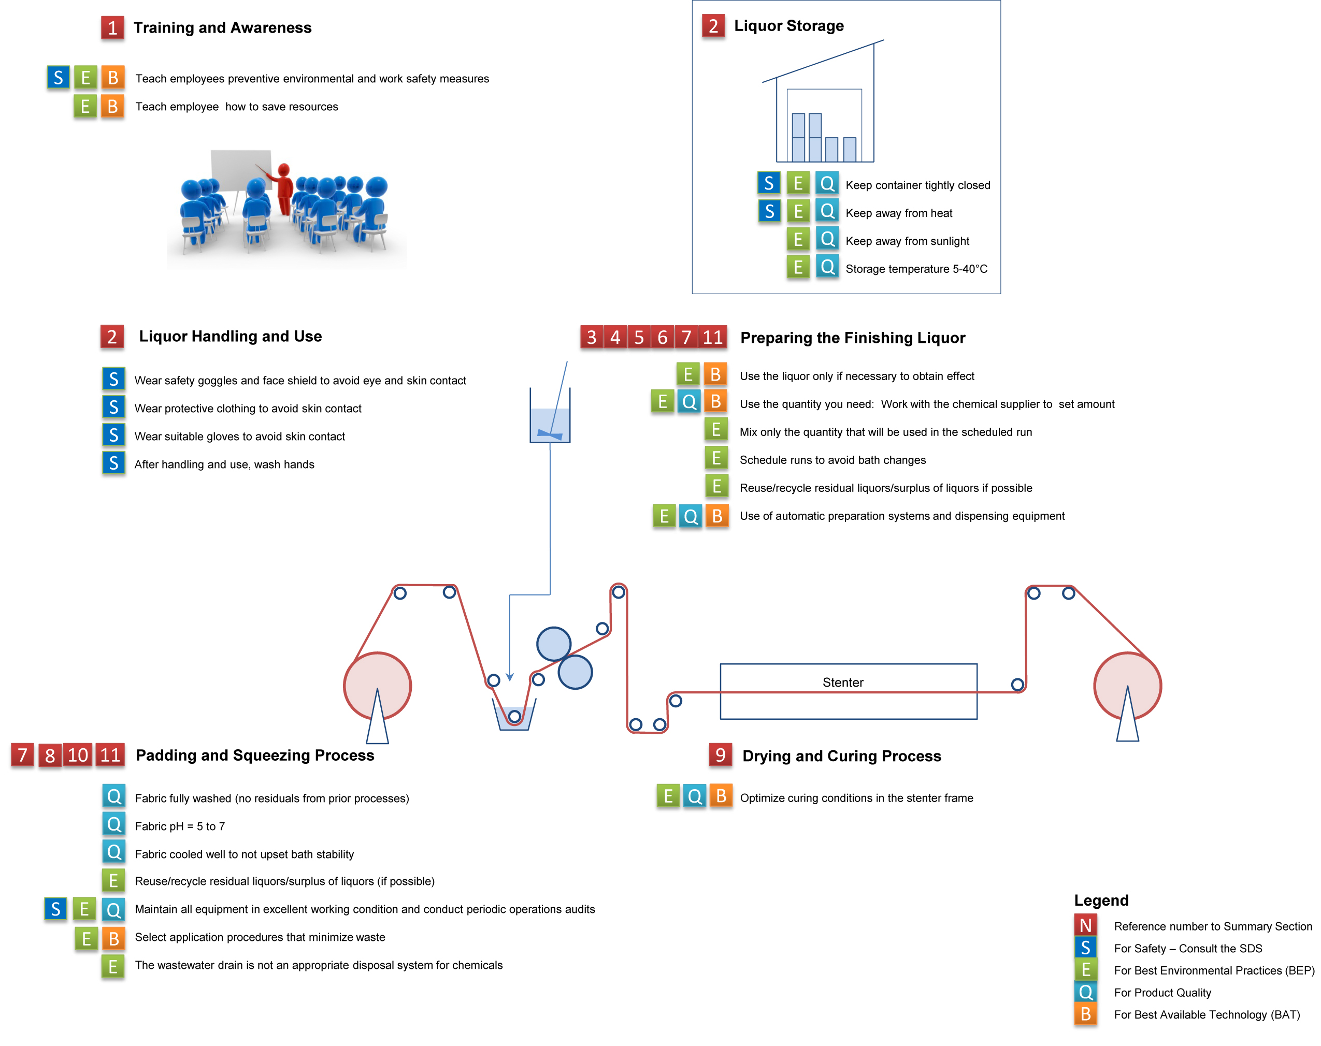
Best Environmental Practices (BEP) Guidance for the Textile Industry
Kai-Volker Schubert,^{1,2} Steve Korzeniowski,² Seiji Shin-ya,³ Takayuki Nakamura,⁴ Mike Cheek⁵
¹FluoroCouncil, ²The Chemours Company, LLC, ³Asahi Glass Co, Ltd, ⁴Daikin Industries, Ltd., ⁵Huntsman
OVERVIEW
Fluorinated repellent products provide stain, oil and water repellency on fabrics. These fluorinated repellent products, including durable water repellents (DWRs), are usually polymeric fluorotelomer-based substances that are typically applied in combination with other finishing auxiliaries by a pad-dry-cure process. In many cases they are applied with “extenders” which can be other repellents themselves (e.g., hydrocarbons such as waxes) or crosslinkers (e.g., melamine and isocyanate or blocked isocyanates). The use of these “extenders” enhances repellent performance and allows a reduction in the required amount of fluorochemical. While these chemistries perform well on garments and equipment, they may be harmful if released to the environment. This poster is intended to provide an overview of Best Environmental Practices (BEP) to help mills and finishers minimize waste and environmental release, and keep the products on the textile. Product specific steps provided by the manufacturer and legal requirements override the practices offered here, so always verify with the specific supplier what steps are appropriate to take at your facility.
For Textile Mills and Finishers - Easy Steps to Implement BEP
Summary: What Best Environmental Practice (BEP) means in practical terms:
Raise environmental awareness with all employees
Follow advice of the Safety Data Sheet (SDS) and Technical Data Sheet (TDS) for the product
Use the product only if necessary to obtain effects desired
Use only what you need: work with the chemical supplier to set the amount
Mix only what will be used in the scheduled run
Schedule runs to avoid bath changes; batch changes waste liquors
Reuse/recycle residual liquors/surplus of liquors if this can be done without jeopardizing quality; consult your supplier
Maintain all equipment in excellent working condition and conduct periodic operations audits
Optimize drying and curing conditions in the stenter frame
Dispose of chemicals appropriately
Consider additional opportunities to minimize waste and emissions
1. Raise environmental awareness with all employees
Teach employees preventive environmental and work safety measures, as well as measures for saving resources at the company.
Combine with safety training and/or include in other employee training programs.
Tailor employee training to specific roles (e.g., chemicals, raw materials, energy, water, processes, equipment/machinery).
Provide copies of SDSs to all employees and train them to be familiar with the information provided for all chemicals to be handled.
10. Dispose of chemicals appropriately
The wastewater drain is never an appropriate disposal system for chemicals such as residual pad bath liquor.
Collect liquors containing fluorinated repellent for separate treatment, including the rinsing bath from cleaning the application system.
Reuse residual pad bath liquor if possible and appropriate.
Minimize waste water by minimizing change overs and collect all wash/rinse water before and after each run.
  2. Follow advice of the Safety Data Sheet (SDS) and Technical Data Sheet (TDS) for the product
Make all SDS for all chemicals used and stored available, up-to-date and easily accessible. A chemical may not be on site without a copy of its SDS on site.
Before handling any chemical, review all sections of the SDS carefully. For example, review these sections:
    Product Hazard
    Accidental Release Measures
    Exposure Controls/Personal Protection
    Disposal Considerations
  Store all chemicals in accordance with SDS instructions.
  Check the integrity of all areas where chemicals are stored or where a leak is possible, so that leaking chemicals cannot enter the groundwater or the sewer.
Reject dented or leaking containers upon delivery.
Review the TDS for information on optimized recipes and best suited auxiliaries.
11. Additional opportunities to minimize waste and emissions
Use of displacers in the padding device (Foulard) reduces required liquor volume.
Automated dosing systems with integrated self-learning systems minimize waste by:
  Computing exact pick-up and liquor consumption
  Mixing only what will be used in the scheduled run
Low add-on techniques (such as foam applicators) minimize chemical consumption.
Where possible, use direct piping into the bath for each of the chemicals to be used so that the chemicals are not pre-mixed before being introduced into the applicator or machine, and there is no need to clean containers, pumps and pipes before the next step.
Check the input and output flows of the individual processes. Determine the input and output mass flows for both the site as a whole and each individual production process. Implement a product input check that takes account of raw materials, chemicals, dyes and auxiliary materials, etc.
Employ improved measurement and control equipment, for example for temperature, chemical addition, retention time, moisture (in dryers).
Where possible, consider a combination of condensation and scrubbing followed by electrostatic precipitation (ESP) or the use of thermal combustion with energy recovery on the curing/drying frame/stenters used in processing the fabric.
Where possible, consider treatment in wet scrubbers, absorbers, separation via low temperature condensation or combustion to reduce the release of volatile organic compounds from the framing/stenter process.
Where possible, consider exhaust air treatment for emissions-relevant processes.
Overview of BEP when using fluorinated repellent products in the textile industry
(numbers refer to above summary)
3. Use the product only if necessary to obtain effects desired
Use fluorinated repellent only when specified, or when high performance water repellency, or the combination of water/oil, or oil repellency alone is required.
Avoid CMR and PBT substances, and substances which can degrade to CMR and PBT substances.
If possible, consider using chemicals and auxiliary materials with good biodegradability/bioelimination properties, low human and eco toxicity, low volatility and odor intensity.
4. Use only what you need: work with the chemical supplier to set the amount
Use proper type and quantity of auxiliaries. Improper use can result in overuse of fluorinated repellent to compensate for the wetting or softening effect of the surfactant itself.
Check recipes regularly in order to identify and avoid unnecessary chemical volumes.
Pay attention to water quality (e.g., pH, water hardness, suspended solids) to avoid loss in DWR performance, and thereby avoid overuse of the finishing chemicals, or scrap or rework of the fabric.
For Packagers, Brands and Retailers
5. Mix only what will be used in the scheduled run
Minimize the use of all chemicals and auxiliary materials.
Measure, mix and dose chemicals carefully to avoid losses.
Minimize residual liquor by calculating exactly how much liquor has to be prepared.
Guidance on questions to ask your suppliers so you know you are receiving goods finished using Best Available Technology (BAT) and Best Environmental Practices (BEP) for DWR
6. Schedule runs to avoid bath changes and wasted liquors
Optimize process sequences in production to minimize waste in between runs.
To assess that the Best Available Technology (BAT) is used:
Chemical Supplier Name
Fluorinated DWR Product Trade Name
What is the DWR Product's technology platform?
Is the Product based on long-chain or short-chain technology?
If it is long-chain, provide a list of short-chain alternatives with similar performance
Is the DWR Product compliant with the US EPA 2010/15 Stewardship Program and the EU REACH marketing and use restrictions for PFOS, PFOA and related substances?
Is the DWR product registered on the following inventories:
  US EPA TSCA inventory by filing of a Pre-Manufacturing Notification (PMN) or
  Canadian Domestic Substances List (DSL) or
  NICNAS (Australia) or
  REACH compliant
Do you have mammalian toxicity data for the DWR Product?
Do you have aquatic toxicity, bioaccumulation and environmental fate data for the DWR Product?
To assess that Best Environmental Practices (BEP) are utilized:
Has the DWR Product been assessed by a third party such as bluesign technologies and is it registered in the bluesign® bluefinder, a search engine for bluesign® approved textile auxiliaries and dyes? Has the DWR Product been assessed in Finished Product such as Oeko-tex® STeP Certification?
Has your supplier implemented the guidance given in this document?
Can your supplier verify that Best Environmental Practices are being followed in their facilities? This list of “best practice questions” is very close to the list developed by the OIA DWR Task Force for brands to ask chemical suppliers.
7. Reuse/recycle residual liquors/surplus of liquors if this can be done without jeopardizing quality
Re-using process liquors has to be done VERY CAREFULLY to avoid causing quality issues that could lead to off-quality goods production. The material supplier can be consulted to test whether re-use is possible.
8. Maintain all equipment in excellent working condition and conduct periodic operations audits
Optimized process runs and well maintained equipment reduce waste.
Maintain machinery, pumps and piping thoroughly and check for leaks. Consider checking systems for heating medium and chemical dispensing systems too.
Consider a written maintenance plan and execute it for regular maintenance.
Consider carrying out a mass balance check for both the site as well as each individual production process, as knowing where each chemical goes is the best way to ensure optimal use of raw materials.
9. Optimize drying and curing conditions in the stenter frame
High quality, first pass yield of the fabric depends on optimized conditions in the stenter frame.
Minimize energy consumption in stenter frames by:
  using mechanical dewatering equipment to reduce water content of the fabric
  optimizing exhaust airflow through the oven, automatically maintaining exhaust humidity, considering the time taken to reach equilibrium conditions
  installing heat recovery systems
  insulating systems to reduce heat loss
  cleaning and adjusting burners in directly heated stenter frames
Standard good practices for reduction of volatile organic compound emissions and energy recovery of exhaust air are applicable for fluorinated repellents. Work with the machine supplier for details. For example, a combination of condensation and wet scrubbing followed by electrostatic precipitation (ESP) or the use of thermal combustion with energy recovery on the curing/drying frame/stenters may be used.
Available online in English, German, Chinese and Japanese at: http://www.fluorocouncil.org/Resources
Copyright © 2014 FluoroCouncil

