Slide 1
Biosimilars Management Considerations: What Do You Know, What Would You Do?

Slide 2
Faculty
Luis H. Camacho, MD, MPH
Director, Center for Oncology and Blood Disorders
Houston, TX

Slide 3
Commercial Supporter
This activity is supported by an
independent medical education grant from
Sandoz Inc., a Novartis Division.

Slide 4
Disclosure Policy
In accordance with the ACCME Standards for Commercial Support, The France Foundation (TFF) requires that individuals in a position to control the content of an educational activity disclose all relevant financial relationships with any commercial interest. TFF resolves all conflicts of interest to ensure independence, objectivity, balance, and scientific rigor in all its educational programs. Furthermore, TFF seeks to verify that all scientific research referred to, reported, or used in a CME/CE activity conforms to the generally accepted standards of experimental design, data collection, and analysis. TFF is committed to providing learners with high-quality CME/CE activities that promote improvements in health care and not those of a commercial interest.

Slide 5
Activity Staff Disclosures
The planners, reviewers, editors, staff, CME committee, and other members at The France Foundation
who control content have no relevant financial relationships to disclose.

Slide 6
Faculty Disclosures – Activity Faculty
The following faculty report that they have no relevant financial relationships to disclose:
  Luis H. Camacho, MD, MPH

Slide 7

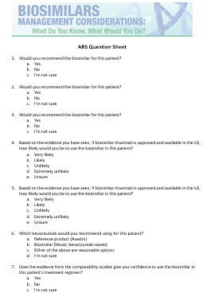
Audience ARS
When you see…
Please answer the corresponding question on your ARS Question Sheet.

Slide 8
Learning Objectives
Define biosimilars, extrapolation of indications, and interchangeability on the basis of FDA definitions and guidance
Explain the similarities/differences between biosimilars and originator (reference) biologics, as well as the difference between the terms biosimilar and generic
Evaluate key aspects of current FDA guidance that inform the health care provider’s knowledge of the biosimilar approval process, manufacturing, and naming, as well as state regulations surrounding substitution practices
Apply foundational knowledge on biosimilars to clinical situations relevant to hematology/oncology practice
1
2
3
4

Slide 9
Outline
Biosimilars Fast Five
  What a biosimilar is and what it is not
  What does the FDA require for biosimilar approval?
  What is the basis to justify extrapolation and/or switching?
  Can a patient be automatically switched to a biosimilar at the pharmacy level?
  Which biosimilars are currently approved?
Biosimilars: Applications in Clinical Practice
  Growth factor support for a patient with small cell lung cancer following 2 cycles of chemotherapy
  Treatment with rituximab for a patient newly diagnosed with CLL
  Treatment with FOLFOX + bevacizumab for a patient with metastatic colorectal cancer

Slide 10

What is a Biosimilar?
“A biosimilar is a biological product that is highly similar to a US-licensed reference biological product for which there are no clinically meaningful differences in safety, purity, or potency of the product”
Biobetter
“Me Too” Biologic
FDA. https://www.fda.gov/Drugs/GuidanceComplianceRegulatoryInformation/Guidances/ucm290967.htm Accessed August 28, 2017.

Slide 11
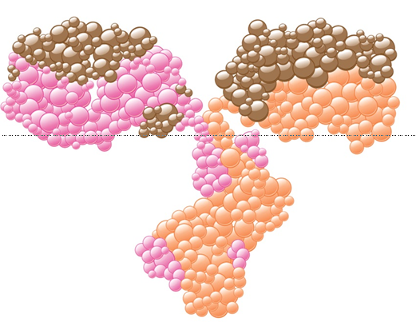

Biosimilars are Biologics
Large, Complex Molecules
Aspirin
MW 180
Monoclonal Antibody
MW 150,000
 | CHEMICAL DRUGS | BIOLOGICS
Size | Small, low molecular weight | Large, high molecular weight
Structure | Simple, well-defined | Complex, heterogeneous
Manufacturing | Reproducible chemical reactions Identical copies can be made | Living cells or organisms Impossible to ensure identical copies
Characterization | Completely characterized | Impossible to fully characterize molecular composition
Stability | Relatively stable | Unstable, sensitive to external conditions
Immunogenicity | Mostly non-immunogenic | Immunogenic
Declerck PJ. GaBI Journal. 2012;1(1)13-16.

Slide 12
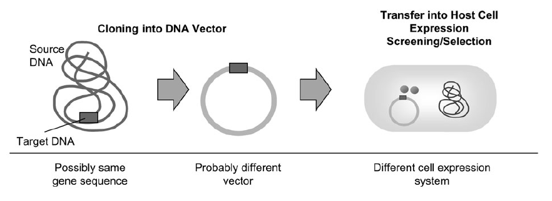
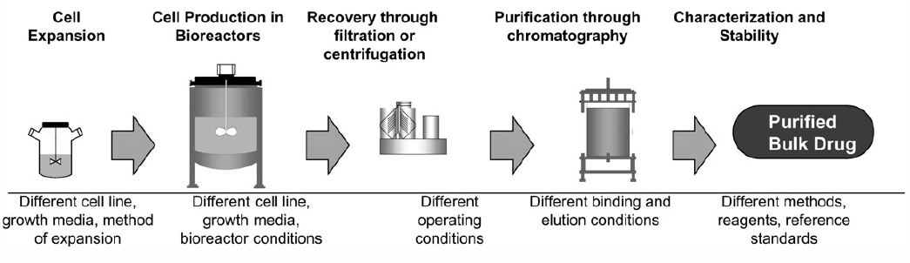
Unlike Producing Small Molecule Drugs, the Manufacturing Process for Biologics is Complex
Creating the Biologic
Transfer into Host Cell
Expression
Screening/Selection
Cloning into DNA Vector
Cell Production
in Bioreactors
Recovery Through
Filtration or
Centrifugation
Purification Through
Chromatography
Cell
Expansion
Characterization
and Stability
Purified
Bulk Drug
Producing the Biologic
Mellstedt H, et al. Ann Oncol. 2008;19:411-419.

Slide 13
Identical Copies of Biologics Cannot Be Made
Variations Over Time
Reference Biologics
Reference Biologics
Highly Similar
Manufacturing/Process Changes
FDA: Demonstration of Comparability
No Adverse Impact Upon Safety or Efficacy of the Drug Product
NOT Identical
Biosimilars
Reference Biologics
Highly Similar
Identical
Generics
Small Molecule Drugs
Biosimilars
Generics

Slide 14
Generics:
Exact Copies
Small Molecules—Approved via FDCA
Small Molecules
Generics
New Drug Applications
505(b)(1) and 505(b)(2)
Abbreviated New Drug Applications
505(j)
Full report of safety and efficacy investigations
Identical to an already approved product
Two pathways
[505(b)(1) and 505(b)(2)]
Based on right reference
No safety/efficacy data required
(only bioequivalence)
FDCA: Food, Drug, and Cosmetics Act
Li EC, et al. J Manag Care Spec Pharm. 2015;21(7):532-539.

Slide 15
Biosimilars:
Highly Similar
Generics:
Exact Copies
Small Molecules—Approved via FDCA
Biologics—Approved via PHSA
Small Molecules
Generics
Biologics
Biosimilars
New Drug Applications
505(b)(1) and 505(b)(2)
Abbreviated New Drug Applications
505(j)
Biologics License Applications
351(a)
Biosimilar Biologics Applications
351(k)
Full report of safety and efficacy investigations
Identical to an already approved product
Full report of safety and efficacy investigations
Highly similar to a 351(a) product
Two pathways
[505(b)(1) and 505(b)(2)]
Based on right reference
No safety/efficacy data required
(only bioequivalence)
Applicant has right of reference to essential investigations
Data showing absence of clinically meaningful difference
Interchangeable biologics are approved under the biosimilars pathway, but must meet higher standards
FDCA: Food, Drug, and Cosmetics Act ; PHSA: Public Health Service Act
Li EC, et al. J Manag Care Spec Pharm. 2015;21(7):532-539.

Slide 16
Biosimilars:
Highly Similar
Generics:
Exact Copies
Small Molecules—Approved via FDCA
Biologics—Approved via PHSA
Small Molecules
Generics
Biologics
Biosimilars
New Drug Applications
505(b)(1) and 505(b)(2)
Abbreviated New Drug Applications
505(j)
Biologics License Applications
351(a)
Biosimilar Biologics Applications
351(k)
Full report of safety and efficacy investigations
Identical to an already approved product
Full report of safety and efficacy investigations
Highly similar to a 351(a) product
Two pathways
[505(b)(1) and 505(b)(2)]
Based on right reference
No safety/efficacy data required
(only bioequivalence)
Applicant has right of reference to essential investigations
Data showing absence of clinically meaningful difference
Interchangeable biologics are approved under the biosimilars pathway, but must meet higher standards
FDCA: Food, Drug, and Cosmetics Act ; PHSA: Public Health Service Act
Li EC, et al. J Manag Care Spec Pharm. 2015;21(7):532-539.

Slide 17
Demonstrating Biosimilarity:
General Principles from the FDA
When a biosimilar is approved, it meets the FDA standard that there be no differences in safety and efficacy
Clinical efficacy and safety of the biologic already demonstrated (i.e. by the innovator)
Biosimilar sponsor only requires evidence that the biosimilar is not significantly different from the reference product
  Goal is not to replicate unnecessary clinical trials
  Smaller-scale direct comparisons and extrapolation
USFDA: Biosimilars. http://www.fda.gov/Drugs/
GuidanceComplianceRegulatoryInformation/
Guidances/ucm290967.htm. Accessed August 28, 2017.

Slide 18
Biosimilar Pathway Represents a Paradigm Shift From Standard Originator Registration Pathway
Biosimilar Development Program Objective:
Establish Biosimilarity Based Upon Totality of Evidence, Not Re-Establish Benefit
Originator Pathway [§351(a)]
Biosimilar Pathway [§351(k)]
Clinical Studies
Conducted in sensitive patient population with sensitive endpoints; Designed to detect a difference, if there is one
Clinical
Studies
Clinical
pharmacology
PK/PD
Clinical pharmacology
Preclinical
Preclinical
Analytical
Analytical
PD = pharmacodynamics
Schneider CK, et al. Nat Biotechnol. 2012;30(12):1179-1185. Kozlowski S, et al. N Engl J Med. 2011;365(5): 385-388. Macdonald J.
Presented at: APEC Biotherapeutics Workshop; September 25, 2013; Seoul, Republic of Korea. Oral Presentation. McCamish M.
Presented at: EMA Workshop on Biosimilars; October 31, 2013; London, UK. Oral Presentation.
FDA. http://www.fda.gov/Drugs/DevelopmentApprovalProcess/HowDrugsareDevelopedandApproved/ApprovalApplications/
TherapeuticBiologicApplications/Biosimilars/ucm291197.htm . Accessed August 28, 2017.
Notes:
McCamish 2013 EMA Workshop on Biosimilars
Slide 4
Scheider 2012, p1180, col 1, para 1

Slide 19
Stepwise Approach
Totality of the Evidence and Approach to Evaluating Biosimilarity
Analytical Studies
Clinical Immuno-genicity Assessment
Animal Studies
Clinical PK/PD Studies
Additional Clinical Studies
The goal of a biosimilar development program is to demonstrate biosimilarity between the proposed product and a reference product,
not to independently establish safety and effectiveness of the proposed product.
FDA. https://www.fda.gov/downloads/AboutFDA/CentersOffices/OfficeofMedicalProductsandTobacco/CDER/UCM526935.pdf. Accessed August 28, 2017.

Slide 20
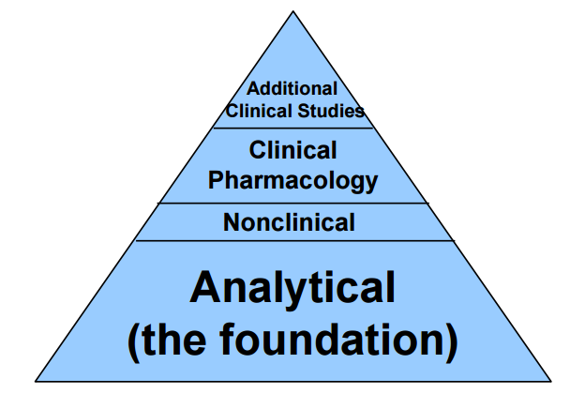
Biosimilar Comparability Exercise
No Clinically Meaningful Differences
Highly Similar
Based on analytics and clinical pharmacology data
Based on targeted clinical trials in a sensitive population

Slide 21

Clinical Studies of Biosimilars
Designed to establish statistical evidence that the proposed product is neither inferior nor superior to the reference product - by more than a specified margin
Clinical
Evidence
Endpoints and Study Populations
are selected so that they will be clinically relevant and sensitive in detecting clinically meaningful differences
INFERIOR
SUPERIOR
FDA. http://www.fda.gov/Drugs/GuidanceComplianceRegulatoryInformation/
Guidances/ucm290967.htm. Accessed August 28, 2017.

Slide 22
Extrapolation is a Novel and Challenging Concept
Per the FDA, 2016:
“Biosimilar extrapolation is from reference product to biosimilar product based on all available data, not from indication studied for biosimilar to other indications.”
The approved indications for the biosimilar are justified based on the total data package
FDA. https://www.fda.gov/downloads/AboutFDA/CentersOffices/OfficeofMedicalProductsandTobacco/CDER/UCM526935.pdf. Accessed August 28, 2017.

Slide 23
Extrapolation: FDA-Approved Indications for Biosimilars
 | Reference | Biosimilar
Structural attributes
Biological functions
Nonclinical/tox
Human PK/PD
Sensitive indication
Less sensitive indications
HIGHLY SIMILAR
HIGHLY SIMILAR
HIGHLY SIMILAR
HIGHLY SIMILAR
HIGHLY SIMILAR
JUSTIFIED
“SIMILARITY SPACE”
The totality of evidence supports no differences in efficacy or safety
A clinical trial is not required for each indication
FDA. https://www.fda.gov/downloads/AdvisoryCommittees/CommitteesMeetingMaterials/ Drugs/OncologicDrugsAdvisoryCommittee/UCM428782.pdf. Accessed August 28, 2017.
Notes:
A sensitive indication is a patient population considered adequately sensitive to detect differences in PK, efficacy, and safety (if they exist). This indication may be different than the patient population used to evaluate efficacy of the originator.

Slide 24
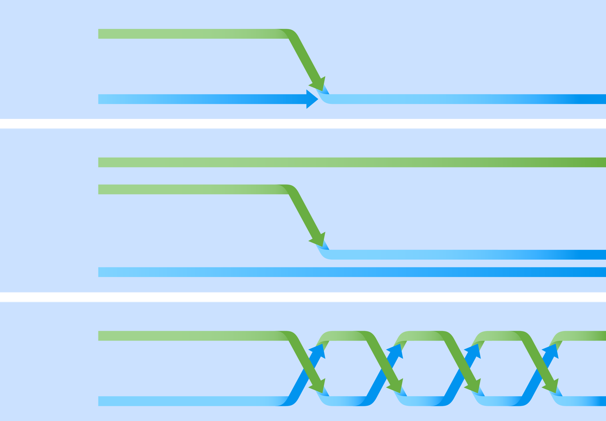
Biosimilar Studies May Be Designed to Address Considerations for Switching Treatments
This defines “interchangeability”
Transition Study
Reference drug
Biosimilar
Single Switch
Reference drug
Biosimilar
Multiple Switches
Reference drug
Biosimilar
Modified from Dörner T, et al. Nat Rev Rheumatol. 2015;11:713-724.
Notes:
Dörner T. Nat Rev Rheumatol. 2015: 722-A-Figure 4

Slide 25
NOR-SWITCH: Non-inferiority Study
Phase 4 multi-indication prospective non-medical switch study in Norway by the Norwegian government
  Adults with spondyloarthritis (SpA), rheumatoid arthritis (RA), psoriatic arthritis (PsA), Crohn’s disease (CD), ulcerative colitis (UC), or plaque psoriasis (PsO)
  N = 481
52-weeks randomized, double-blind non-inferiority study
Remicade
Remicade
Biosimilar Infliximab (CT-P13)
ClinicalTrials.gov. NCT02148640.
Jorgensen K, et al. Presented at UEGW 2016. Vienna, Austria. Abstract LB 15.
Goll GL, et al. Arthritis Rheumatol. 2016;68(S10):19L.

Slide 26
NOR-SWITCH (SpA, RA, PsA, CD, UC, PsO)
No Change in Efficacy, Immunogenicity or Safety
Exploratory Subgroup Analysis (Specific Diagnoses)
Patient Subgroup | Disease Worsening
 | Remicade | CT-P13
CD (n=155) | 14 (21.%) | 23 (36.5%)
UC (n=93) | 3 (9.1%) | 5 (11.9%)
Jorgensen K, et al. Presented at UEGW 2016. Vienna, Austria. Abstract LB 15.
Goll GL, et al. Arthritis Rheumatol. 2016;68(S10):19L.

Slide 27
Interchangeable or Interchangeability
Per the FDA:
Biological product is biosimilar to reference product
Expected to produce same clinical result(s) as reference product in any given patient
If administered more than once, risk in terms of safety or diminished efficacy of alternating or switching between use of the product and its reference product is not greater than the risk of using the reference product without such alteration or switch
FDA. http://www.fda.gov/downloads/Drugs/GuidanceComplianceRegulatoryInformation/Guidances/UCM537135.pdf. Accessed August 28, 2017.

Slide 28
Interchangeable FDA Designation Requires Additional Data
Interchangeable is an FDA designation
  Requires different data standards than ‘biosimilarity’ alone
  Dedicated switching study and post-marketing monitoring
Product with an interchangeable designation may be substituted without intervention of prescribing provider
  State substitution laws will impact practice
  Any biological product under consideration for substitution must first be approved by FDA as "interchangeable“
http://www.fda.gov/Drugs/GuidanceComplianceRegulatoryInformation/Guidances/ucm290967.htm
http://www.ncsl.org/research/health/state-laws-and-legislation-related-to-biologic-medications-
and-substitution-of-biosimilars.aspx. Accessed August 28, 2017.
Notes:
Study endpoints to evaluate PK/PD, immunogenicity, and safety (efficacy is not adequately sensitive at therapeutic doses)
The actual data package of study design and endpoints depends on the complexity of the molecule and degree of analytical similarity
The product presentation and user interface must be similar to the reference

Slide 29
FDA Guidance on Naming
Goal: facilitate pharmacovigilance; prevent inadvertent substitution
Core nonproprietary name + distinguishing suffix (devoid of meaning and composed of 4 lower case letters)
Guidance applies to all biologics (originator/reference products and biosimilars)
Benefits
  Common INN will group similar biologics in electronic systems
  Having suffix for all products reduces perception that biosimilar is inferior to reference product
FDA. https://www.fda.gov/downloads/Drugs/GuidanceComplianceRegulatoryInformation/Guidances/UCM459987.pdf Accessed August 28, 2017.

Slide 30
Currently Approved Biosimilars in the US†
Biosimilar | FDA Approval | Reference Product | Biosimilar Indications
Filgrastim-sndz [Zarxio] | 2015 | Neupogen® | Patients with cancer receiving myelosuppressive chemotherapy; and all other indications of the reference product
Infliximab-dyyb [Inflectra] | 2016 | Remicade® | CD (adult/pediatric); UC; RA; AS; PsA; PsO
Etanercept-szzs [Erelzi] | 2016 | Enbrel® | RA; JIA; PsA; AS; PsO
Adalimumab-atto [Amjevita] | 2016 | Humira® | RA; JIA; PsA; AS; CD; UC; PsO
Infliximab-abda [Renflexis] | 2017 | Remicade® | CD (adult/pediatric); UC; RA; AS; PsA; PsO
Adalimumab-adbm [Cyltezo] | 2017 | Humira® | RA; JIA; PsA; AS; CD; UC; PsO
Bevacizumab-awwb [Mvasi] | 2017 | Avastin® | mCRC; NSCLC; glioblastoma; mRCC; cervical cancer
Trastuzumab-dkst [Ogivri] | 2017 | Herceptin® | HER2-overexpressing breast cancer, HER2 overexpressing metastatic gastric or gastroesophageal junction adenocarcinoma
Infliximab-qbtx [Ixifi]* | 2017 | Remicade® | CD (adult/pediatric); UC; RA; AS; PsA; PsO
Epoetin alfa-epbx [Retacrit] | 2018 | Epogen® | Treatment of anemia in CKD and other indications of the reference product
Pegfilgrastim-jmdb [Fuphila] | 2018 | Neulasta® | Patients with non-myeloid malignancies receiving myelosuppressive anti-cancer drugs (to decrease the incidence of infection--febrile neutropenia)
CD: Crohn’s Disease; UC: Ulcerative Colitis; RA: Rheumatoid Arthritis; AS: Ankylosing Spondylitis; PsA: Psoriatic Arthritis; PsO: Plaque Psoriasis;
JIA: Juvenile Idiopathic Arthritis; mCRC: metastatic colorectal cancer; NSCLC: non-small cell lung cancer; mRCC: metastatic renal cell carcinoma; CKD: chronic kidney disease. *Not planned for market in the US
†As of June 12, 2018
FDA.https://www.fda.gov/downloads/Drugs/DevelopmentApprovalProcess/HowDrugsareDevelopedandApproved/ApprovalApplications/TherapeuticBiologicApplications/Biosimilars/UCM560162.pdf. Accessed June 2018.

Slide 31
Case: 49-Year-Old Male Smoker with a
History of Small Cell Lung Cancer
He received 2 cycles of chemotherapy with a full dose cyclophosphamide, doxorubicin and etoposide
Cycle 2 was complicated by febrile neutropenia requiring a 4-day hospital stay
His counts have subsequently recovered and he is due for cycle 3 of chemotherapy after a 1-week delay

Slide 32
Growth Factor Support with Filgrastim
You decide the patient needs growth factor support with filgrastim
You are told by your pharmacy that there is a biosimilar available that is less expensive

Slide 33

Growth Factor Support with Filgrastim
1. Would you recommend the biosimilar for this patient?
  Yes
  No
  I’m not sure

Slide 34
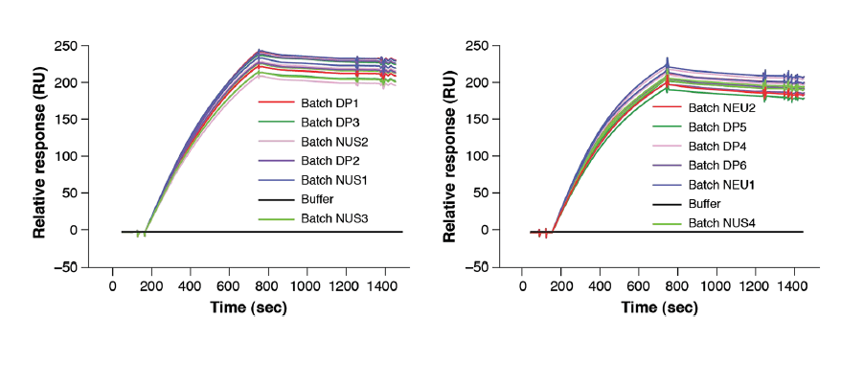
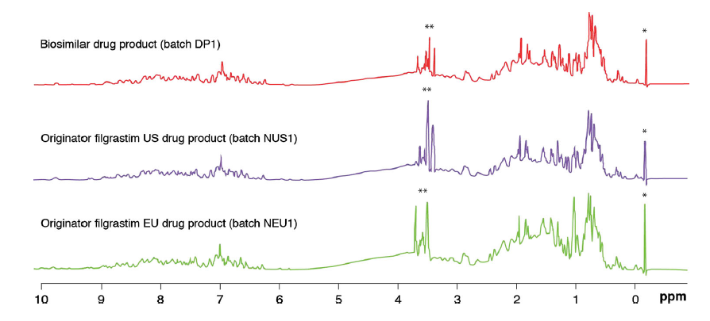
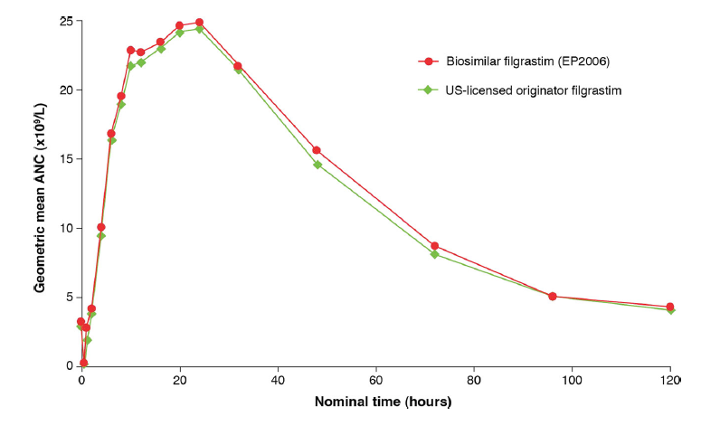
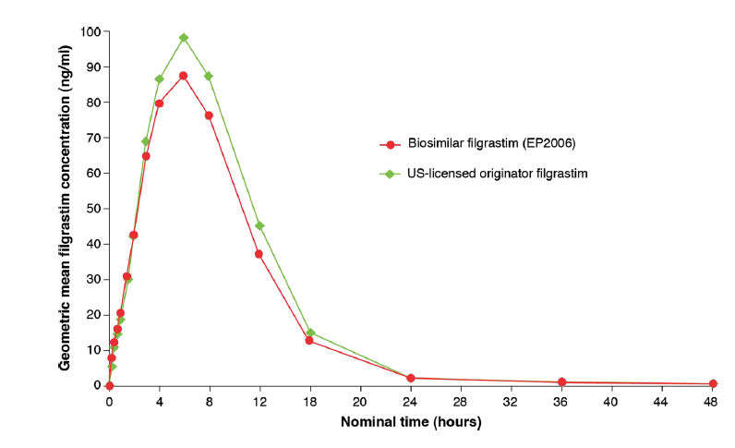
Comparability of Biosimilar Filgrastim with Reference Filgrastim
Receptor Binding Affinities
Protein Characterization (NMR Spectroscopy)
Pharmacokinetic Analysis: No Significant Differences Between the Biosimilar and Reference Product
Pharmacodynamic Analysis
Sorgel F, et al. BioDrugs. 2015;29:123-131.

Slide 35
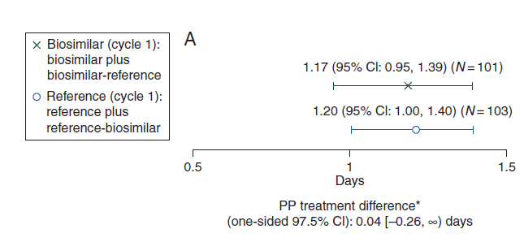
Biosimilar Filgrastim (EP2006) vs Reference
Patients with Breast Cancer Receiving Myelosuppressive Chemotherapy
Biosimilar Filgrastim Non-inferior to Reference
Duration of Severe Neutropenia
218 patients receiving 5 µg/kg/day filgrastim over
6 chemotherapy cycles
EP2006: filgrastim-sndz (Zarxio® in the US; Zarzio® in the EU)
Blackwell K, et al. Ann Oncol. 2015;26:1948-1953.

Slide 36
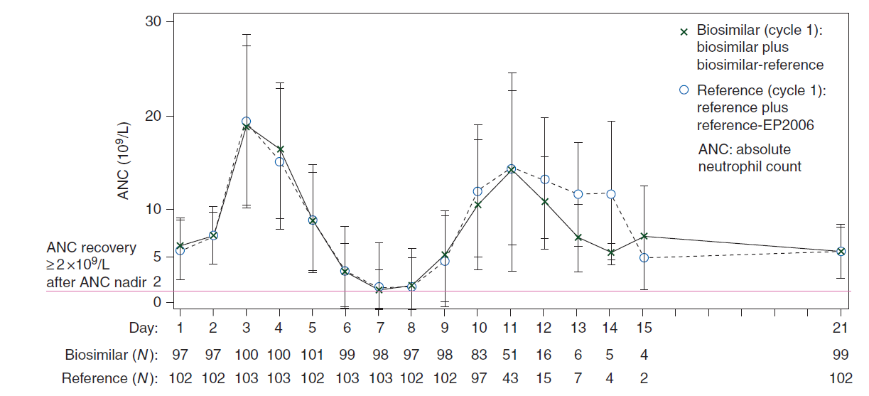
Biosimilar Filgrastim (EP2006) vs Reference
Patients with Breast Cancer Receiving Myelosuppressive Chemotherapy
Biosimilar Filgrastim Non-inferior to Reference
Time Course of ANC in Cycle 1
218 patients receiving 5 µg/kg/day filgrastim over 6 chemotherapy cycles
Blackwell K, et al. Ann Oncol. 2015;26:1948-1953.

Slide 37
Biosimilar Filgrastim Safety
Phase 3 PIONEER Study
  Biosimilar filgrastim vs reference in 218 breast cancer patients receiving (neo)adjuvant myelosuppressive chemotherapy
  No patient developed neutralizing anti-rhG-CSF Abs in any treatment arm
  Treatment emergent AEs 20.6% biosimilar arm vs 19.6% in the reference arm during cycle 1
Blackwell K, et al. Ann Oncol. 2015;26:1948-1953.

Slide 38
Biosimilar Filgrastim Safety
MONITOR-GCSF Study
  International, prospective, observational, open-label pharmaco-epidemiologic study of 1,447 cancer patients treated with myelosuppressive chemotherapy and receiving prophylaxis with biosimilar filgrastim
    1,834 musculoskeletal adverse events; 24.7% reporting bone pain of any grade
    148 adverse drug reactions in 76 patients; 17.6% treatment discontinuation
    Results consistent with safety profile for G-CSFs
Gascon P, et al. Support Care Cancer. 2016;24:911-925.

Slide 39

2. Is biosimilar filgrastim more acceptable to you since it is for supportive care (vs cancer treatment)?
Yes
No
The indication doesn’t really matter (supportive care vs cancer treatment)

Slide 40
Case: 68-Year-Old Female Newly Diagnosed with CLL
You decide to incorporate rituximab into the therapeutic regimen
You are aware that biosimilar rituximab has been approved in Europe

Slide 41

3. If biosimilar rituximab is approved and available in the US, how likely would you be to use the biosimilar in this patient?
  Very likely
  Likely
  Unlikely
  Extremely unlikely
  Unsure

Slide 42
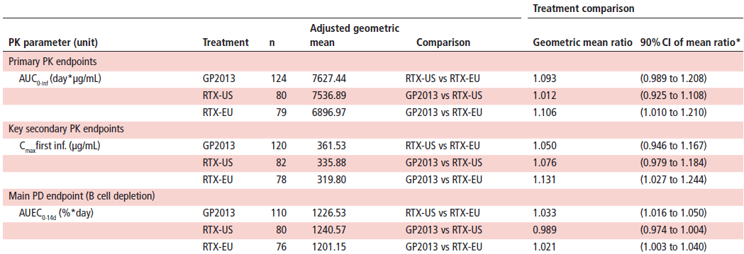
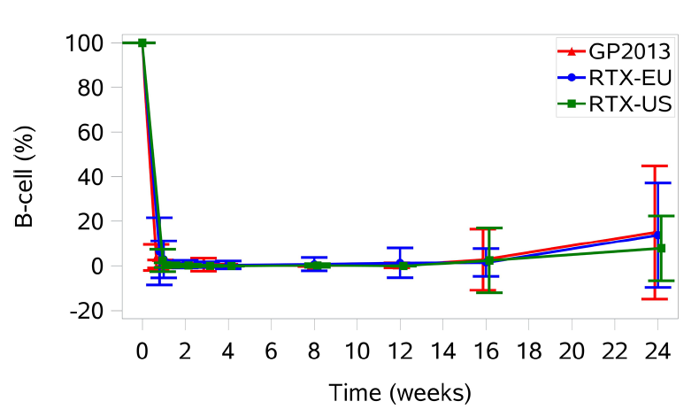
Biosimilar Rituximab GP2013 vs Reference Rituximab in Patients with Rheumatoid Arthritis
3-Way PK/PD Equivalence
N = 312 patients with RA and active disease despite prior anti-TNF therapy
Smolen JS, et al. Ann Rheum Dis. 2017;76:1598-1602.

Slide 43
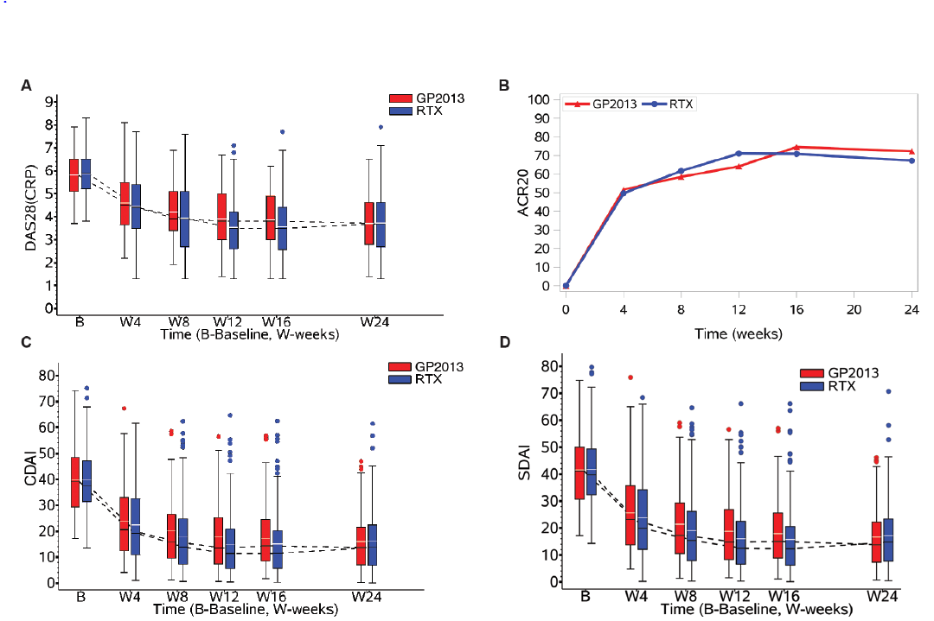
Biosimilar Rituximab GP2013 vs Reference
Highly Similar Efficacy in Patients with RA
N = 312 patients with RA and active disease despite prior anti-TNF therapy
DAS: Disease Activity Score; CRP: C reactive protein; ACR: American College of Rheumatology;
CDAI: Clinical Disease Activity Index; SDAI: Simplified Disease Activity Index
Smolen JS, et al. Ann Rheum Dis. 2017;76:1598-1602.

Slide 44
Case: 68-Year-Old Female Newly Diagnosed with CLL
Incorporation of Rituximab into Her Therapeutic Regimen
4. Based on the evidence you have seen, if biosimilar rituximab is approved and available in the US, how likely would you be to use the biosimilar in this patient?
  Very likely
  Likely
  Unlikely
  Extremely unlikely
  Unsure

Slide 45
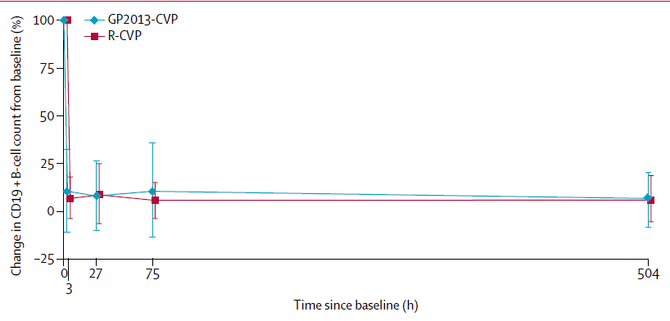
ASSIST-FL: Phase 3 Rituximab Biosimilar vs Reference in Patients with Untreated Advanced Follicular Lymphoma
No Significant Difference Between Groups in Pharmacodynamics
N = 312 biosimilar rituximab GP2013; N = 315 reference rituximab;
for both groups, rituximab was combined with cyclophosphamide, vincristine, and prednisone (CVP)
Jurczak W, et al. Lancet Haematol. 2017;4:e350-361.

Slide 46
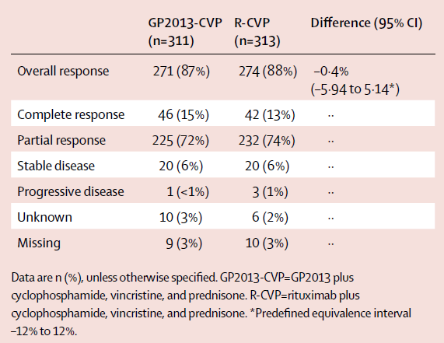
ASSIST-FL: Phase 3 Rituximab Biosimilar vs Reference in Patients with Untreated Advanced Follicular Lymphoma
No Significant Difference Between Groups in Best Overall Response
N = 312 biosimilar rituximab GP2013; N = 315 reference rituximab;
for both groups, rituximab was combined with cyclophosphamide, vincristine, and prednisone (CVP)
Jurczak W, et al. Lancet Haematol. 2017;4:e350-361.

Slide 47
ASSIST-FL: Phase 3 Rituximab Biosimilar vs Reference in Patients with Untreated Advanced Follicular Lymphoma
Similar Safety Profiles
 | GP2013-CVP (Biosimilar, N = 312) | R-CVP (Reference, N = 315)
Any Adverse Events | 93% | 91%
Serious Adverse Events | 23% | 20%
Neutropenia | 26% | 30%
Constipation | 22% | 20%
Nausea | 16% | 13%
Infusion-related Reaction | 13% | 12%
N = 312 biosimilar rituximab GP2013; N = 315 reference rituximab;
for both groups, rituximab was combined with cyclophosphamide, vincristine, and prednisone (CVP)
Jurczak W, et al. Lancet Haematol. 2017;4:e350-361.

Slide 48

5. Do the results from the study in patients with lymphoma increase your confidence regarding the safety and efficacy of biosimilar rituximab for patients with CLL?
Yes
No
I’m still unsure

Slide 49
Case: 49-Year-Old Male with Metastatic Colorectal Carcinoma
Obstructive lesion in the sigmoid colon on colonoscopy
CT scan of the abdomen demonstrated a 9 cm lesion in the liver (unresectable)
Pathology: infiltrating, poorly differentiated adenocarcinoma
15/15 lymph nodes + for tumor
Stage IV colorectal carcinoma (T4, N2, M1)
Treatment approach following discussion and shared decision-making: FOLFOX + bevacizumab
FOLFOX: 5-fluorouracil; leucovorin; and oxaliplatin

Slide 50

Case: 49-Year-Old Male with Metastatic Colorectal Carcinoma
Initial treatment will be FOLFOX + bevacizumab
6. Which bevacizumab would you recommend using for this patient?
Reference product (Avastin)
Biosimilar (Mvasi; bevacizumab-awwb)
Either of the above are reasonable options
I’m not sure
FOLFOX: 5-fluorouracil; leucovorin; and oxaliplatin

Slide 51
Analytical Data Supports
Biosimilarity of ABP 215 to US-Avastin
Primary and higher order structures
Physicochemical properties
Bioassay (inhibition of endothelial cell proliferation assay)
Binding affinities to VEGFA and similar potency
Scientific bridge to justify relevance of data obtained from the use of EU-approved bevacizumab as the comparator product in clinical studies
FDA. https://www.fda.gov/downloads/AdvisoryCommittees/CommitteesMeetingMaterials/Drugs/OncologicDrugsAdvisoryCommittee/UCM566365.pdf. Accessed Oct 2017.

Slide 52
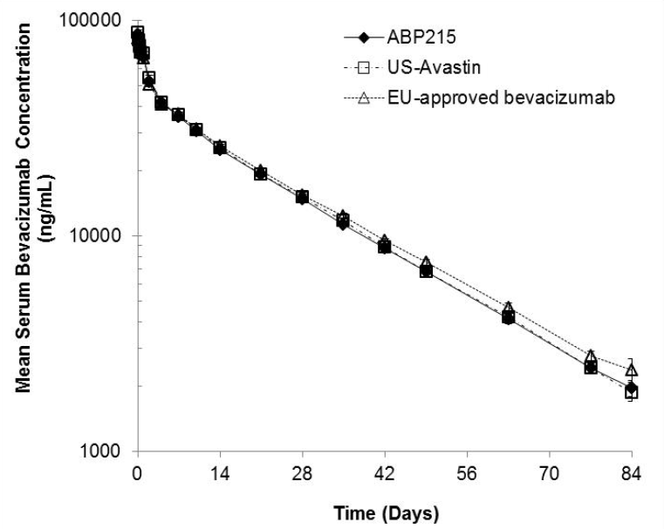
PK Similarity
ABP 215 (biosimilar), US-Avastin, EU-Approved Bevacizumab
Single-blind, single-dose, three-arm, parallel-group study in healthy male subjects
ABP 215 (n = 68), US-Avastin (n = 67), or EU-bevacizumab (n =67) 3mg/kg intravenously
FDA. https://www.fda.gov/downloads/AdvisoryCommittees/CommitteesMeetingMaterials/Drugs/OncologicDrugsAdvisoryCommittee/UCM566365.pdf. Accessed Oct 2017.
Markus R, et al. Cancer Chemother Pharmacol. 2017 Sept 1. [Epub ahead of print]

Slide 53
Comparative Clinical Study in NSCLC
First-line therapy with bevacizumab (15 mg/kg IV every 3 weeks) in combination with chemotherapy (carboplatin 6 AUC and paclitaxel 200 mg/m²) for 6 cycles
Primary endpoint: overall response rate (ORR)
Response | ABP 215 (n = 328) N (%) | EU-Bevacizumab (n = 314) N (%)
ORR | 128 (39.0%) | 131 (41.7%)
Risk ratio (90% CI) | 0.93 (0.80, 1.09)
FDA. https://www.fda.gov/downloads/AdvisoryCommittees/CommitteesMeetingMaterials/Drugs/OncologicDrugsAdvisoryCommittee/UCM566365.pdf. Accessed Oct 2017.

Slide 54
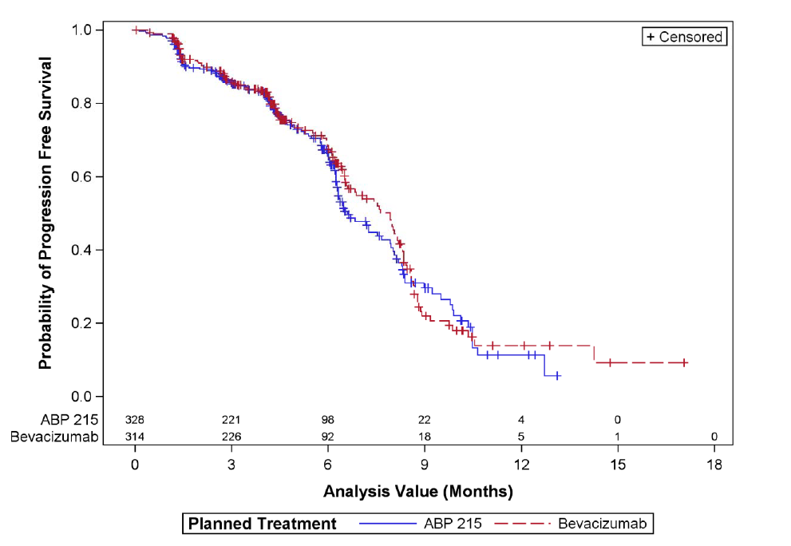
Comparative Clinical Study in NSCLC
Similarity: Progression Free Survival
FDA. https://www.fda.gov/downloads/AdvisoryCommittees/CommitteesMeetingMaterials/Drugs/OncologicDrugsAdvisoryCommittee/UCM566365.pdf. Accessed Oct 2017.

Slide 55
Back to the Case:
49-Year-Old Male with Metastatic Colorectal Carcinoma
Initial treatment will be FOLFOX + bevacizumab
7. Does the evidence from the comparability studies give you confidence to use the biosimilar in this patient’s treatment regimen?
Yes
No
I’m not sure
FOLFOX: 5-fluorouracil; leucovorin; and oxaliplatin

Slide 56
FDA Approval of the Bevacizumab Biosimilar for the Indications of the Reference Product
Justification for extrapolation
  Extensive analytical characterization
  Mechanism of action
  Pharmacokinetics and biodistribution (clinical pharmacology study in healthy volunteers)
  Clinical study in patients with NSCLC
  Immunogenicity
  Safety/toxicity
ABP 215 is highly similar to US-Avastin (based on analytical characterization)
No clinically meaningful differences (based on clinical PK, anti-tumor activity, safety, immunogenicity)
FDA. https://www.fda.gov/downloads/AdvisoryCommittees/CommitteesMeetingMaterials/Drugs/OncologicDrugsAdvisoryCommittee/UCM566365.pdf. Accessed Oct 2017.

Slide 57
Key Messages
Biologics (including biosimilars) are complex drugs that cannot be made “generic”
The comparability exercise used to demonstrate that a biosimilar is “highly similar” to a reference biologic is scientific, robust, and regulated
  An approved biosimilar can be expected to have the same efficacy and safety profile (no clinically meaningful differences) as the reference (originator) product in the approved indications
  Based on the totality of evidence (including analytical studies, human PK/PD, and clinical studies), biosimilars can be approved to treat indications, even without clinical trials in that indication
The increasing availability of biosimilars has the potential to broaden patient access to biologic therapies and provide cost savings for cancer care

Slide 58
Questions?
Please complete the EVALUATION and POSTTEST
Hand them to the coordinator as you leave
Take your CME certificate
Even if you don’t want CME, please complete the forms
Your feedback is extremely valuable in
securing support for future education
We would like to thank
Sandoz
for their support of this CME activity.

Slide 59
For More Information
Please visit:
http://www.biosimilarscme.org/

