Slide 1
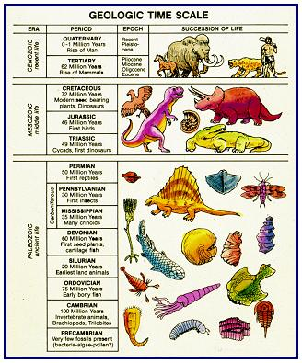
Movement of life (invertebrates) onto land
First reptiles
(approx 300 mya)
First amphibians
(approx 360 mya)
Life in the oceans

Slide 3
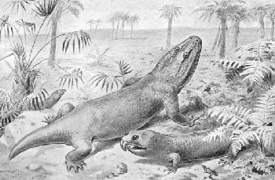
GILLS TO LUNGS
LEGS TO SUPPORT BODY
SKINS/ SCALES TO STOP WATER LOSS FROM BODY
AMPHIBIANS STILL LAID MANY EGGS IN WATER

Slide 4
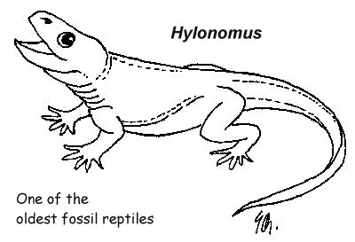
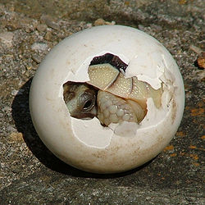
The amniotic egg
How life really got a hold on land
RESEARCH what is it?
how did it allow animals to live all their lives on land?

