Slide 1


Judged by Ordinary People…
The important role of a juror in our American criminal justice system
These materials have been adapted, with permission from The Florida Bar Benchmarks Adult Civic Education Program, for use in Louisiana. Principal authors of the Florida Benchmarks Program are Annette Boyd Pitts and Richard Levenstein. For assistance with adaptation in other states, contact staff@flrea.org

Slide 2

Judged by Ordinary People
What if your life was in the hands of 12 ordinary people? Or 6 people?
If you walked into the courtroom accused of a crime what qualities or characteristics do you want in those people?
Notes:
Six strangers that you don’t know and don’t know each other.

Slide 3
What do YOU think?
What does the Constitution tell us about juries?
What is "a jury"?
Must a jury have 12 members, or will 6 do? How about 5?
Must juries be unanimous?
Are the requirements different in state vs. federal cases?
Notes:
Highlight the questions on the slide and let the audience know that these are some of the questions they will explore today.
Ask if the Constitution requires a jury of our peers? What does that mean? Create an interest in the topic…..
Do not answer questions yet. (Background reading for presenter follows:
http://law2.umkc.edu/faculty/projects/ftrials/conlaw/jurysize.html
Background reading for presenter: The Court had long taken the position that a jury in a criminal case must have 12 members. In 1898, the Court said, "a jury comprised of 12 persons, neither more or less" was a constitutional requirement. In 1970, in Williams v Florida, they Court reconsidered its earlier statements on jury size in a case that affirmed the conviction of a robber convicted by a six-member Florida jury. The Court noted that the Sixth Amendment says nothing at all about jury size, even though 12 person-juries had been traditionally used in America. The expectation that a jury consists of 12 members dated back to the 1300s, but the Court found that to be a "historical accident." Concluding that a six-person jury could fulfill the framers' expectations concerning a jury's functions just as well as a 12-person jury, the Court rejected its prior words on the subject and held that six-person juries satisfy the requirements of the Sixth and Fourteenth Amendments. Justice Harlan harshly criticized the majority's reasoning, asking where and how the Court might draw the line on jury size. Would a three-person jury be okay, he wondered?
In two cases heard together in 1972, Apodaca v Oregon and Johnson v Louisiana, the Court considered the constitutionality of state laws that permitted criminal defendants to be convicted by less-than-unanimous votes. (Oregon allowed convictions on 10 to 2 votes, while Louisiana went further and allowed convictions on votes of 9 to 3). The Court, voting 5 to 4, upheld both state laws even though five justices clearly stated their beliefs that unanimity was required by the Sixth Amendment. The odd result occurred because Justice Powell, concurring in both cases, concludes that the Sixth Amendment imposes greater requirements on the federal government than the Fourteenth Amendment, incorporating the basic Sixth Amendment right to a jury trial, imposes on the states. Powell's rejection of jot-for-jot incorporation was not supported in this case by any other justice.
The Court's conclusion in Apodaca and Johnson adopted reasoning similar to that used in Williams v Florida: the right to a unanimous jury verdict might have been the common expectation at the time the Bill of Rights was adopted, but the First Congress rejected language that would have made the unanimity requirement specific. A concurring opinion by Justice Blackmun suggests that he would have a constitutional problem with 8 to 4 or 7 to 5 verdicts. The four dissenting justices argued that the requirement of proof beyond a reasonable doubt was unconstitutionally weakened by the states' laws allowing non-unanimous jury verdicts in criminal cases.
In Ballew v Georgia (1978), the Court decided it had gone far enough down the slippery slope. Justice Blackmun's opinion for the Court, relying on a set of empirical studies showing problems with smaller juries, found that Georgia's law allowing criminal juries of just five person violated the Sixth Amendment rights of defendants. While concurring in the result, Justice Powell, joined by two other justices, reiterated that he did not think the Fourteenth Amendment imposed exactly the same requirements for juries on states that the Sixth Amendment did on the federal government.
The Supreme Court visited the issue of jury size and unanimity one final time in 1979. In Burch v Louisiana, the Court found Louisiana's law that allowed criminal convictions on 5 to 1 votes by a six-person jury violated the Sixth Amendment right, incorporated through the Fourteenth Amendment, of defendants to a trial by jury. If a jury is to be as small as six, the Court said, the verdict has to be unanimous.

Slide 4
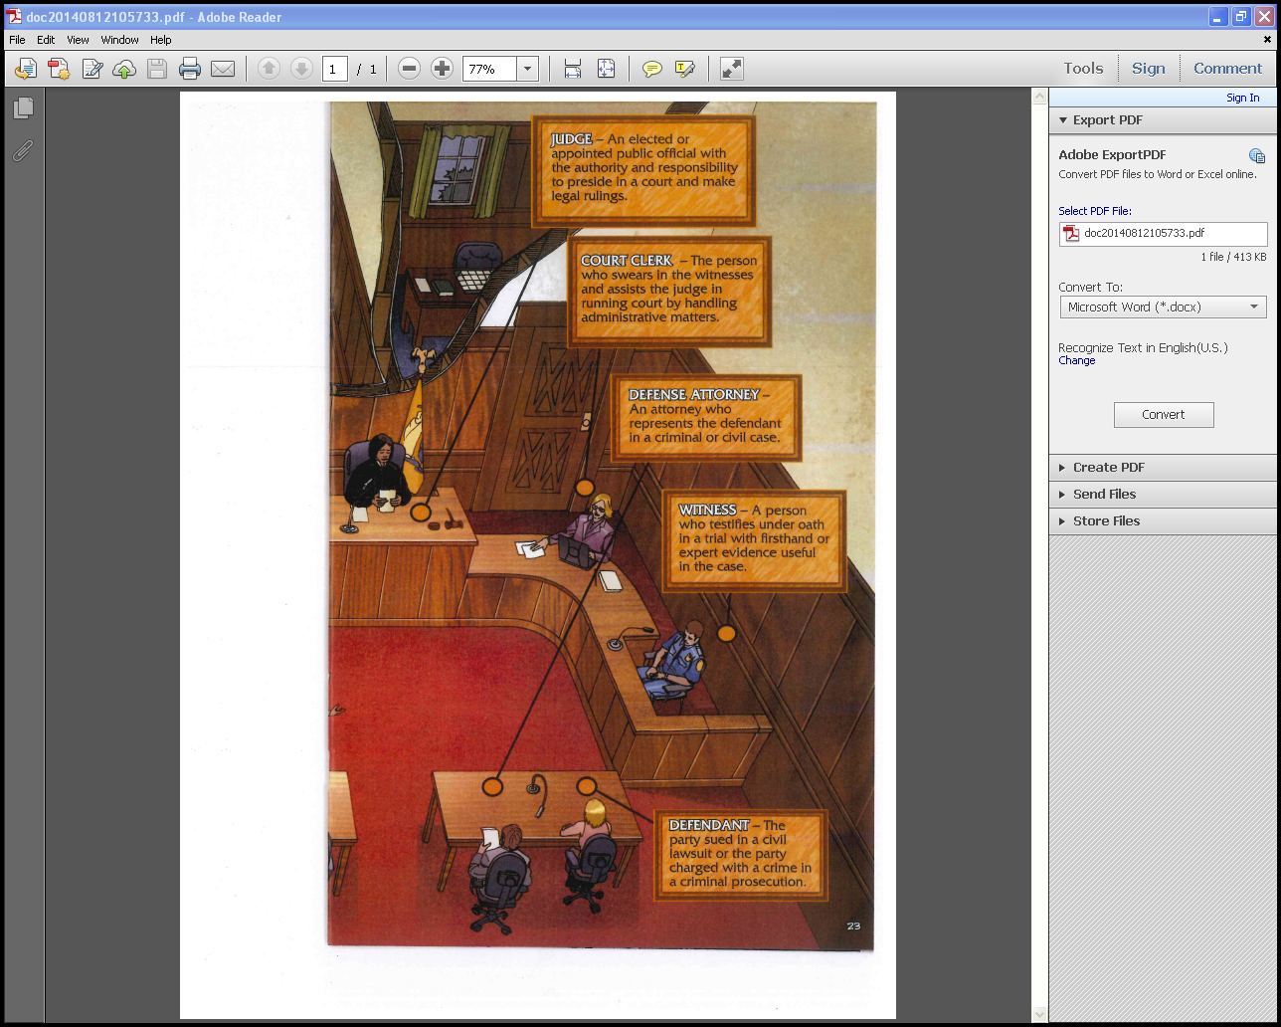
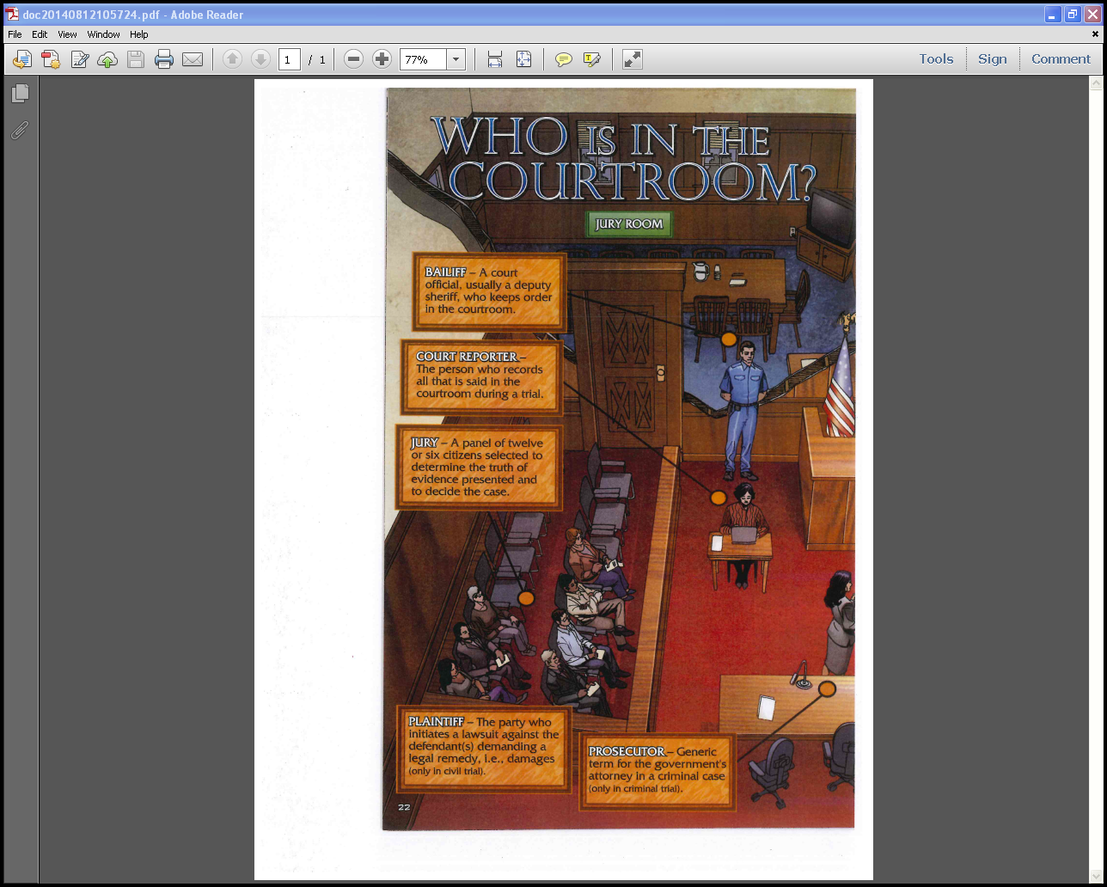
Images from the National Center for State Courts Graphic Novel
Notes:
Highlight persons in a trial using this animated courtroom. While this presentation will focus on a criminal trial, point out differences in civil and criminal cases as you review..
Be sure to highlight the following. In a criminal case, the prosecuting attorney represents society in a criminal case, and society as a whole is the "injured party" in a criminal case. Therefore, if the victim seeks recovery for any harm suffered, he or she must bring a separate civil suit against the defendant. The victim is not a party to the criminal case.

Slide 5
What is a jury?
A jury is a group of people summoned and sworn to fairly evaluate and decide the facts at issue in a trial.
The jury is composed of people who have received a summons to report for jury service by the Clerk of Court. Jurors are ultimately selected by the lawyers involved in a particular case in accordance with specific rules.
Notes:
A summons is a document directing the sheriff or other officer to notify a person that he or she is required to appear in court on a certain day.
The summons tells you what date you are to report, the time which you are to appear, and the Court’s policy regarding requests for postponement or excuse.

Slide 6



Two Court Systems
The judicial branch is divided into 2 parallel court systems: federal courts and state courts.
Federal courts get their powers and jurisdiction from the U.S. Constitution and federal laws.
State courts get their powers and jurisdiction from the Louisiana Constitution and state statutes.
Notes:
We have two parallel court systems (federal and state). Thus we have juries In the federal courts and in the state courts.
We also have juries for civil trials and criminal trials as well.
This presentation will focus primarily on the state courts but you can read about jury selection and other details regarding federal court juries and processes at the link below.
www.flnd.uscourts.gov/jurors/jurySelection.cfm
The U.S. Constitution created a governmental structure known as federalism that calls for the sharing of powers between the national and state governments. The Constitution gives certain powers to the federal government and reserves the rest for the states.
http://www.uscourts.gov/educational-resources/get-informed/federal-court-basics/why-two-courts-systems.aspx

Slide 7
History of Juries
Notes:
Let’s look back at the origin of juries briefly. They are not solely an American phenomenon.

Slide 8
Magna Carta, 1215
No free man shall be arrested or imprisoned or disseised [property taken] or outlawed or exiled or in any way victimized, neither will we attack him or send anyone to attack him, except by the lawful judgment of his peers or by the law of the land.
Notes:
Juries were in documents dating back to the Magna Carta and beyond. Interestingly, the expression “A jury of one’s peers” originates from the Magna Carta, and is not found in the U.S. Constitution. Trial by jury is incorporated in the US Constitution and the Bill of Rights as well as our state constitution.
We will learn exactly what it says during this presentation.

Slide 9

Prior to the American Revolution….
Notes:
Before the American Revolution, courts were seen as instruments of oppression. Juries could be locked up until they reached the "right" decision. Judges were seen as puppets of the king.
Including the right to a jury trial in the Constitution and Bill of Rights was one way to guard against government oppression particularly overzealous or corrupt prosecutors.

Slide 10
Why Did the Founders Think a Jury Was Important?
“For depriving us in many cases, of the benefits of Trial by Jury…” - Declaration of Independence
"The civil jury trial is preferable to any other and ought to be held sacred." -- Virginia Declaration of Rights, 1776
"In civil suits the parties have a right to trial by jury and this method of procedure shall be held sacred." -- Massachusetts Constitution, 1780
Notes:
Why did our Founders think juries were so important? Highlight historical documents that included juries and especially the complaints in the Declaration of Independence.
After 1776 the early state constitutions safeguarded the right to a jury trial in both criminal and civil cases, but the federal Constitution of 1789 guaranteed the right to a jury trial in criminal cases only.
This was remedied by the Bill of Rights, which was adopted in 1791.
http://www.americanbar.org/groups/public_education/resources/law_related_education_network/how_courts_work/trialjury_role.html
Discuss the quotes and ask for their interpretation.

Slide 11
Juries and the United States Constitution
Article III, Section 2
Guarantees that trials of all crimes except impeachment will be by jury
Guarantees due process of the law, including indictment by a grand jury for a capital crime.
Guarantees the right of a jury trial in criminal proceedings.
Guarantees the right of a jury trial in civil cases.
5th Amendment
6th Amendment
7th Amendment
Notes:
Highlight that jury trials were in both the text of the US Constitution even before the bill of rights was added. So the guarantee of a trial by jury was in the structure and function of government in the judicial branch. Why is this important? Not only is it a right but it is a function of government woven into the document which states how our government is structured and organized and functions.
Highlight also the difference between a grand jury and a petit jury.
Grand juries are a holdover from hundreds of years ago, originating during Britain's early history. Deeply-rooted in the Anglo-American tradition, the grand jury originally served to protect the accused from overly-zealous prosecutions by the English monarchy.

Slide 12
What should juries look like?
Bushel’s Case
1670
Independent juries free to come to their own verdict.
Sheppard v. Maxwell
1966
Verdict to be based on evidence presented in court, not from outside sources.
Duncan v. Louisiana
1968
Guaranteed the right to trial by jury in criminal cases.
Williams v. Florida
1970
Permitted the use of a 6-person jury as opposed to the historically implemented 12-person jury.
Taylor v. Louisiana
1975
Jurors cannot be excluded on the basis of gender; juries should represent a cross section of the community.
Batson v. Kentucky
1986
Jurors cannot be excluded on the basis of race; juries should represent a cross section of the community.
Notes:
Briefly highlight some of the important cases regarding juries. You can modify this list to shorten or add different cases. Just briefly mention and highlight the significance of each case. Distribute handouts for audience.

Slide 13
The Fair and Impartial Jury

Slide 14
The Role of the Jury
The jury is the trier of fact. The jurors’ role is to fairly evaluate the evidence presented in a trial to determine what is reliable and credible. Decisions should be based upon the nature and quality of the evidence presented through the testimony of witnesses and the exhibits in evidence.
Jurors must follow the instructions on the law presented by the judge at the conclusion of trial.
Use common sense in evaluating the evidence.
Notes:
http://www.americanbar.org/groups/public_education/resources/law_related_education_network/how_courts_work/trialjury_role.html
When a person is accused of a crime, how should they be seen in the eyes of a juror? (Innocent until proven guilty)

Slide 15
Jurors should not…..
  Do any outside research or google the defendant or witnesses in a trial;
  Be influenced by outside pressures or public opinion about the case;
  Decide cases based on prejudice, bias, or sympathy;
  Decide cases based on their feelings about the lawyers.

Slide 16
Juries and the Louisiana Courts

Slide 17
Louisiana Constitution
The constitutional right to a jury trial extends to CRIMINAL CASES in Louisiana. Art. I Section 17(A).
There is no constitutional right to a jury trial in CIVIL CASES in Louisiana.
The requirements for the number of jurors and concurrence requirements are in the Code of Criminal Procedure and the Code of Civil Procedure.

Slide 18
Juries and the Louisiana Courts
CRIMINAL COURT
CIVIL COURT
Capital cases are tried to 12 person juries. The decision must be unanimous both the guilt and penalty phases.
12 person juries try cases when the punishment must be confinement at hard labor. 10 of 12 must agree to render a verdict.
6 person juries try criminal cases if the punishment may be confinement with or without hard labor for more than 6 months. All 6 must agree.
Other cases are judge-tried.
Jury trials are not available in all civil cases.
The jury threshold is $50,000, exclusive of interest and costs. This is the highest in the U.S.
Cases valued less than this amount are tried by a judge.
Civil juries have 12 jurors, or 6 jurors if the parties agree.
  9 of 12 jurors must agree
  5 of 6 jurors must agree.
Notes:
Note: differentiate between a criminal and civil cases in the context of what the defendant is losing. In a criminal case, the defendant is subject to losing their freedom as opposed to property lost in a civil case.
Eminent domain defined: Amendment V of the U.S. Constitution:
…nor shall private property be taken for public use, without just compensation.
Eminent domain is when the government takes private property for public use
The government must offer a fair price, or, just compensation
Examples: taking your private property to put sidewalks in a neighborhood, taking private property to build a football stadium
Capital cases –
ADVISORY SENTENCE BY THE JURY.—After hearing all the evidence, the jury shall deliberate and render an advisory sentence to the court, based upon the following matters:(a) Whether sufficient aggravating circumstances exist as enumerated in subsection (5);
(b) Whether sufficient mitigating circumstances exist which outweigh the aggravating circumstances found to exist; and
(c) Based on these considerations, whether the defendant should be sentenced to life imprisonment or death.
(3) FINDINGS IN SUPPORT OF SENTENCE OF DEATH.—Notwithstanding the recommendation of a majority of the jury, the court, after weighing the aggravating and mitigating circumstances, shall enter a sentence of life imprisonment or death…
Criminal Cases - http://www.leg.state.fl.us/Statutes/index.cfm?App_mode=Display_Statute&Search_String=&URL=0900-0999/0913/Sections/0913.10.html
Eminent domain - http://www.leg.state.fl.us/Statutes/index.cfm?App_mode=Display_Statute&URL=0000-0099/0073/Sections/0073.071.html
Civil actions: http://www.leg.state.fl.us/Statutes/index.cfm?App_mode=Display_Statute&Search_String=&URL=0000-0099/0069/Sections/0069.071.html
http://www.keithtaylorlaw.com/Downloads/TheFloridaJury.pdf

Slide 19
Deliberation
How a jury makes a decision
Jury instructions are received prior to closing argument. Judge instructs the jury on the law and legal principles that must be followed when weighing the facts.
Provided a verdict form.
Select a foreperson.
In a private space, jurors discuss, deliberate, and decide.
A specific process is not prescribed to the jurors.

Slide 20
Hung Jury
A hung jury, or a deadlocked jury, is when the required number of jurors cannot agree on a verdict in a case .
Louisiana is 1 of only 2 states that allow non-unanimous juries in some criminal cases.
Why do you think a unanimous jury is required in capital cases and relative felonies (sentence may be imprisonment at hard labor for more than 6 months) – but not for all criminal cases?
  Do you think this is fair? Why or why not?

Slide 21
Role of Judges
When cases are tried before a jury, the judge still has a major role in determining which evidence may be considered by the jury.
The jury is the fact-finder, but it is left to "find" facts only from the evidence which is legally admissible.
The judge instructs the jury on the law and legal principles or rules that must be followed in weighing the facts.
Notes:
http://www.americanbar.org/groups/public_education/resources/law_related_education_network/how_courts_work/trialjury_role.html

Slide 22
SENTENCING
In criminal cases in Louisiana, the judge decides the sentence if there is a determination of guilt by the jury.
The jury does not participate in sentencing unless it is a death penalty case.
Unanimous verdicts are required to find the defendant guilty of a capital offense and to impose the death penalty. This is the same as the federal death penalty statute.
Notes:
May also want to mention that judges must abide by sentencing guidelines and laws written by the legislature in sentencing a defendant who has been found guilty.
Judges are not free to impose any sentence they want. There are guidelines and laws pertaining to punishments for specific crimes.

Slide 23
Qualifications of Jurors
What are the requirements for a person to serve on a jury?

Slide 24
What are the qualifications of a juror in Louisiana?
Prospective jurors' names are pulled from the Voter's Registration list of the trial parish and the Department of Motor Vehicles (DMV). Citizens' names are drawn randomly by computer from a master list by the Jury Commission or the clerk of court or his/her designee. The list is called the General Venire. A summons is sent to all persons on the venire, who must report on the assigned day for jury duty. They will then go through a process of jury selection. Those chosen to participate on a jury may claim an exemption if called again within 2 years. Persons over 70 may also claim an exemption.
Taken from both genders
At least 18 years of age
Citizens of the United States and Louisiana
Resident in the trial parish for at least 1 year
Not be interdicted, mentally or physically infirm
Able to read, write & speak English
Not under indictment
Not an unpardoned felon
Notes:
Discussion topic – requirements to be a juror
May want to compare to federal court as time permits. In federal court, jurors are selected at random from a certified list of registered voters. How does this compare to state court.
w.flnd.uscourts.gov/jurors/jurySelection.cfm

Slide 25
Juror Disqualification
You will be disqualified:
  If you’re at not least 18
  If you’re under indictment for a felony
  If you’re a convicted felon whose rights were not restored by a full pardon;
  If you’re not a U.S. citizen, Louisiana citizen, and 1 year resident of the trial parish;
  If you’re interdicted or mentally or physically infirm;
  If you can’t read, write and speak English
Notes:
Title V Chapter 40 provides information on juror qualifications and disqualifications. It also provides information on circumstances for jurors to be excused from jury service. Certain parties are also excused from jury service including the Governor, Lt. Governor, other cabinet members, clerk of court, judges, law enforcement officers, sole care givers to children under 6, and others (see full text of Florida Statute 40.013 below)
40.013 Persons disqualified or excused from jury service.—(1) No person who is under prosecution for any crime, or who has been convicted in this state, any federal court, or any other state, territory, or country of bribery, forgery, perjury, larceny, or any other offense that is a felony in this state or which if it had been committed in this state would be a felony, unless restored to civil rights, shall be qualified to serve as a juror.
(2)(a) Neither the Governor, nor Lieutenant Governor, nor any Cabinet officer, nor clerk of court, or judge shall be qualified to be a juror.
(b) Any full-time federal, state, or local law enforcement officer or such entities’ investigative personnel shall be excused from jury service unless such persons choose to serve.
(3) No person interested in any issue to be tried therein shall be a juror in any cause; but no person shall be disqualified from sitting in the trial of any suit in which the state or any county or municipal corporation is a party by reason of the fact that such person is a resident or taxpayer within the state or such county or municipal corporation.
(4) Any expectant mother and any parent who is not employed full time and who has custody of a child under 6 years of age, upon request, shall be excused from jury service.
(5) A presiding judge may, in his or her discretion, excuse a practicing attorney, a practicing physician, or a person who is physically infirm from jury service, except that no person shall be excused from service on a civil trial jury solely on the basis that the person is deaf or hearing impaired, if that person wishes to serve, unless the presiding judge makes a finding that consideration of the evidence to be presented requires auditory discrimination or that the timely progression of the trial will be considerably affected thereby. However, nothing in this subsection shall affect a litigant’s right to exercise a peremptory challenge.
(6) A person may be excused from jury service upon a showing of hardship, extreme inconvenience, or public necessity.
(7) A person who was summoned and who reported as a prospective juror in any court in that person’s county of residence within 1 year before the first day for which the person is being considered for jury service is exempt from jury service for 1 year from the last day of service.
(8) A person 70 years of age or older shall be excused from jury service upon request. A person 70 years of age or older may also be permanently excused from jury service upon written request. A person who is permanently excused from jury service may subsequently request, in writing, to be included in future jury lists provided such person meets the qualifications required by this chapter.
(9) Any person who is responsible for the care of a person who, because of mental illness, intellectual disability, senility, or other physical or mental incapacity, is incapable of caring for himself or herself shall be excused from jury service upon request.
*unless civil rights restored

Slide 26
Why wasn’t I selected?
Even if you meet the qualifications of a juror, it doesn’t mean you will always be selected for jury duty.
During jury selection (voire dire) the attorneys may decide not to select certain persons based on various reasons.
Peremptory vs Challenge for Cause
Notes:
Distinguish for the audience the difference between the exercise of peremptory challenges vs. challenges for cause. People are always curious about why they were not chosen. 10 peremptory challenges are allowed for criminal defendants facing the death penalty or life in prison; 6 for all other felonies; 3 for criminal misdemeanor and civil cases. You may want to consider also briefly discussing the requirement that peremptory challenges be exercised in a race neutral manner as required by the 3-part process in Melbourne.
See also Chapter 913 Trial Jury (Title XLVII Criminal Procedure and Corrections.
http://www.leg.state.fl.us/Statutes/index.cfm?App_mode=Display_Statute&URL=0900-0999/0913/0913.html
The 2015 Florida Statutes
Title XLVII
CRIMINAL PROCEDURE AND CORRECTIONSChapter 913
TRIAL JURYView Entire ChapterCHAPTER 913
TRIAL JURY
913.03 Grounds for challenge to individual jurors for cause.
913.08 Number of peremptory challenges.
913.10 Number of jurors.
913.12 Qualifications of jurors.
913.13 Jurors in capital cases.
913.15 Special jurors.
913.03 Grounds for challenge to individual jurors for cause.—A challenge for cause to an individual juror may be made only on the following grounds:(1) The juror does not have the qualifications required by law;
(2) The juror is of unsound mind or has a bodily defect that renders him or her incapable of performing the duties of a juror, except that, in a civil action, deafness or hearing impairment shall not be the sole basis of a challenge for cause of an individual juror;
(3) The juror has conscientious beliefs that would preclude him or her from finding the defendant guilty;
(4) The juror served on the grand jury that found the indictment or on a coroner’s jury that inquired into the death of a person whose death is the subject of the indictment or information;
(5) The juror served on a jury formerly sworn to try the defendant for the same offense;
(6) The juror served on a jury that tried another person for the offense charged in the indictment, information, or affidavit;
(7) The juror served as a juror in a civil action brought against the defendant for the act charged as an offense;
(8) The juror is an adverse party to the defendant in a civil action, or has complained against or been accused by the defendant in a criminal prosecution;
(9) The juror is related by blood or marriage within the third degree to the defendant, the attorneys of either party, the person alleged to be injured by the offense charged, or the person on whose complaint the prosecution was instituted;
(10) The juror has a state of mind regarding the defendant, the case, the person alleged to have been injured by the offense charged, or the person on whose complaint the prosecution was instituted that will prevent the juror from acting with impartiality, but the formation of an opinion or impression regarding the guilt or innocence of the defendant shall not be a sufficient ground for challenge to a juror if he or she declares and the court determines that he or she can render an impartial verdict according to the evidence;
(11) The juror was a witness for the state or the defendant at the preliminary hearing or before the grand jury or is to be a witness for either party at the trial;
(12) The juror is a surety on defendant’s bail bond in the case.
History.—s. 184, ch. 19554, 1939; CGL 1940 Supp. 8663(191); s. 85, ch. 70-339; s. 5, ch. 93-125; s. 1520, ch. 97-102.
913.08 Number of peremptory challenges.—(1) The state and the defendant shall each be allowed the following number of peremptory challenges:(a) Ten, if the offense charged is punishable by death or imprisonment for life;
(b) Six, if the offense charged is punishable by imprisonment for more than 12 months but is not punishable by death or imprisonment for life;
(c) Three, for all other offenses.
(2) If two or more defendants are tried jointly, each defendant shall be allowed the number of peremptory challenges specified in subsection (1), and the state shall be allowed as many challenges as are allowed to all of the defendants.
History.—s. 189, ch. 19554, 1939; CGL 1940 Supp. 8663(196); s. 86, ch. 70-339.
913.10 Number of jurors.—Twelve persons shall constitute a jury to try all capital cases, and six persons shall constitute a jury to try all other criminal cases.History.—s. 191, ch. 19554, 1939; CGL 1940 Supp. 8663(198); s. 87, ch. 70-339.
913.12 Qualifications of jurors.—The qualifications of jurors in criminal cases shall be the same as their qualifications in civil cases.History.—RS 2849; GS 3905; RGS 6003; CGL 8297; s. 88, ch. 70-339.
Note.—Former s. 932.19.
913.13 Jurors in capital cases.—A person who has beliefs which preclude her or him from finding a defendant guilty of an offense punishable by death shall not be qualified as a juror in a capital case.History.—s. 12, ch. 1637, 1868; RS 2850; GS 3906; RGS 6004; CGL 8298; s. 89, ch. 70-339; s. 1521, ch. 97-102.
Note.—Former s. 932.20.
913.15 Special jurors.—The court may summon jurors in addition to the regular panel.History.—RS 2853; GS 3909; RGS 6007; CGL 8301; s. 91, ch. 70-339.
Note.—Former s. 932.22.

Slide 27
The Fair and Impartial Jury
What would make a jury “fair” in your eyes?

Slide 28
You Decide
What do you think?
Do you think there should be different requirements or qualifications for people to serve as jurors in Louisiana courts?
What would you add/delete?
What about disqualifications?
Come up with a list individually
and discuss in groups.
Notes:
In the event the audience does not provide feedback, some factors to consider for the qualifications of jurors:
Age (should it be raised? Lowered?)
Citizenship requirement at the state level – yes or no
Education
Language
Literacy
Debriefing: Should jury duty be mandatory or voluntary? What might the impact be?

Slide 29
Coming to a Decision
“Trial by jury is more than an instrument of justice and more than a wheel of the constitution; it is the lamp that shows that freedom lives.”
(Lord Devlin, 1956)

Slide 30

Peggy Cotogno
Executive Director
Peggy.cotogno@lsba.org
These materials have been adapted, with permission from The Florida Bar Benchmarks Adult Civic Education Program, for use in Louisiana. Principal authors of the Florida Benchmarks Program are Annette Boyd Pitts and Richard Levenstein. For assistance with adaptation in other states, contact staff@flrea.org

