Slide 1

Oncology Nursing Showdown: Advanced Non-Hodgkin Lymphoma Edition
Amy Goodrich, RN, MSN, CRNP-AC
Nurse Practitioner
Sidney Kimmel Comprehensive Cancer Center at Johns Hopkins

Slide 2
Accreditation: i3 Health is accredited with distinction as a provider of nursing continuing professional development by the American Nurses Credentialing Center's Commission on Accreditation. A maximum of 1.0 contact hour may be earned by learners who successfully complete this nursing continuing professional development activity. Provider approved by the California Board of Registered Nursing, Provider Number 15824, for 1.0 contact hour.
How to Claim NCPD Credit: Your certificate of attendance will be emailed to you within 7 days. Please also complete an evaluation online at www.i3Health.com/GLAONS-NHL
Commercial Support: This activity is supported by an independent educational grant from Verastem. Aggregate participant data will be shared with commercial supporters of this activity.
Unapproved Use Disclosure: i3 Health requires NCPD faculty (speakers) to disclose to attendees when products or procedures being discussed are off-label, unlabeled, experimental, and/or investigational (not FDA approved), as well as any limitations on the information that is presented, such as data that are preliminary or that represent ongoing research, interim analyses, and/or unsupported opinion. Faculty may discuss information about pharmaceutical agents that is outside of U.S. Food and Drug Administration approved labeling.
This information is intended solely for continuing education and is not intended to promote off-label use of these medications. If you have questions, contact the medical affairs department of the manufacturer for the most recent prescribing information.
Disclaimer: The information provided at this NCPD activity is for continuing education purposes only and is not meant to substitute for the independent medical/clinical judgment of a healthcare provider relative to diagnostic and treatment options of a specific patient’s medical condition.

Slide 3
Disclosures
Amy Goodrich discloses the following commercial relationships:
  Advisory board or panel: AstraZeneca, Janssen
  Consultant: Abbvie, Janssen

Slide 4
Learning Objectives
Evaluate guideline recommendations for the management of individual patients with advanced NHL
Assess emerging efficacy and safety data on novel therapies for advanced NHL
Apply strategies to manage adverse events and optimize treatment experiences for patients receiving novel therapies for advanced NHL
NHL = non-Hodgkin lymphoma.

Slide 5
Advanced Follicular Lymphoma
Impact and Significance
2020 estimated NHL incidence (US)
  77,420 diagnosed
  19,940 deaths
Follicular lymphoma: second most common NHL diagnosis worldwide
  35% of all NHL
  70% of indolent NHL
  Median age 65 years
  M:F ratio 1.2:1
  Grades 1-3, with grades 1, 2, and 3A being indolent
  70%-85% have advanced disease at diagnosis
  2%-3% annual incidence of transformation to DLBCL
FL = follicular lymphoma; M = male; F = female; DLBCL = diffuse large B-cell lymphoma.
Siegel et al, 2020; Dada, 2019.

Slide 6



Advanced Follicular Lymphoma (cont.)
Follicular Lymphoma International Prognostic Index (FLIPI) 2
Age >60
Bone marrow involvement
Largest node >6 cm
Hemoglobin <12 g/dL
Elevated B2M
Add and score 0-5
Score | Risk | 3-Year PFS | 3-Year OS
0 | Low | 91 | 99
1-2 | Intermediate | 69 | 96
3-5 | High | 51 | 84
B2M = beta-2 microglobulin; PFS = progression-free survival; OS = overall survival.
Federico et al, 2009.

Slide 7
Advanced Follicular Lymphoma (cont.)
Indication for Treatment
High tumor bulk
  Any tumor >7 cm in diameter
  Involvement of >3 nodes in 3 areas, each >3 cm in diameter
  Symptomatic enlarged spleen
  Organ compression
  Ascites or pleural effusion
Systemic symptoms
  Unexplained fevers, drenching night sweats, or >10% weight loss
  Declining performance status
  Elevated lactate dehydrogenase (LDH) or B2M
  Cytopenia (granulocyte count <1.0x10⁹/L and/or platelets <100x10⁹/L)
Ardeshna et al, 2014; Decaudin et al, 1999; Solal-Céligny et al, 2010.

Slide 8
Case Study 1: Mr. M
Mr. M is a 68-year-old man recently diagnosed with stage III low-grade FL
Axillary adenopathy noted on pre-op chest x-ray prior to knee replacement surgery
Staging workup revealed 4 cm right axillary node and multiple 2 cm nodes in the abdomen and pelvis
All labs WNL
Other than knee pain and ongoing rehab, feels well
Works part time doing payroll for a friend’s business
PMH includes hypertension and osteoarthritis
pre-op = preoperative; WNL = within normal limits; PMH = past medical history.

Slide 9
Case Study 1: Mr. M (cont.)
Mr. M has a FLIPI score of 1 (age over 60)
Does not meet criteria for treatment and is observed
Develops slowly progressive disease, with axillary adenopathy now measuring 6.5 cm and multiple 3-4 cm nodes in the abdomen (N=2) and pelvis (N=3)
Continues to feel well
Meets criteria for treatment due to bulky disease

Slide 10
Case Study 1: Mr. M (cont.)
What therapy is Mr. M most likely to receive?
  A.) Copanlisib
  B.) Ibrutinib +/- rituximab
  C.) Bendamustine/obinutuzumab
  D.) Any of the above
Notes:
Correct answer is C: Bendamustine and obinutuzumab are approved for first-line therapy of FL. Copanlisib is approved for R/R FL. Ibrutinib is not approved for FL (NCCN, 2020).

Slide 11
Advanced FL: Initial Treatment Options
First Line | Elderly or Infirm | Consolidation/ Extended Dosing
Chemoimmunotherapy: Bendamustine, CHOP, or CVP + obinutuzumab or rituximab Lenalidomide + anti-CD20 Rituximab | Rituximab Chlorambucil ± rituximab Cyclophosphamide ± rituximab Radioimmunotherapy | Rituximab every 8-12 weeks x 12 doses (high tumor burden) Obinutuzumab Q8W x 12 doses Rituximab Q8W x 4 doses (after rituximab monotherapy) Radioimmunotherapy
CHOP = cyclophosphamide/doxorubicin/vincristine/prednisone; CVP = cyclophosphamide/vincristine/prednisone; Q8W = every 8 weeks.
NCCN, 2020.

Slide 12
Obinutuzumab/Chemo in Advanced FL
Rituximab/ chemo
Rituximab maintenance x 2 years
57% received bendamustine
33% received CHOP
10% received CVP
1,202 patients with previously untreated FL
R
Obinutuzumab/chemo
Obinutuzumab maintenance x 2 years
Chemo = chemotherapy; R = randomization.
Marcus et al, 2017.

Slide 13
Obinutuzumab/Chemo in Advanced FL (cont.)
After a median follow-up of 34 months, analysis confirms that obinutuzumab/chemo prolongs PFS versus rituximab/chemo in initial treatment of FL
 | Obinutuzumab/Chemo | Rituximab/Chemo
Overall response rate | 88.5% | 86.9%
Estimated 3-year PFS | 80% | 73.3%
Adverse events (serious adverse events) | 74.6% (46.6%) | 67.8% (39.9%)
Marcus et al, 2017.

Slide 14
Case Study 1: Mr. M (cont.)
Mr. M receives 6 cycles of bendamustine and obinutuzumab
Requires early dose reduction due to neutropenic fever
Goes on to tolerate well after dose reduction
Achieves near complete response
Receives 2 years of obinutuzumab maintenance
Remains in remission for 3 years post maintenance
Develops bulky groin adenopathy, causing lower extremity edema

Slide 15
Case Study 1: Mr. M (cont.)
Mr. M requires further therapy
He is now 74 years old
Enrolls in a clinical trial using a BTK inhibitor
No response
BTK = Bruton tyrosine kinase.

Slide 16
Case Study 1: Mr. M (cont.)
What therapy is Mr. M most likely to receive (third line)?
  A.) Copanlisib
  B.) Venetoclax +/- rituximab
  C.) Bendamustine/obinutuzumab
  D.) Any of the above
Notes:
Correct answer is A: Copanlisib is approved for R/R FL after 2 prior lines of therapy. Bendamustine/obinutuzumab has already been approved for first line therapy of FL. Venetoclax is not approved for FL (NCCN, 2020).

Slide 17
Advanced FL (cont.)
Relapsed/Refractory Treatment Options
Second Line and Beyond | Elderly or Infirm | Consolidation/Extended Dosing | Transformation to DLBCL
Any unused initial therapy options Obinutuzumab Lenalidomide +/- obinutuzumab PI3 kinase inhibitors after 2 therapies: copanlisib, duvelisib, idelalisib Tazemetostat after 2 therapies or no other options | Any unused initial therapy options | Rituximab every 12 weeks x 2 years Obinutuzumab every 8 weeks x 12 doses Rituximab every 8 weeks x 4 doses (after rituximab monotherapy) Radioimmunotherapy Autologous or allogeneic stem cell transplant (select patients) | CAR T: axicabtagene ciloleucel or tisagenlecleucel (only after ≥2 prior chemoimmunotherapy regimens)
CAR T = chimeric antigen receptor T-cell therapy.
NCCN, 2020.

Slide 18
Case Study 1: Mr. M (cont.)
Mr. M arrives to begin copanlisib
What are you going to most closely monitor and educate Mr. M about today?
  Rash/dermatitis and transaminitis
  Lymphocytosis and tumor flare
  Hypertension and hyperglycemia
  Alopecia and vomiting
Notes:
C is the correct answer: hypertension and hyperglycemia are unique adverse events with copanlisib. A is significant with idelalisib and duvelisib. Lymphocytosis and tumor flare are uncommon with copanlisib. PI3K inhibitors are not associated with significant alopecia or vomiting (Copiktra® prescribing information, 2019; Zydelig® prescribing information, 2018; Aliqopa® prescribing information, 2020.

Slide 19
Copanlisib in Relapsed/Refractory FL
CHRONOS-1
Phase 2 study
142 patients with relapsed or refractory indolent lymphoma after ≥2 lines of therapy
Copanlisib 60 mg intravenously on days 1, 8, and 15 of a 28-day cycle
Copanlisib was active in R/R indolent NHL with an objective response rate of 59% (84 of 142 patients)
Activity confirmed in updated analysis
  Median PFS of 11.3 months
R/R = relapsed/refractory.
Dreyling et al, 2017
Notes:
The primary end point was objective response rate; secondary end points included duration of response, progression-free survival, and overall survival. In addition, safety and gene expression were evaluated.

Slide 20
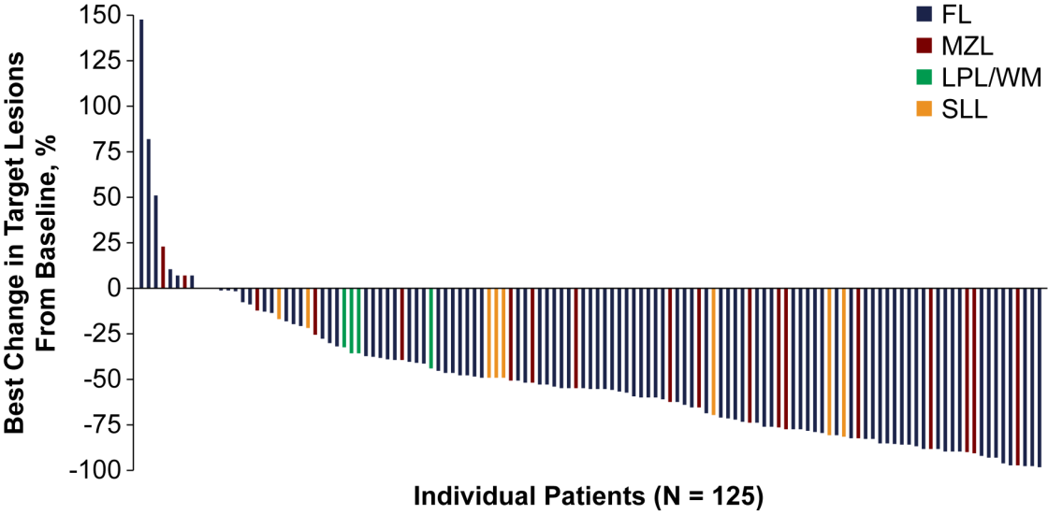
Copanlisib in R/R FL (cont.)
CHRONOS-1
MZL = marginal zone lymphoma; LPL = lymphoplasmacytic lymphoma; WM = Waldenstrom macroglobulinemia; SLL = small lymphocytic lymphoma; N = number.
Dreyling et al, 2017.
Notes:
In this phase 2 study, 142 patients with relapsed or refractory indolent lymphoma after ≥2 lines of therapy were enrolled to receive copanlisib 60 mg intravenously on Days 1, 8, and 15 of a 28-day cycle. The primary end point was objective response rate; secondary end points included duration of response, progression-free survival, and overall survival. In addition, safety and gene expression were evaluated.

Slide 21
Side Effects Unique to Copanlisib
Infusion-Related Hypertension
Elevation begins during infusion
  Peaks 2 hours post infusion
  Remains elevated for 6-8 hours after start of infusion
Pre- and post-infusion BP checks recommended
  Hold if pre-dose BP >150/90; consider dose reduction
26% will have systolic >160 mmHg or diastolic >100 mmHg
  0.9% rate of serious or life-threatening hypertension
Patients may require anti-hypertensives or changes to existing regimens
Consider patient monitoring at home
BP = blood pressure.
Aliqopa® prescribing information, 2020.

Slide 22
Side Effects Unique to Copanlisib
Infusion-Related Hyperglycemia
Hold if pre-dose fasting glucose >160 mg/dL or non-fasting >200 mg/dL; consider dose reduction
  Glucose peaks 5-8 hours post infusion
  Most return to baseline; 17.7% remain elevated 1 day after infusion
41% with blood glucose >250 mg/dL
  2.8% with serious or life-threatening hyperglycemia
10% of patients with baseline normal hemoglobin A1c developed abnormal levels
Patients with diabetes should monitor glucose closely
Aliqopa® prescribing information, 2020.

Slide 23
PI3K Inhibitors
 | Idelalisib | Duvelisib | Copanlisib
Dose | 150 mg orally twice daily | 25 mg orally twice daily | 60 mg infusion on d1, 8, 15 in 28-day cycle
Dosage form | Tablets: 150 mg, 100 mg | Capsules: 25 mg, 15 mg | For injection as lyophilized solid in single-dose vial for reconstitution
Most common adverse events (>20%) | Diarrhea, fatigue, nausea, cough, pyrexia, abdominal pain, pneumonia, rash | Diarrhea or colitis, neutropenia, rash, fatigue, pyrexia, cough, nausea, upper respiratory infection, pneumonia, musculoskeletal pain, anemia | Hyperglycemia, diarrhea, decreased general strength and energy, hypertension, leukopenia, neutropenia, nausea, lower respiratory tract infection, thrombocytopenia
Warnings/ precautions | Severe cutaneous reactions, anaphylaxis, neutropenia, embryo-fetal toxicity | Hepatotoxicity, neutropenia, embryo-fetal toxicity | Infections, hyperglycemia, hypertension, noninfectious pneumonitis, neutropenia, severe cutaneous reactions, embryo-fetal toxicity
Drug interactions | Strong CYP3A inhibitors and inducers, CYP3A substrates | CYP3A inhibitors or inducers, CYP3A substrates | CYP3A inhibitors or inducers
d = day.
Aliqopa® prescribing information, 2020; Copiktra® prescribing information, 2019; Zydelig® prescribing information, 2018.

Slide 24
Unique Adverse Events with PI3K Inhibitors
Adverse Event | Incidence | Considerations | Issues
Diarrhea | Idelalisib: 14% Duvelisib: 18% Copanlisib: 36% | Interrupt idelalisib and administer corticosteroids | Can occur at any time. Avoid other drugs that cause diarrhea. Diarrhea from idelalisib responds poorly to antimotility. Median time to resolution: 1 week to 1 month
Pneumonitis | Idelalisib: 4% Duvelisib: 5% Copanlisib: 5% | Monitor patients for pulmonary symptoms. Interrupt drug, initiate steroids | Time to onset <1-15 months
Hepatitis/ hepatotoxicity | Idelalisib: 18% Duvelisib: 8% | Idelalisib: after re-initiation of drug at lower dose, 26% of patients had recurrence. Discontinue idelalisib for recurrent hepatotoxicity. Monitor ALT/AST every 2 weeks for 3 months, every 4 weeks for next 3 months, then every 1-3 months thereafter | Idelalisib: increased AST/ALT to >5x ULN has occurred, usually in first 12 weeks of treatment. Usually resolves with drug interruption. Avoid concurrent use of other drugs that cause hepatotoxicity
ALT = alanine aminotransferase; AST = aspartate aminotransferase; ULN = upper limit of normal.
Aliqopa® prescribing information, 2020; Copiktra® prescribing information, 2019; Zydelig® prescribing information, 2018.

Slide 25
Case Study 1: Mr. M (cont.)
Mr. M is doing well on copanlisib
Has achieved a partial response (<50% tumor burden reduction)
Will remain on therapy until progression or unacceptable toxicity

Slide 26
Advanced Follicular Lymphoma
Takeaways
Chemoimmunotherapy regimens remain important options in the treatment of advanced FL
Novel agents are active; treatment options are increasing
PI3K inhibitors: 3 agents approved in FL
Anti-CD20 options: obinutuzumab and rituximab
Novel agents carry unique side effect profiles
Oncology nurses play a critical role in adverse event identification and patient education
Successful side effect management is key to optimizing patient outcomes

Slide 27
Chronic Lymphocytic Leukemia/ Small Lymphocytic Lymphoma (CLL/SLL)

Slide 28
Chronic Lymphocytic Leukemia
Impact and Significance
2020 estimated CLL incidence
  21,040 diagnosed
  4,060 deaths
Most common adult leukemia in the Western world
Median age: 72 years
M:F ratio 1.6:1
70% will require treatment
Most require treatment 4-5 years after diagnosis
2%-9% incidence of Richter transformation to DLBCL
  May also transform to Hodgkin lymphoma or T-cell lymphoma
Siegel et al, 2020; NCCN, 2019.

Slide 29
Case Study 2
Ms. B is a 61-year-old woman with newly diagnosed CLL
Noted lump on neck, biopsy consistent with CLL/SLL
WBC 32,000/µL; ALC 28,000/µL; hgb 13 g/dL; platelets 125x10⁹/L
Feels entirely well
Staging workup reveals widespread adenopathy, up to 4 cm
PMH includes a-fib (on multiple meds, also on warfarin) and stable glaucoma
Biomarkers pending
WBC = white blood cell count; ALC = absolute lymphocyte count; hgb = hemoglobin; a-fib = atrial fibrillation.

Slide 30
Case Study 2 (cont.)
Favorable prognostic molecular biomarkers for CLL include which of the following?
  TP53 mutations
  Mutated IGHV
  ALK amplification
  Del(17p)
IGHV = immunoglobulin heavy-chain variable; ALK = anaplastic lymphoma kinase.
Notes:
B is the correct answer. Mutated immunoglobulin heavy-chain variable (IGHV) is associated with longer survival and better response to therapy. TP53 and del(17p) are high-risk features associated with poor outcomes. ALK plays no role in prognostics for CLL (NCCN, 2020).

Slide 31
CLL Prognostic Factors
 | FISH | Karyotype | Mutations
Unfavorable | del(17p) del(11q) | Complex (>3 abnormalities) (>5?) | TP53 Unmutated IGHV (≤2%) NOTCH-1 SF3B1 BIRC3 ATM
Neutral | Normal +12
Favorable | del(13q) (sole abnormality) |  | Mutated IGHV (>2%)
FISH = fluorescence in situ hybridization.
NCCN, 2019.

Slide 32
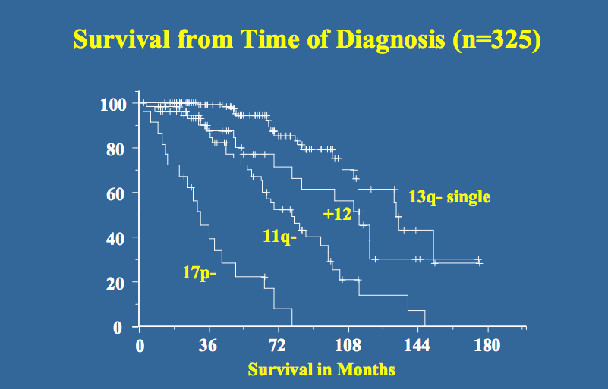
Prognostic Value of FISH for CLL
Survival from Time of Diagnosis (n=325)
(248 with no prior treatment)
Survival in Months
Döhner et al, 2000.

Slide 33
Prognostic Value of FISH for CLL (cont.)
Abnormality | Patients, % | Median Time to Treatment, mos | Median OS, mos
del(17)(p13.1) | 7 | 9 | 32
del(11)(q22.3) | 18 | 13 | 79
Trisomy 12 | 16 | 33 | 114
del(13)(q14) | 55 | 49 | 133
None detected | 18 | 92 | 111
mos = months.
Döhner et al, 2000.

Slide 34
Updated 2018 International Workshop on CLL
Guidelines to Initiate Therapy
Any One of the Following Criteria Should Be Met to Initiate CLL Therapy:
Progressive marrow failure, hemoglobin <10 g/dL, or platelets <100x10⁹/L
Massive (≥6 cm below the left costal margin) or progressive or symptomatic splenomegaly
Massive (≥10 cm in longest diameter) or progressive or symptomatic lymphadenopathy
Autoimmune complications of CLL that are poorly responsive to corticosteroids
Symptomatic extranodal involvement (eg, skin, kidney, lung, spine)
Increased pace of progressionª
Disease-related symptoms: Unintentional weight loss of ≥10% within the previous 6 months Significant fatigue Fever ≥100.5⁰ F for ≥2 weeks without evidence of infection Night sweats for ≥1 month without evidence of infection
ªProgressive lymphocytosis with an increase of ≥50% over a 2-month period, or lymphocyte doubling time (LDT) ≤6 months. LDT can be obtained by linear regression extrapolation of absolute
lymphocyte counts obtained at intervals of 2 weeks over an observation period of 2 to 3 months; patients with initial blood lymphocyte counts <30 x 10^9/L may require a longer observation period
to determine the LDT. Factors contributing to lymphocytosis other than CLL (eg, infections, steroid administration) should be excluded.
Hallek et al, 2018.

Slide 35
Case Study 2 (cont.)
Ms. B’s biomarkers reveal mutated IGHV and normal FISH findings
She has favorable prognostic results
She is asymptomatic
Observed for 4 years
Develops splenomegaly with progressive thrombocytopenia
Loses 10 lbs due to early satiety
Platelets 88x10⁹/L

Slide 36
Case Study 2 (cont.)
Ms. B requires therapy due to her symptomatic splenomegaly and thrombocytopenia
Repeat FISH studies reveal unchanged, normal findings
Treatment options discussed

Slide 37
Case Study 2 (cont.)
What treatment do you anticipate her to be receiving?
  Ibrutinib
  Acalabrutinib
  Venetoclax/obinutuzumab
  Any of the above
Notes:
D is the correct answer. C is most attractive, as Bruton tyrosine kinase (BTK) inhibitors are generally avoided in patients with a-fib and/or on anticoagulation (NCCN, 2019).

Slide 38
CLL/SLL Without Del(17p)/TP53 Mutation
Suggested Regimens for Front-Line Treatment
Frail With Significant Comorbidity OR Age >65; Younger Patients With Significant Comorbidities | Age <65 Without Significant Comorbidities
Preferred first-line regimens: | Preferred first-line regimens:
Ibrutinib Acalabrutinib ± obinutuzumab Venetoclax/obinutuzumab | Ibrutinib Acalabrutinib ± obinutuzumab Venetoclax/obinutuzumab
Other recommended regimens: | Other recommended regimens:
Bendamustine + anti-CD20 monoclonal antibody (not recommended for frail patients) Chlorambucil + anti-CD20 monoclonal antibody High-dose methylprednisolone (HDMP)/rituximab Ibrutinib/obinutuzumab Obinutuzumab Chlorambucil Rituximab | Bendamustine + anti-CD20 monoclonal antibody FCR (fludarabine/cyclophosphamide/rituximab) FR (fludarabine/rituximab) HDMP/rituximab Ibrutinib/rituximab PCR (pentostatin/cyclophosphamide/rituximab)
HDMP = high-dose methylprednisolone.
NCCN, 2019.

Slide 39
CLL/SLL Without Del(17p)/TP53 Mutation
Suggested Regimens for Relapsed/Refractory Treatment
Frail With Significant Comorbidity OR Age >65; Younger Patients with Significant Comorbidities | Age <65 Without Significant Comorbidities | Maintenance Therapy
Preferred relapsed/refractory regimens: | Preferred relapsed/refractory regimens: | Post second-line:
Acalabrutinib Ibrutinib Venetoclax/rituximab Duvelisib Idelalisib/rituximab | Acalabrutinib Ibrutinib Venetoclax/rituximab Duvelisib Idelalisib/rituximab | Lenalidomide Ofatumumab
NCCN, 2019.

Slide 40
CLL/SLL Without Del(17p)/TP53 Mutation
Suggested Regimens for Relapsed/Refractory Treatment (cont.)
Frail With Significant Comorbidity OR Age >65; Younger Patients With Significant Comorbidities | Age <65 Without Significant Comorbidities
Other recommended regimens: | Other recommended regimens:
Alemtuzumab ± rituximab Chlorambucil/rituximab Reduced-dose FCR or PCR HDMP/rituximab Idelalisib Lenalidomide ± rituximab Obinutuzumab Ofatumumab Venetoclax Dose-dense rituximab Bendamustine/rituximab ± ibrutinib or idelalisib | Alemtuzumab ± rituximab Bendamustine/rituximab FC/ofatumumab FCR HDMP/rituximab Idelalisib Lenalidomide ± rituximab Obinutuzumab Ofatumumab PCR Venetoclax Bendamustine/rituximab ± ibrutinib or idelalisib
FC = fludarabine/cyclophosphamide.
NCCN, 2019.

Slide 41
CLL14: Venetoclax/G vs CHL/G
First-Line CLL With Comorbidities
12% with TP53 abnormality
Obinutuzumab/
venetoclax (6 mos) + venetoclax (6 mos)
Follow-up phase
Previously untreated CLL with coexisting medical conditions (n=445)
R
Obinutuzumab/
chlorambucil (6 mos) + chlorambucil (6 mos)
G = obinutuzumab; CHL = chlorambucil.
Fischer et al, 2019.

Slide 42
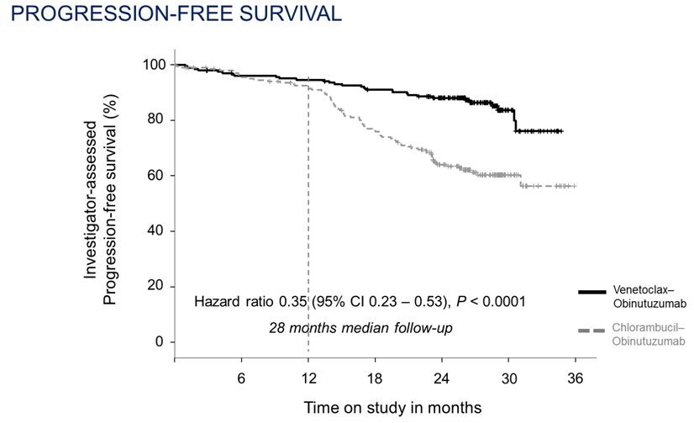
CLL14: Venetoclax/G vs CHL/G (cont.)
First-Line CLL With Comorbidities
Progression-Free Survival
24-month PFS:
Ven/G: 88%
CHL/G: 64%
MRD negative: 57% in venetoclax arm
Ven = venetoclax; MRD = minimal residual disease; CI = confidence interval.
Fischer et al, 2019.

Slide 43
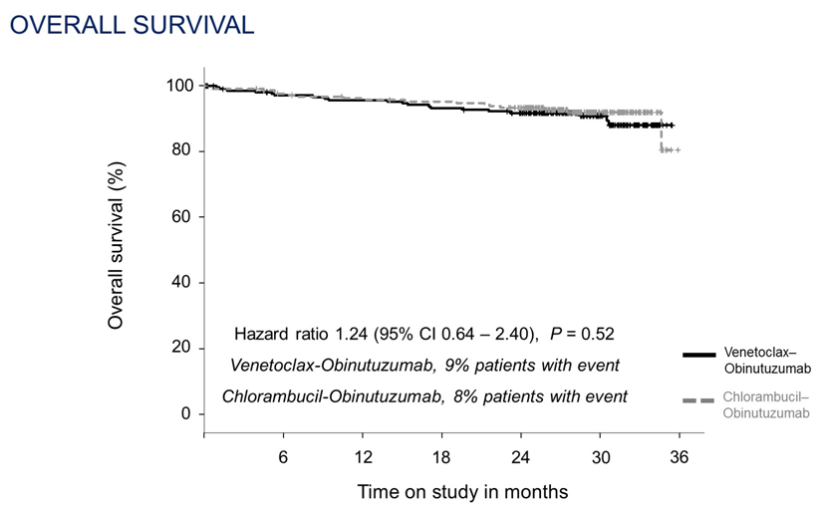
CLL14: Venetoclax/G vs CHL/G (cont.)
First-Line CLL With Comorbidities
Overall Survival
Fischer et al, 2019.

Slide 44
Case Study 2 (cont.)
What is your primary concern and teaching focus with Ms. B starting venetoclax?
  Tumor lysis syndrome
  Pneumonitis
  Diarrhea/colitis
  Rash
Notes:
A is the correct answer. Venetoclax is ramped up due to risk of TLS, and all patients require monitoring. B-D are not significant issues with venetoclax (NCCN, 2019).

Slide 45
Venetoclax
 | Venetoclax
Dose | Ramp up for first 5 weeks, then 400 mg daily
Dosage form | Tablets: 10 mg, 50 mg, 100 mg
Most common adverse events (>20%) | Neutropenia, diarrhea, upper respiratory tract infection, fatigue, cough, nausea
Warnings/ precautions | Tumor lysis syndrome, neutropenia, immunizations, embryo-fetal toxicity
Drug interactions | Strong or moderate CYP3A inhibitors, P-gp inhibitors
P-gp = P-glycoprotein.
Venclexta® prescribing information, 2019.

Slide 46
TLS Prophylaxis Based on Tumor Burden: CLL/SLL
Tumor Burden |  | Prophylaxis |  | Blood Chemistry Monitoring
 |  | Hydration | Antihyperuricemics | Setting and Frequency of Assessments
Low | All LN <5 cm AND ALC <25x10⁹/L | Oral (1.5-2 L) | Allopurinol | Outpatient For first dose of 20 mg and 50 mg: pre-dose 6-8 hours, 24 hours For subsequent ramp-up doses: pre-dose
Medium | Any LN 5-10 cm OR ALC >25x10⁹/L | Oral (1.5-2 L); consider additional intravenous | Allopurinol | Outpatient For first dose of 20 mg and 50 mg: pre-dose 6-8 hours, 24 hours For subsequent ramp-up doses: pre-dose For first dose of 20 mg and 50 mg: consider hospitalization for patients with CrCL <80 ml/min
High | Any LN >10 cm OR ALC >25x10⁹/L AND any LN >5 cm | Oral (1.5-2 L) and intravenous (150-200 mL/hr as tolerated) | Allopurinol: consider rasburicase if baseline uric acid is elevated | In hospital: For first dose of 20 mg and 50 mg: pre-dose 4, 8, 12, 24 hours Outpatient For subsequent ramp-up doses: pre-dose 6-8 hours, 24 hours
TLS = tumor lysis syndrome; LN = lymph nodes; CrCl = creatinine clearance.
Venclexta® prescribing information, 2019.

Slide 47
Novel Anti-CD20 Antibodies: Obinutuzumab
Special Considerations for Use
Minimize infusion reactions
  Divide initial dose over 2 days
  Premedicate with steroids/antihistamines
  Anticipate TLS
  Premedicate patients with antihyperuricemics and adequate hydration, especially those with high tumor burden and/or high circulating lymphocyte count
  Monitor for infections, cytopenias, GI events
Single-Agent Dosing
CLL Cycle 1: 100 mg on Day 1; 900 mg on Day 2; 1,000 mg on Days 8, 15 Cycles 2-6: 1,000 mg on Day 1
FL Cycle 1: 1,000 mg on Days 1, 8, 15 Cycles 2-6 OR cycles 2-8: 1,000 mg on Day 1 Then 1,000 mg every 2 months for up to 2 years
GI: gastrointestinal.
NCCN, 2020; Gazyva® prescribing information, 2020.

Slide 48
Case Study 2 (cont.)
Ms. B tolerated venetoclax and obinutuzumab without significant toxicity and remains in a complete remission
What is the primary reason ibrutinib or acalabrutinib were not used in the first-line setting for Ms. B?
  Venetoclax/obinutuzumab has better overall survival than ibrutinib or acalabrutinib
  Ms. B is not elderly or infirm so was ineligible for ibrutinib or acalabrutinib
  Ms. B has a history of a-fib and is on warfarin
  Ms. B does not have high-risk features of 17p(del) or unmutated IGHV
Notes:
C is the correct answer. BTK inhibitors (BTKi) have black box warnings of a-fib and bleeding, putting her at risk of those toxicities. B is incorrect because patients of any age are eligible for BTKi therapy, A is incorrect, as there have been no head-to-head trials. D is incorrect because BTKi therapy is indicated for high- or low- risk patients (NCCN, 2019).

Slide 49
CLL/SLL With Del(17p)/TP53 Mutation (cont.)
Suggested Regimens: Complete Absence of Chemotherapy
First Line | Relapsed/Refractory
Preferred regimens | Preferred regimens
Acalabrutinib ± obinutuzumab Ibrutinib Venetoclax/obinutuzumab | Acalabrutinib Ibrutinib Venetoclax/rituximab Duvelisib Idelalisib/rituximab Venetoclax
Other recommended regimens | Other recommended regimens
Alemtuzumab ± rituximab HDMP/rituximab Obinutuzumab | Acalabrutinib Alemtuzumab ± rituximab HDMP/rituximab Idelalisib Lenalidomide ± rituximab Ofatumumab
NCCN, 2019.

Slide 50
Unique Adverse Events With BTK Inhibitors
Adverse Event | Incidence | Mechanism | Considerations | Issues
Atrial fibrillation | Ibrutinib: 4% Acalabrutinib: 3% | ? Related to BTK and TEC kinase inhibition that are expressed in human heart | 63% of those on ibrutinib who developed a-fib returned to NSR | Drug interactions between ibrutinib and antiarrhythmic agents, anticoagulants
Bleeding/ hemorrhage | Any grade Ibrutinib: 39% Acalabrutinib: 50% Grade ≥3 Ibrutinib: 4% Acalabrutinib: 3% | BTK also expressed in other hematopoietic lineages, including platelets | Hold for 3 days before and after minor procedures; hold for 7 days before and after major procedures | Increased risk of bleeding on concomitant anticoagulant or antiplatelet therapy
Transient lymphocytosis | Ibrutinib: 77% in CLL Acalabrutinib: 53% | Egress of lymphocytes from lymph nodes into peripheral blood | Typically begins in first few weeks; typically resolves by 6 months | Not always progression; no correlation with response to BTK therapy
NSR = normal sinus rhythm.
Calquence® prescribing information, 2019; Imbruvica prescribing information, 2020; Rogers & Khan, 2017.

Slide 51
Unique Adverse Events With BTK Inhibitors (cont.)
Adverse Event | Incidence | Mechanism | Considerations | Issues
GI toxicity (nausea, vomiting, diarrhea) | Any grade Ibrutinib:201%, 18%, 59% Acalabrutinib: 19%, 13%, 31% Grade ≥3 Ibrutinib: 2%, 2%, 4% Acalabrutinib: 0.8%, 1.6%, 3.2% | ? Off-target effect, resulting from other TK blockade | Most improve with time Support with antiemetics and antidiarrheals Evening dosing with antiemetic premed and morning antidiarrheal Dietary modifications | Less off-target side effects with second generation: acalabrutinib
Headache | Any grade Ibrutinib: 14% Acalabrutinib: 39% Grade ≥3 Ibrutinib: 1% Acalabrutinib: 1.6% | Unknown | Supportive care Lifestyle changes | Typically transient
TK = tyrosine kinase; premed = premedication.
Calquence® prescribing information, 2019; Imbruvica prescribing information, 2020; Rogers & Khan, 2017.

Slide 52
Unique Adverse Events With BTK Inhibitors (cont.)
Adverse Event | Incidence | Considerations | Issues
Infections (grade ≥3) | Ibrutinib: 21% Acalabrutinib: 19% | Consider prophylaxis | Cases of progressive multifocal leukoencephalopathy (PML) and pneumocystis jirovecii pneumonia (PJP) have occurred
Second malignancies | Ibrutinib: 10% Acalabrutinib: 12% | Advise protection from sun exposure | Most common site of second malignancy was skin cancer: 6% with ibrutinib, 7% with acalabrutinib
Hypertension | Ibrutinib: 19% Acalabrutinib: 3% | Monitor for new/uncontrolled hypertension | Initiate antihypertensives as needed
NR = not reported.
Calquence® prescribing information, 2019; Imbruvica prescribing information, 2020; Rogers & Khan, 2017.

Slide 53
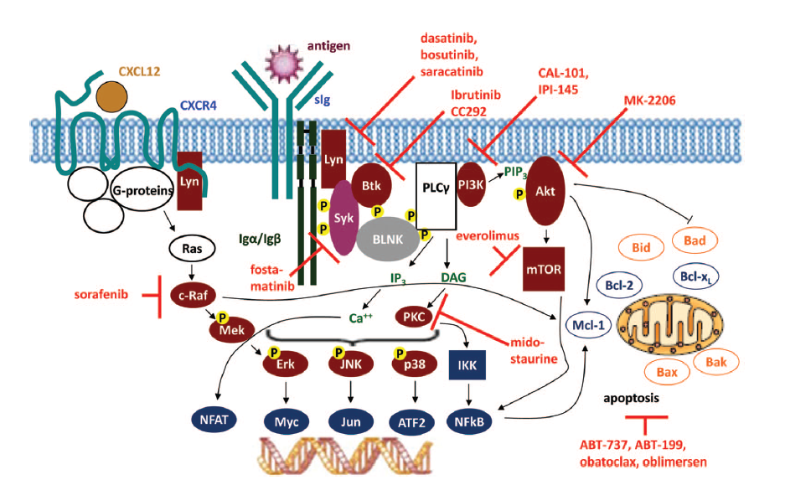
Pathways of Current Novel Agents
Idelalisib
Duvelisib
Copanlisib
Ibrutinib
Acalabrutinib
Acalabrutinib
Venetoclax, ABT-737, obatoclax, oblimersen
Venetoclax
Hallek, 2013.
Notes:
Schematic of BCR signaling.
Ligation of BCR activates Lyn and Syk, which activate BTK and initiate a downstream cascade that in a normal B cell can lead to proliferation, activation, anergy, or apoptosis. In many B-cell malignancies, the pathway is overexpressed, leading to proliferation and survival. BTK inhibitors block this pathway.

Slide 54
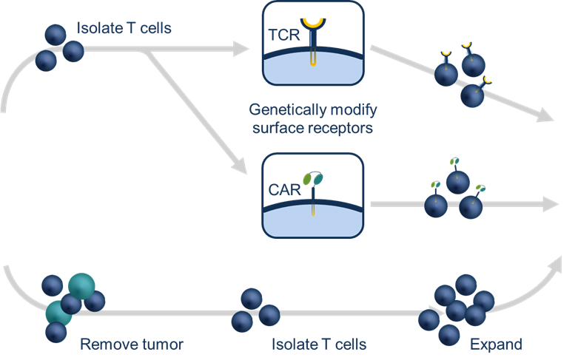

Understanding CAR T-Cell Therapy in NHL
2
T cells isolated and genetically engineered to express a modified T-cell receptor
3
1
Engineered cells given back to the patient, where they often expand in response to exposure to the tumor
T cells taken from cancer patient
2 weeks
Tumor Infiltrating Leukocytes (TIL)
2-3 months
Patient
Patient
June et al, 2015.

Slide 55
CAR T-Cell Therapy in FL and CLL/SLL
Axicabtagene ciloleucel and tisagenlecleucel
  Approved for use in FL transformed to DLBCL
Existing CAR T-cell agents and new agents under study in CLL
Currently in CLL, long-term remissions ~30%-35%
Challenges with CAR T:
  Patient-specific therapy
    Patient characteristics can affect their ability to generate cells; those characteristics are likely important in the development of toxicities
NCCN, 2020; Yescarta® prescribing information, 2020; Kymriah® prescribing information, 2018.

Slide 56
CAR T-Cell Therapy in FL and CLL/SLL (cont.)
Current products and products under development for NHL are quite different, potentially impacting clinical effectiveness and toxicity:
  May have different biological characteristics (CD28 vs 4-1BB)
  May contain different mixtures of T-cell subsets
  May have been grown and produced using different technology
  May be administered at different doses
Toxicity management recommendations across products are NOT the same
  Risk Evaluation and Mitigation Strategy (REMS) program required
  Can require administration and management in specialized centers with experience
Vitale & Strati, 2020.

Slide 57
CLL/SLL Takeaways
Moving toward chemo-free era
Chemoimmunotherapy regimens being replaced by novel agents
No chemotherapy use in 17p(del) or TP53 mutations
3 novel oral agent classes: BCL2i, BTKi and PI3Ki
Novel agents carry unique side effect profiles
Oncology nurses play a critical role in adverse event identification and patient education
Adherence becomes a central issue with predominantly oral therapy
Successful side effect management is key to optimizing patient outcomes
BCL2i = BCL2 inhibitors; BTKi = BTK inhibitors; PI3Ki = PI3K inhibitors.

Slide 58
Thank you for joining us!
Please submit an online evaluation at:
i3Health.com/GLAONS-NHL

Slide 59
References
Aliqopa® (copanlisib) prescribing information (2020). Bayer. Available at: http://labeling.bayerhealthcare.com/html/products/pi/Aliqopa_PI.pdf
Ardeshna KM, Qian W, Smith P, et al (2014). Rituximab versus a watch‐and‐wait approach in patients with advanced‐stage, asymptomatic, non‐bulky follicular lymphoma: an open‐label randomised phase 3 trial. Lancet Oncol, 15(4):424‐435. DOI:10.1016/S1470-2045(14)70027-0
Calquence® (acalabrutinib) prescribing information (2019). AstraZeneca. Available at: https://www.azpicentral.com/calquence/calquence.pdf#page=1
Copiktra® (duvelisib) prescribing information (2019). Verastem, Inc. Available at: http://www.verastem.com/wp-content/uploads/2018/08/prescribing-information.pdf
Dada R (2019). Diagnosis and management of follicular lymphoma: a comprehensive review. Eur J Haematol, 103(3):152-163. DOI:10.1111/ejh.13271
Decaudin D, Lepage E, Brousse N, et al (1999). Low-grade stage III-IV follicular lymphoma: multivariate analysis of prognostic factors in 484 patients–a study of the Groupe d’Etude des Lymphomes de l’Adulte. J Clin Oncol, 17(8):2499-2505. DOI:10.1200/JCO.1999.17.8.2499
Döhner H, Stilgenbauer S, Benner A, et al (2000). Genomic aberrations and survival in chronic lymphocytic leukemia. N Engl J Med, 343:1910-1916. DOI:10.1056/NEJM200012283432602
Dreyling M, Santoro A, Mollica L, et al (2017). Phosphatidylinositol 3-kinase inhibition by copanlisib in relapsed or refractory indolent lymphoma. J Clin Oncol, 35(35):3898-3905. DOI:10.1200/JCO.2017.75.4648
Federico M, Bellei M, Marcheselli L, et al (2009). Follicular Lymphoma International Prognostic Index 2: a new prognostic index for follicular lymphoma developed by the International Follicular Lymphoma Prognostic Factor Project. J Clin Oncol, 27(27):4555‐4562. DOI:10.1200/JCO.2008.21.3991
Fischer K, Al-Sawaf O, Bahlo J, et al (2019). Venetoclax and obinutuzumab in patients with CLL and coexisting conditions. N Engl J Med, 380:2225-2236. DOI:10.1056/NEJMoa1815281
Gazyva® (obinutuzumab) prescribing information (2020). Genentech. Available at: https://www.gene.com/download/pdf/gazyva_prescribing.pdf
Hallek M (2013). Signaling the end of chronic lymphocytic leukemia: new frontline treatment strategies. Blood, 122(23):3723-37234. DOI:10.1182/blood-2013-05-498287
Hallek M, Cheson BD, Catovsky D, et al (2018). iwCLL guidelines for diagnosis, indications for treatment, response assessment, and supportive management of CLL. Blood, 131(25):2745-2760. DOI:10.1182/blood-2017-09-806398
Imbruvica® (ibrutinib) prescribing information (2020). Janssen Biotech, Inc. Available at: https://imbruvica.com/files/prescribing-information.pdf
June CH, Riddell SR & Schumacher TN (2015). Adoptive cellular therapy: a race to the finish line. Sci Transl Med, 7(280):280-ps7. DOI:10.1126/scitranslmed.aaa3643
Kymriah® (tisagenlecleucel) prescribing information (2018). Novartis. Available at: https://www.novartis.us/sites/www.novartis.us/files/kymriah.pdf
Marcus R, Davies A, Ando K, et al (2017). Obinutuzumab for the first-line treatment of follicular lymphoma. N Engl J Med, 377(14):1331-1334. DOI:10.1056/NEJMoa1614598
National Comprehensive Cancer Network (2019). NCCN Clinical Practice Guidelines in Oncology: chronic lymphocytic leukemia/small lymphocytic lymphoma. Version 4.2020. Available at: https://www.nccn.org
National Comprehensive Cancer Network (2020). NCCN Clinical Practice Guidelines in Oncology: B-cell lymphomas. Version 1.2020. Available at: https://www.nccn.org
Rogers BB & Khan N (2017). Supportive care and management of treatment-emergent adverse events in chronic lymphocytic leukemia. J Adv Pract Oncol, 8:97-111. DOI:10.6004/jadpro.2017.8.7.19

Slide 60
References (cont.)
Siegel RL, Miller KD & Jemal A (2020). Cancer statistics, 2020. Ca Cancer J Clin, 70(1):7-30. DOI:10.3322/caac.21590
Solal-Céligny P, Cahu X & Cartron G (2010). Follicular lymphoma prognostic factors in the modern era: what is clinically meaningful? Int J Hematol 92(2):246-254. DOI:10.1007/s12185-010-0674-x
Venclexta® (venetoclax) prescribing information (2019). AbbVie. Available at: https://www.rxabbvie.com/pdf/venclexta.pdf
Vitale C & Strati P (2020). CAR T-cell therapy for B-cell non-Hodgkin lymphoma and chronic lymphocytic leukemia: clinical trials and real-world experience. Front Oncol, 10:849. DOI:10.3389/fonc.2020.00849
Yescarta® (axicabtagene ciloleucel) prescribing information (2020). Kite Pharma. Available at: https://www.gilead.com/-/media/files/pdfs/medicines/oncology/yescarta/yescarta-pi.pdf
Zydelig® (idelalisib) prescribing information (2018). Gilead Sciences, Inc. Available at: https://www.gilead.com/-/media/files/pdfs/medicines/oncology/zydelig/zydelig_pi.pdf

