Slide 1
Self-Responsibility
Notes:
Hello everyone, thank you for joining us for this presentation.
Today, I will be presenting about the topic of Self-Responsibility which is a core topic in the Spiritual Teaching as presented by Billy Meier.

Slide 2
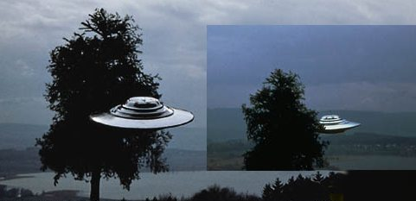
Evidence
Notes:
For certain, the Billy Meier case has many extraordinary aspects such as the UFOs, Extraterrestrials, Prophecies, Advanced Technology, Ancient Earth History, Contact Reports, etc. which are all very interesting and gets the attention of one who is searching for the truth and for things beyond our everyday life. For certain, these kinds of topics have got my attention since I first saw one of Billy’s photographs.
One could choose to examine the evidence and try to prove or disprove the case based on the UFO and Extraterrestrial aspects alone. This is all very worthwhile and one can find sufficient evidence to lead to the conclusion that the Billy Meier case is real. Or on the other hand, one who is trying to prove or disprove the authenticity of the case can find a whole array of counter-evidence, critics and disinformation campaigns, etc., because in the mainstream these days, the Billy Meier case is perceived by the masses as a fraud, unfortunately. For one who has just come across this material, it can certainly be disappointing and lead one to dismiss the case altogether, and also to dismiss any further information presented such as the Spiritual Teaching.
The authenticity of the case is really for the individual to decide and not for anyone else to convince another of. To listen to what the Spiritual Teaching has to say is in the discretion of each individual and should not be forced upon them. If one has doubt regarding the authenticity of the case, then that is justified and one should not blindly believe what the Spiritual Teaching has to say.
A critic could say: if the Plejarens are real, why haven’t they shown themselves as they could easily publicly land their beamships somewhere for everyone to see? On the other hand, a supporter of the case could say: if the Plejarens wanted to completely prove their existence to us, they could have done so already, but that is not in their interest and not beneficial for us.
As I am standing here today and presenting the Spiritual Teaching, my personal stance is the latter, since if they were to prove their existence to us without a doubt, it would be an interference in the evolution of our planet which is less developed than their own. It is much more important that we are given a chance to progress in our evolution without coercion from their part so that we are given a choice of whether or not to study, learn and benefit from the advanced knowledge imparted to us, such as the Spiritual Teaching. With this, we are given a choice, because as the saying goes, it is much more beneficial if one acknowledges the truth on their own, than it would be if it is forced upon them.

Slide 3
Self-Responsibility
1) We should become self-responsible for our life, i.e., we should strive to fulfil our duties which are given to us as responsibilities, such as caring for our own well-being, the well-being of our fellow human beings, or the well-being of the environment, etc.
2) Another way to look at ‘Self Responsibility’ is something like: we should accept responsibility for the state of our life, i.e. we have created the life we are currently living through the choices we have made, and no one else, or a God could be responsible for the state of our lives.
Notes:
In summary, we as individuals need to take responsibility for the causes we choose to create and also for the effects which arise as a result of the causes.

Slide 4
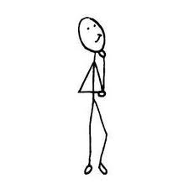
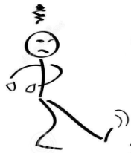
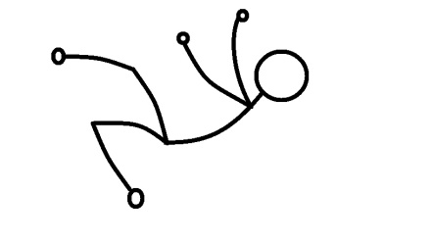
Self-created Destiny
The destiny which you determine yourselves through your thoughts and feelings, through your activity and your actions and deeds is based on consequences, i.e. effects which you yourselves create through distinct causes and which you then have to bear as your destiny, both in the good as in the evil. – GoTT C 28, 105
Feeling
Acting
Effect
Destiny
Thinking
(Cause)
Notes:
So this is the first scenario, of which I am pretty sure most of us here are acquainted with, although the majority of our humankind are not. That is, as stated above: …
In this sense, we are completely responsible for what happens in our life, because we in fact, had a choice of the kinds of thoughts we cherish. One leads to a good result, and the other to a bad result. It is cause and effect.

Slide 5
Self-created Destiny
Happiness, Peace, Love, Freedom,
Harmony, Feeling for Others, Fairness,
Prosperousness, etc.
Rich, poor, famous, unknown, capabilities, etc.
Inner misery, Inner pain, Inner affliction,
Suffering, Psychic illness, Unfairness, etc.
Thinking
(Cause)
Notes:
This slide shows the good (blue) and the bad (red) and the in-between (green), which is neither good or bad.
Essentially, as shown from the previous slide, the result of our thinking and feelings create these different conditions shown here. The blue part signifies the result of good and neutral-positive thinking and the red shows the result of bad and non-neutral thinking. These ideal values such as Happiness, Peace, Love, Freedom and harmony is actually unique to each individual, and each individual can have a different kind of happiness or peace, etc.
The result of bad thinking usually leads to these negative values which lead to inner distress or psychic illness.
The middle part is neither good or bad, which means these are indeed created by the thoughts and feelings of the individual, but in-terms of the truth and reality, these values are seen as neither good nor bad; contrary to what mainstream promotes these days or what the masses of people think in our times. So essentially, one can be rich and have inner affliction or psychic illness, or one can be poor and have happiness, peace, love and freedom.
A person can actually have values from all of these categories since no one is actually perfect and are all in need of evolution by making mistakes. So a typical person can experience happiness over the duration of his or her life, but at the same time suffer from inner misery or psychic illness. But the overall goal, is to keep ones destiny within the good values as much as possible, and whether one is rich or poor, famous or unknown, these values do not play a role in overall goal of life according to the truth and reality, i.e. creational laws and recommendations.
If a person finds themselves mostly in the bottom category, and experiences inner misery, inner pain, unfairness, etc. then the worst thing this person can do is actually ignore the causes or even attribute the responsibility or blame somewhere else or to someone else. And the best thing a person like this can do is to recognise, analyse and accept the responsibility for the causes which lead to the effects at the bottom category so that the negative thoughts and feelings can be changed to neutral-positive and good modes of thinking.

Slide 6
1% of life
Your Birth,
Your eventual Death,
Environment and Family in which we are born,
Certain sicknesses (e.g. epidemics, cancer, etc.),
Once in a life time accidents,
Natural planetary and cosmic events (e.g. asteroids, volcanoes), etc.
Notes:
So while 99.9% of our life and destiny is determined by ourselves and is our full responsibility, there are events and external circumstances that we do not have full control over.
These are the very few things that a person do not have full control over, but how a person chooses to react to it and build his or her life upon it is entirely up to the individual’s responsibility.

Slide 7
Consider, everything that you do falls back onto you, because this lies in the natural happening itself, as it is given through the creational laws; thus all your thoughts and feelings take, through the energy and power that animates them, and as soon as they arise, a form that corresponds to their content and they swing out from you and attract again things of the same kind; you however remain connected with your thoughts and feelings in fine-fluidalness in a swinging-wave-based wise, thus everything sent out attracts, through the interaction, things of the same kind and comes back to you again; therefore your own thoughts and feelings pulsate through you fine-fluidally just as this happens to those who receive your corresponding mental and feeling-based impulsations and who respond to them in the fashion that they return back to you.
Goblet of the Truth, 28: 163
Thought and Feeling
(Cause)
Response (Effect )
Notes:
Now, to add to the self-created destiny, we have our fellow human beings who come into play. How does this work? …. Read above sentence
So in effect, what the above sentence tells us is that we create our own destiny through our thoughts, but at the same time we receive feedback from fellow human beings in regards to the kinds of thoughts we have. This feedback from our fellow human beings helps us to refine our thoughts and create a better destiny for ourselves.
So this essentially provides us with another means to examine the kinds of thoughts we have, e.g. if we are constantly receiving negative thoughts from others, then we can likely conclude that we ourselves are cherishing negative thoughts, but if on the other hand, we constantly receive neutral-positive thoughts from others, then we can most probably conclude that we ourselves are cherishing neutral positive thoughts.

Slide 8
Self-created Destiny
Feeling
Acting
Effect
Destiny
Thinking
(Cause)
Notes:
This diagram is a combination of the two previous slides, where a person create his or her own destiny through his or her thoughts, feelings and actions, but at the same time, this person receives the same thought-feeling energy which he or she has sent out from his or her fellow human beings.
Thus, in all cases, whether the effect manifests as something pertaining to oneself, i.e. one’s own destiny or manifests as a fellow human being’s thoughts and feeling towards you, the causes of both can be traced back to the thoughts and feelings of oneself.

Slide 9
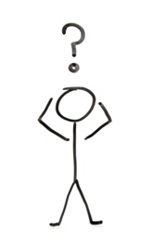
What is the cause?
Notes:
Now in this scenario, the person in the middle is confused as to why the people around him is negatively inclined or seems angry at him or her.
And this is usually a pretty common scenario for someone who has no idea about the workings of the thoughts. Because for example, the person in the middle may or may not have met those people around him, but yet they are negatively inclined towards this person. That is, if someone has no idea about the fact that what goes on in our mind – the thoughts – actually are not only contained in ourselves, but in fact it swings as swinging waves out into the environment and strikes the fellow human beings.
So in fact, the person in the middle, only has to control himself or herself and perceive his or her own self-responsibility, in order to stop the seemingly unexplainable negative feedback.

Slide 10
Effect
Cause
Cause
Cause
Effect
Effect
Consider you are always being struck by the out-coming effects of your own thoughts and feelings whose constant creator and nurturer you are, and indeed both in the form of the good, the best and positive and in the form of the evil, bad and negative.
Goblet of the Truth, Chapter 28 : 165

Slide 11
By withdrawing the cause, the effects are no longer effectuated
Notes:
By perceiving the self-responsibility in terms of stopping the causes which created the negative effects, the negative effects no longer come into play. Thus, by controlling his or her thoughts, and forming them in a neutral positive manner, the negative effects are no longer there.
And in fact, by controlling one’s own thinking, one automatically becomes self-responsible because this person has recognised that he or she is responsible (or the cause of) effects that comes about through the thoughts he or she cherishes.

Slide 12
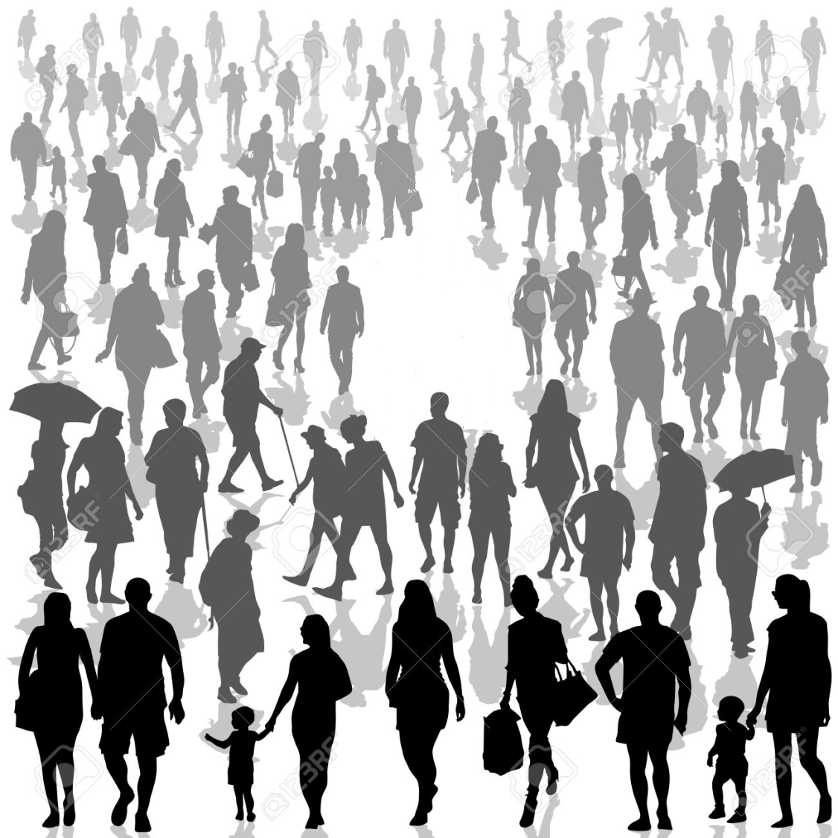
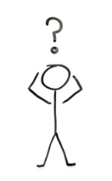
All behaviours of the human beings affect the fellow human beings contagiously and are able to spread out like an epidemic or in the worst case, even like a pandemic.
Notes:
Now, in this next scenario, although this person has learned to control his or her thoughts, they nevertheless seemingly are dragged into unwanted patterns of thoughts.
Especially in cities, crowds of people, or group situations, if one is sensitive enough or is monitoring his or her own thoughts, they would quickly realise that their thoughts are influenced by the people around them, for the good or for the bad.
So how does the self-responsibility come into play here? Even though this person is not the direct source of his or her thoughts which are co-created by external influences, is this person still responsible for the out-coming effects of his or her influenced thoughts?

Slide 13
Where does the responsibility lie?
Thus, the human beings are infected by the thoughts and feelings as well as by the behavioural-patterns of others like by a contagious illness-virus, in which case the patterns reach from love and happiness, from joy, freedom and harmony, etc., up to the unsatisfaction, revenge and retribution as well as to the evil Gewalt and to the murder.
External Influence
Cause
Effect
Notes:
So in this slide, it depicts a person who as a result of being influenced by a third party, creates thoughts that then effect others who become unhappy and then re-send the thoughts back to him or her.
If this person is trying to learn his or self-responsibility, and control his or her thoughts, how does self-responsibility play in this scenario?

Slide 14
Where does the responsibility lie?
Hence, the truth unmistakably comes to fruition, that the human being himself/herself, bears the responsibility for all his/her thinking, feeling and deeds, etc., because without a doubt, he/she, without exception and always himself/herself, supplies the cause of his/her thinking, feeling and deeds, etc., that in each case, bring a distinct effect. This is doubtlessly so in every case, even then when the human being accepts external foreign influences as the reason for his/her thinking, feeling and deeds, etc.
Decalogue/Dodecalogue, P. 110
External Influence
External influences are rendered ineffective by the responsible one.
Notes:
According to the Spiritual Teaching, this person is in fact still responsible for the thoughts that he or she creates even though they were influenced by external sources. … read above sentence
So in effect, by doing nothing against the negative external influence, is itself a cause of the person furthering the negative influence and generating negative thoughts towards others. So this teaches us that in order to be fully self-responsible, we not only have to care for the thoughts we create within ourselves but we have to learn to differentiate between negative and positive, external influences that may influence us.

Slide 15
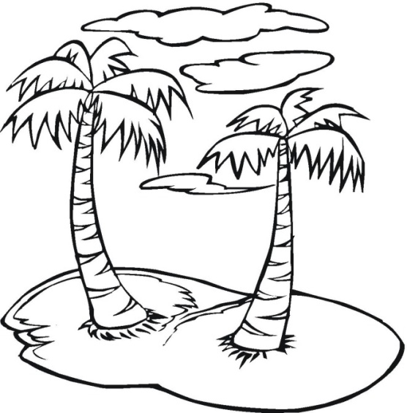
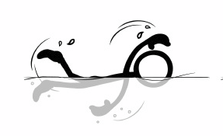
Notes:
So in this next scenario, this person learns that he or she is being influenced by external sources and thinking or acting in a way he or she may not want.
Thus this person learns that by going into seclusion, it is possible to stop the negative influences on him or her since the negative influence has a certain range of effect, that is the thoughts of each human being has a certain radius of effect that gets weaker and weaker the further the distance.
So essentially this person freed himself or herself from the negative influences of others.

Slide 16
Over time…
Cause
Effect
If you really only sit and rest in your life and only want to rest from all your activity until the end of your life, then you push away the rhythmic law of the always valid motion as it is given in all things through the Creation Universal Consciousness.
And you all amongst you human beings of Earth who act in this wrong wise, you fall ill and tire out because your own swinging waves, your own motions and your conscious awakeness cannot keep pace with the ruling motion of the Creation Universal Consciousness; truly, you can only stay fresh, joyful and healthy, if you integrate yourselves into and adjust yourselves to the rhythm of the creational-universal motion.
Goblet of the Truth, Chapter 28, 467, 469
Notes:
But is this the best way to live in terms of our self responsibility. Yes, this person now has control over his or her own thinking without negative external influences, but in the long term, this also has negative consequences.
If you have seen the movies like cast away, or people isolated on an island, or even drifting through space alone, you quickly see that the person who is isolated quickly develops psychological issues.

Slide 17
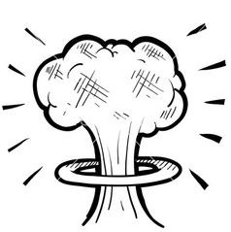
Shared Destiny
What you sow, that you will reap, and indeed in every respect, be it in the good or in the evil; therefore you cannot refer to your invented godheads and tin gods or to your next ones, fellow human beings or to your imaginary angels, saints and idolised human beings with regard to the responsibility, because this lies by you alone for all things, for everything that your destiny brings you, as also for everything whatsoever that happens in the world in terms of war and peace, love and hatred, fairness and unfairness, freedom and unfreedom, harmony and disharmony as well as in terms of good and everything evil. – GoTT C 28, 124
Notes:
In fact, everyone has the responsibility to shape our world together with the rest of our human kind. If someone else blows up the planet, then we’re still responsible even though we were not directly involved. As a collective we have the responsibility to act, to change ourselves and to be a good example to others.
Although we cannot change the people around us, since we can only change ourselves, we can only be a good example for our fellow human beings who than out of their own self initiative recognises your good example and brings about the change towards the good within themselves.

Slide 18
And if you know this constant interaction that is absolutely certain to occur, that is given through all ways in
the entire Creation-realm and that with absolute certainty unstoppably triggers and unfolds itself again and
again, then you can also use it and love it consciously and without fear; and if you comprehend this, then you can use your knowledge to impart many things through your thoughts and feelings to your fellow human beings that you cannot do through your words alone; and truly it is then also possible for you to be able to co-live the thoughts and feelings of your fellow human beings with them, because it is possible for you to perceive and logically follow their thought- and feeling-world, which has nothing to do with telepathy, however, but is a factor of empathy, i.e. of the ability for deep feelings for the others.
Goblet of the Truth, Chapter 28: 247
Notes:
Having the knowledge and being aware that the thoughts of others can affect us for both the good and the bad, and vise versa; we can in turn use this knowledge and strive to convey our thoughts and feelings towards others that bring about a good effect in our fellow human beings.
Although in these days, with the very large crowd of people, for example in the cities, it is very easy to feel overwhelmed by the people around us and also very hard to perceive our self responsibility – that is, we have to strive to protect ourselves from the negative external influences (e.g. the unbalanced thoughts of others) and at the same time, realise that what we send out in our thoughts and feelings is exactly what we will also receive in most cases.
The interaction between people is unavoidable and part of evolution; although the crowds of people in our overpopulated cities these days are abnormal and represent an extreme condition, one should not shut themselves out completely from others. The interaction between people is bound to happen since it is a part of our evolution. Striving to go the middle way and not the extremes is the best way, e.g. in between living as a hermit in seclusion being one extreme or living completely in crowded cities being the other extreme.

Slide 19
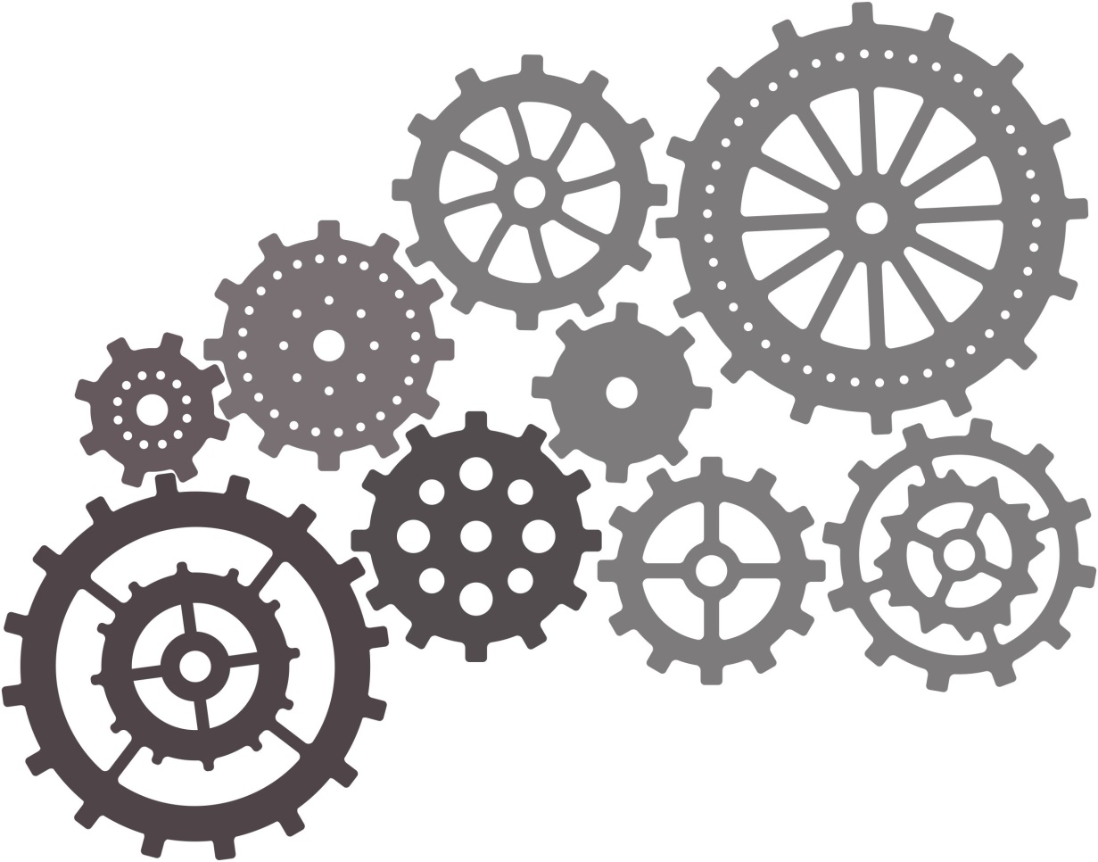
In the Creation, in the Universal Consciousness, and in all its created creations and in everything existent that
it has created, one wheel of the happening interlocks into the other; in strict logicalness one thing is the consequence of another thing and at the same time controllingly turns everything that is connected with it,
through which no irregularity can occur; the whole is like a gigantic giant-wheelwork, in which from all sides
the cogs of the wheels precisely and sharply interlock and incessantly move everything further and drive it forwards to the development; and you human beings of Earth, you stand with the decision- and determination power given to you through your free will in the middle of this immense machinery, equipped with an unmeasurable might which is given to you and with which you are able to direct the big wheelwork of your own life and destiny in any direction that you choose, that is to your own prosperity or adversity, to your fortune or unfortune, to the negative, bad, evil, terrible or to the positive, good, depending on how you form and use your free will.
Goblet of the Truth, Chapter 28 - 269
Notes:
Each wheel represents a person and we are inseparably connected to one another.

Slide 20
Notes:
Also, looking at it from a bigger picture, each wheel can also represent a grouping of people.

Slide 21
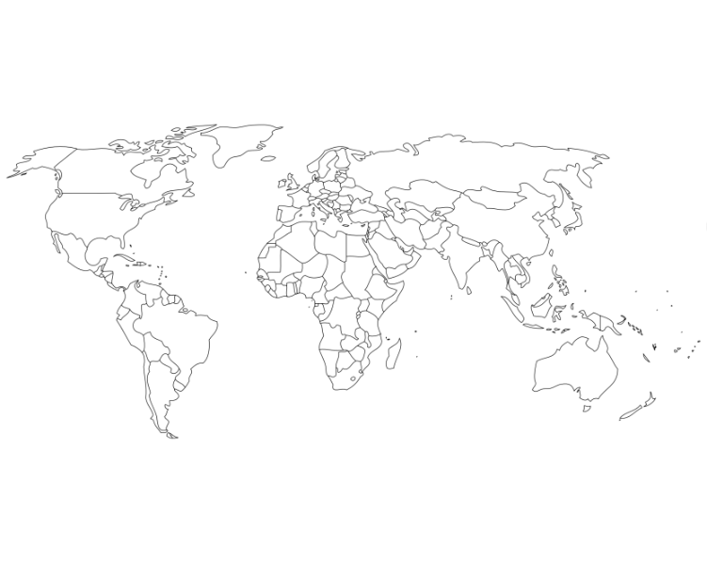

Slide 22
To Carry Responsibility
To carry the responsibility for oneself
is endlessly better, than to
shift it onto another human being
SSSC, 13. December 2015, 10:17 am Billy

