Slide 1
Annual General Meeting 2017 September 27, 2017 ISNA Elementary School
Sherway Homeowner’s and Recreation Association est. 1976

Slide 2
Agenda
Elections
Financials
New Strategic Plan 2017
By-Laws Revision & Ratification by Membership
Councillor Jim Tovey
Sherway Year-In-Review/Community Update
SHORA opportunities
Open Q & A
Adjournment & Social
Sherway Homeowner’s and Recreation Association est. 1976
2017 AGM

Slide 3
Housekeeping Items
Welcome
Thank you ISNA Elementary for hosting
Washroom facilities
Water
Golden Rule
Everyone will have an opportunity tonight.
Sherway Homeowner’s and Recreation Association est. 1976
2017 AGM

Slide 4
SHORA Elections 2017
2017 SHORA Executive Election run by Jamie Pugh
Positions to be nominated:
President
Vice-President
Secretary
Treasurer
Sherway Homeowner’s and Recreation Association est. 1976
2017 AGM

Slide 5
October 2016 Starting Balance = $3,279.88 Cash Flow In = $2,042.26 Cash Flow Out = $1,704.91 September 2017 Closing Balance = $3,617.23 Difference of $337.35
SHORA Finances 2016-2017
Advertising Revenue = 59%
Deck the Streets = 35%
Miscellaneous = 6%
Newsletter/Flyer Printing= 43%
D&O Insurance = 28%
Events = 15%
Start-up Costs = 13%
Miscellaneous = 1%
Sherway Homeowner’s and Recreation Association est. 1976
2017 AGM

Slide 6
Strategic Plan 2017
Reason behind the creation of a strategic plan.
By-laws gave rules and position responsibilities, but nothing to define our purpose. No guiding principles existed.
No previous documents existed to talk vision and future strategy.
What does SHORA represent?
Created a Living document – Available now online next to our By-Laws link.
Changes to be made as we evolve and if new priorities surface.
Changes will be voted on by the Board of Directors as necessary.
Sherway Homeowner’s and Recreation Association est. 1976
2017 AGM

Slide 7
Strategic Plan 2017
Mission Statement:
SHORA's mission is to preserve and enhance and protect our residents’ sense of community and property values. The Board will serve the Homeowners by taking a fair, ethical and objective approach in representing the interest of all homeowners. Sherway will be maintained as a safe, friendly, and enjoyable place to live for each Homeowner and his/her respective family.
Vision Statement:
To preserve the Sherway community that residents are proud to call home – and to affirm and grow the value of both our properties and vibrant community.
Sherway Homeowner’s and Recreation Association est. 1976
2017 AGM

Slide 8
Strategic Plan 2017
5 top priorities:
Protect and enhance the value of our community’s environmental sustainability.
Compile and maintain a voluntary database of Sherway resident contact information to support association management, improve communication, promote community initiatives, and improve safety/security initiatives.
Develop a communication plan to provide more effective communication between SHORA , Sherway residents, and other parties engaged in the Sherway community.
Promote community spirit through the development and successful execution of events to engage residents socially, in order to enhance the Sherway homeowner lifestyle.
Enhance use of the green space and improve community facilities for the benefit of all members.
Sherway Homeowner’s and Recreation Association est. 1976
2017 AGM

Slide 9
By-Laws Revision
City of Mississauga requires in order to be an affiliated group, SHORA must revise our 2006 By-Law document to fill gaps. This is required to become & stay affiliated.
Why be affiliated?
By-Law Additions
Disolution Clause
Remaining asset dispersal (charity).
Conflict of Interest Clause
Directors must disclose conflicts & cannot be enriched through SHORA activities.
Behaviour Standards/Code of Conduct
Guidelines for good conduct, and outlines the process for breaching protocol.
AGM notice to Membership & City 21 days prior
Already being adhered to.
Sherway Homeowner’s and Recreation Association est. 1976
2017 AGM

Slide 10
By-Laws Revision
Questions pertaining only to these By-Law additions?
Motion to Pass 2017 By-Law revisions sent to the community September 6, 2017, to bring SHORA By-Laws into accordance with the City Of Mississauga’s requirements for affiliated groups.
Seconding by a SHORA Executive
General vote by membership
Sherway Homeowner’s and Recreation Association est. 1976
2017 AGM

Slide 11
Councillor Jim Tovey
Sherway Homeowner’s and Recreation Association est. 1976
2017 AGM

Slide 12
Sherway 2016/2017 Year In Review
Events
Toronto and Region Conservation Authority
Sherway Trail Extention
Environment
Dixie/QEW EA, Stormwater Management Pond
Air Traffic
Sherway Homeowner’s and Recreation Association est. 1976
2017 AGM

Slide 13
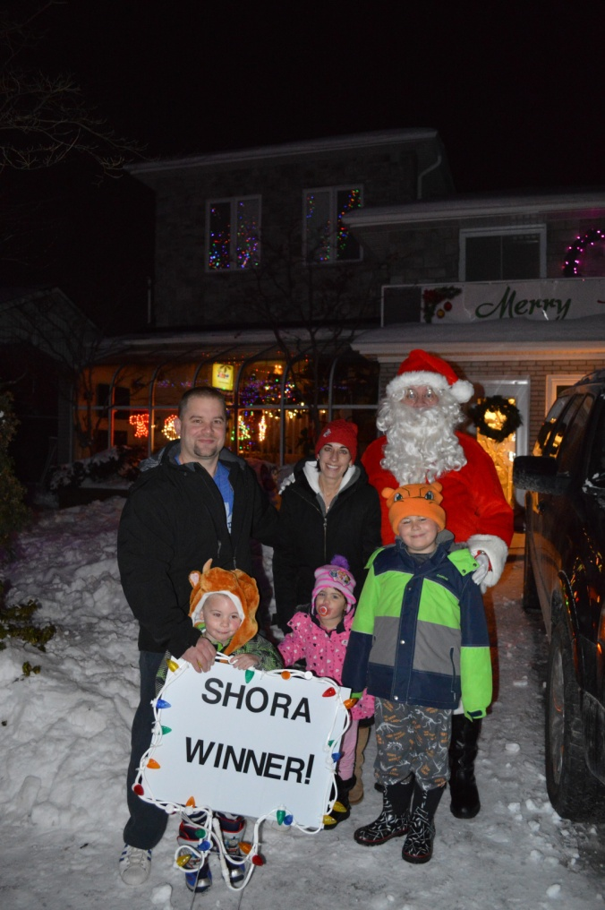
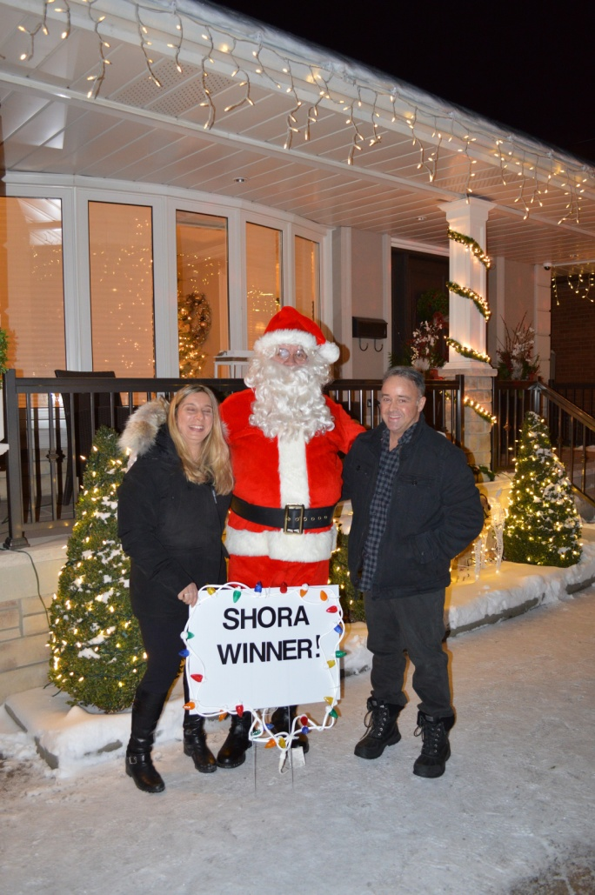
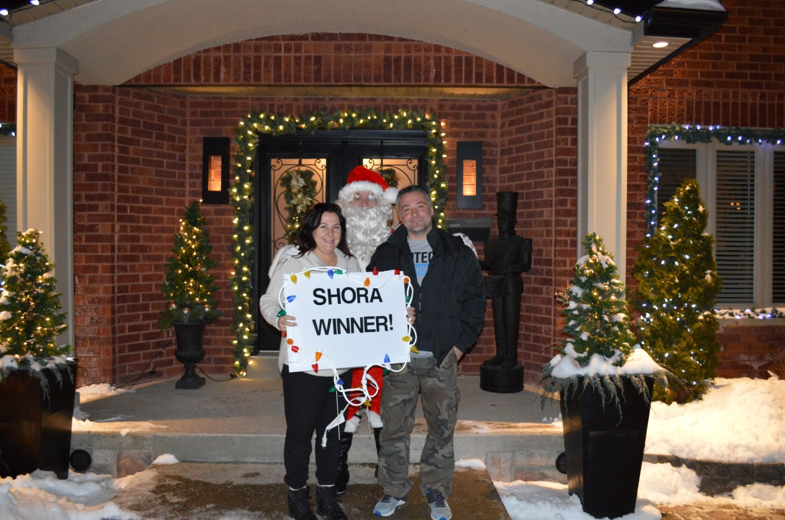
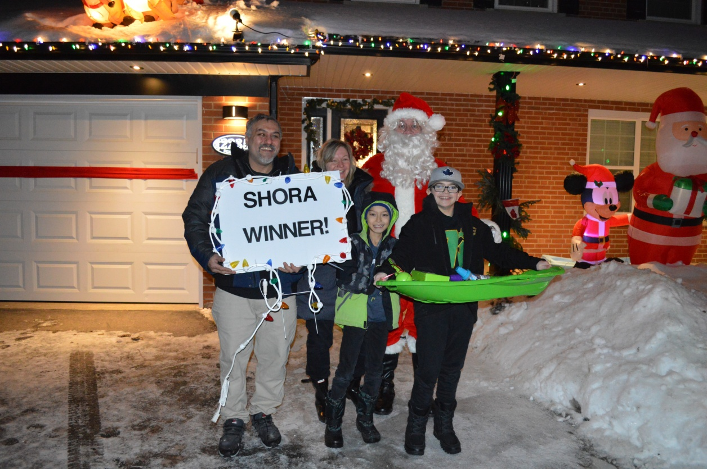
SHORA Events
DECK THE STREETS 2016
Sherway Homeowner’s and Recreation Association est. 1976
2017 AGM

Slide 14
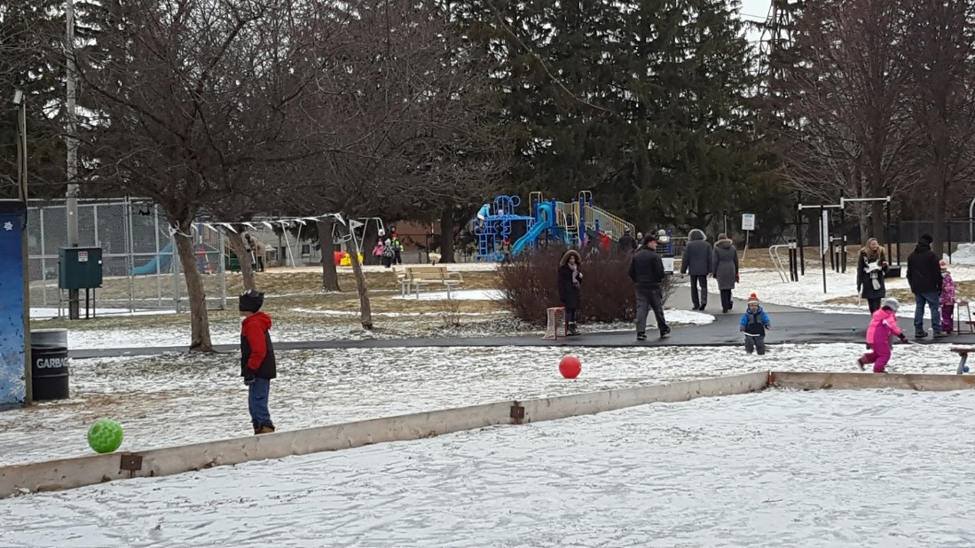
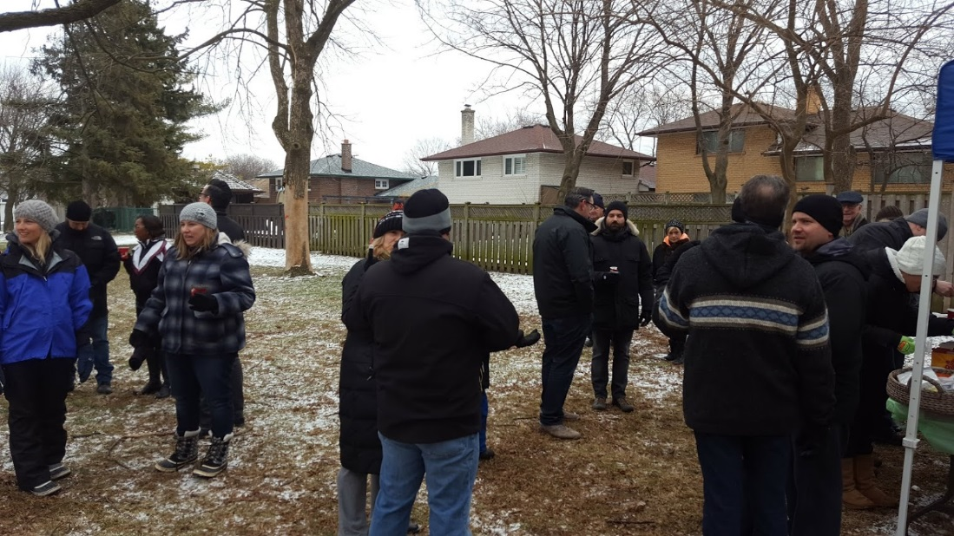
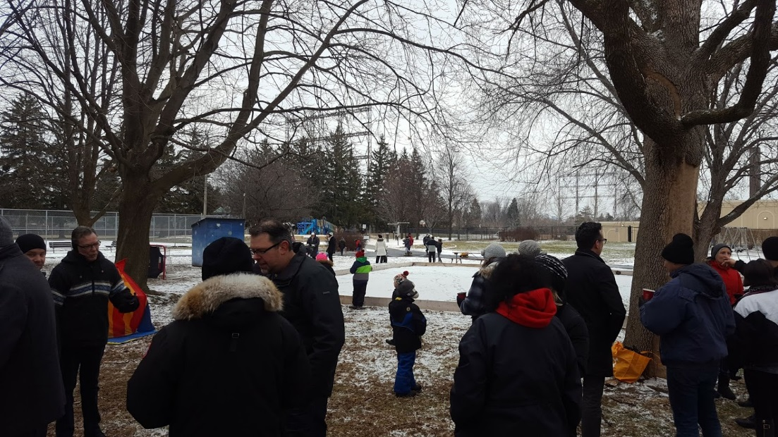
SHORA Events
Winter Warmup Feb 5, 2017

Slide 15
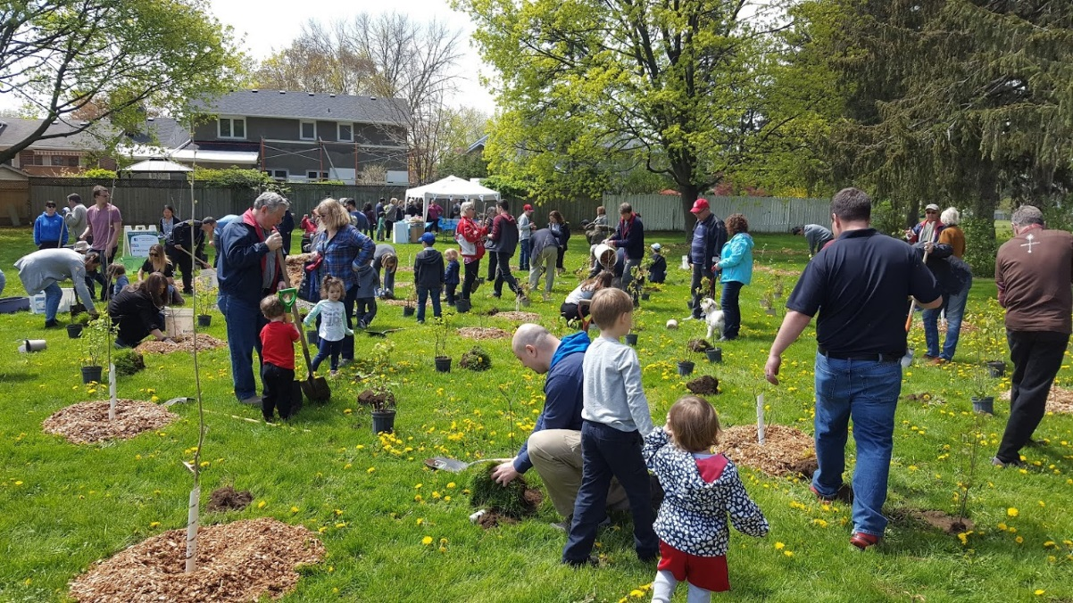
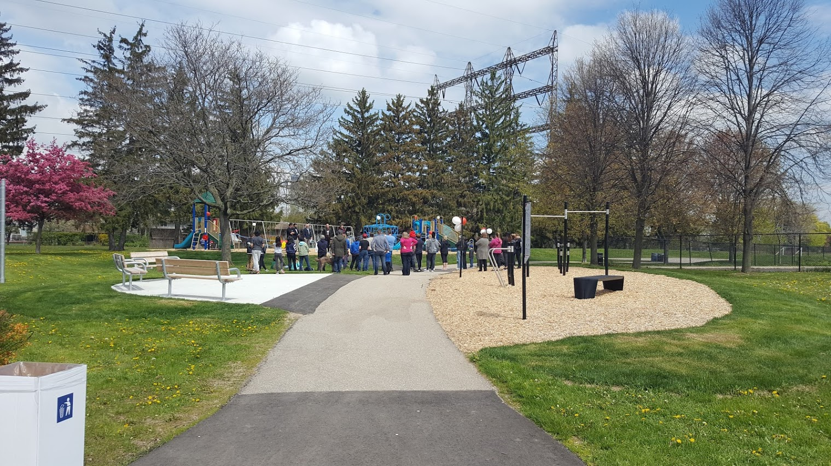
SHORA Events
Laughton Heights Park Opening
May 13, 2017

Slide 16
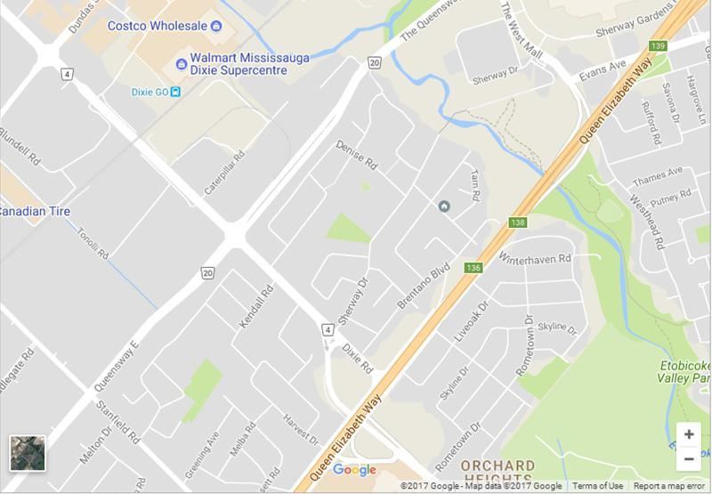
Sherway
Sherway Homeowner’s and Recreation Association est. 1976
2017 AGM

Slide 17
Sherway – TRCA New Trail
Sherway Homeowner’s and Recreation Association est. 1976
2017 AGM

Slide 18
Sherway – TRCA New Trail
This project focuses on constructing approximately a 0.7 kilometre section of trail in the Etobicoke Creek Valley within the City of Toronto. This new section of trail will be built in the area between Sherway Drive and a connection immediately south of the QEW and will connect the City of Toronto with the City of Mississauga.
This project will accomplish the following:
• Create 0.7 kilometres of new trail within the Etobicoke Creek Valley
• Incorporate and implement restoration works alongside trail development to improve existing water quality and habitat features.
• Create trail gateway to link the City of Toronto with the City of Mississauga
• Incorporate staging area and educational kiosk
Sherway Homeowner’s and Recreation Association est. 1976
2017 AGM

Slide 19
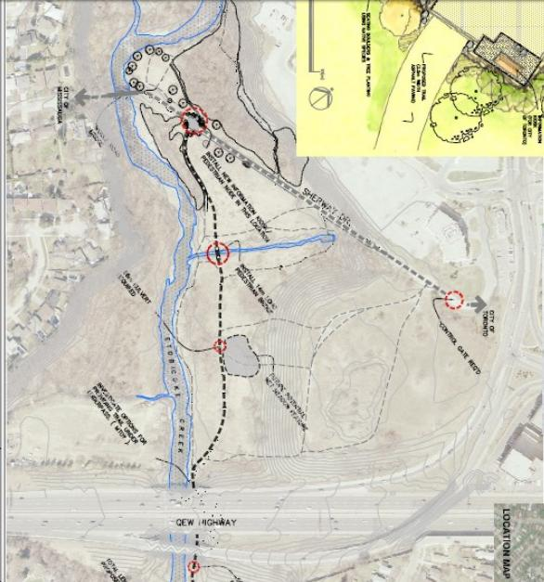
Sherway – TRCA New Trail
SHERWAY

Slide 20
Sherway - Environment
Sherway Homeowner’s and Recreation Association est. 1976
2017 AGM

Slide 21
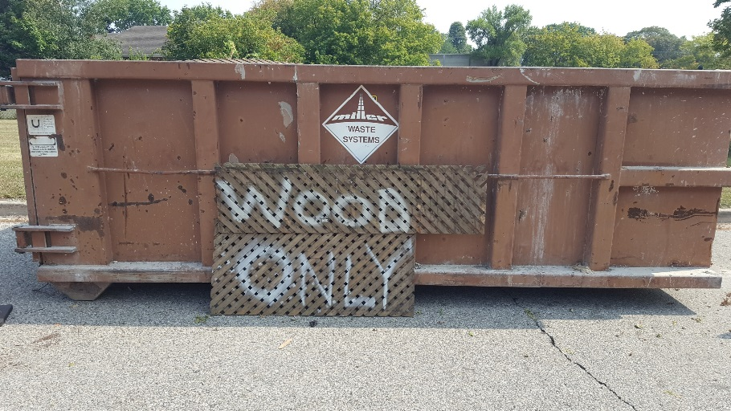
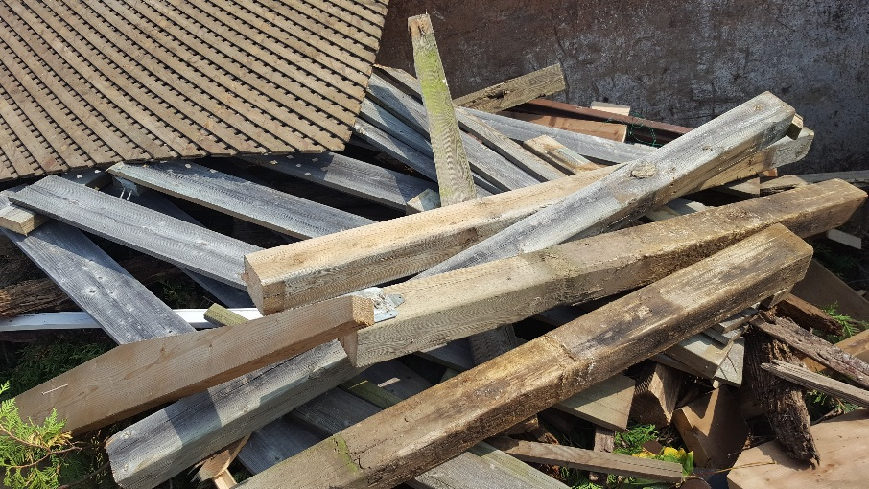
Sherway - Environment
Wood Bin Project September 15th to 18th 2017.
Successful removal of neighbourhood wood
Co-ordinated with Councillor Tovey’s office, Region of Peel & SHORA
4 full bins of wood removed from Sherway
Sherway Homeowner’s and Recreation Association est. 1976
2017 AGM

Slide 22
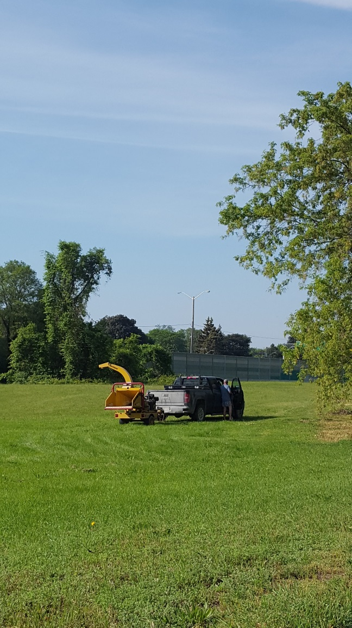
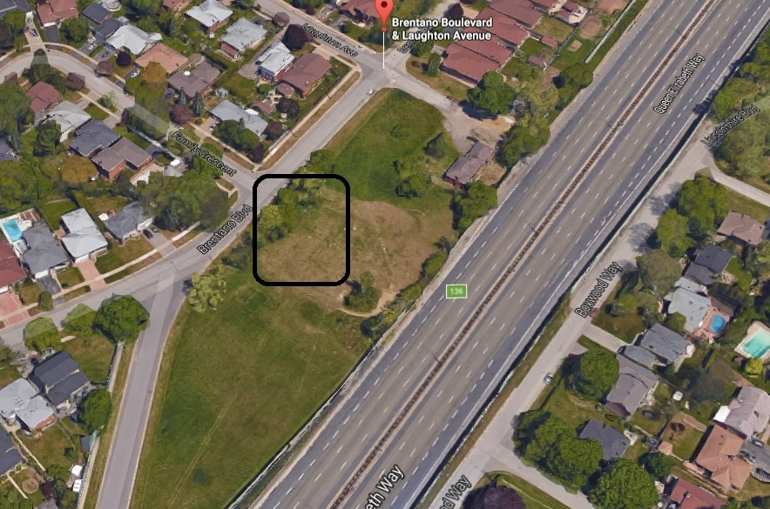
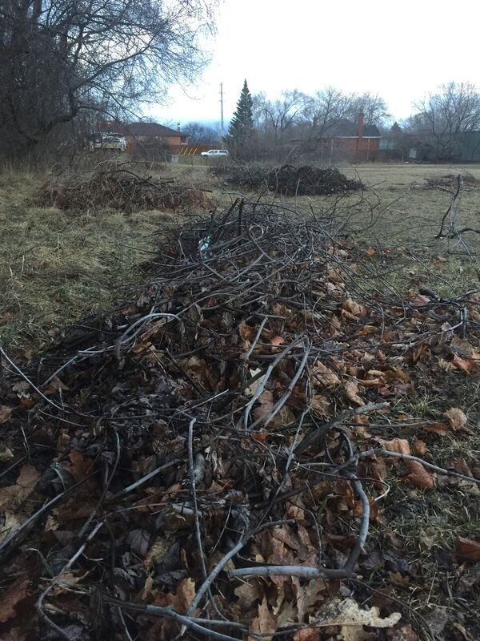
Sherway - Environment
MTO Brentano Field Cleanup
Illegal Dumping plus overgrown brush made for an eyesore, less usable field, and was a potential pest problem.
Advocating of MTO by SHORA VP Jamie Pugh & Dir. of Env Angela Pye sparked the cleanup.
4 workers off and on for 2 days.
Please help us keep this area clean by reporting any illegal dumping to the City of Mississauga (311)
Sherway Homeowner’s and Recreation Association est. 1976
2017 AGM

Slide 23
Sherway - Environment
Sherway Homeowner’s and Recreation Association est. 1976
2017 AGM

Slide 24
Sherway - Environment
SHORA discovered in Fall 2016 through neighbourhood complaints that Sherway was being subjected occasional industrial odours.
SHORA engaged neighbouring industry to begin dialogue & crude reporting.
SHORA also engaged the Ministry of the Environment to voice concerns and include on the reporting.
There is process improvement being undertaken and implemented this week by local industry to try and remove any potential cause of industrial odour.
The Ministry of the Environment is also working with another industrial neighbour to improve their process.
This progress was a result of SHORA advocacy, in combination with neighbourhood reporting.
Moving forward, to make any further progress, we need more residents to report industrial odour.
Sherway Homeowner’s and Recreation Association est. 1976
2017 AGM

Slide 25
Sherway - Environment
How to odour report:
Odour complaints can be called in directly to the MoE Climate Change's Spills Action Centre (SAC) 1-800-268-6060. SAC operates 24 hours a day, seven days a week and will take odour complaints any time (after 5 pm on weekdays and all hours on weekends).
David Keene, Senior Environmental Officer for our area can also be contacted directly when there is an odour issue in the area as well (905)319-3170.
Email info@sherwayhomeowners.com to advise, so SHORA can follow up on the complaint
Take a leaflet with these procedures on the way out tonight.
Sherway Homeowner’s and Recreation Association est. 1976
2017 AGM

Slide 26
Sherway – Dixie/QEW Stormwater
Sherway Homeowner’s and Recreation Association est. 1976
2017 AGM

Slide 27
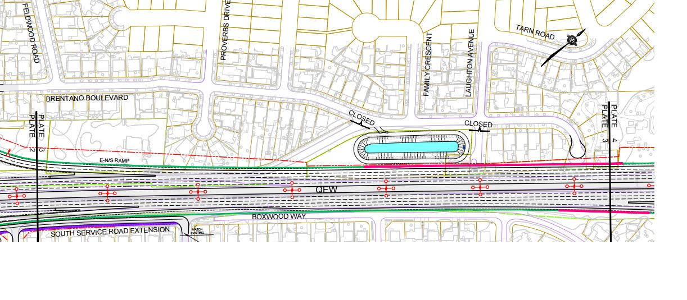
Sherway – Dixie/QEW Stormwater
Sherway Homeowner’s and Recreation Association est. 1976
2017 AGM

Slide 28
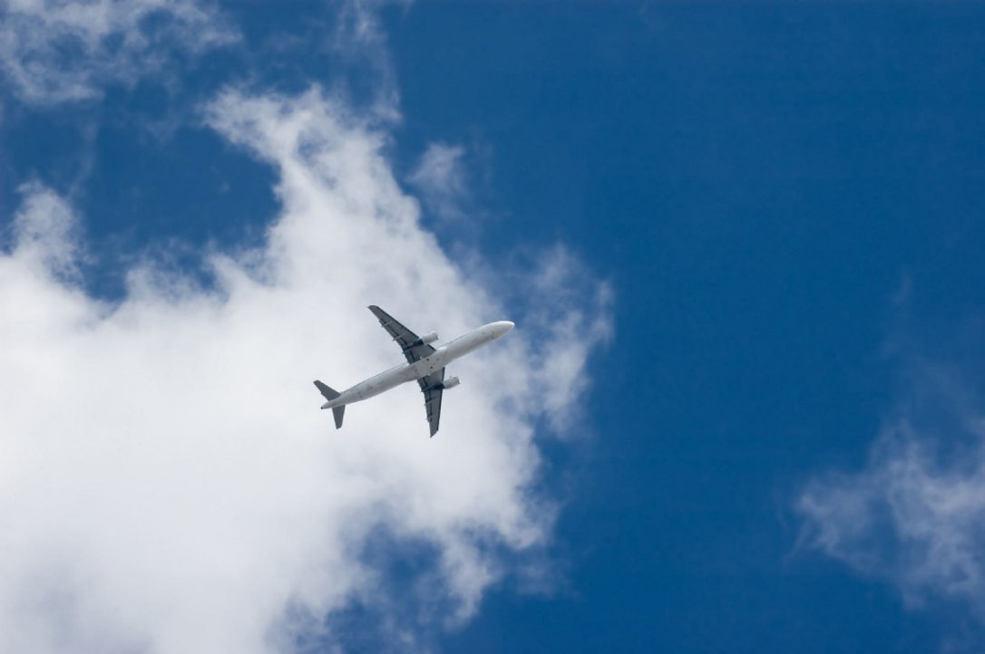
Sherway – Air Traffic
Sherway Homeowner’s and Recreation Association est. 1976
2017 AGM

Slide 29
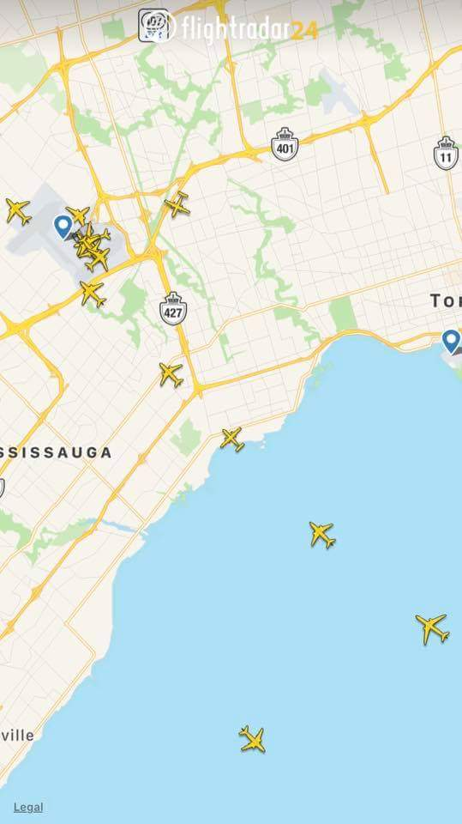
Sherway – Air Traffic
Runway 05/23 at Toronto Pearson had a major renovation for the first time since its’ initial construction. This runway handles 45% of all Pearson flights.
Between March 28 and May 16, temporary air traffic shifted from to alternative runways such as North South runways 15L-33L & 15R-33R. These two runways went from seeing 6.9% of all flights(31,000/yr), to 65% of all air traffic at Pearson
Construction ended, plane traffic went back to normal.
Sherway Homeowner’s and Recreation Association est. 1976
2017 AGM

Slide 30
Sherway – Air Traffic
So what is the problem/issue?
NAV Canada & G.T.A.A. have commissioned study by an independent 3rd party called HELIOS, to look at 6 different Noise Mitigation Initiatives.
Part 1 of the study looked at initiatives #1-#4 & were presented to NAV Canada & Public on September 20, 2017. This looked at approach paths, angles, best practices in operations.
This leaves the G.T.A.A. part of the study, yet to be presented:
#5 is Weekend Runway Alternation (Noise Sharing on Weekends)
#6 is a review of the Preferential Runway System. (Night time Noise Sharing)
#5 & #6 could dramatically increase the amount of plane traffic overhead Sherway.
Pearson passenger growth slated to double by 2037 regardless of runway changes.
31,000/yr will become 60,000 by 2037, assuming North/South usage is a steady 6.9%
Sherway Homeowner’s and Recreation Association est. 1976
2017 AGM

Slide 31
Sherway – Air Traffic
So what are we doing?
SHORA has joined & aligned with CAAS
includes Markland Woods , Rockwood, Alderwood, Mimico
includes M.P. James Maloney, M.P. Borys Wrzesnewskyj, M.P. Peter Fonseca
Fighting runway alternation and the increased usage of the North/South runways, based on airplane safety studies from the 80’s and 90’s
SHORA is looking for a Director of Air Traffic to represent SHORA at the CAAS table.
Sherway Homeowner’s and Recreation Association est. 1976
2017 AGM

Slide 32
SHORA Positions Available
Director of Air Traffic
Director of Recreation
Director of Schools
Events Committee
General Volunteers for Event Days/Helpers
Flyer Drop Volunteers
Stay afterwards and let us know if you are interested in getting involved!
Sherway Homeowner’s and Recreation Association est. 1976
2017 AGM

Slide 33
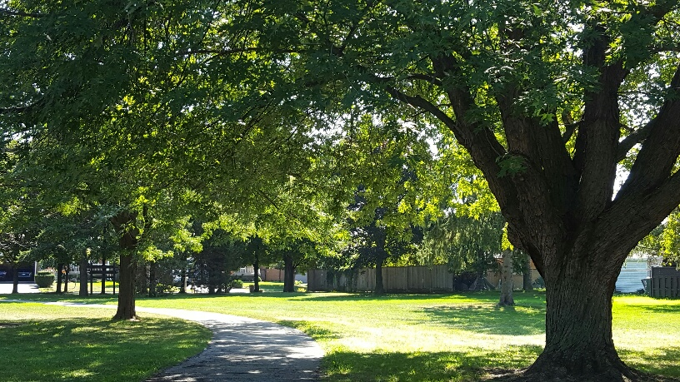
Open Q & A
Sherway Homeowner’s and Recreation Association est. 1976
2017 AGM

Slide 34
Thank you for coming to SHORA AGM 2017!
Sherway Homeowner’s and Recreation Association est. 1976
2017 AGM

