Slide 1
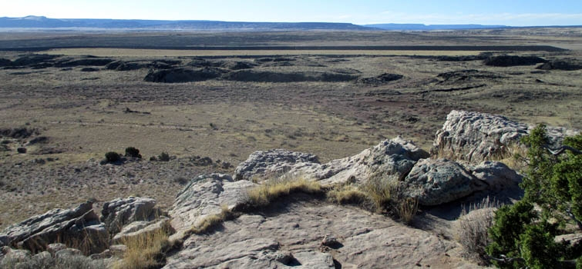
Office of Legacy Management
“Committed to Long-Term Stewardship”
Bluewater Disposal Site in New Mexico
Carmelo Melendez - Director
NCW 2019

Slide 2
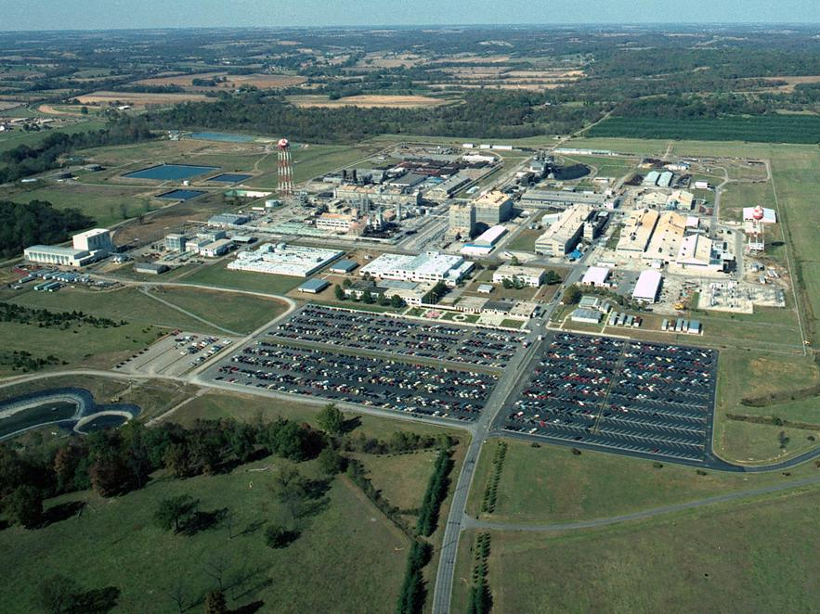
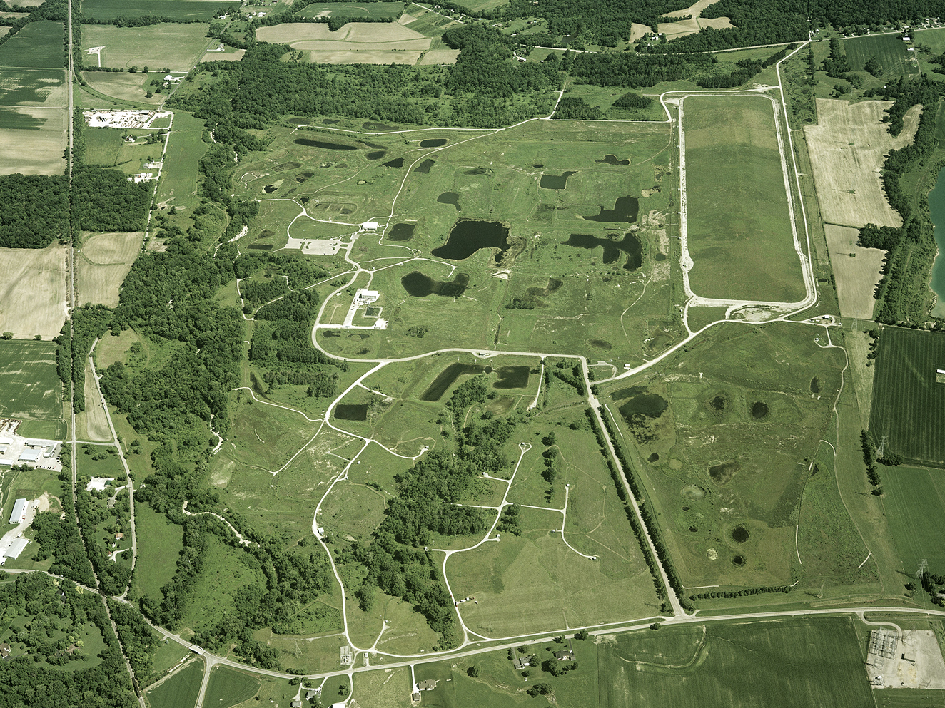
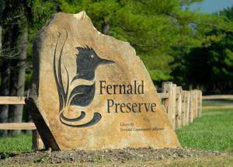
Remediating Sites
Fernald, Ohio: From Feed Materials Production Center to Nature Preserve.

Slide 3
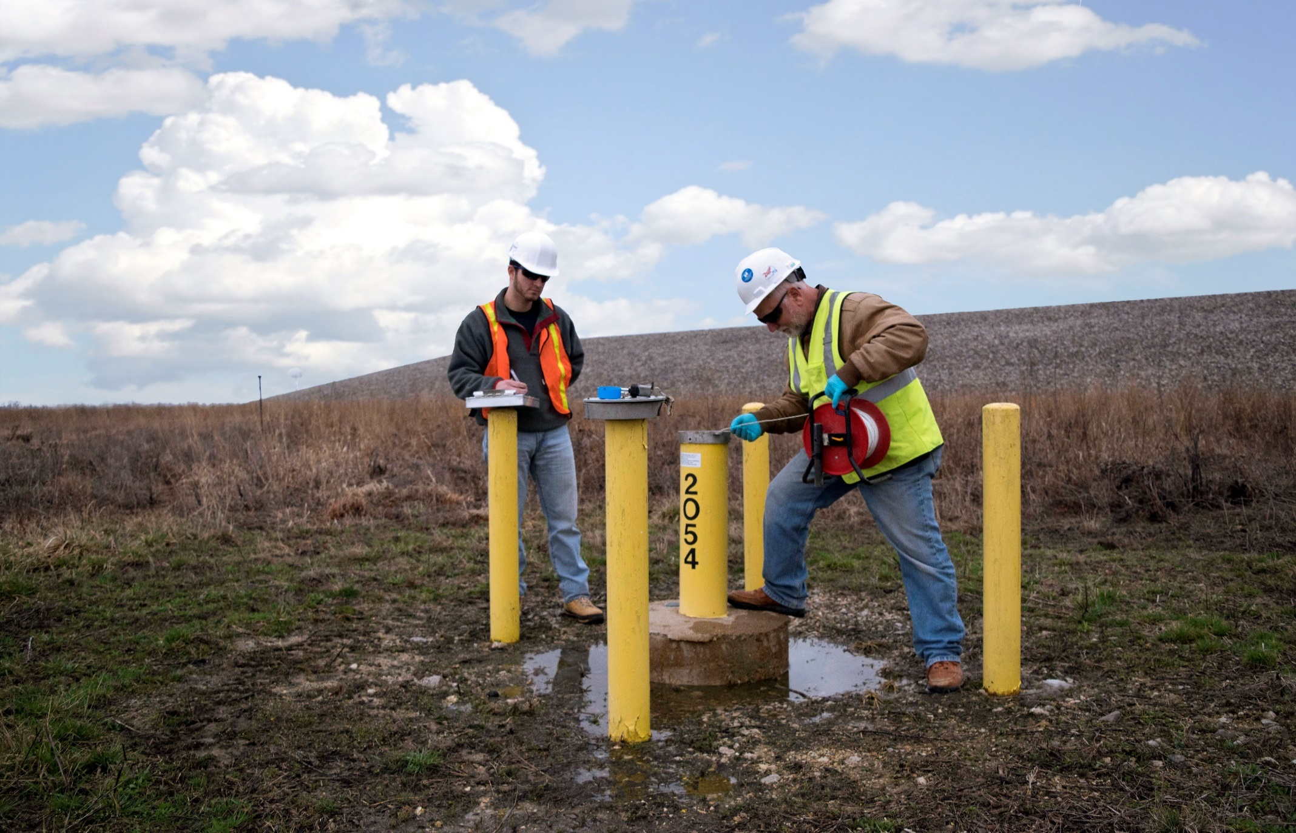
Monitoring Remedial Activities
Monitoring Well at the Weldon Spring Site, Missouri

Slide 4
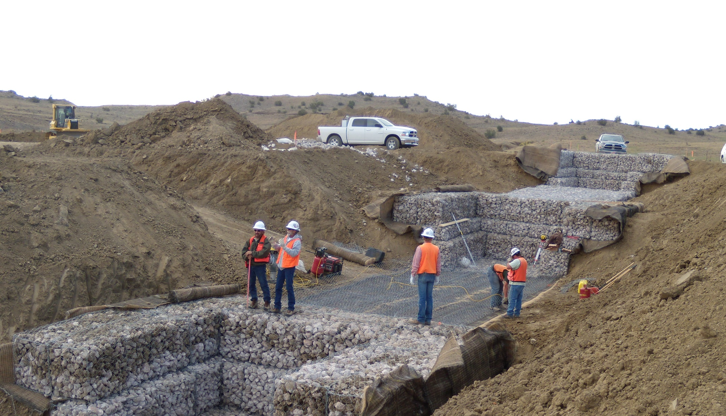
Protecting the Environment
Installation of Rock Erosion Barriers at L-Bar, New Mexico

Slide 5
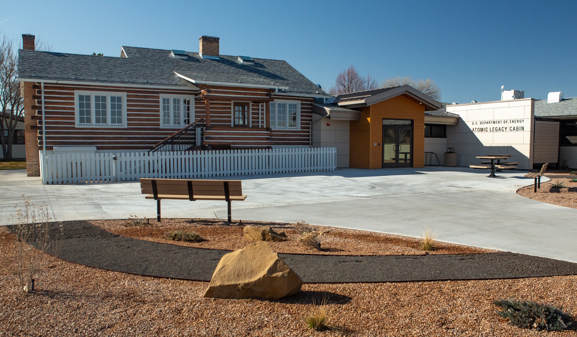
Preserving our History
Atomic Legacy Cabin in Grand Junction, Colorado

Slide 6
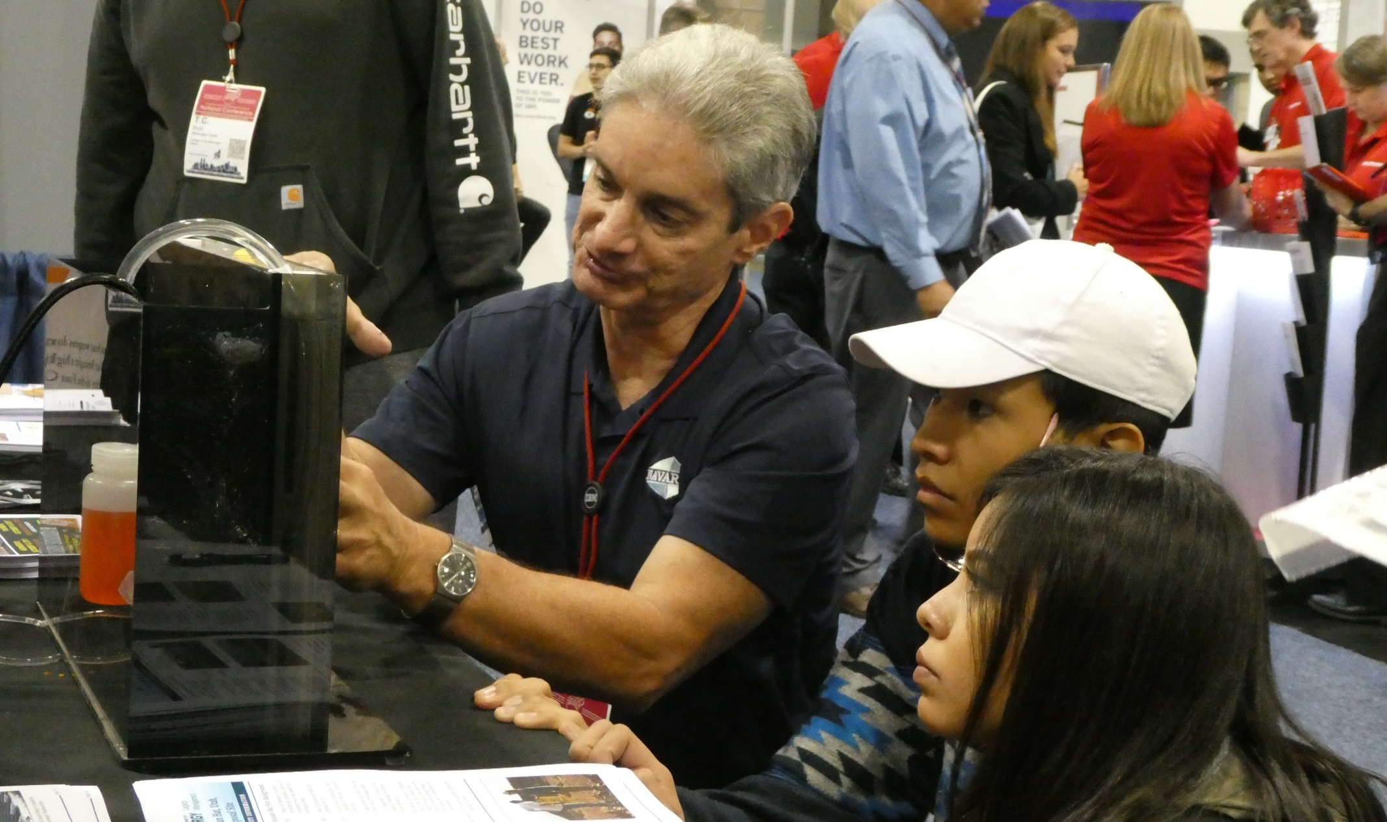
Educating the Public
Illustrating three dimensional modeling at a Navajo Nation Science, Technology, Engineering and Mathematics (STEM) Event.

Slide 7
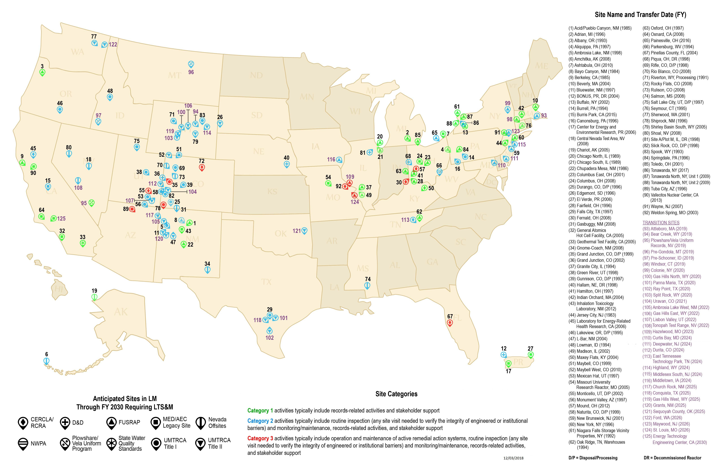
Current and Anticipated LM Sites Through FY 2030

Slide 8
Take Aways to Consider
What investment is required not desired in infrastructure for “Min-Safe” operations during Cleanup and Future Missions?
What infrastructure does not have a radiological safety nexus?
Can the existing infrastructure be abandoned or conveyed while achieving a Record of Decision & LTSM Transfer?
Are we “Reducing Footprint” just for achieving a metric?
Are we over-investing in maintenance and repairs for infrastructure slated for cleanup or closure?
Can we partner with Industry and/or Local Governments into a long term stewardship vision?

Slide 9
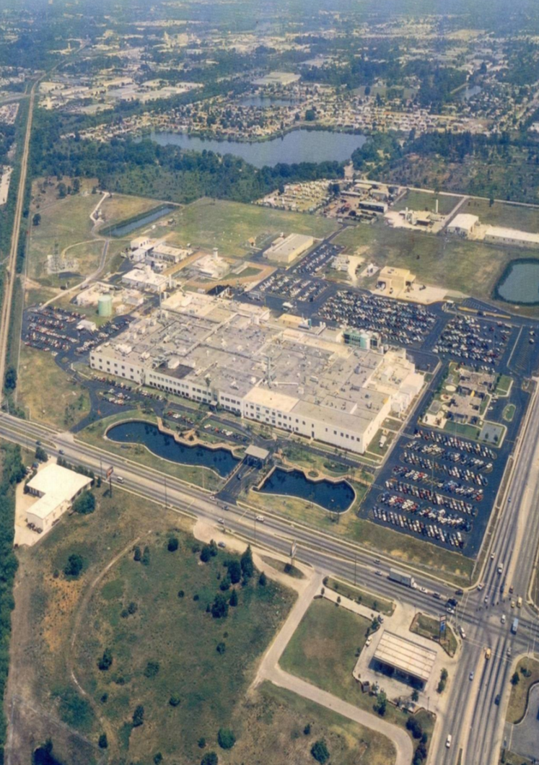
STAR Center
The 1995 sales agreement
requires DOE to complete environmental restoration of the impacted areas and grants an easement to access these areas for corrective actions
Science, Technology
and Research
(STAR) Center
Former Pinellas Plant

Slide 10
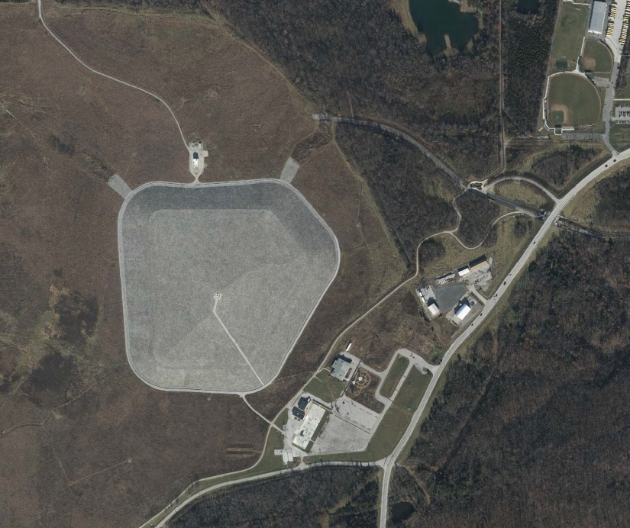
Weldon Spring Site
LCRS Building
Disposal Cell
Restored Prairie
Interpretive Center
Rental Trailer Offices
Lab Building
Former Administration Building Concrete Pad – Recycled 2015

Slide 11
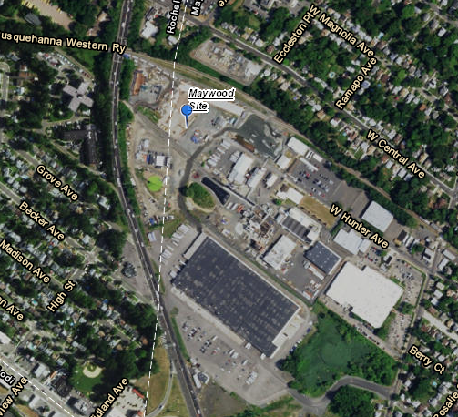
Maywood, NJ Site
Expected Transition to LM from USACE with several buildings and infrastructure.
Expect to perform remedy maintenance and groundwater monitoring for decades.

