Slide 1
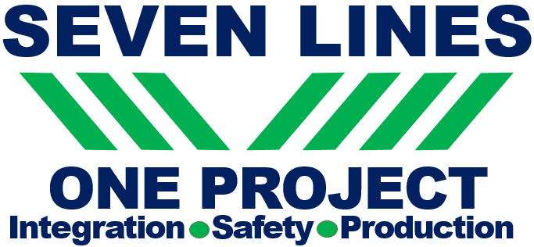
DUF6 Operations
Zack Smith,
MCS President and Project Manager
Robert E. Edwards, III,
Manager/Officially Designated Federal Security Authority
Portsmouth/Paducah Project office

Slide 2
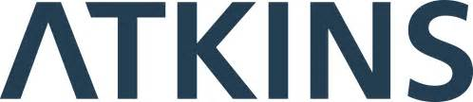


Mid-America Conversion Services is a joint venture that blends the strengths of its partners into a single cohesive team
Program Management, Nuclear/Chemical Operations, Commercial Waste Processing Expertise
Conversion Program Management, Engineering, Design Operations Experience,
Efficient integration into the Paducah and Portsmouth sites

Slide 3
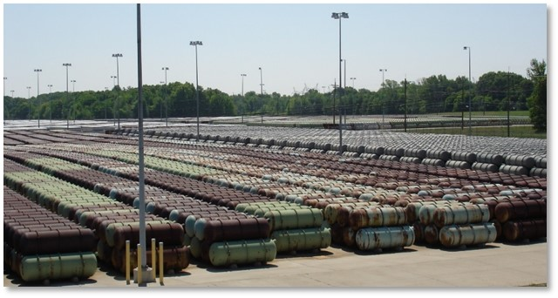
DUF6 Conversion Project
Approximately 800,000 total
metric tons initial DOE inventory
    DUF6 resulted from uranium enrichment process at three Gaseous Diffusion Plants (GDP) in Portsmouth, OH, Paducah, Kentucky, and Oak Ridge, Tennessee.
    DUF6 placed in steel cylinders that accumulated over time in site storage yards.
    Facilities constructed at Portsmouth and Paducah to convert DUF6 into aqueous hydrofluoric acid (HF) for recycle into commerce and stable uranium oxide for storage, beneficial reuse, or disposal.

Slide 4
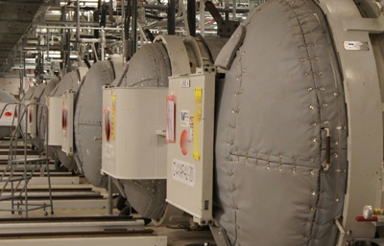
DUF6 Conversion Project
    DUF6 Mission
    Operate conversion facilities to safely convert DUF6 into a more stable chemical form (oxide) for beneficial reuse or disposal thus reducing immediate and future risk to workers and surrounding community.

Slide 5
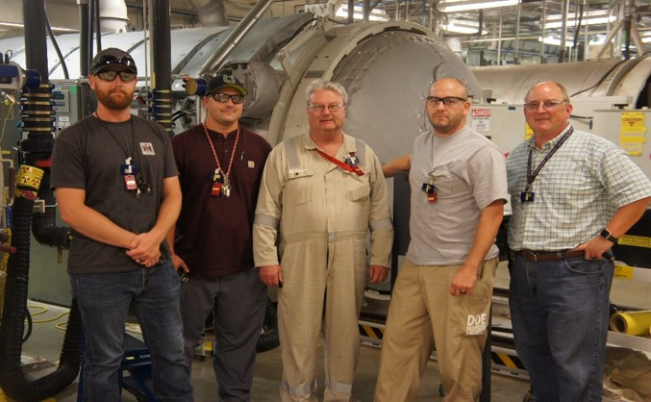
First 18 Months of Contract
    PORTS had not operated in previous 2 ½ years
    Significant training weaknesses identified at PORTS and PAD
    Minor corrective maintenance work packages drove excessive shutdowns
    Frequent safety occurrences and pauses
    Plant Operational Uptime at 12%

Slide 6
Improvement Initiatives
    Training - Fixed Highest Priority Issues Promptly
        Committed early to highly qualified workforce
        "All Hands-On-Deck" approach - Everybody helped!
        Longer Term improvements ongoing
    Engaged Workforce
        Safety Initiatives and Safety First advocacy
        Job tasks and approaches in work packages
    Listened and Engaged Quickly, Decisively and Effectively
        Plant Manager directly involved
        Short turnaround times
        Communications
        Formed "focused task teams" to address most urgent
          labor force played key roles on teams

Slide 7
Improvement Initiatives…continued
    Implemented Long-Term Plant Improvements
        Reduced worker time in hazard area
        Modifications made tasks easier to perform
        New equipment has higher reliability
    Voluntary Protection Program participation
        Process of self-assessing was valuable
        Demonstrated to workforce we were committed to worker involvement
        Portsmouth achieved STAR Status!
          Paducah next
        Workforce is proud of where they are at - and want to do more

Slide 8
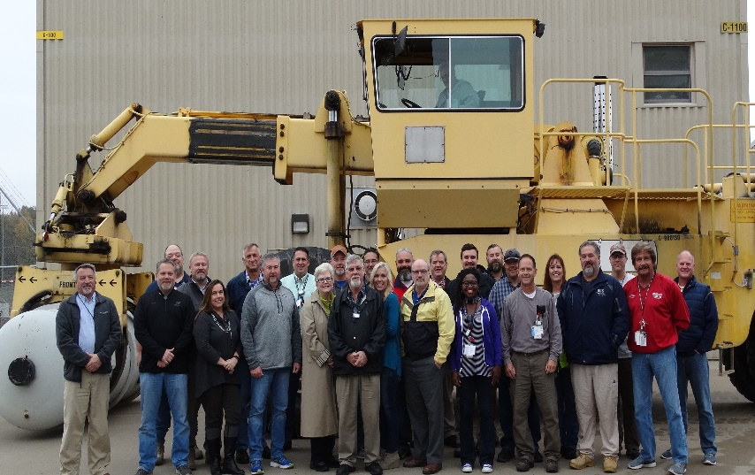
Today
    PORTS/PAD are fully operational
    7 Lines operating has been demonstrated
    Most training deficiencies resolved and program improvements continue
    Corrective maintenance packages similar to prior year can now be completed and lines returned operational within 48 hours (Rebound)
    Demonstrated Plant Operational Uptime 70% over 6-month period

Slide 9
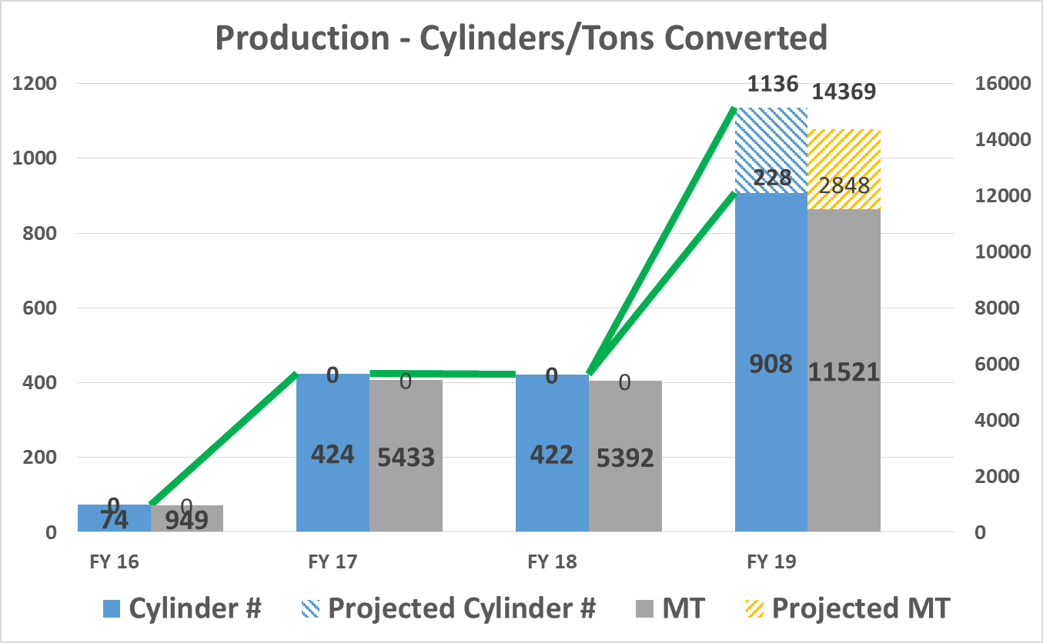

Slide 10
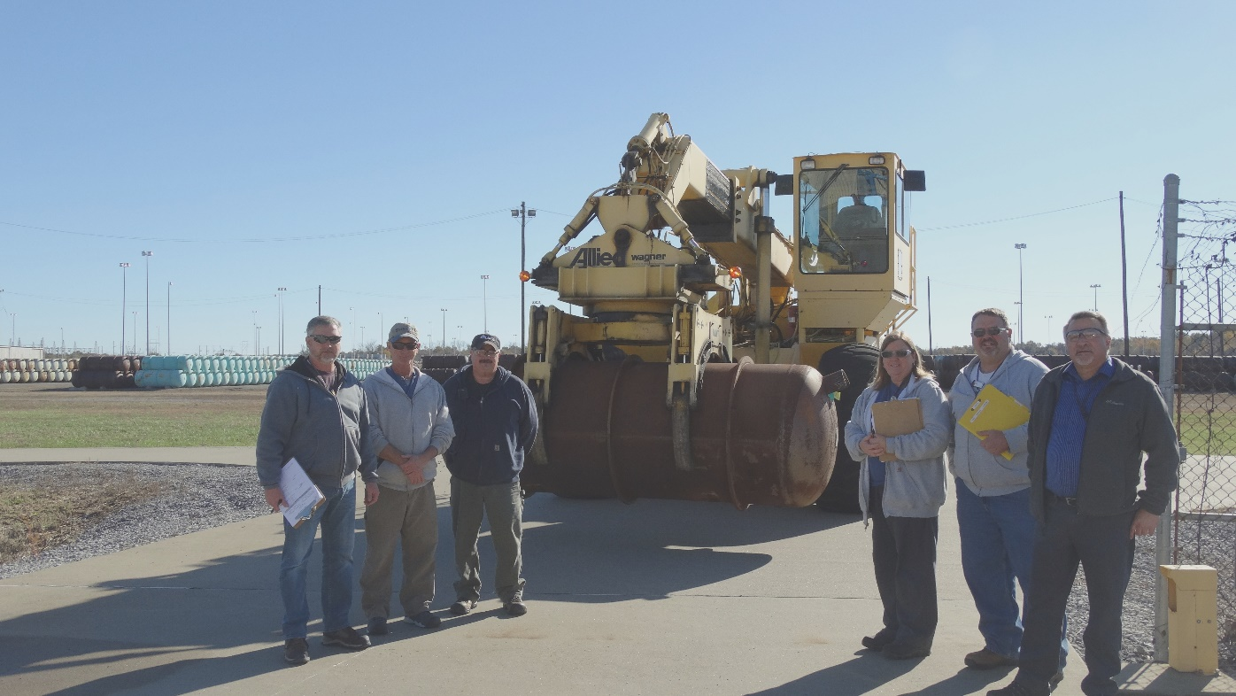
Closing Summary
    Non-standard/defective cylinders are challenging and present project risk
    DOE – MCS interface is good
    Safety initiatives successful

