Slide 1
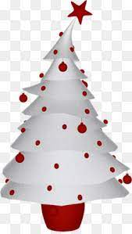
“Waco Lights Up for Christmas”
Home decorating contest 2022

Slide 2

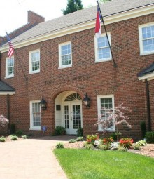
Our contest judges
Christine Cribb,
Executive Director
Kathryn Pennington, Administrative Assistant

Slide 3
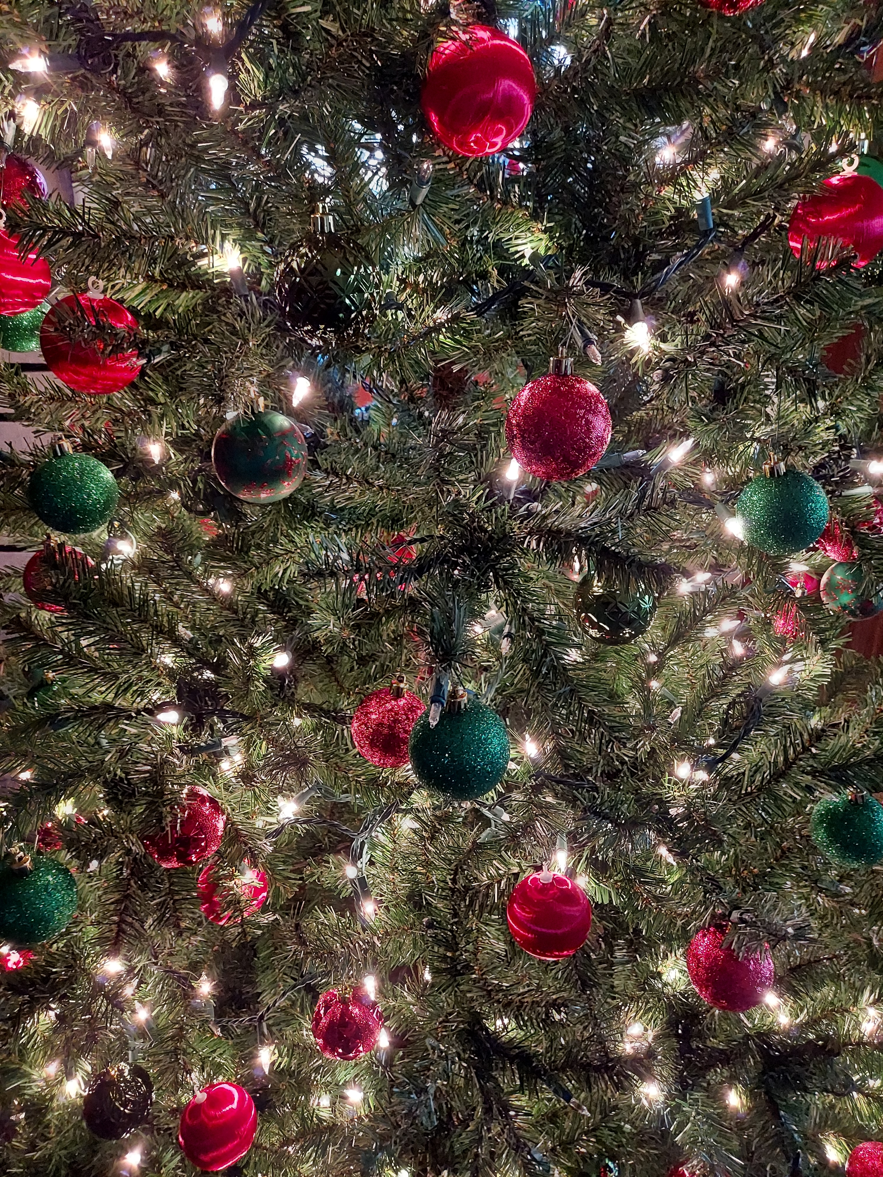
There were 42 homes visited
The Decorations ranged from a simple classic tree in a window to blinking lights and animations

Slide 4
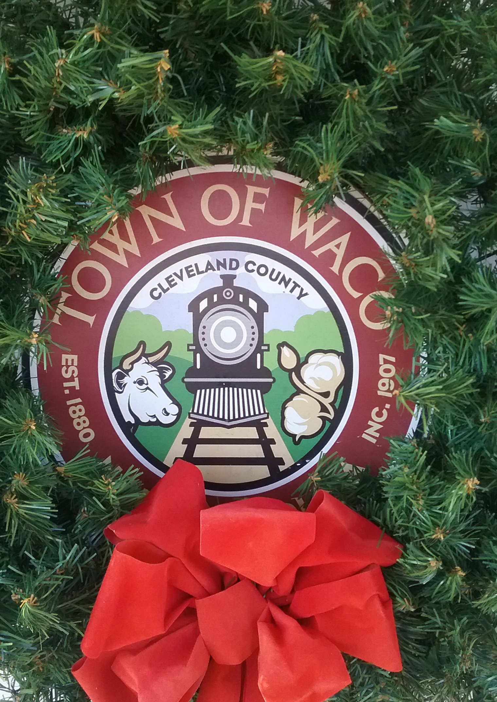
scoring
Coverage (0 – 10 points)
Atmosphere (0 – 10 points)
Showmanship (0 – 10 points)
Festiveness bonus (0 – 5 points)
Traditional Theme (0 – 5 points)
Extra Effort bonus (0 – 5 points)
Christmas tree visible from the street (0 – 5 points)

Slide 5
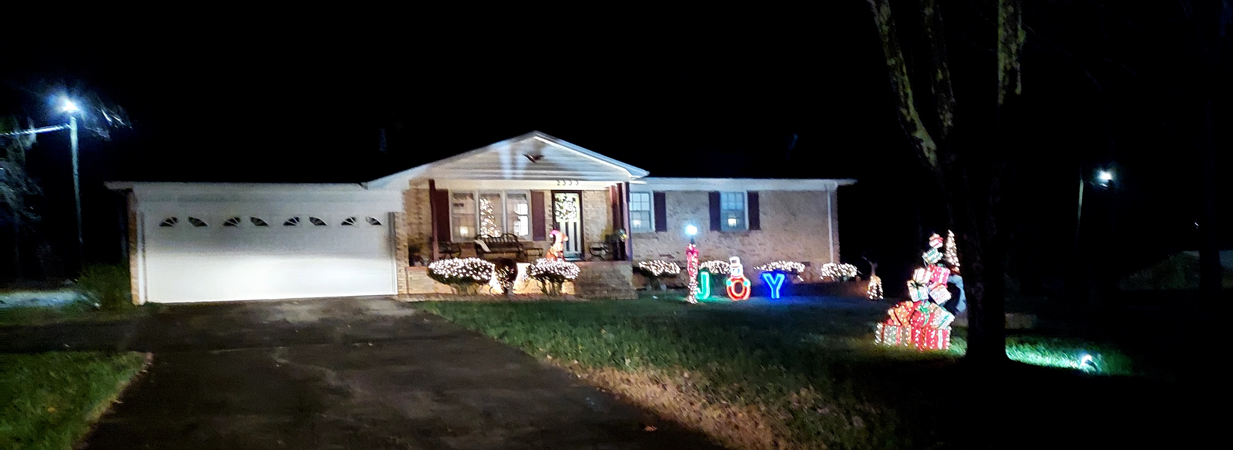
5th place - score of 93% - 2333 Cherryville rd.
Betty Padgett

Slide 6
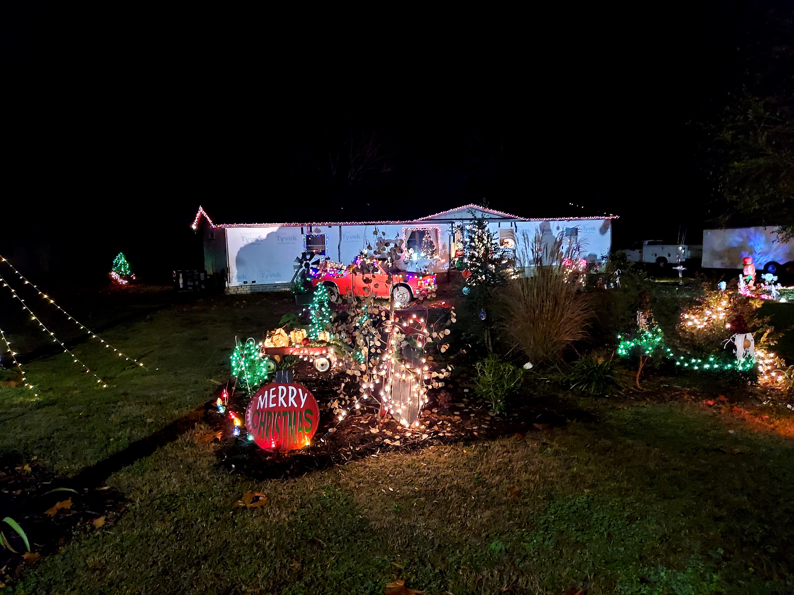
4th place – score of 95 - 133 Moss St.
Tracy Chichester

Slide 7
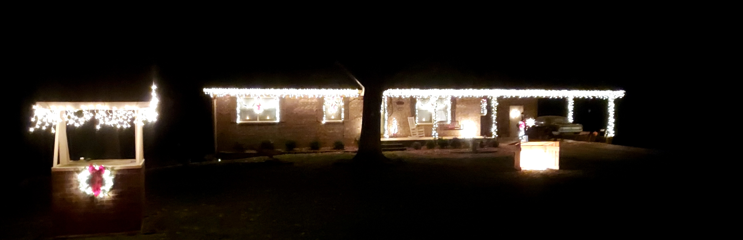
3rd place (tie) – score of 96 - 416 Phillips Dr.
Chester and Becky Haynes

Slide 8
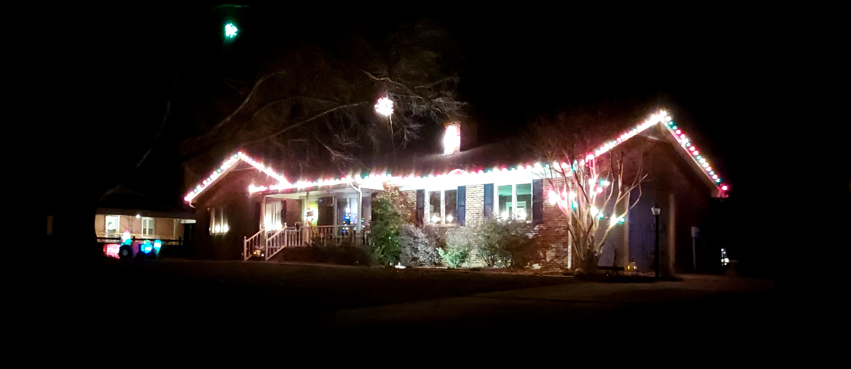
# 3 (tie) – score of 96% - 2604 Fallston–Waco rd.
Joey and Lori Barrett

Slide 9
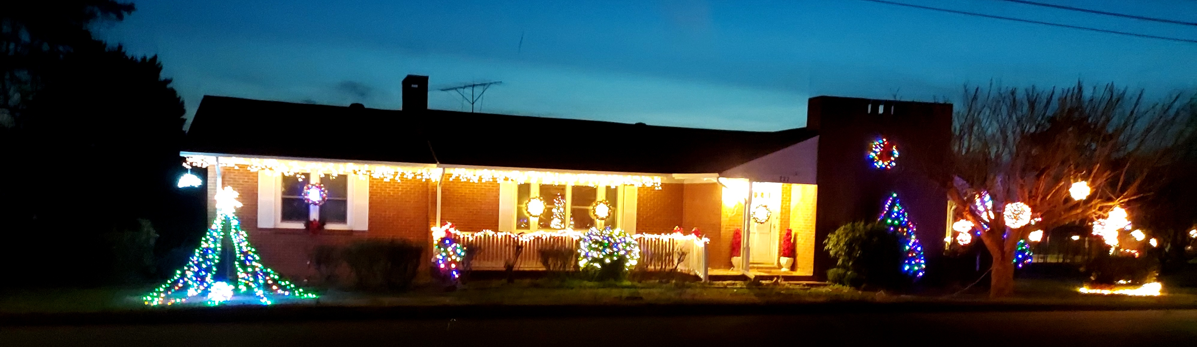
2nd place – score of 97 - 222 South Main St.
Pat Darty

Slide 10
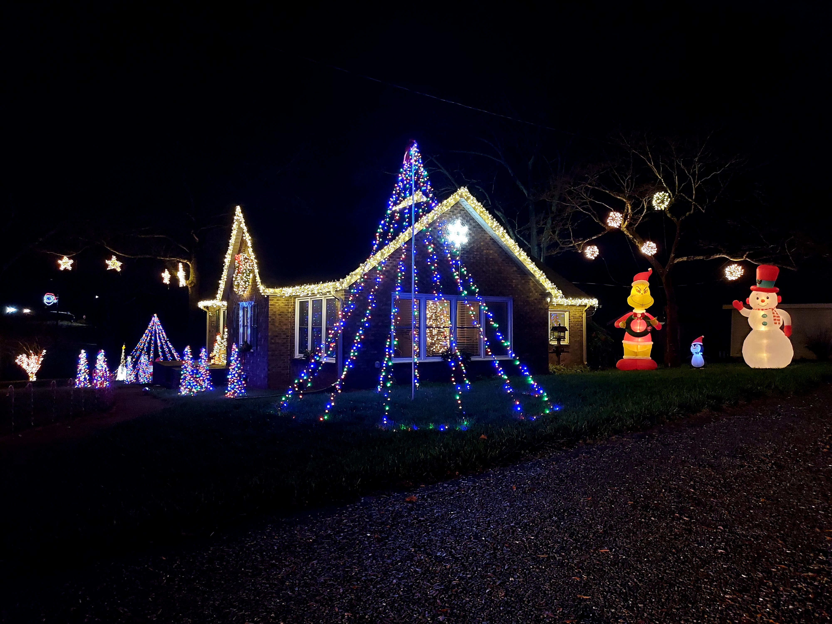
1st place – score of 100 - Cherryville rd.
Darrel and Amanda vess

