Slide 1


How to Judge Judicial Candidates
“Judges rule on the basis of law, not public opinion, and they should be totally indifferent to pressures of the times.”
Warren E. Burger
Chief Justice, US Supreme Court 1969-1986

Slide 2
What Distinguishes Our Government?
A chief executive who is not responsible to the legislature (as the chief executives are under a parliamentary system).
A separate, impartial, nonpolitical judiciary with the authority to declare laws unconstitutional and to enforce the protections granted by the Constitution.

Slide 3
So what does the public know?
A 2014 national survey conducted by the Annenberg Public Policy Center of the University of Pennsylvania has found that:
Only 36% of respondents could name all three branches of the U.S. government, just as many (35 percent) could not name a single one.
Just over a quarter of Americans (27 percent) know it takes a two-thirds vote of the House and Senate to override a presidential veto.
One in five Americans incorrectly thinks that a 5-4 Supreme Court decision is sent back to Congress for reconsideration.

Slide 4
Xavier University Study:
Americans Put to Shame
Center for the American Dream 2012 study revealed that :
One in three natural born citizens failed the civics portion of the US Citizenship Test.
Compared to a 97.5 percent pass rate for immigrants.

Slide 5
Xavier Study Continued
  85 percent did not know the meaning of “rule of law.”
  82 percent could not name “two rights stated in the Declaration of Independence.”
  75 percent were not able to correctly answer, “What does the judicial branch do?”
  71 percent were unable to identify the Constitution as the “supreme law of the land.”

Slide 6
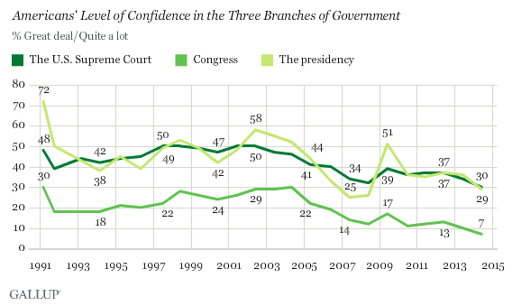
Gallup Poll 2014
Americans' confidence in all three branches of the U.S. government has fallen, reaching record lows for the Supreme Court (30%) and Congress (7%), and a six-year low for the presidency (29%).
The presidency had the largest drop of the three branches this year, down seven percentage points from its previous rating of 36%.

Slide 7
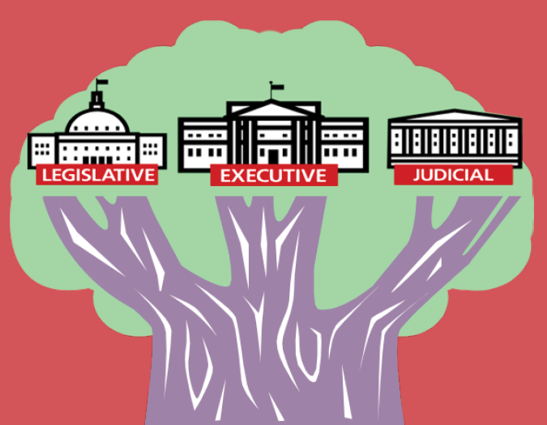
Three Branches of Government
Legislative Branch – Makes the law
Executive Branch – Enforces the law
Judicial Branch – Interprets and applies the law
“ The accumulation of all powers, legislative, executive, and judiciary, in the same hands...may justly be pronounced the very definition of tyranny.”
James Madison

Slide 8
Role of judges
The judicial branch interprets and applies the law. Cases have to be brought before the courts. Courts do not reach down and find controversial issues to address.

Slide 9
Judicial Decision-Making
Judges should be fair and impartial in applying the law.
Judges must follow the law:
  US and State Constitutions
  Case law/Precedent
  Statutory Law
  Sentencing guidelines
  Court Procedures/Rules
  Code of Judicial Conduct

Slide 10
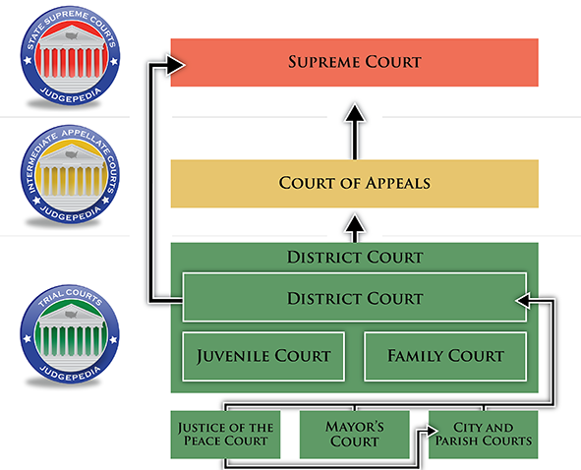
Louisiana Judicial system

Slide 11
Qualifications for judges
Judges of city courts elected after the effective date of this Section shall be licensed to practice law in the State of Louisiana for at least five years previous to their election, and qualified resident electors of the territorial jurisdiction of the court for at least two years prior to their election.
- LA Rev Stat § 13:1873
Age limit of 70

Slide 12
How are judges different from other elected officials?
Legislators make decisions based on the needs/desires of their constituents or voters, their own beliefs, or their political party’s agenda.
Judges evaluate cases presented to them based on evidence, case law, and statutory law, relying on their personal knowledge, experience, and expertise.
Judges should be fair and impartial in evaluating the law.

Slide 13
How are judges selected in Louisiana?
Selection of state court judges in Louisiana occurs through partisan elections.
The Louisiana Supreme Court and Louisiana Court of Appeals have 10-year terms, and District Courts have 6-year terms.
Article V of the Louisiana Constitution

Slide 14
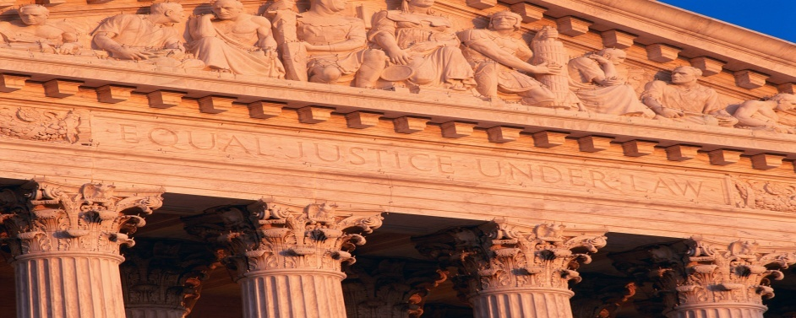
Judicial Decision-Making
“A Judge is bound to decide each case fairly, in accord with the relevant facts and applicable law, even when the decision is not the one the home crowd wants.”
- William H. Rehnquist, Chief Justice-1986-2005

Slide 15
How are judges held accountable?
Oath of Office – sworn to support, protect and defend the US Constitution and Louisiana Constitution
The Appellate Process – Judicial decisions can be appealed to a higher court for review. (Appellate review)
Judges must follow the Constitution (US and Louisiana), Statutes / Sentencing Guidelines, Case Law (Precedent), Rules: Court and Procedural.
Impeachment

Slide 16
Unpopular Decisions vs. Misconduct
What is the difference between an unpopular decision and judicial misconduct? How should these be evaluated differently in the selection of judges?
Rule of law or majority rule?
Notes:
If time permits discuss unpopular or controversial judicial decisions and ask how these are different from misconduct. You can mention cases such as Brown v. Board of Education or other cases. Ask the audience if these should be evaluated differently in the selection of judges. This could be an entirely new session to review some controversial cases and the results. Provide examples of JQC cases.

Slide 17
Judicial Selection
What factors would you consider important in the selection of trial court judges?
What is the best way to ensure a fair and impartial judiciary?

Slide 18
Important or Not Important?
Legal education
Areas of legal practice
Age of judicial candidate
Years of practicing law
Temperament
Trial experience
Volunteer service in community
Income/socioeconomic status
Notes:
This is the component that should be the critical element of the presentation. Ask participants what considerations they feel are important in the selection of judges. Go through each topic and question the audience. For example, “would you consider a judge’s legal education background when selecting judges?” Most would say yes. Then explore further….what is most important about that…where they went to school…etc. Then for example when you get to age…most people would say it doesn’t matter as long as they meet the constitutional requirements. But probe deeper. Ask if they would select someone younger or someone middle aged. What about someone 68 years old. Any considerations? After reviewing the full list quickly with the group, ask each person to review the indicators listed on the Handout B and select the top five considerations they would consider most important in selecting judges. After they have completed the task individually, the groups at each table should work together to come to a consensus on the top five characteristics. Give each group one sheet to record their top five group answers. Then ask each group to place tally marks by their top five responses on chart paper at the front of room. Debrief and circle top five for whole group.

Slide 19
Important or Not Important?
Integrity and honesty
Name recognition
Overall judicial record (if previously a judge)
Endorsements
Disciplinary record or sanctions
Advertisements or campaign materials
Other
Notes:
Have audience come up with any additional considerations they feel are important to add to the list. Make sure they are added to the Handout as well before the select their top five.

Slide 20
How to evaluate judicial candidates?
Review bios of judicial candidates, and evaluate their experience in the field of law they would be working in as a judge.
Consult multiple sources.
Talk to other members of your community who may know the judge or have served on a jury in his court.
Evaluate the candidate’s community service work.
Examine the candidate’s disciplinary record as an attorney or judge.

Slide 21
How to evaluate judicial candidates?
Review the candidate’s endorsements.
  Endorsements from neutral associations, such as newspapers and local or state bar associations
    Bar associations often send detailed Q&As to candidates, interview candidates, and poll bar members. These can be found on each bar association’s website.
    Newspapers tend to focus more on qualifications, while bar associations tend to focus more on ideology and judicial philosophy.
  Issue oriented sources, such as political associations and labor groups

Slide 22
How to evaluate judicial candidates?
Examine the candidate’s campaign funding sources.
  You can research a candidate’s campaign funding using online sources such as the Nola.com campaign finance contribution database. This allows you to search for candidates and see who has donated to their campaign and how much they donated.

Slide 23
How can we ensure a fair and impartial judiciary
Judges who are free to decide cases fairly and impartially, relying on the facts and the law.
Judges whose decisions are not influenced by outside pressures such as political factors.

Slide 24


Peggy Cotogno
Executive Director
Peggy.cotogno@lsba.org
These materials have been adapted, with permission from The Florida Bar Benchmarks Adult Civic Education Program, for use in Louisiana. Principal authors of the Florida Benchmarks Program are Annette Boyd Pitts and Richard Levenstein. For assistance with adaptation in other states, contact staff@flrea.org.

